Slide 1
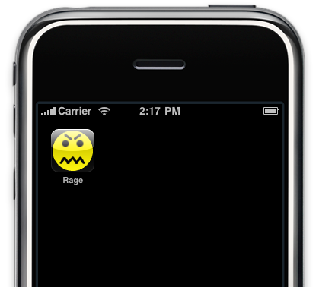


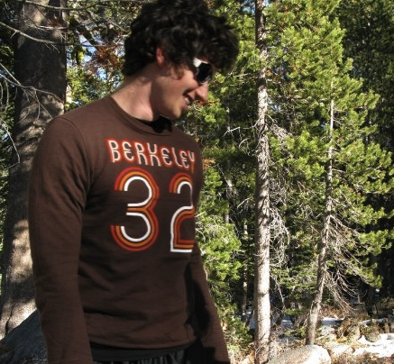

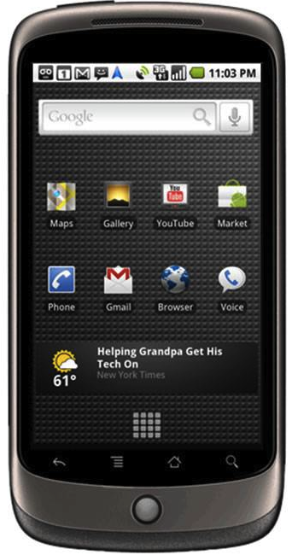
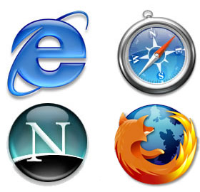
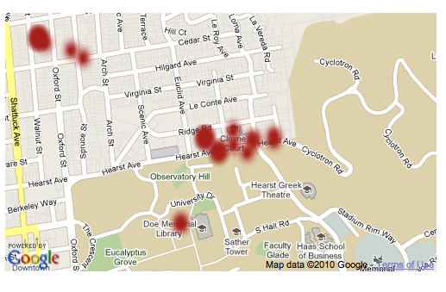
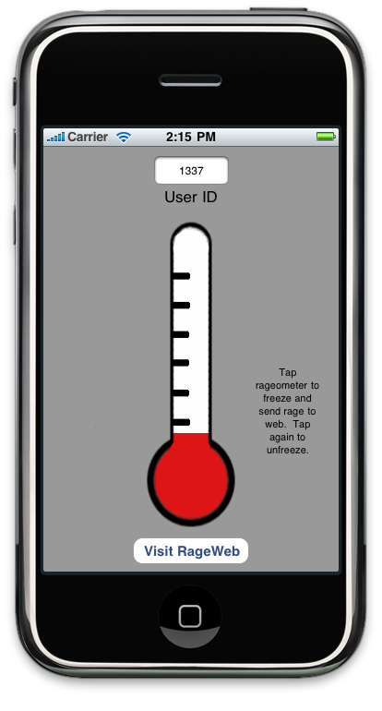
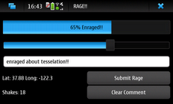
Rage App!
Neil Bell, Michael Hsueh, Nicholas Jalbert, Barret Rhoden
Library Support for Integrating Mobile Devices with Cloud Services.
Introduction
Rage App
Cloud
The future of computing will be mobile devices working in conjunction with the cloud.
Our goal is to develop an easy-to-use, flexible framework for sending key-value pairs from a mobile device to a back-end in the cloud.
We identified a desirable set of framework characteristics:
Flexible—easy extension of messages to accommodate the growing number of mobile sensors.
Dynamic—network aware and able to change or delay messages based on quality of connection.
Robust—seamlessly handles multiple data formats.
For proof of concept, we built the Rage App using our framework prototype.
Rage App allows users to express their anger at a particular location for a particular reason.
    Accelerometers detect rage amount, GPS detects location.
Use our framework to upload key-value pairs of sensor readings and other information into the cloud.
Back-end implemented in PHP, accepts serialized data using POST submissions from mobile device.
Uses SimpleXML Library to parse XML key-value pairs into PHP array.
Application-specific customization needs only a single line of code modified.
Database uses a column-per-key format. Requires one-time setup for implementation.
    Customizable for any schema.
Rage Data
Stored in Cloud
Displayed on Web
<incident>
<uid />
  <timestamp />
<rage />
<comment />
<lat />
<long />
</incident>
A Key-Value Framework
Implementation
Cooperative components in both the mobile client and the back-end web server.
    Encapsulates connectivity and serialization behind a simple key-value interface on the client side.
    The websites sees the message as a simple XML message.
Allows for mobile-aware intelligence about when to send data:
    If there is no connection, save the message until there is a connection.
    For slow connection and a large multimedia message, delay message send.
Client Side API Example:
    msg = new MobKVMessage(URL);
    msg->addKeyValue(String, String);
    msg->addKeyValue(String, Blob);
    msg->send();
Built Rage App for Nokia N900 and Apple iPhone.
    Implemented our communication library in both C++ and Objective C.
    Rage App captures accelerometer and GPS data and sends it to the cloud.
Nokia N900 provides a standard Linux platform with the QT UI and application framework.
    Familiar model for Linux programmers.
    Very portable—execute on desktop and phone.
Apple requires all applications use their proprietary SDK.
    Objective C is object oriented so our communication library implemented as a set of classes.
    Interoperability is (by design) discouraged.
Back-end mashup with Google Maps
Serialized XML message format
Future Work/Conclusion
Extend support to additional data interchange formats (e.g., JSON, YAML).
Connectivity awareness and deferral of transfers over slow connections.
Built-in framework support for “standard” sensors like microphone, camera.
Integration with additional cloud services like social networking and route calculation.

