Slide 1
StockInsights
Lin Huan Jhe, Rajiv Wickramaratne and Nick Carr

Slide 2
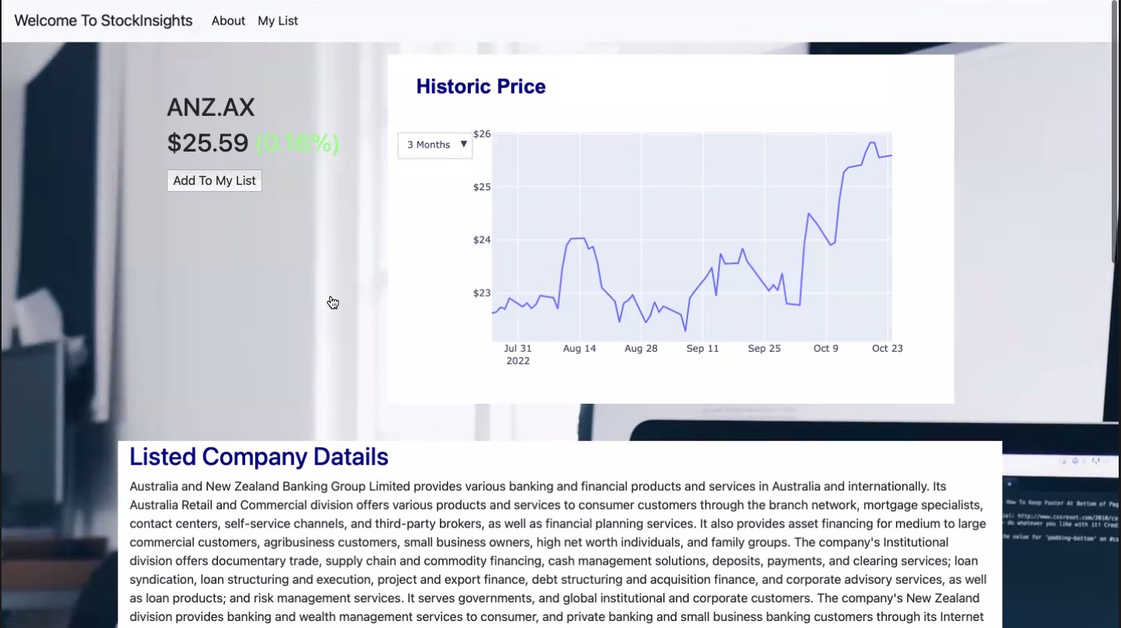
What is our project about and how did we get started?
StockInsights is an application that allows you to query financial information from any listed Australian company.
Flask, Python, JavaScript, HTML, CSS, yfinance, google trends, web scraping, Plotly, anime.js and MongoDB.

Slide 3
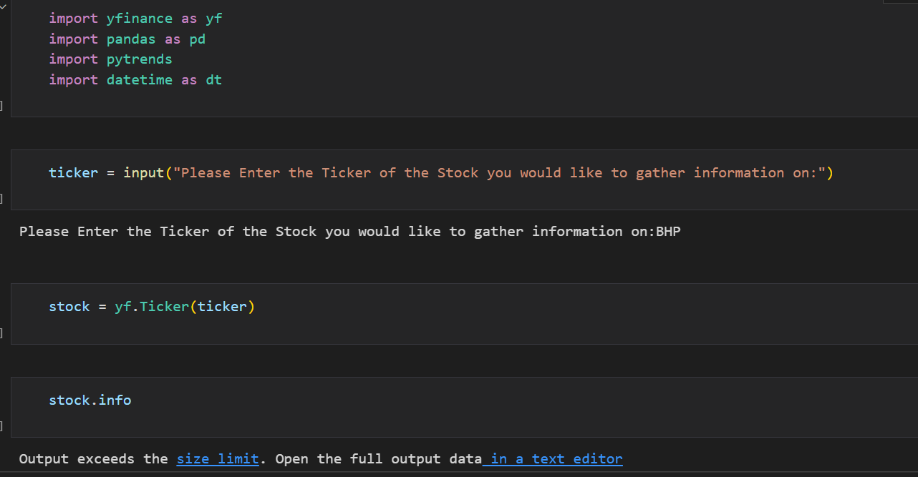
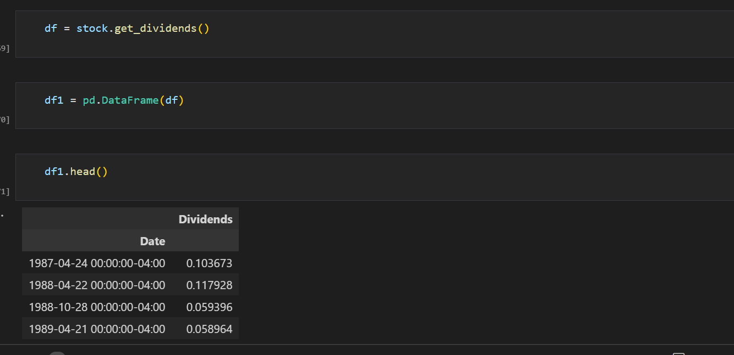
Installing libraries, data exploration and cleaning

Slide 4
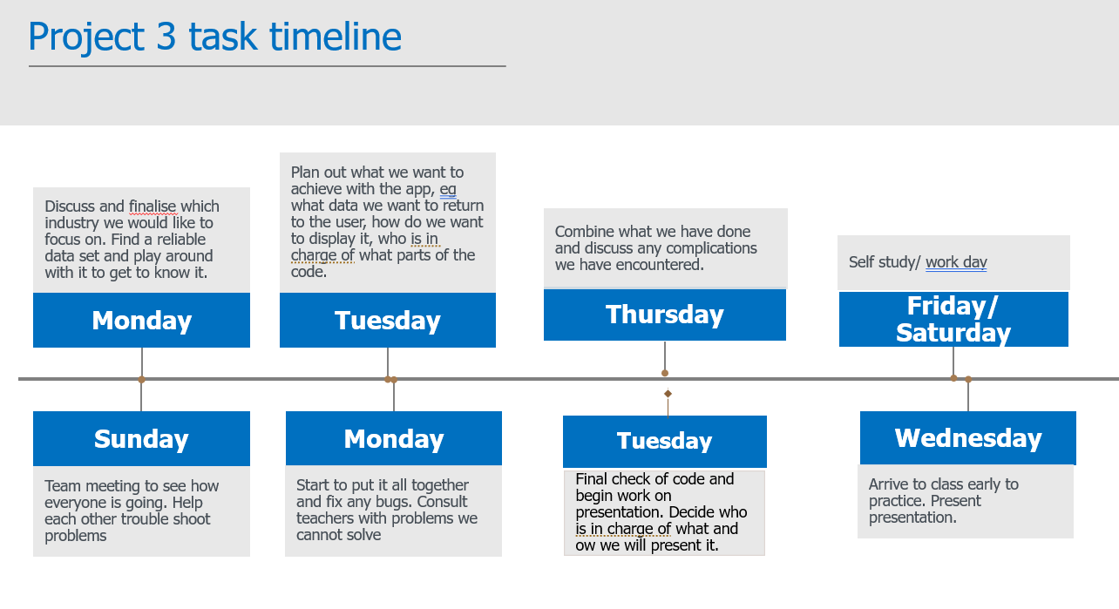
Project timeline

Slide 5
Challenges encountered
Aligning schedules
Time pressure
Technical challenges, eg errors encountered

Slide 6
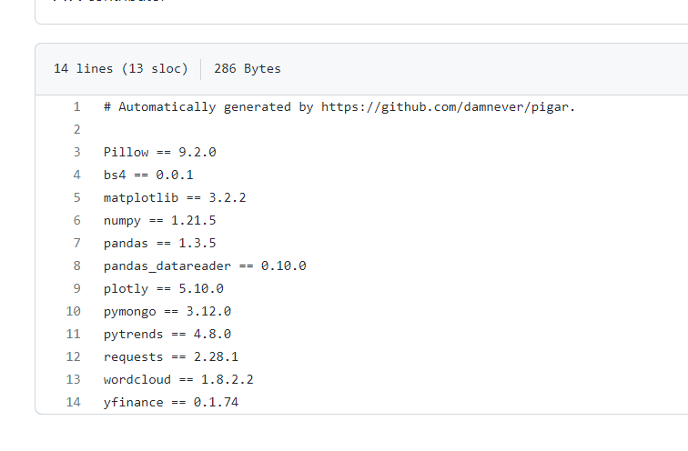
Install requirements

Slide 7
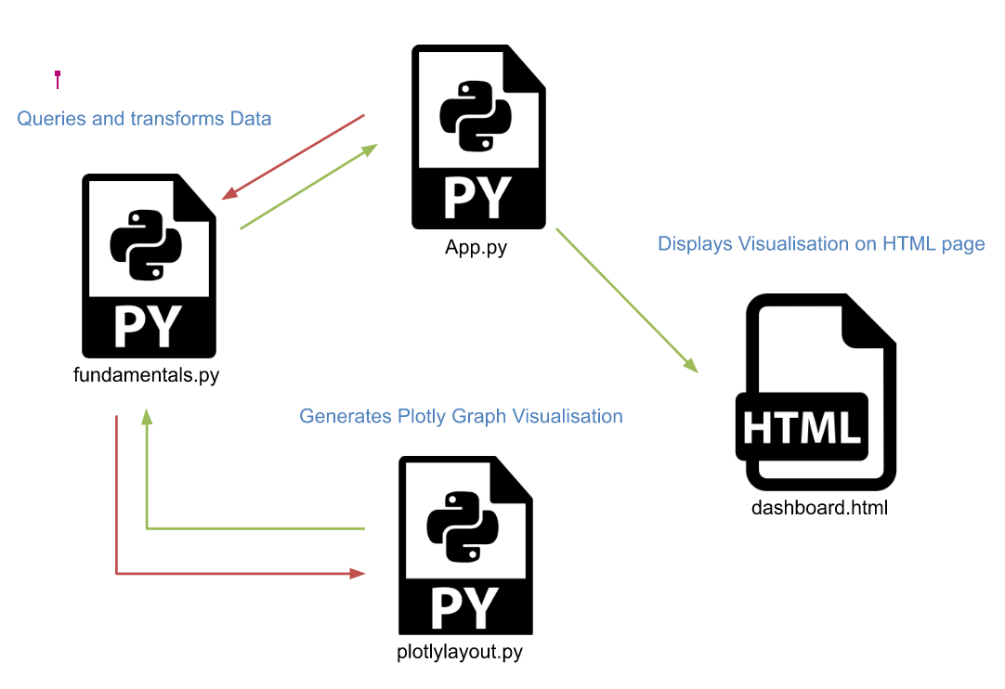
Code structure

Slide 8
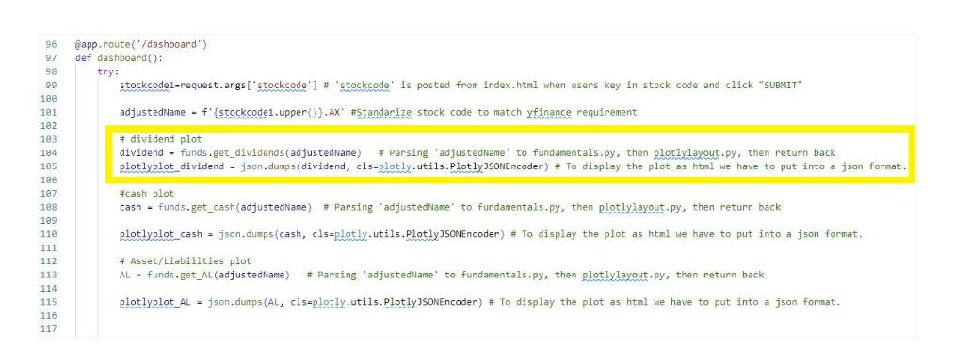
Dividends example- app.py

Slide 9
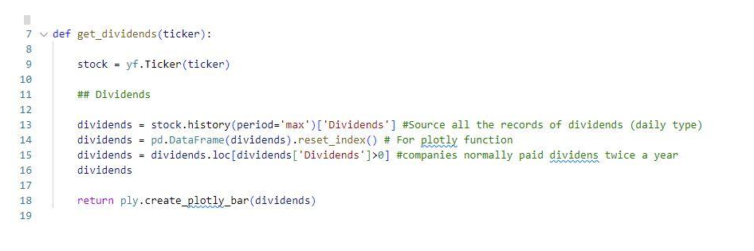
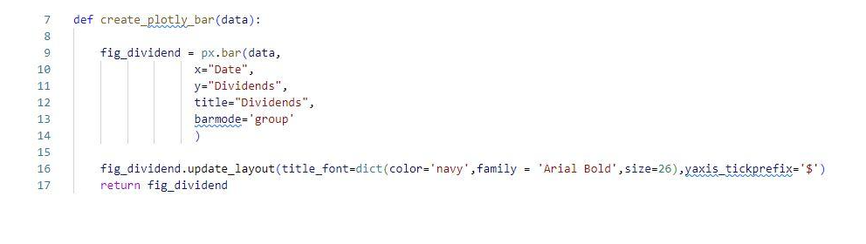
Dividends example- fundamentals.py
Dividends example- plotlylayout.py

Slide 10
Code structure

Slide 11
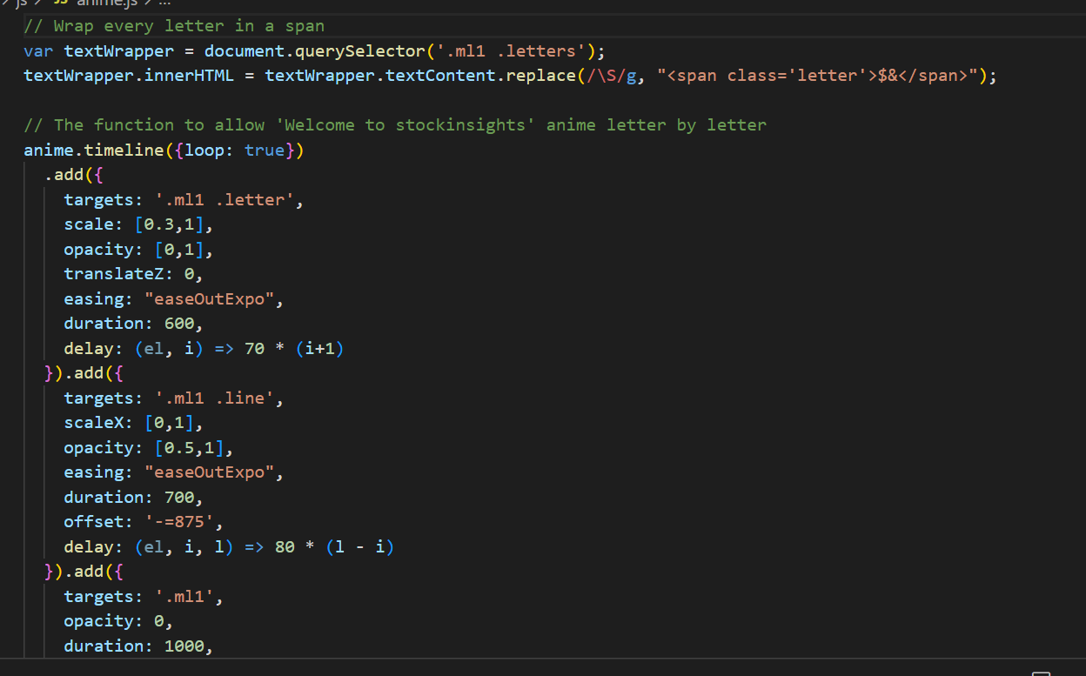
A glance at our code
JavaScript

Slide 12
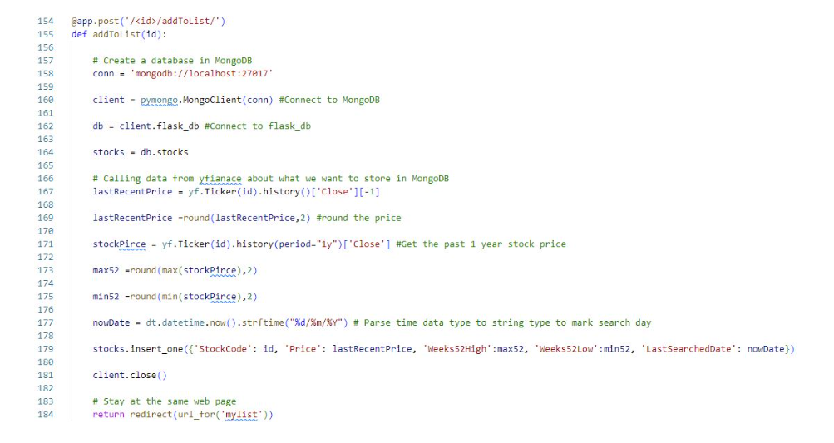
MongoDB

Slide 13
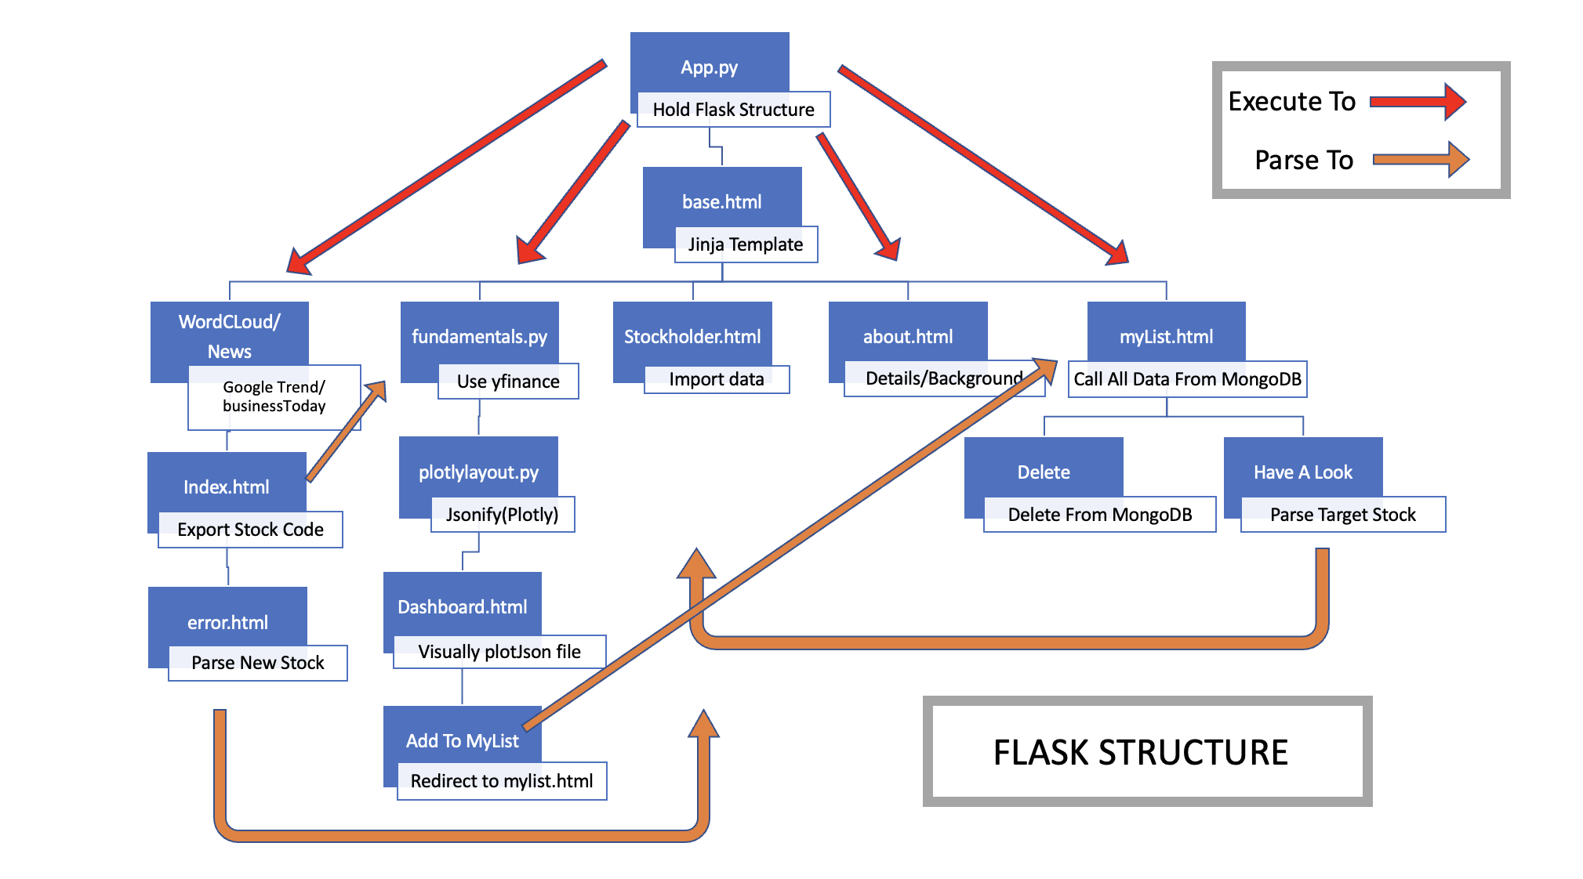
Flask structure

