Slide 1
Plugin Development Week 2
OOP Part 2

Slide 2
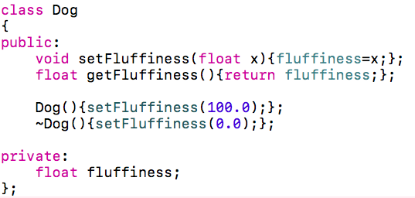
Remember Classes?

Slide 3
Remember Classes?
Getters and Setters
Constructor and destructor
Private variable

Slide 4

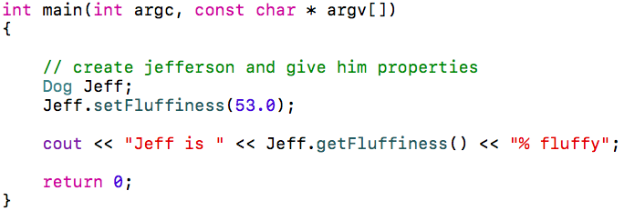

We can then use our class…

Slide 5
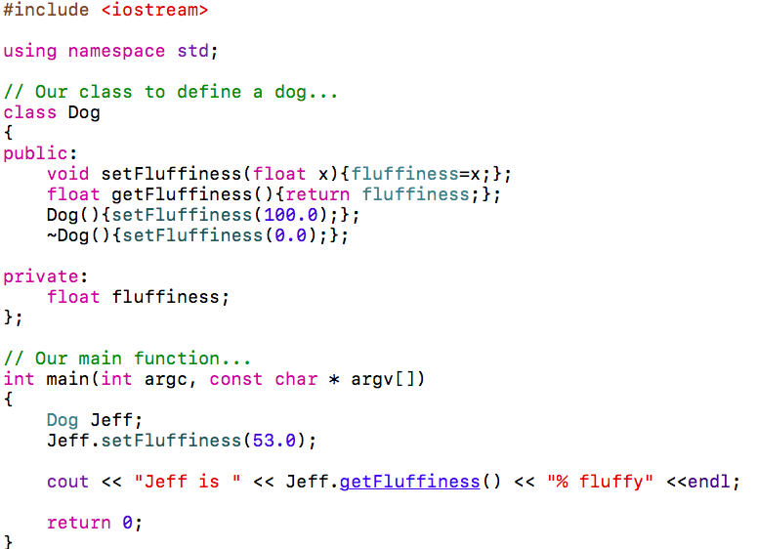
Our main.cpp file currently looks like this…

Slide 6
Our main.cpp file currently looks like this…
Our class
Our main fn

Slide 7
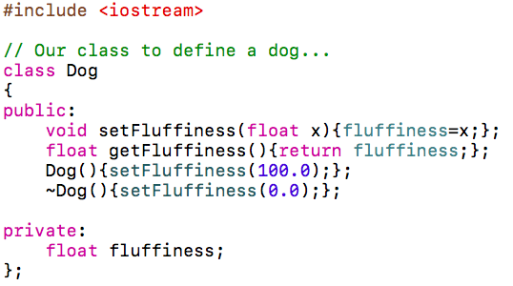
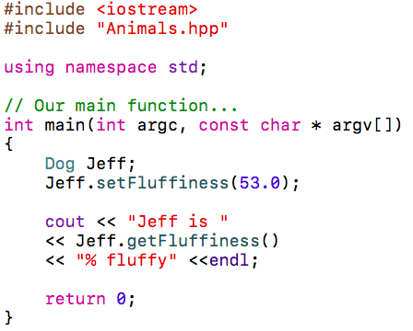
We can use additional files for our class…
<Animals.hpp>
<main.cpp>

Slide 8
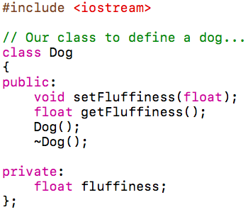
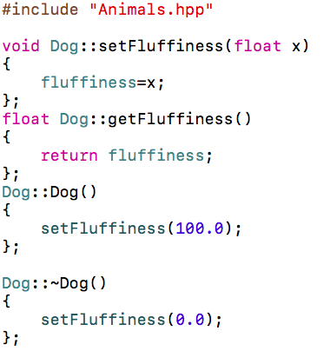
And we don’t just have to use the header…
<Animals.hpp>
Function declarations
<Animals.cpp>
Function definitions
We use the Dog:: prefix to define
Attributes of the Dog class

Slide 9
Object Oriented Programming
Encapsulation
The process of wrapping up variables and functions into classes
It is to bind code and data together and to keeps them safe from outside interference
This means we need to develop a good interface (getters and setters) for people to interact with data
In C++ encapsulation comes from the class definition and access restrictions

Slide 10
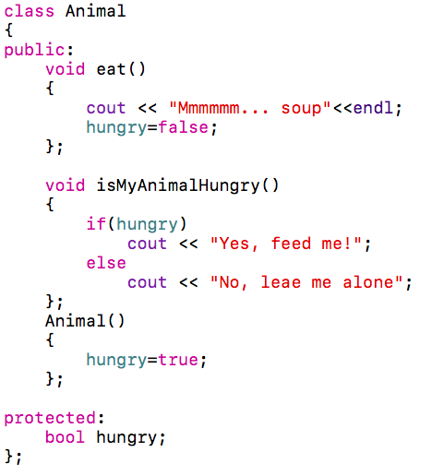
Object Oriented Programming
Encapsulation
Accessible functions
Constructor to initialize our hidden variable
We can’t access this when we create an instance of Animal

Slide 11
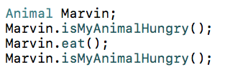

Object Oriented Programming
Encapsulation

Slide 12
Object Oriented Programming
Inheritance
Describes the way data and functions can be shared between objects
i.e. a class can inherit the attributes of another class without redefining them
Classes can keep their own functions and data whilst inheriting from multiple other classes
In C++ a class can inherit from other classes by mentioning them at the beginning its definition

Slide 13
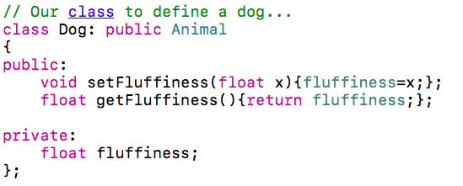
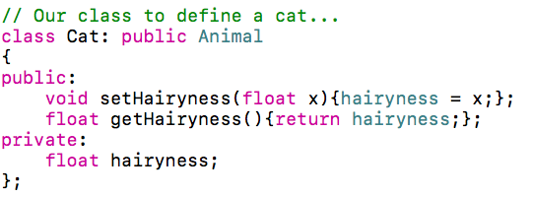
Object Oriented Programming
Inheritance

Slide 14
Object Oriented Programming
Inheritance
The Dog and the Cat can now both use the functions and variables from the Animal class
Hungry is protected, not private, meaning derived classes can use it

Slide 15
Object Oriented Programming
Polymorphism
Means one name many forms. It happens when there is a hierarchy of classes related by inheritance.
To a call to a member function will cause a different function to be executed depending on the type of object that invokes the function.
This means a base class can have a type of functionality that can be overridden by its inheriting classes.
In C++ we do this by overriding functions

Slide 16
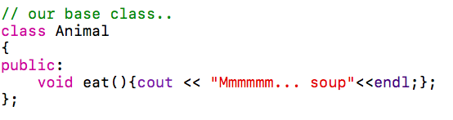
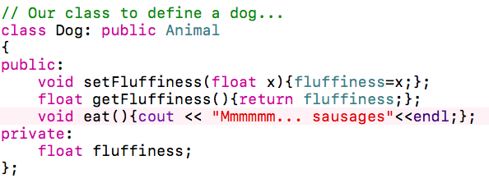
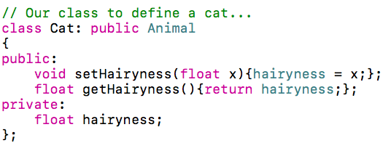
Object Oriented Programming
Polymorphism
Overridden eat() method
This means the cat will eat soup, but the dog will eat sausages

Slide 17
Tasks…
Create an Animal class
Give the functions: numberOfLegs(), doANoise(), furColour().
Make your Horse class from last week inherit the Animal class’ interface
Override the doANoise() function to make your Horse do a Neigh
Create other animals and give them their own noises
In the main function, make all of your animals say something.

