Slide 1
Week 3

Slide 2
Listening Test
http://bit.ly/2gfp5DG
Only in Chrome, Firefox or Edge (Windows)

Slide 3
Git and GitHub

Slide 4
What is Git?
VCS - Version Control Software
Track project lifeline
Store delta’s of files, not the file versions
Ease collaboration between developers
Keep track of development state and history
Use online services to host (GitHub, BitBucket, GitLab etc)

Slide 5
A git repository
All repositories have a Master branch
First resource (base branch) of the project
All repositories have an initial commit
First commit (base objects) of the project
Future branches and commits all stem from the Master

Slide 6
A git repository – new local
Initialise the local git
Add files to git
Commit initial state
Make changes
Commit
git init
git add <filename> // Add file
git add * // Add all files
git commit –a –m “Initial”
git commit –a –m “Commit 2”

Slide 7
A git repository - cloning
Clone from remote
Perform some changes
Commit the changes
Push to the remote repository
Pull updates from the remote
git checkout https://github.com/me/my_repo
git commit –a –m “My commit message”
git push origin master
git pull origin master

Slide 8
Commit chain
Master
Base Commit
Bug Fix
New Feature
The Initial commit
Contains the raw files
Add a commit
Fix that bug!
Commit to the repository
Push ‘master’ forward
Commit to the repository
Push ‘master’ forward

Slide 9
Branching
Master
Base Commit
Bug Fix
New Feature
Branching:
Use Master and Develop separately
Commit from the base independently
Develop
Bug Fix
New Feature

Slide 10
Branching
Make sure we are up to date
Checkout our branch
Push to the remote
Make some changes
Commit our changes
Push to the remote
git pull origin master
git checkout develop
git push origin develop
git commit –a –m “Commit message”
git push origin develop

Slide 11
Merging
Master
Bug Fix
Merge ‘Develop’ into ’Master’
Develop
Merging:
Pull our changes from Develop into Master
Master will contain ‘Develop’ but not the other way!
Bug Fix
New Feature

Slide 12
Merging
Make sure both branches up-to-date
Merge develop into master
git checkout develop
git pull origin develop
git checkout master
git pull origin master
git merge develop

Slide 13
Why Branch?
Develop code separately from the core
‘Divide and conquer’ – Branches for specific parts of the project
Hotfixing – Pushing onto the master to fix production bugs
Develop, Preview and Deploy – Traditional view. Develop moves incrementally, Deploy only tested commits

Slide 14
Branch Divergence
Caused by two commits to same branch on same parent commit
Will trigger merge command
Forgot to pull updates locally
Developing on same point, should use branches
Master
Base Commit
John Doe’s Cool Feature
Merge
Jane Doe’s MegaFeature

Slide 15
Merge Conflicts
‘MASTER’
‘DEVELOP’

Slide 16
Merge Conflicts
Some parts have been merged
Parts which have delta’s on same line cannot be merged. Which one is right?
Human needed

Slide 17
GitHub and Remotes
Use remotes to store and share your code
Allow others to commit onto it
Pull their changes locally
Add a remote and give it a name
Default store is called ‘origin’
git remote add url local_name
git remote add https://github.com/user/repo origin
git push origin master
git remote add http://myserver.com/me private
git push private master

Slide 18
3rd party software
OSX and Linux have git included (OSX requires Xcode)
Windows – git terminal available
Terminal is annoying, use a GUI!
SourceTree
GitHub.com app
Tower

Slide 19
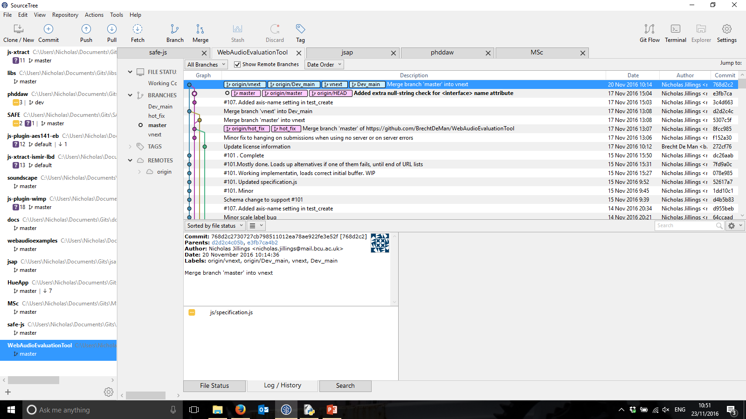
Source Tree
Have multiple gits
Easily track remote and local status
In-built mergers
Visual guide of commit history

Slide 20
Do it yourselves!
Create a GitHub account
Create a repository
Pull to your local drive
Add some code
Commit and push!

