Slide 1
-Recap-
Using JUCE to make a simple overdrive plugin

Slide 2

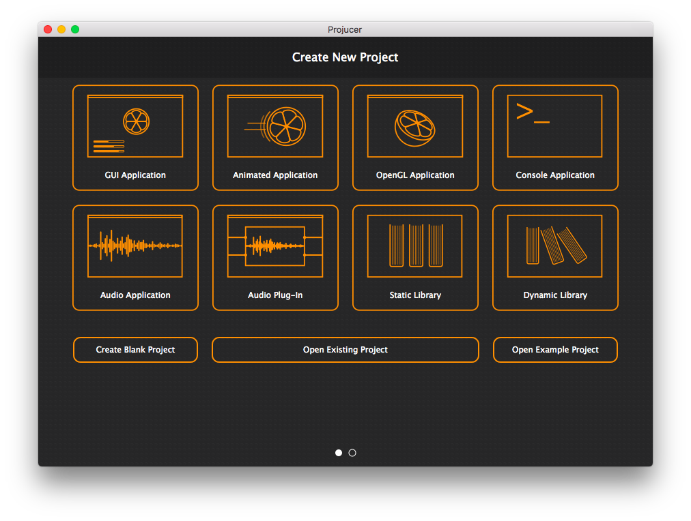
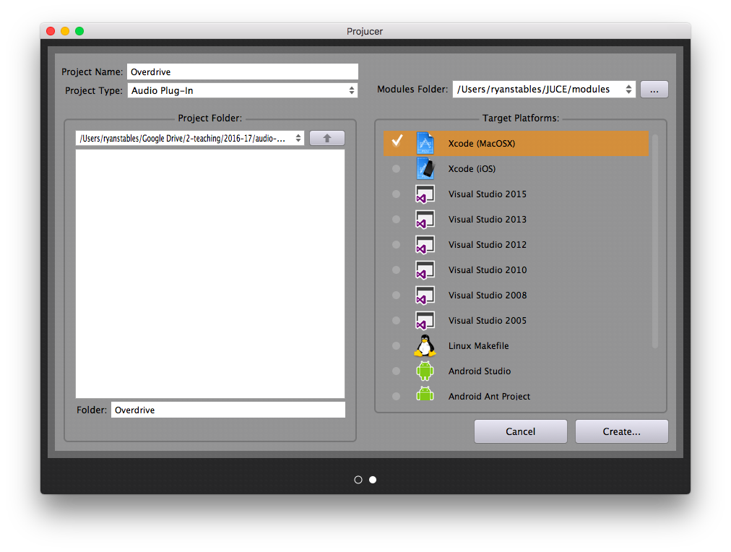
Configuration

Slide 3
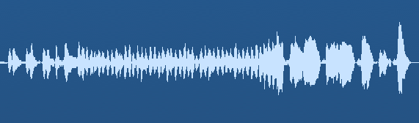
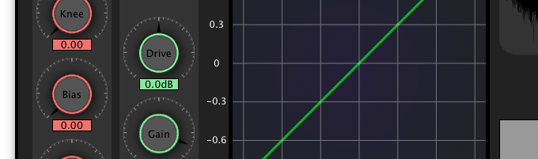
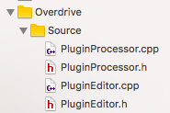
Concept
Processor
(The thing that handles the audio processing)
Editor
(The thing that handles the user interface)
Base class: AudioProcessor
Derived class: OverdriveAudioProcessor
Base class: AudioProcessorEditor
Derived class: OverdriveAudioProcessorEditor

Slide 4
Communication
To update the processing parameters using the interface:
A reference to the AudioProcessor is passed into the constructor of the AudioProcessorEditor
To update the interface if the processing parameters change (automation etc):
A timer can be set in the AudioProcessorEditor that periodically checks if the processor’s parameters have changed
AudioProcessor
Timer regularly
checks the
the audio
Reference to the
Processor as an arg
To the constructor
AudioProcessorEditor

Slide 5
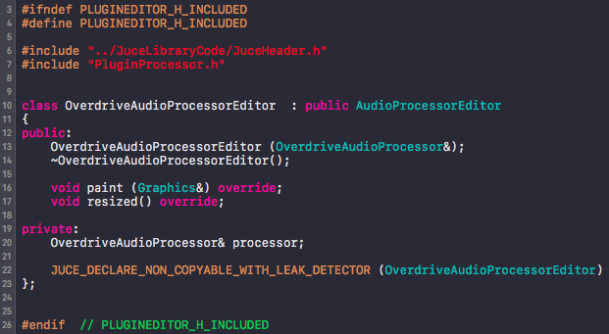
Classes: The Editor
The editor defines functions to configure the UI…

Slide 6
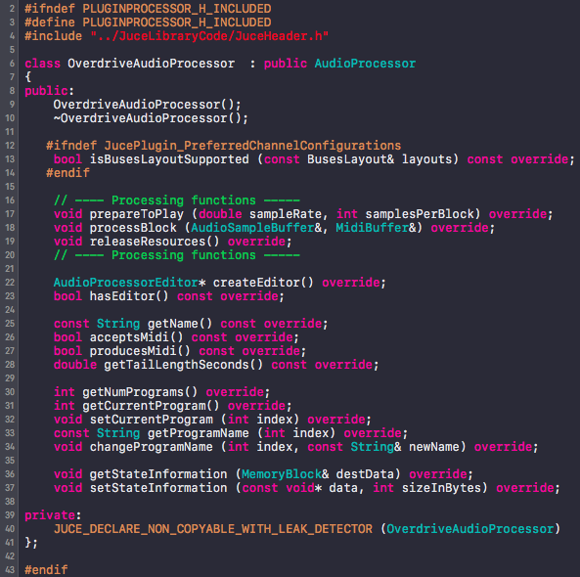
Classes: The Processor
The processor defines functions to do the audio processing…
The functions that do the majority of the work are:
prepareToPlay()
Allocate resources when the plugin is initialised
processBlock()
do the processing to each incoming frame of audio
releaseResources()
Clear resources after the plugin is closed

Slide 7
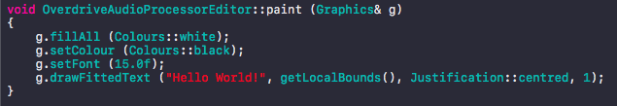
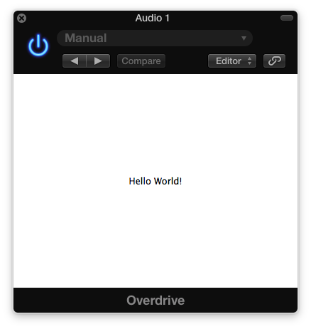
Interface
To draw the interface, we can override the paint() function.
We use the constructor to set the size of the window and to allocate any parameters when the plugin starts up.

Slide 8
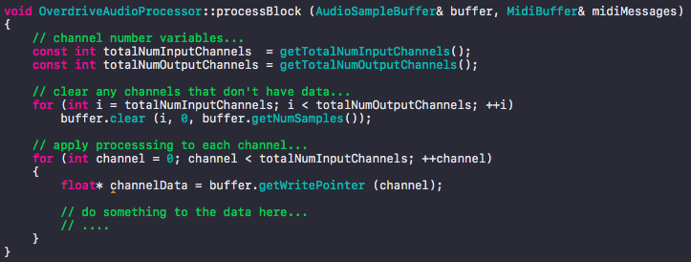
Process Block
The process block is where the audio comes into your plugin
Here, you have to apply your processing to it, then send it back out using the .getWritePointer() routine from the AudioSampleBuffer class.

Slide 9

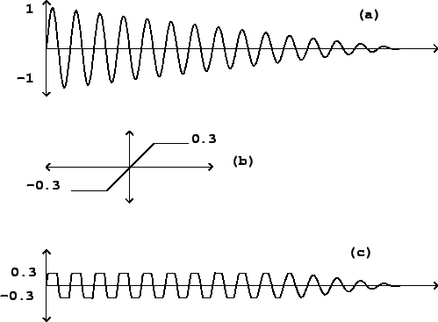
Overdrive
We can put some processing in here. For example, let’s clip the audio

Slide 10
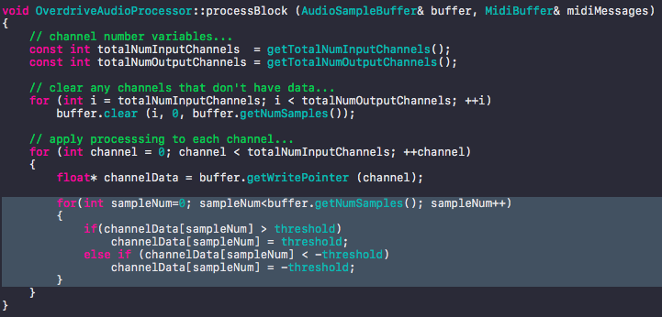
Overdrive
In our processBlock() function….
In the Private section of the class declaration…

Slide 11
Adding a threshold parameter
It would be useful if we could control the amount of distortion being applied. To do this we can make the threshold variable available through the interface.
A - Add slider to the UI…
Create a Slider object in the editor class
Inherit from the Slider::Listener class
Make it visible and set it’s properties
Override the Listener’s pure virtual function: sliderValueChanged()
B - Add the parameter to the processor…
Create a pointer to an AudioParameterFloat object in the editor class
Allocate memory to it
Replace the corresponding your corresponding parameter
Connect your slider to your parameter in the editor
C - Let the parameters update the UI component…
Make the editor inherit Timer functions
Override the timer callback

Slide 12
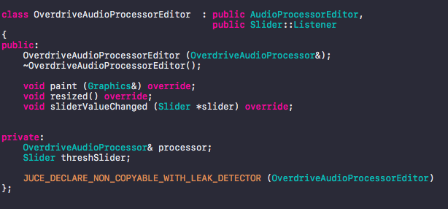
Adding a threshold parameter
A - Add slider to the UI…
Create a Slider object in the editor class
Inherit from the Slider::Listener class

Slide 13
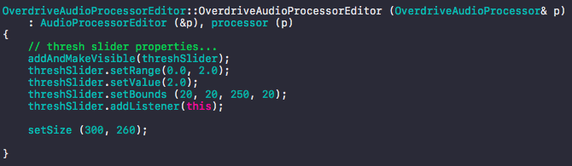

Adding a threshold parameter
A - Add slider to the UI…
3. Make it visible and set it’s properties
4. Override the Listener’s pure virtual function: sliderValueChanged()

Slide 14

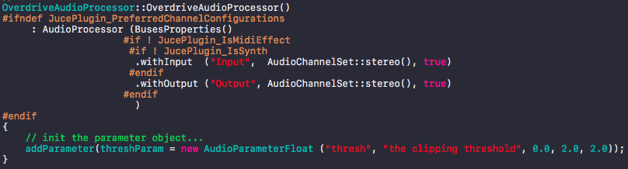
Adding a threshold parameter
B - Add the parameter to the processor…
1. Create a pointer to an AudioParameterFloat object in the processor
2. Allocate memory to it and add it to the plugin in the constructor of the processor

Slide 15
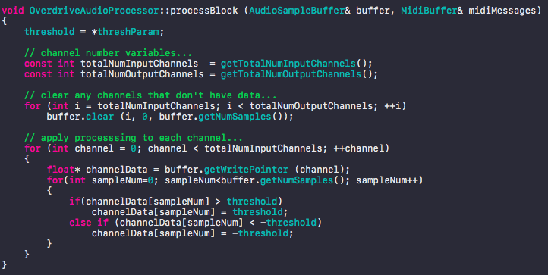
Adding a threshold parameter
B - Add the parameter to the processor…
3. Use it to update your variable in the process block

Slide 16
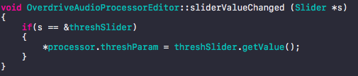
Adding a threshold parameter
B - Add the parameter to the processor…
4. Connect your slider to your parameter in the editor
NB: This can be turned into an if-else-if statement when you add additional sliders!

Slide 17
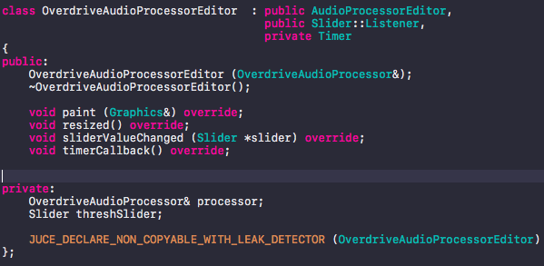
Adding a threshold parameter**** PRIVATE***
C - Let the parameters update the UI component…
Make the editor inherit from the Timer class

Slide 18

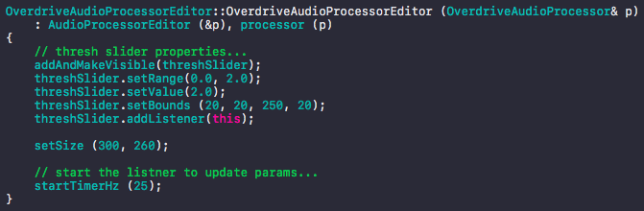
Adding a threshold parameter
C - Let the parameters update the UI component…
2. Override the timer callback
Then start the timer running in the constructor…

Slide 19
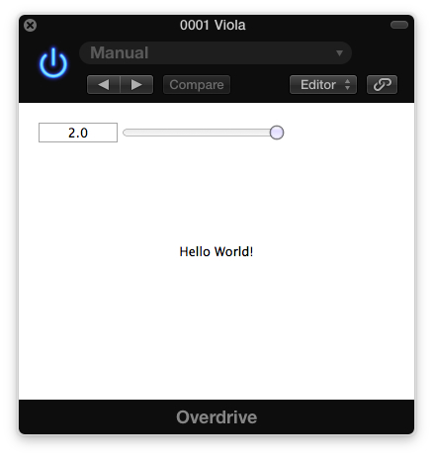
Our plugin…

Slide 20
What next?
Remove the text from the centre of the window
Change the size of the window to 300 x 260
Change the colour of the window to red
Add an input gain parameter
Add an output gain parameter

