Slide 1

Movie Recommendation Capstone
Final Presentation

Slide 2
Problem Identification
Recommend Movies based on a single input movie
Application in targeted ads
Single movie being searched is often all the information available

Slide 3
Data Used
IMDB data about movies
Top 3 IMDB reviews for each movie
Use web scraping via BeautifulSoup to acquire data
Movielens customer review dataset for testing accuracy

Slide 4
Data Collection
Used Python BeautifulSoup library to collect IMDB data regarding movie information and reviews
Limited to movies over a sufficiently large popularity threshold
Manipulated and cleaned this data using pandas library

Slide 5
Exploratory Data Analysis
Visualized how the data varied between genres for further analysis
Used the Movielens data to extract meaningful relationships between genres, via how popular each genre was among each user
Created a heatmap of correlations between genre data, shown next slide

Slide 6
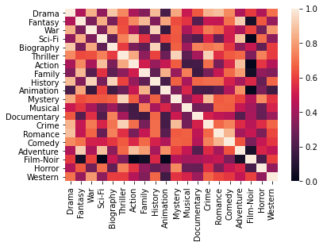
Heatmap of Genre Correlations
Certain genres showed more similarity than others
Largely in line with reasonable assumptions

Slide 7
Hierarchical Genre Clustering
Used Agglomerative Hierarchical Clustering to cluster each genre
Combined genres into genre pairs to explore more nuanced relationships among genres
Used multiple cutoffs to construct clusters and superclusters for movie genres, for use in final model

Slide 8
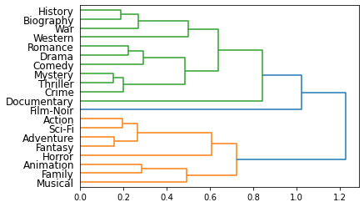
Genre Dendrogram

Slide 9
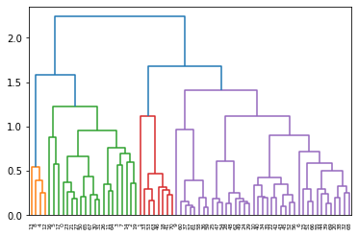
Genre-Pair Dendrogram

Slide 10
Clustering - continued
Also clustered the movies via decade
Modern movies (post-2000) are very distinct in viewship from older movies
Clustered the data accordingly, creating combined clusters for genre and decade information

Slide 11
Processing Review Text
Used NLTK library to process review data
Found highest rated 1-grams and bigrams in all reviews, using TF-IDF method, a popular weighting scheme
Manually filtered the final list of words and phrases for ones which would be relevant for separating different movies
Constructed new dataframe with movies as rows, keywords as columns, keyword counts as values

Slide 12
Modeling
Three key metrics
Average standardized score – use standardized Movielens data to determine the average score of movies recommended to customers
Coverage – the percentage of the total number of movies available that the model can potentially recommend
Personalization – how personalized (unique) recommendations are for each input movie

Slide 13
Modeling - 2
Multiple models tested
Full model (using both genre clustering and keyword filtering)
Top 5 per cluster model (no keyword filtering, just take top 5 movies for a given cluster)
Top 5 model (no clustering or keyword filtering)

Slide 14
Modeling - 3
Constructed a matrix of recommended movies for each input movie
Can be accessed very quickly once constructed, and updated for new movies
Tested each metric for each model

Slide 15
Modeling - 4
Top 5 models performed better when it came to average user rating
Expected, because it only chooses very highly rated movies
However, full model significantly outperformed the others on coverage, and outperformed both on personalization
Still a respectable average standardized score of about 0.5

Slide 16
Conclusion
Model performance is a tradeoff between average score and other important metrics
Full model balanced this tradeoff well
Additional filtering using other movie attributes could be a project for the future

