Slide 1
Capstone Presentation
Information Cascade Prediction on r/wallstreetbets

Slide 2
Introduction/Motivation I
r/wallstreetbets is a subreddit where stocks are discussed
GME surge has made it better known to the public
Prediction of how information flow develops on Reddit could have real-world applications for event prediction
Information Cascades

Slide 3
Introduction/Motivation II
Information Cascades begin with a single post
Cascade Trees – single post, comment tree resulting from post
Cascade Forest – multiple posts connected via comments
Will use machine learning to predict whether a cascade will double in size from its current point

Slide 4
Data Collection/Cleaning I
The most lengthy part of the process
Mined posts and comments from Reddit searching for specific stock symbols
Used PRAW and Pushshift APIs
Acquired lots of information including post content, upvotes
# replies and timestamp most pertinent to this project

Slide 5
Data Collection/Cleaning II
Data didn’t require much cleaning
Removed posts/comments from bots
Ended with two dataframes, one for posts, one for comments
They are linked via post/comment IDs

Slide 6
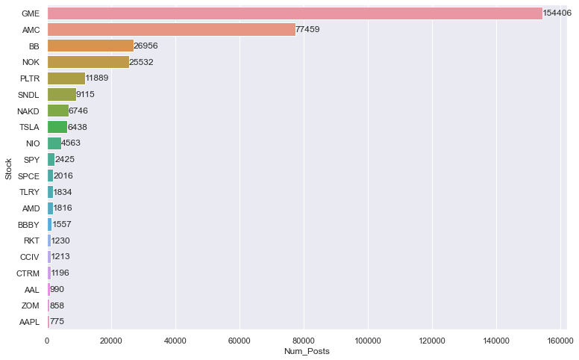
EDA I

Slide 7
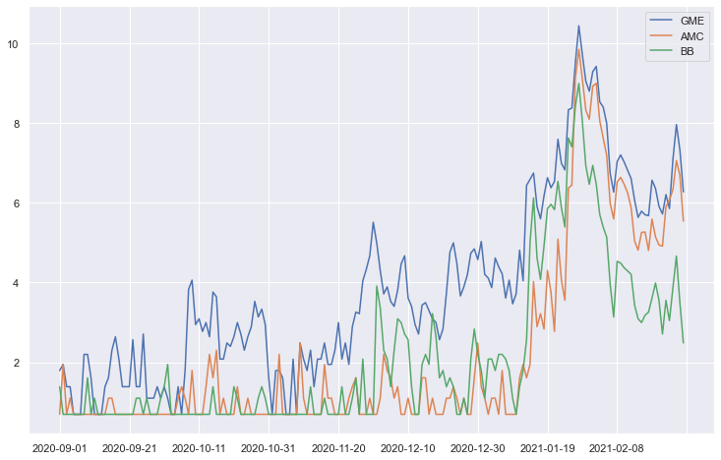
EDA II

Slide 8
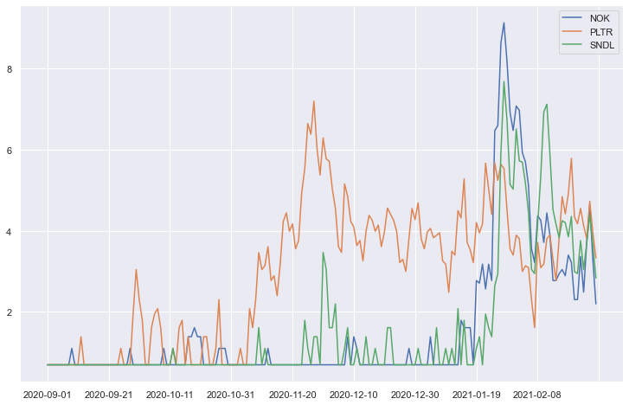
EDA III

Slide 9
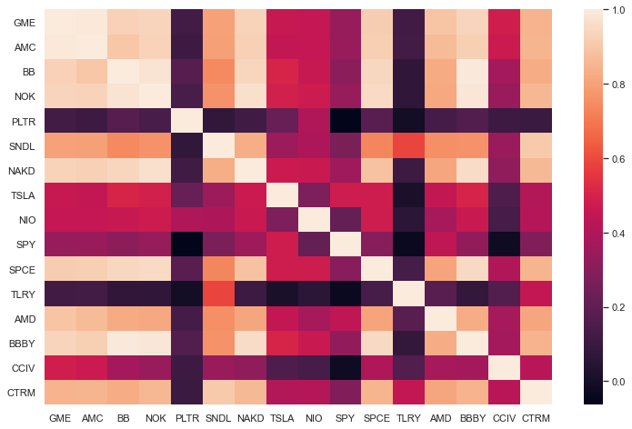
EDA IV

Slide 10
Preprocessing I
Convert data into Graph format, using NetworkX
Two graphs, one ‘disconnected’, one ‘connected’
Disconnected – only posts and comments, ‘Cascade Trees’
Connected – some posts are connected, ‘Cascade Forests’

Slide 11
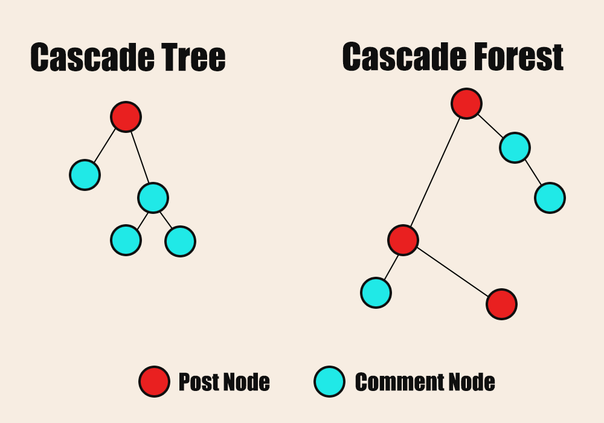
Preprocessing II

Slide 12
Modeling I
Temporal feature extraction from both graphs
Separation of cascades into training and test ‘folds’
Different models to predict if cascade will double in size
Logistic Regression, Random Forest, XGBoost

Slide 13
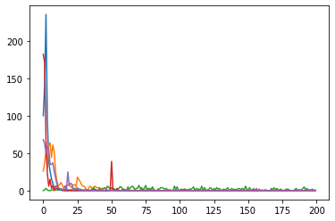
Modeling II – Cascade Trees

Slide 14
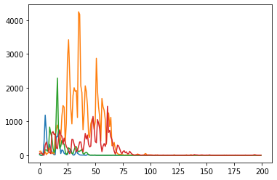
Modeling III – Cascade Forests

Slide 15
Modeling IV
Feature extraction focused on temporal features
Average time for a new node to be added at various stages of the graph (1/2, 1/4, 1/10)
Ratios between these values
For cascade forests, focused on new post nodes as well as comment nodes

Slide 16
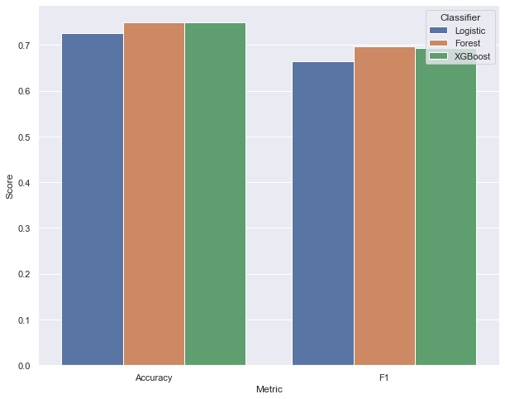
Modeling V – Cascade Trees

Slide 17
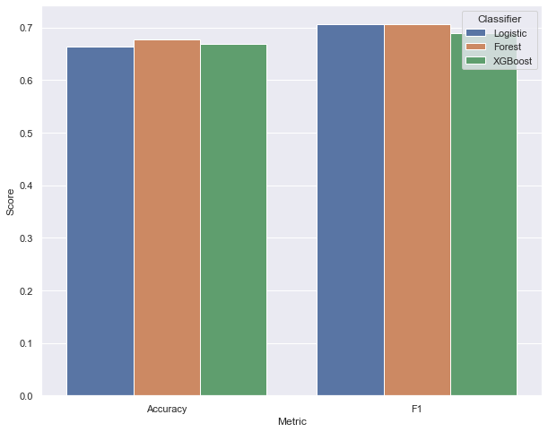
Modeling VI – Cascade Forests

Slide 18
Conclusion
Methods predicted trees and cascades fairly well
Did not work for the large GME cascade, more complex shape
Future work could extract more features, gather more data

