Slide 1
Big Mountain Resort Presentation

Slide 2
Problem identification
The problem we wished to solve was whether we could justifiably increase ticket prices based on data relating to Big Mountain Resort’s competitors.
Additionally, we would use this data to determine whether adding (or removing) features to the resort would be a cost-effective strategy.

Slide 3
Recommendation and key findings
The key finding was that analysis of the data indicated that an increase in ticket price was indeed the suggested action, within margin of error.
Big Mountain’s number of runs, fast quads, vertical drop, total chairs, and snow making area are important features that make the resort competitive.
Increasing vertical drop and the number of runs would provide support for increased ticket price.

Slide 4
Modeling results - 1
The figures for Big Mountain were higher than the vast majority of resorts for features like vertical drop, fast quads, snow making area, and total chairs.
Using a Random Forest regressor on the resort data, it was concluded that the ticket price could feasibly be increased from $81 to $95, with a mean absolute error of $10.
Therefore, there was considerable support for a ticket price increase.

Slide 5
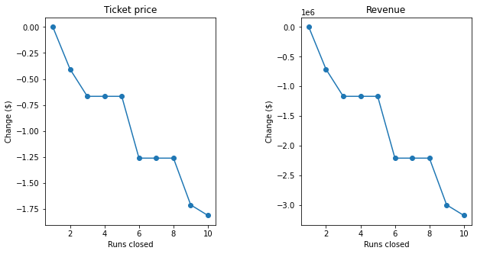
Modeling results - 2
We examined the impact of closing runs on potential revenue. Based on the data, closing 5 runs wouldn’t decrease support for ticket price any more than closing 3.

Slide 6
Modeling results - 3
The model examined some possible alterations to the resort and how they would affect ticket price.
Increasing the vertical drop by 150 feet and adding an additional chairlift could potentially increase ticket price support.
The proposed increase in snow making (2 acres) did not support a price increase, so is not advised.

Slide 7
Conclusion
This study has provided valuable insights.
Notably, increasing the ticket price is justified based on the data.
Also, increasing vertical drop and adding a chairlift are strong ideas to consider.
Further study is advised, for example, number of visitors to the resort per season would aid additional decisionmaking.

