Slide 1
Node Localization in an Obstacle-Rich Environment
Nick Kantack
5-6-19

Slide 2
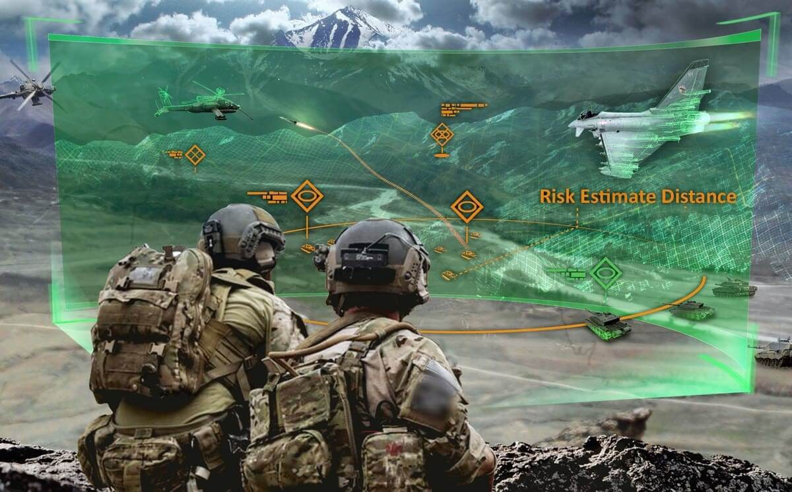
Introduction
Research Goal:
An array of body-worn wireless sensors determines the positions of each personnel team member and provides an augmented reality representation to each member (teammates can “see” each other through walls).
Provides powerful coordination capabilities to
Tactical teams (e.g. soldiers and SWAT)
Rescue teams in low visibility conditions (e.g. firefighters)
Why not use existing systems (e.g. GPS)?
Need to operate in GPS denied areas
GPS significantly increases power demand of sensors
GPS system latency is problematic for AR compatibility
https://medium.com/@info_35021/augmented-reality-in-military-ar-can-enhance-warfare-and-training-408d719c2baa

Slide 3
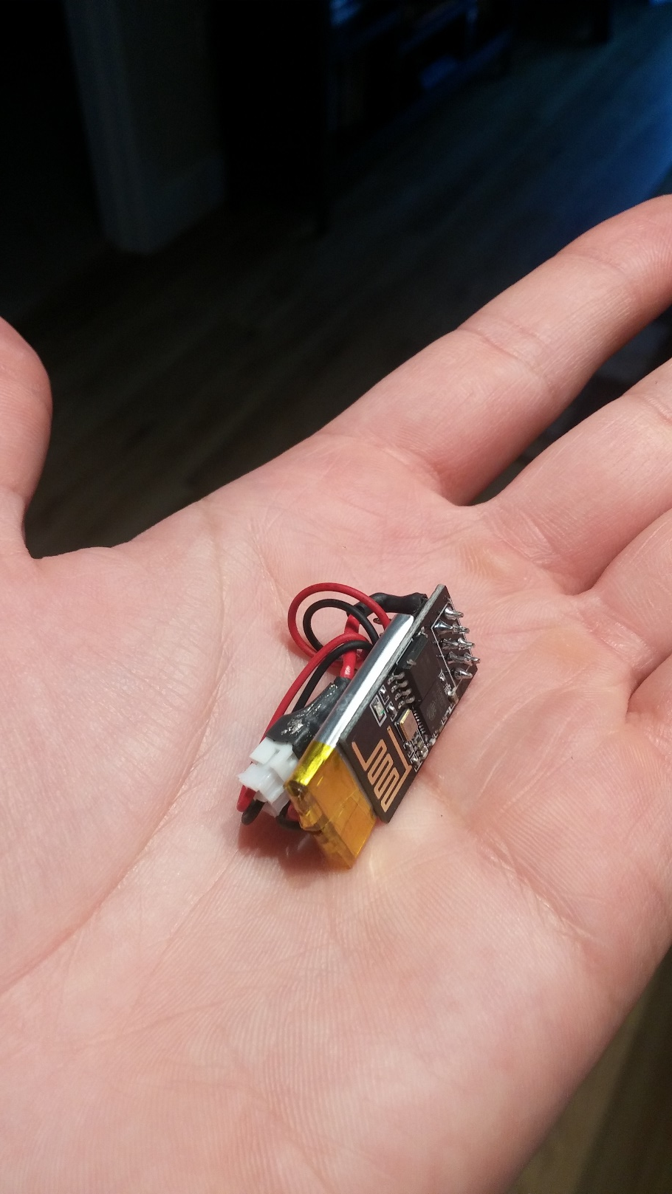
Introduction
Project scope: develop an algorithm that can map N nodes using only measured node-to-node distances contaminated by obstacles.
Solution requirements:
Adequate noise handling (specifically, with many nearby obstacles, walls, and floors)
Efficient node-level computation to minimize node power needs
Minimal System Latency for AR compatibility
Intended use on small, lightweight, body-worn sensors

Slide 4
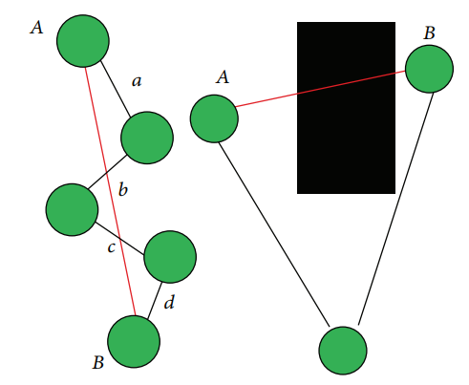
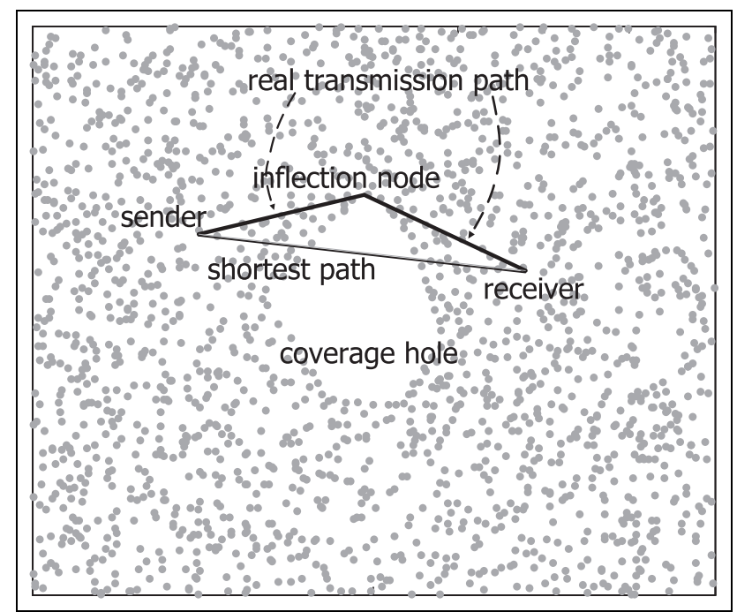
Current Node Localization Techniques
Ignore wall effects entirely
Use range dropping to identify wall effects
Infer out of range distances from in-range distances
Limited in handling of in-range yet contaminated distance measurements
Gaussian Mixed Model to restore distances [3]
Useful for NLOS dominated environments
Limited in wall-contaminated LOS environments (e.g. nodes in separate rooms, floors, etc.)
Stojkoska, B. R. [1]
Li, Q et. al. [2]

Slide 5
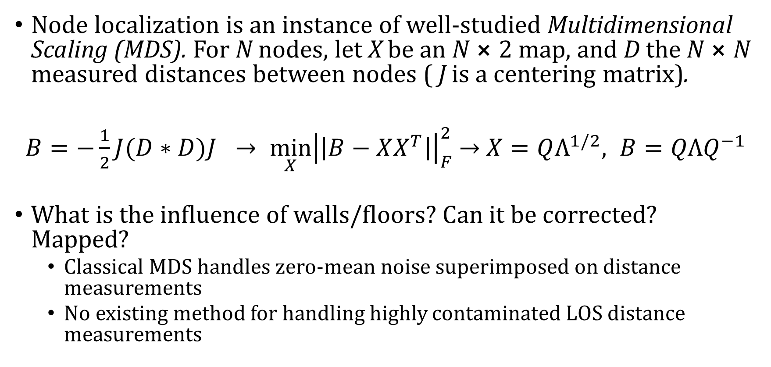
Problem Formulation – Classical MDS
Node localization is an instance of well-studied Multidimensional Scaling (MDS). For N nodes, let X be an N $⨯$2 map, and D the N $⨯$N measured distances between nodes ( J is a centering matrix).
$B=−\frac{1}{2}J(D∗D)J →\min_{X}{{\left|\left|B−XX^{T}\right|\right|}_{F}^{2}}$ $→$ $X=QΛ^{1/2}, B=QΛQ^{−1}$
What is the influence of walls/floors? Can it be corrected? Mapped?
Classical MDS handles zero-mean noise superimposed on distance measurements
No existing method for handling highly contaminated LOS distance measurements

Slide 6
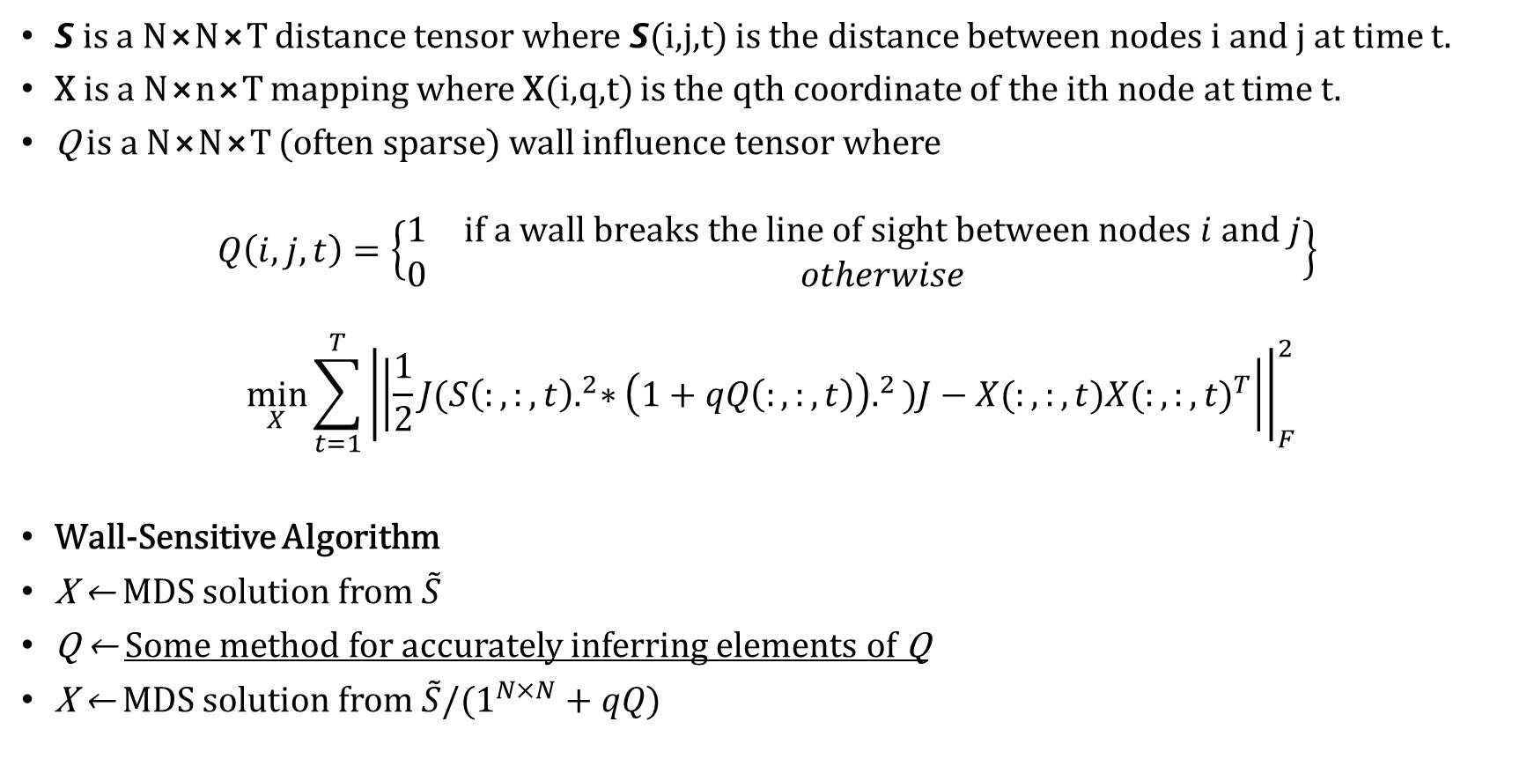
Problem Formulation – Modified MDS
𝙎 is a N⨯N⨯T distance tensor where 𝙎(i,j,t) is the distance between nodes i and j at time t.
X is a N⨯n⨯T mapping where X(i,q,t) is the qth coordinate of the ith node at time t.
Q is a N⨯N⨯T (often sparse) wall influence tensor where
$$Q\left(i,j,t\right)=\left\{\begin{matrix}1 & if a wall breaks the line of sight between nodes i and j \\ 0 & otherwise\end{matrix}\right\}$$
$$\min_{X}{\sum_{t=1}^{T}{{\left|\left|\frac{1}{2}J({S\left(:,:,t\right).}^{2}∗{\left(1+qQ\left(:,:,t\right)\right).}^{2})J−X(:,:,t){X(:,:,t)}^{T}\right|\right|}_{F}^{2}}}$$
Wall-Sensitive Algorithm
X ← MDS solution from $\tilde{S}$
Q ← Some method for accurately inferring elements of Q
X ← MDS solution from $\tilde{S}/(1^{N×N}+qQ)$

Slide 7
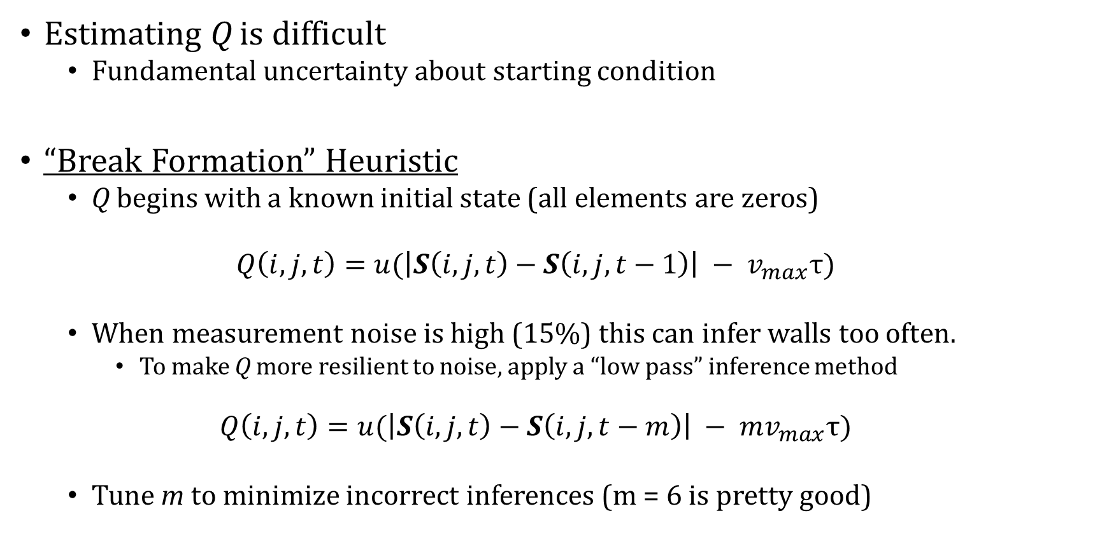
Problem Formulation – Estimating Q
Estimating Q is difficult
Fundamental uncertainty about starting condition
“Break Formation” Heuristic
Q begins with a known initial state (all elements are zeros)
$$Q\left(i,j,t\right)=u(\left|S\left(i,j,t\right)−S\left(i,j,t−1\right)\right| − v_{max}τ)$$
When measurement noise is high (15%) this can infer walls too often.
To make Q more resilient to noise, apply a “low pass” inference method
$$Q\left(i,j,t\right)=u(\left|S\left(i,j,t\right)−S\left(i,j,t−m\right)\right| − {mv}_{max}τ)$$
Tune m to minimize incorrect inferences (m = 6 is pretty good)

Slide 8
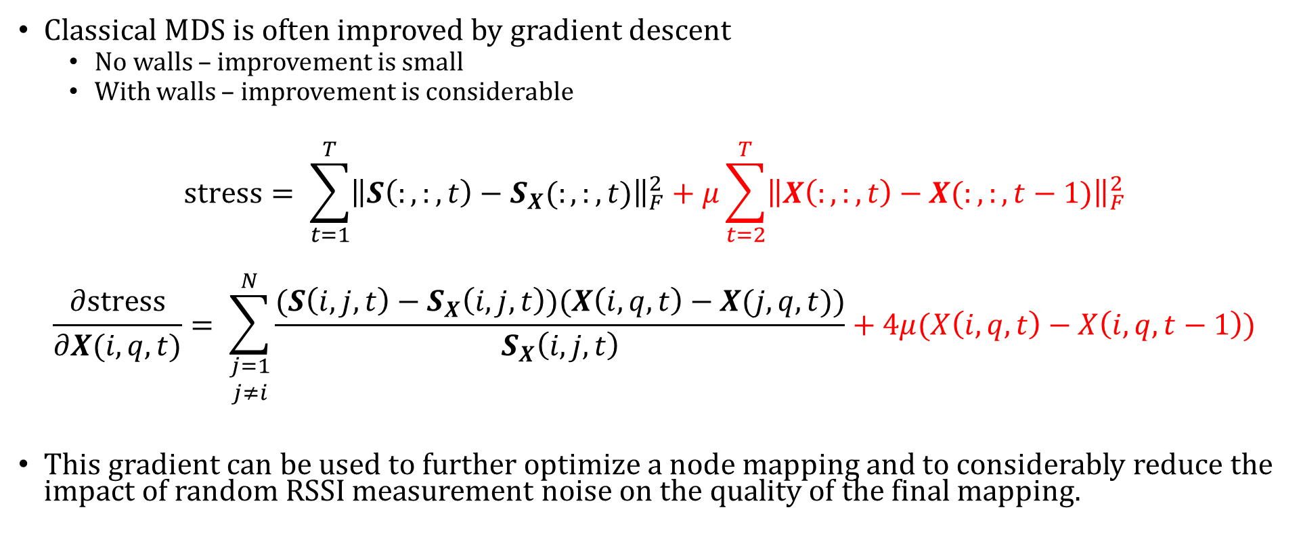
Problem Formulation – Gradient Descent
Classical MDS is often improved by gradient descent
No walls – improvement is small
With walls – improvement is considerable
$$stress= \sum_{t=1}^{T}{{\left\|S\left(:,:,t\right)−S_{X}(:,:,t)\right\|}_{F}^{2}}+μ\sum_{t=2}^{T}{{\left\|X\left(:,:,t\right)−X(:,:,t−1)\right\|}_{F}^{2}}$$
$$\frac{∂stress}{∂X(i,q,t)}= \sum_{\begin{aligned}j=1 \\ j≠i\end{aligned}}^{N}{\frac{(S\left(i,j,t\right)−S_{X}\left(i,j,t\right))(X\left(i,q,t\right)−X(j,q,t))}{S_{X}\left(i,j,t\right)}}+4μ(X\left(i,q,t\right)−X\left(i,q,t−1\right))$$
This gradient can be used to further optimize a node mapping and to considerably reduce the impact of random RSSI measurement noise on the quality of the final mapping.

Slide 9
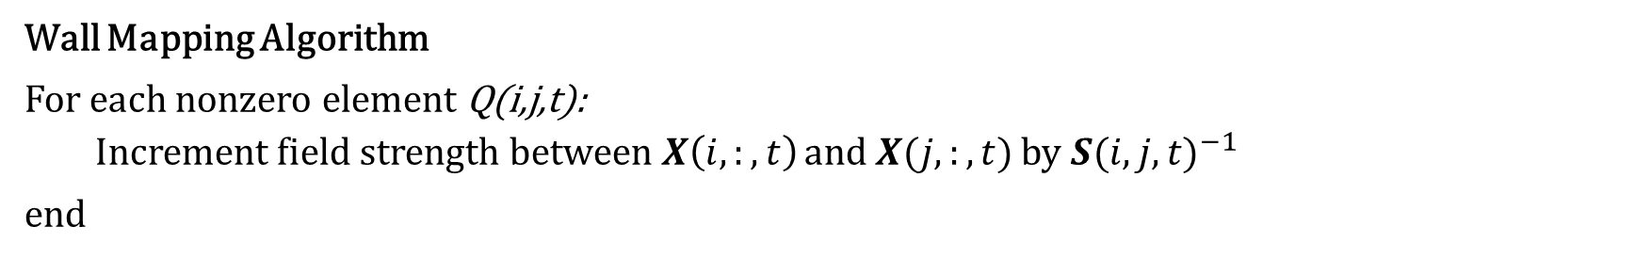
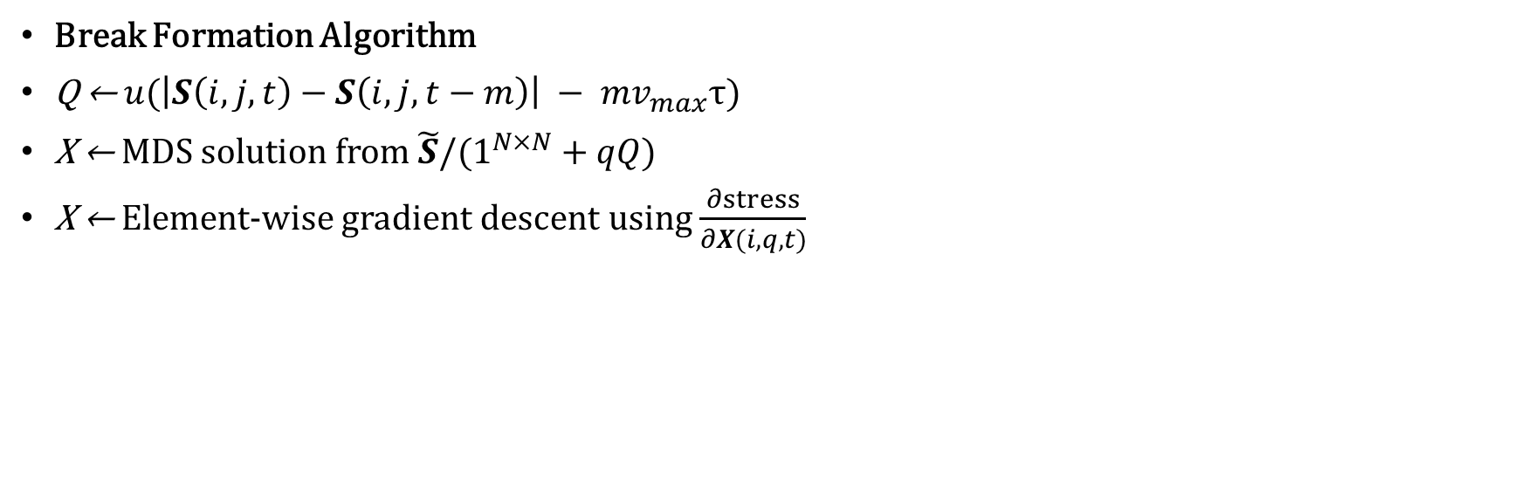
“Break Formation” Algorithm
Break Formation Algorithm
Q ← $u(\left|S\left(i,j,t\right)−S\left(i,j,t−m\right)\right| − {mv}_{max}τ)$
X ← MDS solution from $\tilde{S}/(1^{N×N}+qQ)$
X ← Element-wise gradient descent using $\frac{∂stress}{∂X(i,q,t)}$
Wall Mapping Algorithm
For each nonzero element Q(i,j,t):
Increment field strength between $X\left(i,:,t\right)$ and $X(j,:,t)$ by ${S(i,j,t)}^{−1}$
end

Slide 10
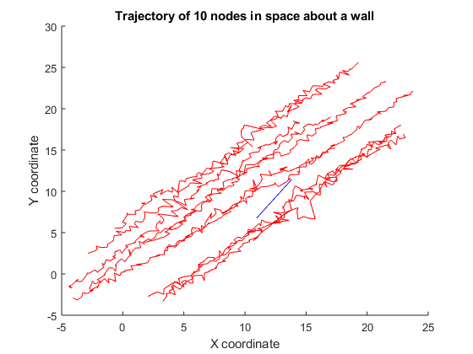
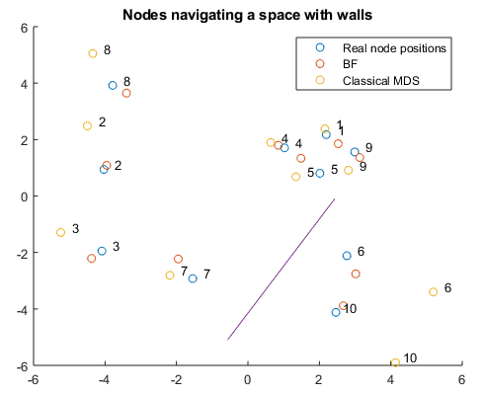
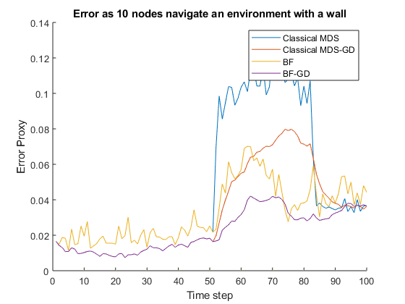
Results – Simulation Design

Slide 11
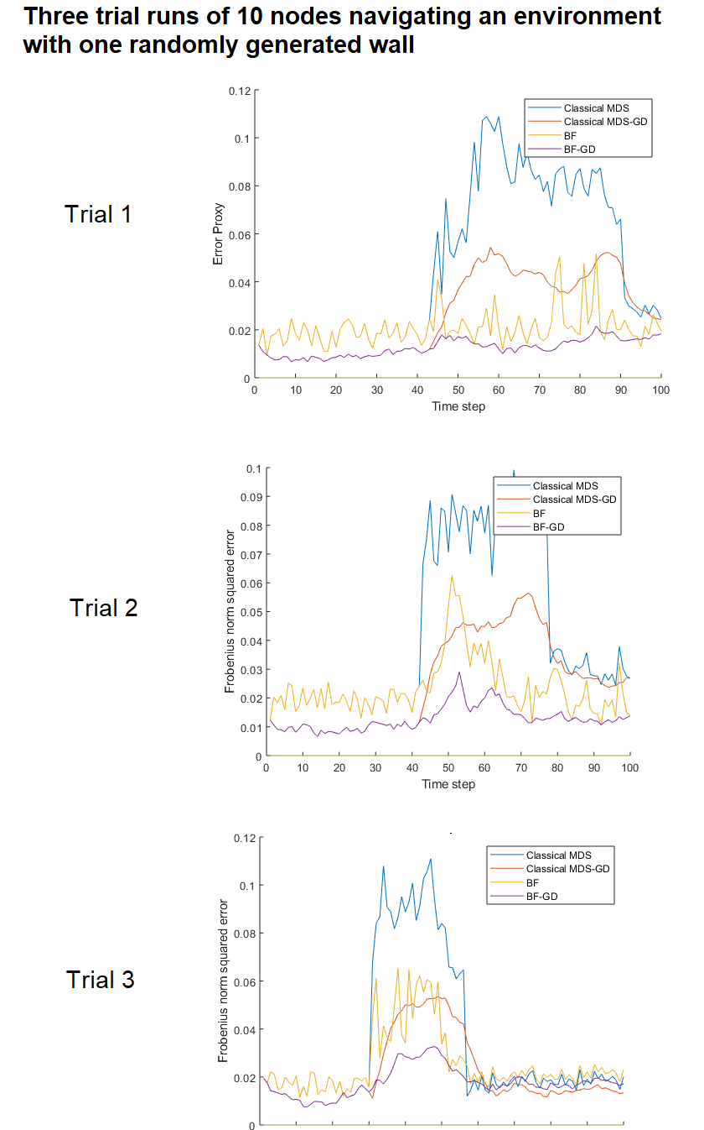
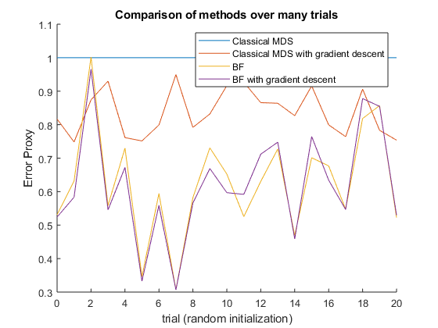
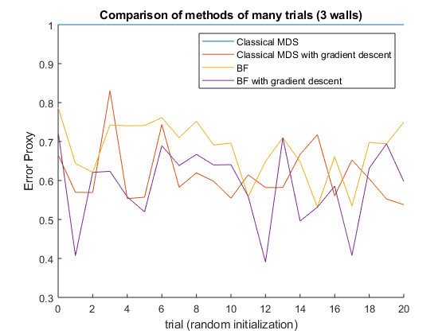
Results – Algorithm Comparison

Slide 12
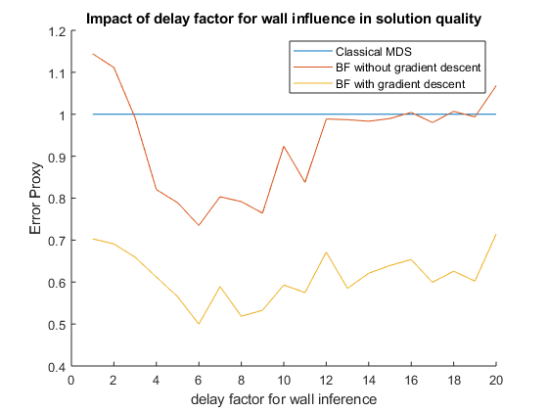
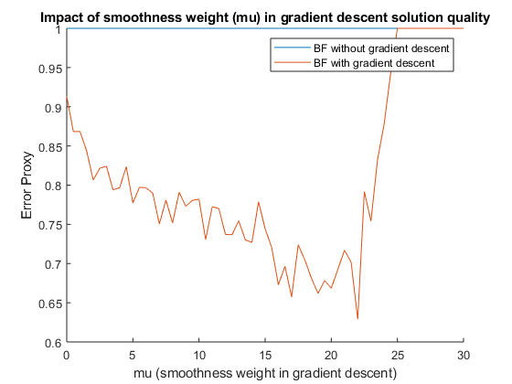
Results – Optimizing algorithm parameters

Slide 13
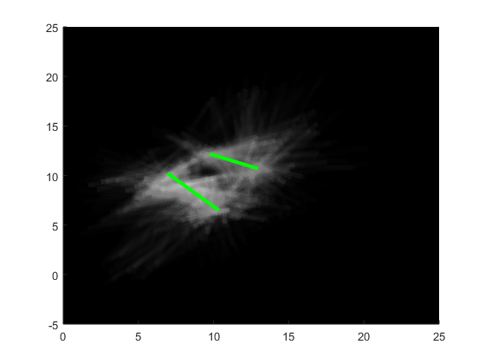
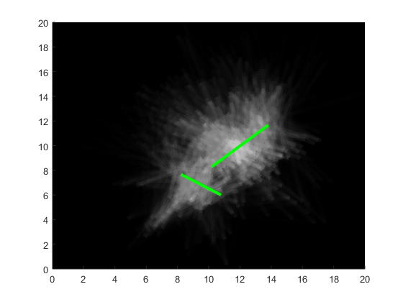
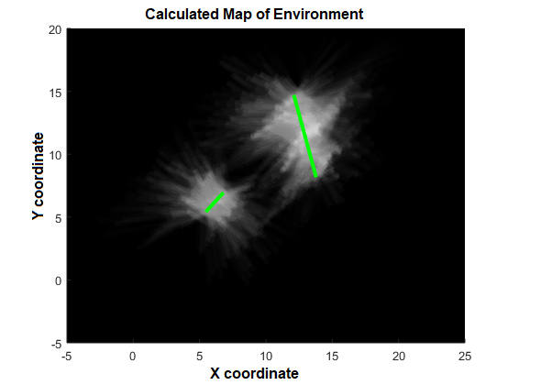
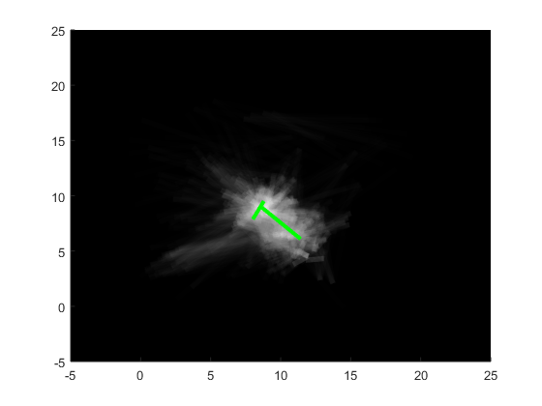
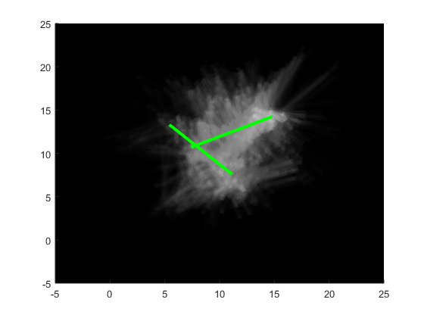
Results – Generating a Wall Map

Slide 14
Conclusion
“Break Formation” is a obstacle-sensitive algorithm based on Classical MDS which significantly better handles node localization in an obstructive environment
BF produces a wall inference tensor Q as a byproduct of node localization. Q is useful in reconstructing a probabilistic map of the environment

Slide 15
References
[1] B. R. Stojkoska “Node Localization in 3D Wireless Sensor Networks Based on Multidimensional Scaling Algorithm” International Scholarly Research Notices Volume 2014 (2014)
[2] Q. Li, et. al. “RMDS: Ranging and multidimensional scaling-based anchor-free localization in large-scale wireless sensor networks with coverage holes” International Journal of Distributed Sensor Networks Vol. 13 (2017)
[3] B. Li “A Robust Wireless Sensor Network Localization Algorithm in Mixed LOS/NLOS Scenario” Sensors 15 (2015)

