Slide 1
Node Localization in an Obstacle-Rich Environment
Nick Kantack
4-8-19

Slide 2
Problem Outline
Research Goal:
An array of body-worn wireless sensors determines the positions of each personnel team member and provides an augmented reality representation to each member (teammates can “see” each other through walls).
Provides powerful coordination capabilities to
Tactical teams (e.g. soldiers and SWAT)
Rescue teams in low visibility conditions (e.g. firefighters)
Project scope: develop an algorithm that can map N nodes using only measured node-to-node distances contaminated by obstacles.
Solution requirements:
Adequate noise handling (specifically, with many nearby obstacles, walls, and floors)
Efficient node-level computation to minimize node power needs
Minimal System Latency for AR compatibility

Slide 3
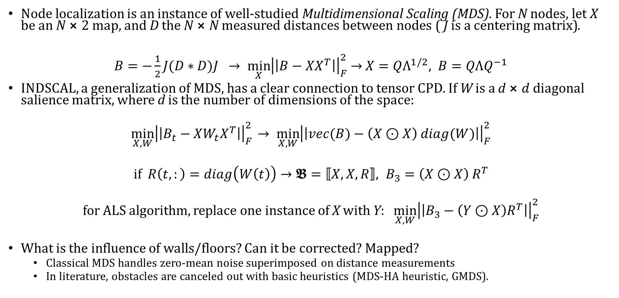
Current Solutions
Node localization is an instance of well-studied Multidimensional Scaling (MDS). For N nodes, let X be an N $⨯$2 map, and D the N $⨯$N measured distances between nodes ( J is a centering matrix).
$B=−\frac{1}{2}J(D∗D)J →\min_{X}{{\left|\left|B−XX^{T}\right|\right|}_{F}^{2}}$ $→$ $X=QΛ^{1/2}, B=QΛQ^{−1}$
INDSCAL, a generalization of MDS, has a clear connection to tensor CPD. If W is a d $⨯d$ diagonal salience matrix, where d is the number of dimensions of the space:
$$\min_{X,W}{{\left|\left|B_{t}−XW_{t}X^{T}\right|\right|}_{F}^{2}} → \min_{X,W}{{\left|\left|vec(B)−\left(X⊙X\right) diag(W)\right|\right|}_{F}^{2}}$$
if $R\left(t,:\right)=diag\left(W\left(t\right)\right)→𝕭=⟦X, X, R⟧, B_{3}=\left(X⊙X\right)$ $R^{T}$
for ALS algorithm, replace one instance of X with Y: $\min_{X,W}{{\left|\left|B_{3}−\left(Y⊙X\right)R^{T}\right|\right|}_{F}^{2}}$
What is the influence of walls/floors? Can it be corrected? Mapped?
Classical MDS handles zero-mean noise superimposed on distance measurements
In literature, obstacles are canceled out with basic heuristics (MDS-HA heuristic, GMDS).

Slide 4
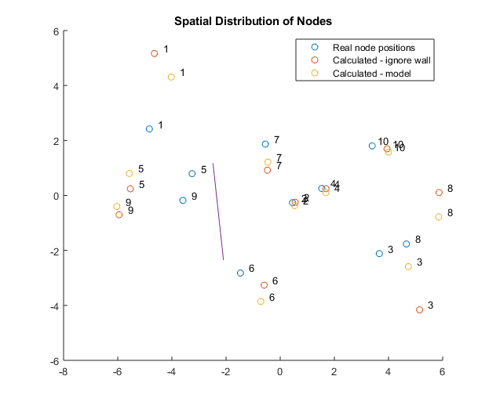
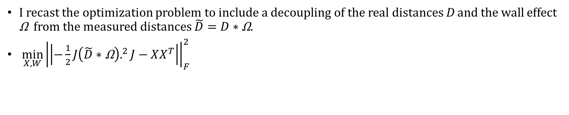
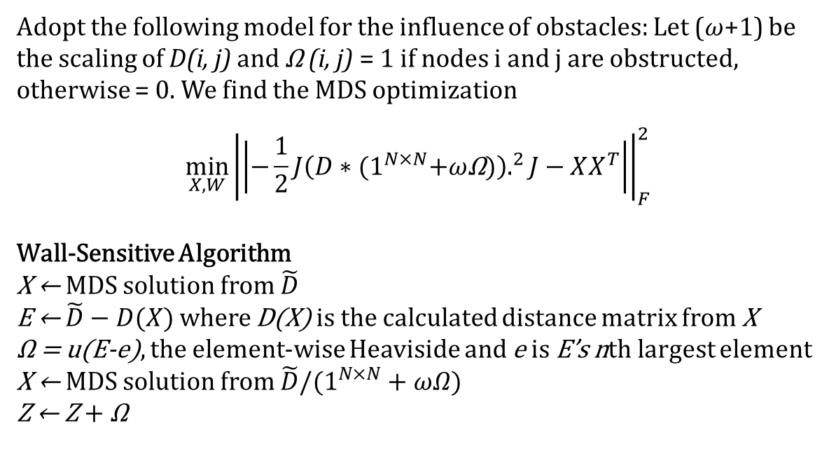
Proposed Research into Novel Method
I recast the optimization problem to include a decoupling of the real distances D and the wall effect Ω from the measured distances $\tilde{D}=D∗\text{Ω}$.
$\min_{X,W}{{\left|\left|−\frac{1}{2}J{\left(\tilde{D}∗\text{Ω}\right).}^{2}J−XX^{T}\right|\right|}_{F}^{2}}$
Adopt the following model for the influence of obstacles: Let (ω+1) be the scaling of D(i, j) and Ω (i, j) = 1 if nodes i and j are obstructed, otherwise = 0. We find the MDS optimization
$$\min_{X,W}{{\left|\left|−\frac{1}{2}J{\left(D∗(1^{N×N}\text{+}\text{ω}\text{Ω})\right).}^{2}J−XX^{T}\right|\right|}_{F}^{2}}$$
Wall-Sensitive Algorithm
X ← MDS solution from $\tilde{D}$
E ← $\tilde{D}−D(X)$ where D(X) is the calculated distance matrix from X
Ω = u(E-e), the element-wise Heaviside and e is E’s nth largest element
X ← MDS solution from $\tilde{D}/(1^{N×N}+ωΩ)$
Z ← Z + Ω

