Slide 1

Performance Characterization of Porous Silicon (PoSi) Schottky Devices
Nick Kantack
V. R. Whiteside, Y. Cheng, N. Shahabi Sani, L. A. Bumm, and I. R. Sellers
4/16/2016

Slide 2
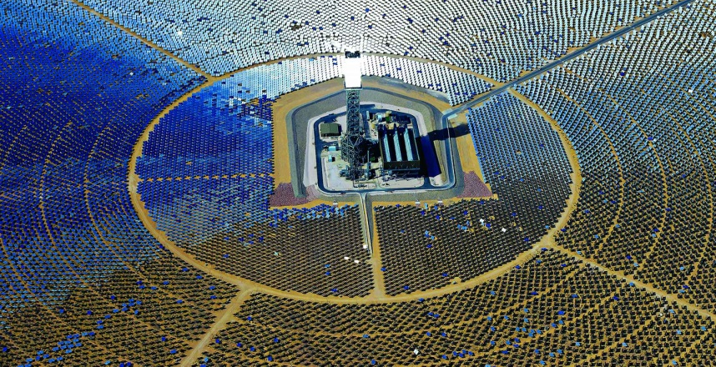
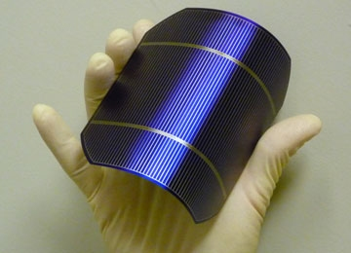
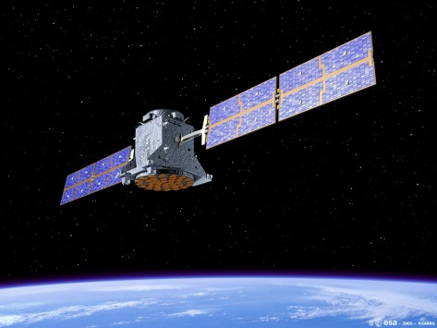
Motivation
Solar energy
Cheap
Efficient
Versatile
Silicon is the most established of all solar technologies.
Innovations for silicon cells can apply to other emerging solar materials
Porous silicon reduces reflection, the primary loss separating current cells from ideal performance.

Slide 3
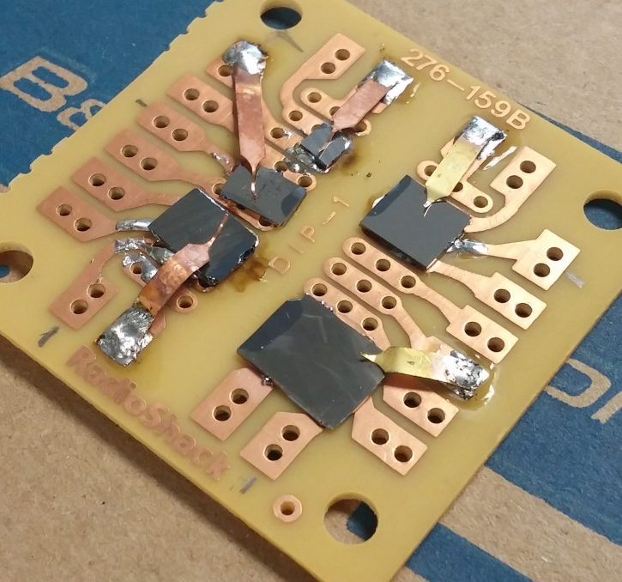
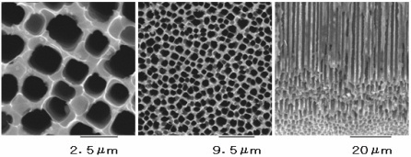
Research Summary
Device Structure
The nature of PoSi devices fabricated at OU are not fully understood.
Would like to know:
What charge transport models dominate?
What loss mechanisms dominate?
What is the quality of the devices?
How do they compare to non-porous silicon?
Pd
Si/PoSi
Al
Si Cells
SEM of Porous Silicon
PoSi Cells
Quantum14 Inc. Kajino-cho, Koganei-shi, Tokyo

Slide 4
Discussion of Reflectivity
Porous silicon schottky devices demonstrated ~25% lower reflectivity.
Light entering the pores impinges the walls multiple times, increasing probability of absorption.
Reflectivity is high in these devices due to Palladium layer.

Slide 5






Theory Of Device Performance
P Type
Semiconductor
N Type
Semiconductor
Metal
N Type
Semiconductor
Schottky Barrier
$$E_{C}$$
$$E_{C}$$
$$E_{F}$$
$$E_{F}$$
Bandgap
$$E_{V}$$
$$E_{V}$$
A Schottky Diode uses a metal-semiconductor interface, in our case Palladium joining an N-type Silicon layer (porous or non-porous).

Slide 6






IV Characterization
Observe device properties an non-idealities in a standardized way
Diode behavior
Ohmic behavior
$$Current$$
$$Log(Current)$$
$$Ideal$$
$$Real$$
$$Voltage$$
$$Voltage$$

Slide 7
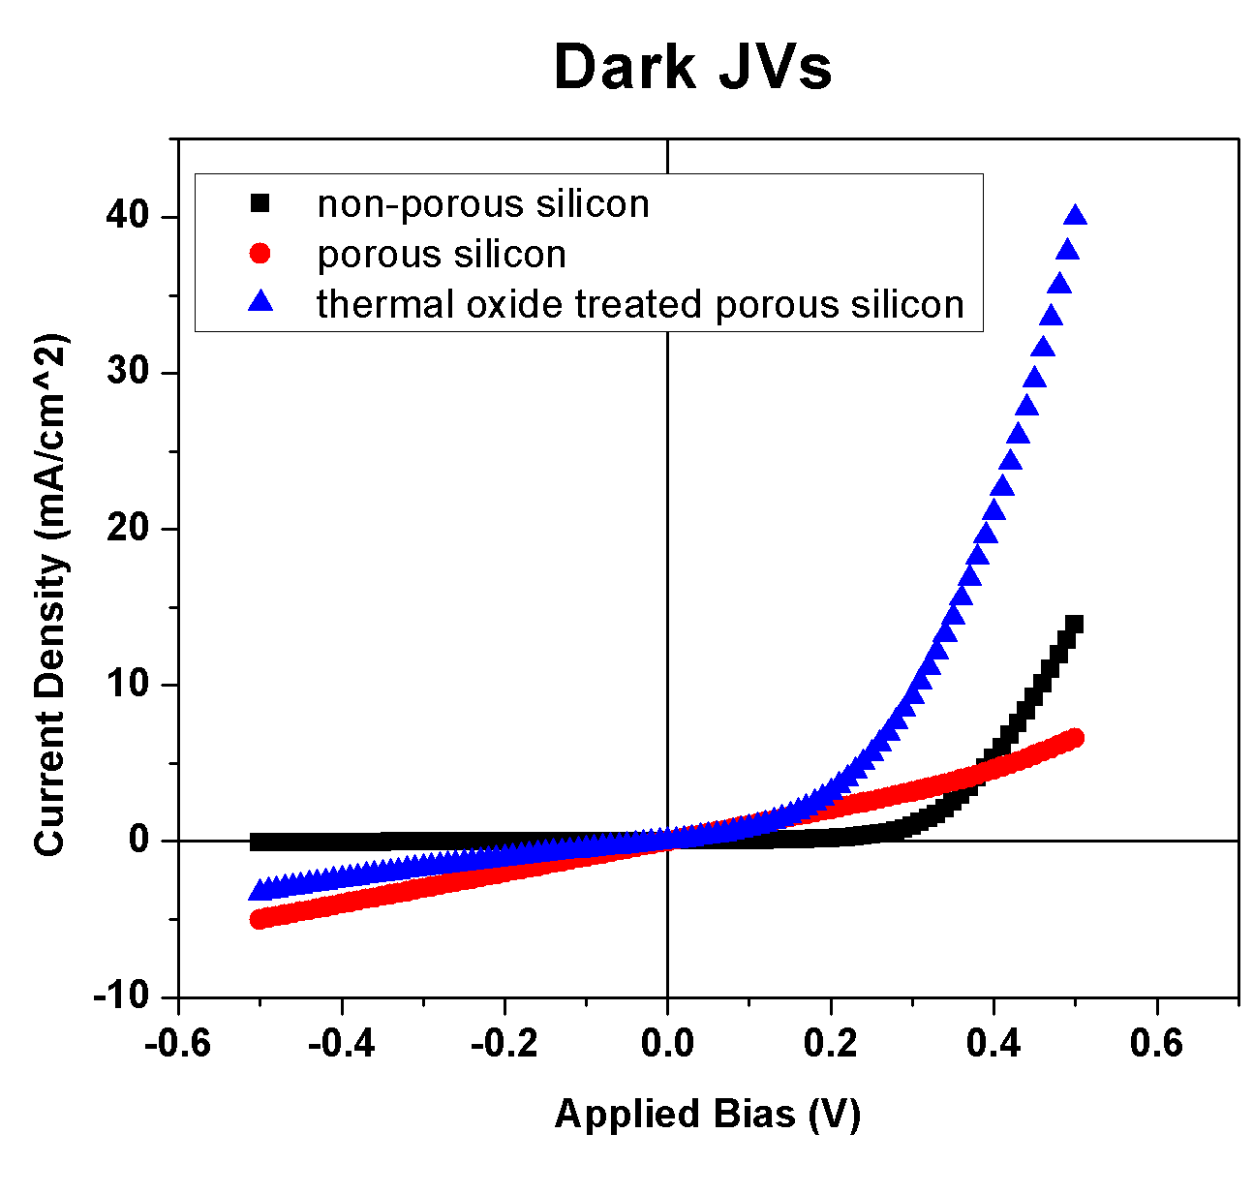
Measuring IV Performance
Discernable diodic behavior from all samples
Ohmic leakage current evident in samples (constant slope), indicating density of shunt paths.

Slide 8



Thermionic Emission Model
Charge across the junction in terms of kinetic energy.
The temperature of the device affects the distribution of kinetic energies among carriers.
$$E$$
Metal
N Type
Semiconductor
$$I$$
$$N$$
$$E_{C}$$
$$E_{F}$$
$$E_{V}$$

Slide 9
Temperature Dependent IV Characterization
Temp (K)
Temperature dependence taken from 77K to 350K at 10K steps. Saturation current and fill factor change smoothly with temperature.

Slide 10


Expanded Model
The following equation models metal-semiconductor-metal lead selenide diodes.
Daniel Bozyigiti, et. al. “A quantitative model for charge carrier transport, trapping and recombination in nanocrystal-based solar cells”
I adapted this equation to incorporate the resistivity elements into an expanded diode equation.

Slide 11
Fitting the IVs: Expanded Model
The expanded model largely explains the current observed in the devices.
Offset likely due to omission of voltage lowering

Slide 12
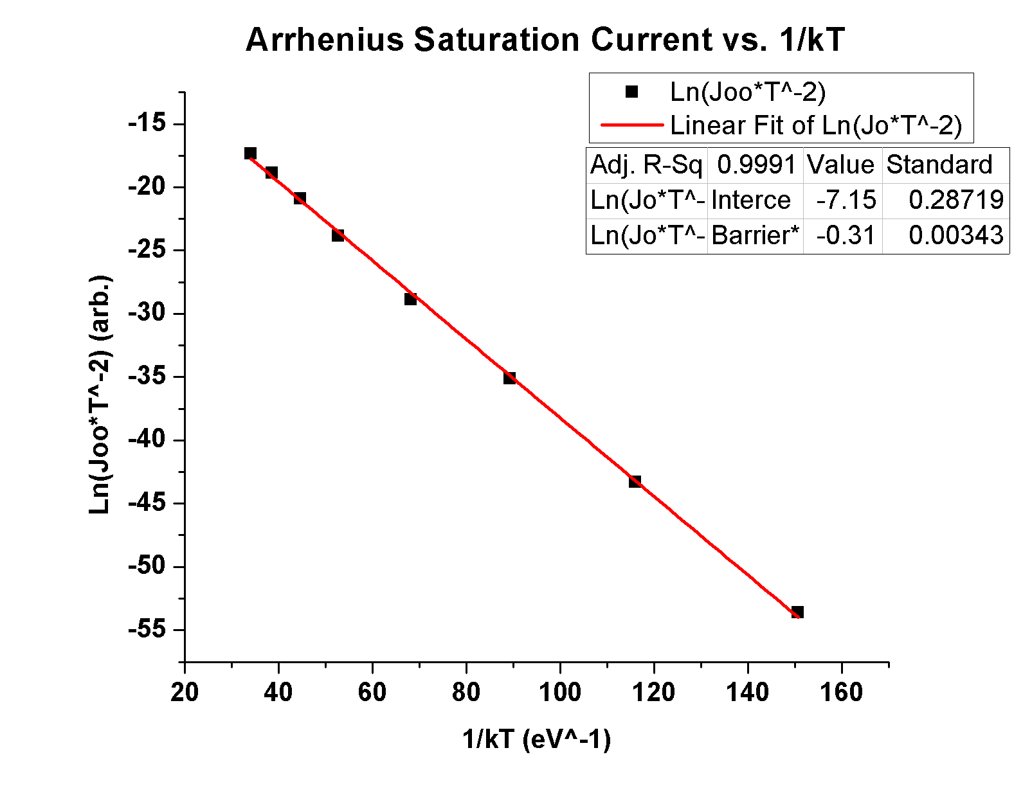
Extracting Constants
Arrhenius Saturation Current is linear with inverse temperature.
Intercept - Richardson Constant
Slope - Barrier Height
Barrier Heights (eV)
Non-porous | Porous | ThermalO
0.34 | 0.25 | 0.31

Slide 13
Conclusions
Identified a compelling diode model incorporating resistivity effects
Observed results consistent with thermionic emission theory
Determined physical constants about device characteristics from the fitting constants
Barrier height
Richardson Constant

Slide 14
Future Work
Perform this analysis on new cells from OU
Standardize the cell area
Test in conjunction with quantum dots
Better understand deviations from model
Tunneling current in reverse bias?

Slide 15


Acknowledgements
Dr. Ian Sellers
Dr. Vincent Whiteside
Dr. Lloyd Bumm and the Bumm Group
Fellow researcher group members
Partners of the Oklahoma NASA Energy and Materials Symposium, and the University of Tulsa for hosting the event
Oklahoma Center for the Advancement of Science & Technology
OARs program grant number # AR 14-041

