Slide 1
CAPSTONE PROJECT
Cyclistic Bike-Share
Analysis
How do annual members and casual riders use Cyclistic bikes differently?
Nick Khurshid | April 2026
📊 Interactive Dashboard: public.tableau.com/app/profile/nick.khurshid

Slide 2
BUSINESS TASK
What Are We Solving?
"How do annual members and casual riders use Cyclistic bikes differently?"
Understand
Convert
Identify behavioral differences between casual riders and annual members across time, location, and ride patterns.
Use data-driven insights to recommend marketing strategies that convert casual riders into annual members.
Data Source: Divvy Bikeshare 2023 | Tool: Google BigQuery · R · Tableau

Slide 3
DATA OVERVIEW
About the Dataset
12
5M+
13
Monthly CSV Files
Trip Records
Data Fields
Key Variables Included
ride_id Unique trip identifier
start / end station Station names and coordinates
rideable_type Bike type (classic, electric, docked)
member_casual User type: annual member or casual rider
started_at / ended_at Precise trip timestamps
Data: Divvy Bikeshare 2023 · Processed via Google BigQuery

Slide 4
DATA CLEANING
Preparing the Data
01
02
Removed Duplicates
Invalid Ride Durations
Verified zero duplicate ride_ids using BigQuery GROUP BY / HAVING.
Deleted trips under 1 minute and over 24 hours as operationally implausible.
03
04
Missing Station Names
Invalid Member Values
Replaced NULL station names with 'Unknown' to preserve record count.
Filtered out entries with values other than 'member' or 'casual'.
New columns created: ride_length · day_of_week · hour · month

Slide 5
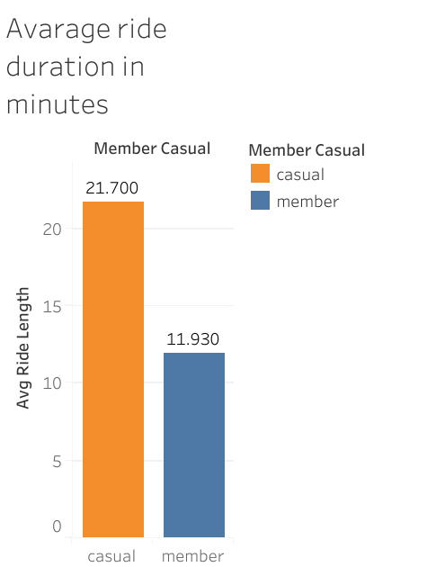
INSIGHT 1
RIDE DURATION
How Long Do People Ride?
[ VISUALIZATION ] Bar chart: Avg. ride duration
Casual vs. Member
Casual Riders
Significantly longer average ride duration – suggesting leisure and exploratory use.
Annual Members
Shorter, more consistent ride duration – suggesting purposeful, routine commuting.
Data: Divvy Bikeshare 2023 | Tableau: public.tableau.com/app/profile/nick.khurshid

Slide 6
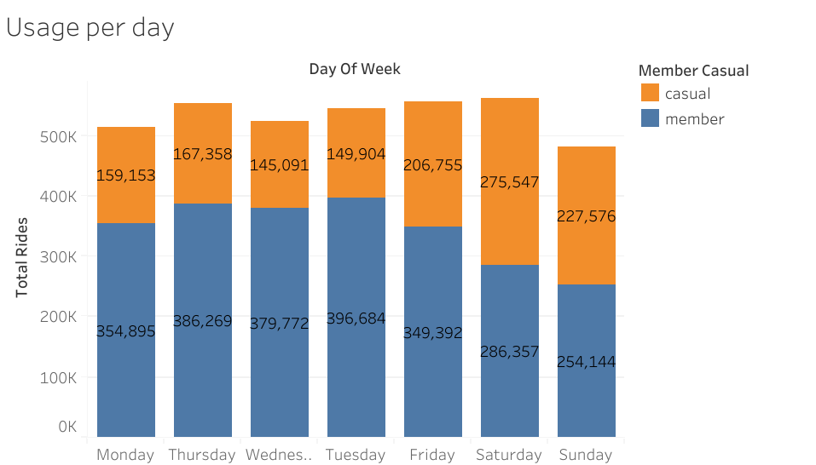
INSIGHT 2
WEEKDAY USAGE
When During the Week?
[ VISUALIZATION ] Bar chart: Rides by day of week
Casual vs. Member
Casual Riders
Peak usage on weekends (Sat & Sun) – consistent with recreational patterns.
Annual Members
Consistent usage on weekdays (Mon–Fri) – aligned with daily commute behavior.
Data: Divvy Bikeshare 2023 | Tableau: public.tableau.com/app/profile/nick.khurshid

Slide 7
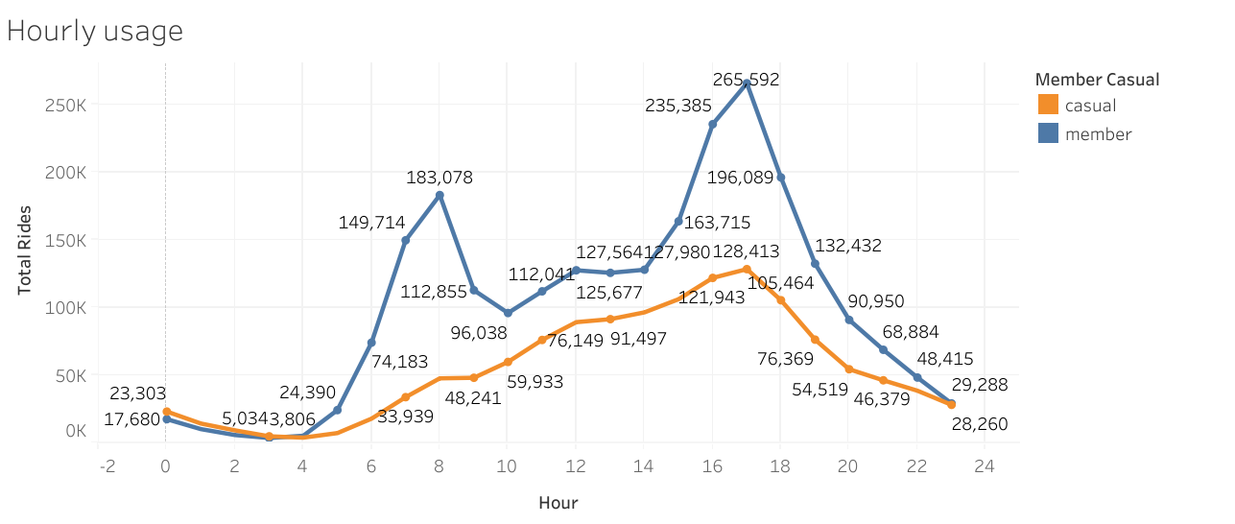
INSIGHT 3
TIME OF DAY
What Time Do They Ride?
[ VISUALIZATION ] Line chart: Rides by hour
Casual vs. Member
Casual Riders
Higher usage in the afternoon – typically for leisure trips and tourism.
Annual Members
Clear peaks at 08:00 AM & 05:00 PM – classic morning and evening commute.
Data: Divvy Bikeshare 2023 | Tableau: public.tableau.com/app/profile/nick.khurshid

Slide 8
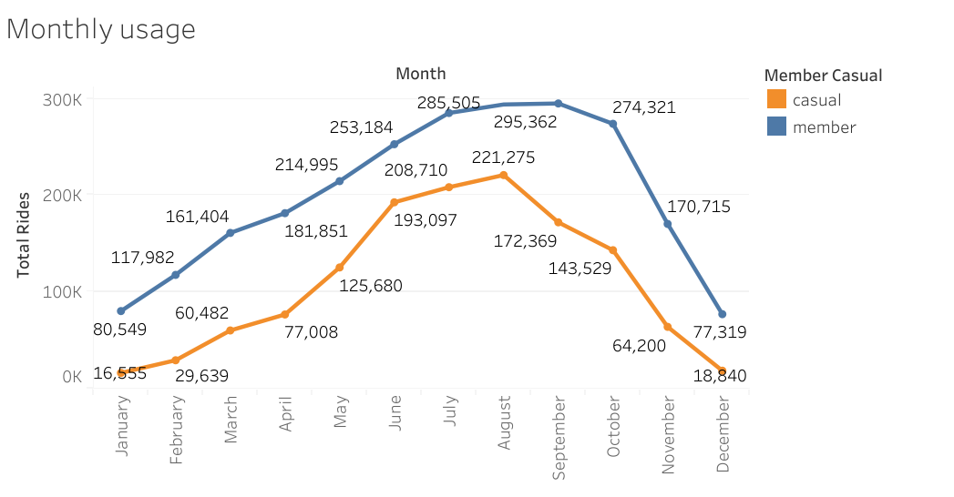
INSIGHT 4
MONTHLY USAGE
How Does Season Affect Rides?
[ VISUALIZATION ] Line chart: Monthly ride volume
Casual vs. Member
Casual Riders
Usage drops sharply in winter months – highly sensitive to weather conditions.
Annual Members
More stable usage year-round – less affected by seasonal or weather changes.
Data: Divvy Bikeshare 2023 | Tableau: public.tableau.com/app/profile/nick.khurshid

Slide 9
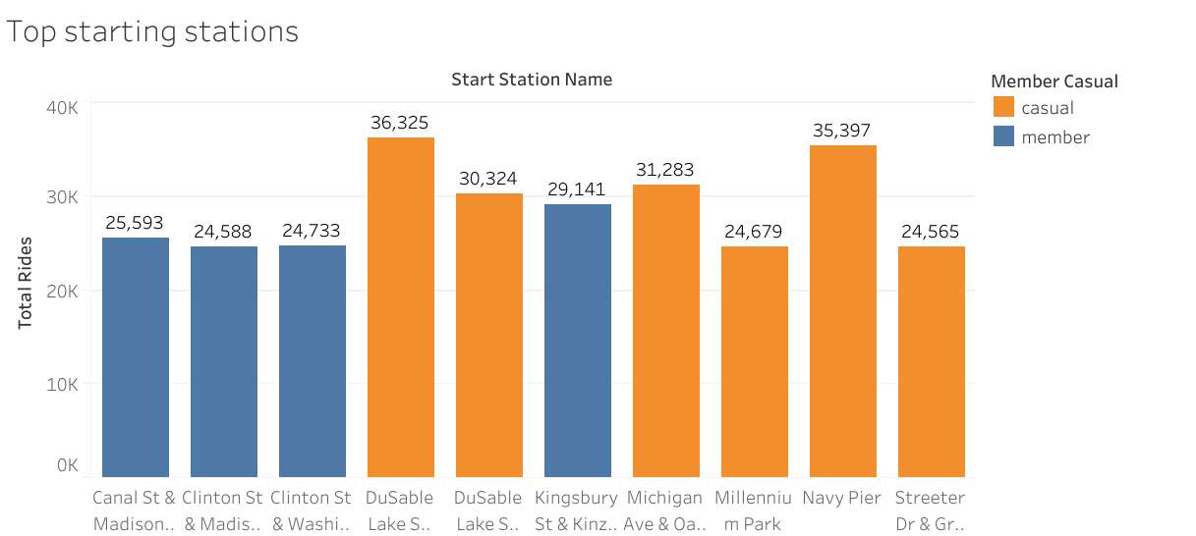
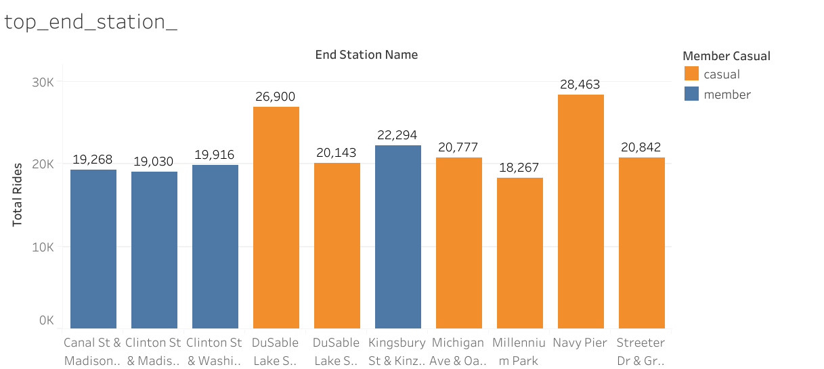
INSIGHT 5
STATION PATTERNS
Where Do They Start & End?
[ VISUALIZATION ] Map or bar chart:
Top 10 start stations
Casual Riders
Leisure-oriented stations near parks, lakefront, and tourist attractions.
Annual Members
Routine-oriented stations near offices, transit hubs, and residential areas.
Data: Divvy Bikeshare 2023 | Tableau: public.tableau.com/app/profile/nick.khurshid

Slide 10
RECOMMENDATIONS
Three Actions to Drive Conversions
1
Weekend Membership Plan
Casual riders peak on weekends. A Saturday–Sunday or leisure-focused membership tier directly matches their usage pattern and lowers the conversion barrier.
2
Summer Conversion Campaign
Casual ridership surges May–August. Targeted promotions during peak season – when casual riders are most active – maximize campaign visibility and impact.
3
Value-Based Pricing Communication
Show casual riders the cost savings of membership vs. pay-per-ride using their actual usage data. Personalized savings estimates create a compelling conversion argument.
Cyclistic Bike-Share Analysis · Nick Khurshid · April 2026

