Slide 1

Artistic Stylizer Platform
CMPT 475N-200
Prof. Pablo Rivas

Slide 2
Meet the Team
Nick Klacik – CS
Brandon Litwin – CS
Ian Sniffen – CS
Nicole Padrazo – IT
Kevin Kleinschmidt -IS

Slide 3
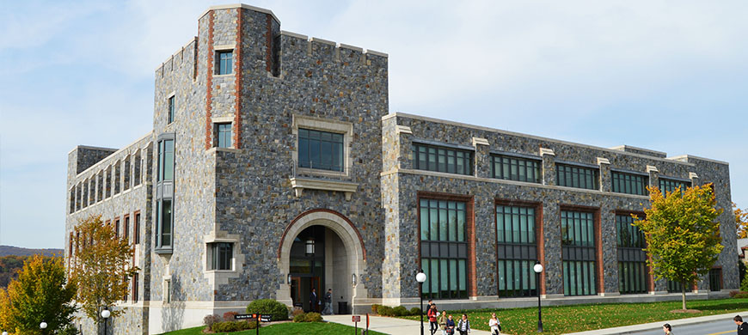
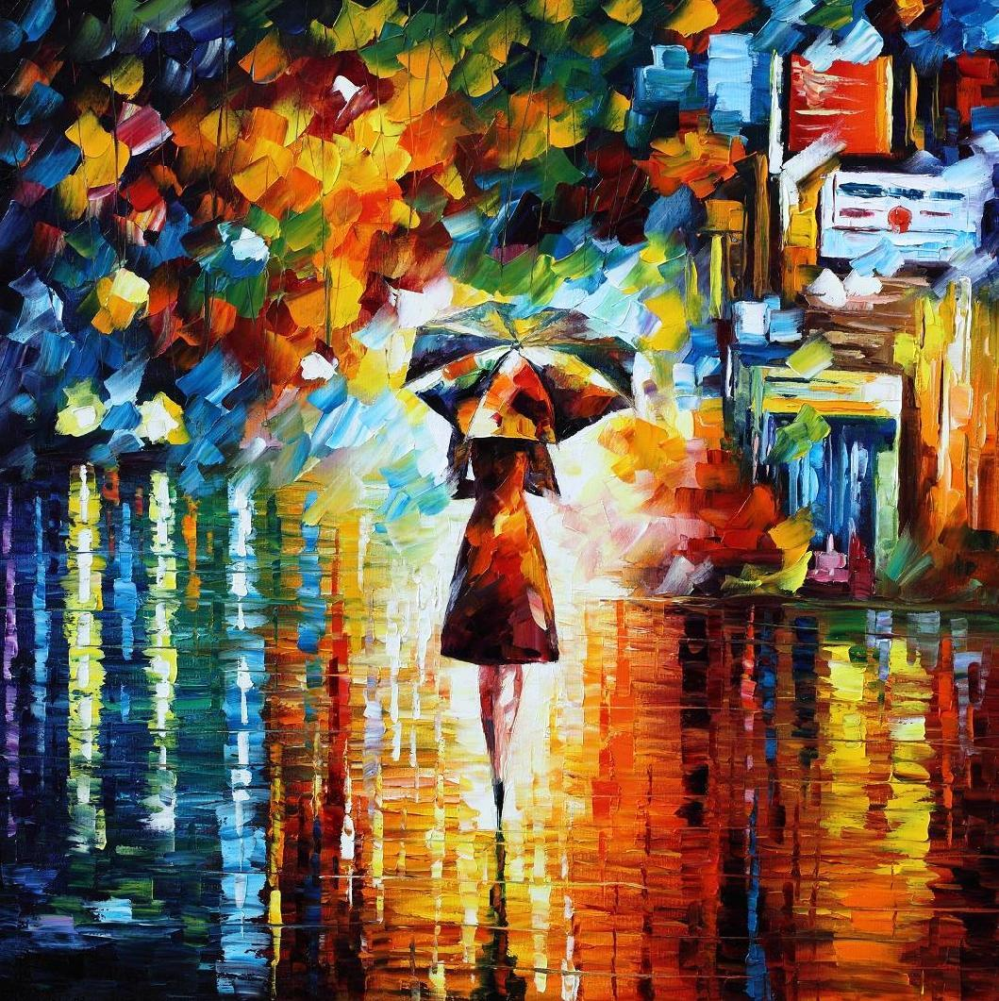
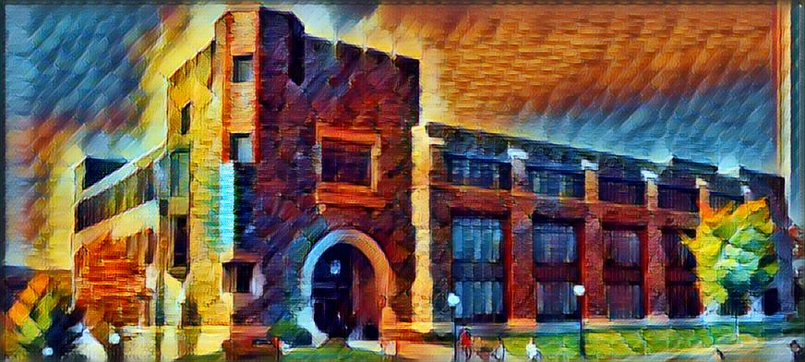
Our Application
Web platform to serve users requesting to process a stylized picture
Machine learning API that performs image style transfer
Data store for user credentials and photos

Slide 4
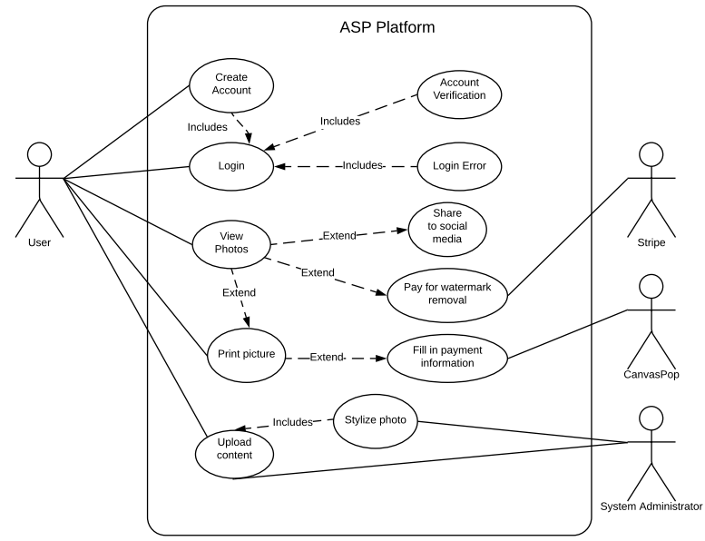
Features
Create Account
Upload and style images
View previous uploads
Watermark
CanvasPop ordering
Social media sharing

Slide 5
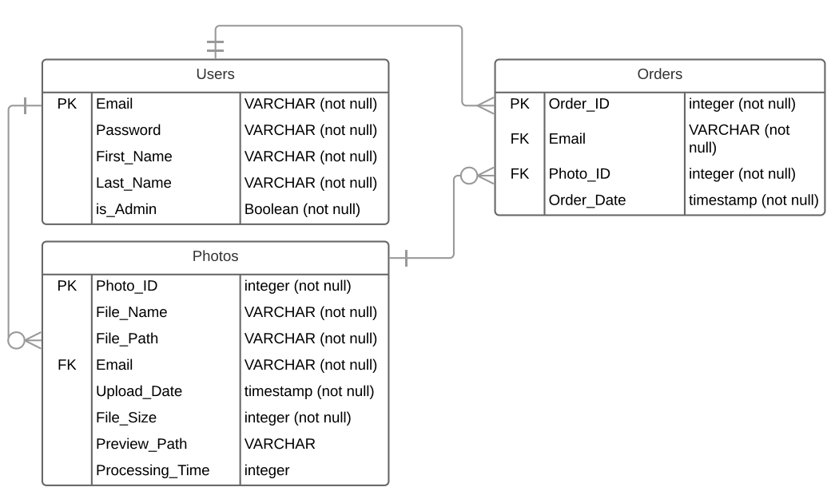
Database Design

Slide 6
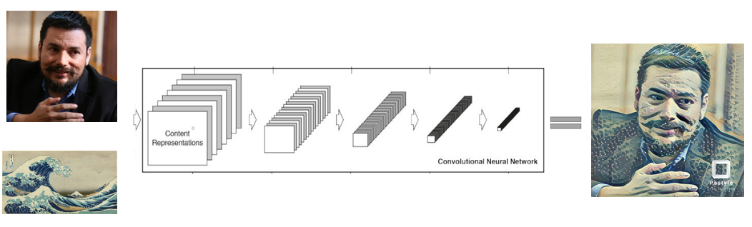
Fast Style Transfer in Tensorflow
Machine learning API developed by Logan Engstrom
Uses Tensorflow for API training
We provide six default styles to users

Slide 7
IT Infrastructure
Ubuntu 18.04 server
Apache Webserver
Postgres DB
PHP
Python

Slide 8
Image Watermarking
All images uploaded are watermarked
Watermarks can be removed with purchase
Completed with PHP functions

Slide 9

CanvasPop
Image printing service
Uses a pop-up store
All payment and processing handled by CanvasPop

Slide 10

Stripe
Payment processing service
Used for watermark removal payment

Slide 11
Social Media Sharing
Users can share to their Facebook accounts
Implemented via Facebook SDK for JavaScript
Sharing done on view page
Shares selected image

Slide 12
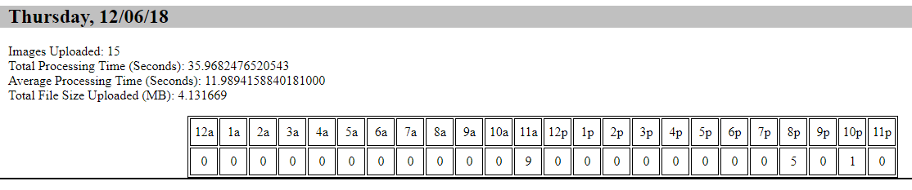
System Logs
Can be viewed by system administrators
Shows the following:
Images uploaded
Processing time
Data uploaded (MB)

Slide 13
Project Timeline
9/26: Design complete
10/17: Basic UI, DB, and CanvasPop completed (early demo)
10/31: New Style API and Stripe implemented
11/7: Project prototype complete (mature demo)
11/14: Watermarking implemented
11/16: First CanvasPop order made
12/12: Final deliverable, presentation

Slide 14

Thank You!
Questions?

Slide 15
Demo
https://sp.marist.ai

