Slide 1
COSC 120: Computer Science I Module 3
Instructors:
Dr. Xiaohong (Sophie) Wang (xswang@salisbury.edu)
Department of Mathematics & Computer Science
Salisbury University
Fall 2020

Slide 2
Module 3: Arrays and Functions
Arrays
Modular Programming
Defining and Calling Functions
Passing Data into a Function
Returning a Value from a Function
Local and Global Variables
Default Arguments
Using Reference Variables as Parameters
Overloading Functions
Recursion Function
Partial contents of this note refer to https://www.pearson.com/us/
Copyright 2018, 2015, 2012, 2009 Pearson Education, Inc., All rights reserved
Dissemination or sale of any part of this note is NOT permitted

Slide 3
Arrays
Array in C++
Range-Based for loop
Processing Array Contents
Arrays as Function Arguments
Two-Dimensional Arrays
Partial contents of this note refer to https://www.pearson.com/us/
Copyright 2018, 2015, 2012, 2009 Pearson Education, Inc., All rights reserved
Dissemination or sale of any part of this note is NOT permitted

Slide 4
Array in C++
Array:
is a data type that allows variables of this type store multiple values of the same type
Values are stored in adjacent memory locations
Defined using the date type of each element and a[] operator:
int tests[5];
Size
Array Data type
Name

Slide 5
Accessing Array Elements
Each element in an array is assigned a unique subscript from 0 to n-1 while n is the size of the array
To access an element in an array:
array_name[subscript]
int tests[5];
0 | 1 | 2 | 3 | 4
tests[0]
tests[1]
tests[2]
tests[3]
tests[4]

Slide 6
Accessing Array Elements (Cont’d)
Each array element can be used as a regular variable:
tests[0] = 79;
cout << tests[0]; //
cin >> tests[1];
tests[4] = tests[0] + tests[1];
Arrays must be accessed via individual elements:
cout << tests; // not legal

Slide 7
Using a Loop to Step Through an Array
Example – The following code defines an array, numbers, and assigns 99 to each element:
const int ARRAY_SIZE = 5;
int numbers[ARRAY_SIZE];
for (int count = 0; count < ARRAY_SIZE; count++)
numbers[count] = 99;
The variable count starts at 0, which is the first valid subscript value
The loop ends when the variable count reaches 5, which is the first invalid subscript value
The variable count is incremented after each iteration

Slide 8
Array Initialization
An array can be initialized with an initialization list: const int SIZE = 5; int tests[SIZE] = {79,82,91,77,84};
The values are stored in the array in the order in which they appear in the list.
The initialization list cannot exceed the array size.
79 | 82 | 91 | 77 | 84
tests[0]
tests[1]
tests[2]
tests[3]
tests[4]

Slide 9
No Bounds Checking in C++
When you use an array subscript, C++ does not check whether it is a valid subscript or not
You can use subscripts that are beyond the bounds of the array
A common mistake: off-by-one error
Subscripts are between 0 and n-1, not 1 and n
int values[3] = {5, 8, 10};
// Syntax correct, but may corrupt other memory
// locations, crash program, or cause elusive bugs
values[3] = 12;
int numbers[10];
for (int count = 0; count < 10; count++)
numbers[count] = 0;

Slide 10
Processing Array Contents
Array elements can be treated as ordinary variables of the same type as the array
Each element is a variable
Processing an element is no different than processing other variables
When using ++, -- operators, don’t confuse the element with the subscript: i=2; tests[i]=10;
cout << tests[i]++; //add 1 to tests[i] then display
cout << tests[i++]; // increment i (i=i+1), then display

Slide 11
Array Assignment
To copy one array to another,
Don’t try to assign one array to the other:
newTests = tests; // Won't work
Instead, assign element-by-element:
for (i = 0; i < ARRAY_SIZE; i++)
newTests[i] = tests[i];
Note: Anytime the name of an array is used without brackets and a subscript, it is seen as the array’s beginning memory address (not a variable).

Slide 12
In-class practice
Take 5 integers from user and store these numbers in an array
Use a for loop to find the largest element of this array
Display this element
Test you code
Question: How to implement this practice using range-based for loop?
Reference code: LargestInteger.cpp

Slide 13
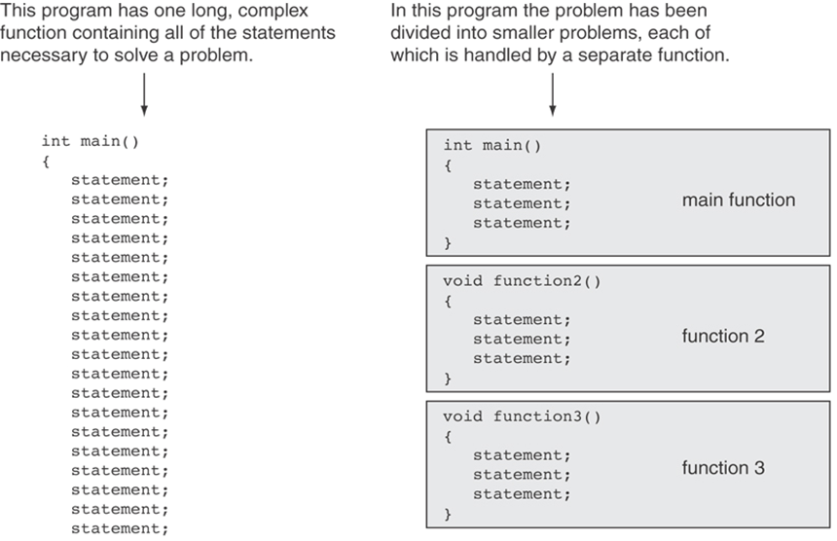
Modular Programming
Modular programming: breaking a program up into smaller, manageable functions or modules

Slide 14
Advantages of using functions
Code reuse:
Golden rule of function: if you need to write one sentence more than once, write it as a function
Decompose complex problem into simpler ones
Reliability: avoid to copy bugs
Maintainability: modify one place, affect all calls to this function
Improve the clarity of code
Question: Is there any disadvantage of using functions?
zetcode.com

Slide 15
Defining and Calling Functions
Function definition: contains the statements that make up a function
Function call: a statement that causes a function to execute
Note:
You MUST place either the function definition or the function prototype ahead of all calls to the function. Otherwise, the program will not compile.
We will introduce function prototype later.

Slide 16
Function Definition
return_type function_name(parameter list)
{
body of the function
}
return type: data type of the value that function returns (the output of the function)
name: name of the function. Function names follow same rules as variables
parameter list: variables containing values passed to the function (the input of the function)
body: statements that perform the function’s task, enclosed in {}
Take a function as a black box. The input and output are its interfaces.
https://www.tutorialspoint.com/cplusplus/cpp_functions.htm

Slide 17
Example
// function returning the max between two numbers
int max(int num1, int num2) {
// local variable declaration
int result;
if (num1 > num2)
result = num1;
else
result = num2;
return result;
}
Questions:
What is the return type?
How many input parameters? What are their types?
https://tutorialink.com/cpp/cpp-functions.cpp

Slide 18
Calling a Function
Function main is called automatically when a program starts; all other functions are called by function call statements
How to call a function:
function_name(arguments);
E.g.: max(a, 200);
When called, program executes the body of the called function
After the function terminates, execution resumes in the calling function at point of call
Values/variables corresponding to the parameter list

Slide 19
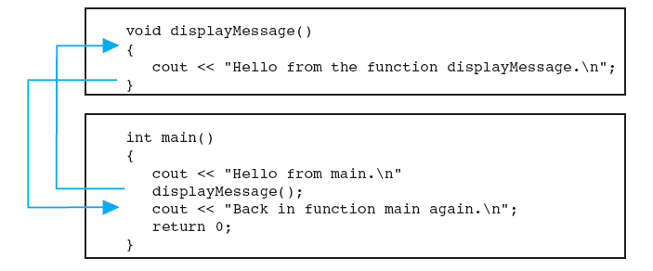
Flow of Function Call
Jump to the called function
Program starts
Back to the calling function

Slide 20
In-class practice
Define a function named rectDraw to draw the following rectangle with asterisks
Call the rectDraw function in the main function
Test your code
*
********
********
********
********
Reference code: RectDraw.cpp

Slide 21
Function Prototypes
Compiler must know the following about a function before it is called:
name
return type
number of parameters
data type of each parameter
Two solutions:
Define a function before call it
Declare a function with a function prototype (i.e. function declaration) before call it

Slide 22
Function Prototypes
Syntax of function prototype:
return_type function_name(parameter_list);
Must end with a semicolon
Usually placed near the top of a program
When using prototypes, can place function definitions in any order in source file
In the parameter list, the parameter names are optional. For example, the following two are both correct.
int protofunction (int first, int second); or
int protofunction (int, int);

Slide 23
Example
...
void deep();
void deeper();
int main() {
cout << “I am starting in function main. \n”
deep();
cout << “Back in function main again. \n”
return 0;
}
void deep() {
cout << “I am now in the function deep. \n”
deeper();
cout << “Now I am back in deep. \n”
}
void deeper() {
cout << “I am now in the function deeper. \n”
}
Function prototypes

Slide 24
Passing Data into a Function
Can pass values into a function at time of call:
Function call
ret = max(a, b);
int max(int num1, int num2) {
// local variable declaration
int result;
if (num1 > num2)
result = num1;
else
result = num2;
return result;
}
Passing data
Function definition

Slide 25
Parameter and Argument
Values passed to function are arguments
ret = max(a, b);
Variables in a function that hold the values passed as arguments are parameters
int max(int num1, int num2)
Arguments
Parameters

Slide 26
In-class practice
Define a function named rectDraw to draw a rectangle of size width * height with asterisks.
width and height are two parameters of the rectDraw function
In the main function, ask the user to input the values of these two arguments; call the rectDraw function to draw the rectangle
Test your code
Reference code: RectDraw2.cpp

Slide 27
Arrays as Function Arguments
To pass an array to a function, use the array name:
To define a function that takes an array parameter, use empty [] for array argument:
int tests[5] = {79,82,91,77,84};
showScores(tests);
// function prototype
void showScores(int []);
// function header
void showScores(int scores[])
No size declarator inside the brackets
No size declarator inside the brackets
Note: When an entire array is passed to a function, it is not passed by value, but passed by reference (only the starting memory address is passed).

Slide 28
Arrays as Function Arguments
When passing an array to a function, it is common to pass array size so that function knows how many elements to process:
showScores(tests, ARRAY_SIZE);
Array size must also be reflected in prototype, header:
// function prototype
void showScores(int [], int);
// function header
void showScores(int scores[], int size)
# of elements

Slide 29
Example
#include <iostream>
using namespace std;
void showValues(int [], int); // Function prototype
int main() {
const int ARRAY_SIZE = 8;
int numbers[ARRAY_SIZE] = {5, 10, 15, 20, 25, 30, 35, 40};
showValues(numbers, ARRAY_SIZE);
return 0;
}
void showValues(int nums[], int size) {
for (int index = 0; index < size; index++)
cout << nums[index] << " ";
cout << endl;
}
Output:
5 10 15 20 25 30 35 40

Slide 30
In-class practice: Array Rotation
Write a function Rotate that rotates an array of size n by d elements to the left
Use array as argument
In the main function, call the function Rotate and show the rotated array
Test your code
For example:
Input: [1 2 3 4 5 6 7], n = 7, d = 2
Output: [3 4 5 6 7 1 2]
Reference code: ArrayRotation.cpp
https://www.geeksforgeeks.org/array-rotation/

Slide 31
Returning a Value from a Function
The return Statement
Used to return a value from a function or end execution of a function
Can be placed anywhere in a function
Statements that follow the return statement will not be executed
Can be used to prevent abnormal termination of program
In a void function without a return statement, the function ends at its last }

Slide 32
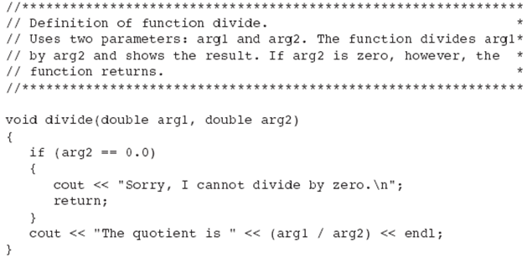
End Function Execution Using return

Slide 33
Returning a Value From a Function
In a value-returning function, the return statement can be used to return a value from function to the point of call. Example:
Return Type
int sum(int num1, int num2) { double result; result = num1 + num2; return result; }
Value Being Returned

Slide 34
In-class practice
Define a function that takes an integer n as input and return whether it is a power of 4 or not
In the main function, ask the user to input an integer; call this function to show the result
Example :
Input: 16
Output: 16 is a power of 4
Input: 20
Output: 20 is not a power of 4
Reference code: PowerOf4.cpp
https://www.geeksforgeeks.org/find-whether-a-given-number-is-a-power-of-4-or-not/

Slide 35
Using Reference Variables as Parameters
Passing data into a function (passing by value)
The argument value is copied into the parameter (num = val)
Value change of the parameter (num) does not affect the argument (val) because they are two independent variables
int val=5;
doubleInt(val);
void doubleInt(int num){
num *= 2;//num = num*2
}
val
num
num = val
5
5
argument in
calling function
parameter in
doubleInt function
Q: How to change the argument value synchronously when we change the parameter value?

Slide 36
Passing by Reference
A reference variable is an alias for another variable
An alias is another name for an existing variable
Use a reference variable as a function parameter
Any changes made to the reference variable are actually performed on the argument variable
val
num
If we change num, what will happen to val? Why?
5

Slide 37
Passing by Reference
How to define?
Place an ampersand (&) in front of the parameter name in the function header
In the function prototype, also include the ampersand after the data type
void doubleInt(int & num){
num *= 2
}
void doubleInt(int & num);
or
void doubleInt(int&);

Slide 38
Why Passing by Reference?
Allow a function to work with the original argument from the function call, not a copy of the argument
Allow the function to modify values stored in the calling environment
Provide a way for the function to ‘return’ more than one value

Slide 39
Example
#include <iostream>
using namespace std;
void swap (int &first, int &second)
{
int temp = first;
first = second;
second = temp;
}
int main()
{
int a = 2, b = 3;
swap(a, b);
cout << a << " " << b;
return 0;
}
Output:
3 2
https://www.geeksforgeeks.org/references-in-c/

Slide 40
In-class practice
Ask the user to input three integers
Define a function to sort these integers in ascending order, using reference variables as parameters
Test your code
Input three integers: 1 3 2
Sorted List: 1 2 3
Reference code: Sort3Integers.cpp
This practice refers to Don’s Handouts_COSC120_Spring2012.pdf

Slide 41
Local and Global Variables
Local variables
Defined within a block
Do not exist outside the function in which they are declared, i.e. they can not be accessed or used outside that function
Other functions may have separate, distinct variables with the same name
void func() {
// age is a local variable and cannot be
// accessed outside this function
int age = 18;
cout << age;
}
https://www.geeksforgeeks.org/scope-of-variables-in-c/

Slide 42
Global Variables
Are usually declared outside of all of the functions, at the top of the program
Can be accessed from any part of the program
Are available throughout the lifetime of a program
int g = 10; // Global variable
void func1() {
g = 20;
cout << g << endl;
}
int main() {
func1();
g = 30;
cout << g << endl;
return 0;
}
Output:
20 30
https://www.geeksforgeeks.org/scope-of-variables-in-c/

Slide 43
Local Variables VS Global Variables
Local Variables | Global Variables
Declares within a function | Declared outside any function
Accessible only within the function it is declared | Accessible by all functions in the program
Created when the function starts executing and is destroyed when control leave the function | Are destroyed when the program is terminated
More reliable and secure (the value can't be changed by other functions) | Are used when values are to be shared among different functions
https://www.slideshare.net/03062679929/functions-in-c-ppt
https://pediaa.com/difference-between-local-and-global-variable/

Slide 44
Lifetime of Variables
#include <iostream>
using namespace std;
int num = 0;
void func() {
int num = 2;
cout << "num defined in func: " << num << "\n";
}
int main() {
cout << "Global variable num: " << num << "\n";
int num = 1;
cout << "num defined in main: " << num << "\n";
func();
return 0;
}
Output:
Global variable num: 0
num defined in main: 1
num defined in func: 2
Global variable
Local variable
Local variable
Note: Local variables → smaller scope → larger priority
Global variables → larger scope → smaller priority

Slide 45
Lifetime of Variables
num = 0
Global
#include <iostream>
using namespace std;
int num = 0;
void func() {
int num = 2;
cout << "num defined in func: " << num << "\n";
}
int main() {
cout << "Global variable num: " << num << "\n";
int num = 1;
cout << "num defined in main: " << num << "\n";
func();
return 0;
}
main
Here

Slide 46
Lifetime of Variables
num = 0
Global
#include <iostream>
using namespace std;
int num = 0;
void func() {
int num = 2;
cout << "num defined in func: " << num << "\n";
}
int main() {
cout << "Global variable num: " << num << "\n";
int num = 1;
cout << "num defined in main: " << num << "\n";
func();
return 0;
}
num = 1
main
Here

Slide 47
Lifetime of Variables
num = 0
Global
#include <iostream>
using namespace std;
int num = 0;
void func() {
int num = 2;
cout << "num defined in func: " << num << "\n";
}
int main() {
cout << "Global variable num: " << num << "\n";
int num = 1;
cout << "num defined in main: " << num << "\n";
func();
return 0;
}
num = 1
main
num = 2
func
Here

Slide 48
Lifetime of Variables
num = 0
Global
#include <iostream>
using namespace std;
int num = 0;
void func() {
int num = 2;
cout << "num defined in func: " << num << "\n";
}
int main() {
cout << "Global variable num: " << num << "\n";
int num = 1;
cout << "num defined in main: " << num << "\n";
func();
return 0;
}
num = 1
main
Here

Slide 49
Lifetime of Variables
#include <iostream>
using namespace std;
int num = 0;
void func() {
int num = 2;
cout << "num defined in func: " << num << "\n";
}
int main() {
cout << "Global variable num: " << num << "\n";
int num = 1;
cout << "num defined in main: " << num << "\n";
func();
return 0;
}
Here
Question: How can C++ distinguish these variables with same names?

Slide 50
Static Local Variables
How can a program “remember” what value is stored in a local variable?
static local variables retain their contents between function calls.
static local variables are defined and initialized only the first time the function is executed. 0 is the default initialization value.

Slide 51
Example
#include <iostream>
using namespace std;
void showLocal(); // Function prototype
int main() {
showLocal();
showLocal();
return 0;
}
void showLocal() {
static int localNum = 0; // Static local variable
cout << localNum << endl;
localNum += 5;
}
The default initialization value is 0, which is equivalent to:
static int localNum = 0;
Output:
0
5
Thinking: Is static local variable a good design?

Slide 52
In-class practice
What is the output of the following program?
int globvar;
void fct1() {
int i = 5;
cout << globvar << " " << i << endl;
}
void fct2() {
int i;
i = 17;
globvar = 3;
}
int main() {
globvar = 25;
fct1();
fct2();
fct1();
return 0;
}
Output:
25 5
3 5
This practice refers to Don’s Handouts_COSC120_Spring2012.pdf

Slide 53
Default Arguments
A default argument is a constant that is passed automatically to a parameter if the argument is missing on the function call.
Usually listed in the function prototype. E.g.:
void showArea(double = 20.0, double = 10.0);
or
void showArea(double length = 20.0, double width = 10.0);
void showArea(double length, double width) {
double area = length * width;
cout << "The area is " << area << endl;
}
showArea();
The area is 200
showArea(12.0);
The area is 120
showArea(12.0, 5.5);
The area is 66

Slide 54
Default Arguments
Default arguments can be declared in function header if no prototype
Multi-parameter functions may have default arguments for some or all of them:
The defaultless ones are declared first in the parameter list
int getSum(int, int=0, int=0);
void showArea(double length = 20.0, double width = 10.0)
{
double area = length * width;
cout << "The area is " << area << endl;
}

Slide 55
Two-Dimensional Arrays
A 2-D array is an array of 1-D arrays
Use two size declarators in definition:
First declarator is number of rows; second is number of columns
Use two subscripts to access element:
const int ROWS = 4, COLS = 3;
int exams[ROWS][COLS];
columns
exams[0][0] | exams[0][1] | exams[0][2]
exams[1][0] | exams[1][1] | exams[1][2]
exams[2][0] | exams[2][1] | exams[2][2]
exams[3][0] | exams[3][1] | exams[3][2]
r
o
w
s
exams[2][2] = 86;

Slide 56
2D Array Initialization
Two-dimensional arrays are initialized row-by-row:
Some array elements without initial values will be set to 0 or NULL
const int ROWS = 2, COLS = 2;
int exams[ROWS][COLS] = {{84, 78}, {92, 97}};
84 | 78
92 | 97
int exams[ROWS][COLS] = {{84}, {92, 97}};
exams[0][1] is automatically set to 0

Slide 57
Passing Two-Dimensional Array to Function
When a 2-D array is passed to a function, the parameter type must contain a size declarator for the columns
The size declarator for rows is optional (use empty [ ])
Use array name as argument in function call:
const int COLS = 2; // Prototype void getExams(int [][COLS], int); // Header void getExams(int exams[][COLS], int rows)
Here COLS is a global constant
getExams(exams, 2);

Slide 58
Use Nested Loop to Step through 2D Array
What is the output of the following program?
#include <iostream>
using namespace std;
void readArray(int n[][2], int row) {
}
int sumOfArray(int n[][2], int row) {
int total = 0;
for (int i = 0; i < row; i++) {
for (int j = 0; j < 2; j++) {
total += n[i][j];
}
}
return total;
}
int main() {
int num[3][2] = {{3, 4}, {9, 5}, {7, 1}};
readArray(num,3);
cout << "The sum is: " << sumOfArray(num, 3);
return 0;
}
Output:
The sum is: 29
https://www.programiz.com/cpp-programming/passing-arrays-function

Slide 59
Overloading Functions
Sometimes we want to create functions that perform the same task but take different parameter types or different number of parameters
float absolute(float var){ //float type parameter
if (var < 0.0)
var = -var;
return var;
}
int absolute(int var) { //int type parameter
if (var < 0)
var = -var;
return var;
}
https://www.programiz.com/cpp-programming/function-overloading

Slide 60
Overloading Functions
Overloaded functions have the same name but different parameter lists
Different number of parameters
Different data types of parameters
Do NOT consider different return types
Compiler will determine which version of function to call by argument and parameter lists
int sum(int num1, int num2);
int sum(int num1, int num2, int num3);
int sum(int num1, int num2, int num3, int num4);
float absolute(float var);
int absolute(int var);

Slide 61
Example
#include <iostream>
using namespace std;
int plusFunc(int x, int y) {
return x + y;
}
double plusFunc(double x, double y) {
return x + y;
}
int main() {
int myNum1 = plusFunc(8, 5);
double myNum2 = plusFunc(4.3, 6.26);
cout << "Int: " << myNum1 << "\n";
cout << "Double: " << myNum2;
return 0;
}
Output:
Int: 13
Double: 10.56
https://www.w3schools.com/cpp/cpp_function_overloading.asp

Slide 62
In-class practice
Define 3 overloading functions
have the same name Average
have 2, 3, and 4 integer parameters, respectively
return the average of input arguments
the return type is double
In the main function, call Average functions to calculate and show the average of
2 and 3
2, 3, and 5
2, 3, 5, and 8
Reference code: OverloadAverage.cpp
https://www.bestprog.net/en/2018/08/07/...

Slide 63
9. Recursion Function
A recursive function is one that calls itself
Assume the input argument is 2:
countDown(2) outputs 2..., then it calls countDown(1)
countDown(1) outputs 1..., then it calls countDown(0)
countDown(0) outputs Blastoff!, then returns to countDown(1)
countDown(1) returns to countDown(2)
countDown(2) returns to the calling function
void countDown(int num){
if (num == 0) // stop condition
cout << "Blastoff!";
else{
cout << num << "...\n";
countDown(num-1); // recursive call
}
}

Slide 64
What Happens When Called?
first call to
countDown
num is 2
output:
2...
countDown(1);
second call to
countDown
num is 1
return
1...
countDown(0);
third call to
countDown
num is 0
return
Blastoff!
// no
// recursive
// call
return

Slide 65
Solving Problems with Recursion
Two important steps:
Define the recursive function
Define the stop condition
Example: factorial calculation
n! = n*(n-1)*(n-2)*...*3*2*1 if n > 0
n! = 1 if n = 0
Define the recursive function:
n! = n * (n-1)!
Define the stop condition:
0! = 1 (base case)

Slide 66
Recursive Factorial Function
#include <iostream>
using namespace std;
int factorial(int); // Function prototype
int main(){
int number;
cout << "Enter an integer value to display its factorial: ";
cin >> number;
cout << "The factorial of " << number << " is " << factorial(number);
return 0;
}
int factorial(int n){
if (n == 0)
return 1; // Base case
else
return n * factorial(n - 1); // Recursive case
}
Enter an integer value to display its factorial: 5
The factorial of 5 is 120
Example code: Factorial.cpp

Slide 67
In-class practice
The Fibonacci numbers are the numbers in the following integer sequence
0, 1, 1, 2, 3, 5, 8, 13, 21, 34, 55, 89, 144, …
In mathematical terms, the sequence Fn of Fibonacci numbers is defined as
Fn = Fn-1 + Fn-2
where:
F0 = 0 and F1 = 1
Use recursive function to calculate and display the first 10 Fibonacci numbers
Test your code
Reference code: Pr20-6.cpp

Slide 68
Thanks

Slide 69
Reading textbook
Chapter 6, 7, 8, 20

Slide 70
Reference
The teaching materials of this course refer to:
Professor Xiaohong (Sophie) Wang. COSC 120 teaching materials
Salisbury University
Textbook:
Starting Out with C++: From Control Structures through Objects, by Tony Gaddis, Pearson (9th Edition)
Instructor materials of the above textbook (All rights reserved)

