Slide 1
Kickstarter Projects 2009-2017

Slide 2
Background
Kickstarter is a online crowdfunding platform that anyone can use. The steps to creating a Kickstarter campaign are to make an account, set a minimum funding goal, set reward levels, and then set a deadline for the campaign. The campaign creator can post his ideas, and progress toward the final product. The rewards for each campaign vary from small things such as card to actually being involved in the production process.
The campaign creator can put his idea into 1 of 15 categories that are made up of 159 sub-categories.
The end goal of this project is to determine if we can predict weather a campaign will succeed or fail

Slide 3
Preliminary Process
I started this analysis with a pre-scraped data set of 378660 Kickstart projects that ranged in dates from 2009-2017. Each project had a status of either failed, canceled, successful, live, undefined, suspended. I first went about dropping all of the undefined and live data, as I wanted to report on weather it was successful or not. I then decided that if it was cancelled or suspended that it would count it as a fail.
At this point I had 375,858 projects. I then made columns for the length of the campaign in days and for the Missed Goal Amount (Goal – Pledge).
At his point I did an analysis of the data.

Slide 4
Exploratory Data Analysis
 | Successful | Failed | Total
Total Projects: | 133,956 | 241,902 | 375,858
Total Projects(%): | 35.64% | 64.36% | 100%
Project Goal Total (USD): | $1,276,982,904 | $15,759,549,233 | $17,036,532,137
Average Goal(USD): | $9,533 | $65,148 | $45,327
Project Pledged Total (USD): | $3,036,889,046 | $376,943,769 | $3,413,832,815
Average Pledged(USD:) | $22,671 | $1,558 | $9,083
Backers(AVG): | 264 | 18.5 | 106

Slide 5
Moving data to Tableau
I converted my data in python to a CSV file in order to connect it with Tableau.
Tableau is used to mine data and then to visualize it.
I went ahead and further analyzed the data while making visualizations

Slide 6
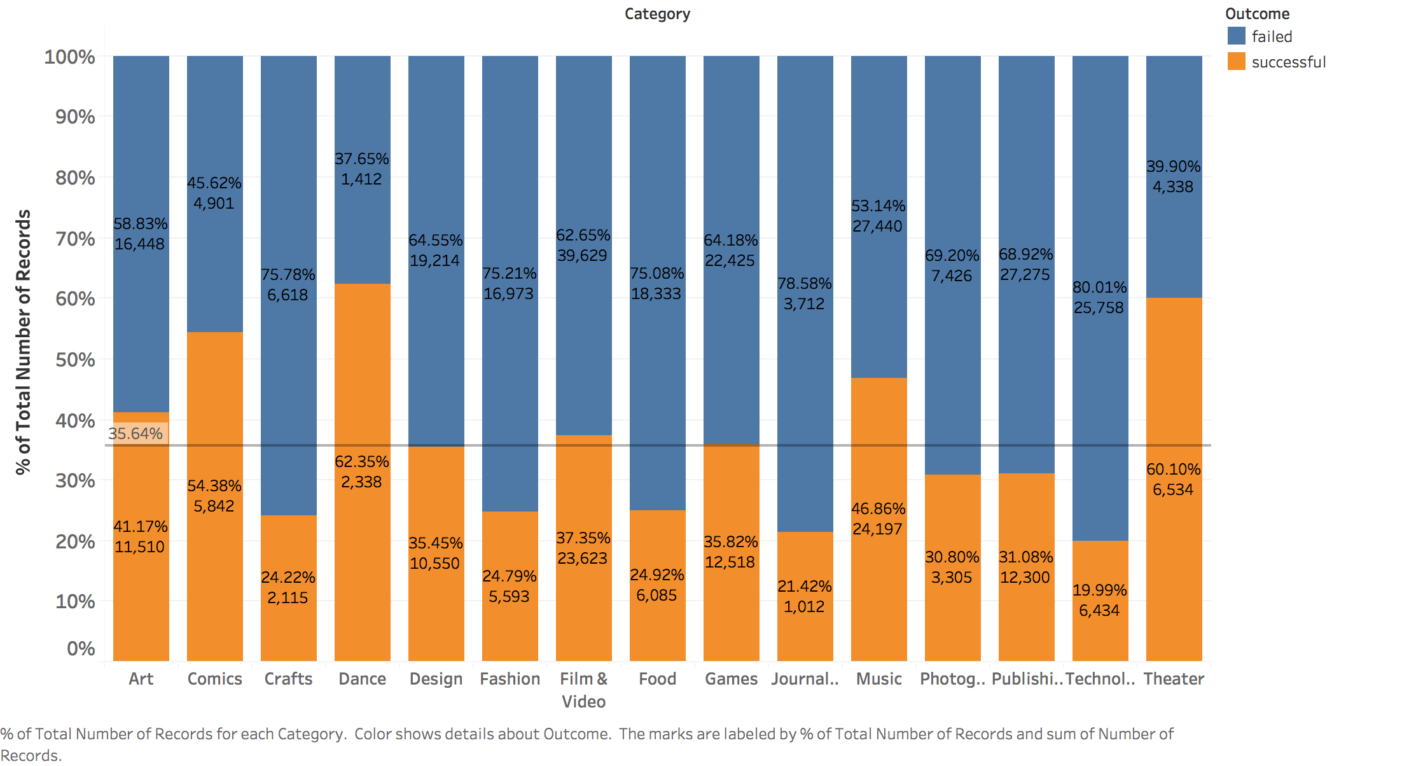
Average by Category
This shows the data split based on their category and showed the percent total of each.

Slide 7
Category Average Results
The average success rate was 35.64%
The 3 categories with the highest success rate:
Dance: 62.35%
Theater: 60.10%
Music: 46.86%
The three categories with the lowest success rate were:
Technology: 19.99%
Journalism: 21.42%
Crafts: 24.22%

Slide 8
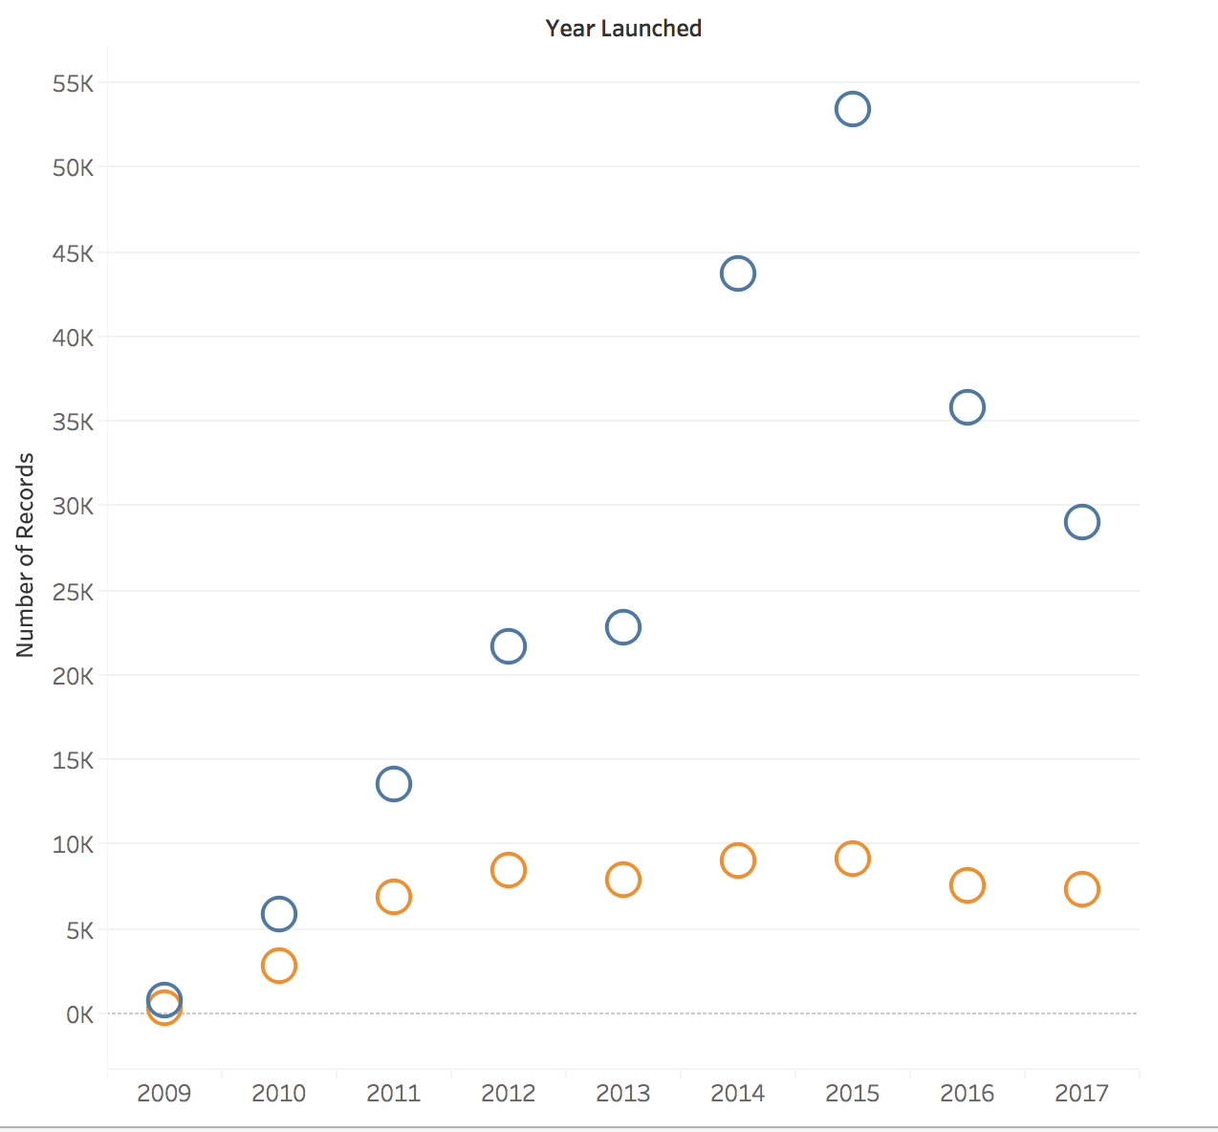
Yearly Breakdown
See that successful projects per year is approximately the same.
Number of unsuccessful projects varies widely year to year.

Slide 9
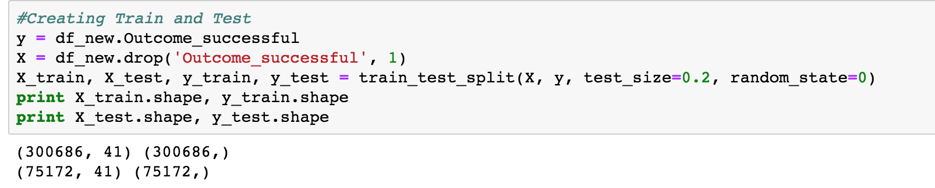
Train/Testing Data
Goal: Test to see if we could predict if a project would be successful
Dropped all data that we wouldn't know at the start of a project
Trained all the data
Models used:
Logistic Regression
K-Nearest-Neighbor
Decision Tree Learning
Random Forest Classifier

Slide 10
Model Predictions
The model with the best accuracy was Logistic Regression at 64.36%
I ran the models with 1000 random projects.
Model | Accuracy(%) | STD. Dev (%)
Logistic Regression | 64.36% | 0.26%
Nearest Neighbor | 62.55% | 0.17%
Decision Tree | 60.61% | 0.21%
Random Forest | 64.29% | 0.21%

