Slide 1

OneSnap
Efficient Web Page Import
by Andrew Wheeler
andrew@igmo.org

Slide 2
Problem
Current Web page -> OneNote capture/import tools are clunky
  Import to only one section or
  Import to multiple sections via file browser – slow and not OneNote-ish
  Must open OneNote to add comments or edit page’s title
Switching to OneNote while browsing interrupts workflow!
Wife wanted a tool to help manage her online Xmas shopping.

Slide 3
Solution: OneSnap
From a single OneSnap dialog in IE:
  Capture & import web page to any OneNote section
  Select import section via hotlists: user-configurable lists of sections
  Add comments and modify page title

Slide 4
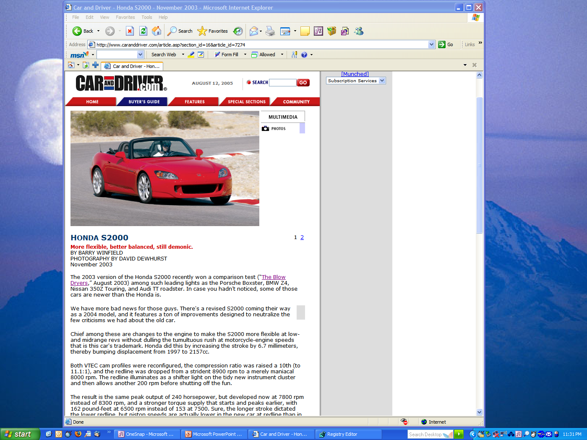
Screen Shots
Find the page you want…

Slide 5
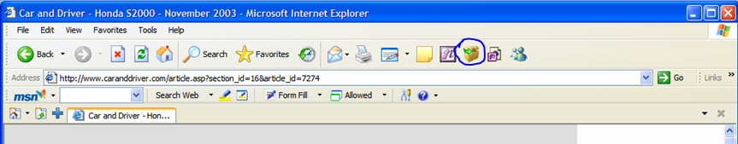
Click OneSnap!

Slide 6
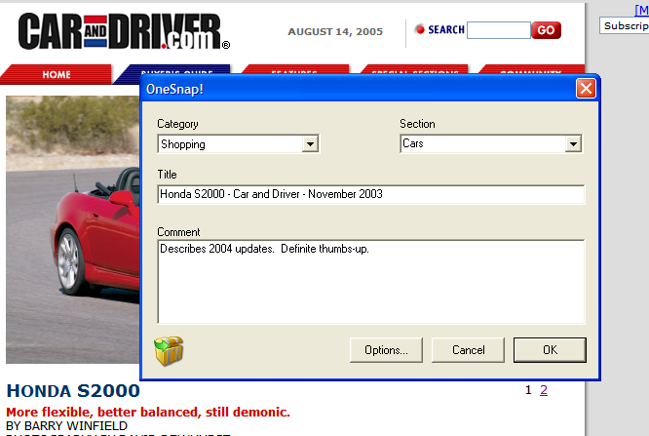
Pick section, add a comment, and Go!

Slide 7
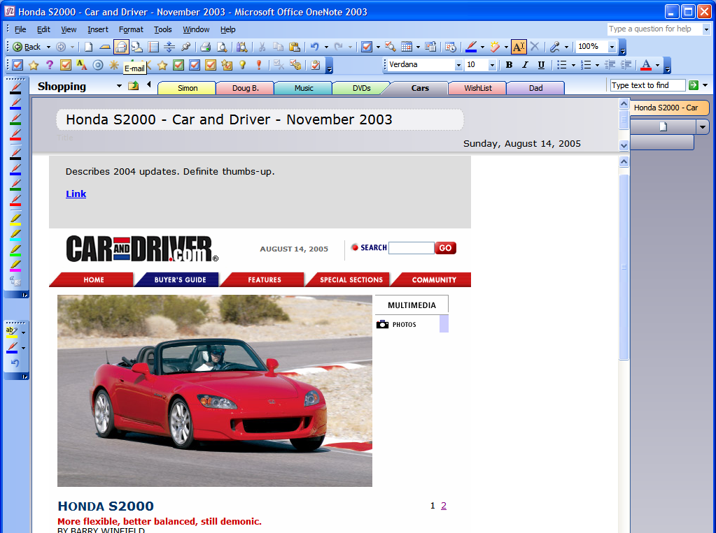
OneSnap imports web page as bitmap!

Slide 8
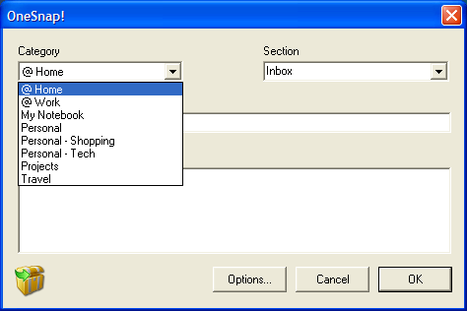
Hotlists
Hotlists (“Categories”) are user-configurable lists of sections.

Slide 9
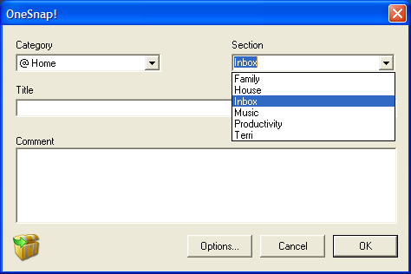
Hotlists cont’d.
Sections are “friendly names” for .one file paths.

Slide 10
Hotlists – Nifty Details
Hotlists hold any group of .one files –they need not be path-related.
E.g., “Favorites Home” could include:
  Friendly Name Path (from My Notebook)
  Inbox Inbox.one
  Family Personal\Family.one
  House House\Inbox.one
  Music Shopping\Music.one
  Productivity Personal\Productivity\Inbox.one
    Tech Tech\Inbox.one

Slide 11
… Nifty Details cont’d.
Hotlists are stored in XML file – easily edit, share on multiple computers
Users may configure hotlists
    Ideas
  Context-based @home, @work, etc.
  Favorites frequent import spots
  Shopping/Gifts by category or person

Slide 12
… Nifty Details cont’d
On first use OneSnap auto-generates hotlists matching user’s Notebook structure
Dialog persists selections
  Last hotlist and section selected
  Last section selected for each hotlist

Slide 13
Other Features
“Max width” option – shrink captured page if width is larger than threshold
“Import as Background Image” Option

Slide 14
Future Work: web plugins
The truth is, complex content pasted from the web or other apps will probably always require some amount of cleanup before you're happy with it.
- Peter Baer
Enter Greasemonkey-like Javascript plugins to capture pages in a custom manner. Examples:
  Amazon - import competitor price list as sub-page
  Virtual Earth - import search tabs and scratch pads

Slide 15
Other Future Work
Integrated hotlist management
Hotlist setup wizard
Firefox support

Slide 16
Conclusions
OneSnap makes web page importing to OneNote more efficient
  Abstracts file system details
  Enables user-specified import hotlists based on user’s workflow
  Keeps users browsing – no context-switching to OneNote
Hope to integrate Greasemonkey-like functionality soon.

Slide 17
THANKS!!!!
Thanks for reviewing my PowerToy!

Slide 18
Contact Info
Andrew Wheeler
andrew@igmo.org
512-381-3710 (work)
512-301-1843 (home)

