Slide 1
Analyzing Vivino Wine Ratings
Nicholas Lichtsinn
IST 652

Slide 2
Proposal Topic
Analyzing wine ratings on the Vivino app and website

Slide 3
Research Questions
What country has the most expensive and least expensive wines on average?
Does rating depend more on country of origin or winery?
Is year a better predictor of rating than price?
Are more recent or older wines receiving better ratings?
Are the higher rated wines priced higher?

Slide 4
Data Collection
I used a Kaggle dataset with 5 different CSV files, one for each type of wine.
Tried to find corresponding review postings on the app but was unable to match with the review dataset that I already had.

Slide 5
Processing the Data
Removed and added columns so I could concatenate the CSV files and work off of one dataframe.
Started running statistics on the data with pandas functions.

Slide 6
Question
How does country determine rating vs winery?

Slide 7
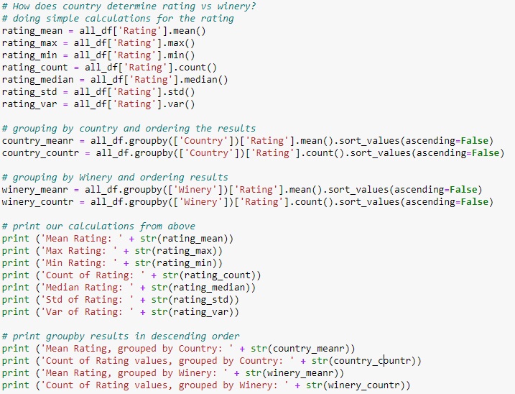
Python Code:

Slide 8
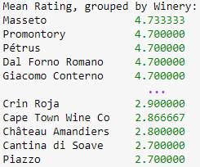
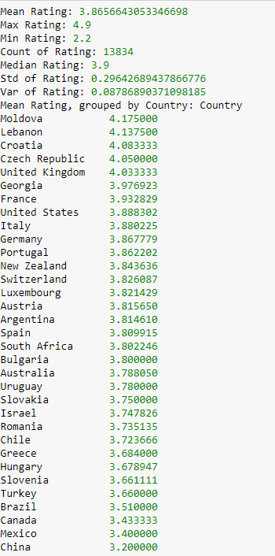
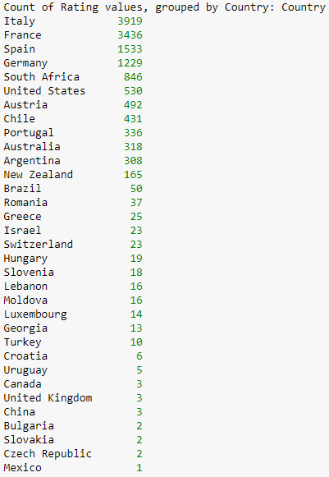
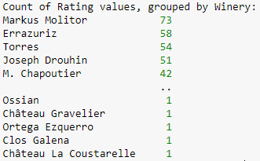
Output

Slide 9
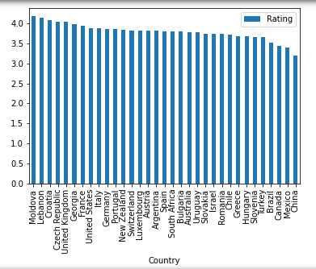
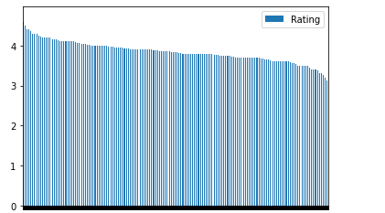
Visualizations
Rating
Rating
Wineries
Countries

Slide 10
Conclusions
The data and graphs tell two different stories, one showing the data being similar and one different.
Based on our statistical data wineries are a better predictor of wine rating than country of origin.
This may seem obvious but it is nice to see the data show what seems logical.

