Slide 1
IST 687, Group4
Electricity Production and Consumption in Europe
Jamie Bigley, Bomin Powers, Nick Lichtsinn, Emily Lorenzen, Aaron Chadwick

Slide 2
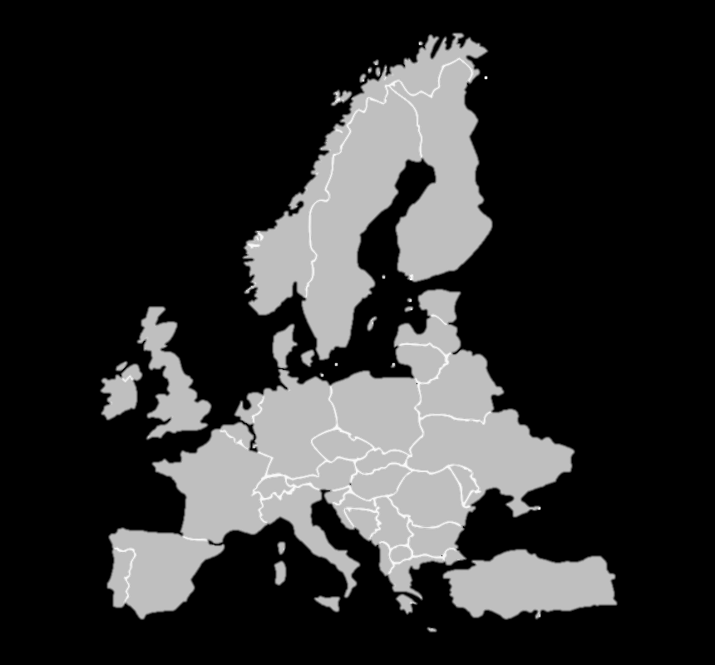






Agenda
Introduction
01
Brief description about the topic and objectives of this project
Electricity generation problems
02
Identify what issues are created by energy generation and consumption
Data questions
03
To understand the how the different data points are related to energy generation in Europe
Reflection
04
The lessons learned from our analysis throughout this project

Slide 3
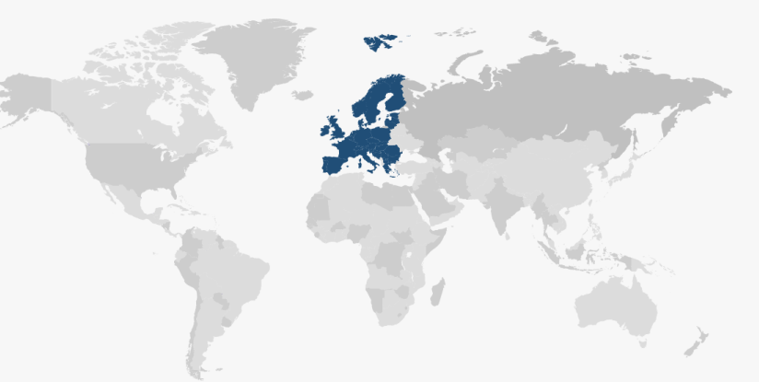
Introduction
Introduction
01
Brief description about the topic and objectives of this project
In this project, we focus on the energy generated in Europe. In today’s world countries are trying to solve the major issue of how to produce energy while minimizing the negative effects caused by its production and consumption. We chose Europe due to the diversity of the many different countries GDP, population, climate, and wealth. As just a fragment of the world, this continent provides the most diversity per area. Although there are many factors that weigh in on energy consumption and production, we will be focused on just a few specific data points in order to try to make accurate predictions.

Slide 4





Electricity generation problems
02
Identify what issues are created by energy generation and consumption
ISSUES arise from the use of energy
Fossil & Nuclear Fuels
GREENHOUSE GAS EMISSIONS
Emissions of greenhouse gases that cause climate change by creating a greenhouse effect in the earth's atmosphere.
80%
the world's electrical production
ACID RAIN
A rain or any other form of precipitation that is unusually acidic, meaning that it has elevated levels of hydrogen ions.
CLIMATE CHANGE
Global warming driven by human-induced emissions of greenhouse gases and the resulting large-scale shifts in weather patterns.
Today, 80% of the world's electrical production comes from fossil and nuclear fuels, and virtually all transportation is fueled by liquid petroleum (gasoline).
DEPENDENCY ON FOSSIL FUELS
Fossil fuels still providing the bulk, 77%, of the energy consumption by 2040, according to a new report by the U.S. Department of Energy’s Energy Information Administration (EIA)
http://www.geni.org/globalenergy/faq/general/faq_I-am-concerned-about-global-energy-problems.shtml

Slide 5
Data Questions
Renewable energy vs Fossil Fuels consumed by year?
What is Energy consumption per capita?
Does land area determine energy production?
Do countries with a higher GDP produce more renewable energy or fossil fuels?
At what point will renewables outpace fossil fuels?

Slide 6
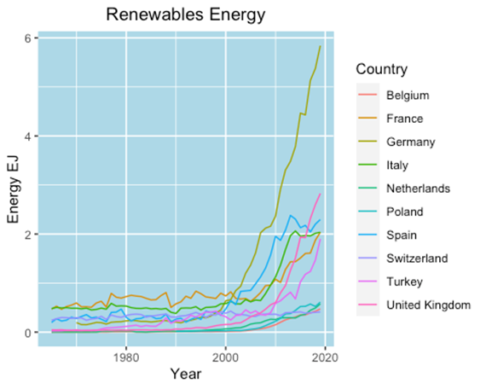
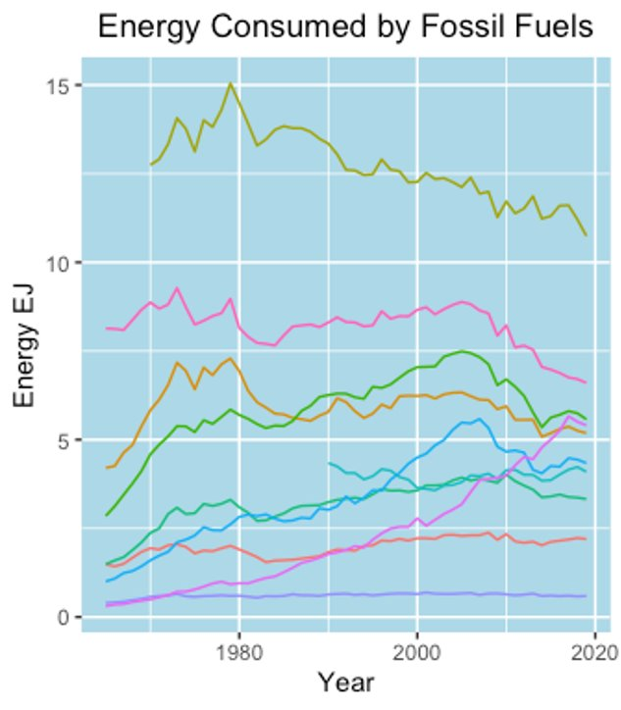
Renewable Energy vs Fossil Fuels consumed by year
Countries were filtered down by GDP, otherwise the higher energy producing and energy consuming countries for Europe would have 'squished' the smaller ones toward the bottom of the y-axis.
Even with just the Top 10, we can see some disparity in both renewables and fossil fuels.
Overall fossil fuel consumption has been stable or decreasing, while starting roughly 2000 renewables energy started to increase for the larger/more populous countries in the group, Germany especially.
This could be the slow replacement of fossil fuels while increase energy demands are being met by renewables.
Check POINT

Slide 7
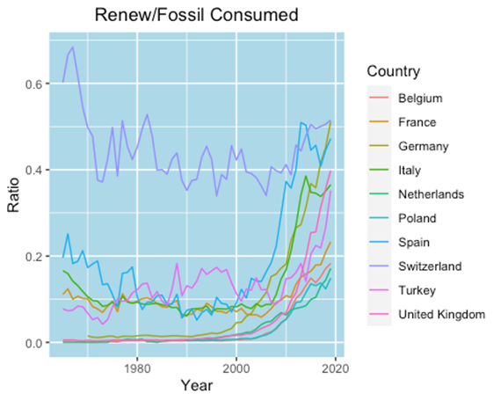
Renewable Energy vs Fossil Fuels consumed by year
Check POINT
This is the ratio of energy consumption Renewables v Fossils.
Pre Year 2000, consumption was stable and mostly Fossil based.
Starting Year 2000 most countries' ratio picked up on renewables.
The exemption is Switzerland which remained stable with a high renewable ratio.

Slide 8
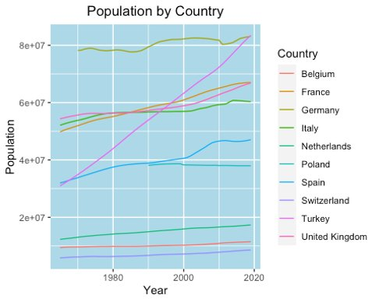
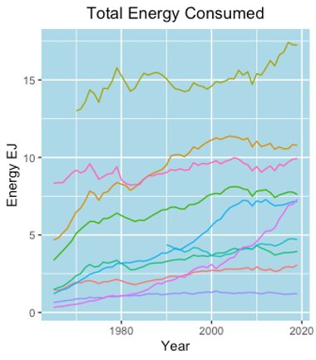
What is Energy consumption per capita?
Population has grown year over year and so has total energy consumed.
Countries with higher populations tend to consume more energy.
Germany is at the top, while Switzerland is at the bottom.
The one country that stands out is Turkey.
Population has grown significantly from the 1960's to 2019 in most countries but has stayed similar in Switzerland, Belgium, and the Netherlands.
Check POINT

Slide 9
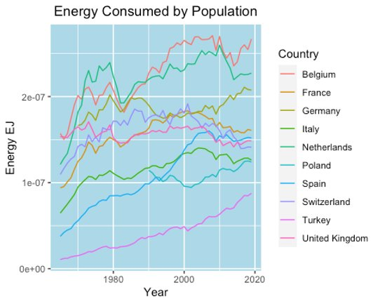
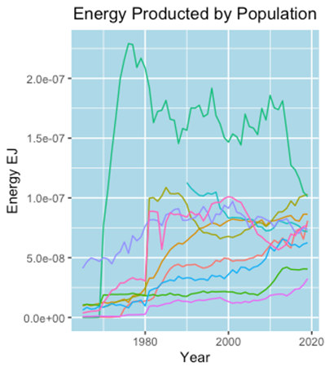
What is Energy consumption per capita?
Energy consumed per capita has also gone up over time but slowing down in the last 10 years.
Could be due to energy efficient populations or governments enacting climate-conscious policies.
Check POINT

Slide 10
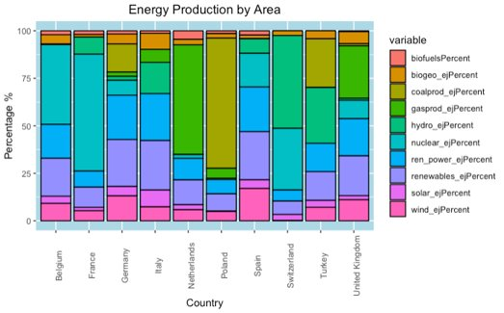
Does land area determine energy production?
Check POINT
Here we see that the percentage of energy produced by area (country) varies. There doesn't appear to be any overall trend.
This makes sense as each country has its own energy policies and preferences that are not necessarily dictated only by natural resources.
Country size also doesn't mean certain resources are more or less available than others.

Slide 11
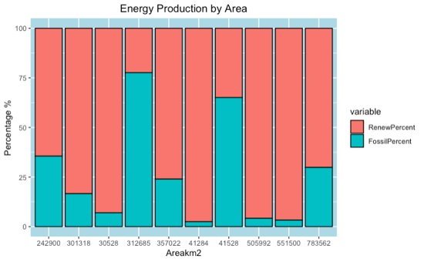
Does land area determine energy production?
Check POINT
Here we show the Renewable resources and Fossil Fuels produced by each country's land area.
There is not a significant correlation between land area and type of energy produced.

Slide 12
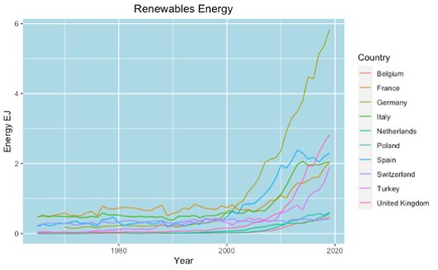
Do countries with a higher GDP use
more renewable energy sources instead of fossil fuels?
GDP Rank​ | Country​
1st​ | Germany​
2nd​ | United Kingdom​
3rd​ | France​
4th​ | Italy​
5th​ | Spain​
6th​ | Netherlands​
7th​ | Turkey​
8th​ | Switzerland​
9th​ | Poland​
10th​ | Belgium​
With Germany being an extreme case, the higher GDP countries do use more renewable energy sources compared to fossil fuels.
Check POINT

Slide 13
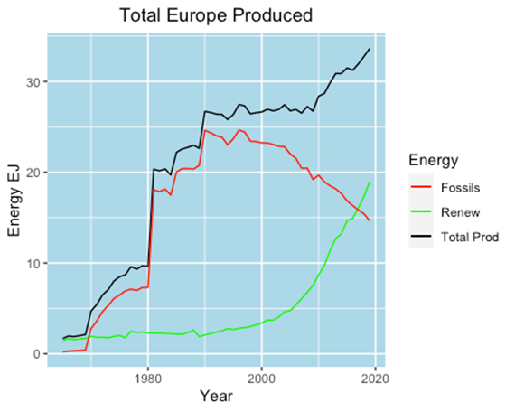
At what point will renewables outpace fossil fuels?
Check POINT
Renewable energy produced has been exponentially increasing since 1990 with fossil fuel production declining at a similar rate since the late 90's.
Renewable production surpassed fossil fuels around 2016 and the trend has been continuing since

Slide 14
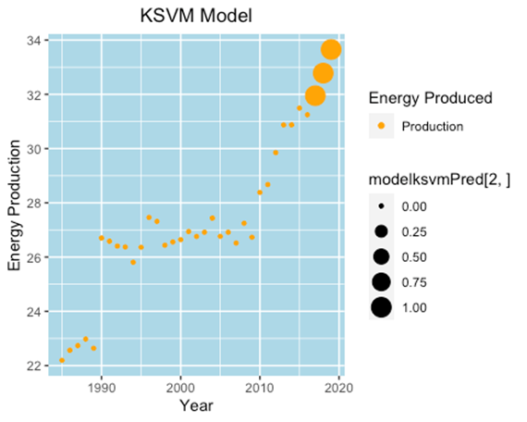
At what point will renewables outpace fossil fuels?
Check POINT
Using the SVM Model we can see the point when renewable energy production in terms of percentage of total production with point size showing us when it surpassed 50%
This graph is showing us that renewables surpassed 50% right around 2015 agreeing with our ggplot model

Slide 15
Reflection
Data analysis and grouping was much more involved than originally anticipated. Learned how to join, clean up data from multiple sources, and use smaller subsetted data frames to make specific analysis lines easier. Had to filter and rerun plots a few times to sort out data and make the analysis easier/clean out outliers to make the data clearer. Plot formatting to make graphs and charts more legible/visible.

Slide 16
Thank you
Source:
http://www.geni.org/globalenergy/faq/general/faq_I-am-concerned-about-global-energy-problems.shtml
https://ourworldindata.org/worlds-energy-problem
https://eos.org/articles/worlds-heavy-dependence-on-fossil-fuels-projected-to-continue
https://www.brookings.edu/essay/why-are-fossil-fuels-so-hard-to-quit/
Selecting Data Sets:
https://www.bp.com/en/global/corporate/energy-economics/statistical-review-of-world-energy.html (world energy production)
https://ember-climate.org/data/
https://ember-climate.org/data/european-electricity/ (European electricity)
https://data.worldbank.org/indicator/SP.POP.TOTL (country populations)
https://data.worldbank.org/indicator/NY.GDP.MKTP.CD (country gdp’s)
https://web.archive.org/web/20181019121934/https://unstats.un.org/unsd/environment/totalarea.htm (country areas)

