Slide 1

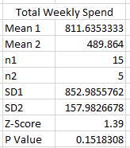
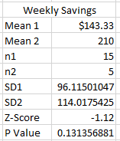
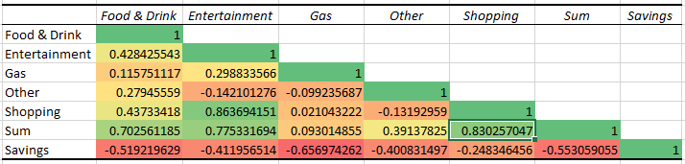
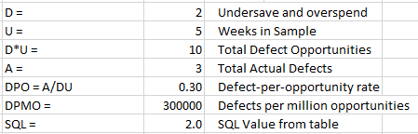
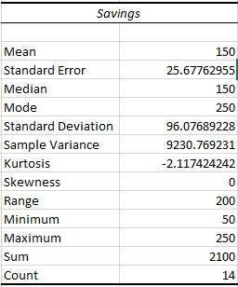
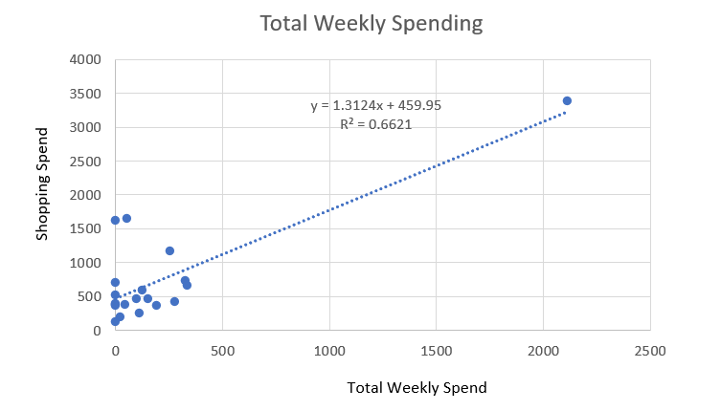
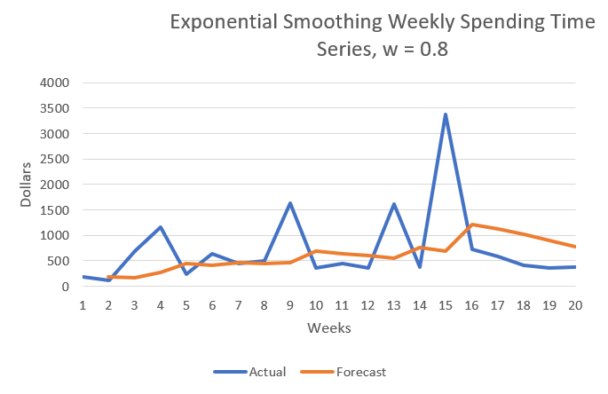
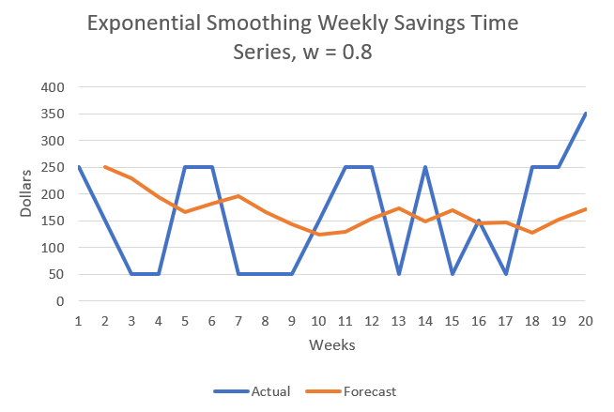

Increasing Weekly Savings
Process owner: Nick Lichtsinn
Key Dates --->
Define
10/9/2021
Measure
10/22/2021
Analyze
11/12/2021
Improve
11/26/2021
Control
12/10/2021
DEFINE
MEASURE
ANALYZE
IMPROVE
Purpose:
Decrease weekly spending and increase savings
Spend is too high and savings are too low
I Limited gas spend and large purchases over $100.
H₀: μ₁≤ μ₂
H_{a}: μ₁> μ₂
H₀: μ₁≥ μ₂
H_{a}: μ₁< μ₂
Gas spend had the highest coefficient for Savings (-0.656)
Did it Work?
Fail to Reject H₀!
Impact:
Save down payment for house and build equity
Pay for wedding
Both P-Values were > α = 0.05
Highest correlation coefficient for Total Weekly Spending was Shopping (0.830)
SQL Increased to 2.0!
CONTROL
Baseline for Output (Savings):
Mean = $150
SD = 96.07
SQL = 1.4
66.21% of Weekly Spending can be described by Shopping Spending
Weekly Spending has been lower than forecasted since implementation
Goal: Save $250 per week
Savings have been higher than expected for 4/5 weeks post-implementation
Team Members: Nick Lichtsinn & Fiancé

Slide 2
Phase: Define
Problem Statement & Operational Definitions
The purpose of this process improvement project is to decrease spending and increase savings per week.
Impact:
Be able to pay for our wedding next year
Save money for a down payment on house to build equity
Stop paying monthly rent to build equity
Goal:
Save $250 per week
Success:
I will measure success as an increase in the weekly savings after implementing the new process
Operational Definitions:
Weekly Spend on Food & Drink: money spent on groceries, eating at restaurants and alcohol.
Weekly Spend on Entertainment: money spent on events, movies, video games and other entertainment
Weekly Spend on Gas: money spent on gas and other car related costs
Weekly Spend on Shopping: money spent on personal and non-essential items
Weekly Spend on Other: money spent on things that are not accounted for in any of the other categories
Sum of Weekly Spend: sum of money spent in all categories per week
Sum of Weekly Savings: sum of money saved each week
Defects:
Overspending weekly limit of $1100
Not saving $250/week
Inputs
This will be my output (y)

Slide 3
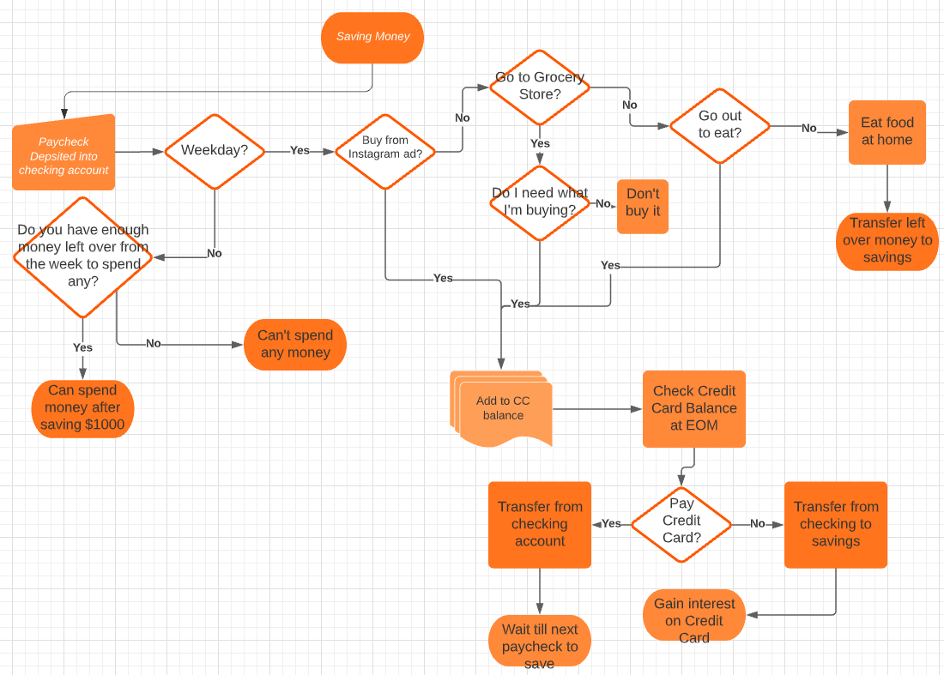
Phase: Define
Process Map
This process map shows the current process we are using to save money.
We will implement changes to this process to increase savings.

Slide 4
Phase: Measure
Identifying the Data
Type of Data:
The data in this project are US dollar amounts taken from my bank statements and separated into seven categories: Food & Drink, Entertainment, Gas, Other, Shopping, Sum of Weekly Spend, Sum of Weekly Savings.
The data are Continuous because dollar amounts can take on any value within a finite or infinite interval.
Data Collection:
I collected all data by downloading and reading my online bank statements from my Chase and Wells Fargo Bank Accounts and separated the data into the 7 categories. I used the first 15 weeks of data (7/25/2021 – 11/20/2021) to see the current state of spending and savings and took the last 5 weeks (11/7/2021 – 12/11/2021) of data after I implemented the new process.
Measurement Error:
I could have measurement error when classifying my data into the different categories based on my bank statements. At most this would account for 1 error per week, and the sum of weekly spend and weekly savings will still be accurate. To minimize measurement error, I could categorize my data again to check for inaccuracies or have someone else categorize my data to verify. Going forward I could classify by category each time I used my card so there is no chance of categorization error.

Slide 5
Data Measurement Plan
Phase: Measure
Performance Measure | Data Source and Location | How Will Data Be Collected | Who will Collect Data | When will Data be Collected | Target Sample Size
Weekly Spend on Food & Drink | Chase Bank Statements | Downloading & Reading Online Bank Statements | Nick Lichtsinn | 7/25/2021 – 11/20/2021 | 15 Weeks
Weekly Spend on Entertainment | Chase Bank Statements | Downloading & Reading Online Bank Statements | Nick Lichtsinn | 7/25/2021 – 11/20/2021 | 15 Weeks
Weekly Spend on Gas | Chase Bank Statements | Downloading & Reading Online Bank Statements | Nick Lichtsinn | 7/25/2021 – 11/20/2021 | 15 Weeks
Weekly Spend on Shopping | Chase Bank Statements | Downloading & Reading Online Bank Statements | Nick Lichtsinn | 7/25/2021 – 11/20/2021 | 15 Weeks
Weekly Spend on Other | Chase Bank Statements | Downloading & Reading Online Bank Statements | Nick Lichtsinn | 7/25/2021 – 11/20/2021 | 15 Weeks
Sum of Weekly Spend | Chase Bank Statements | Downloading & Reading Online Bank Statements | Nick Lichtsinn | 7/25/2021 – 11/20/2021 | 15 Weeks
Sum of Weekly Savings | Wells Fargo Bank Statements | Downloading & Reading Online Bank Statements | Nick Lichtsinn | 7/25/2021 – 11/20/2021 | 15 Weeks
This data measurement plan outlines the categories I decided to measure to identify my overall spending and savings over the last 15 weeks.

Slide 6
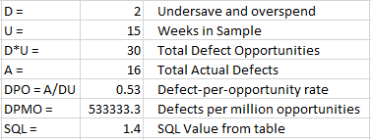

Phase: Measure
SQL & Sample Size
Sigma Quality Level (SQL):
I calculated a baseline SQL for the first 15 weeks of data and will run this test again on the second sample after implementing my process improvement changes.
My baseline SQL for my process was 1.4, this gives me a lot of room for improvement.
Sample Size:
I originally intended on using monthly spending and savings, but this did not allow for a large enough sample size to test my improvements, so I switched to weekly data. I treated each week as a separate sample and acquired 15 weeks of previous spend and 5 weeks after I implemented my improvements.
Formula:
Using this formula for sample size I worked backwards to calculate my sample size needed. My standard deviation of my 15 weeks of savings was $96.07, my Z at 95% confidence was 1.96 and I am comfortable with an error of $85. I got an N = 4.87 so I rounded to 5 samples to be able to detect a change in savings value.

Slide 7
Phase: Analyze
Correlation Analysis
I used correlation analysis to determine which input was most closely related to my spending and my savings amounts per week.
From this correlation matrix we can see that Shopping (0.830), Entertainment (0.775) and Food & Drink (0.702) are most closely related to my spending each week in that order.
My weekly savings are most closely related to my Gas spending (-0.656), Weekly Total Spending (-0.553) and my Food & Drink spending (-0.519). I am very surprised to see Gas spending be most closely related to Savings, when it does not have a strong relationship with my total weekly spend and has the lowest average spend of all the categories.
This is intuitive as I could be spending more overall when I drive places for vacation or visiting friends.

Slide 8
Phase: Analyze
Simple Linear Regression
Because Shopping had the closest relationship (0.8302) with my total spend each week, I chose this input to analyze further. I used Shopping spending as the input variable using a Simple Linear Regression analysis:
From this Simple Linear Regression, we see an R Squared value of 0.6621 meaning that about 66.21% of the variation in overall spend per week can be explained by variation in my Shopping spending. To lower my spending each week to save more, it will be important to lower my Shopping spending each week.

Slide 9
Phase: Improve
Implementing a Solution
My Correlation and Simple Linear Regression analysis show that total spending can be lessened if I lower my Shopping spending each week. To reduce my Shopping spending each week I implemented some new process rules:
No Big Purchases: since the main variation in my spending came from a couple large purchases I will not purchase and items over a $100 for the next 5 weeks.
Limit Gas Spending to $30/week: because Gas spend had the highest negative relationship with my savings per week, I will limit myself to spending $30/week on Gas and car related things to hopefully increase my savings per week.
Weeks 15-20:
For the last 5 weeks I have implemented these new rules and collected the data in the same method as before, pulling data from my bank statements into excel for analysis.
I succeeded in following my 2 rules, my mean gas spend per week was $28.69 and I did not have any large purchases over $100 post-implementation

Slide 10

Phase: Improve
SQL & Hypothesis Test
Sigma Quality Level (SQL): I calculated a new SQL using the last 5 weeks of data that I gathered to compare to my baseline SQL of 1.4. The new SQL for my process is 2.0, an increase of 0.6. And a decrease of 233,333 Defects per million opportunities.
Hypothesis Test: my previous mean for weekly spending was $811.64 and mean saving was $143.33. My new means respectively were $489.86 and $210.00. For each of these I ran a two-sample, right-tailed (Left for Savings) hypothesis test with α = 0.05 to see if the new mean was meaningfully different from the baseline mean. Using this formula:
H₀: μ₁≤ μ₂
H_{a}: μ₁> μ₂
H₀: μ₁≥ μ₂
H_{a}: μ₁< μ₂
For my total weekly spend, I had a Z-score of 1.39 and a P-Value of 0.1518.
This was not statistically significant at the α = 0.05, and I will not reject the null hypothesis.
For my weekly savings, I had a Z-score of -1.12 and a P-Value of 0.1313.
This was not statistically significant at the α = 0.05, and I will not reject the null hypothesis.
Because both of my P-Values were not statistically significant at the α = 0.05 level I must conclude that my new means are not meaningfully different.

Slide 11
Phase: Control
Time Series & Next Steps
Because my new means were not statistically significant, I wanted to look at an exponential smoothing time series chart for both my Total Weekly Spending and Weekly Savings to anticipate future spending and saving habits.
From the time series charts here we can see that my spending has been below anticipated for the last 5 weeks and savings has been higher for the last 3 so my changes could be on the right track. It is possible with more weeks on this improved plan and a larger sample size I would see more significant results.
Moving forward I will have to monitor my progress to see if the trend holds and might implement new rules on spending, maybe limiting other variables than gas to see if they have a meaningful impact on my spending and saving habits.

