Slide 1
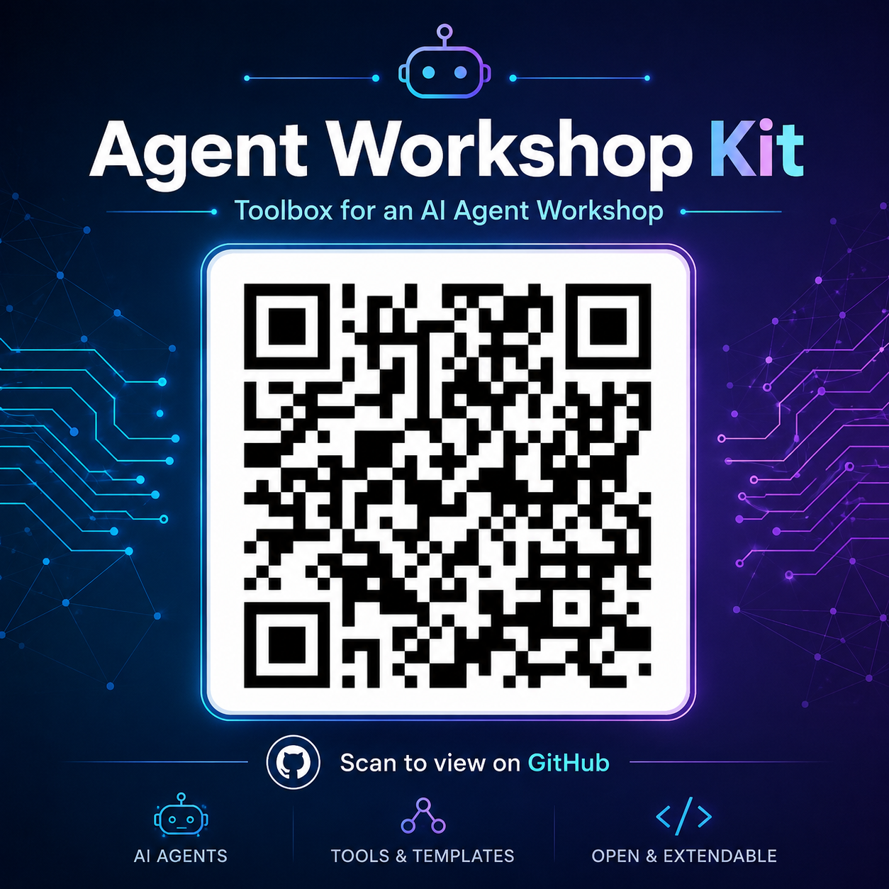
Agentic AI for
Research Workflows
A hands-on workshop · drive an LLM model with OpenCode
1 setup + 2 hands-on tasks · ~2 hours · follow along on screen
Scan for the kit
github.com/nicklj/agent-workshop-kit

Slide 2
TODAY
One setup, two hands-on tasks
The agent loop: prompt → tool call → observe → repeat. You'll watch it run dozens of steps a chat window couldn't sustain.
TASK 0
TASK 1
TASK 2
Setup
Loop on data
Loop on code
Get everyone on the same agent, model, and Python environment.
Multi-file analysis, data cleaning, a cross-validated model, and a memo.
Build a 3D FEM solver from scratch — write, run, debug, validate.
Agentic AI Workshop · github.com/nicklj/agent-workshop-kit
2

Slide 3
0
TASK 0
Setup
Same agent, same model, same Python env. We'll do all five steps together.

Slide 4
TASK 0 · STEP 1
Get an OpenAI API key
OPTIONAL — OpenCode has free models. Do this step only to run gpt-5.4-mini. Using a free model? Skip to Step 4.
1
Create an account (or sign in)
platform.openai.com/signup
2
Open billing → Add to credit balance → top up US$5
platform.openai.com/settings/organization/billing
3
Open the API keys page
platform.openai.com/api-keys
4
Create new secret key, name it "workshop", copy it now
you can't see it again — keep it handy for Step 4
Agentic AI Workshop · github.com/nicklj/agent-workshop-kit
4

Slide 5
TASK 0 · STEP 2
Point $WORKSHOP at the kit, then install uv
Unpack the kit anywhere, then set WORKSHOP to that folder — used in every command below. Persist it so new terminals see it.
macOS / Linux
Windows (PowerShell)
# set WORKSHOP, then reload
echo 'export WORKSHOP=\
"/path/to/workshop"' >> ~/.zshrc
source ~/.zshrc
# install uv
curl -LsSf \
https://astral.sh/uv/install.sh | sh
# setx persists; also set this session
setx WORKSHOP "C:\path\to\workshop"
$env:WORKSHOP = \
"C:\path\to\workshop"
# install uv
powershell -ExecutionPolicy ByPass -c `
"irm https://astral.sh/uv/install.ps1 | iex"
Verify: uv --version (open a new terminal if it isn't found)
Agentic AI Workshop · github.com/nicklj/agent-workshop-kit
5

Slide 6
TASK 0 · STEP 2
Create the environment & verify
uv pip install targets the .venv in the current folder automatically — no activation needed.
macOS / Linux
Windows (PowerShell)
cd "$WORKSHOP"
uv venv .venv --python 3.12
uv pip install -r requirements.txt
cd $env:WORKSHOP
uv venv .venv --python 3.12
uv pip install -r requirements.txt
verify — should print: ok
# macOS / Linux
"$WORKSHOP/.venv/bin/python" -c "import pandas, matplotlib, sklearn, skfem; print('ok')"
# Windows (PowerShell)
& "$env:WORKSHOP\.venv\Scripts\python.exe" -c "import pandas, matplotlib, sklearn, skfem; print('ok')"
Agentic AI Workshop · github.com/nicklj/agent-workshop-kit
6

Slide 7
TASK 0 · STEP 3
Install OpenCode
macOS / Linux — pick one
curl -fsSL https://opencode.ai/install | bash # install script
brew install sst/tap/opencode # Homebrew
npm install -g opencode-ai # npm (needs Node.js)
Windows — two choices
npm install -g opencode-ai # needs Node.js from nodejs.org
# — or — download OpenCode Desktop (GUI, no Node.js) from opencode.ai
Verify: opencode --version · not found? open a new terminal so the install dir is on PATH.
Agentic AI Workshop · github.com/nicklj/agent-workshop-kit
7

Slide 8
TASK 0 · STEP 4
Pick your model
OPTION A · FREE MODEL
OPTION B · OPENAI KEY
No account, no key, no spend. Good enough for both tasks.
Use the key from Step 1 to run gpt-5.4-mini.
in OpenCode
in OpenCode
opencode auth login
→ OpenAI → API Key → paste
/models
→ openai / gpt-5.4-mini
opencode
/models
→ pick a free model
Open the model picker with /models (or the keybind in the footer). Your choice persists; the active model shows in the TUI footer.
Agentic AI Workshop · github.com/nicklj/agent-workshop-kit
8

Slide 9
TASK 0 · STEP 5
Smoke test — ask the agent three things
Launch in an empty folder: mkdir ~/opencode_smoke && cd ~/opencode_smoke && opencode
"List the files in this folder."
1
It calls a tool and reports the folder is empty.
"Create hello.txt with the text 'hello workshop'."
2
It writes the file — check it from another terminal.
"Run $WORKSHOP/.venv/bin/python -c 'import pandas; print(pandas.__version__)'"
3
THE REAL TEST: it runs the workshop Python and reports a version.
Agentic AI Workshop · github.com/nicklj/agent-workshop-kit
9

Slide 10
TASK 0 · READY?
You're set when all of these are true
✓
opencode --version works (or the OpenCode Desktop app opens)
✓
A model is active — shown in the TUI footer
✓
echo "$WORKSHOP" prints your kit folder
✓
The venv's Python imports pandas, matplotlib, sklearn, skfem
✓
Smoke test #3 printed a real version number
✓
(OpenAI-key route) opencode auth list shows openai
Agentic AI Workshop · github.com/nicklj/agent-workshop-kit
10

Slide 11
1
TASK 1
Loop on data
Hand the agent a messy 200-design sweep. It cleans, analyses, models, and writes the memo.

Slide 12
TASK 1 · FIRST, A RULE
AGENTS.md — standing rules for your agent
A plain-Markdown file OpenCode reads at the start of every session in a project.
task1_kit / AGENTS.md
# Workshop environment rule
Always run Python as
$WORKSHOP/.venv/bin/python
(and the same with -m pip
for installs).
Never use the system python.
Persistent instructions the agent always sees
Lives in the project — travels with the kit when copied
No need to repeat the same setup in every prompt
Here: it pins the workshop Python so the agent never grabs the wrong env
Each task kit ships one — copied to a fresh folder, the agent reads it automatically.
Agentic AI Workshop · github.com/nicklj/agent-workshop-kit
12

Slide 13
TASK 1 · LAUNCH
Copy the kit, open OpenCode, hand over the brief
macOS / Linux
Windows (PowerShell)
cp -r "$WORKSHOP/task1_kit" \
~/agent_task1
cd ~/agent_task1
opencode
Copy-Item -Recurse `
"$env:WORKSHOP\task1_kit" `
$HOME\agent_task1
cd $HOME\agent_task1 ; opencode
THEN SAY TO THE AGENT
"Read BRIEF.md and produce the engineering memo it asks for. Don't pre-clean the data — flag any quality issues you find yourself."
Then let it work. Coach only if it stalls — the point is to watch the loop run.
Agentic AI Workshop · github.com/nicklj/agent-workshop-kit
13

Slide 14
TASK 1 · THE TASK
Thermal-aware packaging design exploration
Two CSVs from a 200-design GPU + HBM thermal sweep. A good run will:
Join the two tables on design_id
Catch 3 planted data-quality issues (it isn't told what they are)
Find the Pareto front: max temperature vs. total wire length
Extract design rules — e.g. "12-layer stacks need cold plate or immersion"
Fit + cross-validate a regression for max temperature; defend it with numbers
Write report.md + top_designs.csv
WHY IT BEATS A CHATBOT
Too big to paste
200 rows across two files.
Iterative & verifiable
Clean → plot → model → re-check, all on disk.
Held-out R²
A copy-paste nightmare in chat.
Agentic AI Workshop · github.com/nicklj/agent-workshop-kit
14

Slide 15
2
TASK 2
Loop on code
No starter code. The agent builds a 3D finite-element solver from scratch and validates it.

Slide 16
TASK 2 · LAUNCH
Same move — copy the kit, open OpenCode
macOS / Linux
Windows (PowerShell)
cp -r "$WORKSHOP/task2_kit" \
~/agent_task2
cd ~/agent_task2
opencode
Copy-Item -Recurse `
"$env:WORKSHOP\task2_kit" `
$HOME\agent_task2
cd $HOME\agent_task2 ; opencode
THEN SAY TO THE AGENT
"Read BRIEF.md and build the FEM solver it describes in scikit-fem. Validate the centerline against the 1-D analytical limit before you report."
Expect bugs — a NaN, a wrong sign, a singular matrix. Watching it diagnose and fix is the whole demo.
Agentic AI Workshop · github.com/nicklj/agent-workshop-kit
16

Slide 17
TASK 2 · THE TASK
Build a 3D transient thermomechanical FEM solver
A 5 × 5 × 10 mm silicon-on-copper brick. No solver provided — the agent writes it in scikit-fem.
Structured tet mesh, two material subdomains in z
Transient heat equation, implicit Euler time-stepping
Steady-state linear elasticity with thermal load
Validate against the 1-D analytical centerline limit
Long-horizon loop: write ~200 lines → hit a NaN/sign bug → diagnose → fix
THE NUMBERS TO HIT
344 K
peak centerline temperature
22 MPa
peak von Mises stress (copper)
0.86 s
time to 95% steady state
Agentic AI Workshop · github.com/nicklj/agent-workshop-kit
17

Slide 18
TASK 2 · IF YOU HAVE TIME
Stretch goals to try
1
2
3
Transient stress
Convective cooling
Mesh convergence
Drive the mechanical solve from the temperature history and plot peak σ_vm(t) at the interface.
Swap the fixed top-face temperature for h·(T − T_ambient); find h that keeps peak die T below 360 K.
Refine 2× in each direction and check the peak stress changes by < 5% — a real convergence study.
Agentic AI Workshop · github.com/nicklj/agent-workshop-kit
18

Slide 19
Questions?
Scan for the kit
github.com/nicklj/agent-workshop-kit

