Slide 1
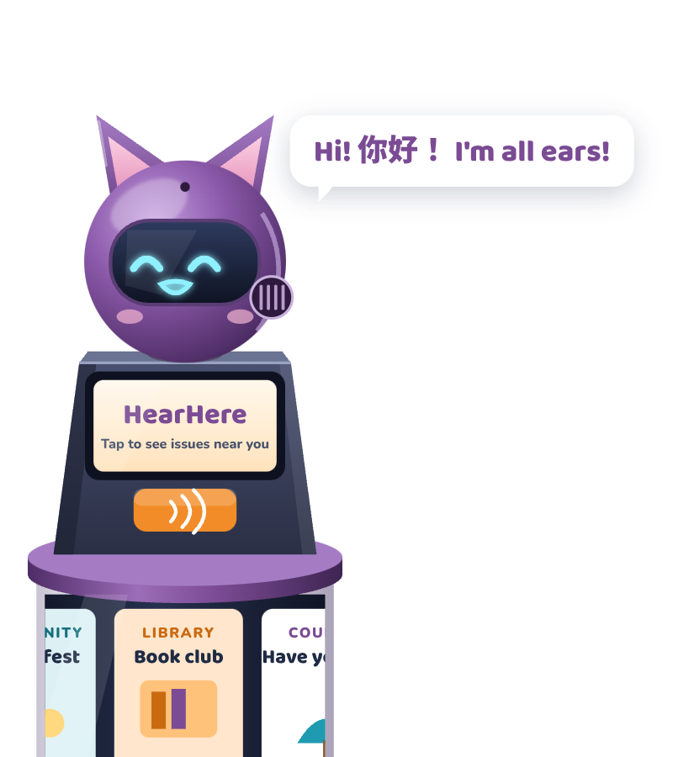
TEAM SWEET POTATOES · GROUP 14 · INFO90006 FIELDWORK FOR DESIGN
HearHere
A street post that helps international residents understand and answer local council decisions
Your street, your say.
Mascot: Spud, the Street Post for Understanding Decisions
Jia-Ying Lee · Xintong Fu · Yu-Hao Lu · Yen-Chu Ou Yang
Notes:
Hi there! I'm Spud. We're Group 14, Team Sweet Potatoes, and this is HearHere: a street post that helps international residents understand and answer local council decisions. Spud stands for Street Post for Understanding Decisions. HearHere. Your street, your say.

Slide 2



The barrier isn't a lack of interest
8
interviews with international residents
4
observation sites (3 physical + council website)
5
themes from thematic analysis
Can't find it
Can't understand it
No idea what happens
Relevant local issues are hard to find. Council news arrives by mail and flyers, but newer residents live on Instagram (Theme 5).
Translated materials still use policy terms people don't understand (Theme 1).
People don't know which department to contact or whether their feedback was heard (Theme 4).
Notes:
Melbourne's councils make decisions about parks, housing and transport. Our fieldwork with eight international residents found the barrier isn't a lack of interest. People can't find relevant information. Translated policies still use terms they don't understand. And they don't know where their feedback goes. Meanwhile, council news arrives by mail and flyers, but newer residents live on Instagram.

Slide 3
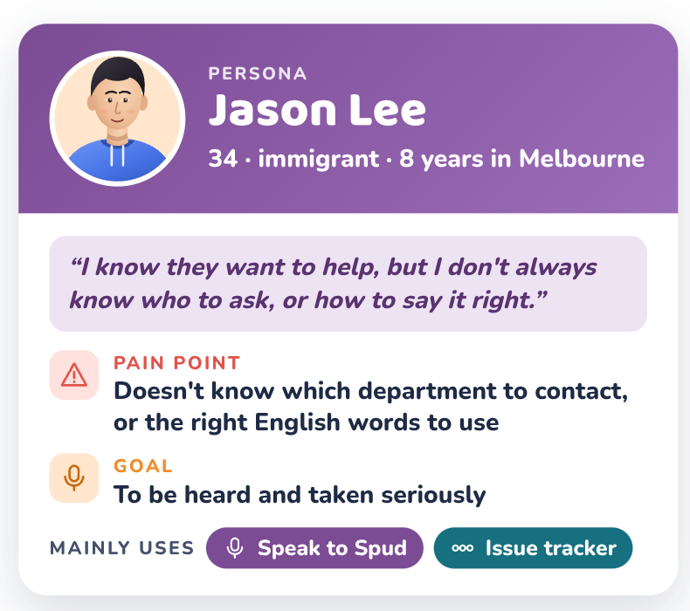
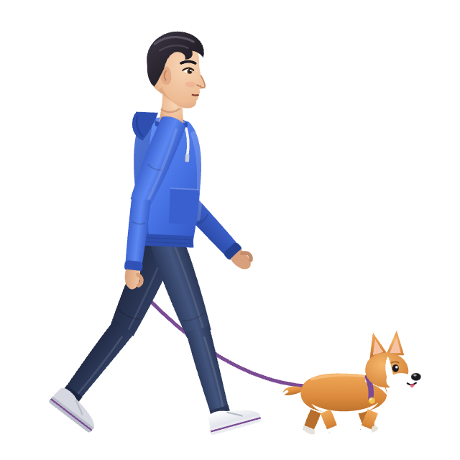
Meet Jason: he wants to be heard
Mainly uses
Speak to Spud + issue tracker
Based on
immigrant interviewees, incl. P4 (dog owner, park rules changed)
Scenario (fictional): Saturday, 8 am. A new park rule says dogs must be on a leash 7–10 am on weekends. Jason disagrees, but doesn't know who to tell or which words to use.
Notes:
Meet Jason. He's 34, has lived in Melbourne for eight years, and English isn't his first language. He's unhappy about a new park rule for dogs, yet he doesn't know who to tell, or which words to use. The park rule is a fictional example.

Slide 4
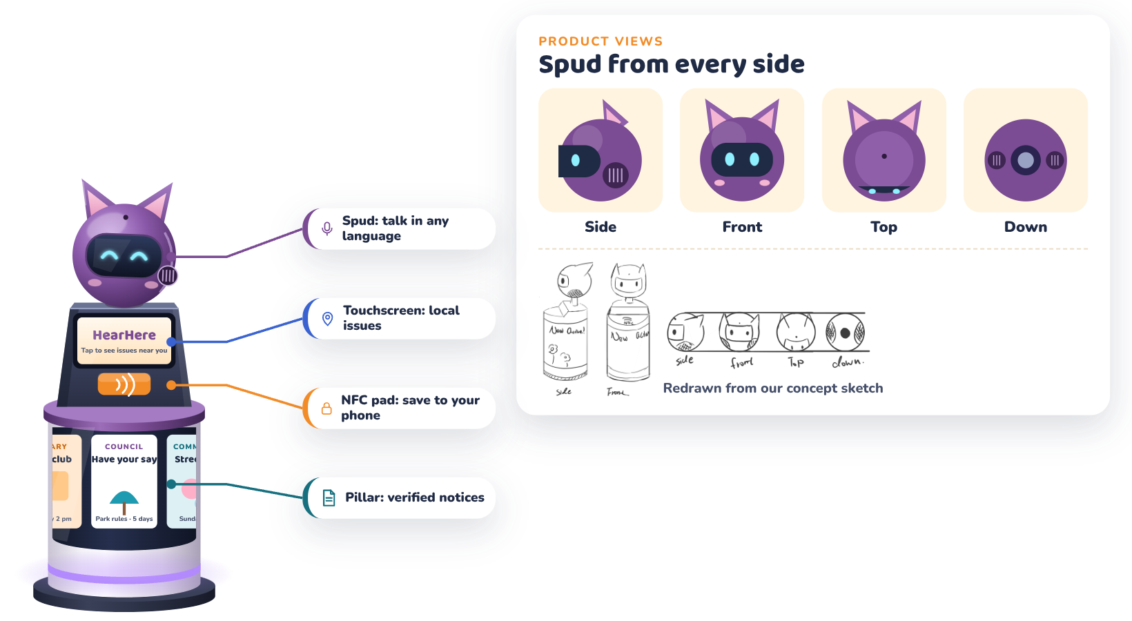
Meet HearHere and Spud
A 130 cm post for footpaths, library entrances and streets near campus. The four views are redrawn from our concept sketch.
Notes:
The post has four parts: Spud, the mascot you talk to; a touchscreen listing nearby issues; an NFC pad that hands the issue to your phone; and a pillar showing verified council and community notices.

Slide 5
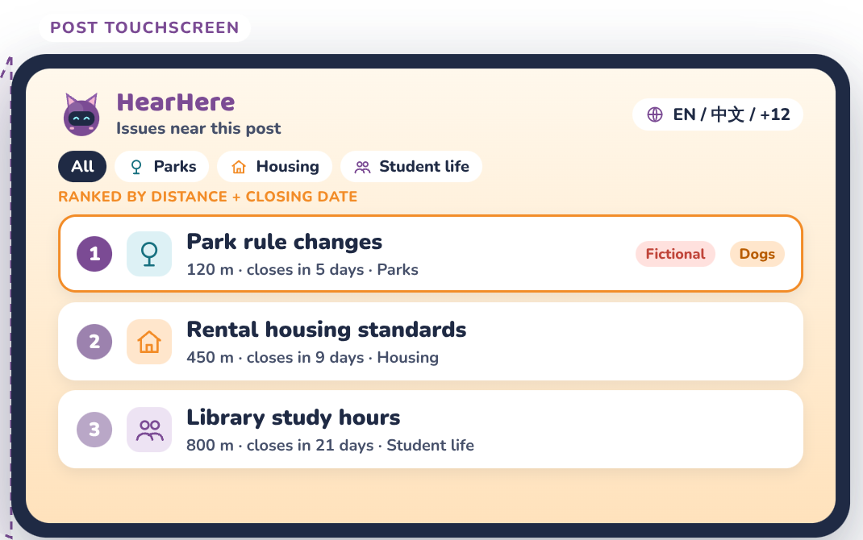
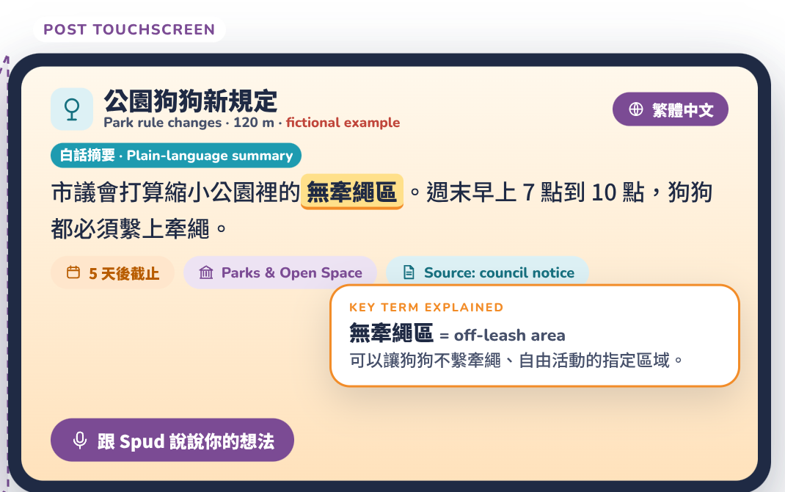
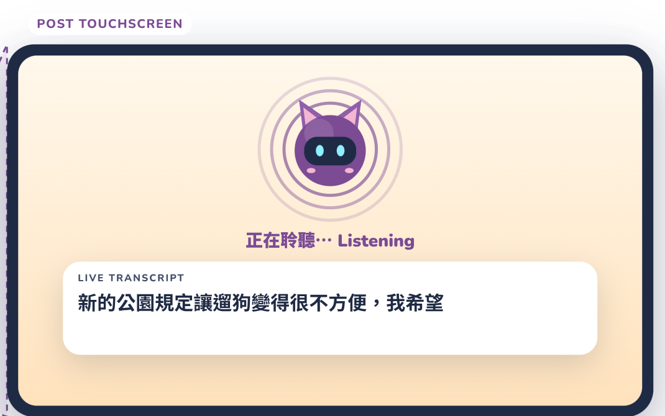
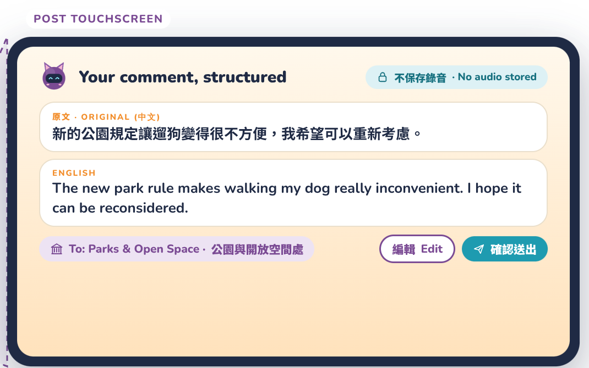
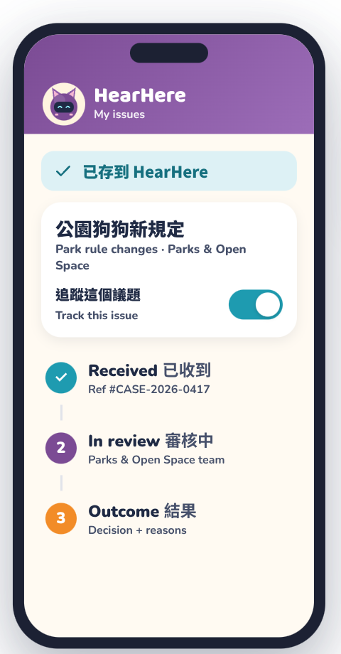

Jason's Saturday morning, step by step
1
Discover
2
Understand
3
Speak
4
Confirm
5
Save & track
›
›
›
›
Nearby issues, ranked by distance and closing date
Plain-language summary in his language, key terms explained
Talks to Spud in Mandarin
AI writes the English comment and names the department
NFC tap to his phone, then follow each stage
新的公園規定讓遛狗變得很不方便，我希望可以重新考慮。
"The new park rule makes walking my dog really inconvenient. I hope it can be reconsidered." → sent to Parks & Open Space
Notes:
Saturday, 8 a.m. Jason walks his dog past a HearHere post. The screen under Spud lists nearby issues by distance, including a new rule for the park next door. Jason taps the park issue. A plain-language summary appears in his own language, with difficult terms explained. Now he simply talks to Spud, in his own language. Spud turns it into a clear English comment, names the responsible department, and lets Jason edit before sending. No audio is stored.

Slide 6

Understand it, then say it in your own words
Content shown is a fictional example
Plain-language summaries: Policy text rewritten simply, with key terms explained (R1).
Speak to Spud: Residents speak in their own language; typing is an alternative (R8).
Review before sending: Original + English side by side, with the responsible department (R4).
Notes:
The summary is in Traditional Chinese for Jason. He taps "Talk to Spud", says what he thinks in Mandarin, and Spud structures it into an English comment addressed to Parks and Open Space. He can edit it before confirming. No audio is stored on the post.

Slide 7
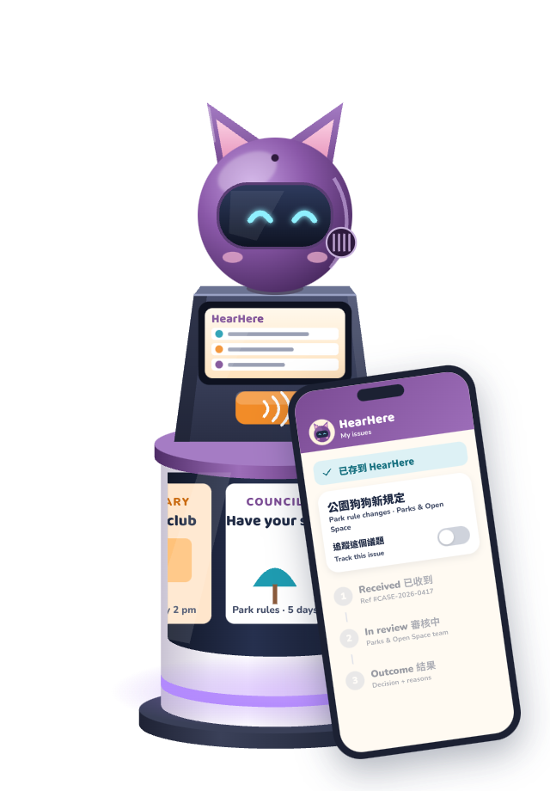
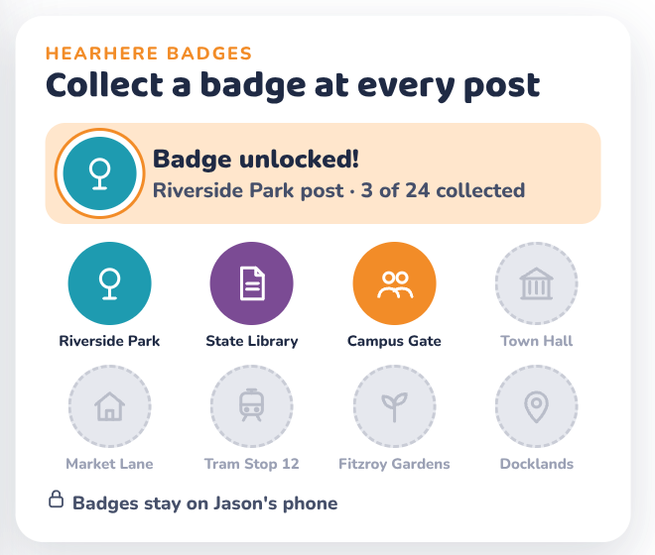
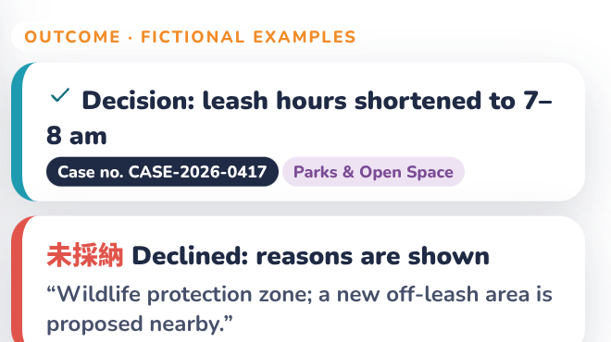



Take it home, track it, collect badges
Status of the issue, not a promise the comment is accepted
NFC hand-off
The post keeps nothing; tracking starts only if Jason opts in (R6).
Progress tracker
Received → In review → Outcome, with a case number or reasons (R5).
Badges
One badge per post visited, stored only on the phone, to encourage return visits.
Notes:
Jason taps his phone on the NFC pad. The issue and his comment move to the HearHere app, and the post keeps nothing. Tracking begins only because Jason chose it. The app shows each stage: Received, In review, then an outcome with a case number, or reasons if declined. Notifications keep him updated. Each new HearHere post Jason visits also earns a badge: a small reward for taking part.

Slide 8
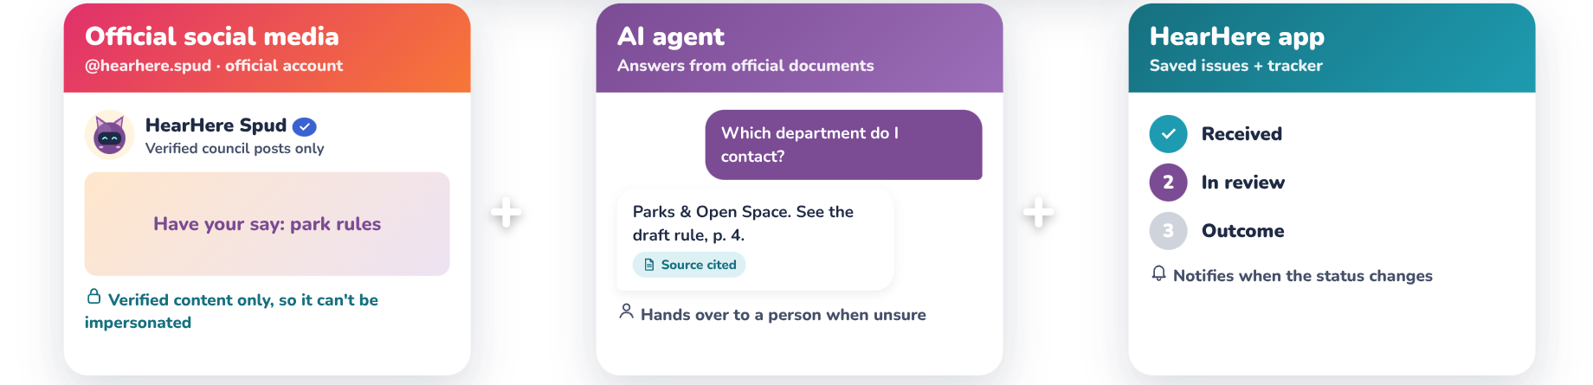

One post, three connected channels
+
+
Responds to Theme 5
Council news goes out by mail and flyers, but newer residents rely on Instagram and friends. HearHere meets them on the channels they already use.
Verified content only
Spud's official account posts only verified council content, so fake accounts are easy to spot.
Notes:
How does it all fit together? Spud's official social media account shares only verified council posts, reaching residents where they already scroll. An AI agent answers questions from official documents and hands over to a named contact when unsure, and the HearHere app tracks each issue.

Slide 9
Every feature maps to a fieldwork requirement
Requirement | HearHere feature | Fieldwork evidence
R1 Multilingual | Plain-language summaries, speak in any language | Theme 1: translation alone doesn't explain terms (P3, P8)
R2 Personal relevance | Issues ranked by distance and closing date | Theme 3: people engage when it affects them (P1, P2, P7)
R3 Visibility | Post on everyday routes; official social account | Theme 5: mail and flyers miss newer residents (P5, P7)
R4 Q&A support | AI agent with cited sources; names the department | Theme 4: unsure who to contact (P4)
R5 Trackable | Received → In review → Outcome tracker | Theme 4: feedback felt ignored (P4, P6)
R6 Privacy | No audio or records kept on the post; opt-in tracking | Speaking in public may feel exposing
R7 Trustworthy | Verified content only; sources shown | Misinformation and impersonation risk
R8 Simple | Speak instead of type; one tap to save | Limited time (Theme 2)
Notes:
Each feature responds to one of the eight requirements from our fieldwork report.

Slide 10
What HearHere changes for Jason
Before
With HearHere
Never sees the park consultation
Policy terms are confusing
Doesn't know which department to ask
Emails a general inbox and hears nothing
Finds it on his usual walk
Reads a summary in his own language
Spud names Parks & Open Space for him
Sees each stage of the issue, and when it changes
No meeting needed
Notes:
For Jason, that means relevant issues on his route, in his own language, a clear department to hear him, and visible progress. All without attending a meeting.

Slide 11



Ethical risks we designed for
Privacy in public
AI accuracy
Speaking aloud may expose someone's background.
Translations or summaries can change meaning.
Mitigation: No recordings kept; typed input; anonymous option
Mitigation: Review and edit before sending; sources cited; human hand-over
Misuse and impersonation
Badges and representation
Fake QR/NFC stickers, fake Spud accounts, spam.
Badges could be farmed; feedback isn't a vote.
Mitigation: Verified official account; rate limits; regular inspection
Mitigation: One badge per post; stored on phone; labelled as feedback, not polling
Notes:
HearHere has limits. Speaking in public may feel exposing, AI can mistranslate, and our fieldwork did not include council staff.

Slide 12



Next: test a low-fidelity prototype
Build
Figma app prototype + cardboard post
Questions for the evaluation
Can first-time users find an issue and give feedback in their own language?
Are people comfortable speaking to Spud in public?
Do bilingual reviewers agree the AI kept the meaning?
Do users understand that tracking is optional?
Do badges bring people back, or only encourage tapping?
Do the tracker stages match real council processes? (council staff)
Test
Think-aloud tasks with 5–8 residents across language backgrounds
Pilot
2–3 sites: library entrance, street near campus
Notes:
Next, we'll test a low-fidelity prototype with residents across languages, and check whether they trust and correct the AI's output.

Slide 13
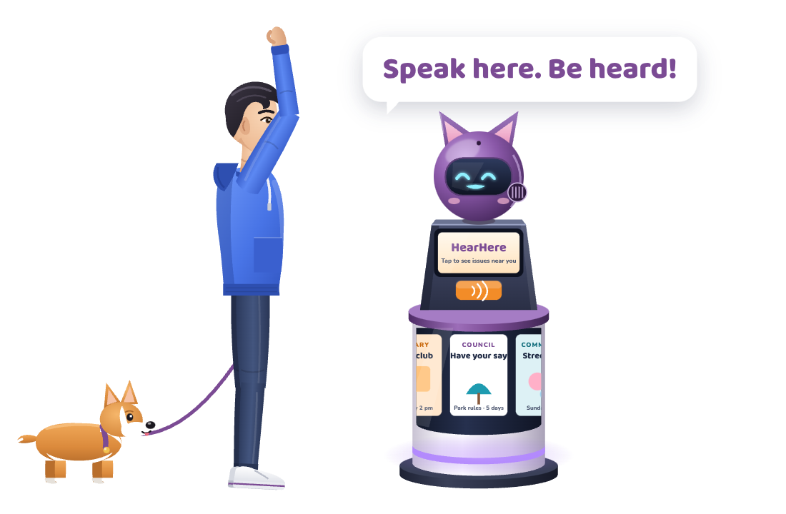
HearHere
with Spud: Street Post for Understanding Decisions
Speak here. Be heard.
Concept video: [add video link]
Jia-Ying Lee 1790130 · Xintong Fu 1840227
Yu-Hao Lu 1781474 · Yen-Chu Ou Yang 1801365
The scenario and park rule are fictional examples. Narration in the video is AI-generated.
Notes:
HearHere, with Spud: the Street Post for Understanding Decisions. Speak here. Be heard!

