Slide 1

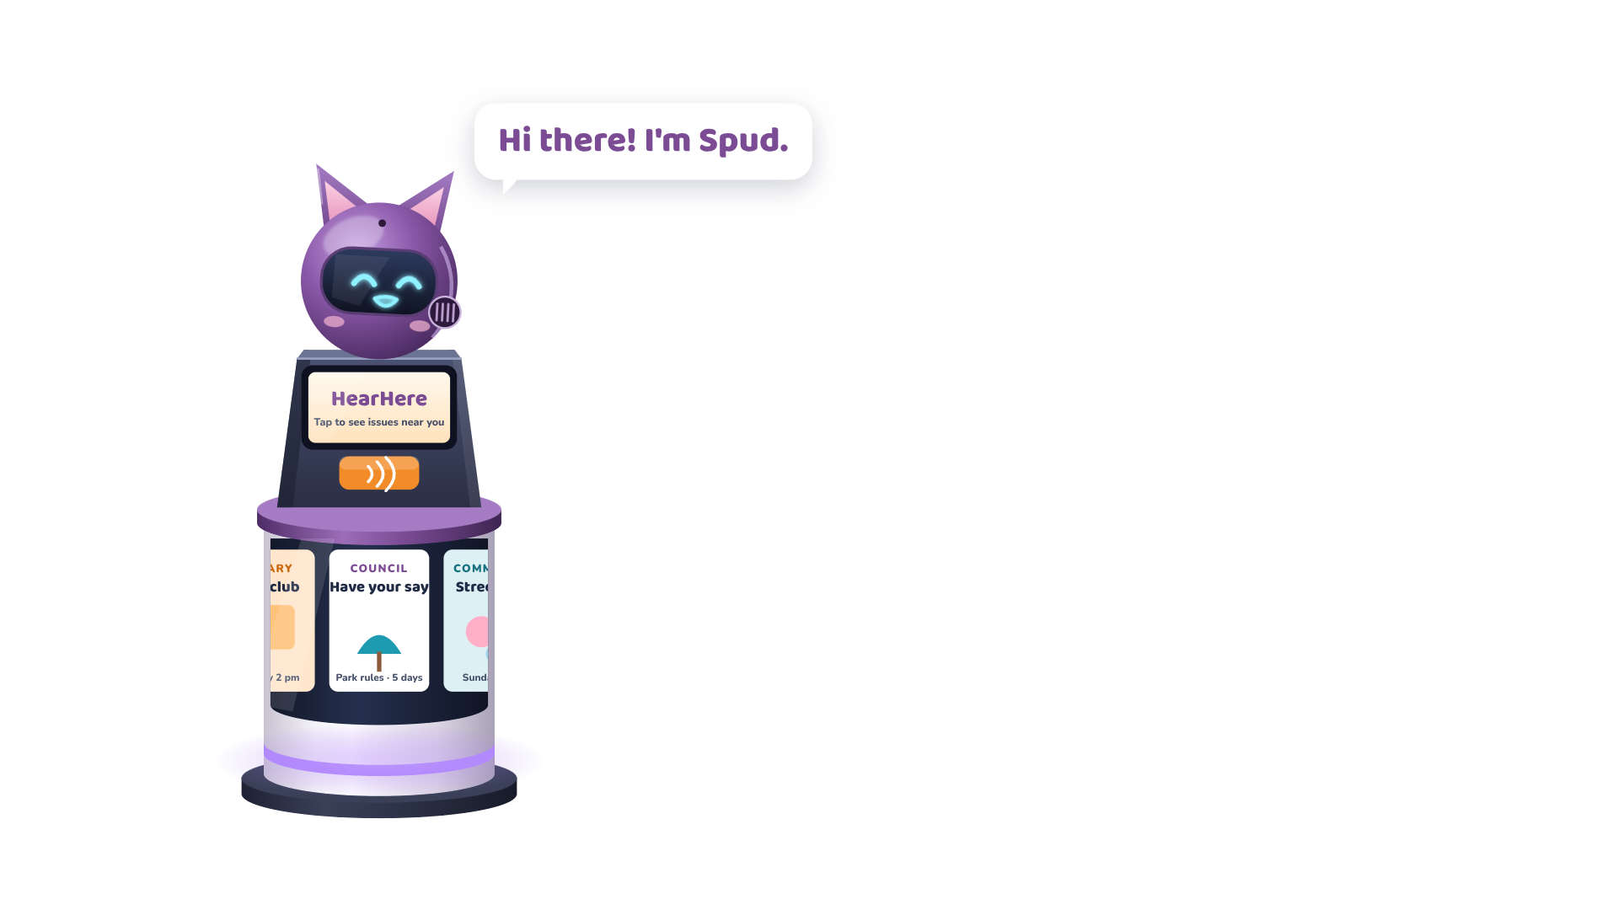

Notes:
Spud: Hi there! I'm Spud.

Slide 2
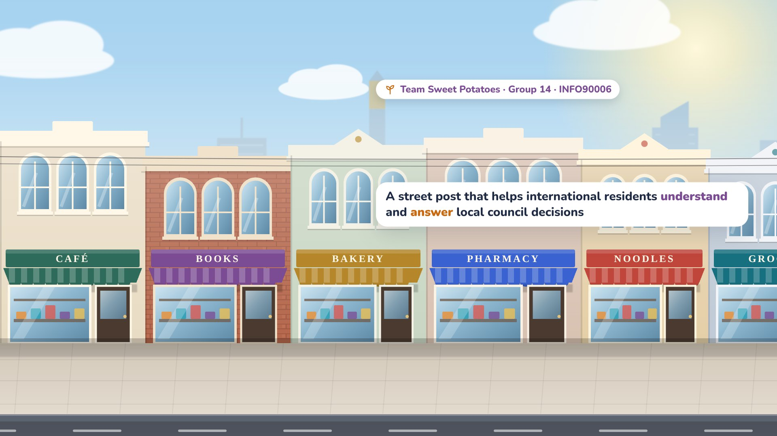

Notes:
Narrator: We're Group 14, Team Sweet Potatoes, and this is HearHere.

Slide 3
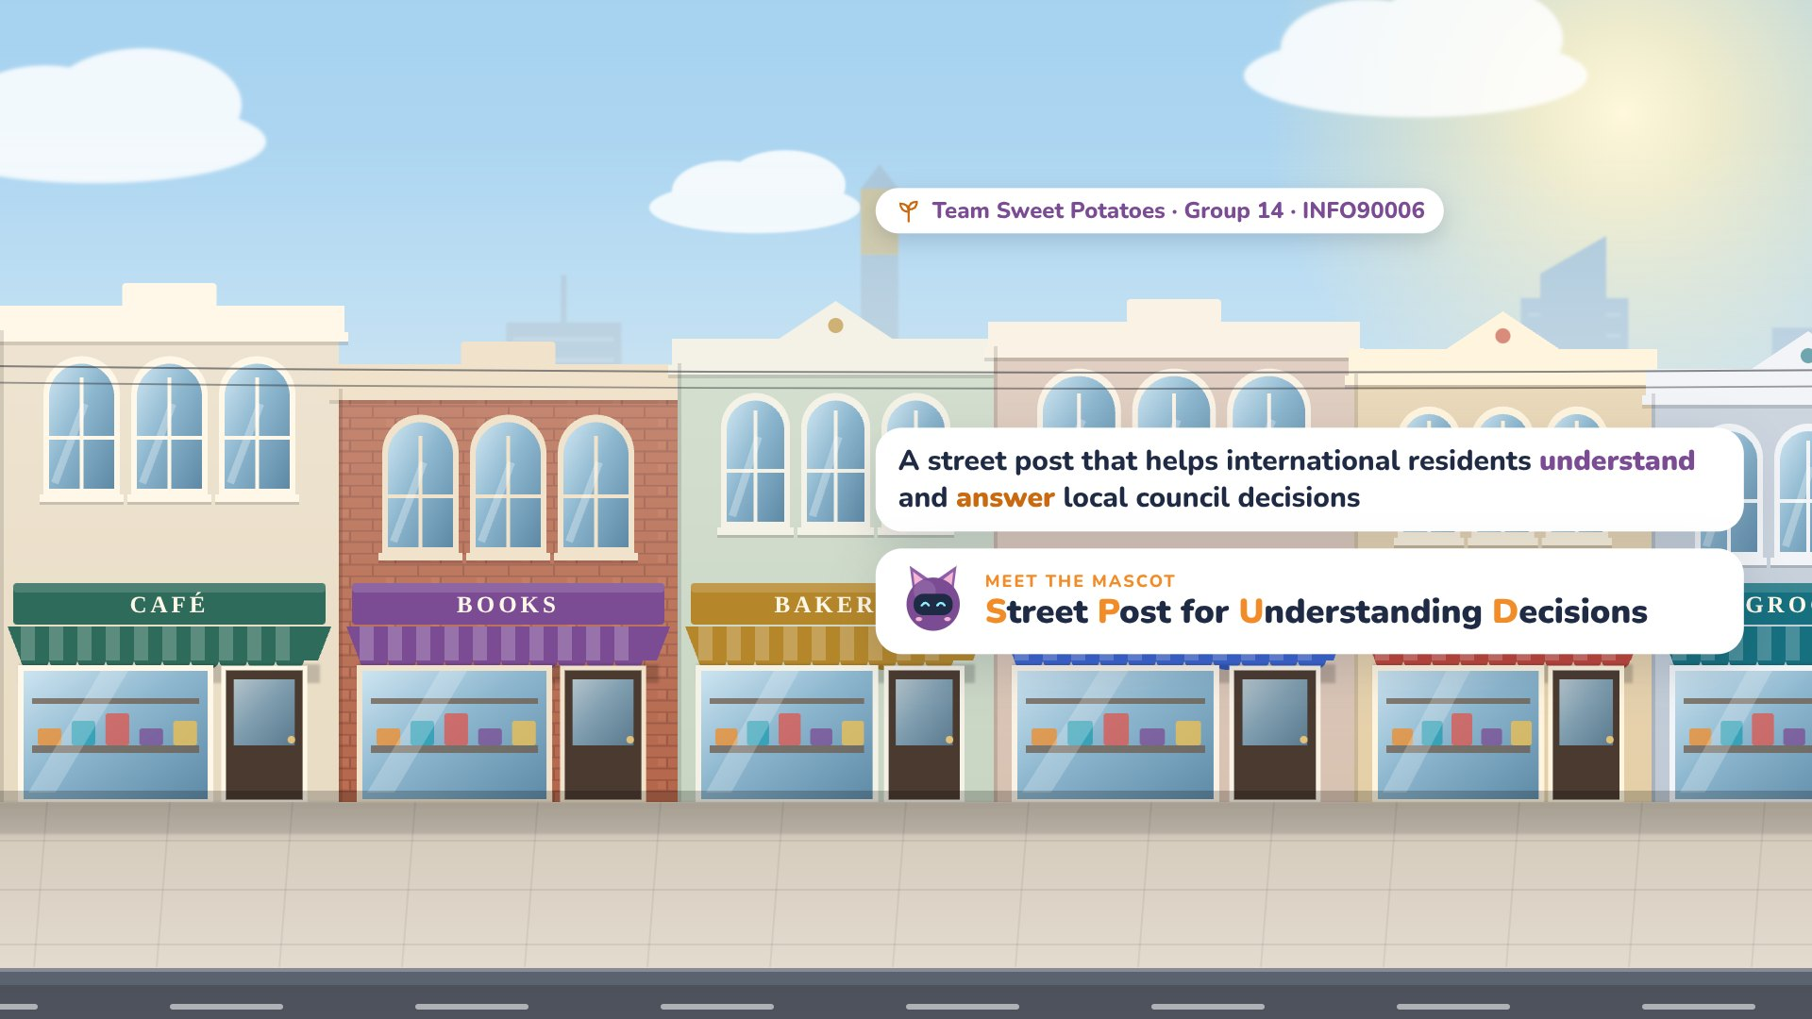
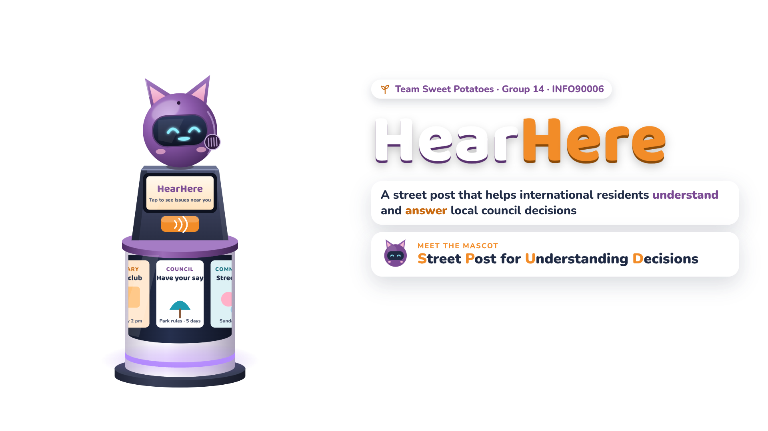
Notes:
Spud: Spud stands for Street Post for Understanding Decisions.

Slide 4
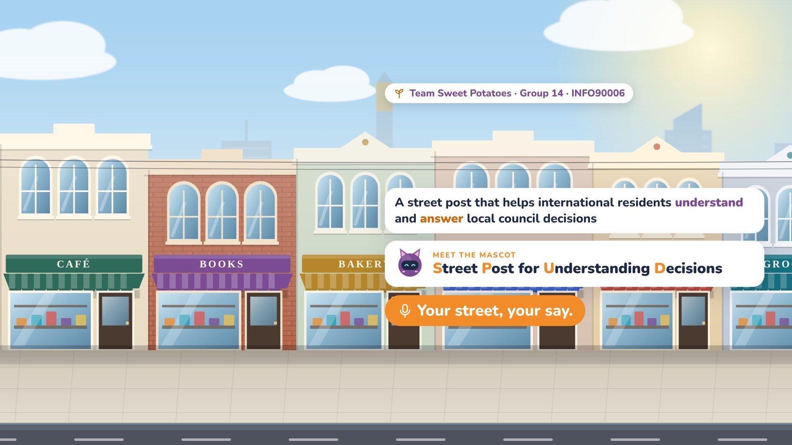
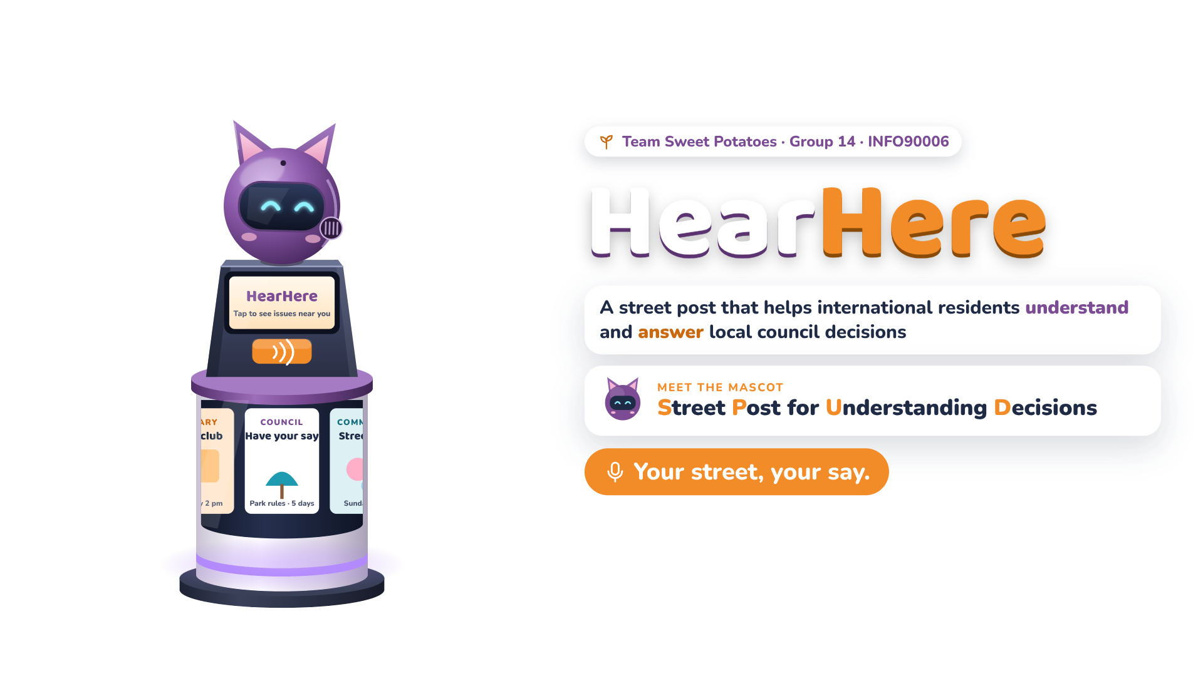
Notes:
Narrator: HearHere. Your street, your say.

Slide 5

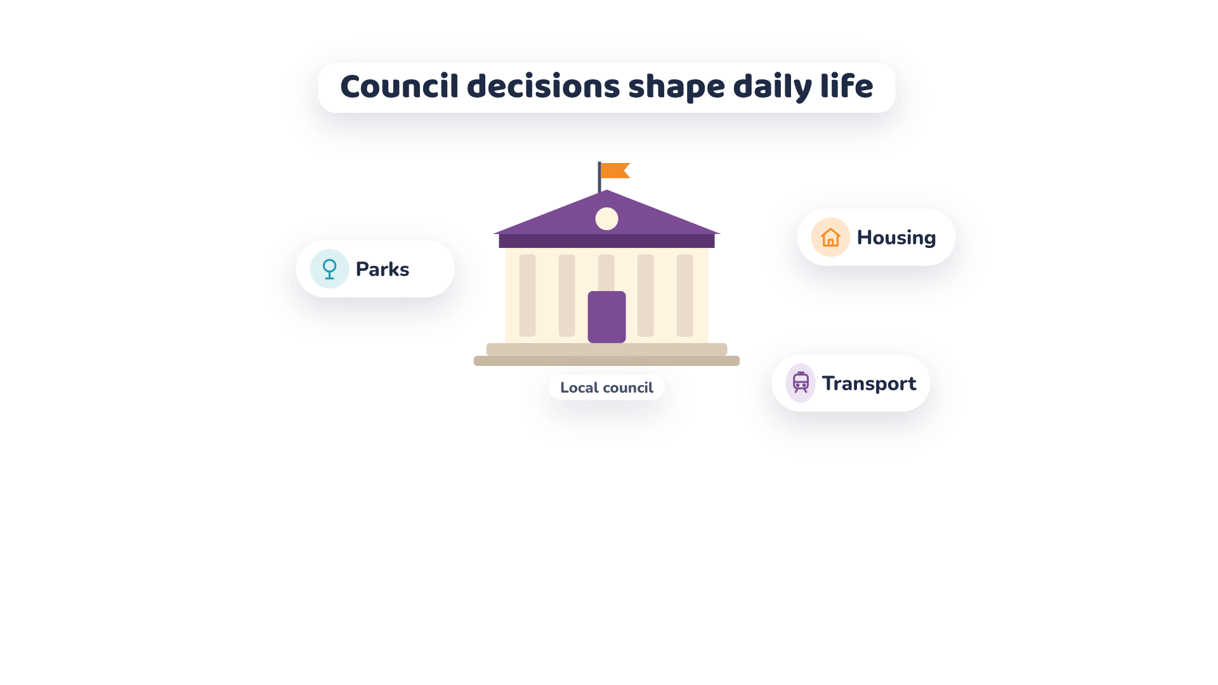
Notes:
Narrator: Melbourne's councils make decisions about parks, housing and transport.

Slide 6
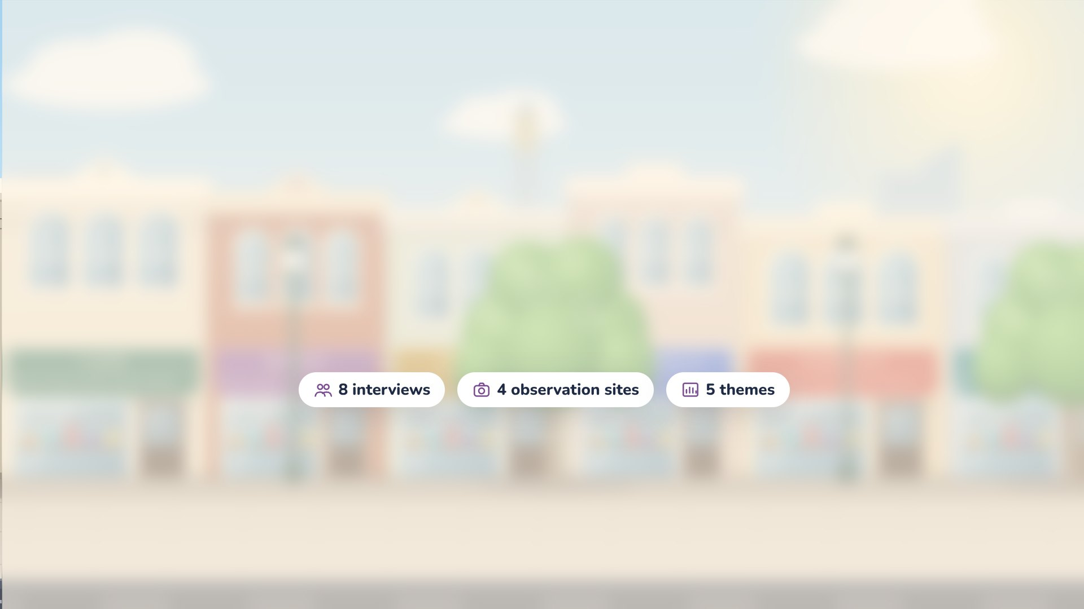
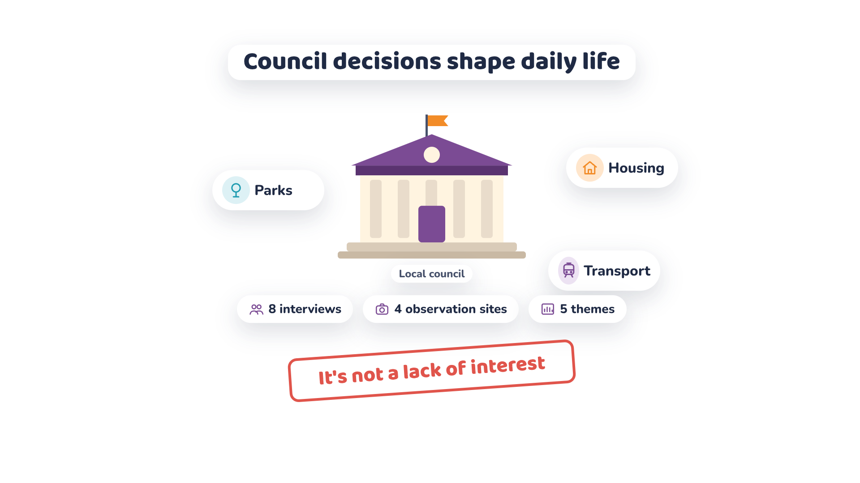
Notes:
Narrator: Our fieldwork with eight international residents found the barrier isn't a lack of interest.

Slide 7


Notes:
Narrator: People can't find relevant information.

Slide 8

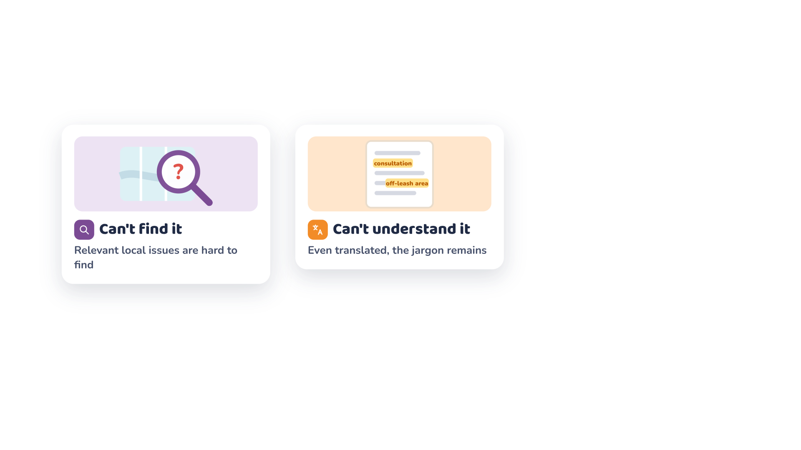
Notes:
Narrator: Translated policies still use terms they don't understand.

Slide 9

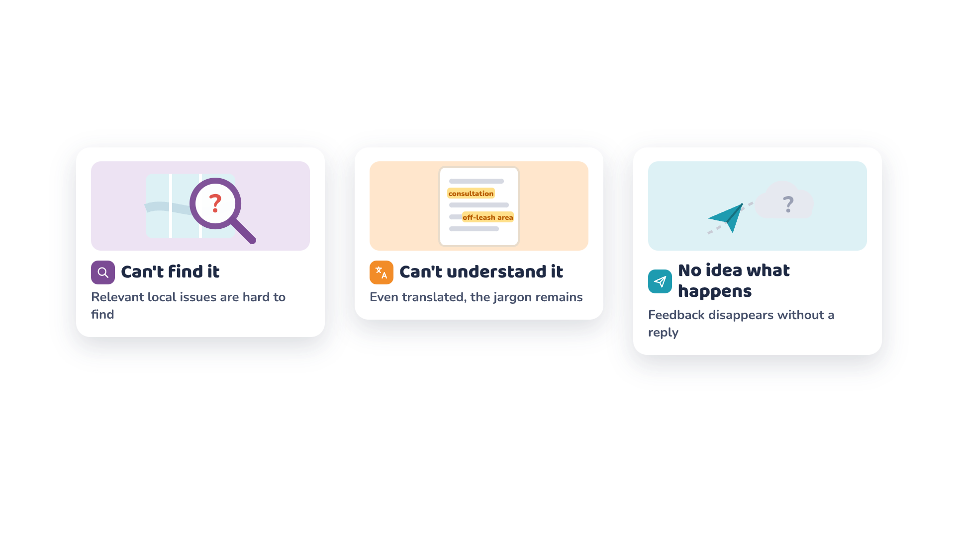
Notes:
Narrator: And they don't know where their feedback goes.

Slide 10


Notes:
Narrator: Meanwhile, council news arrives by mail and flyers, but newer residents live on Instagram.

Slide 11

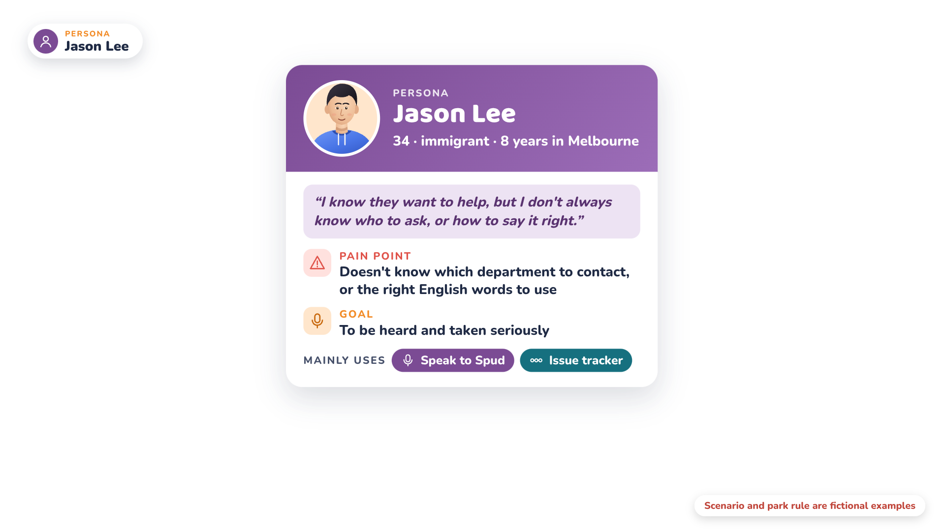
Notes:
Narrator: Meet Jason.

Slide 12

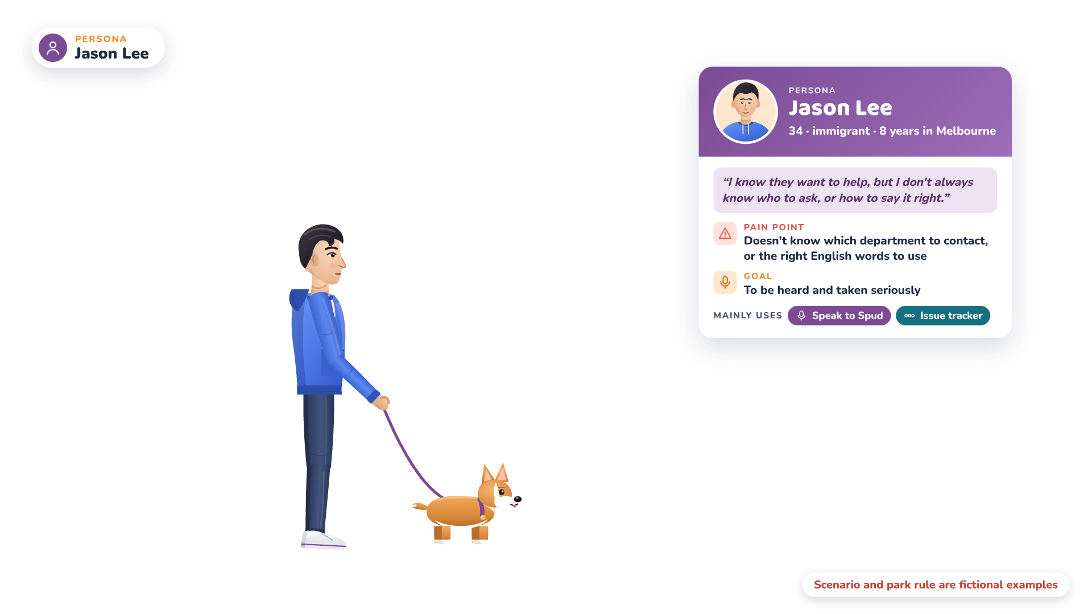
Notes:
Narrator: He's 34, has lived in Melbourne for eight years, and English isn't his first language.

Slide 13

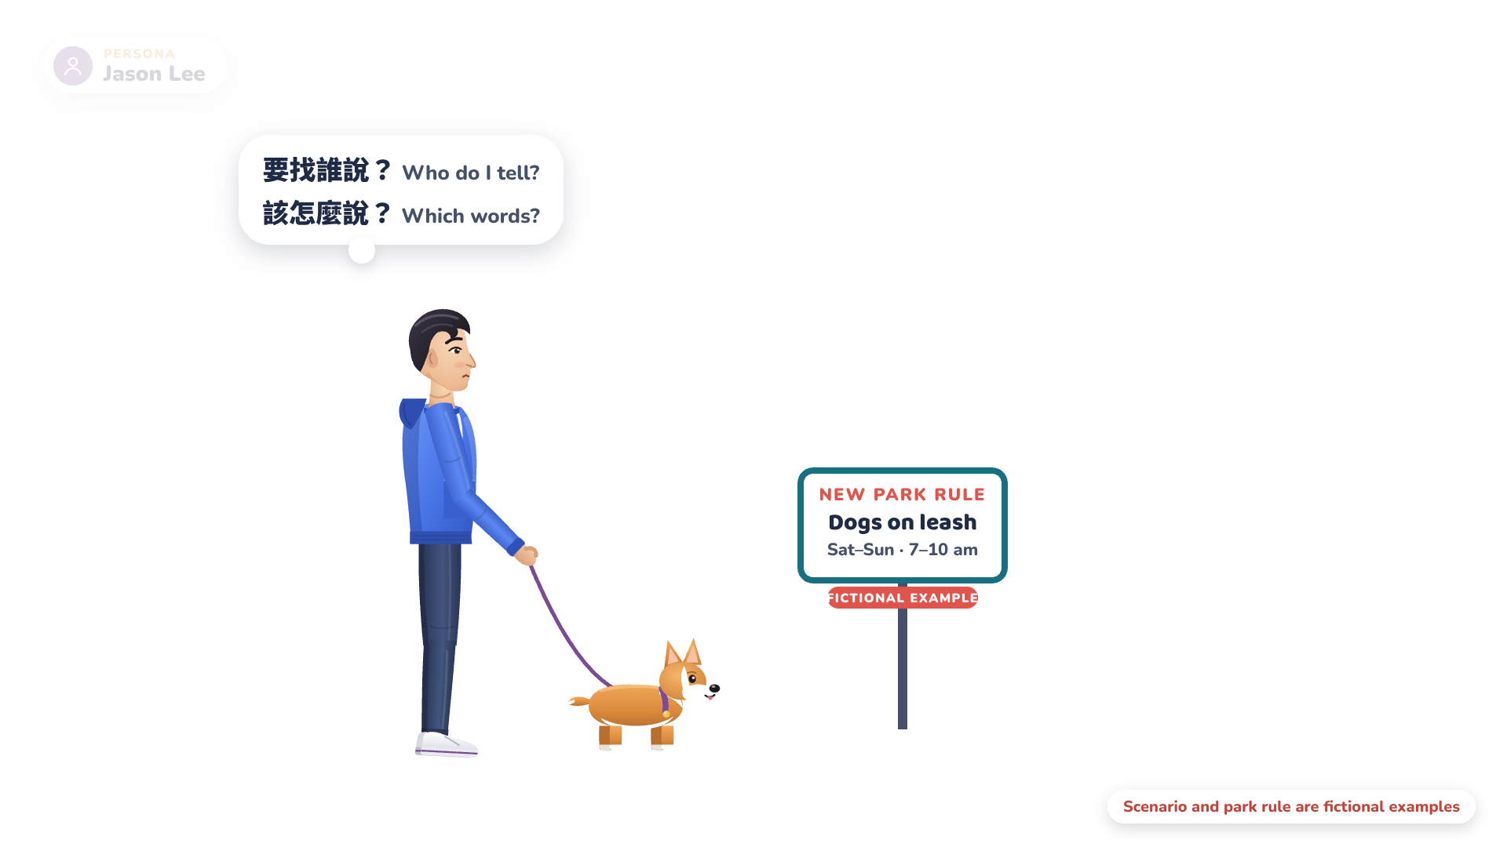
Notes:
Narrator: He's unhappy about a new park rule for dogs, yet he doesn't know who to tell, or which words to use.

Slide 14

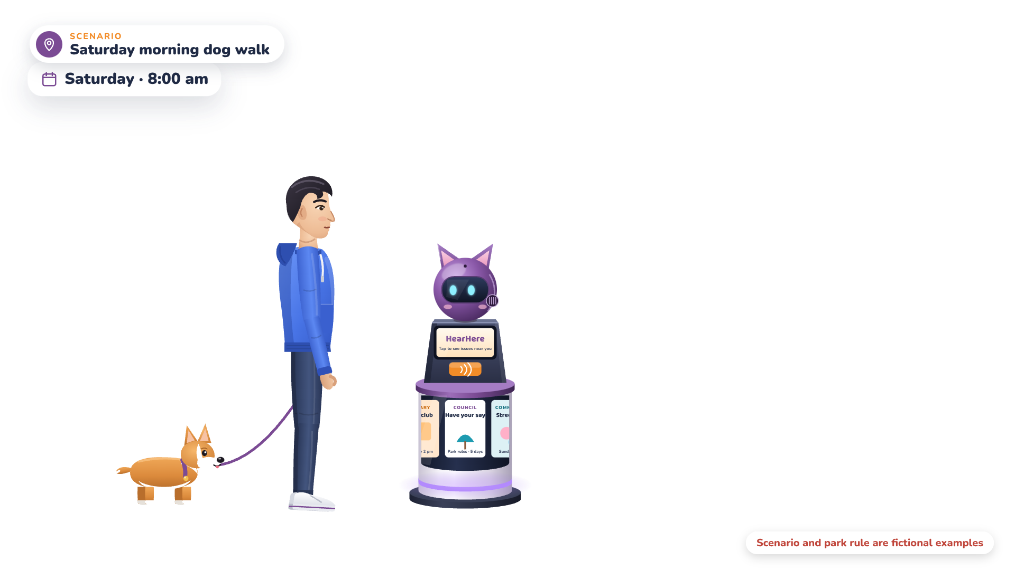
Notes:
Narrator: Saturday, 8 a.m. Jason walks his dog past a HearHere post.

Slide 15

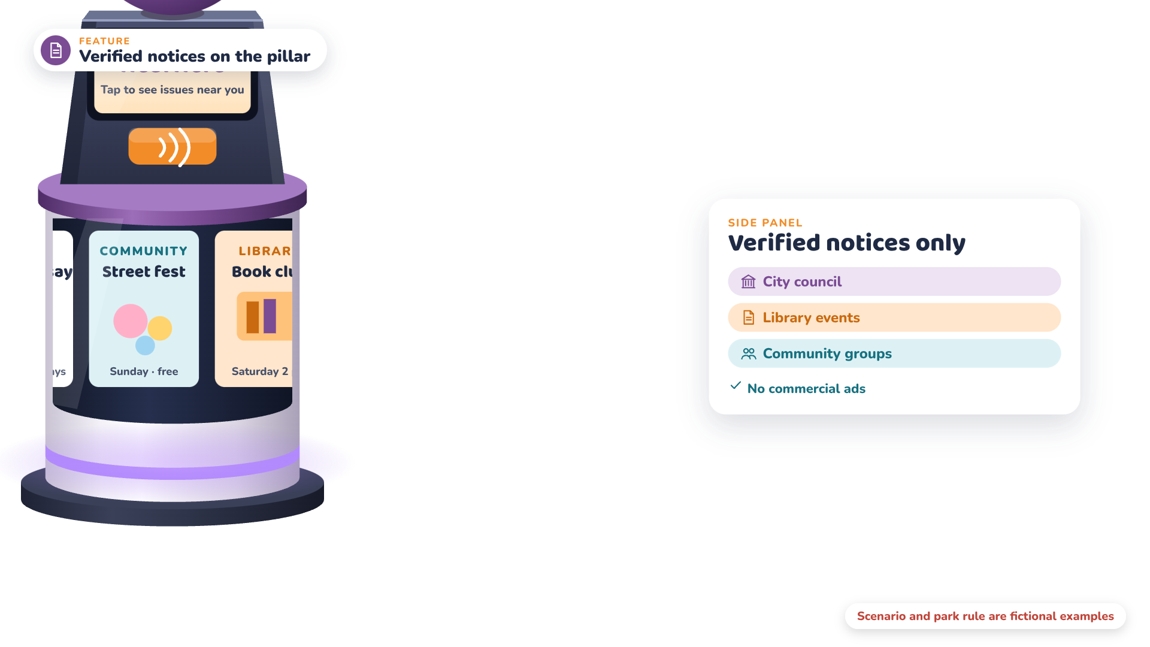
Notes:
Narrator: Its pillar shows verified council and community notices.

Slide 16

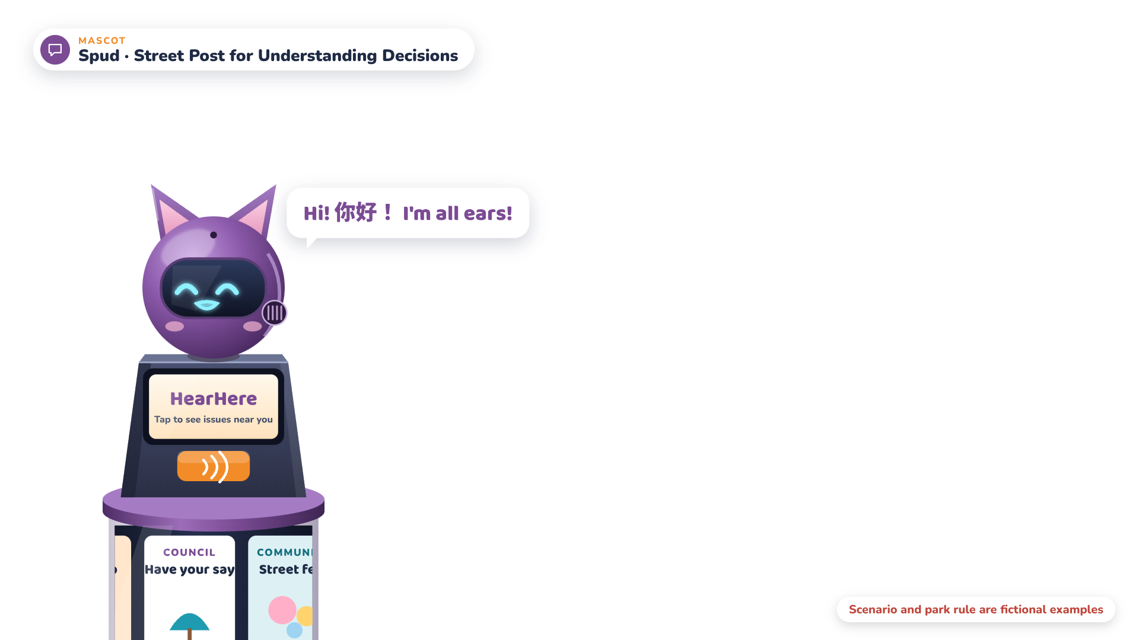
Notes:
Spud: Hi! Got something to say? I'm all ears.

Slide 17
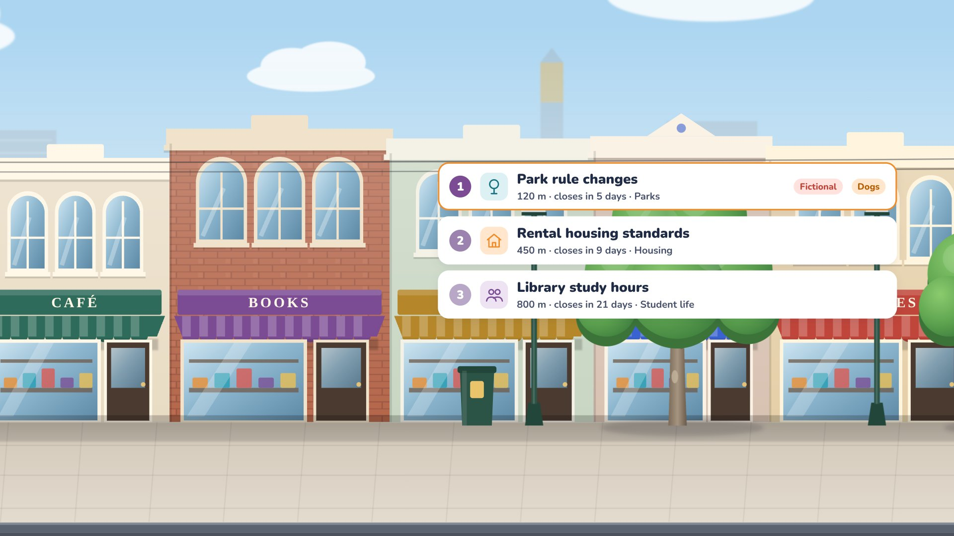
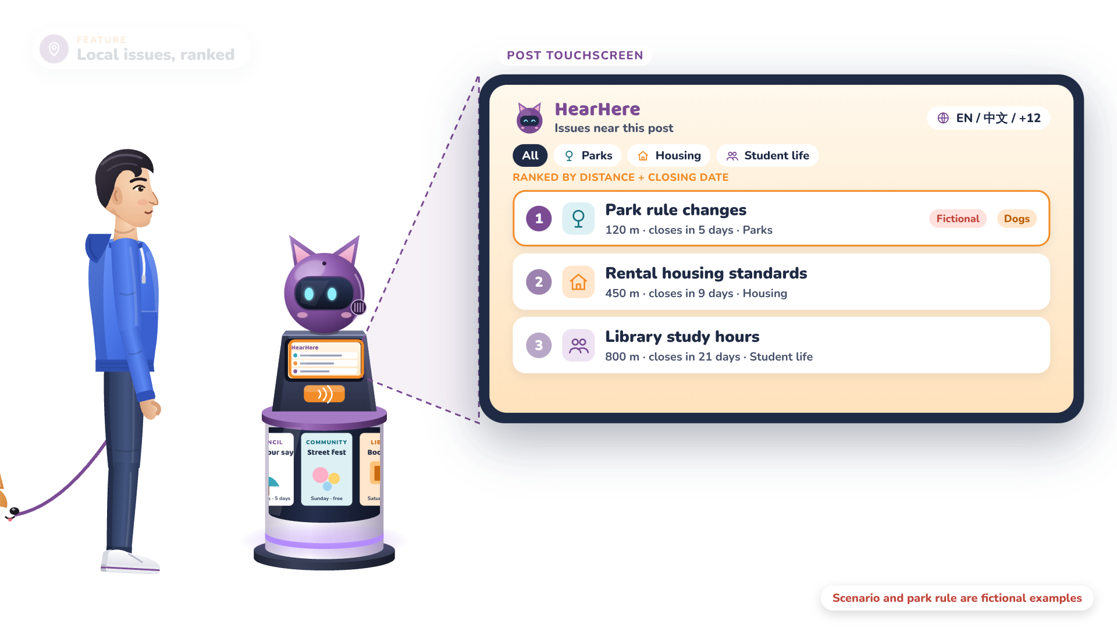
Notes:
Narrator: The screen under Spud lists nearby issues by distance, including a new rule for the park next door.

Slide 18


Notes:
Narrator: Jason taps the park issue.

Slide 19


Notes:
Narrator: A plain-language summary appears in his own language, with difficult terms explained.

Slide 20

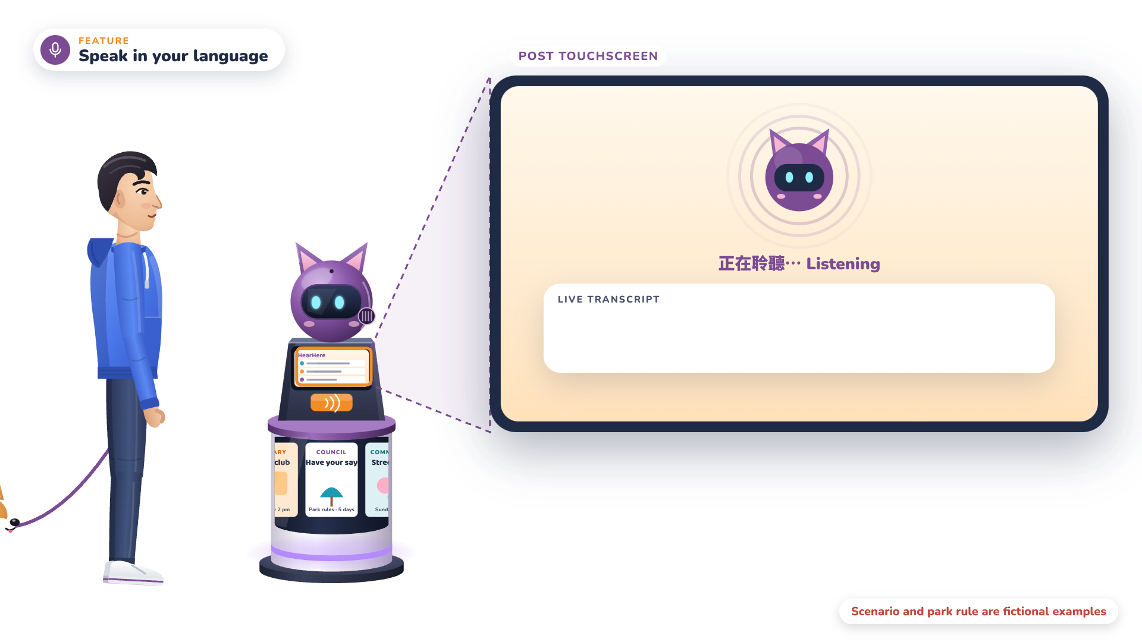
Notes:
Narrator: Now he simply talks to Spud, in his own language.

Slide 21


Notes:
Jason (Mandarin): The new park rule makes walking my dog really inconvenient. I hope it can be reconsidered.

Slide 22
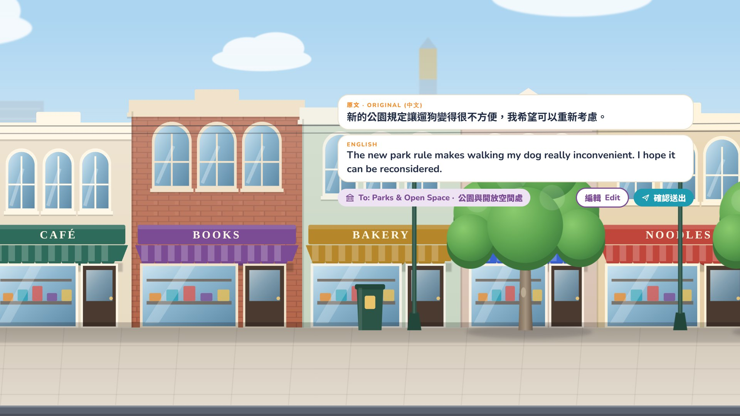
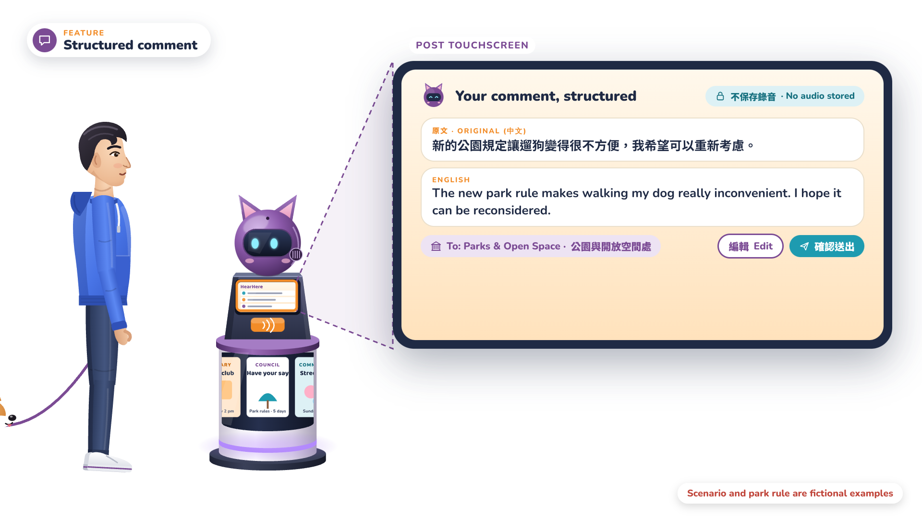
Notes:
Narrator: Spud turns it into a clear English comment, names the responsible department, and lets Jason edit before sending.

Slide 23
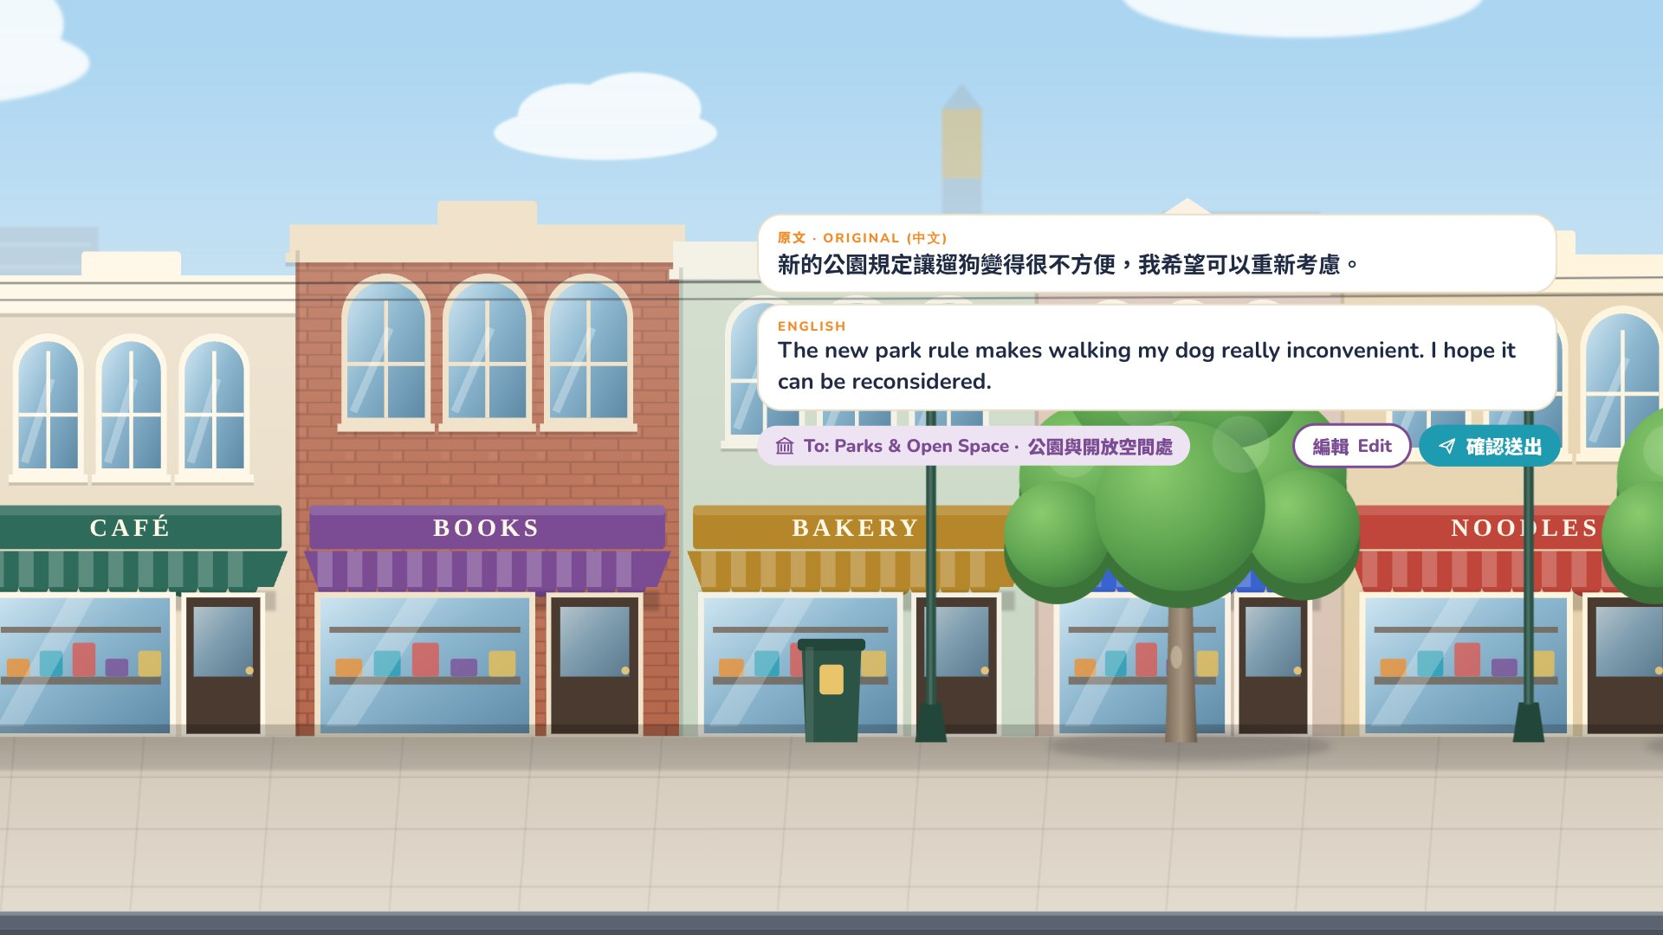
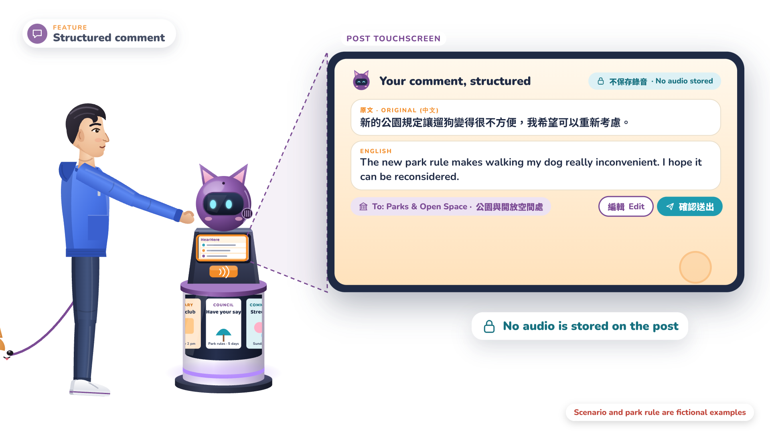
Notes:
Narrator: No audio is stored.

Slide 24


Notes:
Narrator: Jason taps his phone on the NFC pad.

Slide 25


Notes:
Narrator: The issue and his comment move to the HearHere app, and the post keeps nothing.

Slide 26

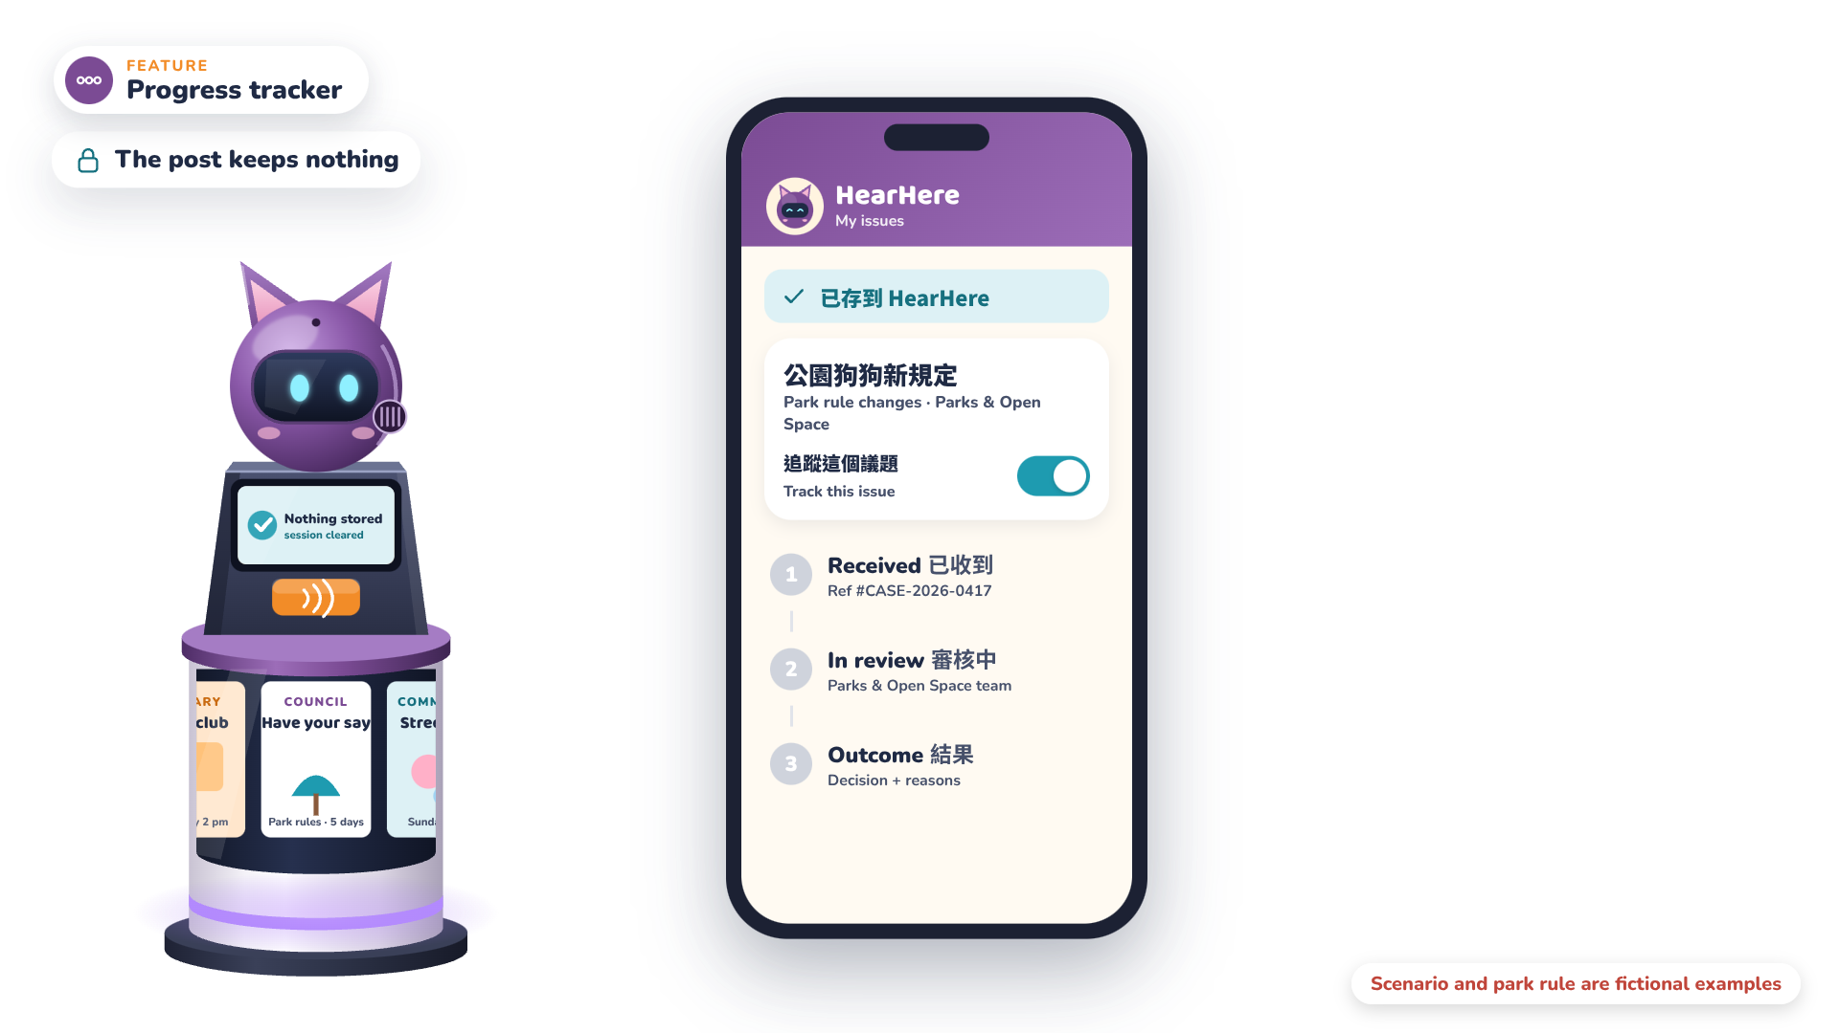
Notes:
Narrator: Tracking begins only because Jason chose it.

Slide 27
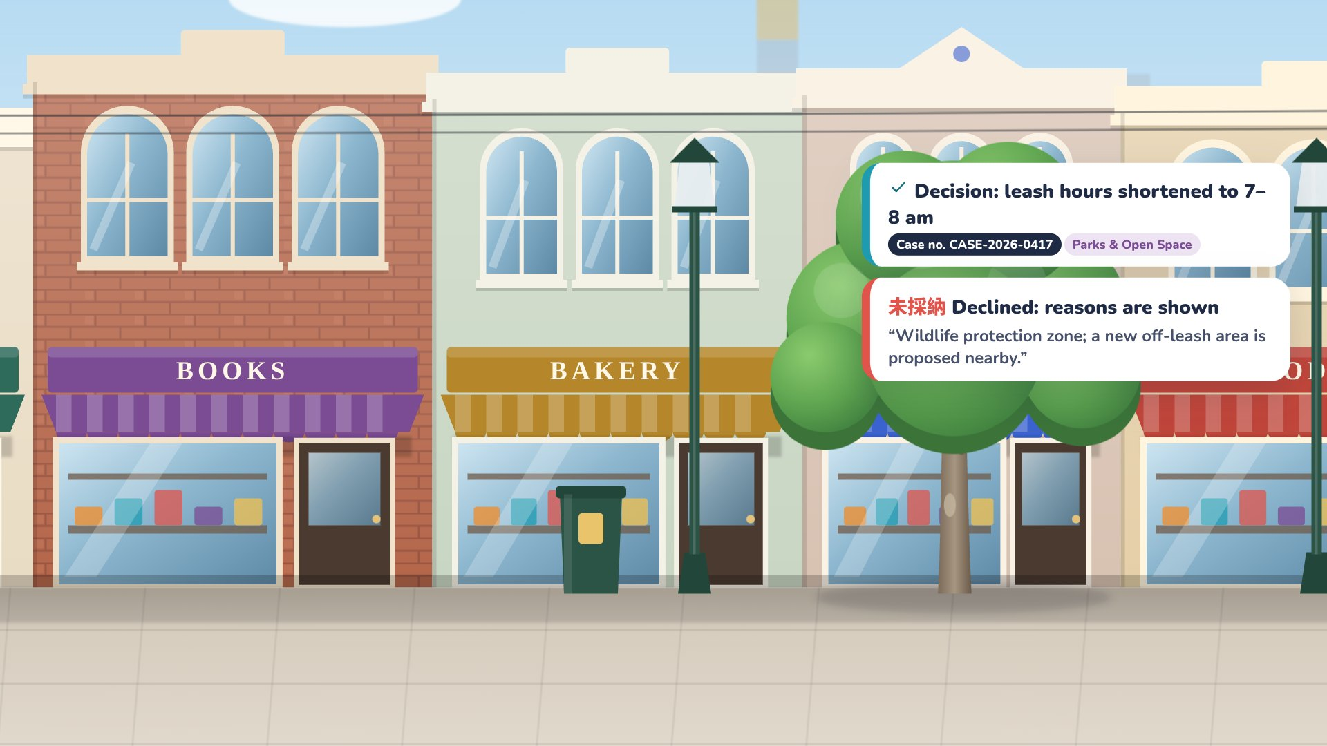
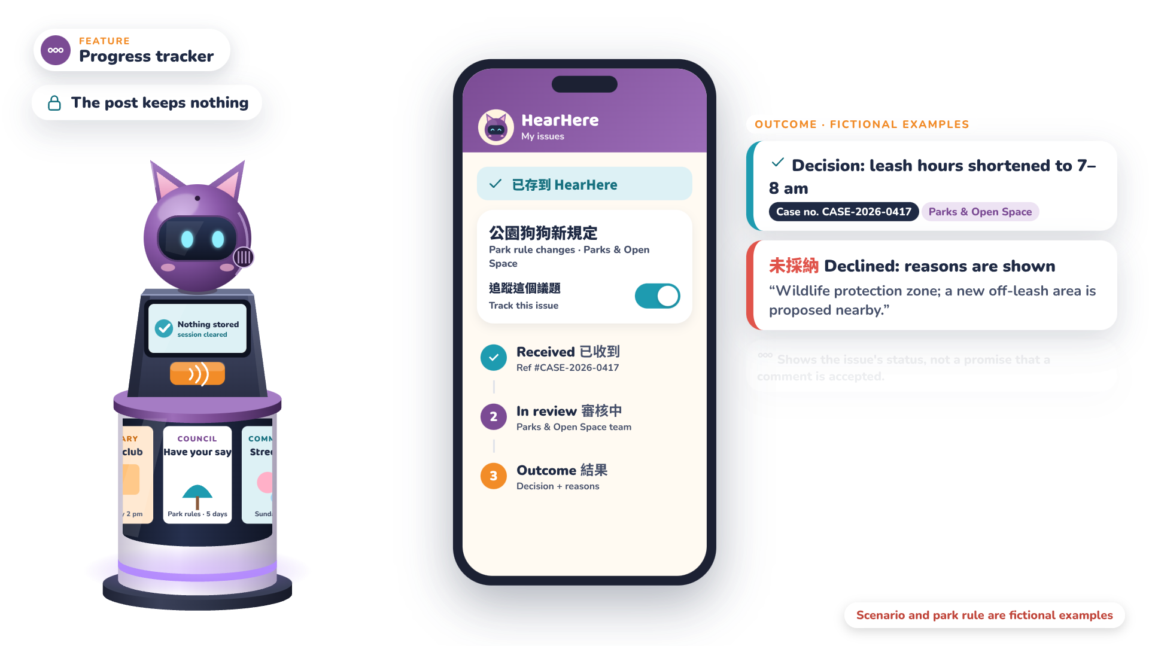
Notes:
Narrator: The app shows each stage: Received, In review, then an outcome with a case number, or reasons if declined.

Slide 28
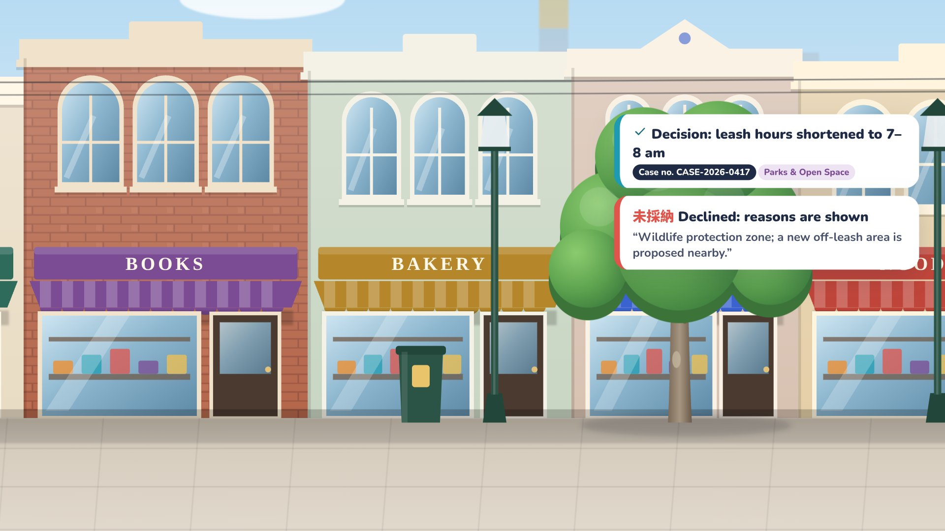
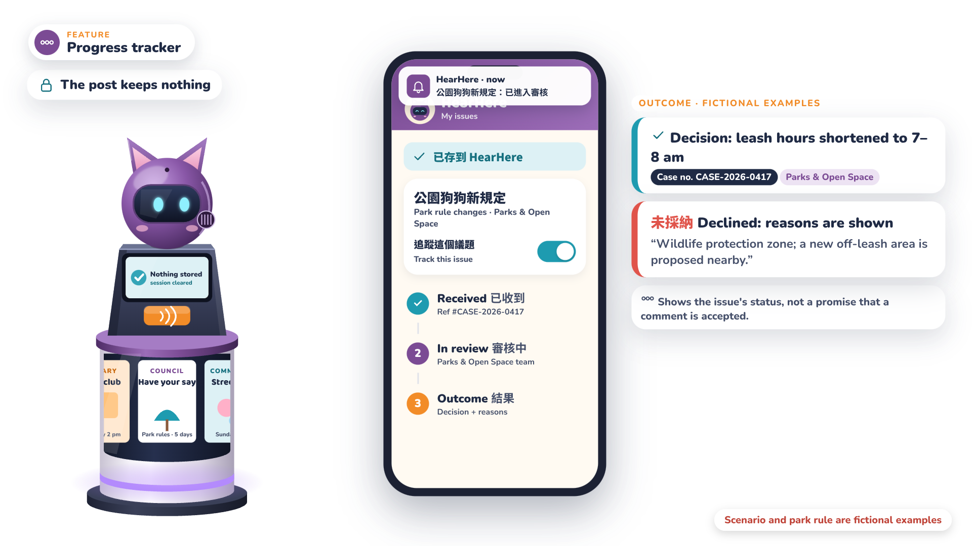
Notes:
Narrator: Notifications keep him updated.

Slide 29
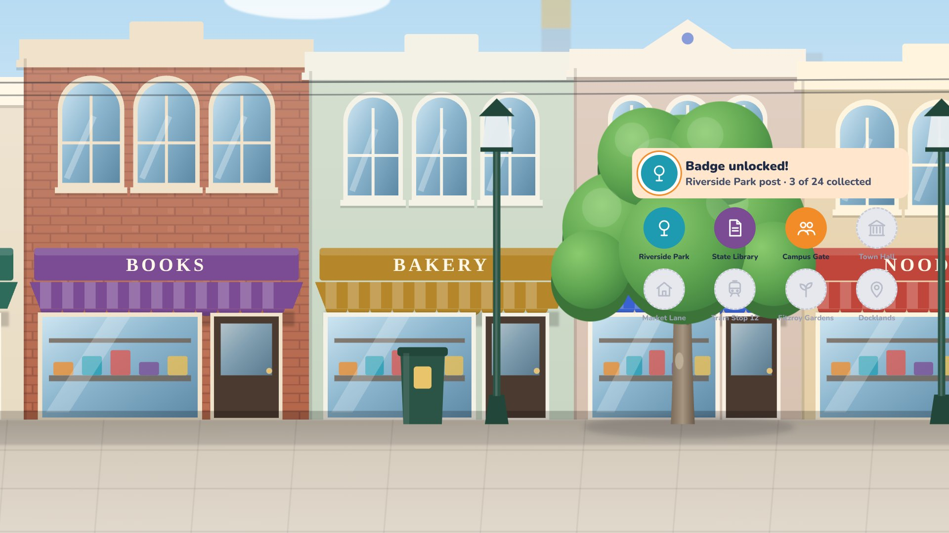
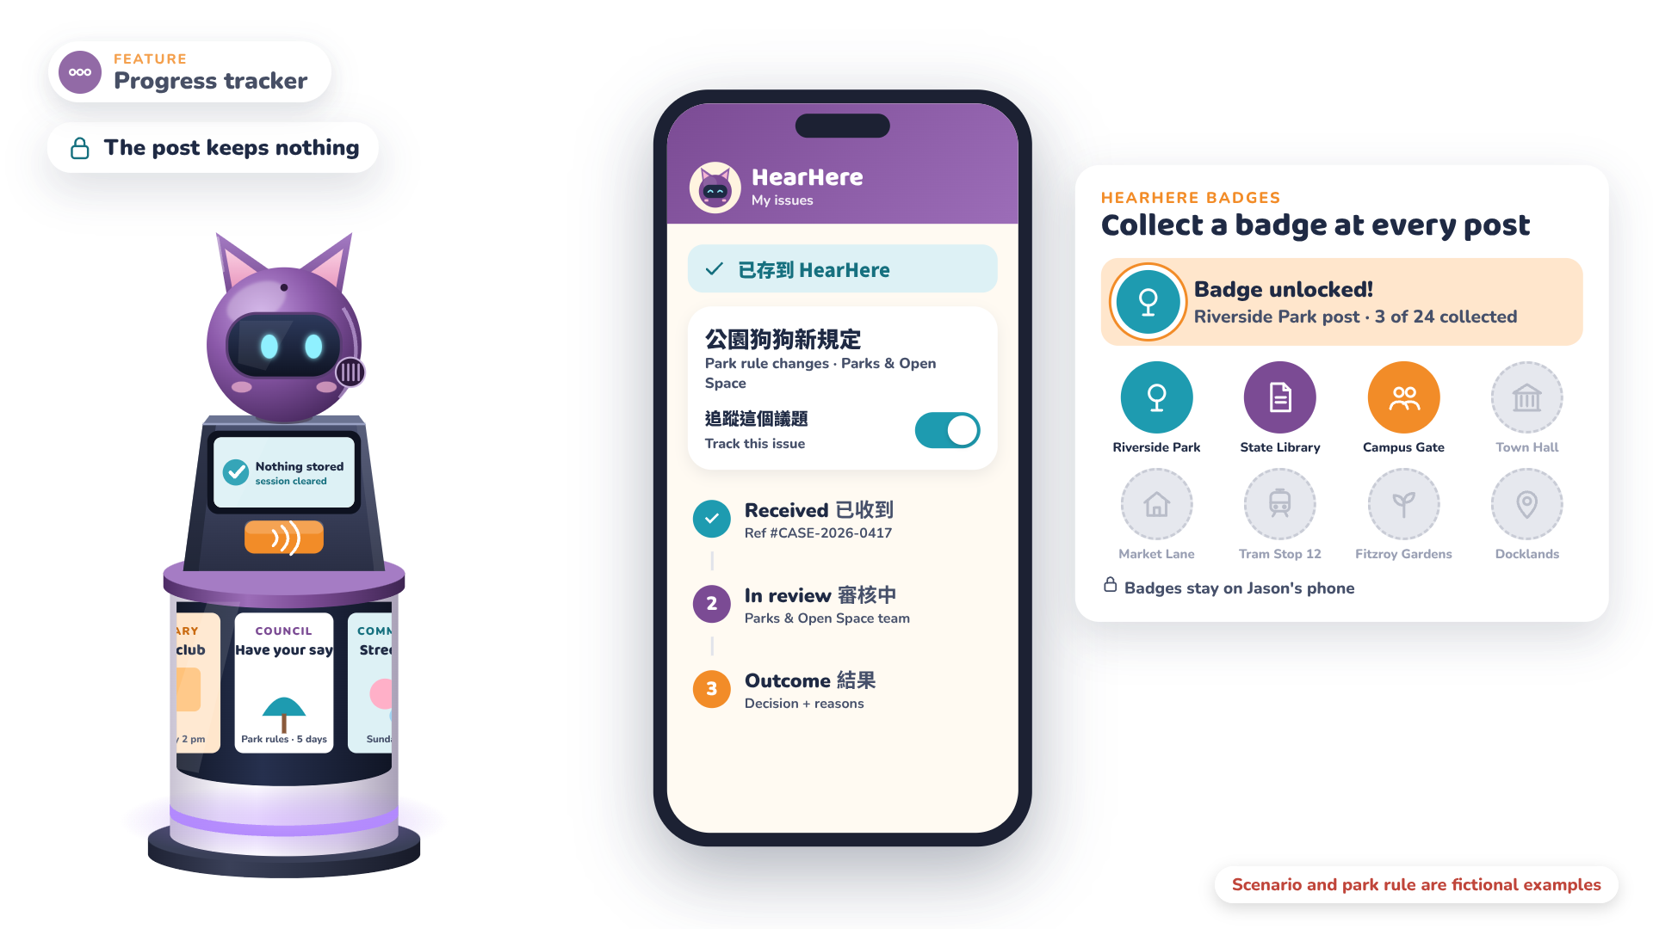
Notes:
Narrator: Each new HearHere post Jason visits also earns a badge: a small reward for taking part.

Slide 30
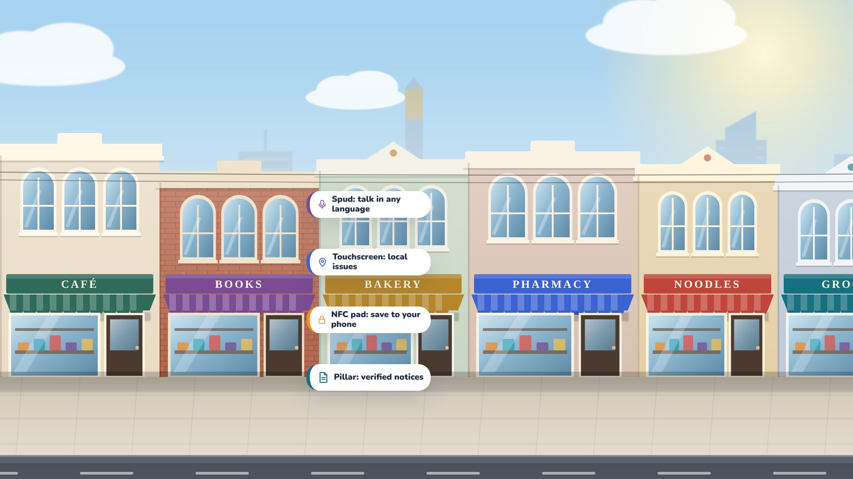
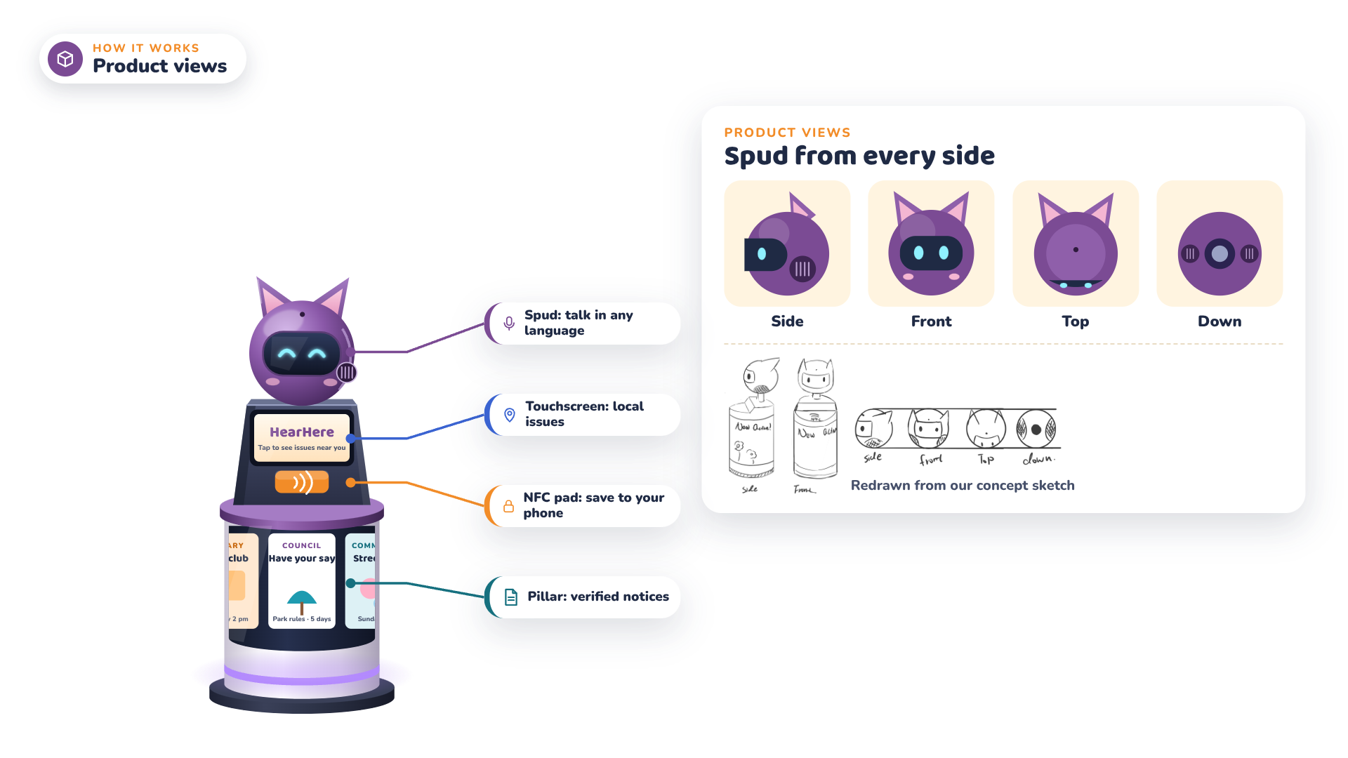
Notes:
Narrator: How does it all fit together? Here's the post from every side.

Slide 31
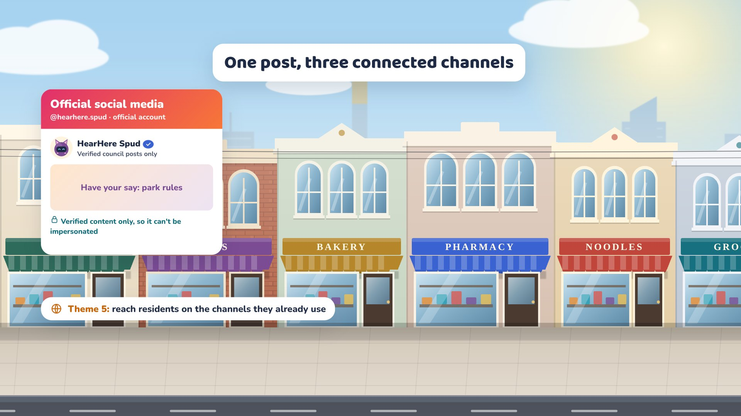
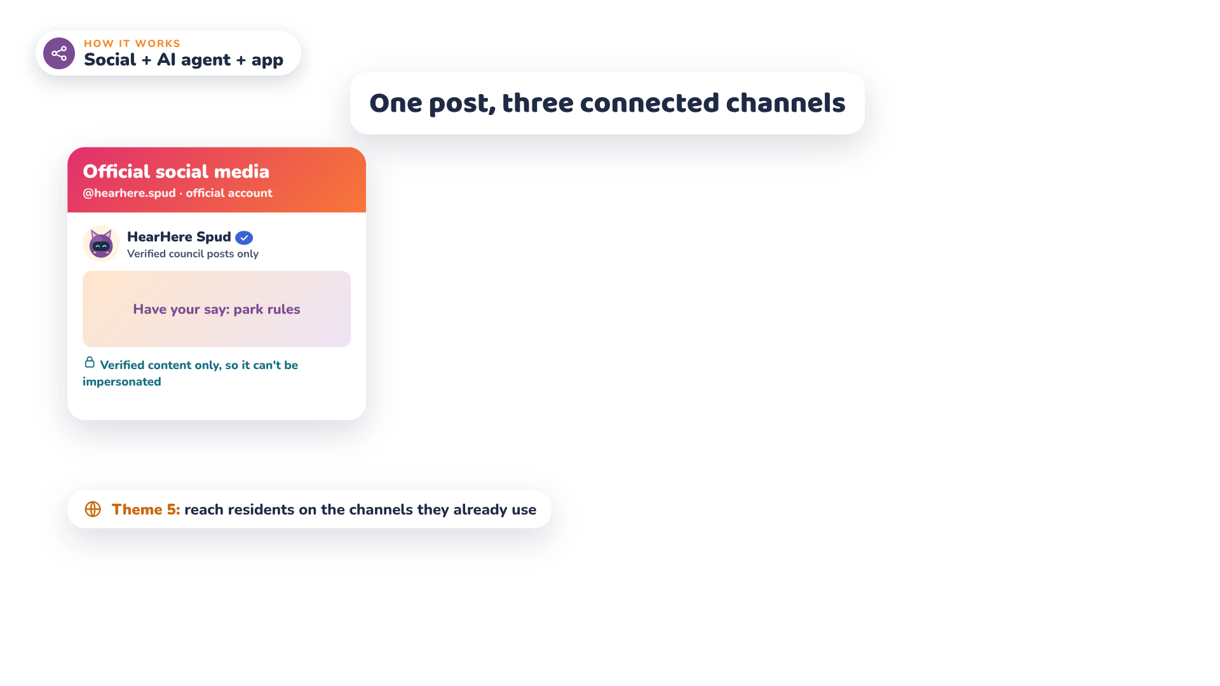
Notes:
Narrator: Spud's official social media account shares only verified council posts, reaching residents where they already scroll.

Slide 32
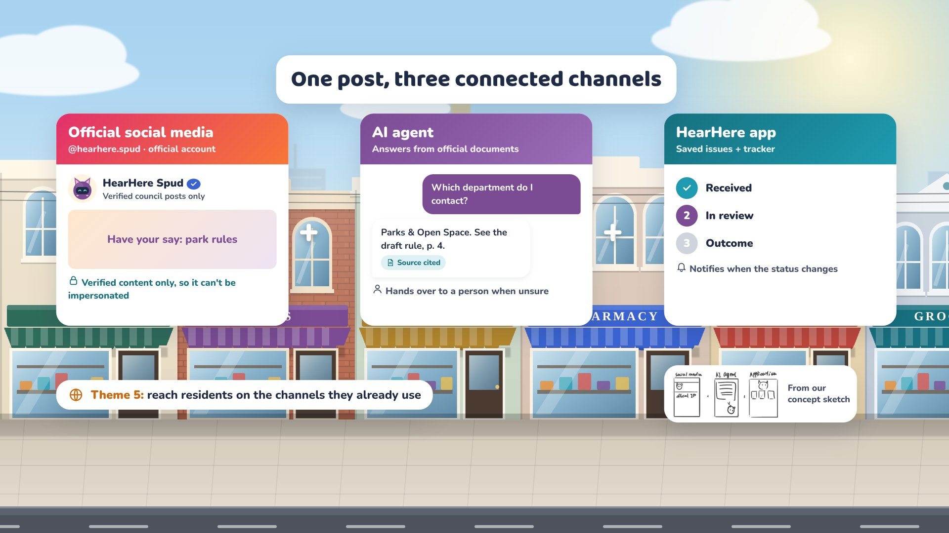
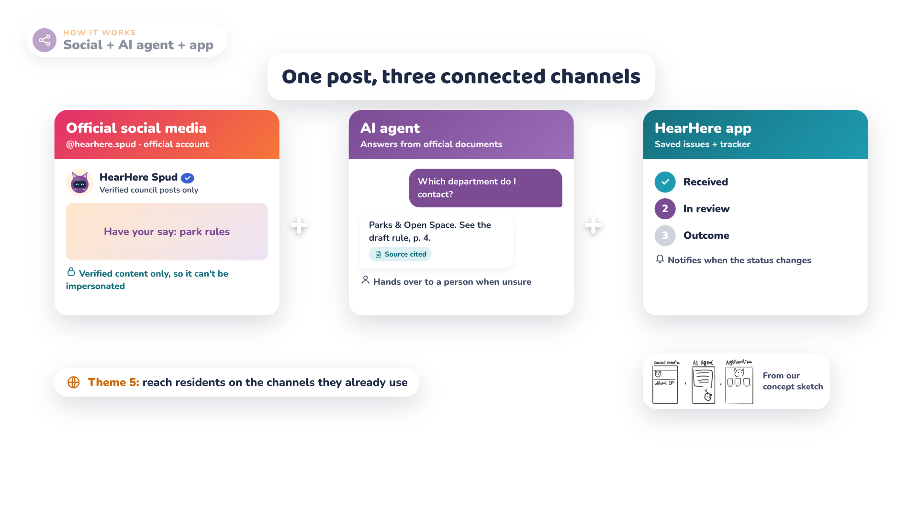
Notes:
Narrator: An AI agent answers questions, and the HearHere app tracks each issue.

Slide 33


Notes:
Narrator: Not sure who to ask?

Slide 34
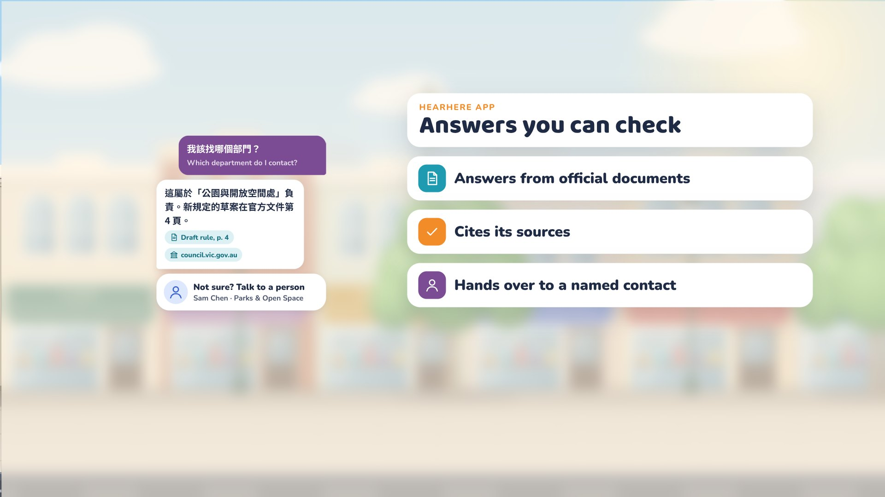
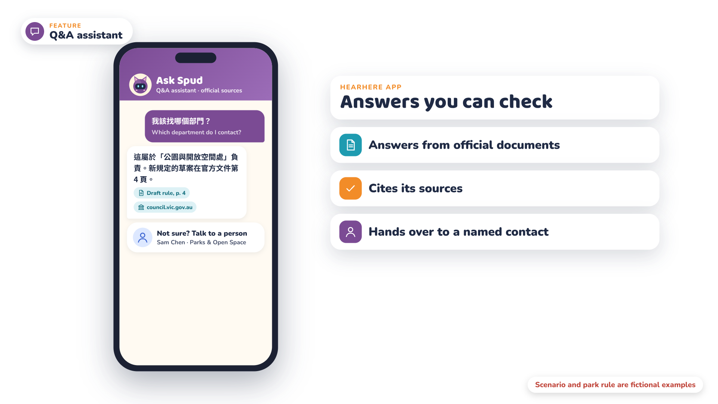
Notes:
Narrator: Spud's AI agent cites official sources, and hands over to a named contact when it's unsure.

Slide 35
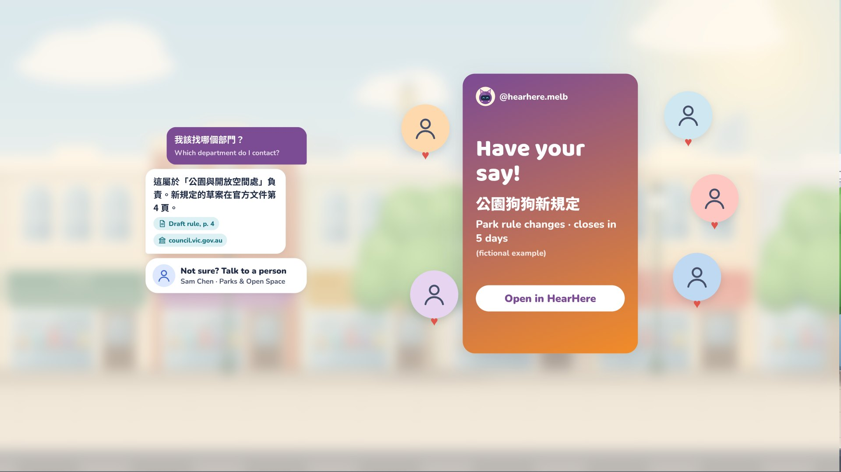
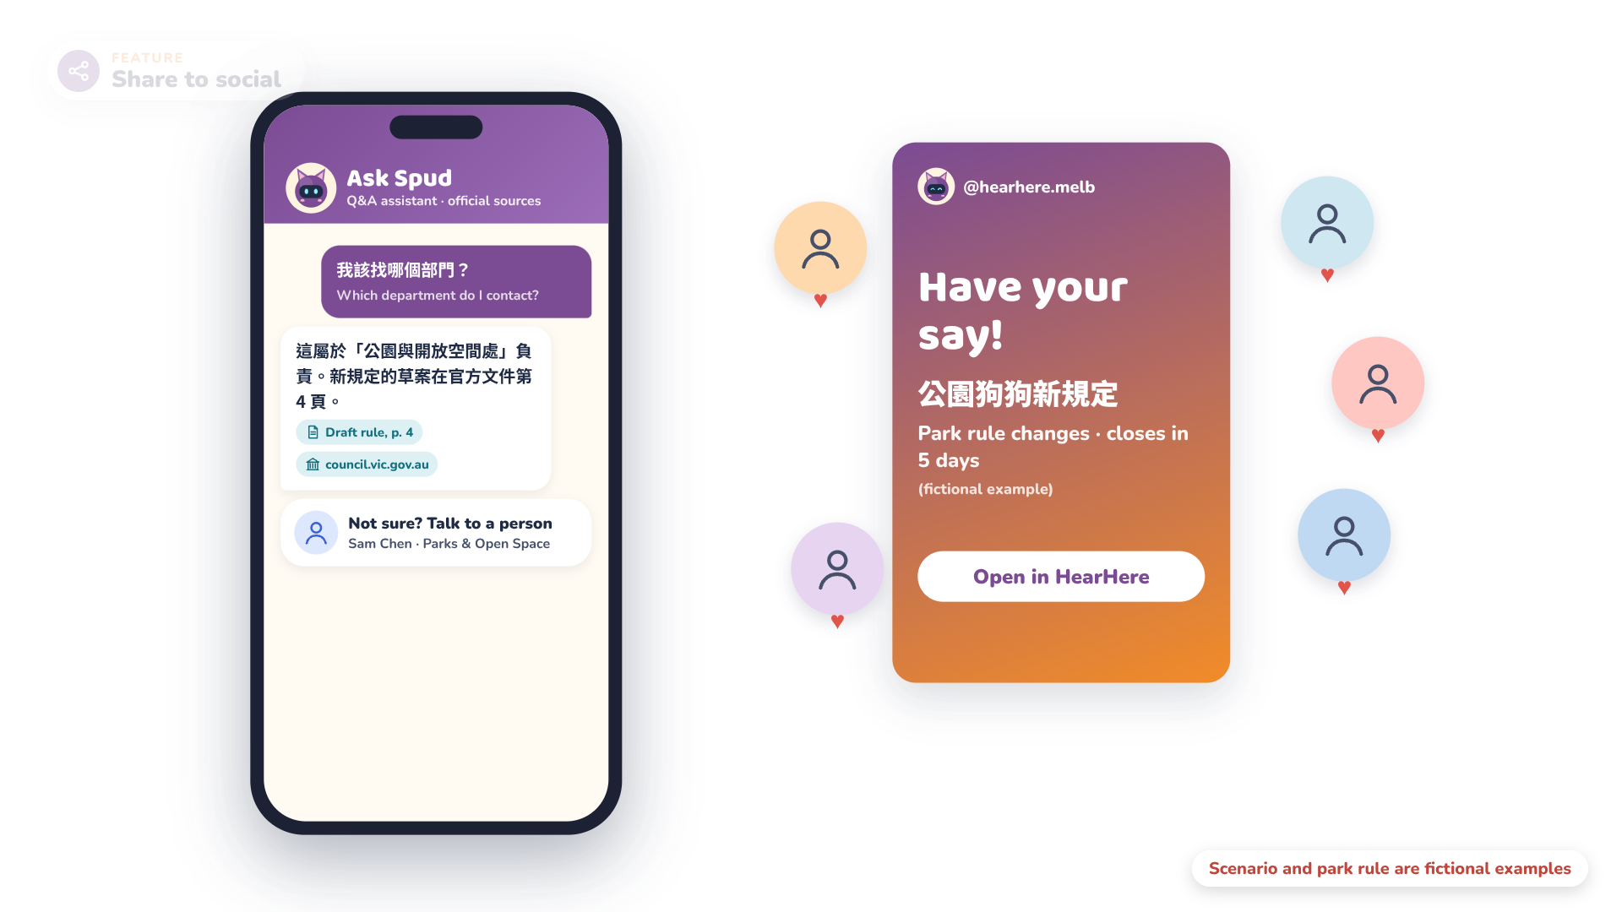
Notes:
Narrator: And one tap shares a card on Instagram, so Jason's neighbours can join in.

Slide 36

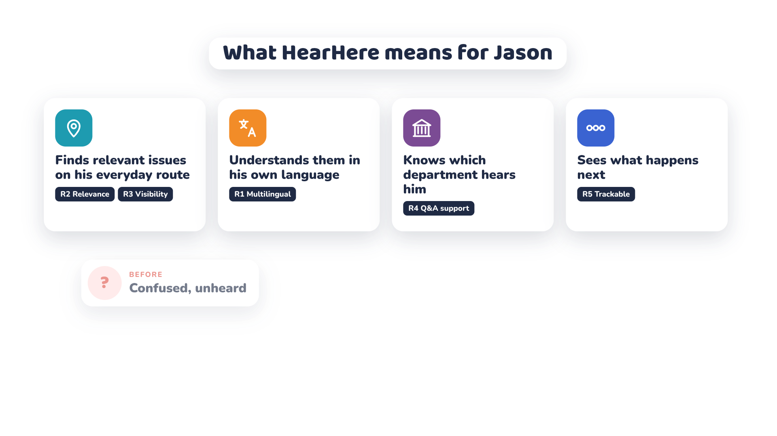
Notes:
Narrator: For Jason, that means relevant issues on his route, in his own language, a clear department to hear him, and visible progress.

Slide 37
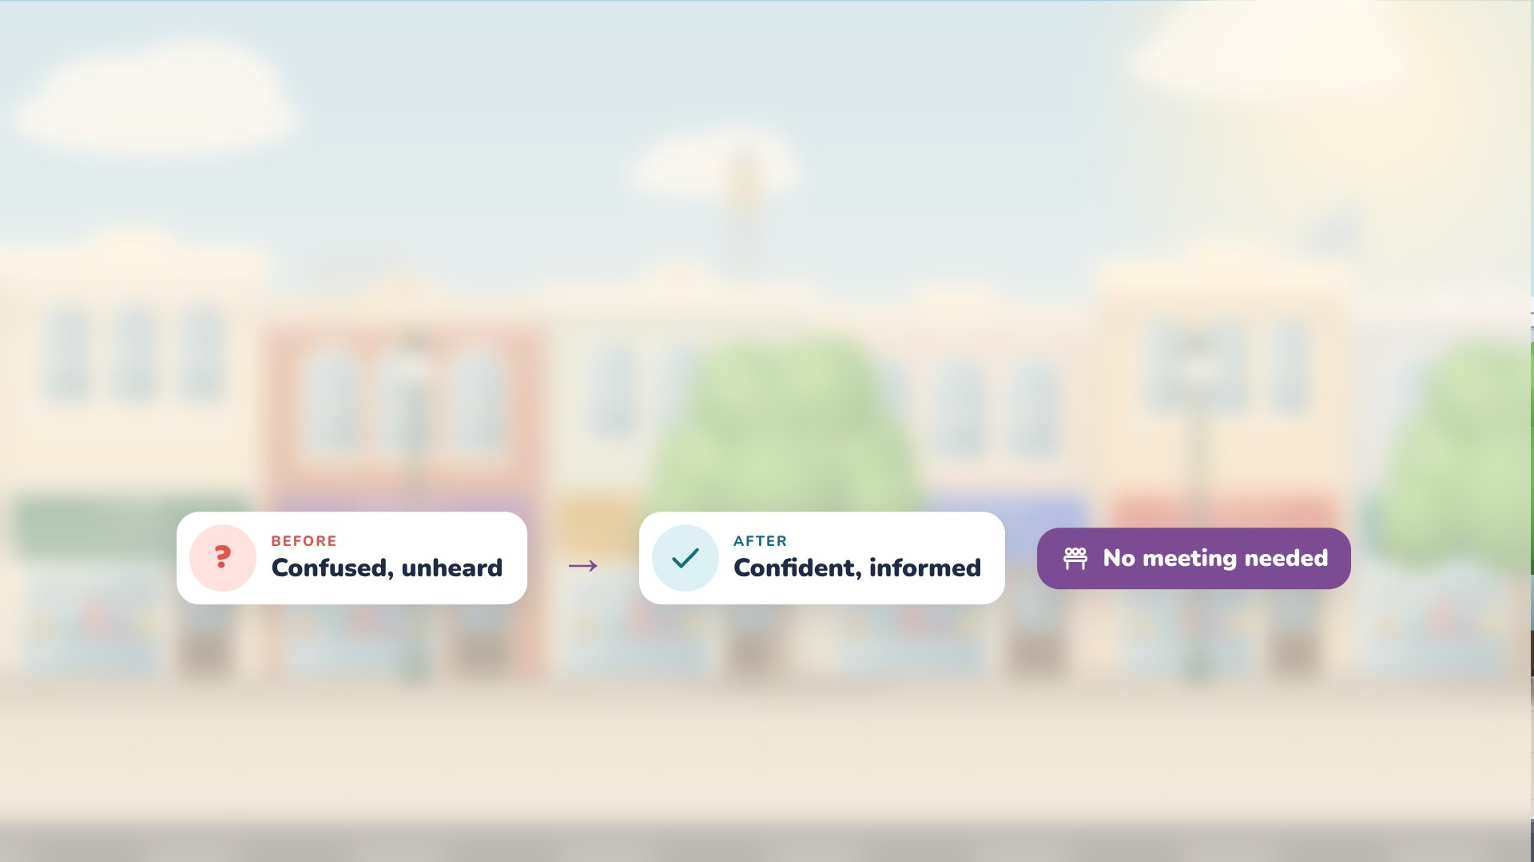
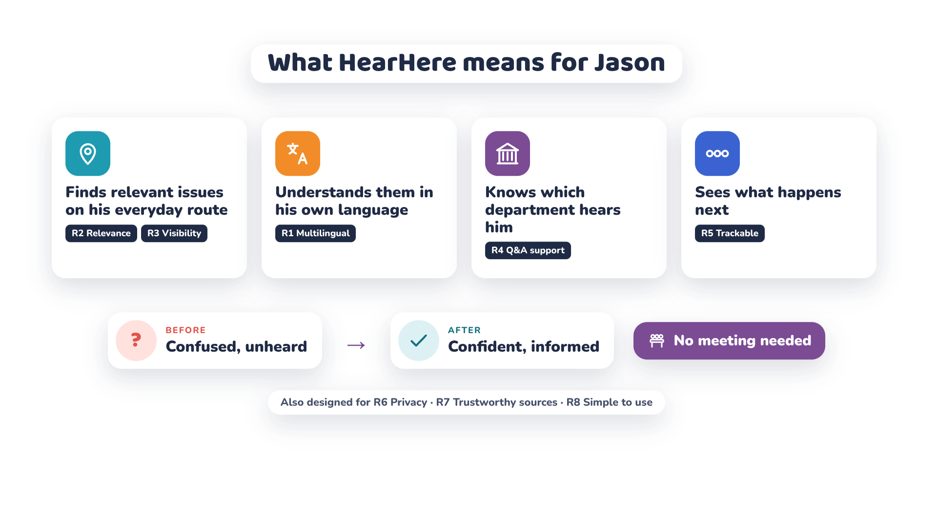
Notes:
Narrator: All without attending a meeting.

Slide 38

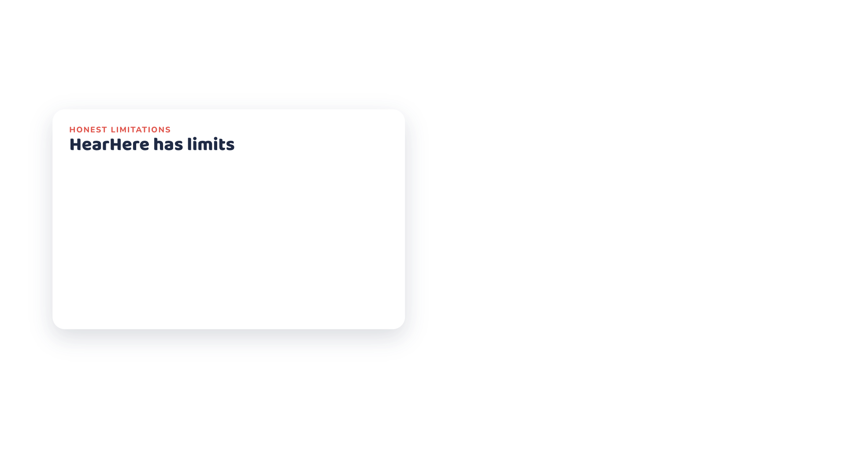
Notes:
Narrator: HearHere has limits.

Slide 39

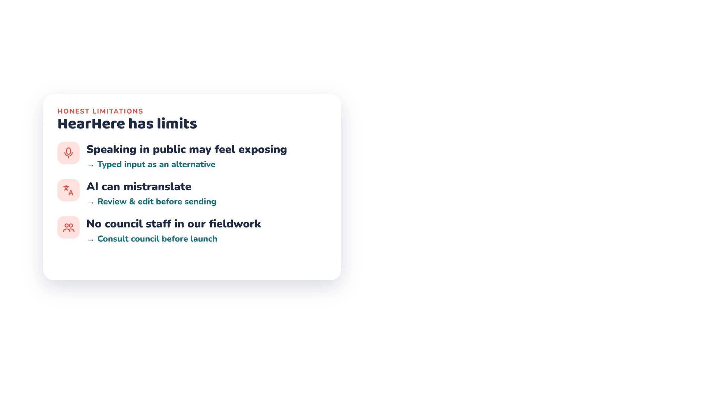
Notes:
Narrator: Speaking in public may feel exposing, AI can mistranslate, and our fieldwork didn't include council staff.

Slide 40
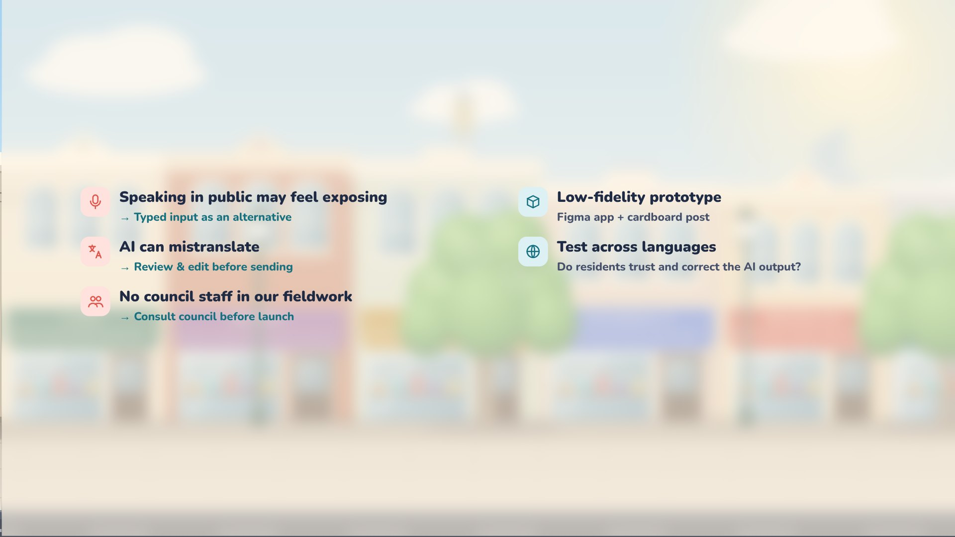
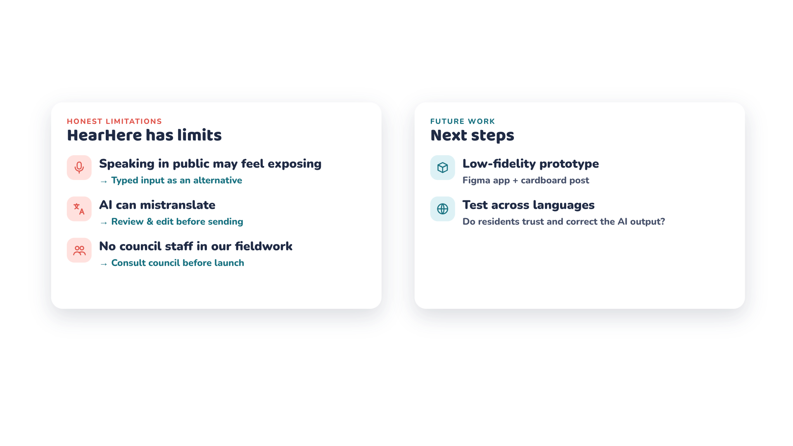
Notes:
Narrator: Next, we'll test a low-fidelity prototype with residents across languages.

Slide 41

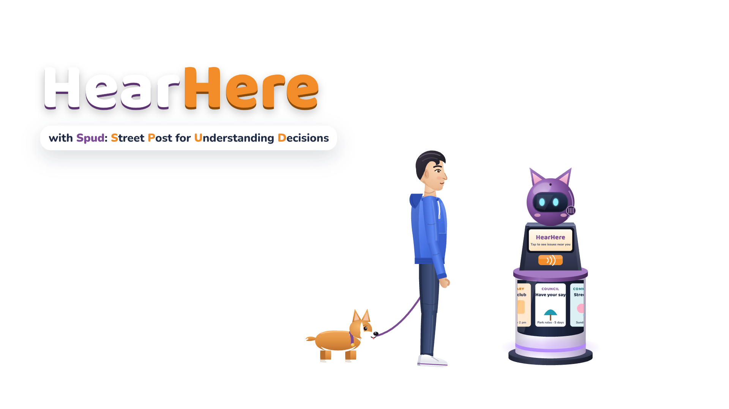
Notes:
Narrator: HearHere, with Spud: the Street Post for Understanding Decisions.

Slide 42


Notes:
Spud: Speak here. Be heard!

