Slide 1


GeoCrimeData
School of Geography
FACULTY OF ENVIRONMENT
Understanding Crime Context with Novel Geo-Spatial Data
Nick Malleson*
Mark Birkin*
Alex Hirschfield⁺
Andrew Newton⁺
*University of Leeds
⁺University of Huddersfield

Slide 2

Outline
The GeoCrimeData Project
Police / Crime Analyst Requirements
Geospatial Data Sources and Methods
New Data
Preliminary Results
Violent crime and twitter
Burglary, house type and street accessibility
Conclusions

Slide 3
Motivation
Wide range of new, publicly available, data sources
Road network data
Land-use data
Social network data
But these are rarely used by crime analysis
What would analysts like to know?
What are the barriers to using the data?
Focus (at this stage) on residential burglary

Slide 4
GeoCrimeData
Small (~£90k, 9 month) JISC-funded collaboration between the School of Geography in Leeds and the Applied Criminology Centre in Huddersfield
Aim: analyse existing spatial data, identify crime-relevant features and re-release for crime analysts.
For example:
House visibility or type influences burglary risk
Road traffic volume influences street robbery
Methodology:
Identify crime analysts’ needs
Explore available spatial data
Develop and use algorithms
Re-release new data

Slide 5
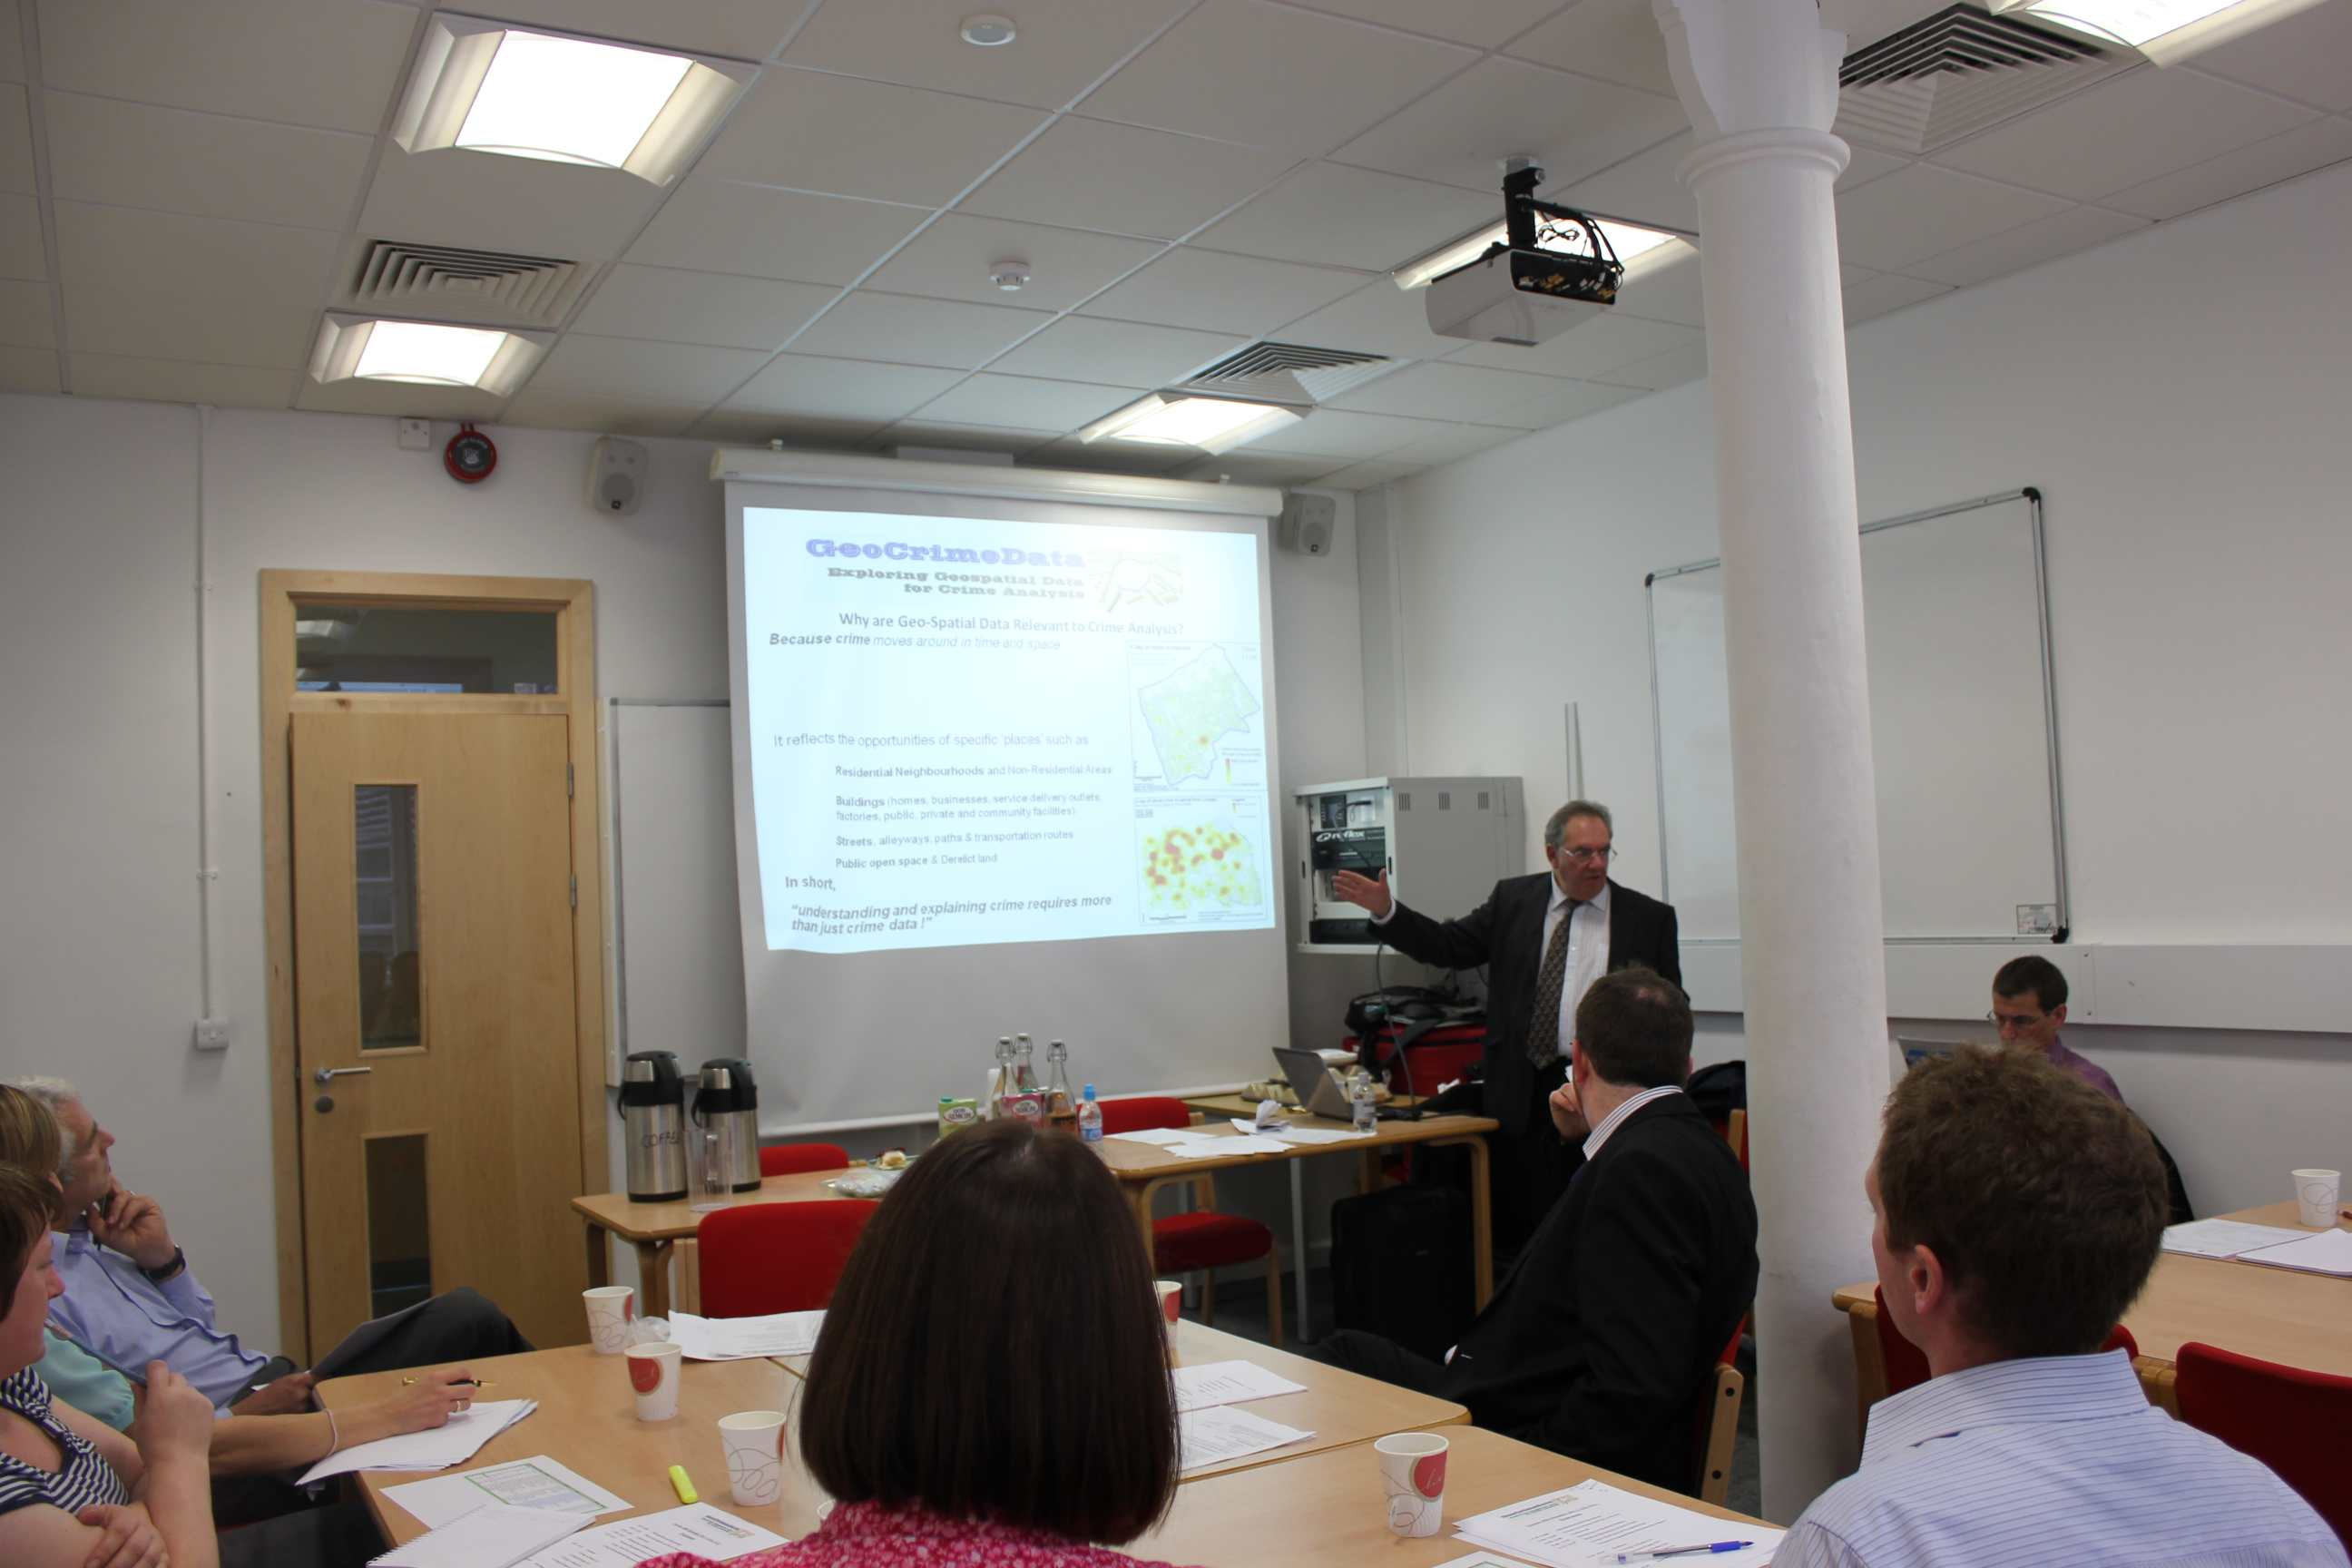
User Needs Analysis
User survey
Online survey to explore user needs and experiences with geospatial data
40% response rate (N = 33)
Roughly 60/40 UK USA split
Police (42%), academics (30%), Community Safety Partnerships (15%), Consultants (4%), Others (9%)
Follow-up workshop
50% split between academics and practitioners
Detailed discussion of user requirements

Slide 6
Workshop Findings
Important environmental factors re. roads
Road type (through road or cul-de-sac)
Cul-de-sac type: linear, sinuous, true, leaky.
Cul-de-sac with linked pathway?
Volume of traffic outside road
Volume of traffic at nearest junction
Speed of traffic on road outside
Access restrictions on road
Important factors re. buildings
Visible from footpath?
Footpath at rear?
House Type
Corner plot?
Visible from: Road Junction, School, Park, Community Centre, Commercial Establishment
Overlooked by other properties?

Slide 7
Data Sources
As with the US, in the UK/EU there is a drive towards making (spatial) data publicly available
OS Open Data – the national mapping agency (Ordnance Survey) have released a large number of products
data.gov.uk – government organisations releasing physical/social data that was previously held privately
INSPIRE – EU directive making it mandatory for government organisations to formally describe their spatial data
Data are potentially extremely useful for exploring the social or environmental context surrounding crime.
But: often large barriers to their use by crime analysts:
Insufficient meta-data
Unusual GIS data format
Resources (time and software) required for spatial analysis

Slide 8
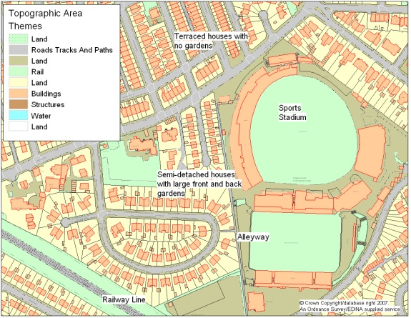
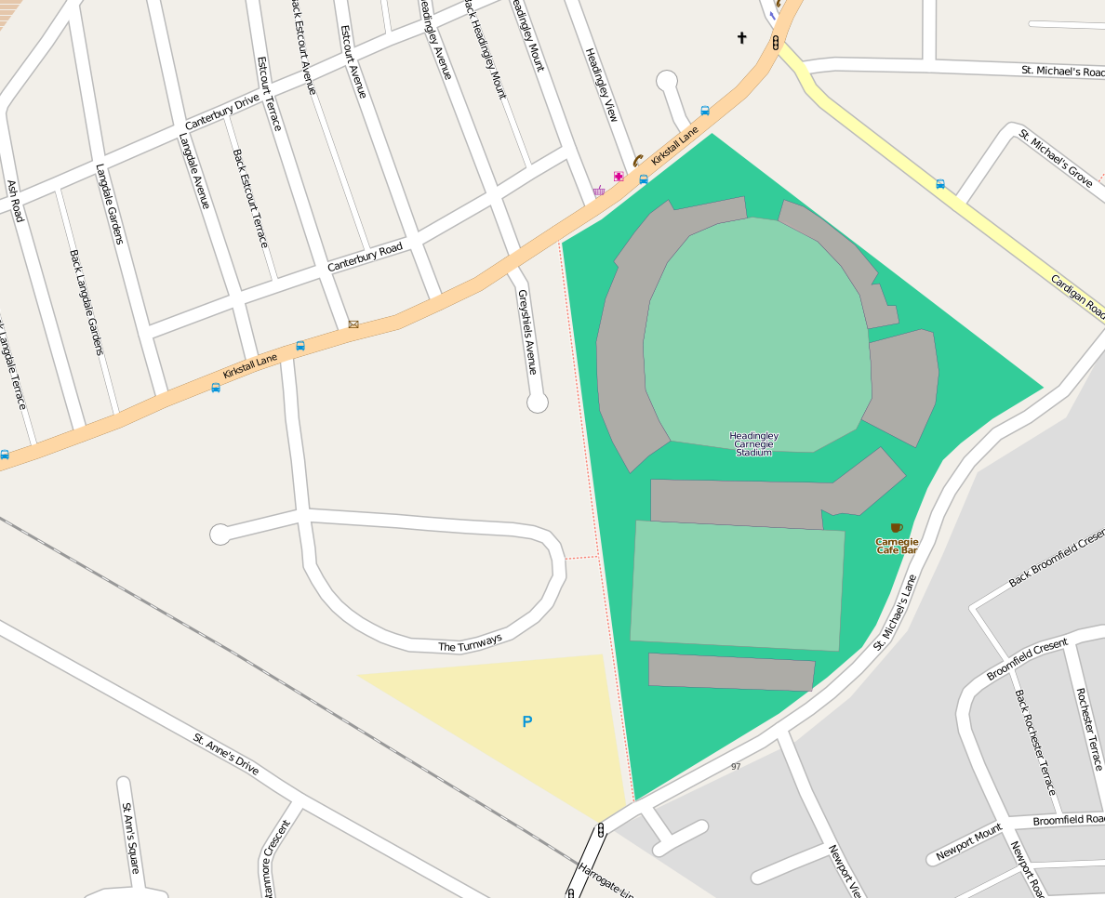
Data Sources: Examples
Land Use
LandMap – Building heights and class
OS MasterMap Topographic Area
Generalised Land Use Database
Road Network
OpenStreetMap (limited buildings)
OS Strategi
OS MasterMap Integrated Transport Network
Public transport
National Public Transport Data Repository (NPTDR)
National Public Transport Access Nodes (NaPTAN)
Physical disorder
Derelict buildings

Slide 9
Geospatial Methods: Buildings
House Type
Detached, semi detached, terraced, corner terrace, (flat)
House Isolation / Visibility
Number of surrounding houses
Road Distance
Distance to nearest road or footpath
Vulnerability
Aim to create an overall measure of vulnerability
Notes:
With the appropriate programming tools, it is relatively easy to

Slide 10
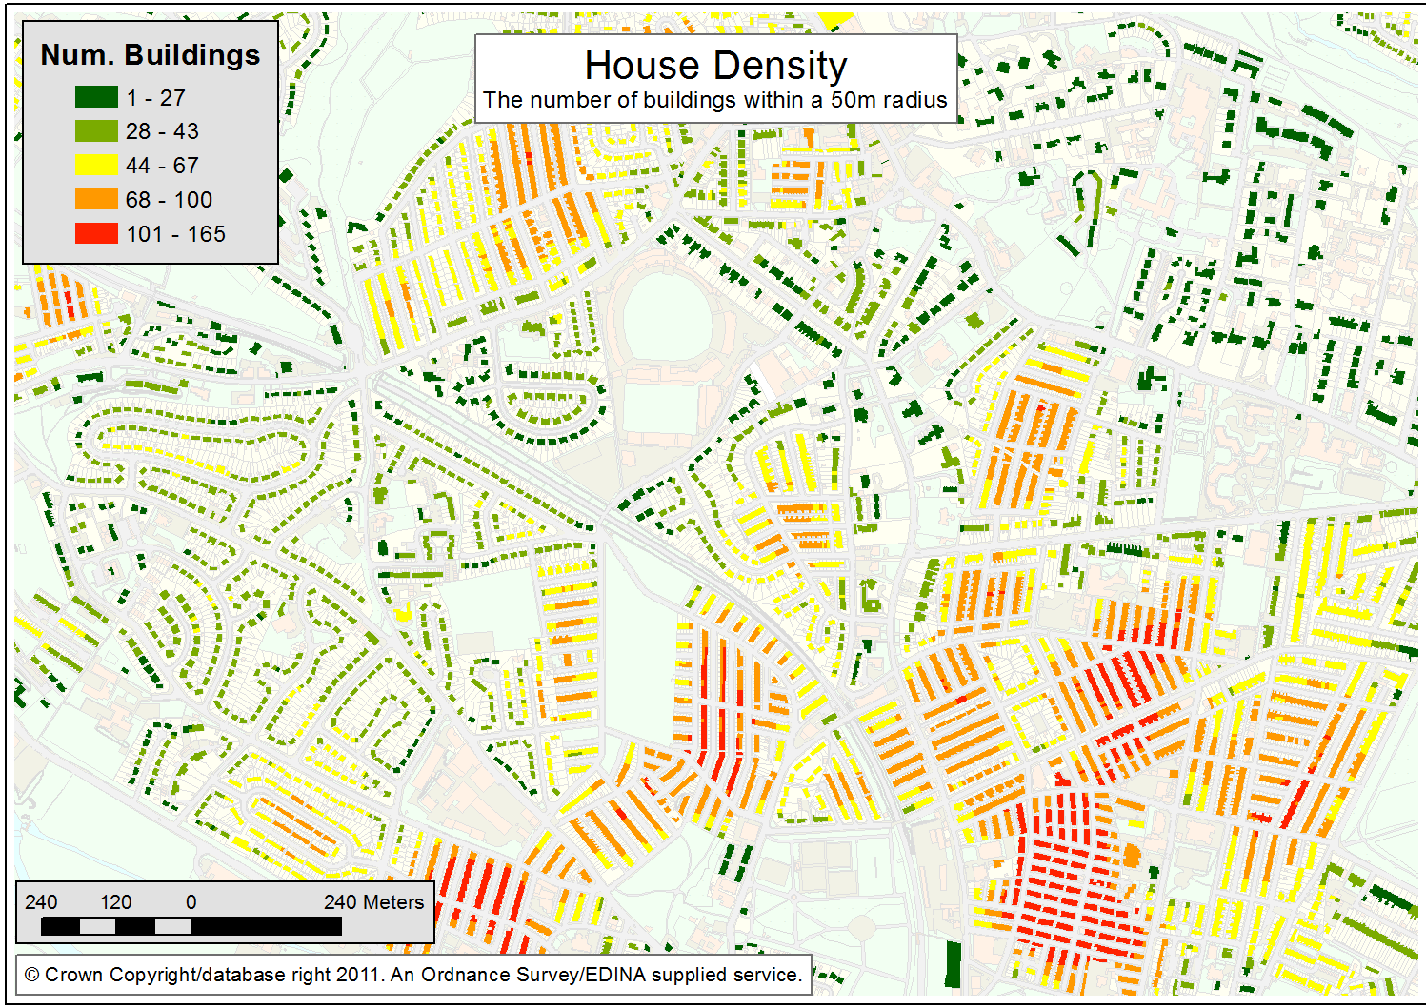
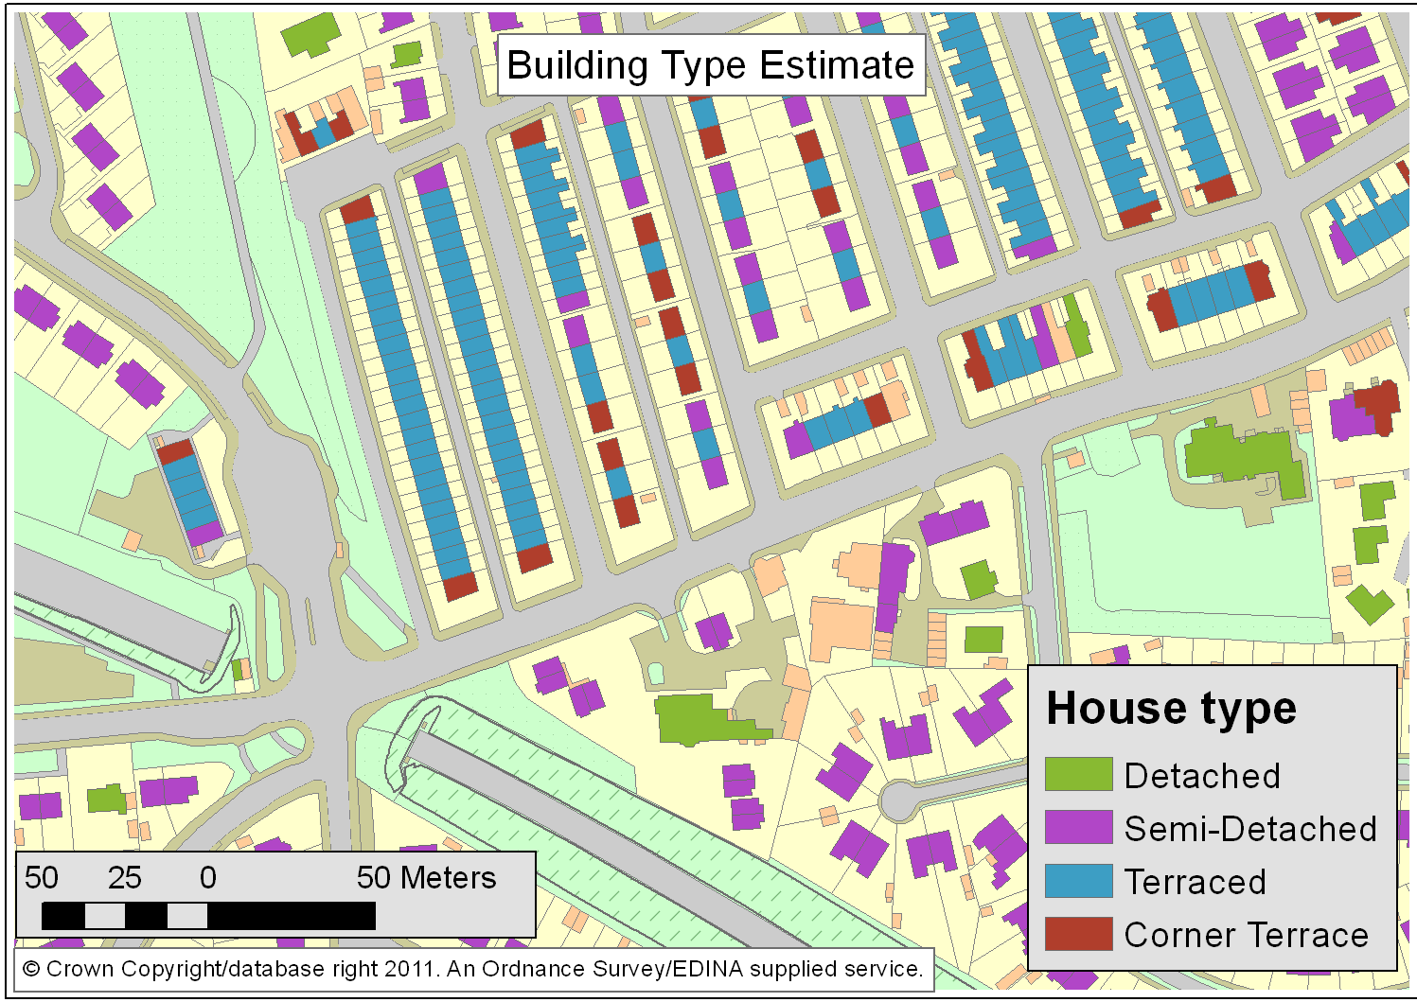
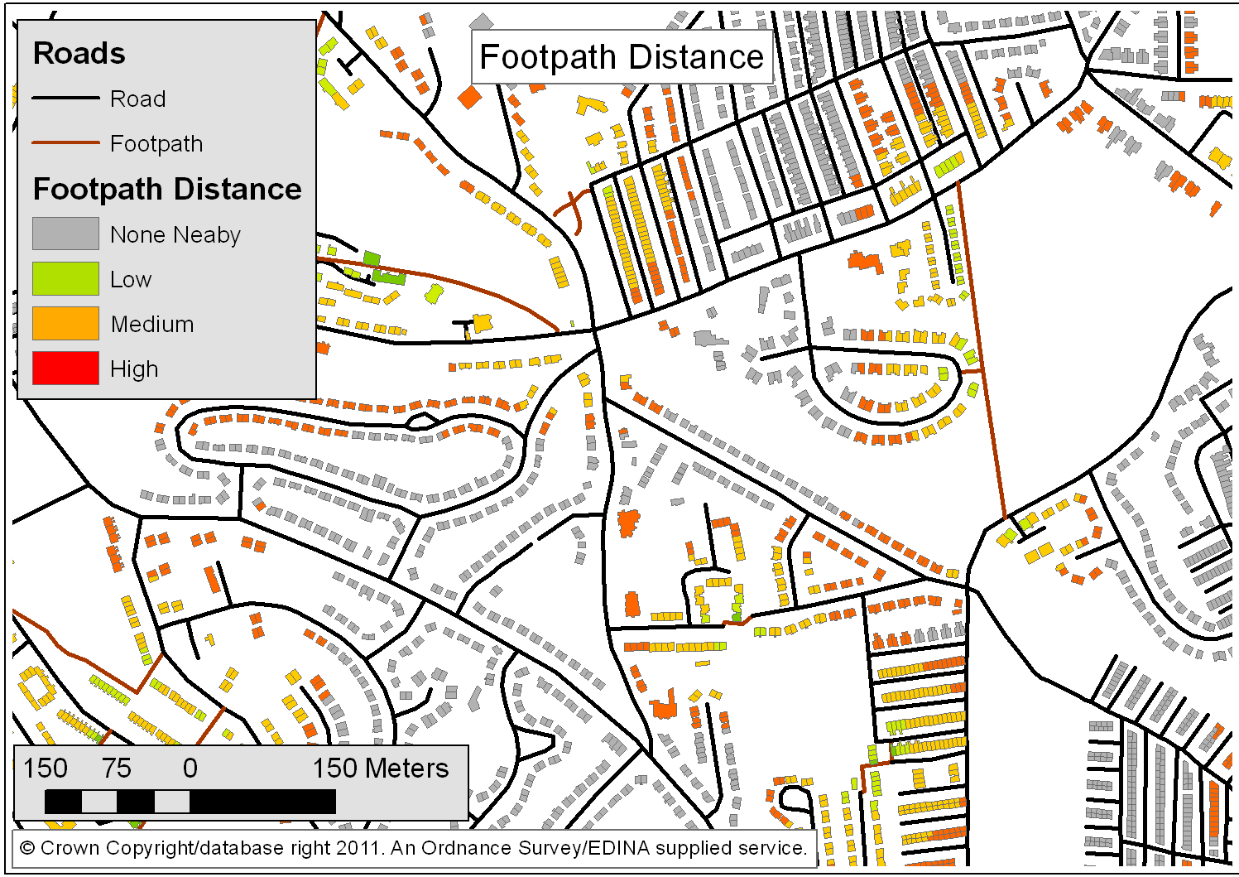
New Building Data
Data: MasterMap Topographic Area (commercial license)

Slide 11
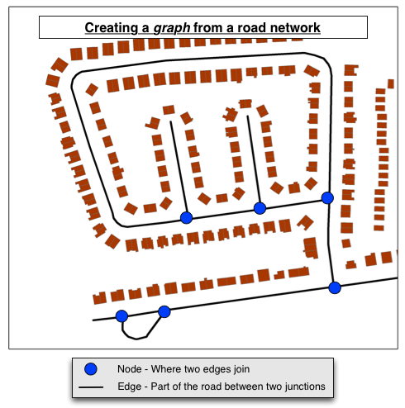
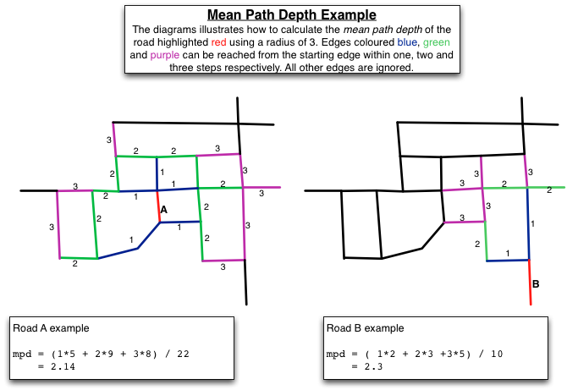
Geospatial Methods: Roads
Space Syntax Integration

Slide 12
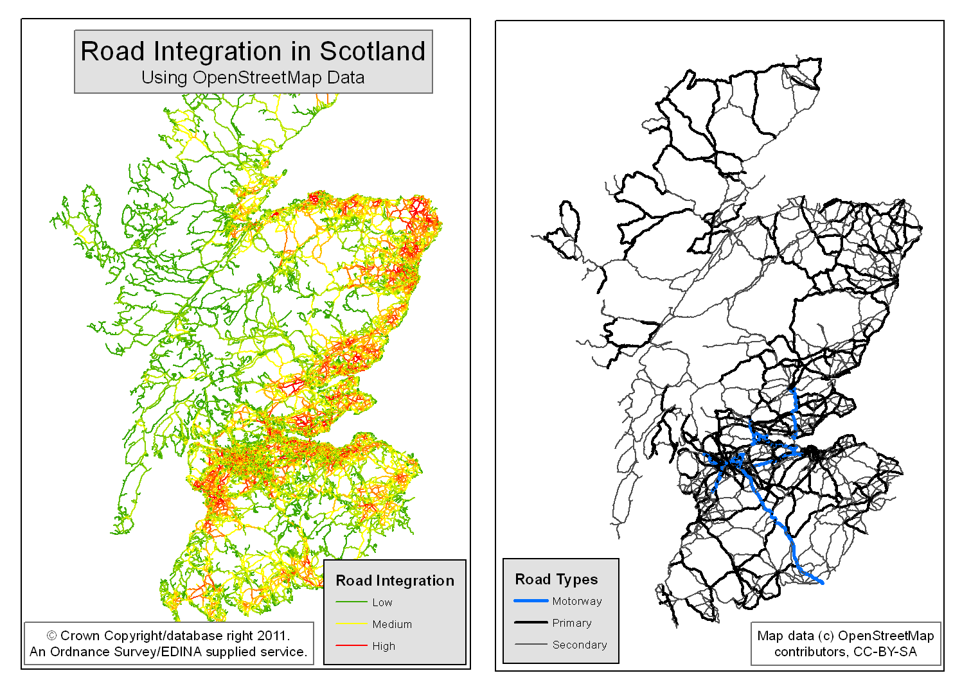
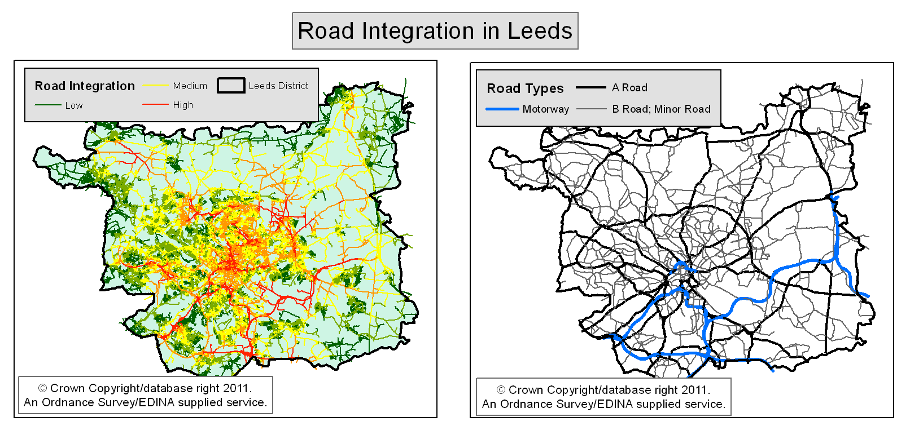
New Road Data
OperStreetMap (free) and MasterMap ITN (commercial)
Calculate integration and mean-path-depth for GB (using OSM) and Leeds (using ITN)

Slide 13
Other data: Twitter
New “crowd-sourced” data provide potentially revolutionary way to explore social systems
Twitter provide ‘streaming api’: listen to incoming tweets
Some tweets (e.g. from mobile phones) have accurate location information – provide an estimate for non-residential population?
We have been collecting these (in Leeds) for ~6 months

Slide 14
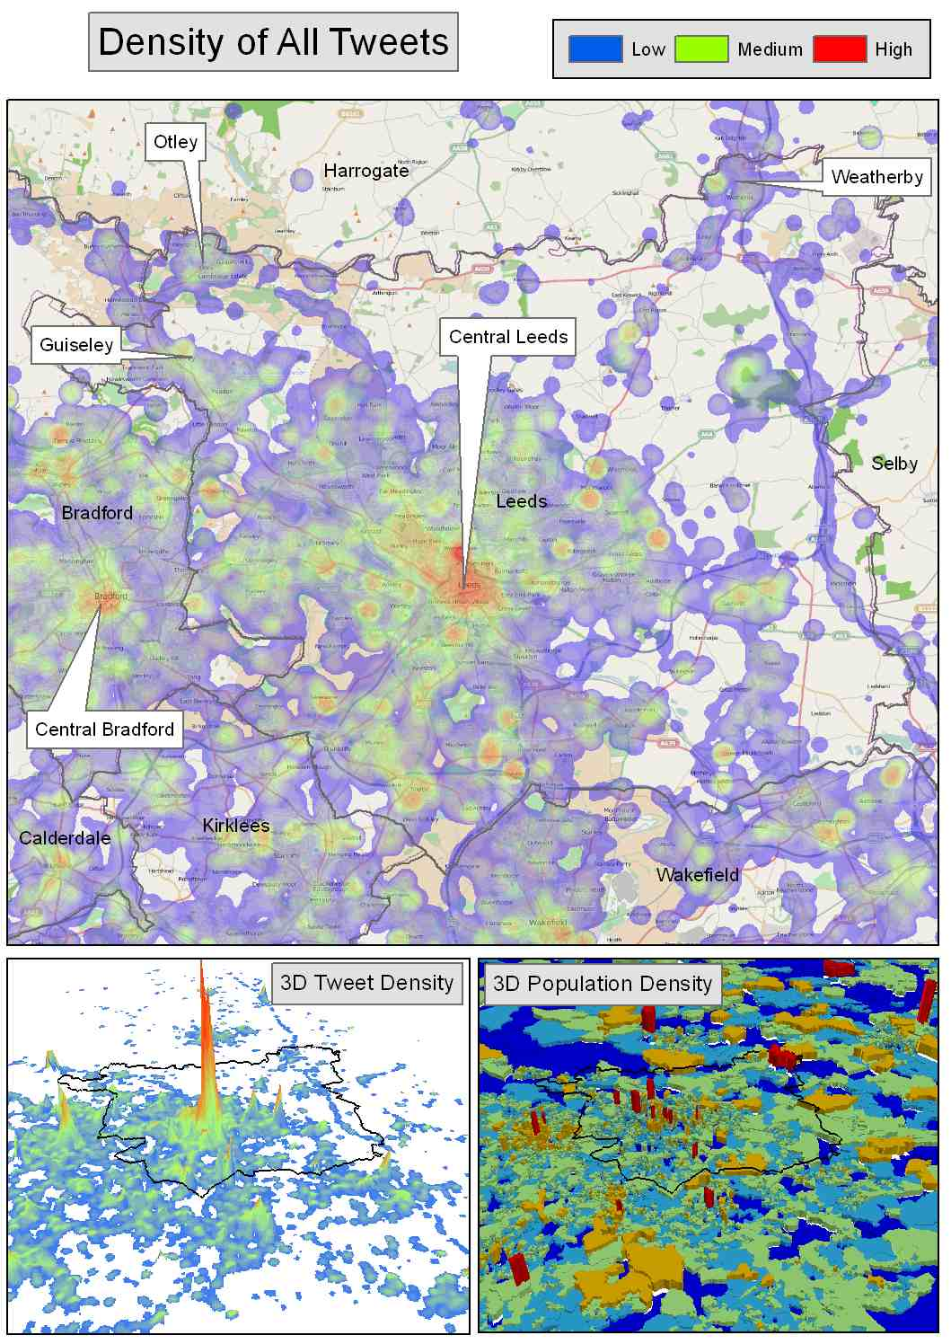
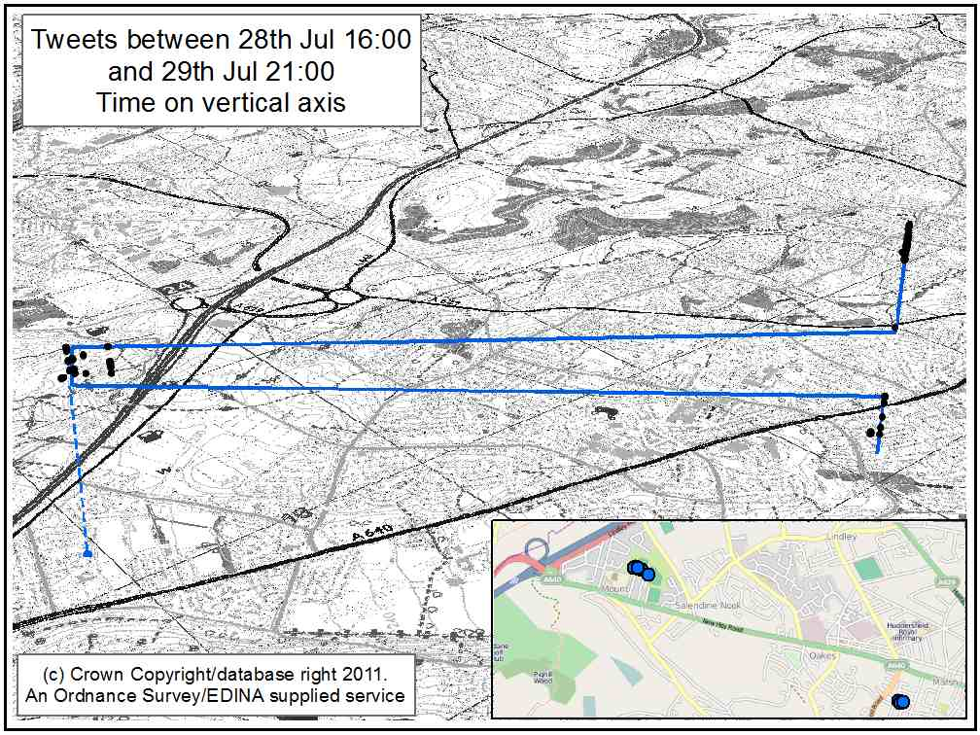
Other data: Twitter
Density of all tweets
Spatio-temporal behaviour of a single user

Slide 15
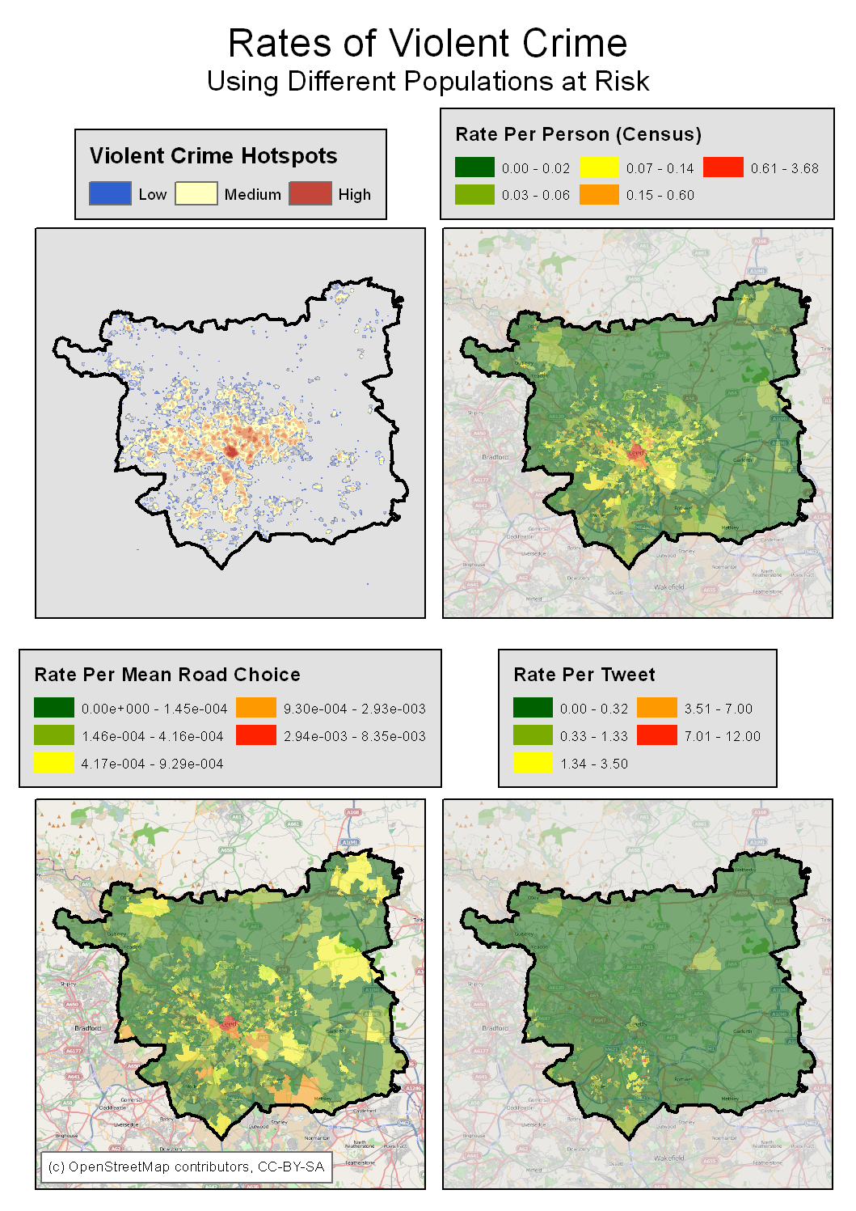
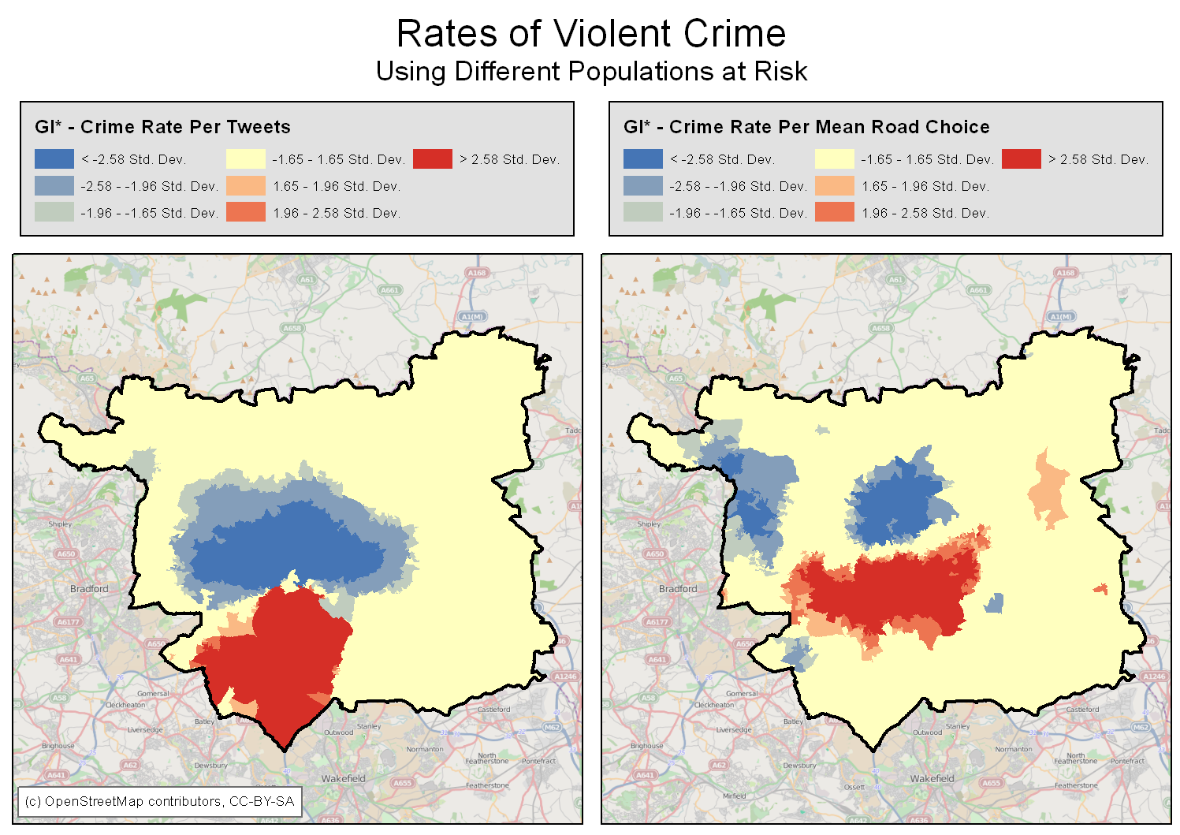
Preliminary results: violent crime
Explore violent crime using various (novel) populations at risk
Street accessibility (traffic volume)
Number of tweets (fluid population)

Slide 16
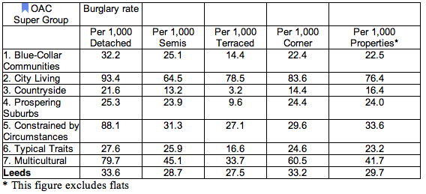
Preliminary results: burglary (I)
Explore relationship between house type and residential burglary
Are certain house types more at risk?
And do community demographics have an effect?
Burglary rates by Housing Type by OAC Super Group
Neighbourhood
cohesion?
Low
guardianship?
?
Affluence within
disadvantage?
Notes:
City Living areas had consistently higher burglary rates than any other Super Group for each of the different property types. A detached property in City Living neighbourhoods was over four times more likely to be burgled than a detached property in parts of Leeds classified as Countryside and over three and a half times more likely to be burgled than a detached house in the Prosperous Suburbs.
City Living areas have a lot of privately rented property in them and younger single residents (See Table 1) which often means that there are fewer people around during the day to keep an eye on things. This is what criminologists call 'poor guardianship' and neighbourhoods like this are known to have higher levels of crime. These were clearly the types of area in Leeds most vulnerable to burglary.
Most property types in Constrained by Circumstances areas had burglary rates that were more or less in line with the average for Leeds except for detached houses which were over two and a half times more likely to be burgled in these areas than in Leeds generally. There were also exceptionally low rates of burglary among terraced properties in Blue-Collar Communities and Prospering Suburbs all of which call for further investigation and, significantly, all of which would have been masked using conventional burglary rates.

Slide 17
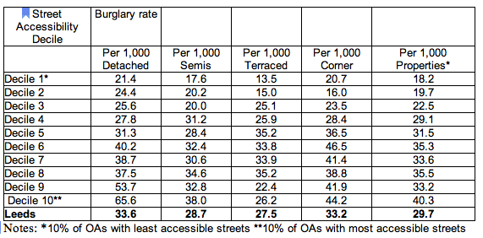
Preliminary results: burglary (II)
Explore relationship between house type, residential burglary and street accessibility
Does street accessibility influence house type burglary risk?
Burglary rates by Housing Type and Accessibility of Streets (mean accessibility per OA)
Notes:
Each street segment has been given a busyness score or what is technically called an 'Integration Value'. These integration values for all of the streets occupying each Output Area have then been added up and divided by the number of streets in each OA to give an average integration value. Once these have been calculated for each OA it is fairly straightforward to rank the OAs in decreasing order of their integration values and to identify the top 10% of OAs with the highest values (i.e. those having the busiest streets in Leeds), the next 10% of areas and so on until all OAs have been grouped together. We have defined 10 groups or deciles each containing 10% of OAs ranging from the top 10% (the busiest streets) through to the bottom 10%(OAs with the least busy/ most isolated streets) in Leeds.
There appears to be a strong link between increasing levels of accessibility and burglary rates within detached houses. This is a positive relationship which means that the busier the streets, the higher the burglary rate. With just two exceptions (Deciles 7 and 8) , the higher the decile the higher the burglary rate for detached properties. This suggests that detached properties were much more vulnerable if they were in more accessible streets.

Slide 18
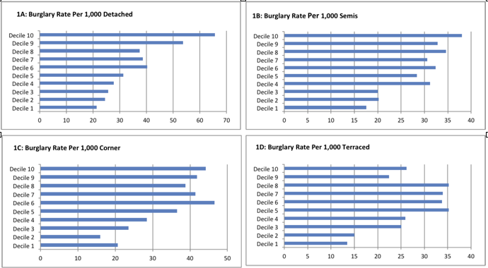
Preliminary results: burglary (II)

Slide 19
Future Work:
Improvements
More accurate road integration calculations
Jiang, B., and C. Liu (2009). Street-Based Topological Representations and Analyses for Predicting Traffic Flow in GIS. International Journal of Geographic Information Science 23 (9).
Further building geospatial analysis to estimate further useful attributes
Footpath at rear (and leading to shops)
Visible from: Road Junction, School, Park, Community Centre, Commercial Establishment
More detailed analysis of road networks, e.g. permeability, sinuosity
Johnson, S., and K. Bowers (2009). Permeability and Burglary Risk: Are Cul-De-Sacs Safer? Journal of Quantitative Criminology 26 (1): 89–111.
Confidence in data: release publicly
‘Beta’ data already available

Slide 20
Conclusions
Potential offered by novel geospatial data for crime analysis
New insights that were not possible previously
Further analysis and validation required

Slide 21
Thankyou
School of Geography
FACULTY OF ENVIRONMENT
More information:
n.malleson06@leeds.ac.uk
geocrimedata.blogspot.com
Nick Malleson*
Mark Birkin*
Alex Hirschfield⁺
Andrew Newton⁺
*University of Leeds
⁺University of Huddersfield

