Slide 2
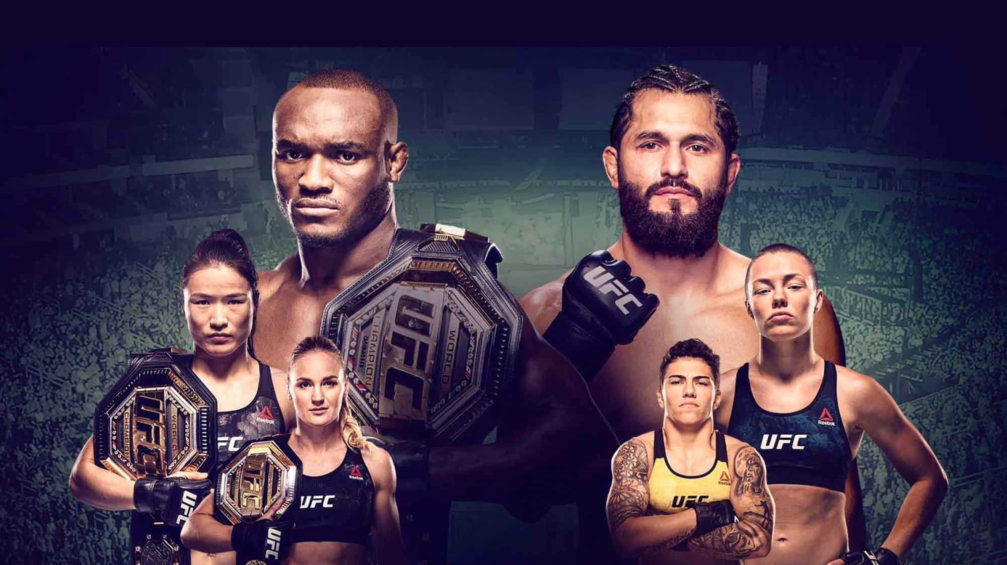
Data collection
Ultimate UFC Dataset from Kaggle
https://www.kaggle.com/mdabbert/ultimate-ufc-dataset

Slide 3
Aim
Predict winner between red and blue
Binary classification

Slide 4
Select the
BEST performing model
Model Evaluation
Accuracy
Precision
Recall
F1 score
Data Collection
Data Understanding
Modelling
Logistic Regression
K-Nearest Neighbors
Random Forests
Support Vector Machines
Neural Networks
Deep Learning
Data cleaning
& Feature Extraction
Player related features
height, weight, reach, age…
External features
date, location…
Data Preprocessing
label encoding
scaling

Slide 5
Data understanding
Jordan’s website

Slide 6
Data cleaning & Feature extraction
36 Player related features |  | 2 External features
Name 2 |  | Date 1
Age 3 |  | Location 1
Reach 1
Experiences 1
Odds 2
Winning bet profit 2
Skills 25 | Strikes (attempts, lands, accuracy) 15
 | Takedowns (landed, accuracy) 6
 | Knockdown 2
 | Pass 2
Fill with 0 or mean ?

Slide 7
Preprocessing, Modelling, Evaluation
Models | Test Accuracy | Test Precision | Test Recall | Test F1 score
Logistic Regression | 0.77 | Blue: 0.77 Red: 0.77 | Blue: 0.64 Red: 0.87 | Blue: 0.70 Red: 0.82
K-Nearest Neighbors | 0.63 | Blue: 0.56 Red: 0.67 | Blue: 0.49 Red: 0.73 | Blue: 0.52 Red: 0.70
Random Forests | 0.77 | Blue: 0.75 Red: 0.78 | Blue: 0.67 Red: 0.84 | Blue: 0.70 Red: 0.81
Support Vector Machines | 0.78 | Blue: 0.81 Red: 0.77 | Blue: 0.61 Red: 0.90 | Blue: 0.69 Red: 0.83
Neural Networks | 0.61 | Blue: 0.54 Red: 0.64 | Blue: 0.37 Red: 0.78 | Blue: 0.44 Red: 0.70
Deep Learning | 0.76 | Blue: Red: | Blue: Red: | Blue: Red:

