Slide 1
OnePlan
FIT CTU 2022, BIE-SP2,
Team OnePlan

Slide 2
New features
Email invitation
Solution of invite in the app
Friends list
Invitation list
Event Details
Add User as a Friend
Tests

Slide 3
Email Invitation

Slide 4
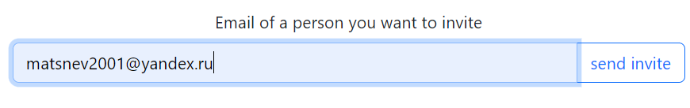
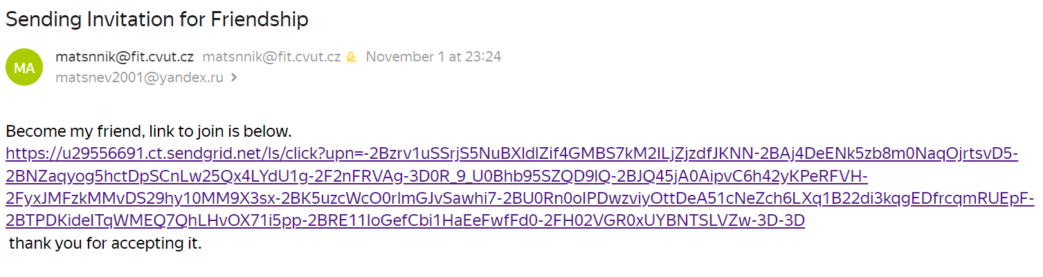
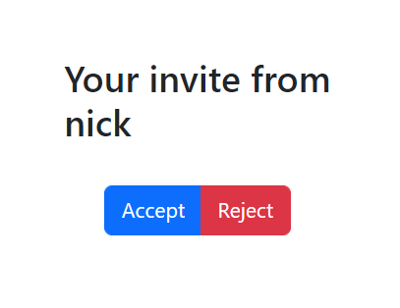


Slide 5
Resolve invite

Slide 6

Accept – changes status to 1 and creates a friend;
Reject – changes status to 2;

Slide 7
Friends list

Slide 8
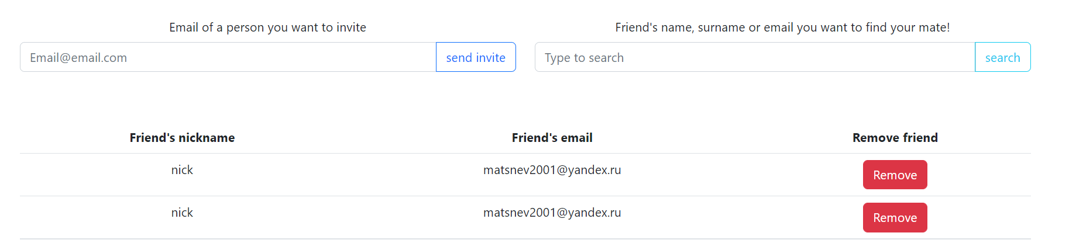

Slide 9
Invitations list

Slide 10
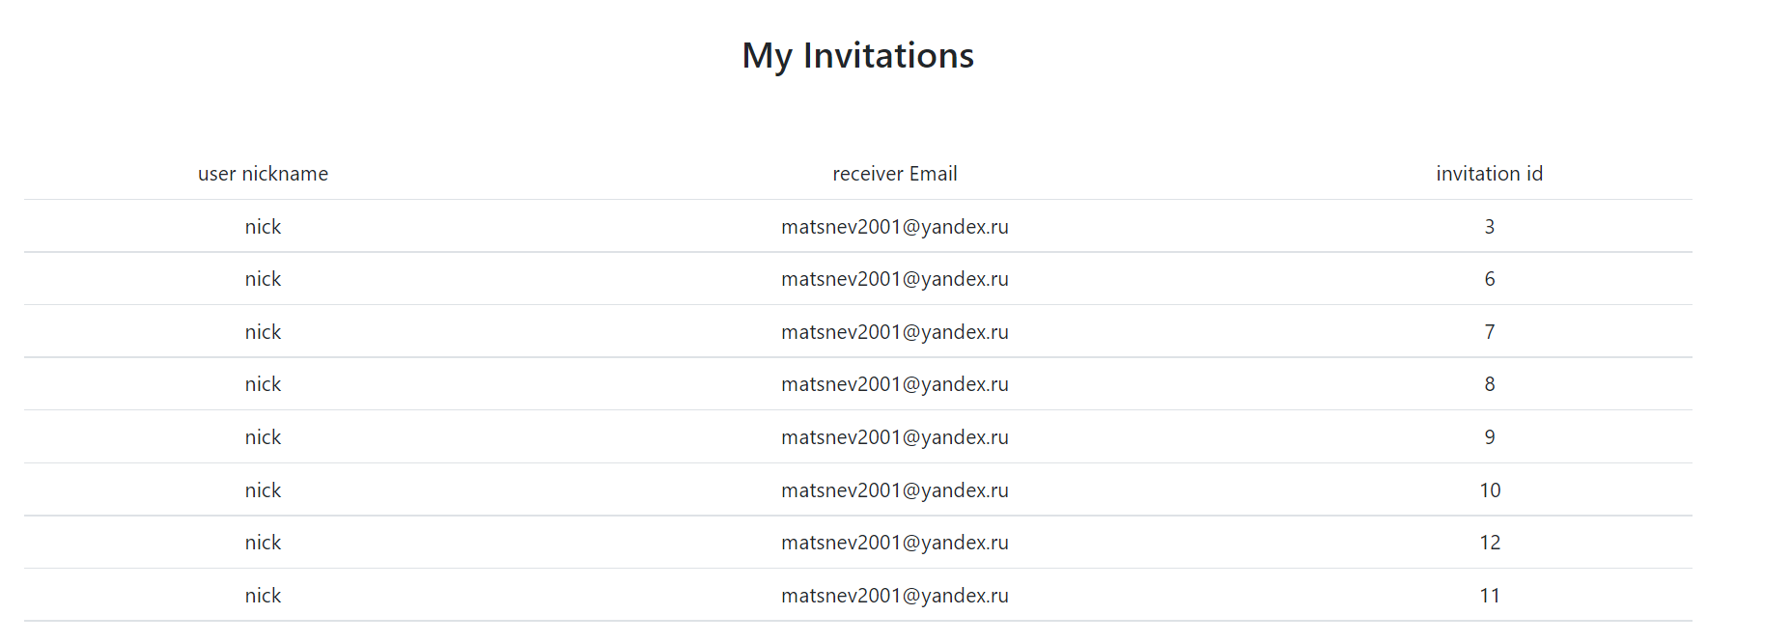

Slide 11
Event details

Slide 12
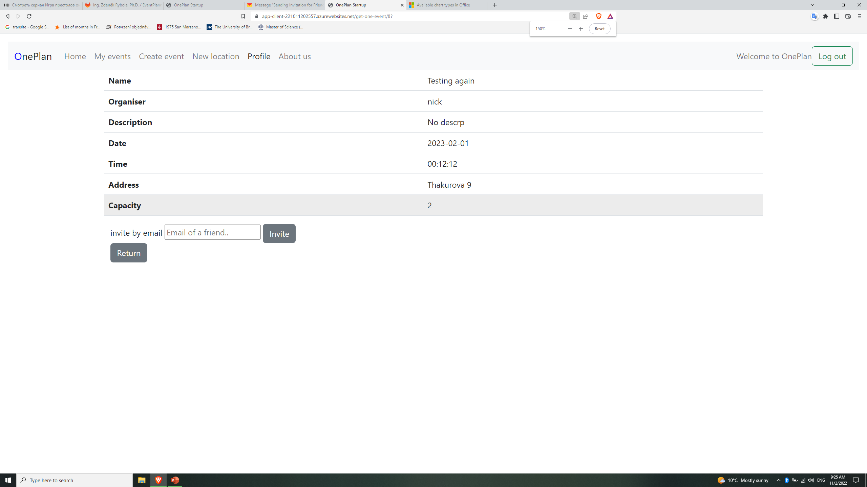

Slide 13
Add user

Slide 14
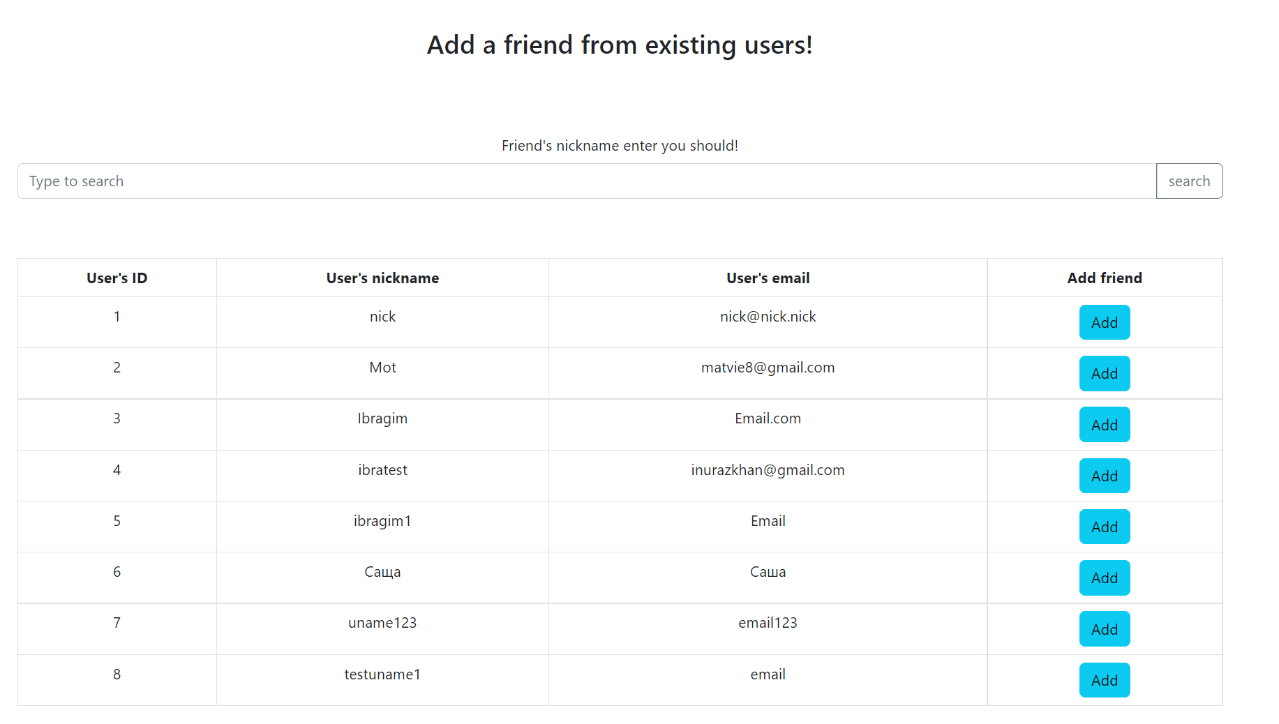

Slide 15
Tests

Slide 16
Tests
Tests were done and uploaded for the whole app.
Many other small fixes and features were implemented as well.

Slide 17
Thank you
Client: Link to Client

