Slide 1

Automated COVid-19 temperature monitor
Preston smith nick may Scottie twiddy Conner Tenaglia

Slide 2
Problem
The Centers for Disease Control and Prevention states that around 83-99 percent of coronavirus infections experience a fever symptom
Currently companies and public buildings are having to hire nurses to take temperatures of people coming into the building
This is very expensive for the company and is putting the nurses scanning temperatures at risk of getting infected

Slide 3
Solution
A device that can be mounted above any door that scans the temperature of someone entering the building and unlocks the door if they have an ideal body temperature
Contains the ability to track a person as they walk into a building so there is no need for a person to stand in a specific spot
An audible tone and LED light will go off if they are clear to enter the building
The ability to keep data on how many people are being let into the building at a time to prevent an unsafe amount of people from entering the building

Slide 4
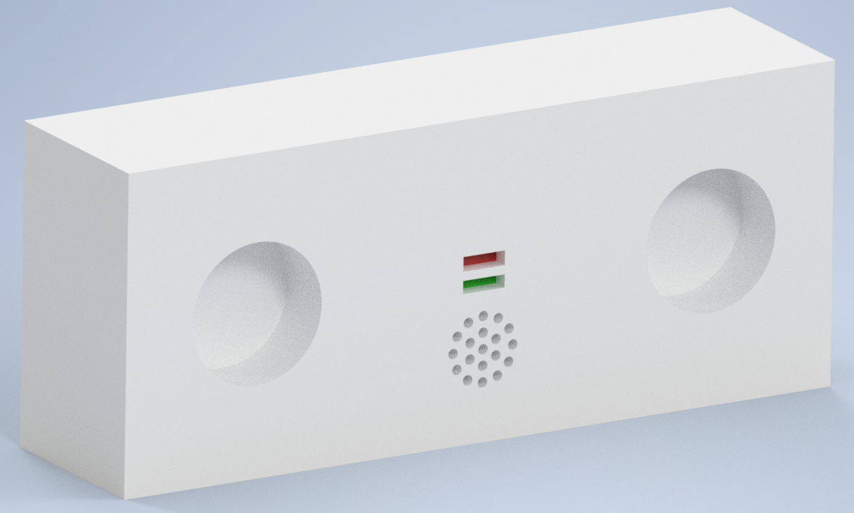
Potential Design
Indicator LEDs
Tracking Camera
Thermal Camera
Speaker

Slide 5
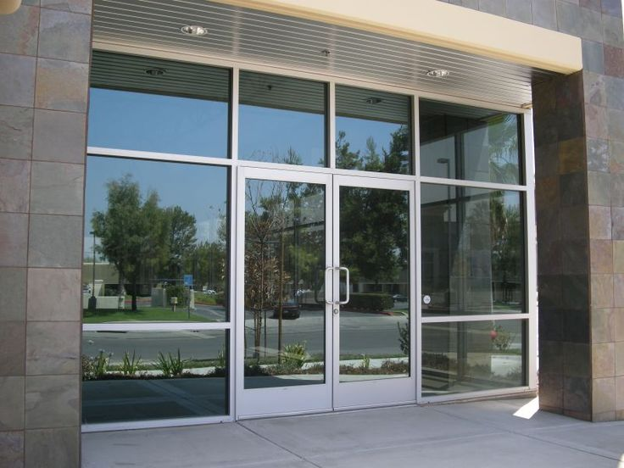
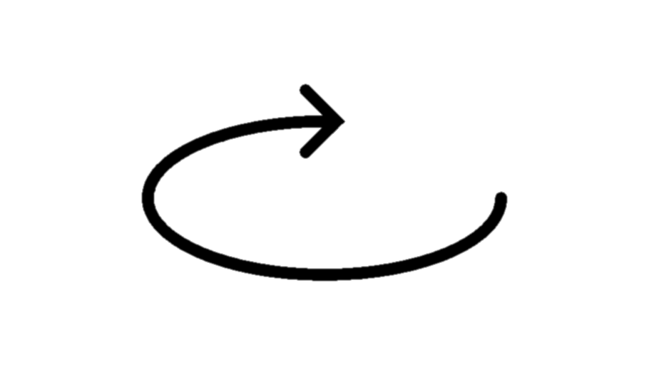
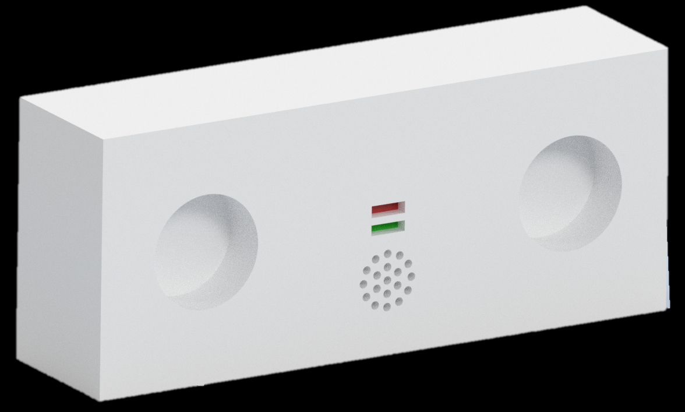
Design Cont.
The ability to tilt vertically and horizontally
Mounted above the door
Hooked up to the electrical locking mechanism for the secure door

Slide 6
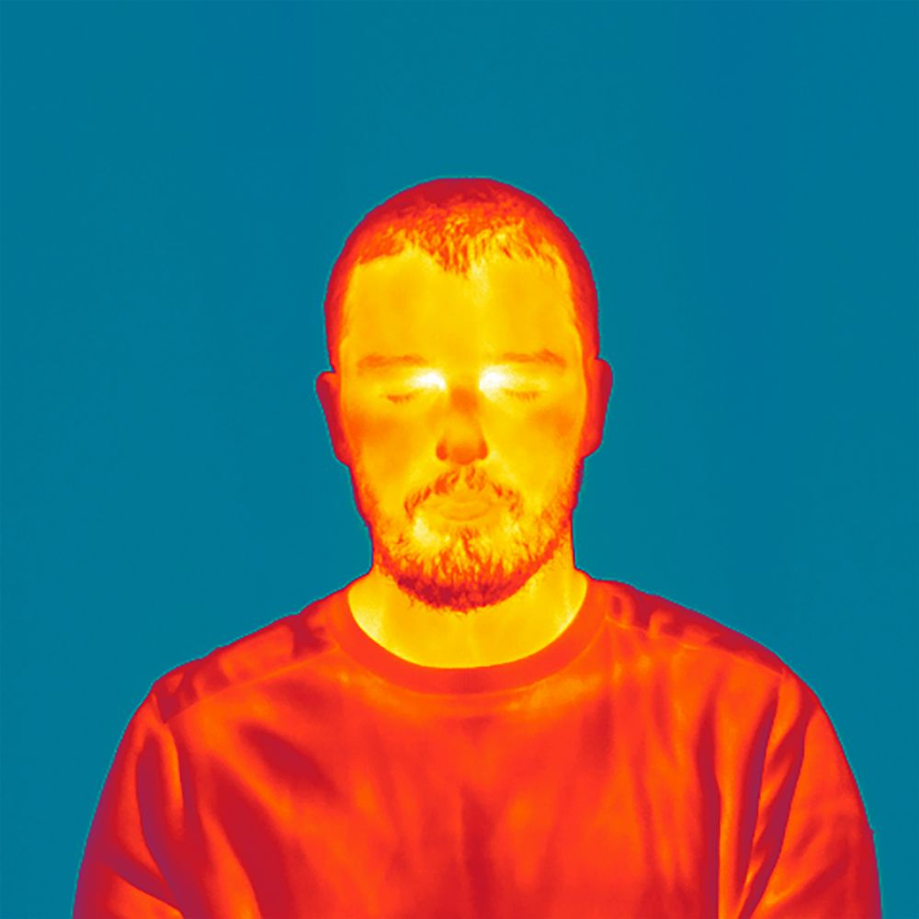
Design Cont.
The imaging camera would create three points on the subject's face for the thermal camera to read data from
If all three points are below 100 degrees Fahrenheit, the door would be unlocked

Slide 7
Design Process
Phase 1
Ordering of parts and microcontroller
Research of how components will interface
Construct a test circuit to get thermal camera and tracking camera up and running separately
Once data can be read from thermal camera begin to interface between both cameras and get points of the face to be read
Develop C code to control a pair of servos for tracking of the subject
Go through testing

Slide 8
Design Process
Phase 2
Research how the components will interface together and what will be needed in order to have an operation board
Design the custom PCB
Check the design and send to a board house
Continue development of code from phase 1 while board is being made
Once board arrives implement the code created in phase 1 to the new design
Troubleshooting and testing
3D print case and get a displayable prototype
Deliver finished product

Slide 9
Skills
Python
C/C++
Assembly
Board Layout
Electronics/Networks knowledge
Image processing

Slide 10
Challenges/Things to consider
Thermal Camera resolution and accuracy
A lot of affordable thermal cameras are low resolution and only accurate to the +/- 2.5 degrees Fahrenheit range
Will PCB design take up too much time?
May have difficulty putting points on someone's forehead to read thermal data in real time
May be hard to scan temperature in certain cases
Hot day, person wearing a hat, etc..
Will have to develop test cases around these

Slide 11
Thank you for your time
Please email us back with any questions or suggestions for our project

