Slide 1
Rice Classification Methods: Derived Features vs. Images
Nick Melamed, Stephanie Owyang, Suvass Ravala

Slide 2
Motivation for Looking at Rice Grains
Rice is consumed by roughly half of the world’s population
Understanding the characteristics of different grains allows for seed quality evaluation
Why is this helpful?

Slide 3
Current Work on the Subject
Main paper: Koklu, M., Cinar, I., and Taspinar, Y.S. 2021
Used image dataset to achieve 100% accuracy w/ CNN, derived feature dataset to achieve 99% accuracy via ANN
Previous work referenced in the paper (w/ rice and other crops) hardly broke above 95%.

Slide 4
Our Data
Image Dataset - Turkey
15K images per rice variety, 5 grains
Arborio
Basmati
Ipsala
Jasmine
Karacadag
Derived Feature Dataset - Cinar 2019
106 features derived from images
90 color (RGB, other color scales)
12 morphological
4 shape

Slide 5
Why 2 Different Datasets?
We were curious if features derived from images could produce the same results as the images themselves
We would assume images are superior…
Can’t we just do one?

Slide 6
Derived Feature Analysis

Slide 7
Data Cleaning/EDA
Train/Test/Validation: 60-20-20
Missing Values: 16 training, 6 validation
Normalization: Min/Max to reduce range of values
Multicollinearity: Drop columns with r > 0.8 → 106 to 11 features

Slide 8
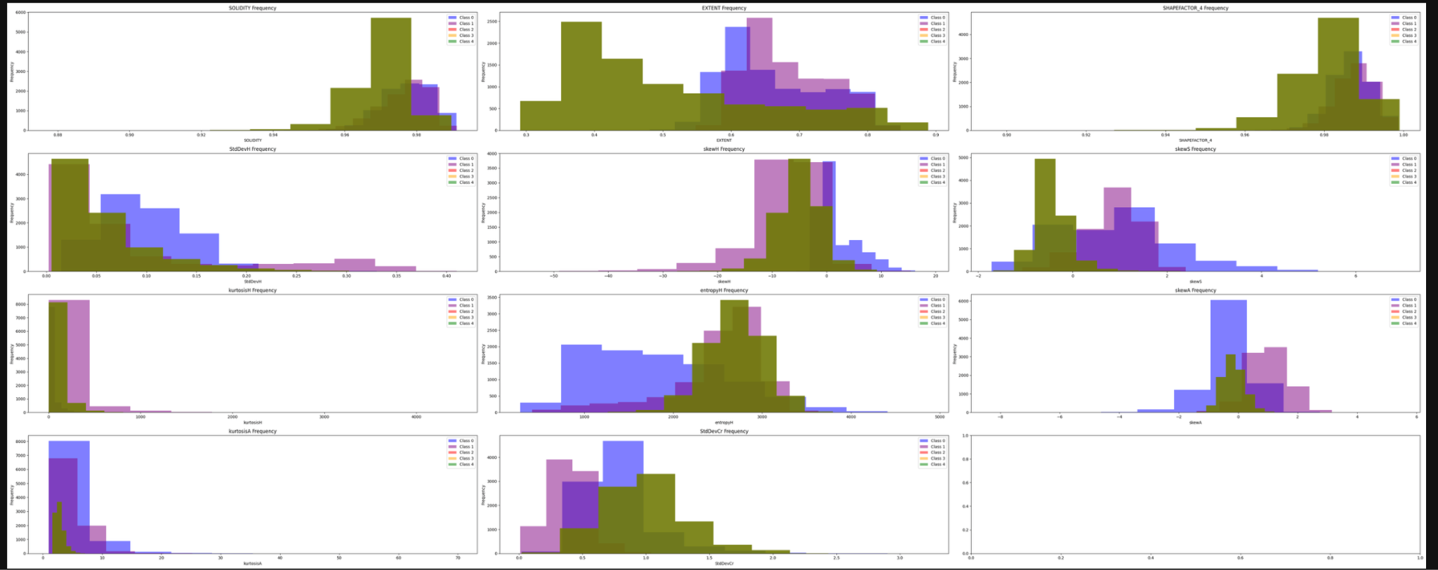
Feature Inspection

Slide 9
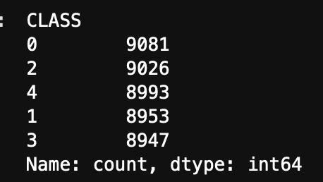
Baseline Model
Majority Class Classifier: All predictions = majority class (0)
Accuracy: 0.2018
Loss: 139599171820.3884 (!)
Why so poor? Good class balance:
What is our starting point?

Slide 10
Attempt #1: Logistic Regression

Slide 11
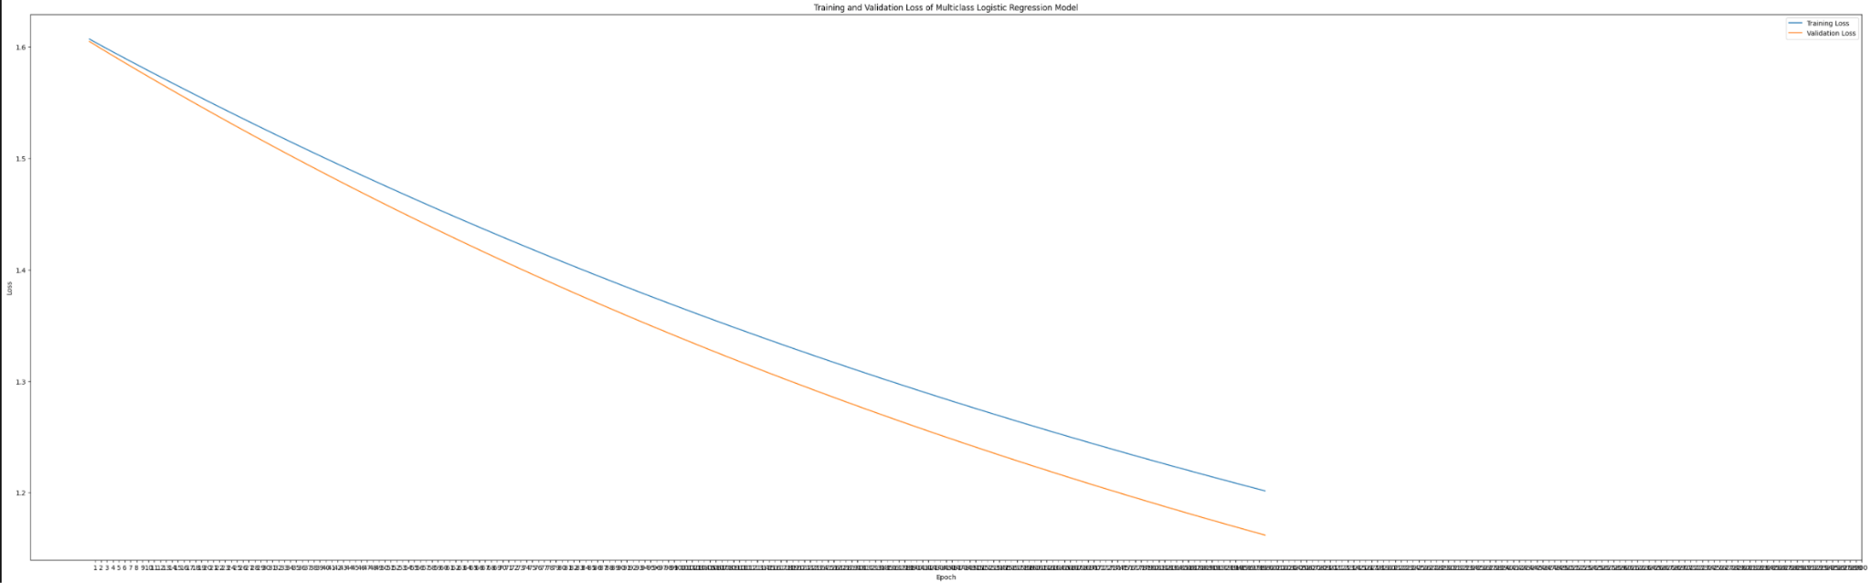
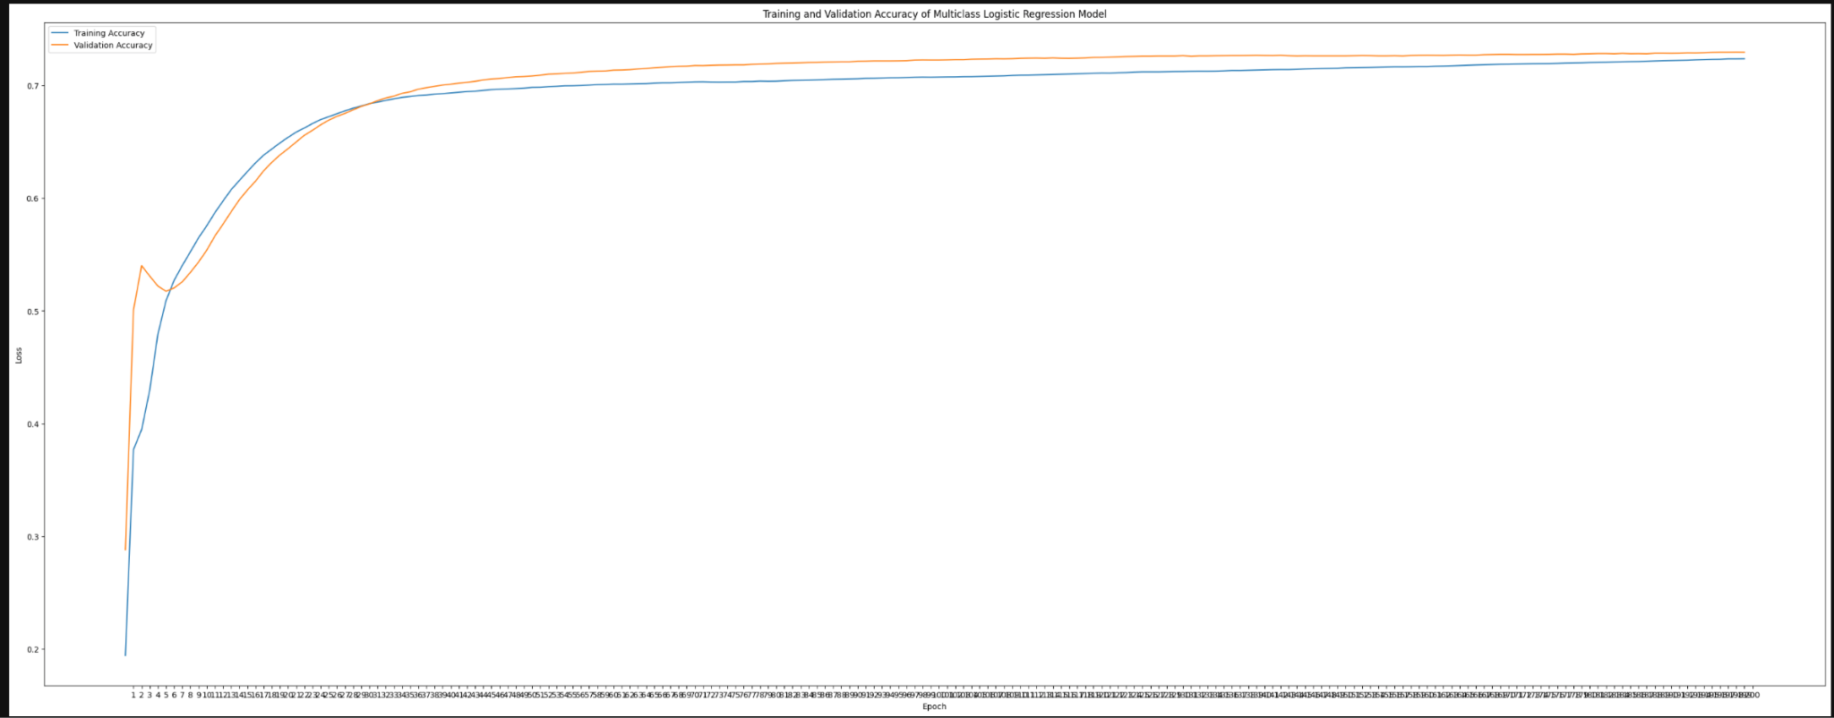
Hyperparameter Tuning: Keras Tuner
Optimal Learning Rate: ~9.7e-5
Optimal Epochs: 200
Optimal Batch Size: 32
Optimal Regularization Parameter: 1e-5 (Elastic Net)
Training and Validation Loss:
Training and Validation Accuracy:

Slide 12
Generalizability and Overfitting Fixes
Attempts to Increase Accuracy:
Reduce LR if Accuracy Doesn’t Increase
Use lower LR in case of complex loss function
Attempts to Reduce Overfitting:
Early Stopping if Loss Doesn’t Improve
Elastic Net Regularization (50/50 L1/L2)
Training Accuracy | Validation Accuracy | Test Accuracy
0.724 | 0.729 | 0.654

Slide 13
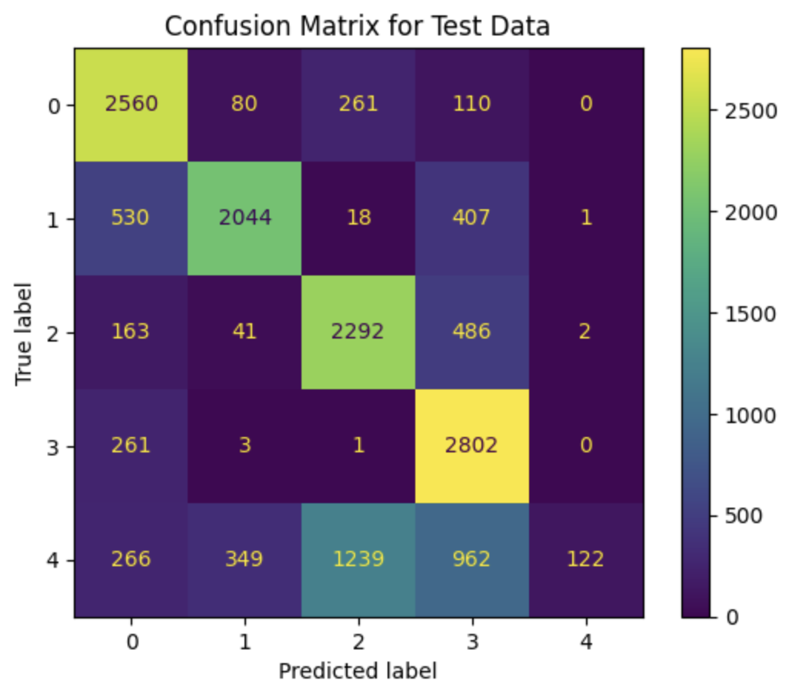
Limitations
Pretty substantial improvement in accuracy, but still rather low
Logistic Regression cannot model nonlinear relationships between features!
Why not 100% Accuracy?

Slide 14
Attempt #2: Feed Forward Neural Network

Slide 15
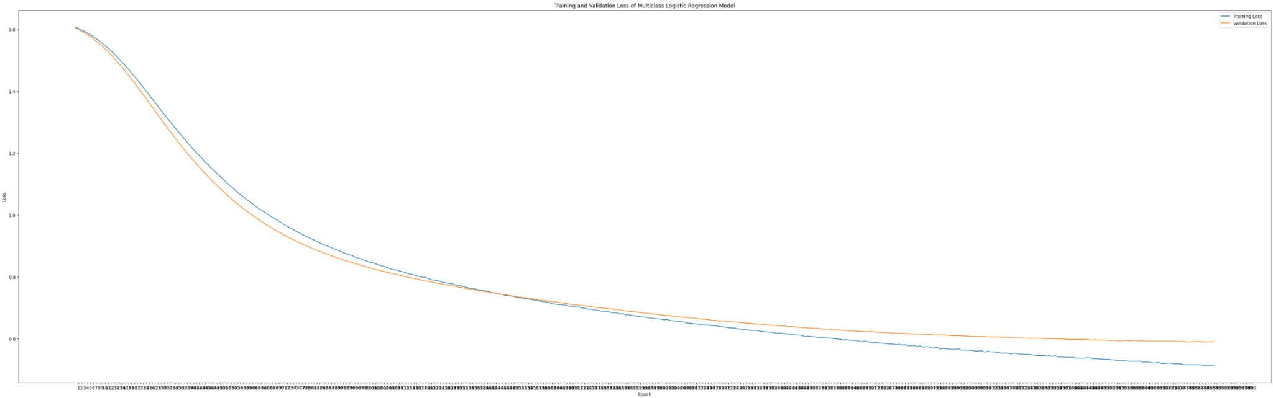
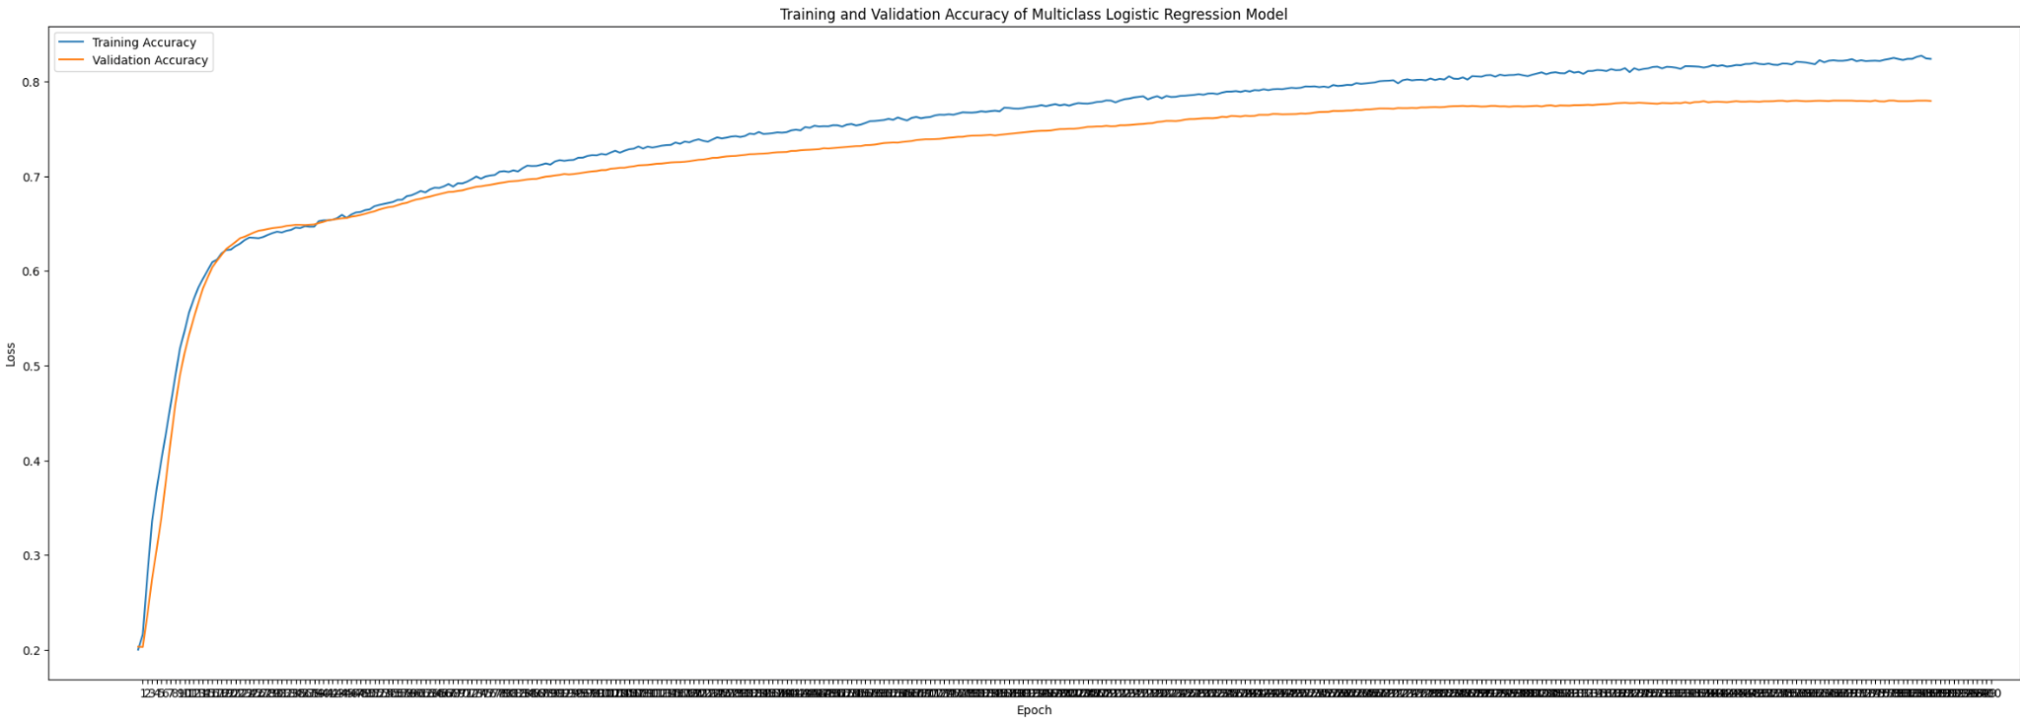
Hyperparameter Tuning: Keras Tuner
Optimal Learning Rate: ~9.7e-6 Optimal Hidden Layers: 1 with 32 neurons Optimal Epochs: 388 Optimal Dropout Rate: 0.0
Optimal Batch Size: 32
Optimal Regularization Parameter: 1e-5 (Elastic Net)
Training and Validation Loss:
Training and Validation Accuracy:

Slide 16
Generalizability and Overfitting Fixes
Attempts to Increase Accuracy:
Reduce LR if Accuracy Doesn’t Increase
Use lower LR in case of complex loss function
Attempts to Reduce Overfitting:
Early Stopping if Loss Doesn’t Improve
Elastic Net Regularization (50/50 L1/L2)
Implemented Dropout and Gaussian Noise (although tuning preferred no dropout)
Training Accuracy | Validation Accuracy | Test Accuracy
0.842 | 0.779 | 0.649

Slide 17
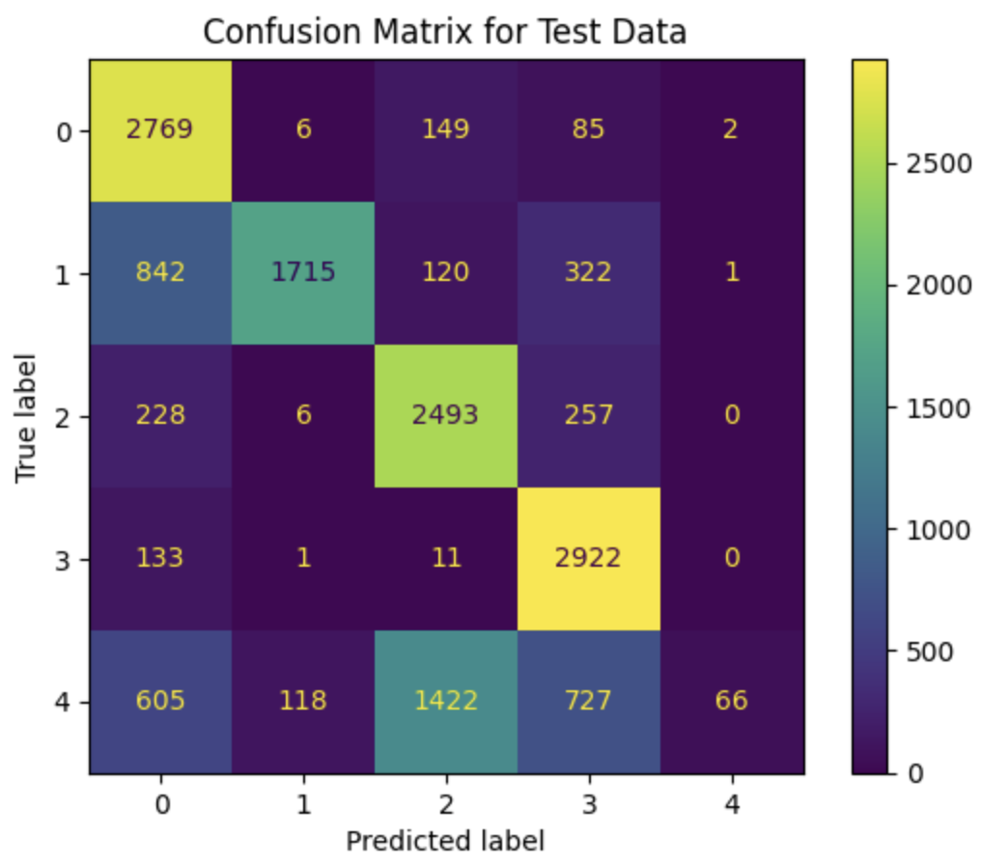
Limitations
Adding nonlinearity didn’t make a huge difference…
Could be high level of noise in data (relatively low number of observations, lot of features), curse of dimensionality, etc.
Why not 100% Accuracy?

Slide 18
Attempt #3: Random Forest, XGBoost

Slide 19
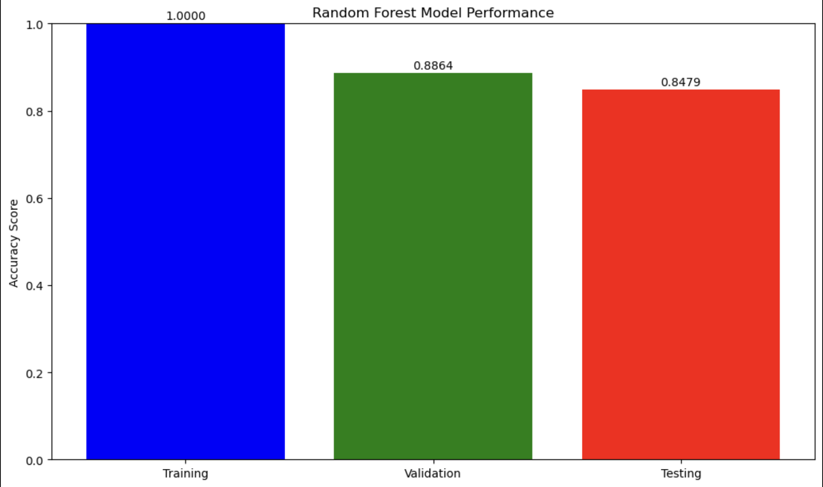
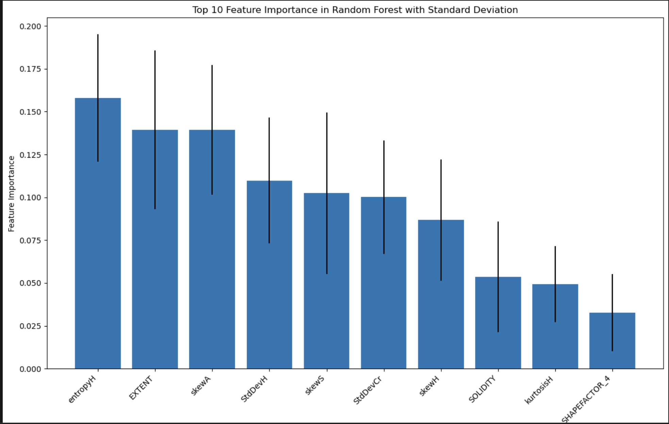
Random Forest - Hyperparameter Tuning
Number of Trees(n_estimators): 100 Class Weights: Balanced Max_Depth : None N Jobs: -1
Max_Features: sqrt
Random State: 1234
Training, Validation and Testing Accuracies:
Feature Importance:

Slide 20
Random Forest - Generalization
Attempts to Increase Accuracy (0.76 -> 0.88):
Increase Parameters (N_jobs, Max_Depth, N_Estimators)
Add Parameters (Max_Features, Bootstrap)
Attempts to Reduce Overfitting:
Large number of n_estimators and averaged results
Random number of features each time (different subsets of data)
Training Accuracy | Validation Accuracy | Test Accuracy
1.000 | 0.891 | 0.884

Slide 21
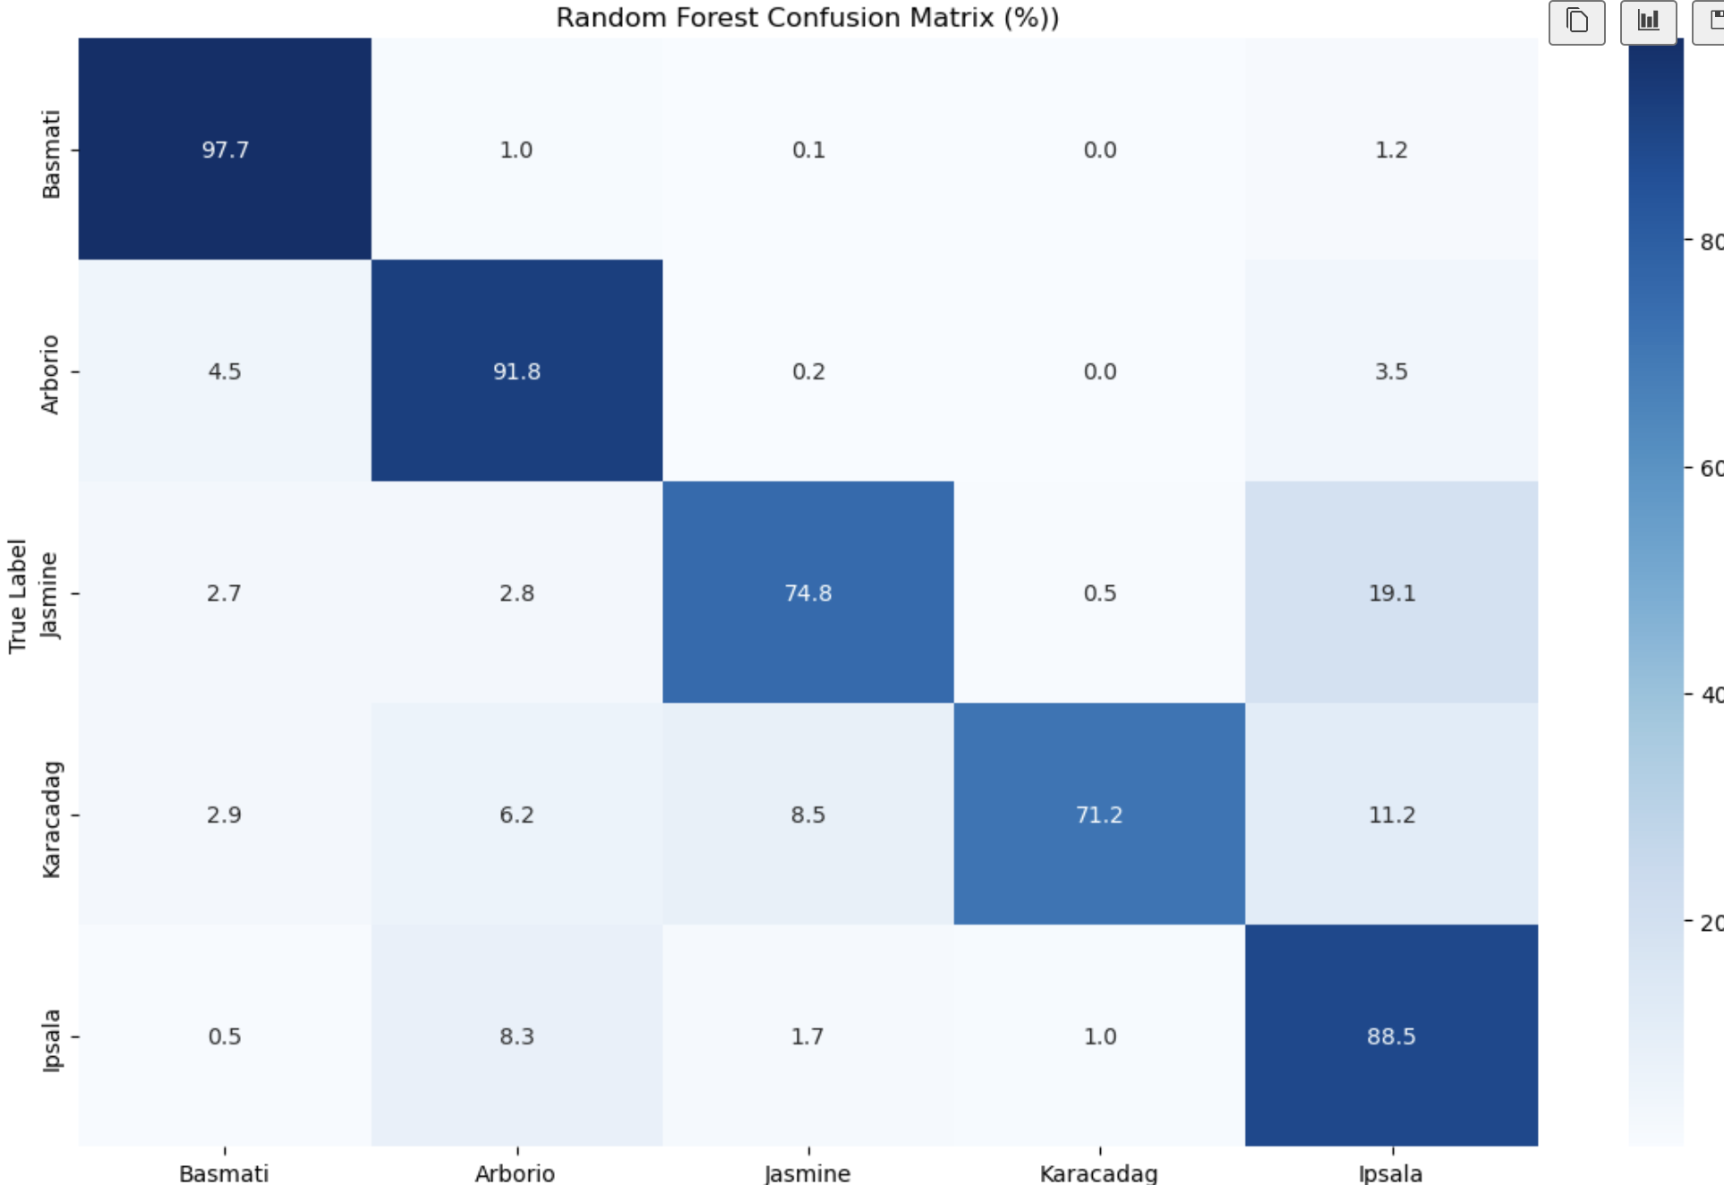
Limitations
Hard to understand the relationship between features and how random forest interprets them
Why not 100% Accuracy?

Slide 22
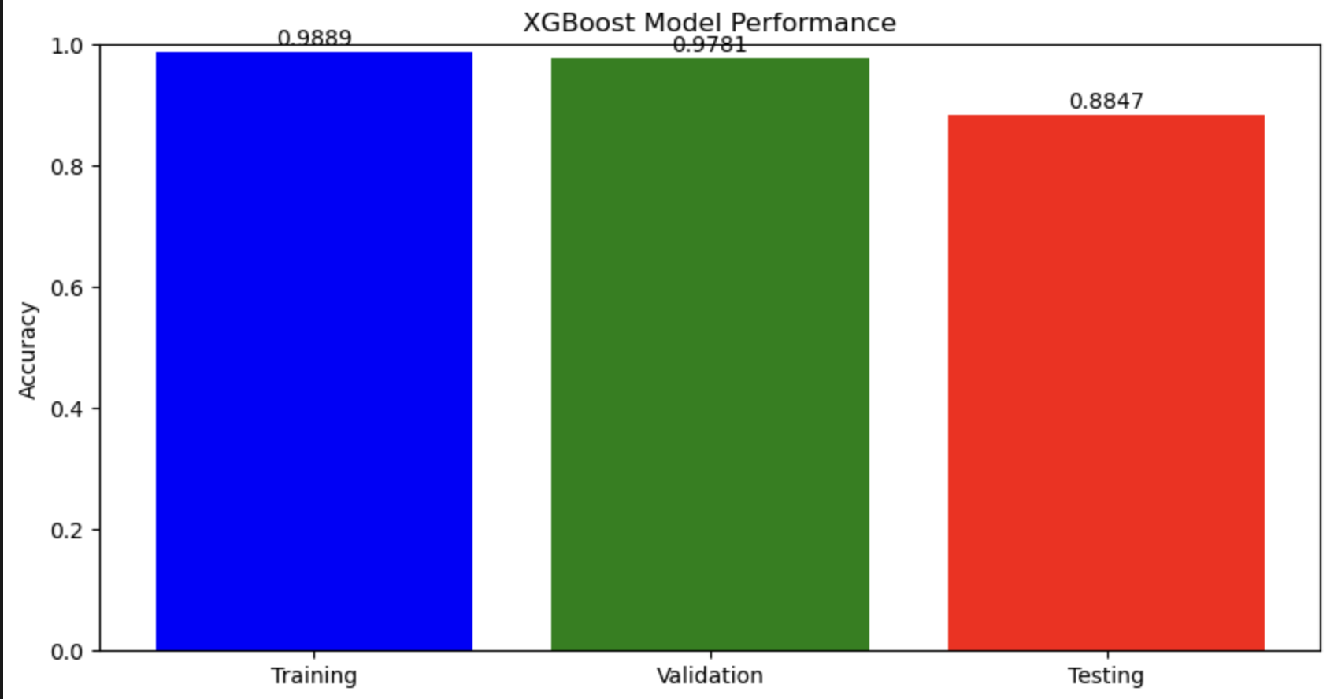
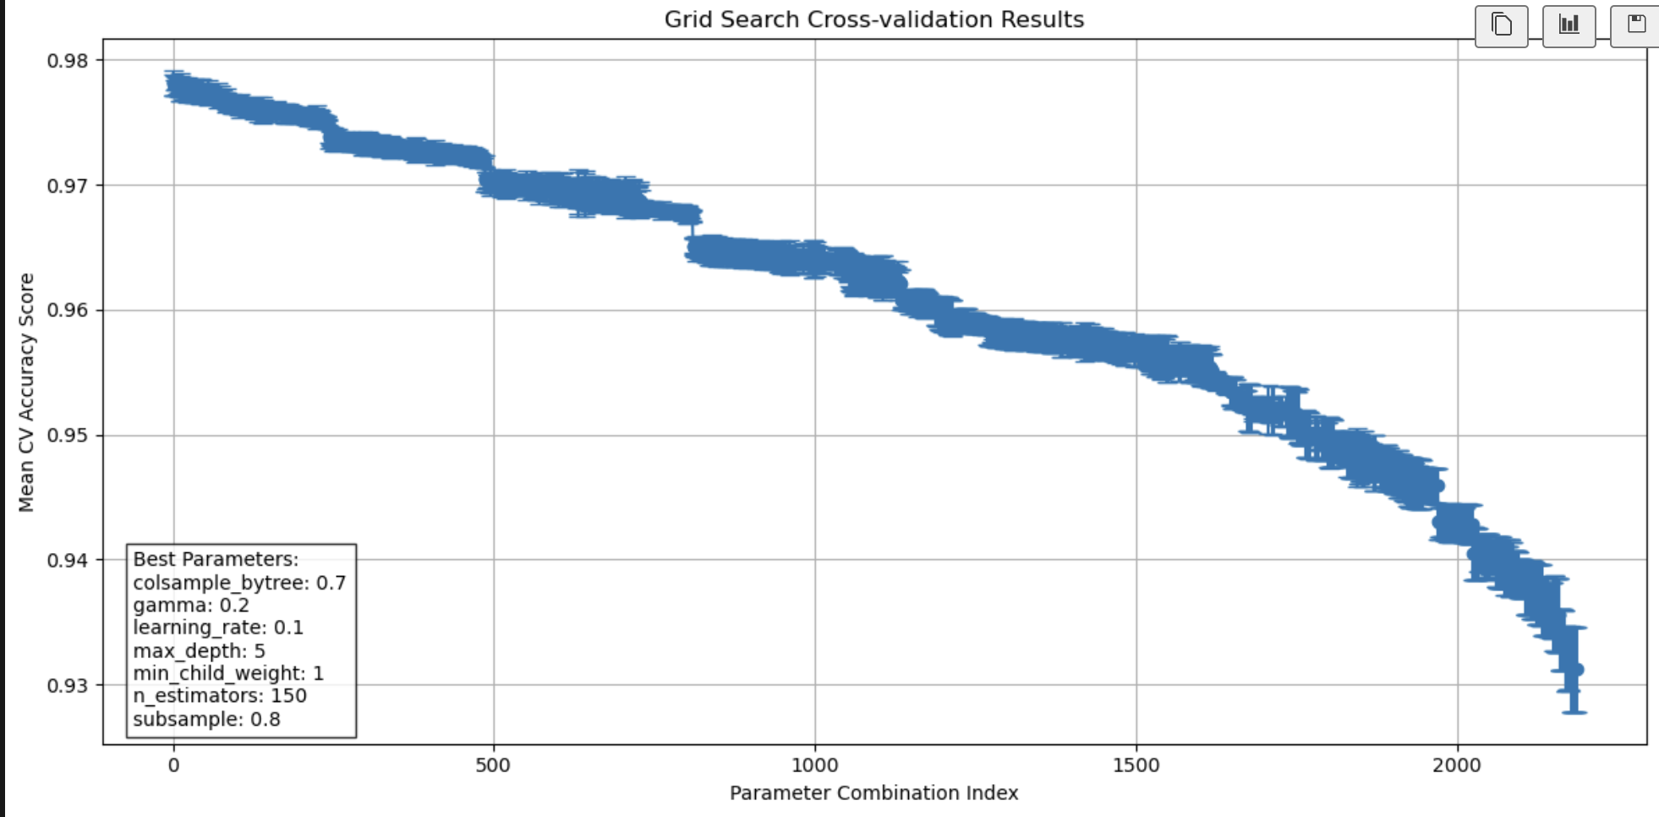
XGBoost - Hyperparameter Tuning
Number of Trees(n_estimators): 150 Sub Sample : 0.8 Max_Depth : 5 Col_bytree: 0.7
Learning_Rate: 0.1
Training, Validation and Testing Accuracies:
Cross Validation:

Slide 23
XGBoost - Generalization
Attempts to Increase Accuracy (0.73 -> 0.89):
Use GridSearch methods : n_estimators, max_depth, earning_rate, sub_sample, col_subtree
Attempts to Reduce Overfitting:
Large number of n_estimators and averaged results
Random number of features each time (different subsets of data)
Training Accuracy | Validation Accuracy | Test Accuracy
0.98 | 0.979 | 0.885

Slide 24
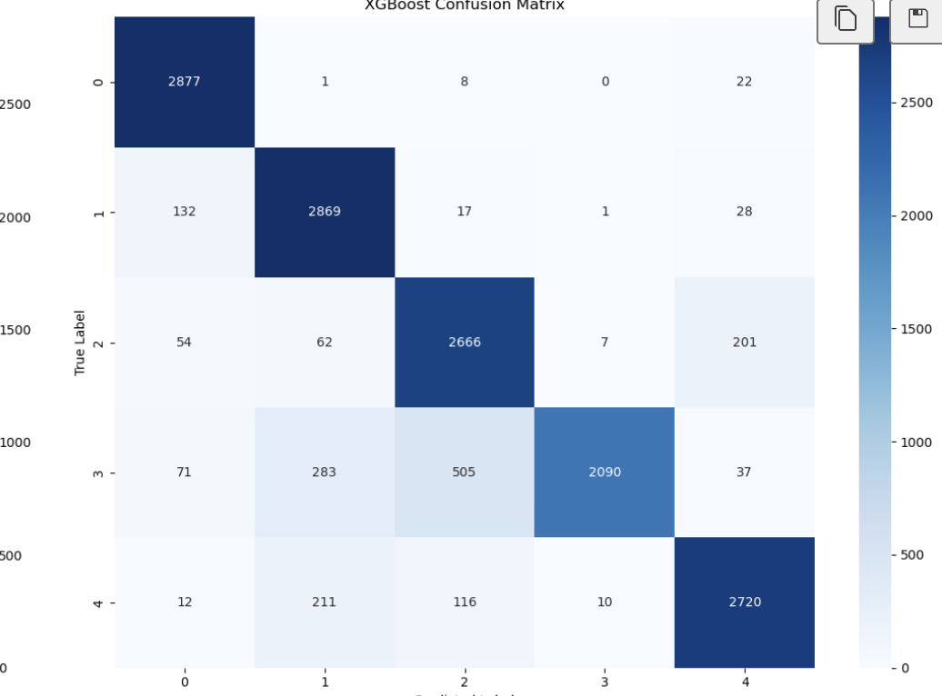
Limitations
Limited Parameters tested for Grid Search optimization
Why not 100% Accuracy?

Slide 25
In general, where does our Derived Feature analysis fall short?

Slide 26
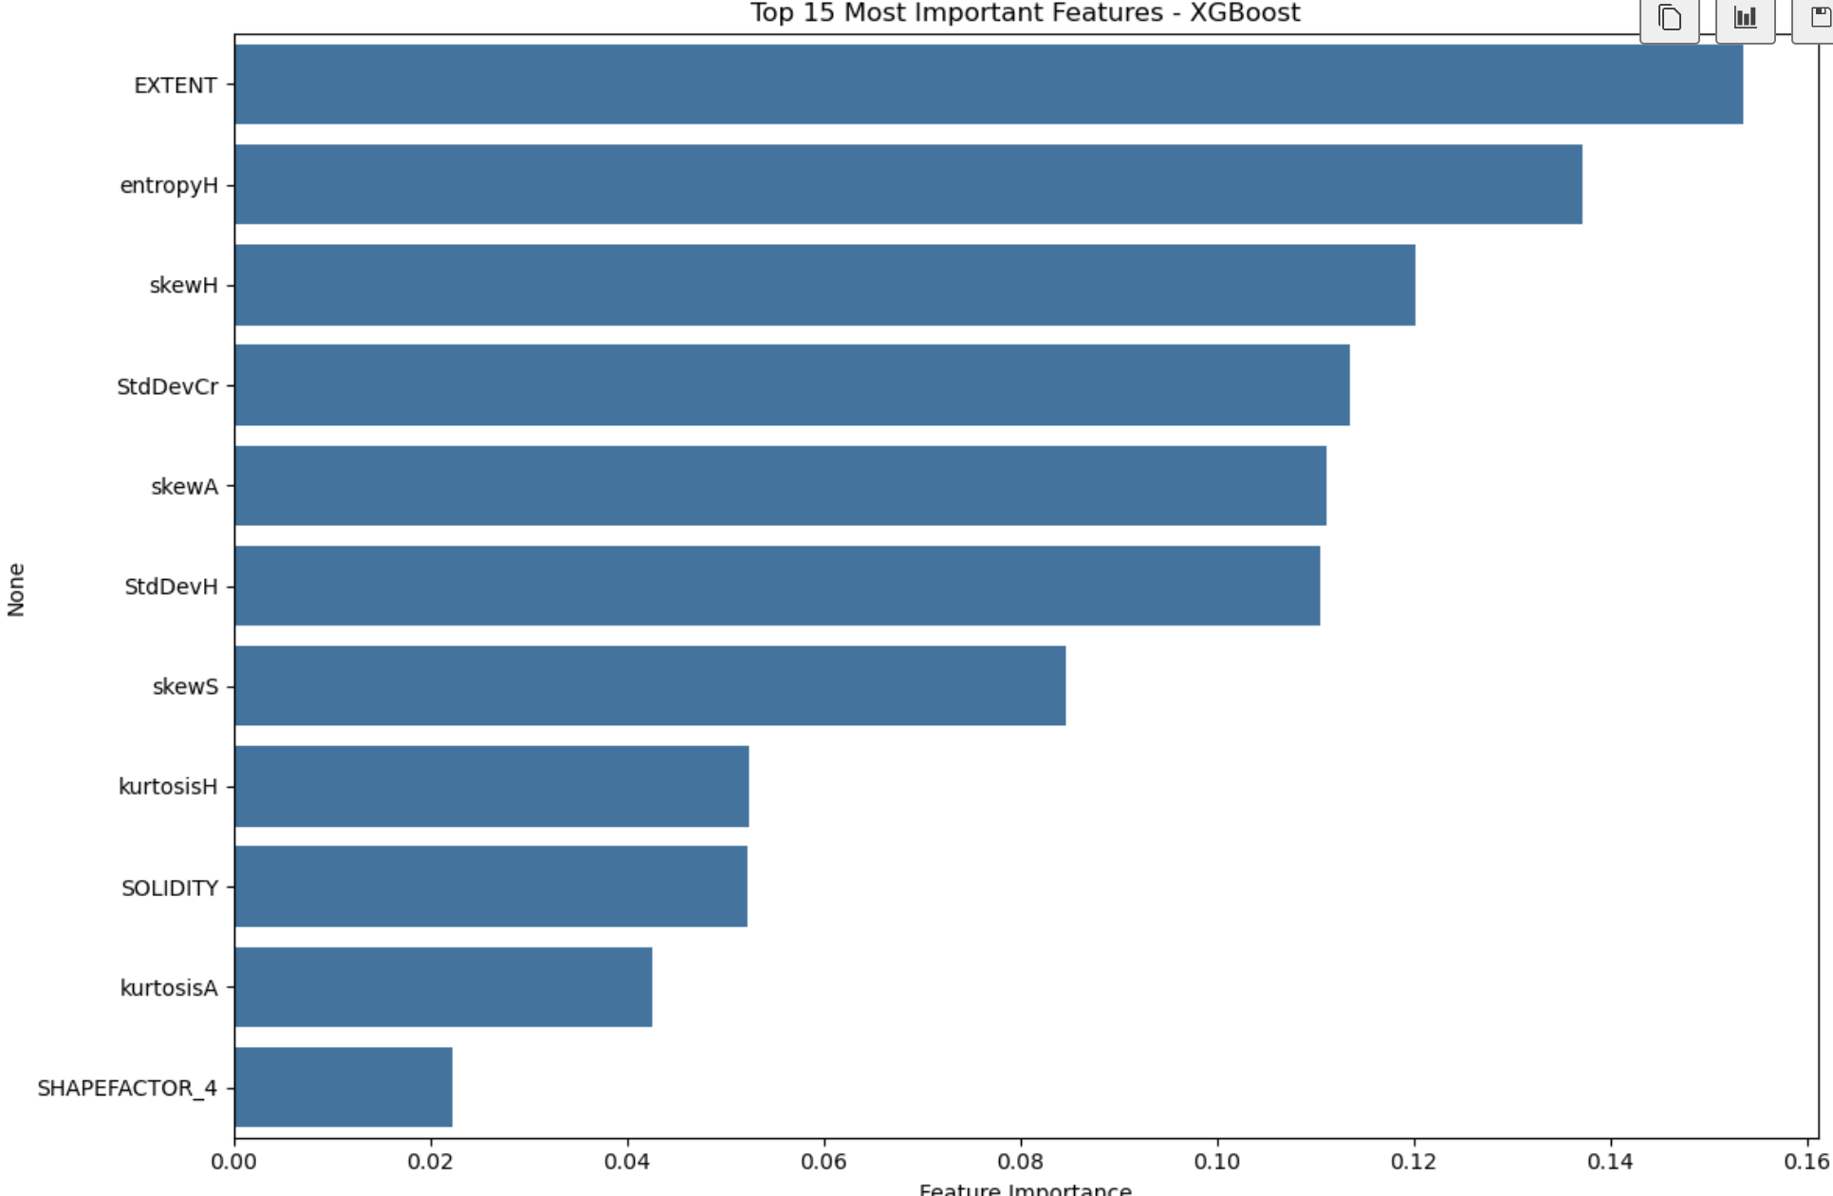
Limitations of using Derived Features
Could have Explored and Generated more Features like Perimeter, Aspect_Ratio (Issue of Multicollinearity…)
Couldn’t Explore All the Feature Relationships
Limited Domain Specific Knowledge

Slide 27
Image Data Analysis
Notes:
The previous models focused on the derived feature set of the different grains of rice, and now we’ll take a look at the images.

Slide 28
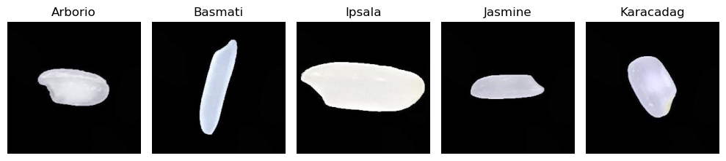
Image Exploratory Data Analysis
75,000 images total
Balanced classes - 15,000 images per rice grain type
Notes:
As Nick described earlier, there are 75,000 images in this dataset, and each type of rice has 15,000 images each of size 250,250 pixels. All of the images have a black background and the grain of rice is centered in the frame. However the angle of the grain, scale, and contrast seem to vary.

Slide 29
Attempt #4: Convolutional Neural Network
Notes:
These images are ideal for a convolutional neural network which excels in hierarchical feature extraction like identifying edges and textures.

Slide 30
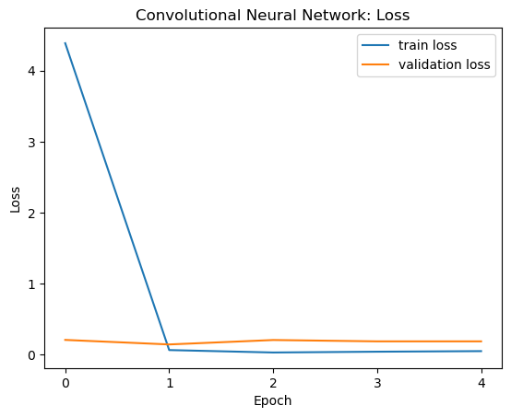
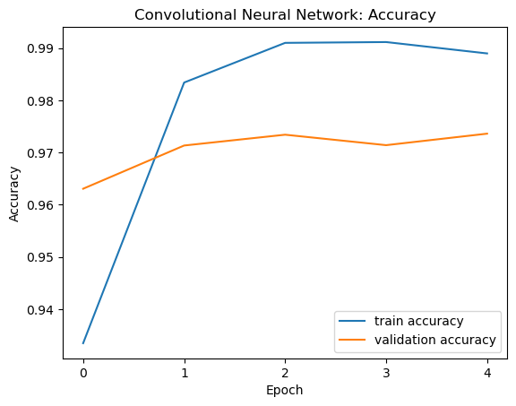
CNN - Baseline
Epochs: 5
Batch Size: 32
Number of Layers: 1
Pooling Method: Max Pooling 2D
Training and Validation Loss:
Training and Validation Accuracy:

Slide 31
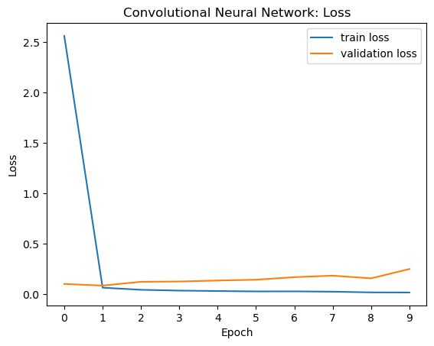
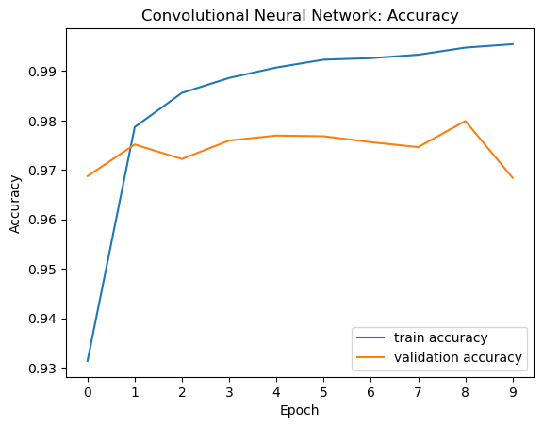
CNN - Hyperparameter Tuning
Optimal Epochs: 10
Optimal Batch Size: 32
Optimal Number of layers: 2 layers
Optimal Pooling Methods: Max Pooling
Training and Validation Loss:
Training and Validation Accuracy:

Slide 32
CNN - Generalization
Attempts to Increase Accuracy
Adding layers
Using different types of activation methods and pooling methods
Attempts to Reduce Overfitting
Using different types of activation methods and pooling methods
Early stop
Training Accuracy | Validation Accuracy | Test Accuracy
0.9948 | 0.9684 | 0.9686

Slide 33
Limitations
Computational cost - each model iteration consumes a lot of memory
Model training time - Each iteration of the model takes a long time to run and is limited to your hardware (or borrowed hardware)
Why not 100% Accuracy?
Notes:
Memory: stores images (image size) , activations (represents features extracted from images), batch size

Slide 34
Concluding Remarks

Slide 35
Summary of Results
 | Training Accuracy | Validation Accuracy | Test Accuracy
Logistic Regression | 0.724 | 0.729 | 0.654
FFNN | 0.842 | 0.779 | 0.649
Random Forest | 1.000 | 0.891 | 0.884
XGBoost | 0.98 | 0.979 | 0.885
CNN | 0.994 | 0.968 | 0.968
Notes:
Comparison of each methods
Logistic Regression gave us a great baseline model to better understand our data, and provide us a starting point to see how we could improve our models, but it has poor performance with complex or non-linear data.
The Feed Forward Neural Network does better in modelling non-linear relationships and scales well with more data, but is prone to overfitting.
Random Forest captures non-linear patterns and feature interactions, and more robust to noise and outliers, but was still prone to overfitting.
XGBoost improves upon Random forest by tuning more parameters like tree depth and learning rate, but overfitting persisted.
Convolutional Neural Network captures spatial hierarchies and features from the raw images, proved to perform the best

Slide 36
Comparison of Methods
Method | Dataset | Advantages | Disadvantages
Logistic Regression | Derived Features CSV | Simple to implement, good baseline | Poor non-linear performance
FFNN | Derived Features CSV | Handles non-linear relationships | Prone to overfitting
Random Forest | Derived Features CSV | Improved performance on non-linear patterns | Less interpretable
XGBoost | Derived Features CSV | More tuning parameters than random forest, usually improves performance | Complex tuning
CNN | Rice Grain Images | Captures spatial hierarchies and features from raw images | Computationally intensive

Slide 37
Further Research
Continue tuning CNN models to improve generalization
Adding more types of rice like bomba, black, red or wild rice
How would this model do with a different background with more noise?
How can this be used to make the rice production process more efficient?
Where do we go from here?

Slide 38
Thank You!

Slide 39
Contributions
Nick: Motivation, EDA/Data Cleaning, Logistic Regression, Feed Forward Neural Network
Suvass: Random Forest, XGBoost, Limitations of Derived Feature Analysis
Stephanie: Image Data Analysis (Convolutional Neural Network), Results Summary, Room for Improvement + Future Research

Slide 40
GitHub Repository
CLICK HERE

