Slide 1
Predicting Air Source Heat Pump Electricity Consumption using Maine Climate Data
Nick Garfield
COS 582 Course Project
12/20/2024

Slide 2
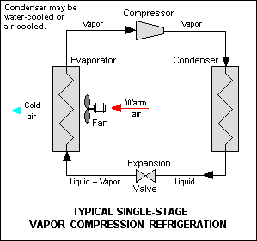
Heat Pump Cycle
Electricity used to pump refrigerant
Reverse valve allows for cool/heat cycles
Heating efficiency > 100%
https://en.wikipedia.org/wiki/Heat_pump_and_refrigeration_cycle#/media/File:Refrigeration.png

Slide 3
Heating Degree Day
Measurement of temperature difference between outside and inside temperature (65F)
Provides quantity for heating demand for given day
HDD = T_AVG – 65 if T_AVG <= 65

Slide 4
Data Sources and Processing
Meteostat: https://dev.meteostat.net/python/
  Access to NOAA – NWS records
Central Maine Power:
  Private usage data for my account
Pandas: https://pandas.pydata.org/

Slide 5
Methods
Ordinary least squares regression
  Linear relationships between HDD and kWh
  Polynomial relationship highlights seasonality of HDD
Statsmodels: https://www.statsmodels.org/dev/gettingstarted.html#documentation

Slide 6
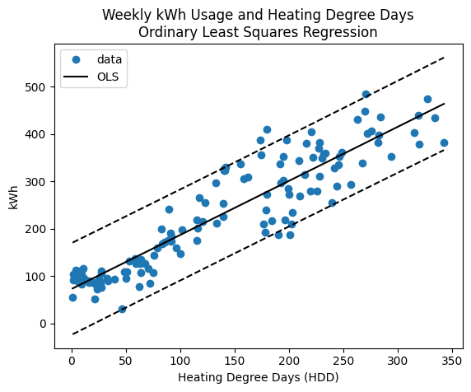
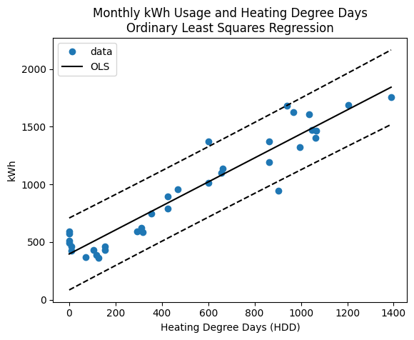
HDD – kWh Relationships

Slide 7
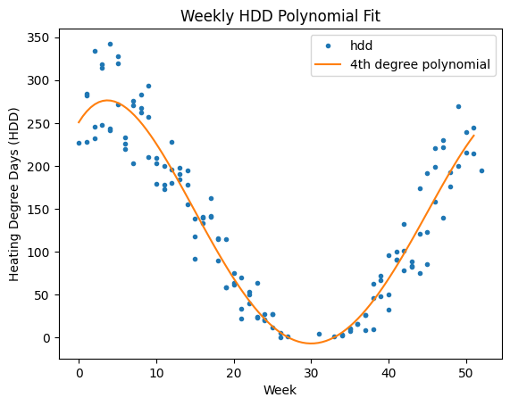
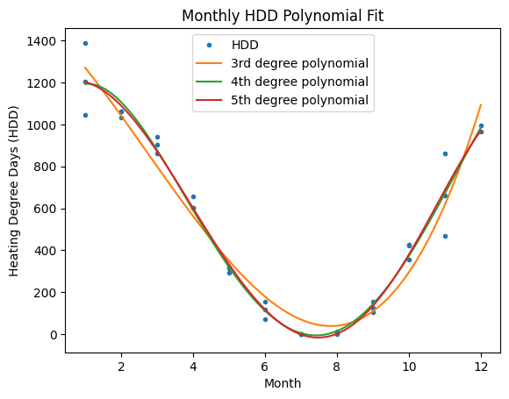
HDD Seasonality

Slide 8
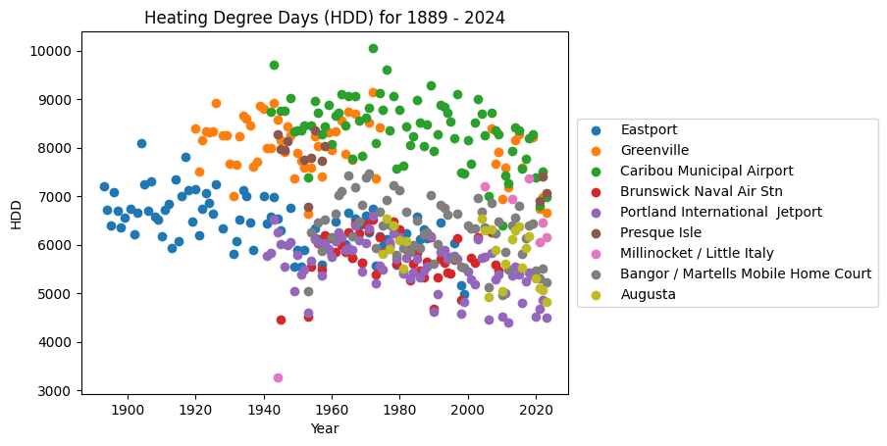
Historical HDD

Slide 9
Conclusion
Energy Consumption (kWh) linearly correlation to HDD for daily, weekly, monthly timescales
Annual HDD is seasonal as expected. 4th degree polynomial fits well for 2022-2024
High variability in annual HDD over length of recorded temperature data in Maine
Potential downward trend in HDD over time

