Slide 1

Time Series Analysis of Chicago Homicide Frequency
Group 1: Victor Cardeno, Caroline Hills, Nicholas Milikich, & Laura Patterson
ACMS 40842: Time Series Analysis
9 December 2019

Slide 2

Introduction
Data Exploration
Analysis
Discussion & Conclusions
References
Time Series Analysis of Chicago Homicide Frequency
1

Slide 3
Introduction
Analyze published Chicago homicide history
Identify patterns
Months where homicide is more prevalent
Points in time that began a trend
Importance
Inform law enforcement
Identify causes of trends
Time Series Analysis of Chicago Homicide Frequency
2
Notes:
This report is an analysis of the published history of homicides in the city of Chicago. At the end of our analysis, we expect to form conclusions about the patterns of crime in the Chicago area, such as the months where crime is most common or show a significant increase or decrease in crime. The results gleaned from this report could potentially help to identify specific points in time that prove to be particularly dangerous in the city, informing the police department and aiding in their efforts to fight wrongdoing in the community. It could also serve to contextualize the data; if our conclusions highlight a month or year where an upward or downward trend in homicides began, it could point researchers to look more closely at any events or legislation that occurred around that time that may have contributed to the change in pattern. We believe this is an important research topic due to the background of the city of Chicago. It is a wonderful city laden with attractions and rich in history, but its standing is weighed down by significant issues with crime and delinquency. Remedying this problem would go a great way towards improving the lives of those in the city and its surrounding area.

Slide 4
Introduction ✔
Data Exploration
Analysis
Discussion & Conclusions
References
Time Series Analysis of Chicago Homicide Frequency
3

Slide 5
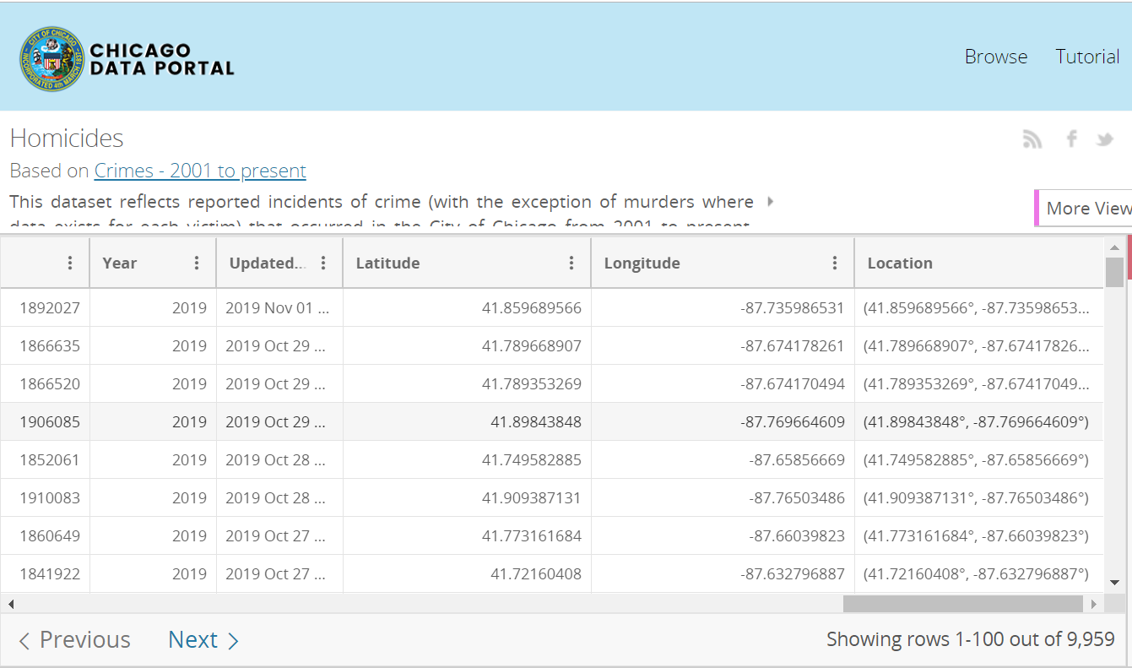
Original Data
Time Series Analysis of Chicago Homicide Frequency
4
Notes:
The dataset includes an entry for each recorded homicide in the city of Chicago from January 2001 through September 2019. Each row describes one particular incident along with qualitative and quantitative details regarding the incident, such as the case number, general location, FBI code, and more. The data is sourced from the Chicago Police Department’s Citizen Law Enforcement Analysis and Reporting system. A sample of the data is shown in Figure 1. In order to conduct a time series analysis on the data, we needed the frequencies of homicides committed in each month of each year. We manipulated the data by extracting the month and day of each incident from the date column and then creating a dataframe with each year as a row and each month as a column, allowing us to record the total number of incidents occurring in Chicago by month and year in the variable hom.dummy. We then fit the hom.dummy dataset to a time series, named hom.ts, to run our models and create our predictions. The data were split into a training set (January 2001 through September 2017) and test set (October 2017 through September 2019).

Slide 6
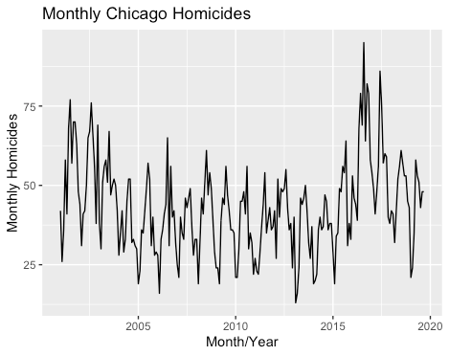
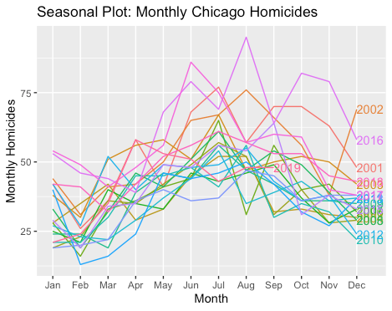
Data Visualization
Time Series Analysis of Chicago Homicide Frequency
5
Notes:
To begin our analysis, we produced some basic graphs to help us gain a better understanding of the data. We started with a basic plot of the time series data, graphing number of monthly homicides through time. This plot is shown in Figure 2. From this figure, we suspect that there is a seasonal aspect to the data, as there are regularly spaced spikes and dips. There appeared to be neither a dominant trend nor a cyclicality. The variance appears constant, so a transformation is not necessary. Next, we created a seasonal plot and a subseries plot of the homicide data in order to further examine the potential seasonality. These plots are shown in Figures 3 and 4. Both of these plots confirmed the seasonality we suspected to be present, as they both showed that the number of homicides was consistently higher in the months between May and November.

Slide 7
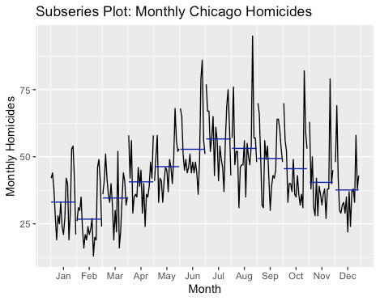
Data Visualization
Time Series Analysis of Chicago Homicide Frequency
6
Notes:
Next, we created a subseries plot of the homicide data in order to further examine the potential seasonality. These plots are shown in Figures 3 and 4. Both of these plots confirmed the seasonality we suspected to be present, as they both showed that the number of homicides was consistently higher in the months between May and November.

Slide 8
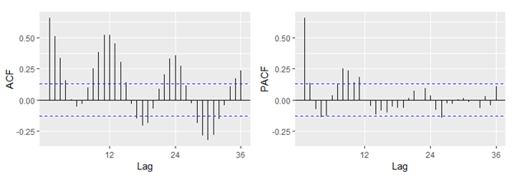
Data Visualization
ACF Plot: Monthly Chicago Homicides
PACF Plot: Monthly Chicago Homicides
Time Series Analysis of Chicago Homicide Frequency
7
Notes:
Lastly, we created an ACF and PACF plot, which are shown in Figures 7 and 8. The ACF plot also confirms our impressions of the data from the initial plot, showing seasonality without trend or cyclicality. The alternating pattern and spikes of decreasing magnitudes in the PACF plot suggest that a moving average term is present in the data that should be explored using an ARIMA model, and further confirms the suspected seasonality with a lack of significant spikes past the twelfth lag.

Slide 9
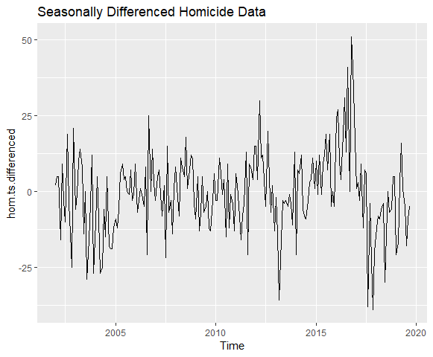
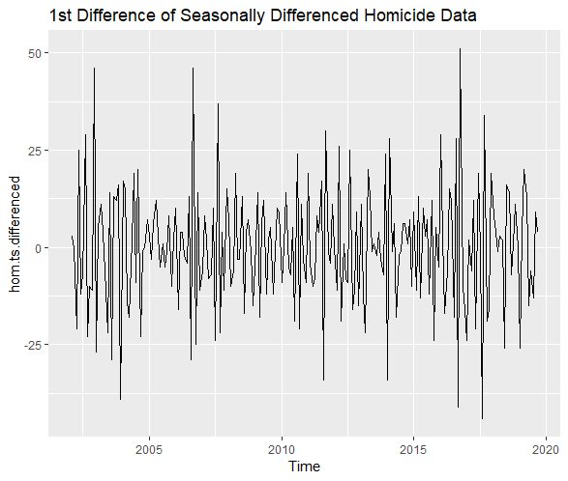
Data Visualization
Time Series Analysis of Chicago Homicide Frequency
8
Notes:
Because of the apparent seasonality, a monthly seasonal differencing was performed and did increase the stationarity of the data (figure 5), and an additional non-seasonal differencing further improved the stationarity (figure 6).

Slide 10
Introduction ✔
Data Exploration ✔
Analysis
Discussion & Conclusions
References
Time Series Analysis of Chicago Homicide Frequency
9

Slide 11
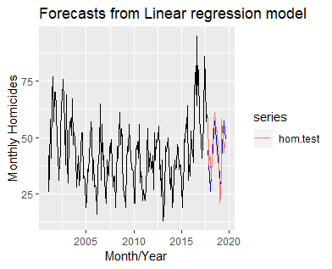
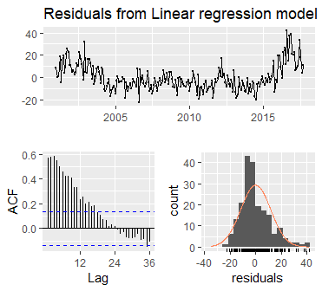
Basic Linear Regression Model (dropped)
ŷ = 33.25 + .0004351*t - 7.236*Feb + 1.470*Mar + 6.234*Apr + 12.29*May + 19.41*Jun + 23.88*Jul + 19.88*Aug + 15.94*Sep + 10.95*Oct + 6.892*Nov + 3.954*Dec
Time Series Analysis of Chicago Homicide Frequency
10
Notes:
The basic linear model illustrated the magnitude of potential linear relationships within the data. The model is set with trend and season as predictors. The most significant predictors are seasons 6-9, corresponding to the months June - September. Their coefficients are positive; the expected number of homicides will be, on average, higher in those months than in January (the baseline). This was what we originally hypothesized given the longer days and large amounts of tourists enjoying Chicago events in those months.
The ACF plot of the linear model shows significant trend and the Breusch-Godfrey test has a p-value of virtually 0. We conclude that there are correlations among the lags. The Ljung-Box test suggests the presence of significant remaining information and possible need for a more complex model with a p-value of essentially 0. The test set RMSE of the linear model is 8.00 and the AICc is 1016.76.
We gained valuable insights from the linear regression. We originally attempted to use average monthly temperature as a predictor in the tslm() function. The resulting linear model did not line up with the data, so we decided to leave out the predictor for the tslm() model. The model did note that the months of May through October are the most significant predictors for homicide numbers. However, we wanted to include the temperature data to test our hypothesis that warmer weather did impact the number of homicides; we included this data as a predictor in a regression model with ARIMA errors.

Slide 12
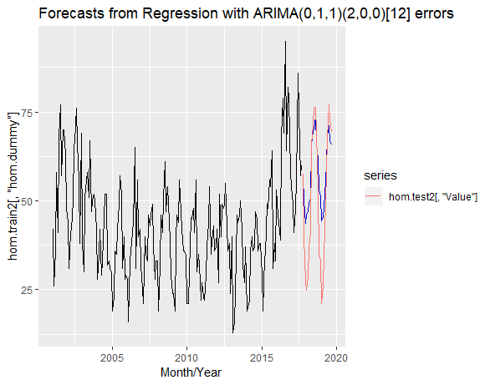
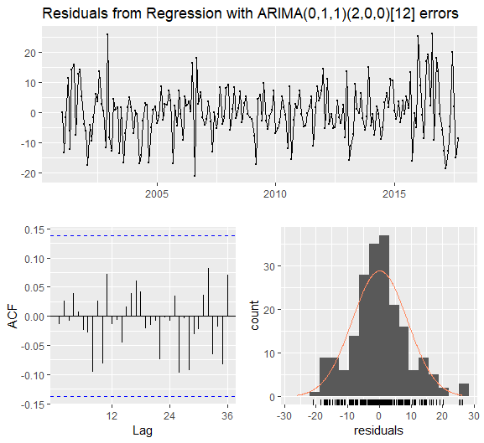

Basic Linear Regression Model with ARIMA Errors (dropped)
Time Series Analysis of Chicago Homicide Frequency
11
Notes:
The linear regression model with ARIMA errors was fit using average monthly temperature as a predictor. The resulting model ACF graph showed that the residuals are white noise, and the Ljung-Box test p-value is 0.98, hence the model is sufficient. The test set RMSE and AICc of the model are 8.71 and 1445.78, respectively.
Using external temperature data as a regressor in a linear model with ARIMA errors created a model with white noise residuals. The temperature data was taken from the National Center for Environmental Information; one value was missing and was filled by averaging the surrounding data points. When graphed, the model does an excellent job staying true to the peaks of the test set data, but fails to account for the valleys in the test set. The model does not account for trend as well as the regular linear model, but the trend was deemed insignificant at an alpha level of 0.05. It is likely that, in order to get a better idea of the temperature trend in the data, you could break down the average temperature into smaller time intervals, such as weekly or even daily recordings and look at the number of homicides at that respective granularity too.

Slide 13
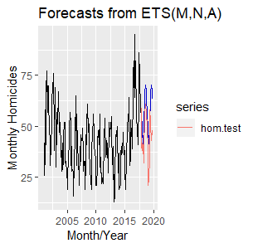
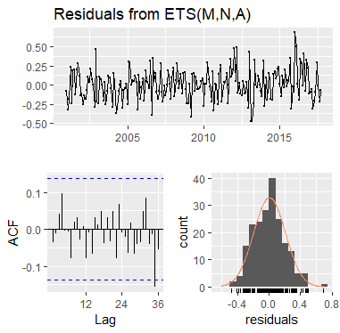

Exponential Smoothing (ETS) Model (dropped)
Time Series Analysis of Chicago Homicide Frequency
12
Notes:
We fit an ETS(M,N,A) model of the data: multiplicative error, no trend, and additive seasonality with parameters α = 0.2576 and γ = 0.0001. An analysis of the residuals suggests that no patterns are evident (Ljung-Box test p-value = 0.20). The test set RMSE is 13.59 and the AICc is 1949.17.
The ETS model had no significant predictive power or insights that would cause us to choose it as our final model over the others. We decided to fit a Holt-Winter’s additive model, because the data appeared to have roughly constant variations, to see if we could gain any predicting power, but the resulting model had slightly higher AICc and RMSE values that indicated it was not better than the ETS model.

Slide 14
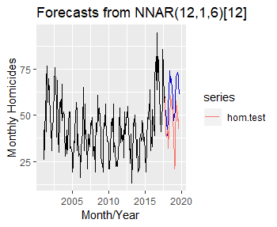
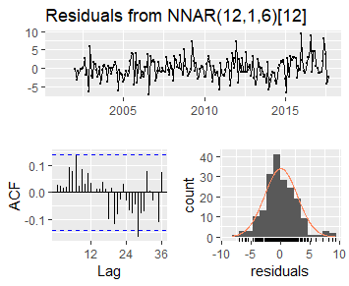
Neural Network Model (dropped)
p = 12 lagged inputs and k = 6 nodes in hidden layer
Time Series Analysis of Chicago Homicide Frequency
13
Notes:
The fitted neural network is NNAR(12,1,6)₁₂. The ACF plot shows one significant lag that just barely breaks the interval and the p-value from the Ljung-Box Test is 0.93; therefore, the residuals could justly be considered white noise and the model sufficient. The RMSE for the test data set is 13.74 and AICc was unable to be calculated.
Neural network models tend to be robust to extreme data, which might make them a good candidate to capture the spike in the data around 2016 and was our motivation to test this forecasting method. The neural network model had a RMSE relatively similar to the other models and the residuals are white noise, but there is no other evidence to show that this model would be a better predictor over the other models. It is especially difficult to choose this model without having an AICc to compare.

Slide 15
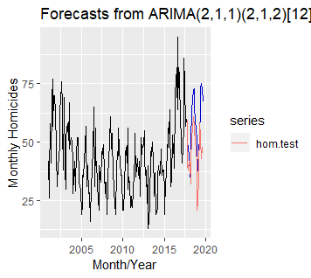
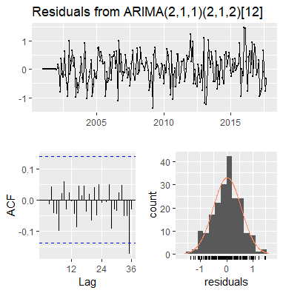
ARIMA Model
Time Series Analysis of Chicago Homicide Frequency
14
Notes:
The homicide data required seasonal differencing and first order differencing to obtain stationality. The R-fitted ARIMA model was an ARIMA(2,1,1)(2,1,2)₁₂ model. The ACF plot showed only one significant lag at l = 35, and the Ljung-Box test returned a p-value of 0.89. Therefore, we fail to reject that the residuals are not autocorrelated; there are no patterns evident and the model is sufficient. The test set RMSE is 14.79 and the AICc is 348.31.
The ARIMA model required seasonal and regular differencing to obtain stationarity. An ADF test of the complete differenced data returned a p-value of 0.043. When fit by the auto.arima() function, the data was transformed with a Box-Cox lambda of 0.26. The resulting RMSE of the ARIMA model is surprising as it indicates that the linear model, which was deemed insufficient in the Ljung-Box test, performed much better on the test data than the more complex ARIMA model.

Slide 16
Model Performance
 | TSLM | TSLM ARIMA Errors | ETS | Neural Network | HW | ARIMA
AICc | 1016.76 | 1445.78 | 1949.17 | N/A | 1963.63 | 348.31
RMSE | 8.00 | 13.99 | 13.59 | 13.74 | 14.32 | 14.79
MAPE | 14.20 | 31.20 | 30.62 | 30.31 | 32.12 | 31.92
Time Series Analysis of Chicago Homicide Frequency
15
Notes:
Table 1 shows the AICc, RMSE, and MAPE of the tested models. RMSE and MAPE performance on the test set suggests that the model with by far the best predictive power was the linear model. However, the linear model is the only model that has non-white noise residuals, so it was not considered as a possible final model.
It is surprising that the more complex models performed so much worse on the test set, especially considering the fact that the linear model, which gave by far the most visually appealing forecasts compared to the test data, was insufficient based on residual analysis. The data shows a spike in 2016, followed by a decrease in 2017 and a return to normal levels in 2018. It appears that all the complex models captured this downward trend in the data that did not actually continue, while the linear model did not. Therefore, the observed model performances may be due to quirks in this particular data set. In further study, this might be corrected by comparing model performance using test sets of variable lengths. For this reason we gave more weight to the AICc than the test set performance in choosing a final model.

Slide 17
Introduction ✔
Data Exploration ✔
Analysis ✔
Discussion & Conclusions
References
Time Series Analysis of Chicago Homicide Frequency
16

Slide 18
Discussion
Regression models performed the best (AICc, RMSE, MAPE)
Final model: ARIMA(2,1,1)(2,1,2)₁₂
More complex models performed worse
Best performing model did not have white noise residuals
Overfitting
Quirks in the data
Other relevant variables
Policy changes, societal phenomena, relevant Chicago events, etc.
Data might be incomplete (only includes investigated homicides)
Time Series Analysis of Chicago Homicide Frequency
17
Notes:
The data does have a trend, but visually it does not seem to be more than slight. We think the seasonality in the data is the more important quality to pay attention to. The data is strongly seasonal and incorporating this aspect into the final model will lead to better predicting power. Therefore, we decided the best model to choose as our final model was the ARIMA model because it captured the seasonality best, had white noise residuals, and had a significantly lower AICc than the other models.
Other variables to account for in future analysis include changes in policy, national societal phenomena, or relevant events in the City of Chicago. It would also be beneficial to include external data on total hours of daylight, unemployment rate, and other statistics that could impact motivations for homicide. For instance, would highly publicized instances of police brutality cause fear and decrease homicides or incite reactionary actions that boost the homicide numbers? It is also important to note, especially in forecasting future crime, that this dataset only includes crime that was reported and investigated by the police. Especially in a large city like Chicago where underground gang violence is prevalent, it is quite likely that this dataset does not provide a wholly accurate assessment of crime in the area.
Our conclusions and insights from this analysis hold a substantial amount of value when investigating the City of Chicago and its crime rates. It could help the police force in the city by informing them about peaks and troughs in crime throughout the year, allowing them to prepare their personnel accordingly and optimize resource allocation. It could also serve the citizens of Chicago through its societal implications. If the municipal government is aware of trends in crime it can proactively provide safety information to citizens and create a safer environment, which generates a positive externality that benefits people living in and visiting the area. In addition, decreasing crime could help to reverse the city’s reputation as one of the most dangerous cities in the United States. Although Chicago already experiences great tourism and events, a shift in public opinion opens many new and unimaginable opportunities for the Windy City.

Slide 19

Conclusions
Knowledge of peaks and troughs in crime throughout the year
Appropriate personnel
Save money
City-wide benefits of reducing crime
Improved reputation & public opinion
Increased tourism
https://www.casino.org/news/wp-content/uploads/2019/07/chicago_casino_BGA.png
Time Series Analysis of Chicago Homicide Frequency
18
Notes:
Our conclusions still hold a substantial amount of value when investigating the City of Chicago and its crime rates. It could help the police force in the city by informing them about peaks and troughs in crime throughout the year, allowing them to appropriate their personnel accordingly and potentially save money in the process. It could also serve the citizens of Chicago through its societal implications; if the municipal government is aware of trends in crime and can use that information to remedy the issue, it would create a safer environment, generating a positive externality that benefits the people who live in the area. In addition, decreasing crime could help to reverse the city’s reputation as one of the most dangerous cities in the United States. Although Chicago already experiences great tourism and events, a shift in public opinion opens many new and unimaginable opportunities for the Windy City.

Slide 20
Introduction ✔
Data Exploration ✔
Analysis ✔
Discussion & Conclusions ✔
References
Time Series Analysis of Chicago Homicide Frequency
19

Slide 21
References
Chicago Data Portal. Homicides https://data.cityofchicago.org/Public-Safety/Homicides/k9xv-yxzs
NOAA National Centers for Environmental Information. Climate at a Glance: City Time Series https://www.ncdc.noaa.gov/cag/
Time Series Analysis of Chicago Homicide Frequency
20

