Slide 1
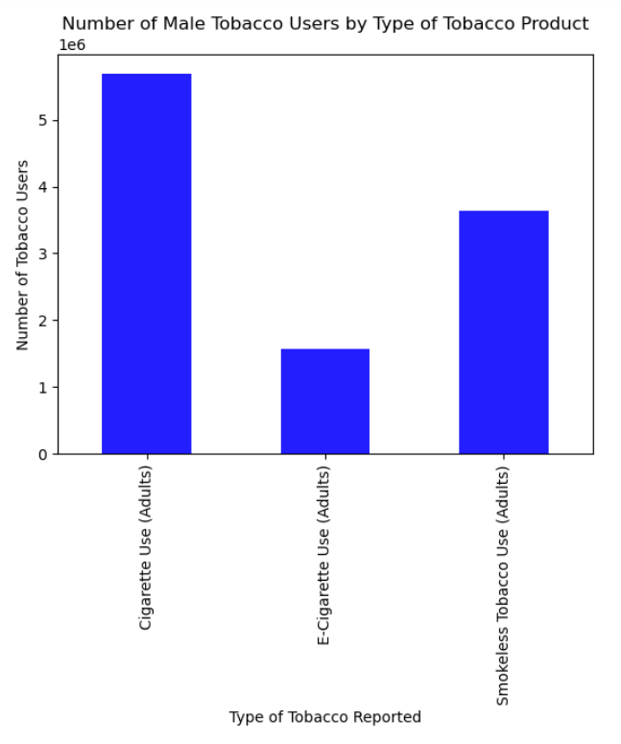
For the men reported in this data set, there were just over 5.6 million cigarette smokers, 3.6 million smokeless tobacco users, and 1.6 million e-cigarette smokers.
*number is reduced to ensure a graph that fits on a screen and is still legible

Slide 2
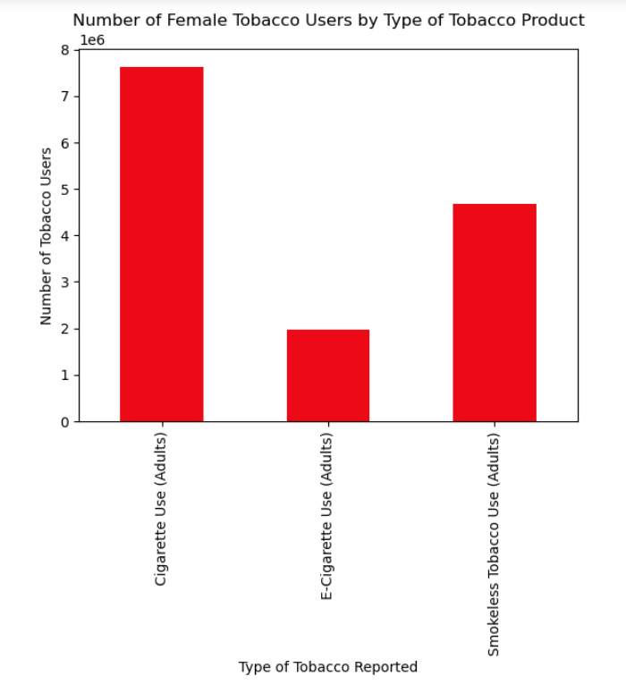
In total, there were 7.6 million cigarette smokers, 4.7 million smokeless tobacco users, and just under 2 million e-cigarette users
There were more women reported as cigarette smokers than in any category of men by 2 million people
*number is reduced to ensure a graph that fits on a screen and is still legible

Slide 3
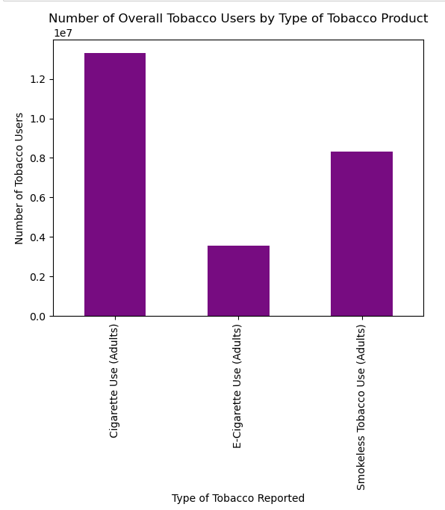
Overall, cigarettes are the most widely used form of tobacco between both genders. There were just over 13 million cigarette smokers reported throughout the US.
For both genders, e-cigarettes are used less than the other types of tobacco
Both genders had the same pattern of usage as cigarettes being the most prevalent, then smokeless tobacco, then e-cigarettes

