Slide 1
DDS: Case Study 01
Beers dataset

Slide 2

Data set/s
Beers.csv:
(Unique key) Brewery_ID: Brewery id of beer
7 columns
Breweries.csv:
4 columns
(Unique key) Brew_ID: Unique identifier of the brewery

Slide 3
Data set/s
We were provided 2 datasets.
Taken together the data contain information on selected breweries in all 50 states of the United States.
It includes their respective beer products;
associated Alcohol by Volume;
International Bitterness Unit;
And their home cities and states.

Slide 4
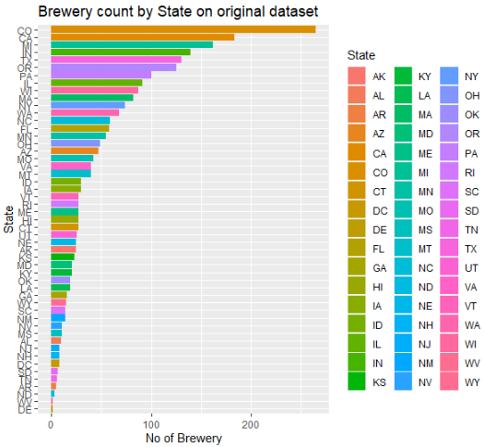
Wrangling / Exploratory Data Analyses
Number of breweries in each state?

Slide 5

Data Wrangling: Merging and Missing Values
Combined both data set
Left join using:
Merge(x=dataset, by=dataset$brew_ID, all.x = TRUE)
Missing Values:
Gg_miss_var() revealed significant missing data;
highest in IBU
62 in ABV column and on IBU column 1005 (~42% of obs.!!)
Resolved
Filled in using mice() from library(mice)

Slide 6
Data Wrangling
Resolved
Filled in using mice() from library(mice)
density plot:
filled in value matches the original density plot
Proceed to use data set with filled in values

Slide 7
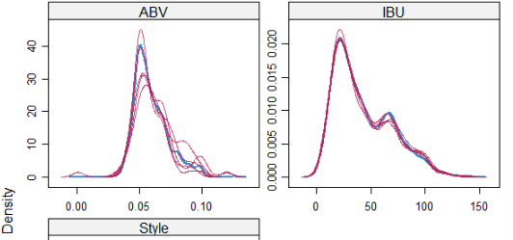
Wrangling /Missing values
Density
Density plots:
Original and filled in “NA”s:
No noticeable difference in distribution

Slide 8
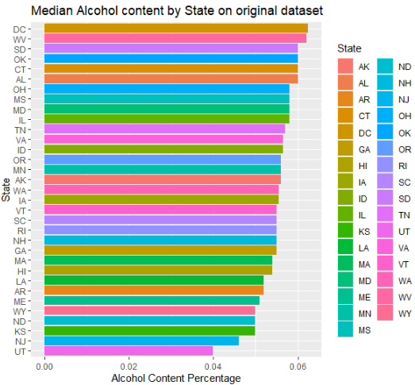
EDA: Median ABV by state
Highest two median ABV found:
Washington DC
West Virginia
Lowest two median ABV found:
New Jersey
Utah

Slide 9


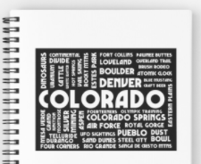

EDA: State with max ABV, most IBU
Max alcoholic beer
Most Bitter beer

Slide 10
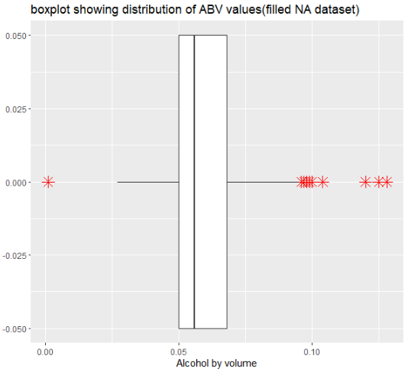
EDA: Summary Statistics for ABV: modified data
ABV
Range from 0.001 to 0.128
Median is 0.056 and Mean is 0.06
Note: These statistical values are the same in the original data set
ABV
Boxplot showing distribution of values.
Red shape are outliers showing, it is right-skewed

Slide 11
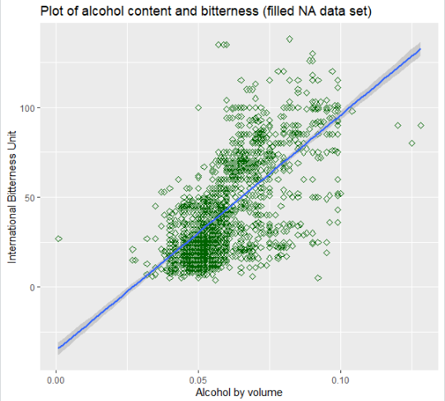
EDA: IBU versus ABV
This scatter plot shows a broad positive linear relationship between the alcohol content and bitterness of beer.
This relationship needs further investigation because it does not appear strong due to strong bitterness in many beers with high alcohol content

Slide 12

www.hiclipart.com

