Slide 1
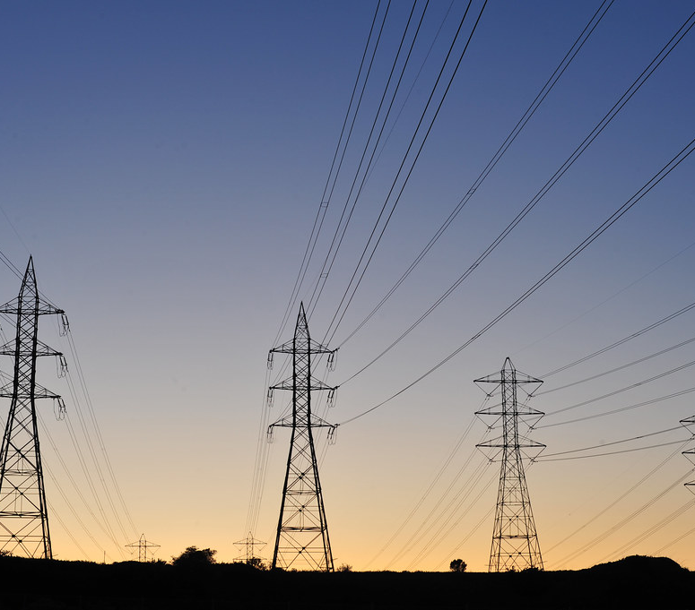

Electricity Price Forecasting
Dallas-Fort Worth-Arlington, TX
Ricco Ferraro, Nicole Norelli, Mingyang Nick YU
This Photo by Unknown author is licensed under CC BY-SA.
This Photo by Unknown author is licensed under CC BY-NC.

Slide 2
Objective & Data
Electricity Price in Dallas-Fort Worth-Arlington, TX
  Purpose: Model & Forecast electricity price for Dallas infrastructure & economic planning
  Source: St Louis Federal Reserve
  Dates: January 2000 to February 2022
  How: Time series techniques for short and long-term forecasts
    Additional variables: Temperature, Gas prices, Consumer Price Index

Slide 3
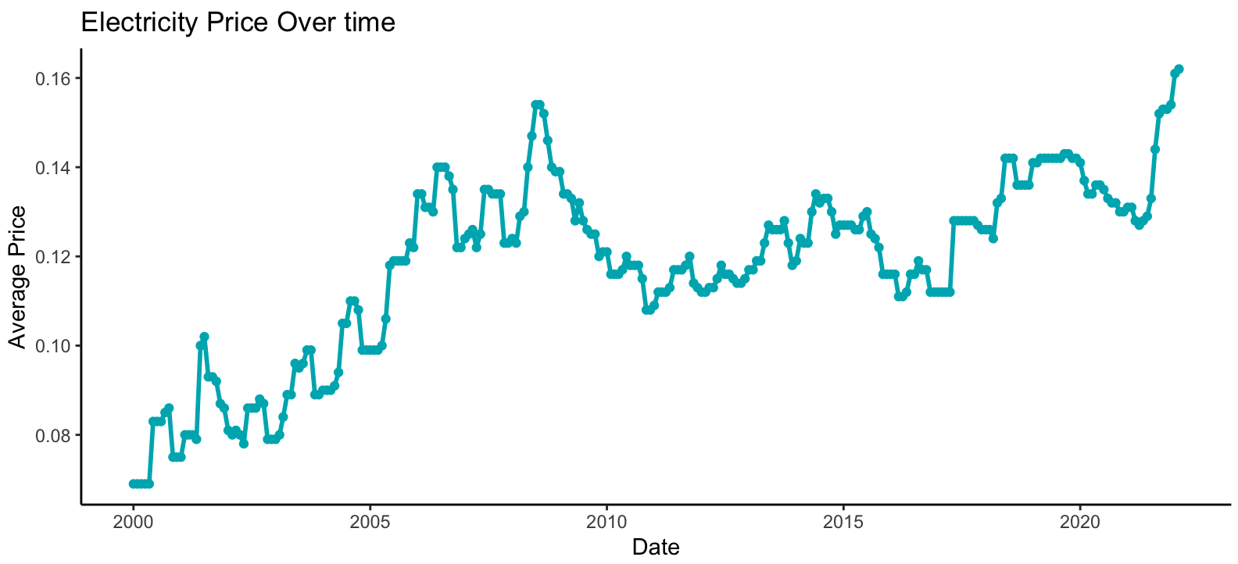
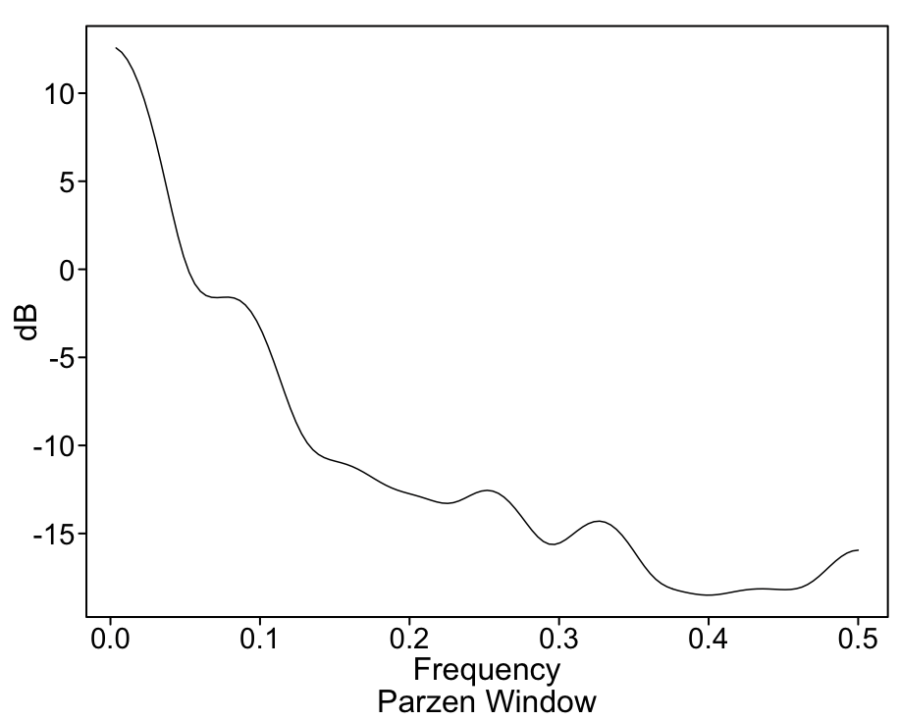
Recap: Electricity Prices
Not Stationary
Seasonal
Wandering

Slide 4
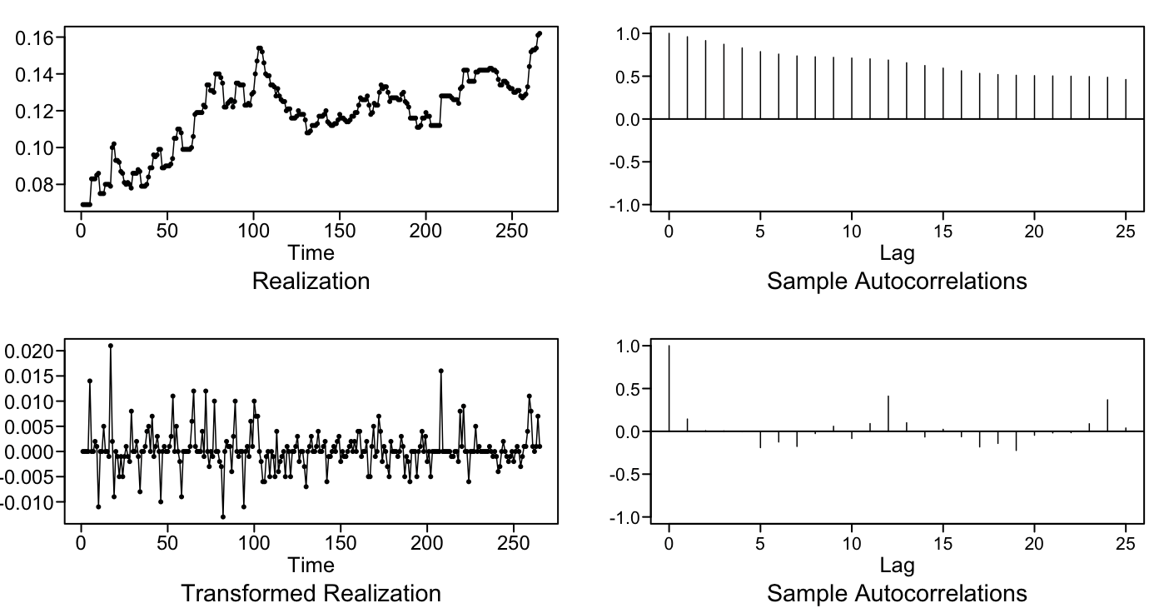
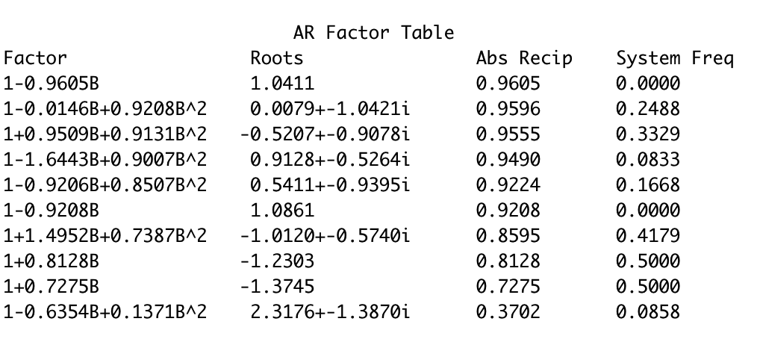
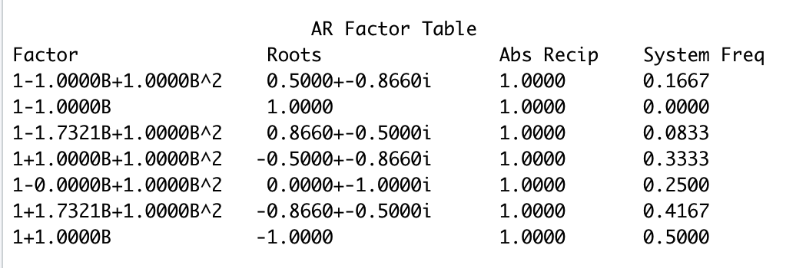
Overfitting Method
AR(16)
s=12 Seasonal Factors

Slide 5
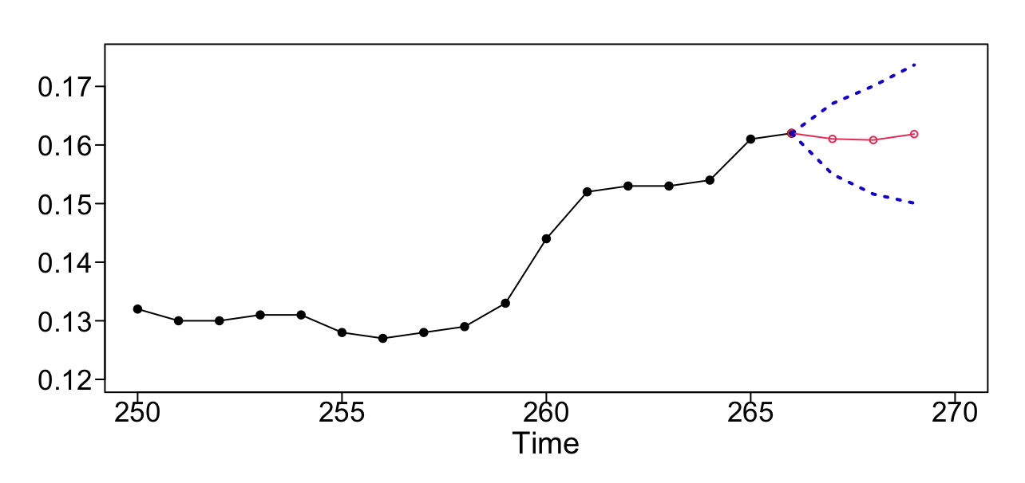
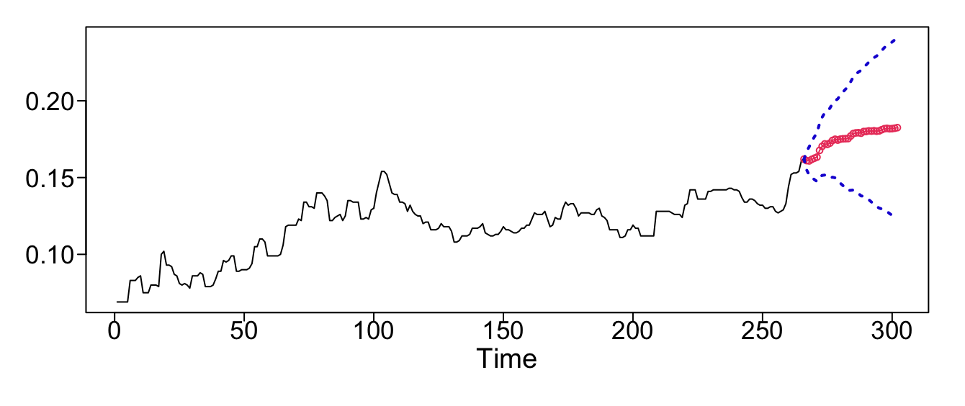
Best Univariate Model:
3 month forecast
1st difference
s=12 with coefficient of 0.4
Fit ARMA(7,4) to residuals
Model 1: ARIMA(7,1,4) s=12
with coefficient of 0.4
36 month forecast
$\left(1+.85B+.135B^{2}+0.92B^{3}+0.61B^{4}−0.17B^{5}+0.05B^{6}+0.00845B^{7}\right)\left(1−B\right)\left(1−0.4B^{12}\right)X_{t}=\left(1+1.015B+{.333B}^{2}+1.007B^{3}+0.794B^{4}\right)a_{t}$ , ${\hat{σ}}_{a}^{2}=0.000154$

Slide 6
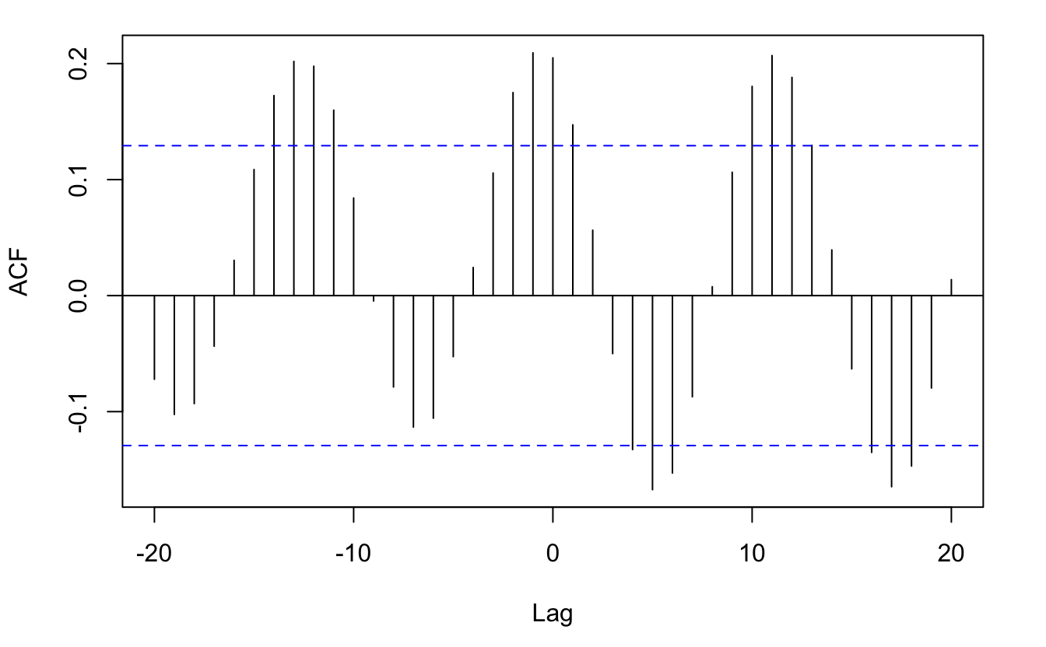
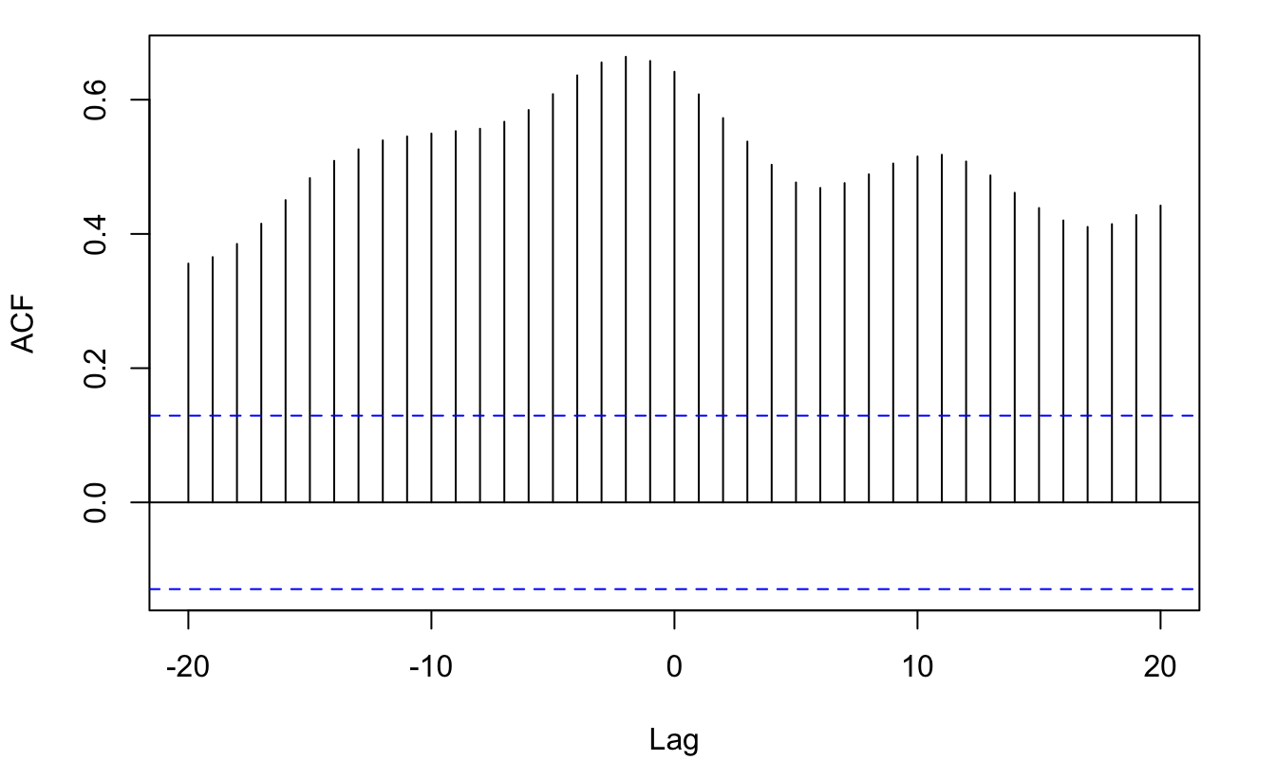
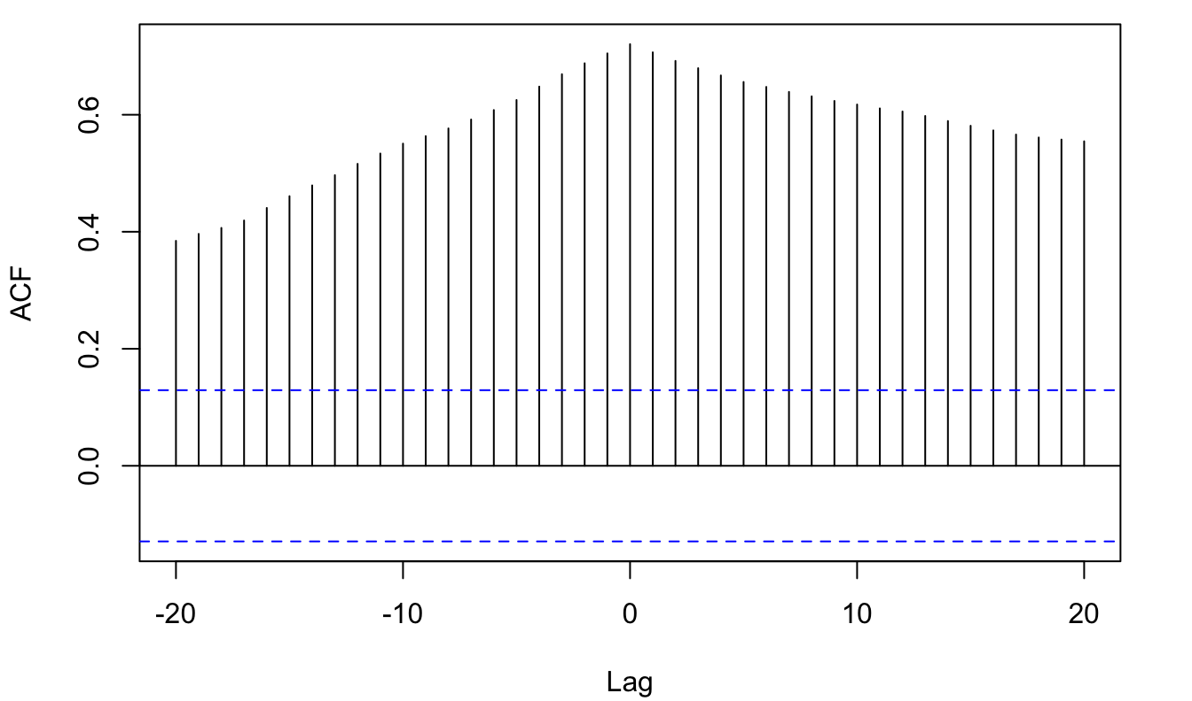
Additional Variables
CCF - Gas & Electricity
CCF - CPI & Electricity
CCF - Temperature & Electricity
Temperature (Dallas)
Gas (Dallas)
Consumer Price Index (CPI)

Slide 7
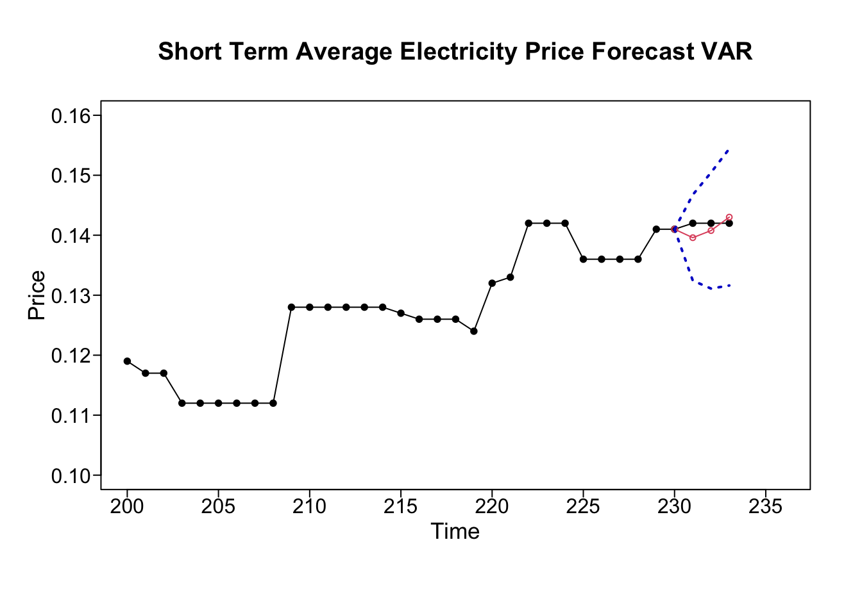
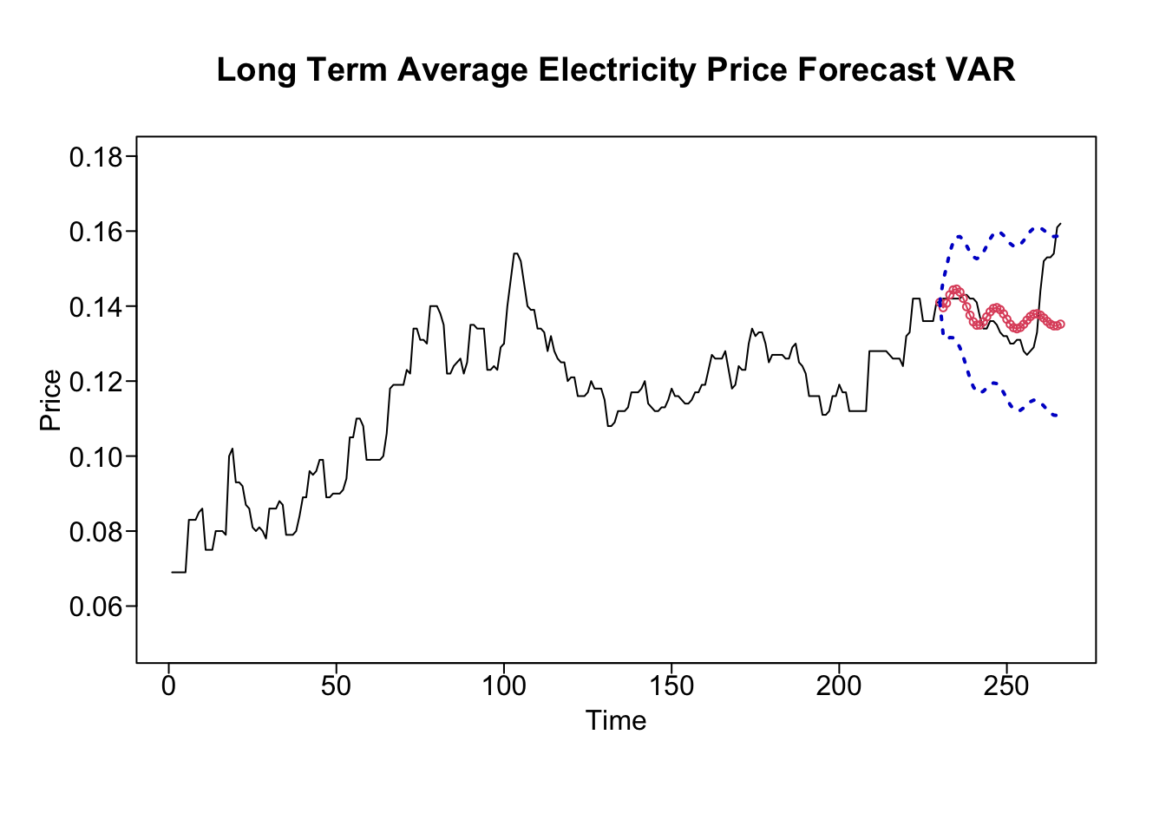
VAR Model:
Explored:
  Lags of 3, 6, 11, and 13
  Endogenous vs Exogenous variables
  Train 1:230, test final 36
Best lag = 3 (3 and 36 month forecast)
  3 month ASE: 0.000002781
  36 month ASE: 0.00009242
AIC: -658.2016

Slide 8
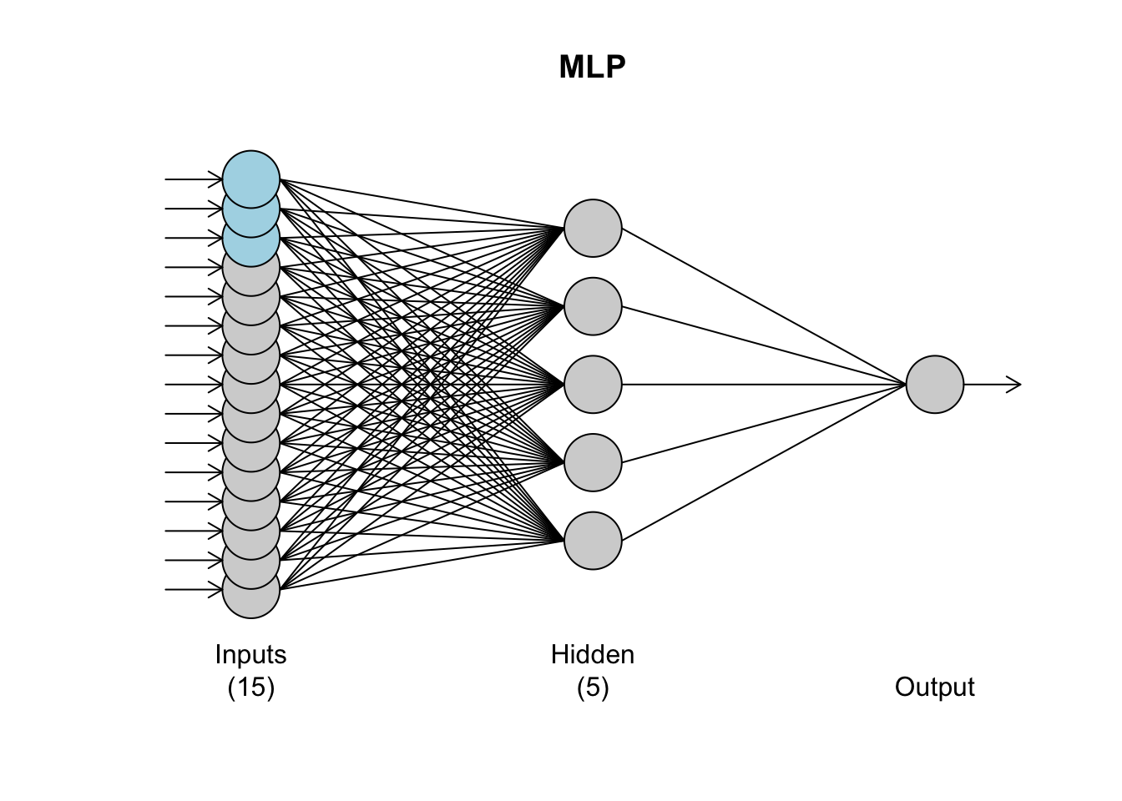
Multilayer Perceptron (MLP)
Includes temperature, gas, and CPI
Train 1:230, test final 36
  Forecast temp, gas, & CPI with univariate MLP
Best model
  5 hidden nodes
  Univariate lags : 1-12
  3 regressors (lag 1)

Slide 9
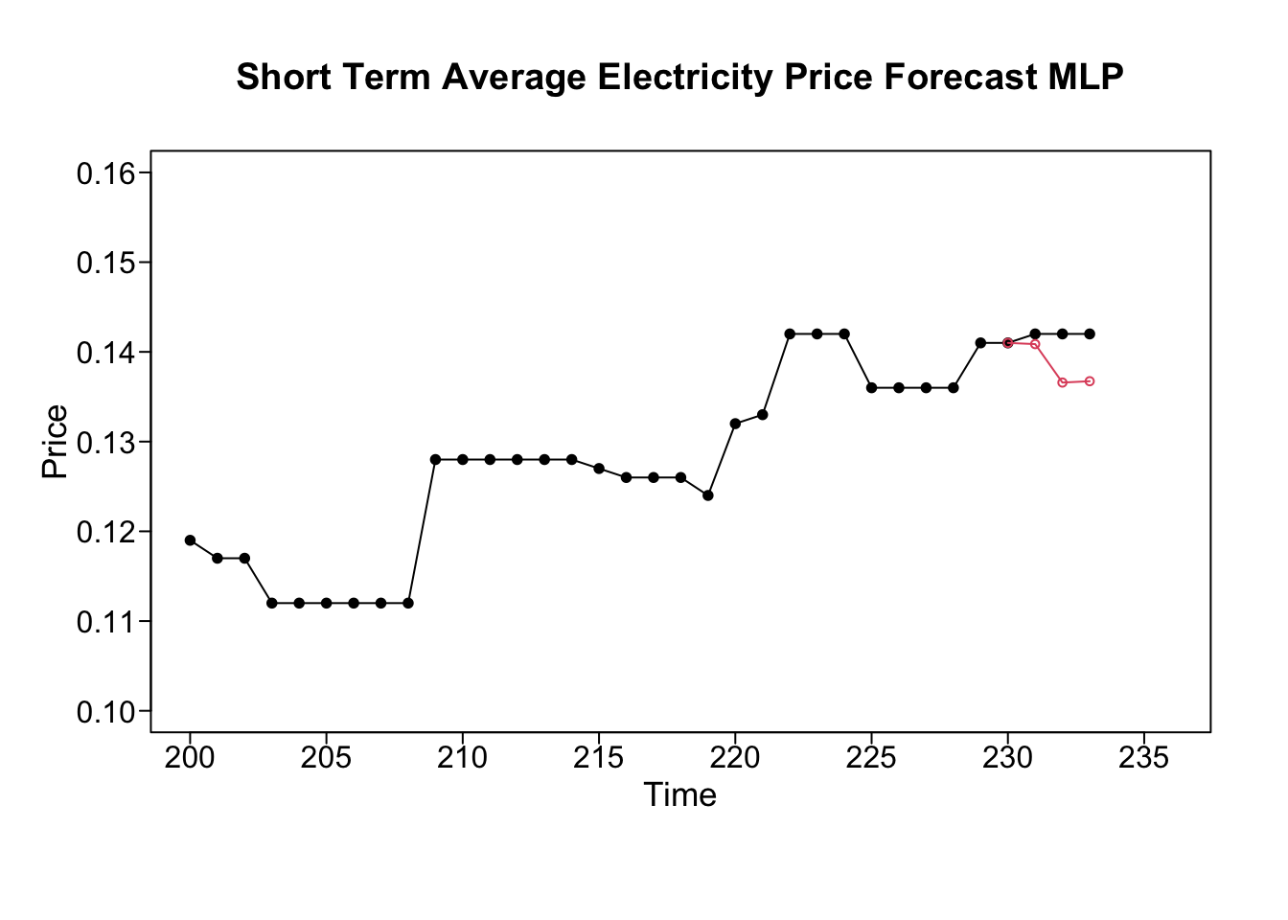
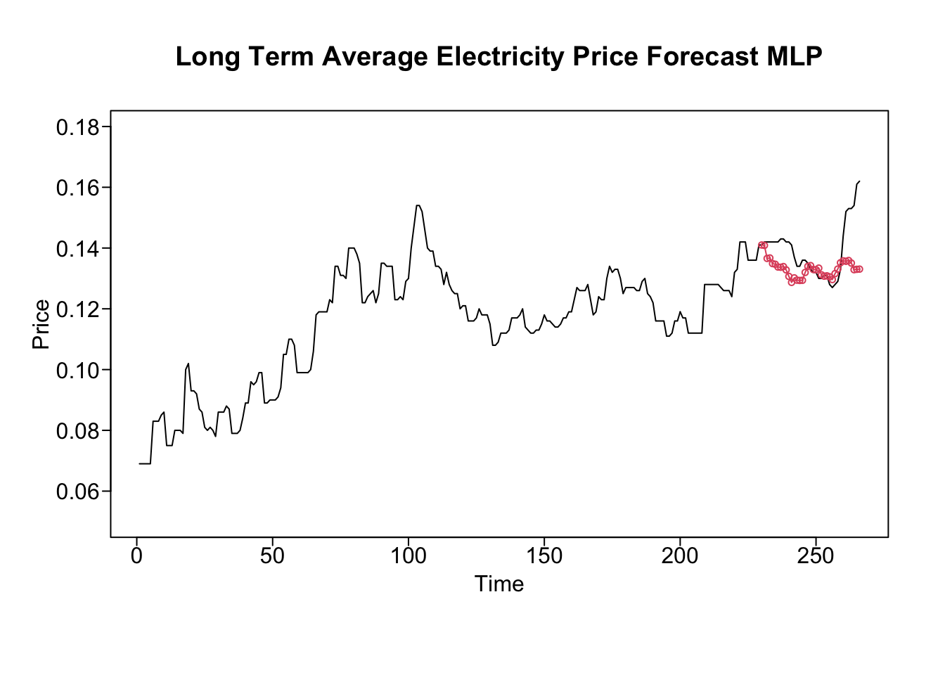
MLP Forecasts
3 month ASE: 0.00001947
36 month ASE: 0.000111

Slide 10
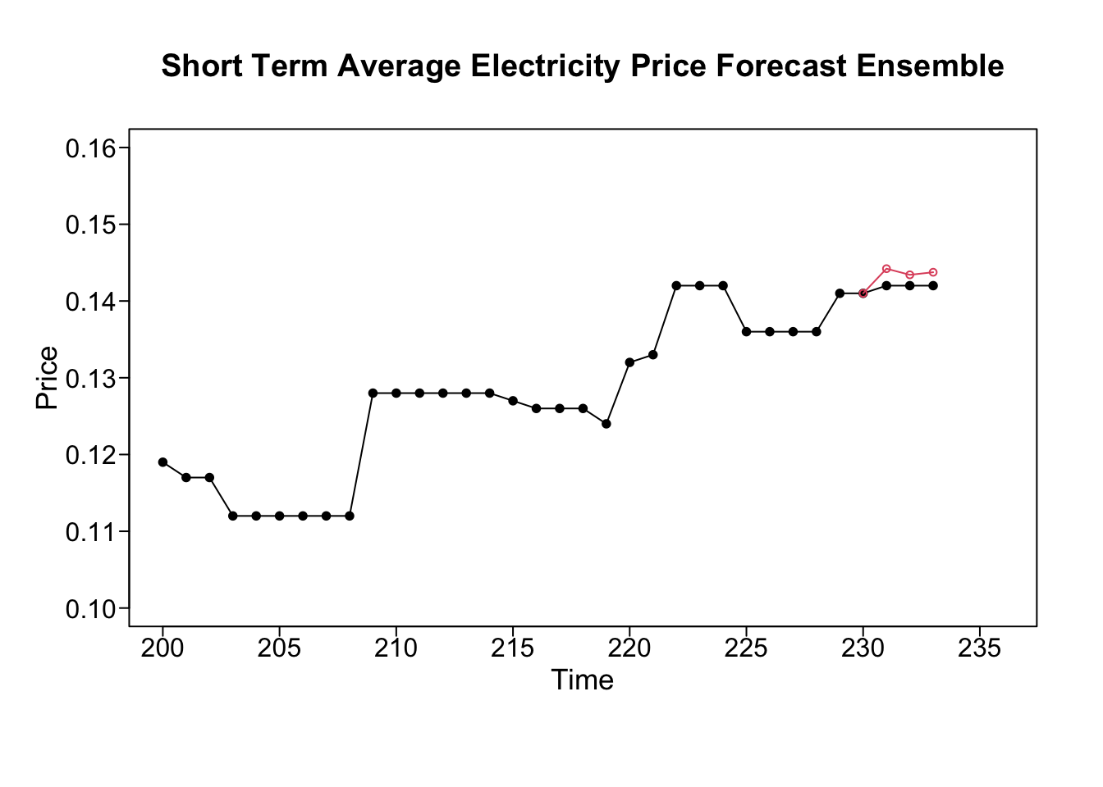
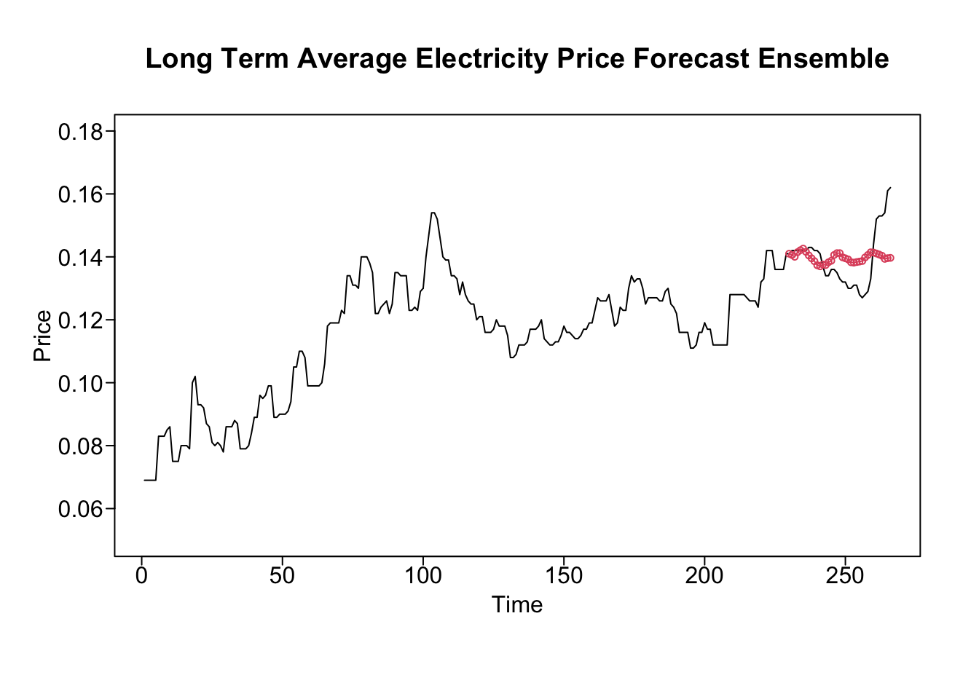
Ensemble 1:
ARIMA(7,1,4) + VAR + MLP
Mean of best univariate, VAR, and MLP

Slide 11
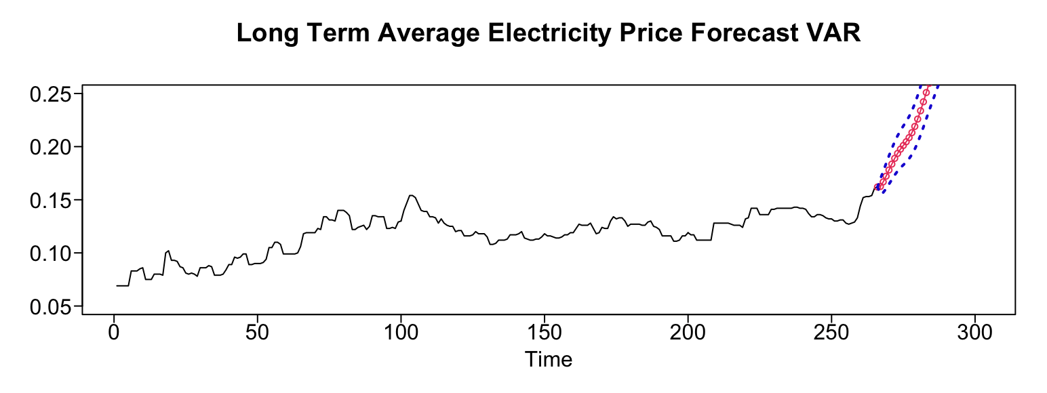
Ensemble 1: Future 36 month

Slide 12
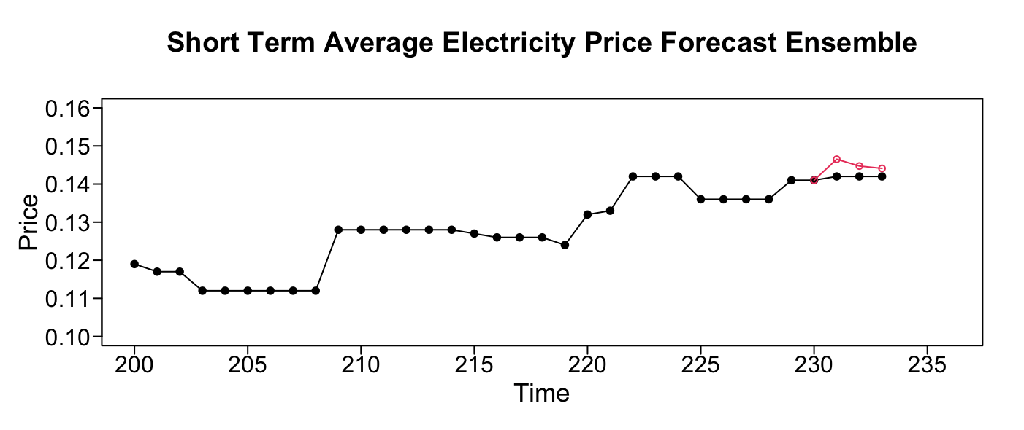
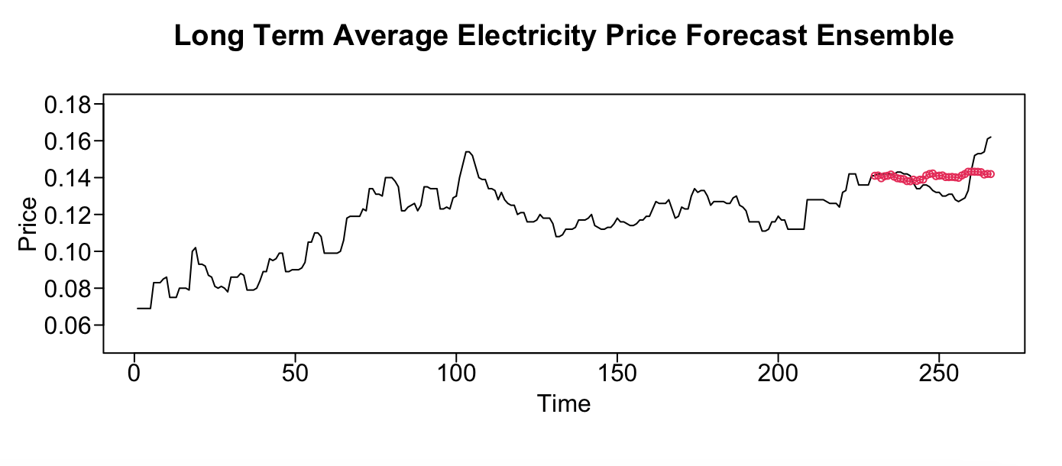
Ensemble 2:
ARIMA(7,1,4) + MLP
Mean of best univariate and MLP
Best 36 month forecast

Slide 13
Results
# | Model Name | Test ASE (3 month) | Test ASE (36 month) | Rolling ASE (horizon = 3) | Rolling ASE (horizon = 36) | AIC
1 | ARIMA(7,1,4) s=12, coefficient 0.4 | 0.0000599 | 0.0001725 | 0.000016 | 0.000196 | -2862.432
2 | VAR | 0.000002781 | 0.00009242 |  |  | -658.2016
3 | MLP | 0.00001947 | 0.000111
4 | Ensemble (1,2,3) | 0.0000033 | 0.0000782
5 | Ensemble (1 & 3) | 0.00001079 | 0.00007769

Slide 14
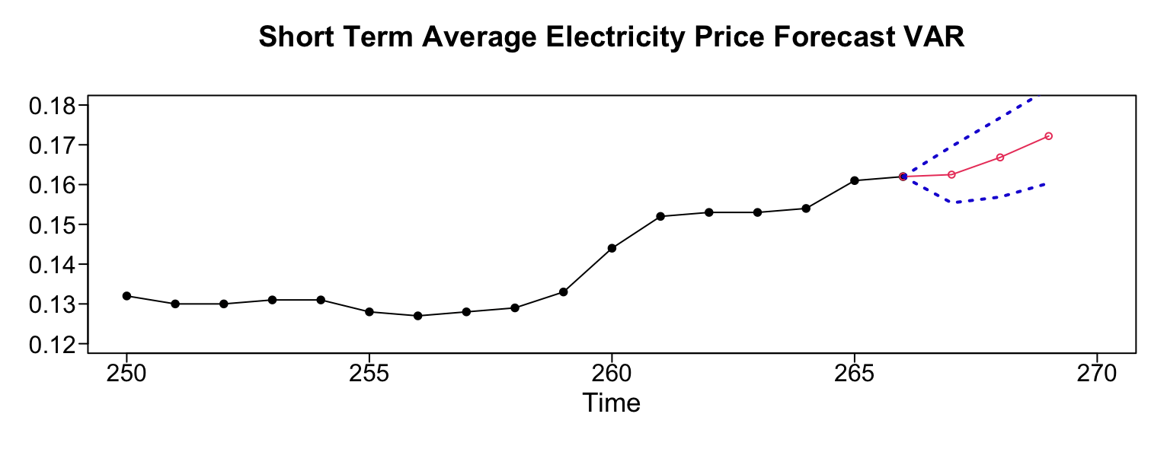
Model Recommendation: 3 month

Slide 15
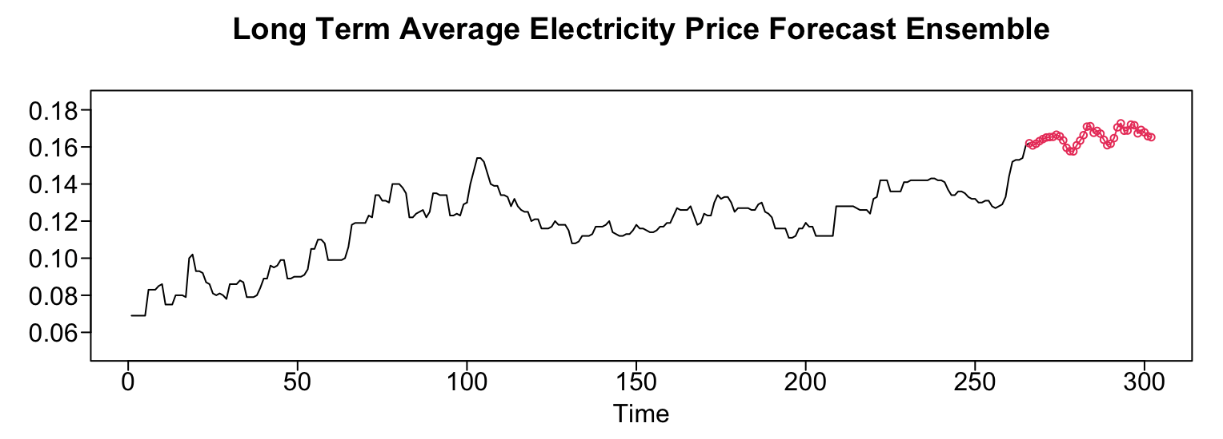
Model Recommendation: 36 month

Slide 16

Questions?
Ricco Ferraro
  rferraro@mail.smu.edu
Nicole Norelli
  nnorelli@mail.smu.edu
Mingyang Nick Yu
  nyu@mail.smu.edu

