Slide 1

Unit title& Code: CIS020-1
‘Shared power’
Presented By:
Name Student Number
1.
2.
3.
4.
5.

Slide 2
Introduction
‘Shared power’ Information System is System that is designed to allow tradesmen share expensive and specialized tools rather than buying them.
The system allows only registered users or tradesmen to add details of the tools that are available for hire.
Other registered members can search for the tools up to 6 weeks, its availability and can hire the tool for up to a maximum of 3 days.
After the booking of the tool, The tool can be collected by the user or Dispatched to the user by a rider which will attract an additional shipping fee. Also returning the booked tool late will attract a fine equals to double the day rate
At the end of every month, An Invoice is produced with all information about the hire charges, delivery charges and lateness charges if applicable. Also an Insurance flat charge cost of £5 is added to all monthly bill.

Slide 3
Tools and Platforms
Programming Language
Python. An interpreted, high-level, general-purpose programming language used to develop software and Web applications
Tools and Platforms
PyCharm. An integrated development environment(IDE) used in computer programming, specifically for the Python language. It is developed by the Czech company JetBrains
Programming Paradigm
Object Oriented Programming Paradigm. The use of Objects(Having both data and Methods) and Classes in the development in order to incorporate Modularity and Code Reuse

Slide 4
Shared Power features/Scope
Add /Delete tool. Add/delete details of tools to the system for hiring purposes
View tools. View the Details of Added tools
Search Tools. Finding by Looking for the tools in the system
Book Tools. Hiring of the tools available
Cancel tool booking. Negate the tool hiring process
Change Tool Detail. Making changes to the tools information
Return a tool. Returning the tools after use
View Invoice. Viewing of monthly charged and other charges

Slide 5
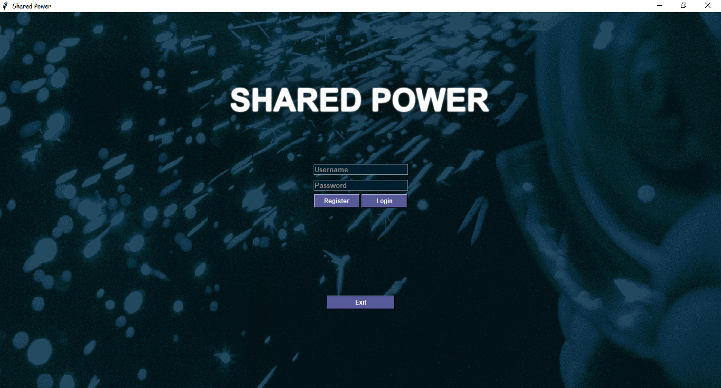
Systems Functionality
On running the application from PyCharm IDE, The application runs without an error and brings the following first page. The page allows the tradesmen to register if they are new or login if they are existing users.

Slide 6
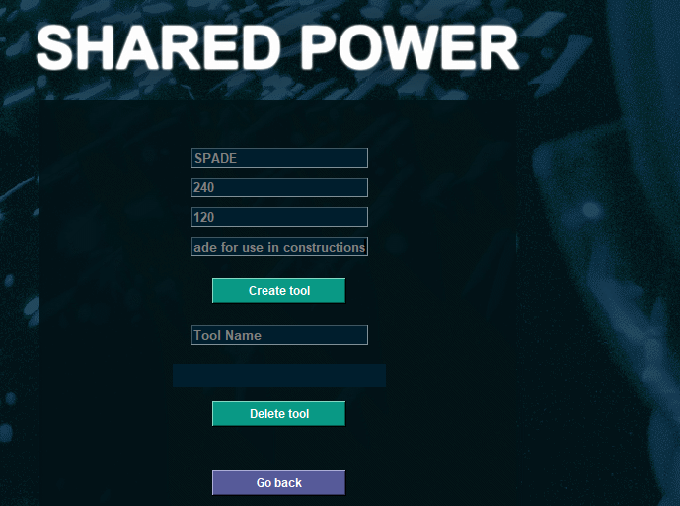
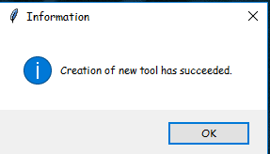
Adding a tool
On adding the Details of the tool, Click “Create tool” Button to add the tool ready for hire.

Slide 7
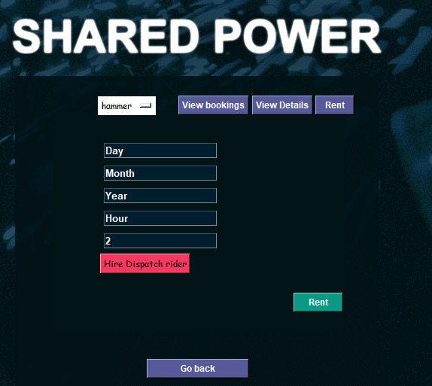
Rent/Hire a tool
To hire a tool, You provide the details of the days, months, year, hour for hiring in order to calculate the charges and for record keeping

Slide 8
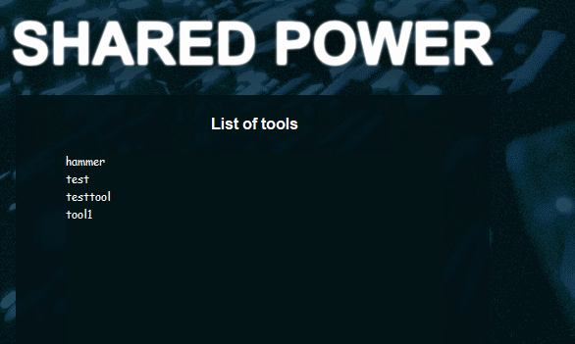
View tools
This is where you are able to see the available tools in the store for hire

Slide 9
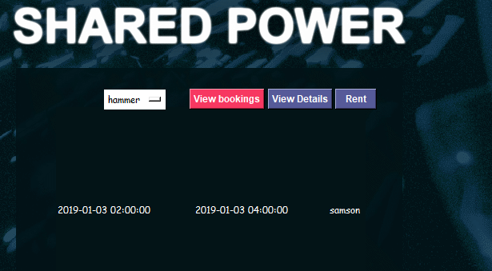
View Bookings
This shows the details of all the hiring made and who booked the tool and at what date/time

Slide 10
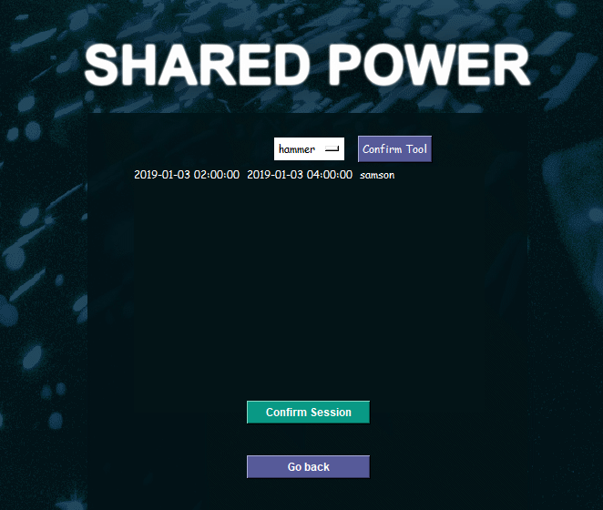
Cancel tool Booking
Cancel the Booked Tool for some other reasons.

Slide 12
References
Meier, B.A., 2017. Python GUI Programming Cookbook. Packt Publishing Ltd.
Prince, R. and Davis, H., 2016. Computer Application: GUIs.
Johansson, R., 2019. Introduction to Computing with Python. In Numerical Python (pp. 1-41). Apress, Berkeley, CA.
Sinha, S., 2017. Python Environment. In Beginning Ethical Hacking with Python (pp. 39-41). Apress, Berkeley, CA.

Slide 13


