Slide 1


Group 5
Slide 1/41

Slide 2
Introduction
Supervisor: Mr. Đỗ Đức Minh Quân
Team leader: Nguyễn Hữu Kỳ Long
Member: Nguyễn Đình Tân
Member: Nguyễn Xuân Ý
Member: Lê Phương Bình
Slide 2/41

Slide 3
Outline
Scenario problem
Our solution
System overview
Overview components
Overview hand gesture recognition algorithm
Development tool
Features and Demo
Future plan
Slide 3/41

Slide 4


Scenario problem
The speak language is the common way to communicate in life
Dumb person must use other way to communicate, it is called hand sign language
Ordinary people talking to one person or a mute like to present / his ideas, presented in a meeting, but they could not understand each other's language
Two dumb person talk with each other but they have distinct hand sign language, which way can they understand each other’s sign
Slide 4/41

Slide 5


Our solution
Using hand gesture recognition. Translating hand signs into content and then show them
Small device has camera can capture hand signs and then translate them into text or sound with the same meaning
Slide 5/41

Slide 6
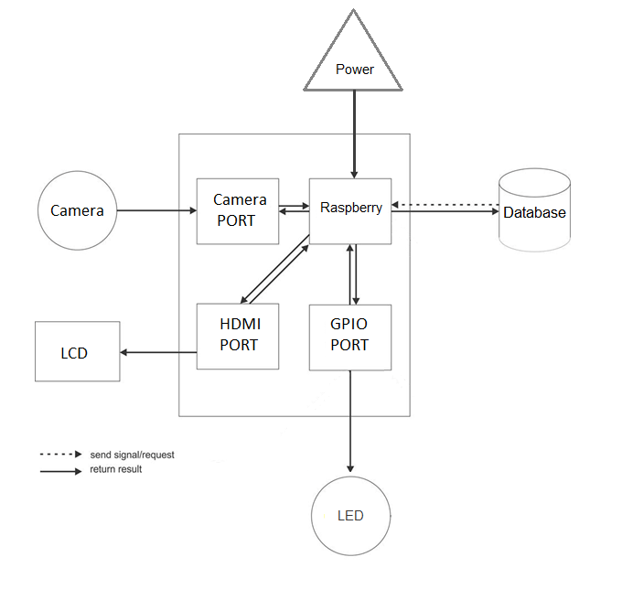
System overview
Slide 6/41

Slide 7
Overview components
Raspberry Pi B2
Lipo Battery
LM2576ADJ - 3A UNI REG Board
Slide 7/41

Slide 8
Raspberry Pi B2
CPU: Quad core 900MHz
RAM: 1GB SDRAM
40 GPIOs
HDMI output
Slide 8/41

Slide 9
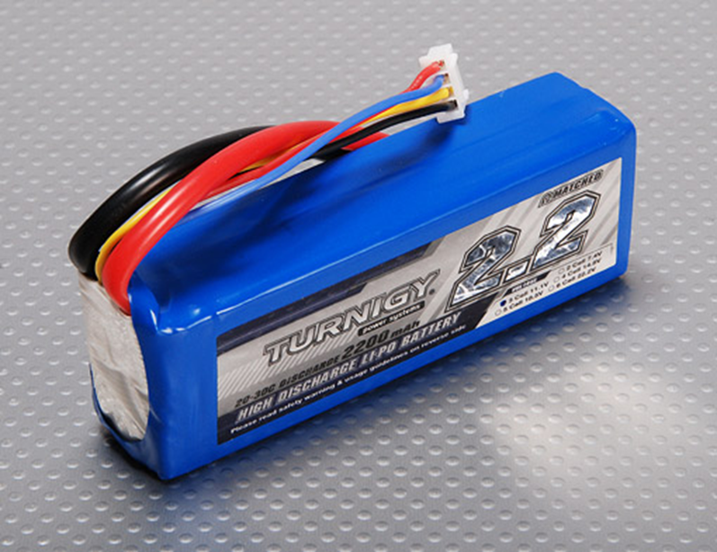
Lipo battery supplies 11.1v and 1A
Slide 9/41

Slide 10
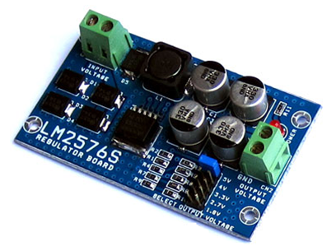
LM2576ADJ - 3A UNI REG Board
Overview:
- UNI-REG board allows changing voltages from 7-23V AC (or 9-32V DC) to 5V, 4V, 3.3V, 2.7V or 1.8V.
- Circuit Board using LM2576 - Step-Down Voltage Regulator.
- On-board screw-terminals are available for easy connection.
Slide 10/41

Slide 11
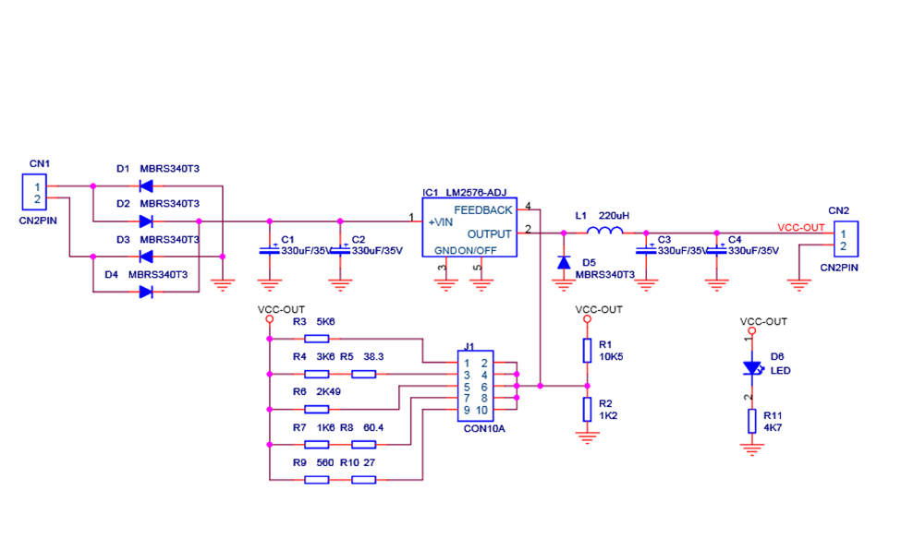
LM2576ADJ - 3A UNI REG Board
Slide 11/41

Slide 12
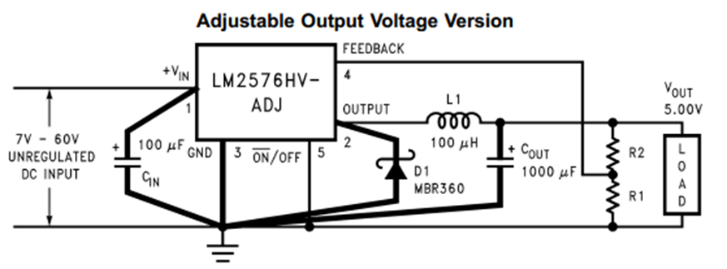
LM2576ADJ - 3A UNI REG Board
VOUT = VREF (1+ R2/R1)
R2 = R1(VOUT/VREF - 1)
Where VREF = 1.23v, R1 between 1k and 5k
Slide 12/41

Slide 13
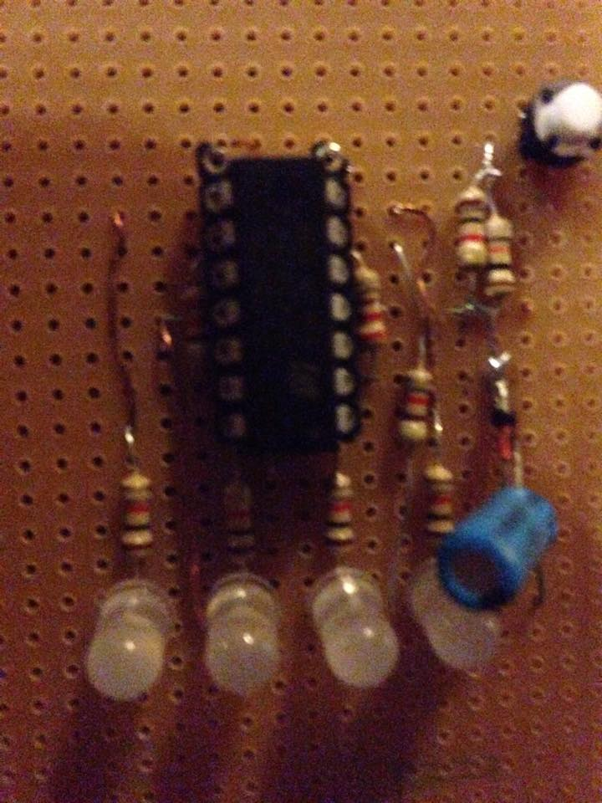
Circuit display the battery capacity via LED
Slide 13/41

Slide 14
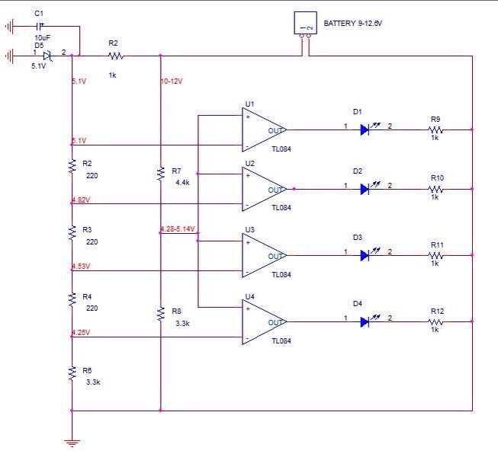
Circuit display the battery capacity via LED
Slide 14/41

Slide 15
Overview hand gesture recognition algorithm
Operating principles of hand gesture recognition
All images of hand sign about a letter in Alphabet must have same ID
Training hand sign database before recognition
Hand sign recognition and return
Slide 15/41

Slide 16
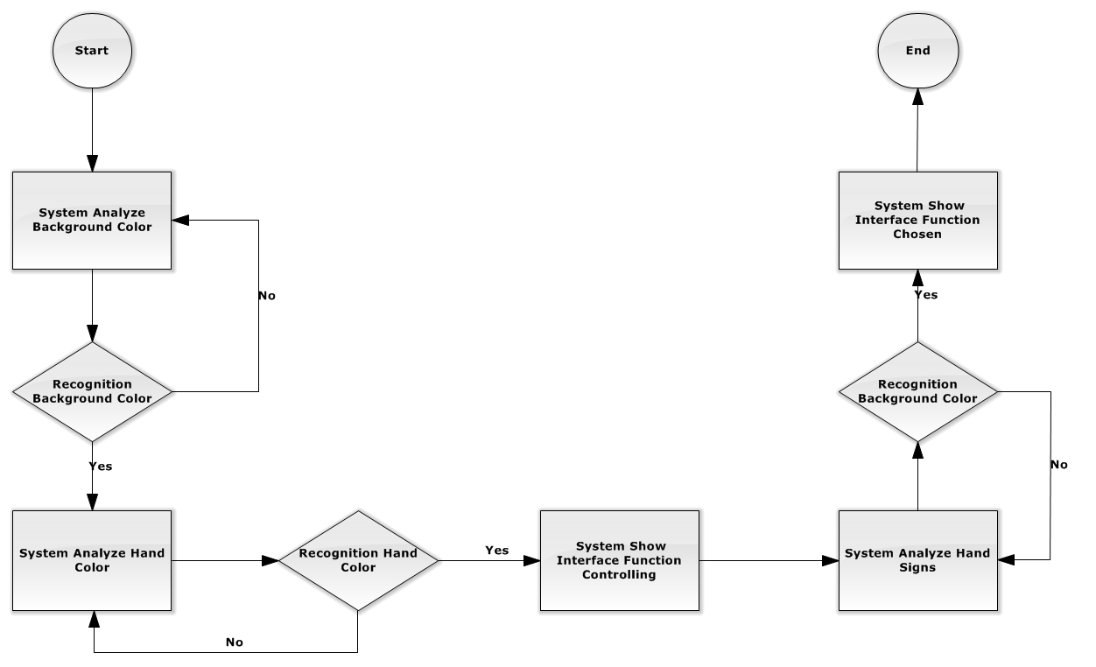
Image processing flowchart
Slide 18/41

Slide 17
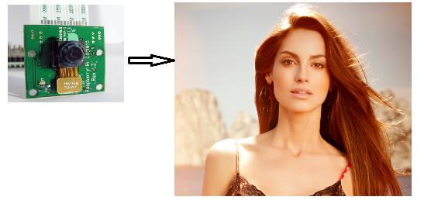
Hand sign recognition processing
Capture background to sampling background color
Slide 19/41

Slide 18
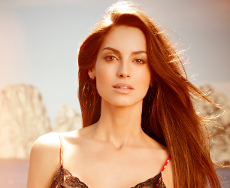
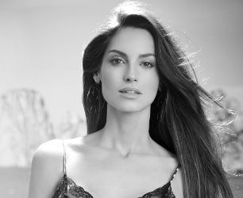
Hand sign recognition processing (Cont.)
Capture hand to sampling hand color
Slide 20/41

Slide 19
Hand sign recognition processing (Cont.)
Capture hand
Slide 20/41

Slide 20
Hand sign recognition processing (Cont.)
Convert image to gray
Slide 20/41

Slide 21
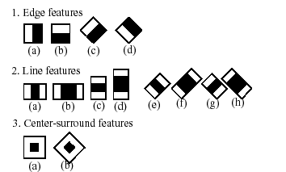
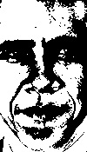

Hand sign recognition processing (Cont.)
Face detecting using haar-like features
Slide 21/41

Slide 22
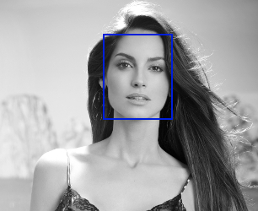
Facial recognition processing (Cont.)
Face detecting using haar-like features
Slide 22/41

Slide 23
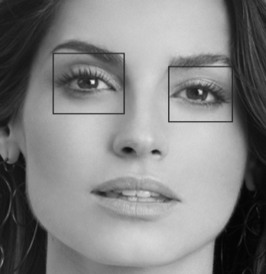
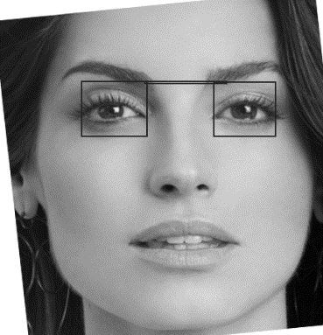
Facial recognition processing (Cont.)
Cut small image and eyes detecting, using haar-like features too
Rotate face if not balance, base eyes
Slide 23/41

Slide 24
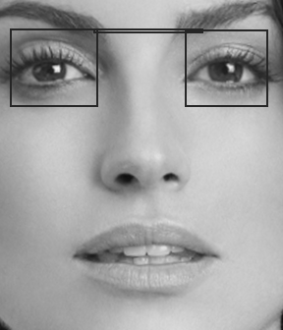
Facial recognition processing (Cont.)
Re-cutting. Result is a complete face
Use to save to training database
Use to recognize face. Result of predict function is ID of training face. Result =-1 if distance is too far
Slide 24/41

Slide 25
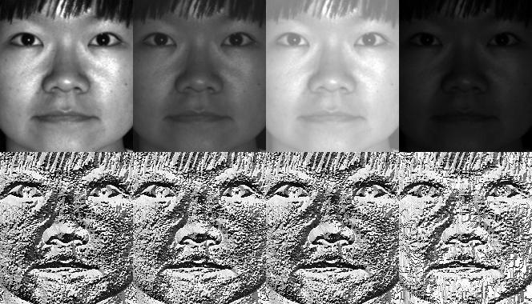
Local binary patterns histogram
Slide 25/41

Slide 26
Development tool
QT Creator
Slide 26/41

Slide 27
THE END
THANK YOU FOR YOUR LISTENING
Slide 41/41

