Slide 1

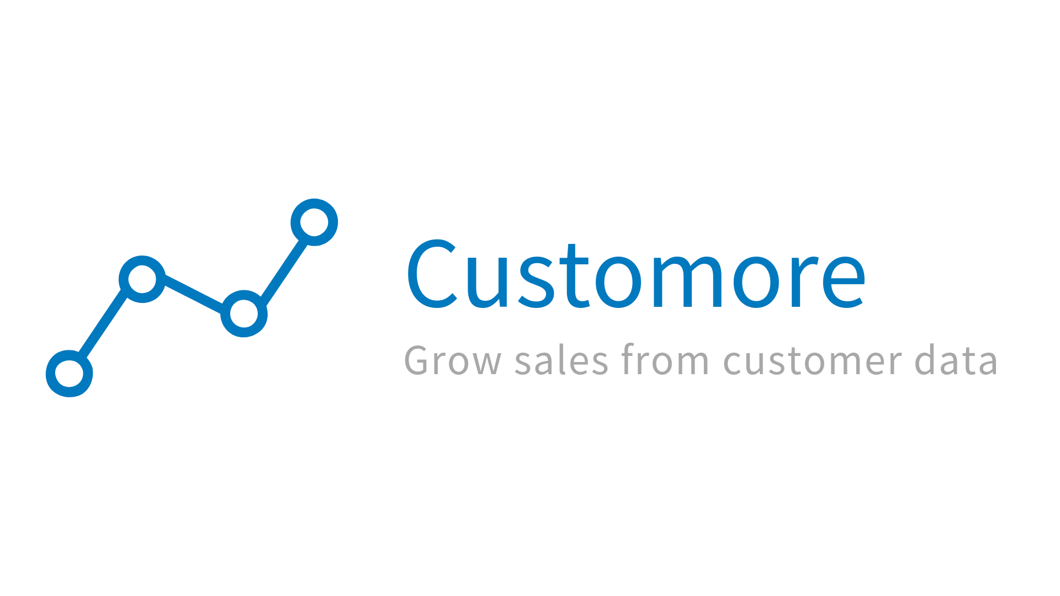
Customore sales performance dashboard
Name: Van Hoang Nam Nguyen

Slide 2
Contents:
1/ Sales performance data from internal Order Management System
2/ Traffic source performance data
3/ Recommendations

Slide 3
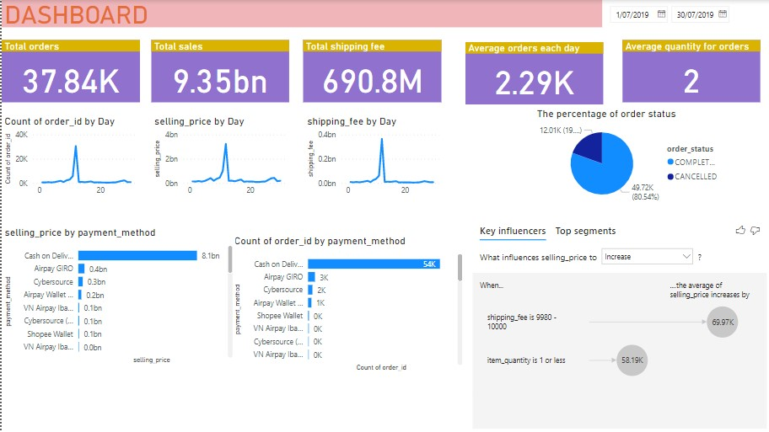
Descriptive statistics

Slide 4
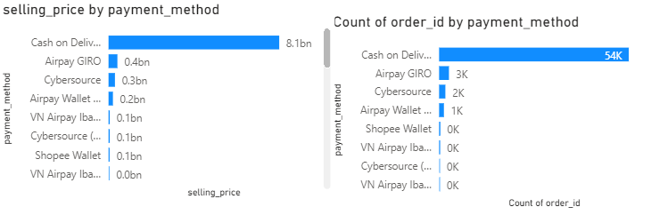
Selling price and total orders are ordered by payment method
Cash of Delivery (COD) is the most effective payment method

Slide 5
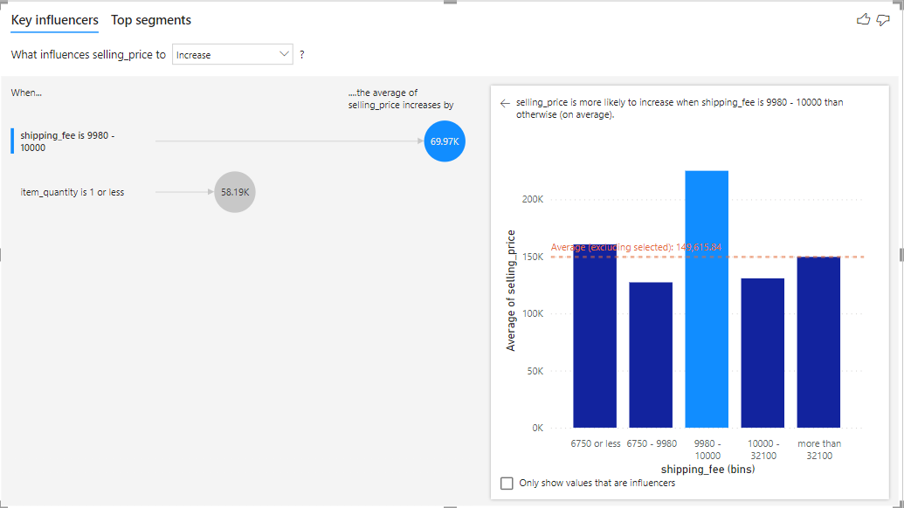
Factors affects an increase in Sales
Therefore, shipping fee is the most affected factor

Slide 6
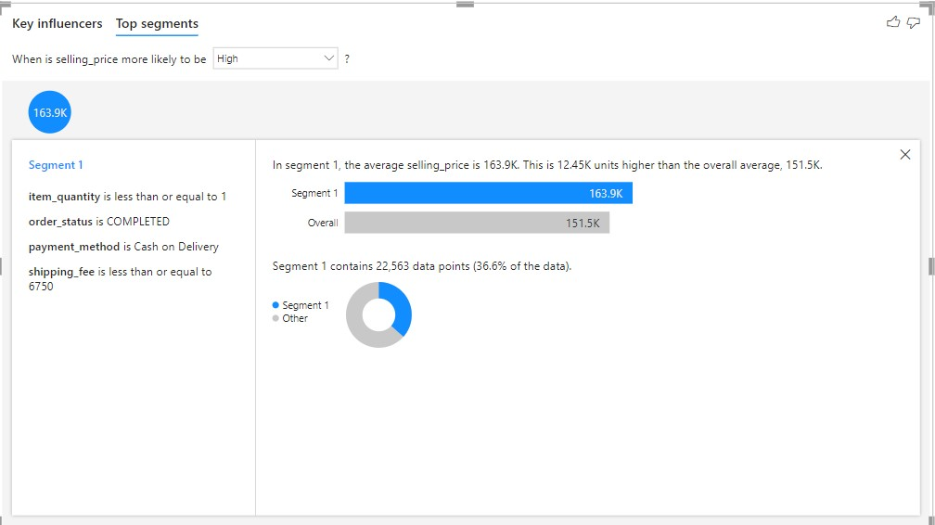
Show Top segment

Slide 7
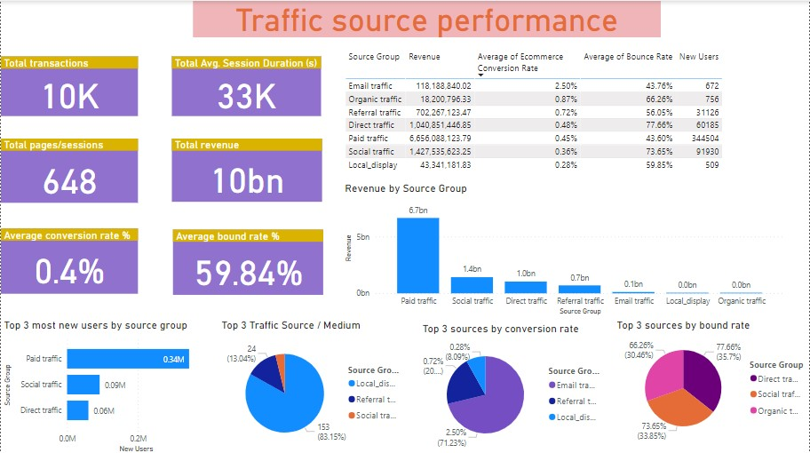
Traffic source performance

Slide 9
Conclusion
To achieve the KPI of target sales:
=) Item quantity <= 1,order status is completed, Cash of delivery, shipping <= 6,750
=) Email traffic is the best to enhance the average of ecommerce conversion rate, which increase the sale of company
=) Direct traffic, social traffic and organic traffic are alarming situations

Slide 10



Recommendations

Slide 11
THANK YOU FOR LISTENING

