Slide 1
Operations Scheduling
Act I – The Single Machine Problem
General problem: given processing times, setups times, due dates, and job flows on machines and workstations, what is the optimal sequence for completing the jobs?

Slide 2
Operations Scheduling - Definition
The process of organizing, choosing, and timing resource (e.g. machines, workstations), usage to carry out all the activities (jobs) necessary to produce the desired outputs at the desired times while satisfying a number of time and relationship constraints among the activities (jobs) and resources (machines).
If resources are not limited, a scheduling problem does not exist!

Slide 3
Types of Scheduling Problems
Job shop
  shop floor control
personnel
  shift scheduling
facilities
  operating rooms in hospitals
vehicles
  routing
vendors
  JIT deliveries
projects
  project planning networks
The Shop Floor anager

Slide 4
The Planning Hierarchy
Process Question(s) answered Result
Forecasting What are the requirements? Forecasted Demands
Strategic Who will produce what? Aggregate Production
Planning levels
Tactical What are the resources? Staffing, overtime,
Planning contracting
MRP/JIT How much do we need when? Planned order releases
Operational How will it be produced? Work Schedule
Planning

Slide 5
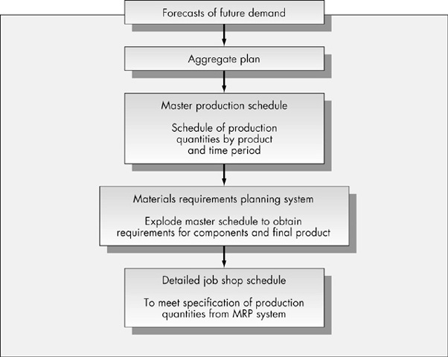
Hierarchy of
Production Decisions

Slide 6
Schedule versus Sequence
Schedule – the order in which jobs are to be completed providing a start time for each job on each machine
Sequence – only provides the order in which jobs are to processed

Slide 7
Solving a Scheduling Problem
Which resources to assign to each task
  Allocation problem
  Use mathematical programming
When each task is to be performed
  Scheduling and sequencing decision
  Solve using
    combinatorics (exhaustive enumeration)
    algorithms
    simulation
    network methods
    heuristics

Slide 8
Job Shop Scheduling Characteristics
job arrival pattern
  static – jobs arrive simultaneously (batch)
  dynamic – jobs arrive continuously over time
number and variety of machines in the shop
  parallel machines
number of workers in the shop
flow patterns
measures of effectiveness
  meet due dates
  minimize WIP inventory
  minimize average flow time in system
  provide high machine/worker utilization
  reduce setup times
  minimize production costs

Slide 9
Some Definitions
n jobs
m machines
Flow shop – n jobs must be processed through m machines in the same order and each job is processed exactly once on each machine.
Job shop – Not all jobs require exactly m operations and some jobs may require multiple operations on a single machine.
Open shop – jobs have no particular routing (e.g. car repair shop)
Sequential processing – the m machines are distinguishable and different operations are performed by different machines.
Parallel processing – any job can be processed on any machine; i.e. the machines are identical.
Flow time – the flow time of job i is the time that elapses from initiation of the first job on the first machine to the completion of job i; i.e. the amount of time job i spends in the system.
Makespan – the flow time of the job that is completed last; i.e. the time required to complete all jobs.
Tardiness – The positive difference between the completion time (flow time) and the due date of a job (zero if difference is negative).
Lateness – the difference between the job completion time and its due date. Lateness can be either positive or negative.

Slide 10


What are machines?
In studying operations scheduling, we use the term “machines” in a very generic way. In manufacturing a machine may be an automatic molding machine; in a health care system, it may be an x-ray machine; in a service industry, it may be a repair person; at an airport, it may be a runway.
Corresponding “jobs” would be planned order releases, patients, customers, and airplanes.

Slide 11
Measures of Effectiveness - General
Efficient utilization of resources
  minimum cost or maximum profit
  high utilization rates (low idle time)
Rapid response to demands
  minimize completion times
Conformance to prescribed deadlines
  meet due dates
  minimize number of late jobs

Slide 12
Measures of Effectiveness - Specific
Meet due dates
Minimize work-in-process (WIP) inventory
Minimize average flow time
Maximize machine/worker utilization
Reduce set-up times for changeovers
Minimize direct production and labor costs
(note: that these objectives can be conflicting)

Slide 13
Example - Measures of Effectiveness
Plane: 1 2 3 4 5
time to land(minutes) 26 11 19 16 23
number passengers 180 12 45 75 252
scheduled arrival 5:30 5:45 5:15 6:00 5:40
1. Minimize total time to land all planes (makespan)
Minimize average time to land all planes (mean flow time)
Land as many people as quickly as possible (weighted makespan)
Minimize tardiness (average or maximum)
Other considerations – remaining fuel, first-come, first-serve,
perishable cargo

Slide 14

Towards a Mathematics of Scheduling
Notation
Assumptions
A Theorem
Problem specification
Some solutions

Slide 15
Notation
n = number of jobs
m = number of machines
t_{ik} = time to process job i on machine k (t_{i} if m = 1)
r_{i} = release time (available date) of job i
d_{i} = due time (date) of job i
w_{i} = weight (value) of job i

Slide 16
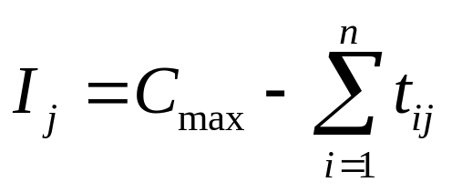
Notation - Performance Measures
C_{i} = completion time of job i
F_{i} = C_{i} – r_{i} , flow time of job i
L_{i} = C_{i} – d_{i} , lateness of job i (L_{i} < 0 denotes earliness)
T_{i} = max{0, L_{i} }, tardiness of job i
E_{i} = max {0, -L_{i} }, earliness of job i
C_{max} = max_{i=1,n} {C_{i}}, makespan
L_{max} = max_{i=1,n} {L_{i}}, max lateness
T_{max} = max_{i=1,n} {T_{i}} , max tardiness
N_{t} = number of tardy jobs
w_{i} = total waiting time of job i
I_{j} = idle time on machine j

Slide 17
Some More on Notation
Let [i] denote index of the job scheduled in the i^{th} position
e.g. if job 3 is scheduled first, then its completion time is: C₃ = C_{[1]} = t_{[1]} = t₃
Therefore the completion time of the job scheduled in
the i^{th} position is
C_{[i]} = t_{[1]} + t_{[2]} + … + t_{[i]}

Slide 18
Typical Job Scheduling Assumptions
All jobs available at the start (static case)
Process times are deterministic
Process time do not depend upon schedule or sequence (e.g. setup times independent of sequence)
Machines never break down
No preemption – once a job is started, it is finished before the next job starts
No cancellation of jobs

Slide 19
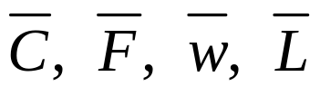
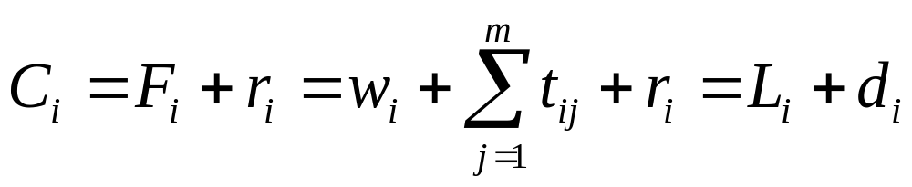
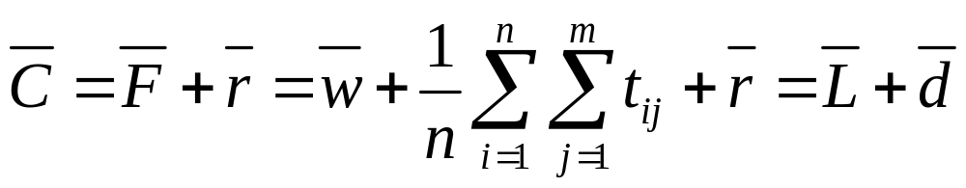
A Theorem
Theorem: The following average performance measures are equivalent (i.e. they produce the same optimal schedule):
proof: since
then:
constant

Slide 20
Problem Specification
performance
measure
classification: n/m/A/B
number of jobs
flow characteristic
number of machines
flow characteristics:
F = flow shop (machine processing order same for all jobs
J = job shop (different jobs have different processing orders
G = general

Slide 21

Why is scheduling so hard?
25! = 15,511,210,043,330,985,984,000,000
The dummy. There are too many to list
For 32 jobs there are 32! = 2.6 x 10³⁵ sequences.
Just list all the job schedules and pick the best one!
At one billion sequences
a second, it would take
8.4 x 10¹⁵ centuries to
list all of them.

Slide 22
Computational Complexity
For n/m/G/ * there are (n!)^{m} schedules.
for example, 5 jobs, 4 machines: (5!)⁴ = 2.0736 x 10⁸
evaluating at 1000 schedules per second:
2.0736 x 10⁵ seconds = 57.6 hours
if m = 5, then 25 billion schedules will take 288 days!
Scheduling problems
fall in the class of
NP-hard problems.

Slide 23
Displaying the solution - Gant Charts
Henry Gantt (1861-1919)
  Born in 1861 in Calvert County Maryland, Gantt led an active life as an industrial engineer and consultant. He worked directly with Frederick W. Taylor for a number of years and in 1917 invented the Gantt chart, a horizontal bar chart that was an innovative way to manage overlapping tasks. Useful for coordinating and scheduling, the Gantt chart was a revolutionary development and was based on time rather than quantity, volume or weight.
Pictorial representation of a schedule
Graphically display the state of each machine at all times

Slide 24
Gantt Charts - 4/3/J/*
M1
2
1
4
3
M2
2
4
3
1
M3
3
4
2
1
0 2 4 6 8 10 12 14
job processing time/machine
operation 1 operation 2 operation 3
1 4/1 3/2 2/3
2 1/ 2 4/1 4/3
3 3/3 2/2 3/1
4 3/2 3/3 1/1

Slide 25
Performance Measures from Gantt Chart
M1
2
1
4
3
M2
2
4
3
1
M3
3
4
2
1
0 2 4 6 8 10 12 14
Makespan = C_{max} = 14
∑ F_{i} = ∑ C_{i} = 14 + 11 + 13 + 10 = 48
∑ L_{i} = (-2) + (-3) + 3 + 2 = 0
∑ T_{i} = 0 + 0 + 3 + 2 = 5
T_{max} = max{0,0,3,2} = 3
N_{t} = 2
job
release date due date
1 0 16
2 0 14
3 0 10
4 0 8

Slide 26
Some Scheduling Rules (heuristics)
First-come, first serve (FCFS) – jobs are processed in the order that they arrive in the shop.
Shortest processing time (SPT) – jobs are sequenced in increasing order of their processing times.
Earliest due date (EDD) – Jobs are sequenced in increasing order of their due dates.
Critical ratio (CR) – schedule the next job with the smallest ratio next where the ratio is the due date minus current time divided by the processing time.

Slide 27
Example – single machine scheduling (r_{i} = 0)
job 1 2 3 4 5
t_{i} 11 29 31 1 2
d_{i} 61 45 31 33 32
FCFS: 1-2-3-4-5
avg Flow time = (11 + 40 + 71 +72 + 74)/5 = 268/5 = 53.6
avg Tardiness = 0 + 0 + 40 + 39 + 42 = 121/5 = 24.2
Nbr tardy jobs (N_{t}) = 3; T_{max} = 42
SPT: 4-5-1-2-3
avg Flow time = (1 + 3 + 14 + 43 + 74)/5 = 135/5 = 27.0
avg Tardiness = 43/5 = 8.6
Nbr tardy jobs (N_{t}) = 1; T_{max} = 43

Slide 28
Example – single machine scheduling (r_{i} = 0)
job 1 2 3 4 5
t_{i} 11 29 31 1 2
d_{i} 61 45 31 33 32
EDD: 3-5-4-2-1
avg Flow time = (31 + 33 + 34 + 63 + 74)/5 = 235/5 = 47.0
avg Tardiness = 0 + 1 + 1 +18 +13 = 33/5 = 6.6
Nbr tardy jobs (N_{t}) = 4
T_{max} = 18

Slide 29
Critical Ratio Scheduling
job 1 2 3 4 5
t_{i} 11 29 31 1 2
d_{i} 61 45 31 33 32
Critical Ratio
= (due date – current time)
/ processing time
Current time = 0
job 1 2 3 4 5
ratio 61/11 =.5.545 45/29=1.551 31/31=1 33/1 = .33 32/2 = 16
Current time = 31
job 1 2 4 5
ratio 30/11 =.2.727 14/29 = .483 2/1 = 2 1/2 = .5
Current time = 60
job 1 4 5
ratio 1/11 -27 (late) -28 (late)
use SPT: #4, #5
CR: 3 – 2 – 4 – 5 – 1
Avg F = 289/5 = 57.8
Avg T = 87/5 = 17.4
Nbr tardy = 4; T_{max} = 31

Slide 30
A Comparison
Rule Avg F Avg T Nbr Tardy Max T
FCFS 53.6 24.2 3 42
SPT 27 8.6 1 43
EDD 47 6.6 4 18
CR 57.8 17.4 4 31

Slide 31
Single-Machine Scheduling
Minimizing Flowtime
assume release time = 0 (flowtime = completion time)
job i 1 2 3 4 5
t_{i} 4 2 3 2 4
natural sequence: 1-2-3-4-5
F = F₁ + F₂ + … + F₅ = 4 + (4+2) + (4+2+3) + (4+2+3+2) + (4+2+3+2+4) = 45
in general:
F = t₁ + (t₁ +t₂) + (t₁ + t₂ + t₃) + …+ (t₁ + t₂ + …+ t_{n})
rearranging:
F = nt₁ + (n-1) t₂ + (n-2)t₃ + … + 2t_{n-1} + t_{n}
therefore use SPT sequence!
t_{[1]} < t_{[2]} < … < t_{[2]}

Slide 32
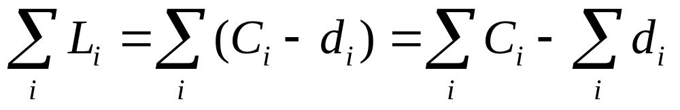
What about lateness?
L_{i} = C_{i} – d_{i}
Since d_{i} is constant for any schedule, minimizing total
completion (Flow) time also minimizes total lateness,
mean waiting time and mean number of jobs waiting (mean WIP).

Slide 33
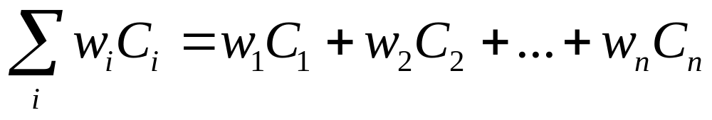
Weighted Flowtime
where w_{i} is the weight or value placed on the i^{th} job
Weighted Shortest Processing Time (WSPT) sequence:
sequence in order of smallest to largest: t_{i} / w_{i}
Minimizes weighted flowtime!

Slide 34
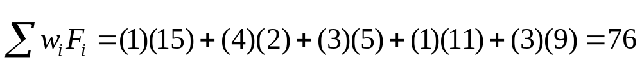
Weighted Flowtime - Example
job 1 2 3 4 5
t_{i} 4 2 3 2 4
w_{i} 1 4 3 1 3
t_{i} / w_{i} 4/1 2/4 3/3 2/1 4/3
Sequence: 2 – 3 – 5 – 4 – 1
C_{i} 15 2 5 11 9

Slide 35



Tardiness & Lateness
If the loudness of the customer's scream is proportional to how tardy the job is, minimize maximum tardiness to make the loudest scream as quiet as possible.
What about the customer? SPT ignores customer due dates?
customer
production
control
sales manager
Minimize T_{max} using EDD sequence

Slide 36
More Tardiness and Lateness
Minimize the number of tardy jobs - N_{t}:
Hodgson’s (Moore) algorithm:
1. compute tardiness for each job in EDD sequence;
set k = position of first tardy job (if none then done)
2. find t_{[j]} = max{t_{i} , i =1,2,…,k} (largest processing time)
3. remove job j from sequence and repeat step 1
4. place removed jobs in any order at the end of the sequence
Minimize the weighted number of tardy jobs:
apply Hodgson’s algorithm replacing step 2 with
2. find t_{[j]} = max{t_{i} / w_{i} , i=1,2,…,k}

Slide 37
Example – Hodgson’s Algorithm
job 1 2 3 4 5 6
t_{i} 10 3 4 8 10 6
d_{i} 15 6 9 23 20 30
EDD: 2 – 3 – 1 – 5 – 4 – 6
C_{i} 3 7 17 27 35 41
first tardy job: #1
optimal:
2 – 3 –4 – 6 – 5 – 1
or
2 – 3 – 4 – 6 –1 –5
# tardy = 2
consider 2, 3, 1; reject #1
sequence: 2 – 3 – 5 – 4 – 6
C_{i}: 3 7 17 25 31
first tardy job: #4 ; remove #5
sequence: 2 – 3 - 4 – 6
C_{i}: 3 7 15 21

Slide 38
Minimize flowtime with no tardy jobs (N_{t} = 0)
(minimize WIP and satisfy customer due dates)
let the schedulable set of jobs = all jobs with d_{i} >= t₁ + t₂ + …+ t_{n}
1. choose the job with largest t_{i} and schedule it right before
the previously scheduled job
2. remove the job and its t_{i} from the set of schedulable jobs
3. repeat steps 1-2 until all remaining jobs have been scheduled
generalizes to weighted flowtime by scheduling last the job
having the smallest weight-to-processing time ratio (heuristic)

Slide 39
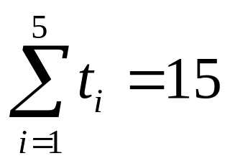
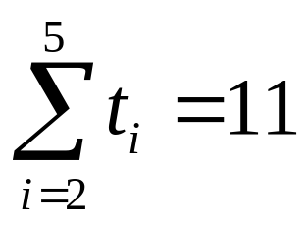
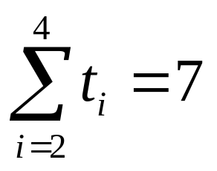
Example – Min Flow with No Tardy Jobs
job 1 2 3 4 5
t_{i} 4 2 3 2 4
d_{i} 16 11 10 9 12
d₁ > 15 therefore x – x – x – x - 1
1.
2.
d₂ , d₅ >= 11 therefore x – x – x – 5 - 1
d₂, d₃, d₄ >= 7, therefore x – x – 3 – 5 - 1
3.
4. t₂ + t₄ = 4 d₂, d₄ >= 4 therefore 2 – 4 – 3 – 5 -1
F = 2 + 4 + 7 + 11 + 15 = 39

Slide 40
Minimize Tardiness
No efficient algorithm exists
1. If all d_{i} are equal, then SPT minimizes total tardiness.
If all t_{i} are equal, then EDD sequence minimizes tardiness.
IF SPT and EDD sequences are identical, the sequence
minimizes tardiness.
If the EDD produces at most one tardy job, then the
sequence minimizes tardiness.
If all jobs must be tardy, then tardiness is equal to flowtime
and SPT sequence is optimal.

Slide 41
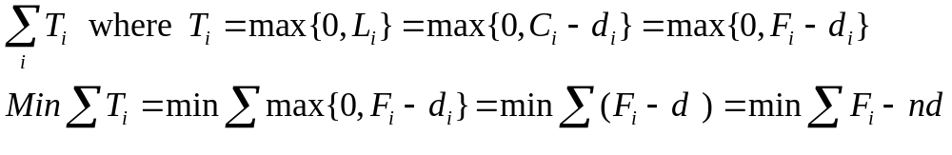
Minimize Tardiness
1. If all d_{i} are equal, then SPT minimizes total tardiness.
If all t_{i} are equal, then EDD sequence minimizes tardiness.
IF SPT and EDD sequences are identical, the sequence
minimizes tardiness.
If the EDD produces at most one tardy job, then the
sequence minimizes tardiness.
If all job must be tardy, then tardiness is equal to flowtime
and SPT sequence is optimal.

Slide 42
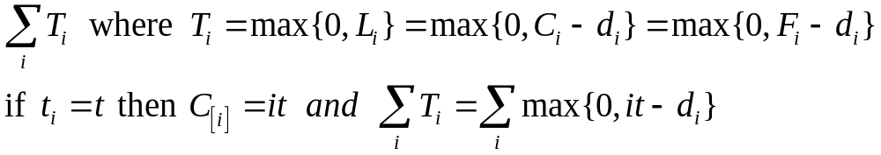
Minimize Tardiness
1. If all d_{i} are equal, then SPT minimizes total tardiness.
If all t_{i} are equal, then EDD sequence minimizes tardiness.
IF SPT and EDD sequences are identical, the sequence
minimizes tardiness.
If the EDD produces at most one tardy job, then the
sequence minimizes tardiness.
If all jobs must be tardy, then tardiness is equal to flowtime
and SPT sequence is optimal.

Slide 43
Lawler’s Algorithm
A powerful
technique
min max_{1<= i <= n} g_{i}(F_{i})
with precedence constraints
g_{i} is a nondecreasing function of the flowtime, F.
examples (r_{i} =0): g_{i}(F_{i}) = F_{i} – d_{i} = L_{i}
g_{i}(F_{i}) = max{F_{i} – d_{i,},0} = T_{i}
V = {set of jobs not required to precede any others}
g_{k}(t) = min {g_{i}(t), i is in set V}
and t = t₁ + t₂ + …+ t_{n} (processing time of current sequence)
Schedule k last
Repeat a. find V
      b. find g_{k}(t)
      c. t is reduced by t_{k}

Slide 44
Lawler’s Algorithm – Example minimize maximum tardiness
job 1 2 3 4 5 6
t_{i} 2 3 4 3 2 1
d_{i} 3 6 9 7 11 7
where (> reads before) 1>2>3 and 4>5 and 4>6
t = 2 + 3 + 4 + 3 +2 + 1 = 15
V = {3,5,6}; min{15-9, 15-11, 15-7} = 4; k = 5; x – x –x –x –x -5
t = 15 - 2 = 13
V = {3,6}; min{13-9, 13-7} = 4; k = 3; x – x – x – x – 3 – 5
t = 13 - 4 = 9
V = {2, 6}; min{9-6, 9-7} = 2; k = 6; x – x – x –6 – 3 – 5
t = 9 – 1 = 8
V = {2, 4}; min{8-6,8-7} = 1; k =4; x – x – 4 – 6 – 3 – 5
t = 8 – 3 = 5
V = {2} therefore 1 – 2 – 4 – 6 – 3 - 5

Slide 45
Lawler’s Algorithm – Example minimize maximum tardiness
t_{i} F_{i} d_{i} T_{i}
Job 1 2 2 3 0
Job 2 3 5 6 0
Job 4 3 8 7 1
Job 6 1 9 7 2
Job 3 4 13 9 4
Job 5 2 15 11 4

Slide 46

Dynamic Scheduling
What if the jobs are not all available to start at the same time? Huh?
schedulable job set = {set of jobs having release times less
than or equal to current time}
heuristic: schedule next the job in the set with the shortest
processing time (SPT).
Generalize to any priority rankings assigned to the jobs.

Slide 47
Bonus Round
Minimize Set-up times
t_{ij} = time to process(set-up) job j if it immediately follows job i
Minimize makespan: traveling salesman problem.
shortest set-up time (SST) heuristic:
1. select a job arbitrarily.
2. choose the job not already in the sequence with the
smallest set-up time when following the given job.
3. add it to the sequence and repeat until all jobs are
sequenced.

Slide 48
Minimize Set-up times - Example
Job a b c d
a - 5 7 4
b 3 - 10 8
c 7 4 - 5
d 2 6 8 -
some examples:
a – d – b – c - a: 4 + 6 + 10 + 7 = 27
b – a – d – c – b: 3 + 4 + 5 + 4 = 16
c – b – a – d – c: 4 + 3 + 4 + 8 = 19

Slide 49
Minimize Set-up times - Example
start
Job a b c d
a - 5 7 4
b 3 - 10 8
c 7 4 - 5
d 2 6 8 -
Job a b c d
a - 5 7 4
b 3 - 10 8
c 7 4 - 5
d 2 6 8 -
Job a b c d
a - 5 7 4
b 3 - 10 8
c 7 4 - 5
d 2 6 8 -
a – d – b – c – a: 4 + 6 + 10 + 7 = 27

Slide 50
Minimize Set-up times - Example
Job a b c d
a - 5 7 4
b 3 - 10 8
c 7 4 - 5
d 2 6 8 -
start
b – a – d – c – b: 3 + 4 + 8 + 4 = 19

Slide 51
Minimize Set-up times –a regret algorithm
Job A B C D
A - 3 4 5
B 3 - 4 6
C 1 6 - 2
D 5 4 7 -
Job A B C D MIN
A - 3 4 5 3
B 3 - 4 6 3
C 1 6 - 2 1
D 5 4 7 - 4
SUM 11
D – B – A – C – D
4 + 3 + 4 + 2 = 9
Job A B C D SUM
A - 0 1 2
B 0 - 1 3
C 0 5 - 1
D 1 0 3 -
MIN 0 0 1 1 2
Job A B C D
A - 0 0 1
B 0 - 0 2
C 0 5 - 0
D 1 0 2 -

Slide 52
General Search Methods
neighborhood search:
1. generate seed – initial schedule
2. generate neighbors from seed
3. approaches:
a. if improvement keep neighbor
b. generate all neighbors and keep best
c. evaluate neighbors until 10 percent improvement
given sequence 1-2-3-4-5-6-7-8
Adjacent pairwise interchange (API): exchange adjacent
jobs i and j in sequence: 1-2-4-3-5-6-7-8
n-1 neighbors to evaluate
Pairwise interchange (PI): exchange jobs i and j in sequence
1-2-7-4-5-6-3- 8
n(n-1)/2 neighbors to evaluate
Insertion (INS): insert jobs k between jobs i and j
1-2-3-4-7-5-6-8
(n-1)² neighbors to evaluate

Slide 53
General Search Methods – Example (API)
job 1 2 3 4 5
t_{i} 1 5 3 9 7
d_{i} 2 7 8 13 11
Objective Min N_{t}
initial seed: SPT: 1 – 3 – 2 – 5 – 4 N_{T} = 3
neighbors: 3 – 1 – 2 – 5 –4 N_{T} = 4
1 – 2 – 3 – 5 – 4 N_{T} = 3
1 – 3 – 5 – 2 – 4 N_{T} = 2*
1 – 3 – 2 – 4 – 5 N_{T} = 3
seed: 1 – 3 – 5 – 2 – 4 N_{T} = 2
neighbors: 3 – 1 – 5 – 2 - 4 N_{T} = 3
1 – 5 – 3 – 2 – 4 N_{T} = 3
1 – 3 – 2 – 5 – 4 N_{T} = 3
1 – 3 – 5 – 4 – 2 N_{T} = 2*

Slide 54
Summary Results for Single Machine Sequencing
The rule that minimizes the mean flow time of all jobs is SPT.
The following criteria are equivalent:
  Mean flow time
  Mean waiting time.
  Mean lateness
Hodgson’s algorithm minimizes number of tardy jobs
Lawler’s algorithm minimizes the maximum flow time subject to precedence constraints.

Slide 55


Classical Job Scheduling
Bad News Good News
There are always more than 2 machines and 2 jobs
Processing times are not deterministic
Not all jobs are ready at the start of a schedule
Optimal solutions are hard!
Can control due dates, capacities, order release dates
Good feasible schedules are readily available
A computer with as many bits as there are protons in the universe,
running at the speed of light, for the age of the universe, would not
have enough time to solve some of these problems.

Slide 56

End of Act I - Intermission
Gosh, these scheduling problems are so much fun. I think I will work problems 4 through 10 in chapter 8.

