Slide 1
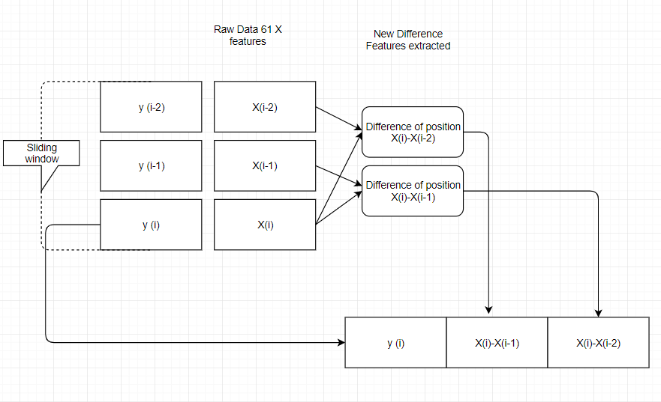
Flowchart explaining cleaning process

Slide 2
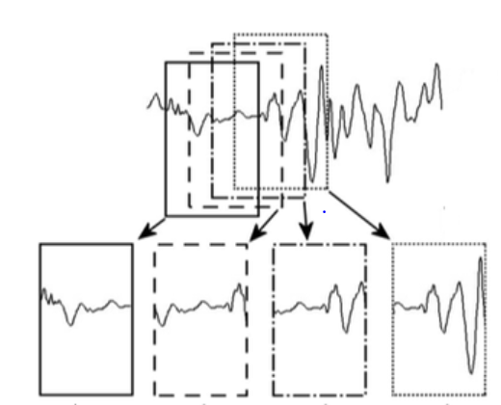
Sliding Window

Slide 3
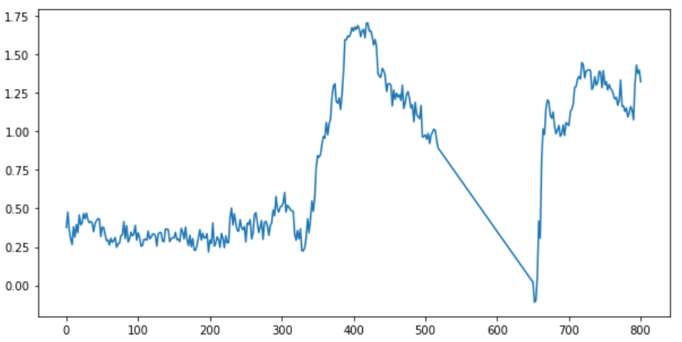
Plot between time and x1 feature using original data

Slide 4
The time series variables are non-stationary, noisy, and seems have significant signal drift over time.
Use signal differences (and possibly high order differences) to detect temporal signal pattern changes while not being affected by signal noises and drifts.

Slide 5
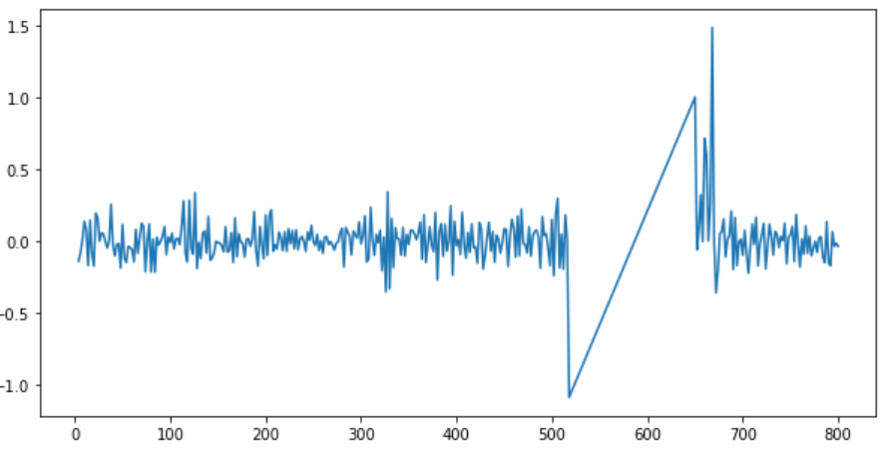
Plot between time and x1 feature using cleaned data

