Slide 1

Namma Veedu
Project history and product review
The idea, Mira, the live website
and the complete customer journey
Through 11 October 2026
01 NAMMA VEEDU
Notes:
Project history as of 10 October 2026, Asia/Calcutta.
Sources: User project brief and repository history
Claims describe recorded implementation and tests, not independent proof of customer outcomes.
The cover uses an existing project visual. It is an illustrative property image, not proof of a listed property or a real visit. Earliest retained local project context is 7 October. Git history begins 8 October.

Slide 2
The original idea
A property advisor people can talk to
Help customers describe the home they want in English or Tamil.
A useful next step after every search
Recommend saved properties, capture interest and arrange a visit.
An owner view of the whole journey
Track conversations, follow-ups, feedback and eventual purchase outcomes.
A system that improves with review
Turn mistakes and feedback into guidance that the owner approves.
02 NAMMA VEEDU
Notes:
Project history as of 10 October 2026, Asia/Calcutta.
Sources: User conversation and initial README
Claims describe recorded implementation and tests, not independent proof of customer outcomes.

Slide 3
Development timeline
Period | Main progress
Day 1 context · 7 Oct | Project idea, property sources and first website direction
8 Oct · first Git record | Streamlit website, Mira runtime, preference controls and persistent storage
9 Oct · refinement | Conversation fixes, feedback drafts, shared records and owner access
10 Oct · journey and reporting | Pagination, visits, email workers, purchase assessment and dashboard
Today · Wati setup | Adapter tested; WhatsApp Business connected; customer delivery validation remains pending
The timeline follows retained evidence. It does not assign unrecorded completion dates.
03 NAMMA VEEDU
Notes:
Project history as of 10 October 2026, Asia/Calcutta.
Sources: git log, 8–10 October 2026; workspace context dated 7 October
Claims describe recorded implementation and tests, not independent proof of customer outcomes.

Slide 4
Property data foundation
Saved record category | Records
Dated auction records with future end dates | 315
Dated ended auctions | 29
Undated auction records marked unavailable | 5,211
Existing sale advertisements | 30
Project references | 162
CMDA approval register entries | 200
Total normalized snapshot | 5,947
Import snapshot counts. These are not 5,947 verified available properties.
04 NAMMA VEEDU
Notes:
Project history as of 10 October 2026, Asia/Calcutta.
Sources: data/schema-reconciliation.md
Claims describe recorded implementation and tests, not independent proof of customer outcomes.

Slide 5
Preparing trustworthy search records
Source reconciliation
Record distinctions
Map different sheets into one normalized property schema.
Keep sale offers, project references and approvals separate.
Data cleaning
Auction safeguards
Normalize known units and numeric prices. Keep missing fields blank.
Separate dated records from undated unavailable snapshots.
Private details
Visible evidence
Omit borrower names, private addresses and raw scraped text.
Show source links and dates. Ask users to verify current status.
05 NAMMA VEEDU
Notes:
Project history as of 10 October 2026, Asia/Calcutta.
Sources: data/schema-reconciliation.md; import_data.py; README.md
Claims describe recorded implementation and tests, not independent proof of customer outcomes.

Slide 6
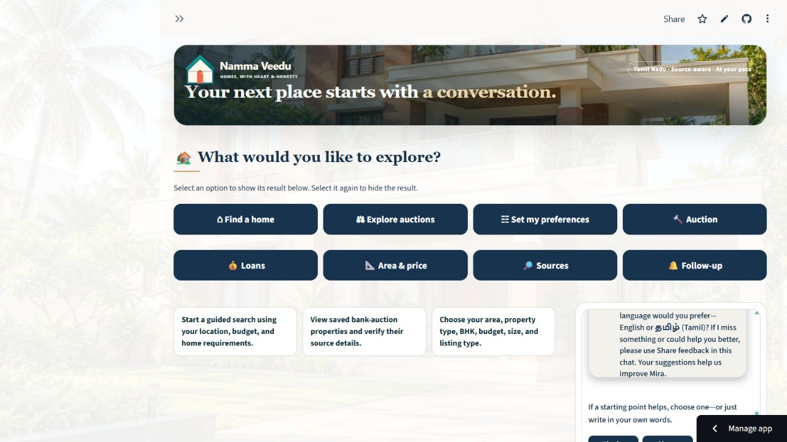
The live customer website
One place to explore
Homes, auctions, preferences, official loan sources and area tools.
Mira beside the search
English/Tamil welcome, guided questions and customer feedback.
Consistent experience
Architectural Wash customer page with readable navy controls.
Live public website
06 NAMMA VEEDU
Notes:
Project history as of 10 October 2026, Asia/Calcutta.
Sources: Public browser observation, 10 October 2026; app.py
Claims describe recorded implementation and tests, not independent proof of customer outcomes.

Slide 7
How Mira answers a request
Understand the message
Identify language, search intent, preferences and the selected property.
Use a constrained tool route
Search local records or use official source links and calculators.
Check the available evidence
Preserve unknown details and explain filters that block a match.
Respond and save the contribution
Return a concise answer and record the turn for owner review.
07 NAMMA VEEDU
Notes:
Project history as of 10 October 2026, Asia/Calcutta.
Sources: agent_runtime.py; agent.py; app.py; README.md
Claims describe recorded implementation and tests, not independent proof of customer outcomes.

Slide 8
How we improved Mira
Conversation guidance
Short references
Added greetings, empathy, clarification and grounded response patterns.
Resolve “the second one” against the visible shortlist.
Preference memory
Tamil and Tanglish
Preserve budget and location while updating multiple requirements.
Improve budget parsing, area wording and language continuity.
Corrections and removal
Training approach
Remove rejected types, amenities or listings without restoring them later.
Prompt guidance and reviewed rules. No model-weight fine-tuning claimed.
08 NAMMA VEEDU
Notes:
Project history as of 10 October 2026, Asia/Calcutta.
Sources: git log; README.md; mira_learning_library.py
Claims describe recorded implementation and tests, not independent proof of customer outcomes.

Slide 9
Feedback and approved learning
Step | What the system does
1 · Collect | Customer submits a comment and optional Mira rating
2 · Link | Save the feedback with its conversation and feedback ID
3 · Draft | Create a learning suggestion for owner review
4 · Review | Owner edits, approves, rejects or pauses the rule
5 · Apply | Only approved guidance affects future Mira responses
Feedback never silently rewrites Mira. The owner retains approval control.
09 NAMMA VEEDU
Notes:
Project history as of 10 October 2026, Asia/Calcutta.
Sources: mira_learning_library.py; app.py; test_mira_learning_library.py
Claims describe recorded implementation and tests, not independent proof of customer outcomes.

Slide 10
Search improvements and recovery
All matching results remain accessible
Five listings per page with numbered pagination.
A clear explanation when nothing matches
Mira identifies restrictive preferences and asks which one to change.
Customer choices stay explicit
Support multiple preferences, shortlist selection and cancellation.
Observed public example
The Flat filter returned 148 saved matches. Page 2 displayed listings 6–10.
10 NAMMA VEEDU
Notes:
Project history as of 10 October 2026, Asia/Calcutta.
Sources: git commits 3340b83, e6c813b; daily QA findings
Claims describe recorded implementation and tests, not independent proof of customer outcomes.

Slide 11
Shared records across public and localhost
One configured Supabase database
Owner authentication
Public and local apps read the same inquiry and approval records.
Mira Studio remains password protected.
Linked customer journey
Private server configuration
Conversation IDs and stable user IDs connect related actions.
Database and messaging credentials stay outside source control.
Historical continuity
Identity limits
Legacy import deduplication and snapshot refresh fixes preserve history.
Browser identity is not a full customer login or cross-device recovery system.
11 NAMMA VEEDU
Notes:
Project history as of 10 October 2026, Asia/Calcutta.
Sources: storage_backend.py; commit 37ab2a6; deployment reports
Claims describe recorded implementation and tests, not independent proof of customer outcomes.

Slide 12
Recommendations and scheduled follow-ups
Save directly through Mira
Collect contact and explicit consent, save the request and show “Follow-up saved”.
Email at explicit End chat
Submit saved recommendations to the entered email for an active opted-in schedule.
Keep the later schedule
One or up to three scheduled emails at three-day intervals, based on the selected option.
Cancellation and delivery evidence
Stop links and queue states support review. SMTP acceptance does not prove inbox receipt.
12 NAMMA VEEDU
Notes:
Project history as of 10 October 2026, Asia/Calcutta.
Sources: followup_service.py; FOLLOWUP_CHANNELS_SETUP.md; app.py
Claims describe recorded implementation and tests, not independent proof of customer outcomes.
Closing a browser tab does not trigger End chat. Delivery-off and cancelled requests do not send. Failed immediate submissions remain queued. Workers and credentials must be configured.

Slide 13
Property selection and visit requests
Choose a property
Visit reminder
Save preferred properties and keep the listing linked to the conversation.
With separate email consent, the reminder becomes due one hour before the confirmed visit.
Book a slot
After the visit
Request a predefined slot or a custom date and time in IST.
A feedback email becomes due two hours later and asks whether the customer attended.
Owner confirmation
Customer controls
The booking starts as Requested. The owner verifies access and confirms it.
Confirm, decline with a reason, cancel or request rescheduling.
13 NAMMA VEEDU
Notes:
Project history as of 10 October 2026, Asia/Calcutta.
Sources: visit_journey.py; visit_journey_ui.py; customer_journey.py
Claims describe recorded implementation and tests, not independent proof of customer outcomes.

Slide 14
The visit response and assistance loop
Customer response | Next action
Confirms the visit | Show a welcoming acknowledgement and retain the visit details
Cannot attend | Capture the reason and offer a new time
Visited and interested | Ask what help is needed to move forward
Property or finance help | Create a consented request for Nick in the appropriate advisor role
Not interested | Capture the reason and offer another search with permission
Advisor requests enter owner review. Nick handles both roles; connection status is recorded manually.
14 NAMMA VEEDU
Notes:
Project history as of 10 October 2026, Asia/Calcutta.
Sources: visit_journey.py; customer_journey.py; FOLLOWUP_CHANNELS_SETUP.md
Claims describe recorded implementation and tests, not independent proof of customer outcomes.

Slide 15
Purchase progress and assessment
Interest starts assistance
“I’m interested” prompts help with a visit, property details or loan guidance.
A customer purchase report is separate
It can stop that property’s visit reminders and create one owner notification.
The dashboard shows supporting evidence
Likelihood assessment, evidence, status, update time and actual purchase outcome.
Validation still needs real outcomes
No confirmed purchases were available for training a calibrated probability model.
15 NAMMA VEEDU
Notes:
Project history as of 10 October 2026, Asia/Calcutta.
Sources: purchase_assessment.py if present; customer_journey.py; complete-release.md
Claims describe recorded implementation and tests, not independent proof of customer outcomes.
Date-filtered reports can use current linked evidence from earlier conversations for the same stable user ID. Silence is not a negative outcome. Owners record confirmed purchase outcomes with evidence. A customer report is not legal verification.

Slide 16
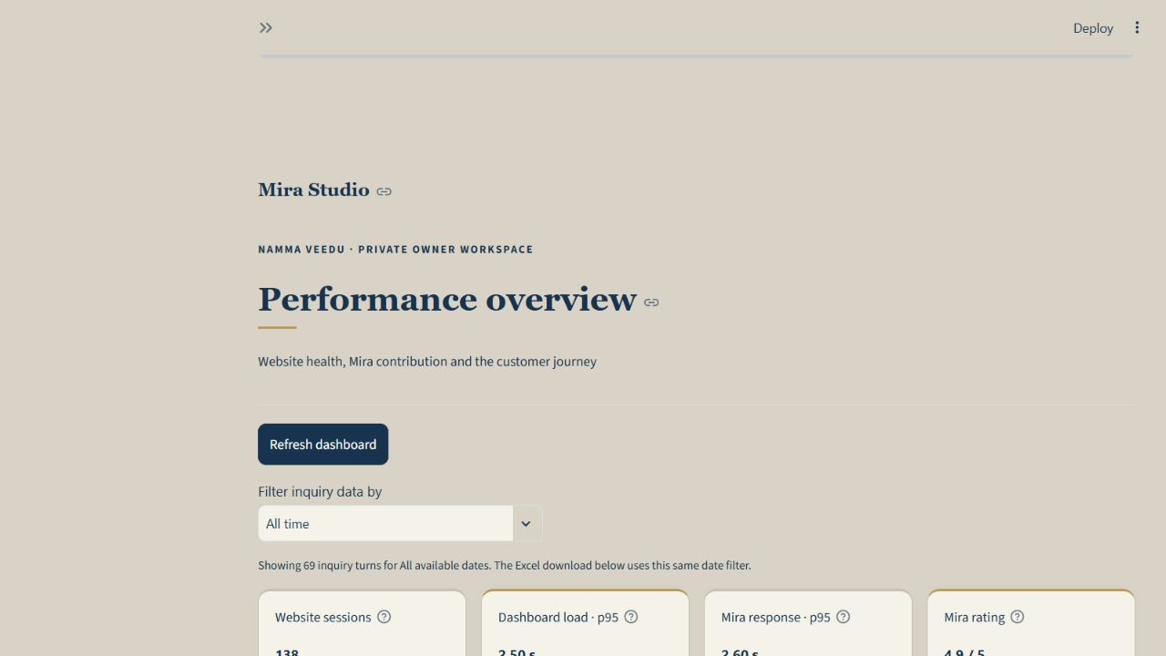
Mira Studio dashboard
Eight primary KPIs
Website and Mira performance, search, follow-ups and customer outcomes.
Separate activity charts
Website sessions and Mira conversations/replies have distinct charts.
Owner action controls
Follow-ups, visits, advisor progress, learning review and outcomes.
Dashboard preview uses fictional QA records
16 NAMMA VEEDU
Notes:
Project history as of 10 October 2026, Asia/Calcutta.
Sources: owner_dashboard_ui.py; isolated owner preview screenshot
Claims describe recorded implementation and tests, not independent proof of customer outcomes.

Slide 17
Eight KPIs and what they measure
KPI | Meaning
Website sessions | Distinct anonymous sessions, not unique people
Dashboard load p95 | Measured browser navigation to dashboard paint
Mira response p95 | Measured server processing time per turn
Mira rating | Latest valid 1–5 rating per conversation
Search success | Search conversations with at least one recorded match
Follow-up acceptance | Latest known SMTP state of attempted search-email schedules
Visits completed | Recorded attendance / currently confirmed requests
Confirmed purchases | Owner-recorded Purchased visit outcomes
17 NAMMA VEEDU
Notes:
Project history as of 10 October 2026, Asia/Calcutta.
Sources: owner_dashboard_ui.py render metrics
Claims describe recorded implementation and tests, not independent proof of customer outcomes.
Search success denominator is conversations with numeric recorded search results. It does not establish availability or satisfaction. p95 displays Not measured when absent. Follow-up acceptance is not inbox delivery and not a historical per-attempt rate. Collection starts with the analytics release.

Slide 18
Four connected owner record views
Inquiries
One summary per conversation, with a complete saved-chat reader.
Mira responses and actions
Replies, response type, matching records, timing and follow-up actions.
Customer feedback
Comments, ratings and conversation-linked feedback IDs.
Mira Learning Library
Current draft and approved rules with the existing owner editor.
Date filters, Excel downloads, snapshot dates and the end-to-end blueprint remain available.
18 NAMMA VEEDU
Notes:
Project history as of 10 October 2026, Asia/Calcutta.
Sources: owner_dashboard_ui.py; inquiry_log.py
Claims describe recorded implementation and tests, not independent proof of customer outcomes.

Slide 19
The end-to-end operating blueprint
Customer-facing journey
Owner oversight
Welcome, language, preferences, search, selection and visit request.
Review inquiries, approve learning, confirm visits and record outcomes.
Follow-up journey
Shared data layer
Recommendation email, scheduled contact, visit reminder and feedback.
Link chats, feedback, schedules and visits through private persistent storage.
Assistance journey
Continuous improvement
Interest, reason for rejection, rescheduling and advisor request.
Observe failures, reproduce with fixtures, fix and run focused regression.
19 NAMMA VEEDU
Notes:
Project history as of 10 October 2026, Asia/Calcutta.
Sources: static/mira-blueprint-flowchart.svg; app.py blueprint; customer_journey.py
Claims describe recorded implementation and tests, not independent proof of customer outcomes.
The owner blueprint covers idea, options, implementation, decisions and results. This slide is a concise narrative summary, while the owner flowchart remains available in the product.

Slide 20
Local dashboard performance
Seconds. Offline Streamlit AppTest with mocked writes. Empty owner fixture: 0.759 s.
No sampled local operation exceeded five seconds. These are not production load benchmarks.
20 NAMMA VEEDU
Notes:
Project history as of 10 October 2026, Asia/Calcutta.
Sources: data/private/daily_qa/2026-10-10-findings.json
Claims describe recorded implementation and tests, not independent proof of customer outcomes.

Slide 21
Mira response samples
Recorded local journey samples in seconds. No exceptions or provider errors in these four cases.
This small sample does not establish live AI latency, model quality or concurrent capacity.
21 NAMMA VEEDU
Notes:
Project history as of 10 October 2026, Asia/Calcutta.
Sources: data/private/mira-performance-current.json
Claims describe recorded implementation and tests, not independent proof of customer outcomes.

Slide 22
Public website checks and timing
Live observation | Result
Branding, welcome and Tamil switching | Passed
Flat results and pagination | 148 saved matches, five listings per page
Empty state and recovery | Zero matches at ₹1 lakh; clearing budget restored results
Loan, area and source panels | Rendered without observed console errors
Warm reload upper bound | 8.945 s
Source / recovery / Tamil switch | 3.169 s / 3.013 s / 4.232 s
Browser-control observations include tool overhead. First saved daily baseline; no daily trend yet.
22 NAMMA VEEDU
Notes:
Project history as of 10 October 2026, Asia/Calcutta.
Sources: daily_qa/2026-10-10-report.md and findings.json
Claims describe recorded implementation and tests, not independent proof of customer outcomes.

Slide 23
Regression evidence and confirmed fixes
Recorded test runs
Feedback and reporting fixes
159 daily checks, 212 release checks and 219 dashboard-release checks passed.
Shared feedback visibility, learning draft refresh and follow-up reporting.
Focused Wati validation
Deployment and visual fixes
33 adapter checks passed using isolated queues and mocked transport.
Cleared stale imports, removed text shadows and improved chart/table contrast.
Bug fixes
Scope of the evidence
Preference removal, stale filters, result pagination and snapshot continuity.
Suites overlap. They are separate runs and must not be added into a unique-test total.
23 NAMMA VEEDU
Notes:
Project history as of 10 October 2026, Asia/Calcutta.
Sources: git log; daily_qa release/test reports
Claims describe recorded implementation and tests, not independent proof of customer outcomes.
159 tests: 294.722s. 212 tests: 454.305s. 219 tests: 330.323s. Wati 33 tests: 38.768s. Tests use isolated fixtures/mock transports. No claim of concurrent-user load, full production messaging or all hosted owner actions.

Slide 24
WhatsApp progress and remaining work
Completed in code
Required before sending
Consent checks, recommendation template adapter, stop link and guarded queue processing.
Check account readiness and approve the recommendation template.
Completed in account setup
Required before activation
Wati trial and business details. Customer moved the sender to WhatsApp Business.
Store private API settings, verify an own-number message and configure a worker.
Current state
Further messaging work
Wati confirms Connected and setup Completed. Production Wati messages remain disabled.
Verified delivery webhooks, incoming replies, STOP handling and WhatsApp visit messages.
24 NAMMA VEEDU
Notes:
Project history as of 10 October 2026, Asia/Calcutta.
Sources: WATI_SETUP.md; whatsapp_followup.py; current Wati browser observation
Claims describe recorded implementation and tests, not independent proof of customer outcomes.
Customer completed Meta connection and QR scan. Refreshed Wati page confirms Connected and setup Completed at 10:15 PM on 10 October; Contacts Completed, Chats Not synced. Business Verification shows Action Required. Production messages remain disabled; no customer message was sent in this verification.

Slide 25
Current delivery and next evidence
Live core product
Remaining proof
Website, Mira, shared records, reviewed learning, visits and owner reporting.
Wati activation, real visit-email receipt, concurrent-user testing and validated purchase outcomes.
The next release should follow a consented message test and verified delivery configuration.
25 NAMMA VEEDU
Notes:
Project history as of 10 October 2026, Asia/Calcutta.
Sources: Complete release and journey deployment reports; WATI_SETUP.md
Claims describe recorded implementation and tests, not independent proof of customer outcomes.

Slide 26
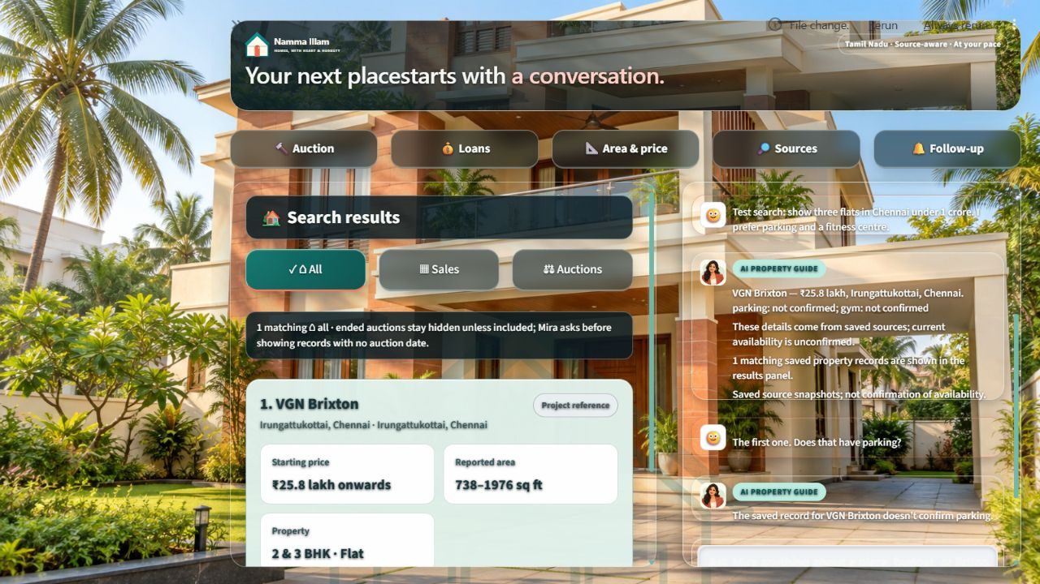
Budget ranges and selected recommendations
Mira keeps both limits
“15–90 lakhs” becomes a ₹15 lakh minimum and a ₹90 lakh maximum. Search, memory and follow-up use the same range.
Customer choice controls the follow-up
Each result has an email and WhatsApp checkbox. Up to three selected properties form the saved recommendation snapshot with recorded price and source.
No BHK is inferred from price, location or property type.
Conversation memory example
26 NAMMA VEEDU

Slide 27
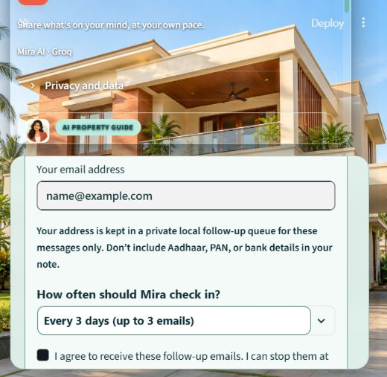
Email continues while WhatsApp approval is pending
Email is the active interim channel
With consent and a valid address, End chat sends the selected recommendations immediately. The saved cadence can continue through the email worker.
One recommendation snapshot
The message includes selected properties, source links and finance next steps. The same saved content will feed WhatsApp after Meta approves the Wati template and production delivery passes its test.
Mira Studio records Email, WhatsApp or both in Follow-up methods.
27 NAMMA VEEDU

Slide 28
Implemented customer journey and dashboard evidence
1
Property data
2
Website and Mira
3
Preferences
Saved records and source boundaries
English and Tamil guided search
Range, type, BHK and location
4
Recommendation
5
Property visit
6
One-hour reminder
Selectable properties and sources
Fixed or requested slot
Consented confirmed email visit
7
Visit response
8
Further assistance
9
Assessment and learning
Attendance, satisfaction and reason
Property help or loan support
Likelihood evidence, feedback and rules
The owner dashboard links inquiry, delivery method, visit evidence, customer feedback, assistance status and provisional purchase likelihood.
28 NAMMA VEEDU

