Slide 1

This presentation is part of an educational modular program designed to provide new and beginning farmers and ranchers with relevant information to initiate, improve and run their agricultural operations
This program is funded by the
Beginning Farmer and Rancher Development Program (BFRDP)
USDA-NIFA-BFRDP 2010-03143

Slide 2



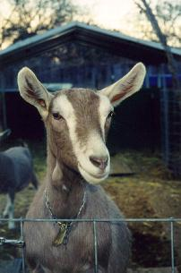
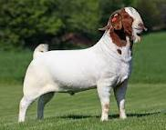
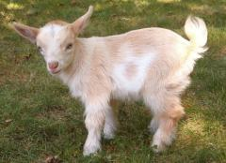
Goat production
This project is partly sponsored by USDA-NIFA-BFRDP 2010-03143.

Slide 3
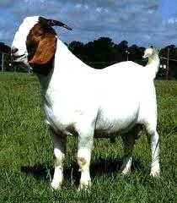
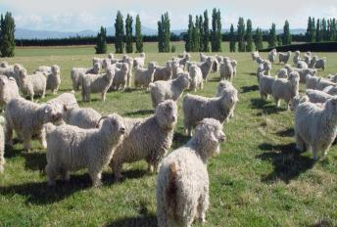
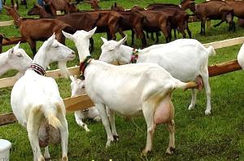
Goat production
In general goats can be raised for meat, milk or fiber production
http://www.angoragoat.com/
http://www.ansi.okstate.edu/breeds/goats/boer/
Angora goats produce mohair
Boer is a meat breed
http://www.veteriner.cc/keci/saanen.asp
Saanens are among the highest milk producers

Slide 4
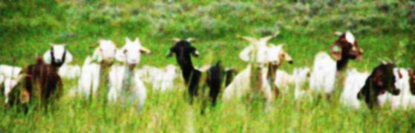
Goat production
In addition, of their initial production purpose, raising goats can be a valuable part of a sustainable farm
Goats fit well into already established farms because they do not compete with cattle or other livestock for feed and usually can use resources that otherwise would go unused
However goats are not “little cattle” they need to be managed as a different type of livestock and not just be expected to behave and eat like cattle

Slide 5
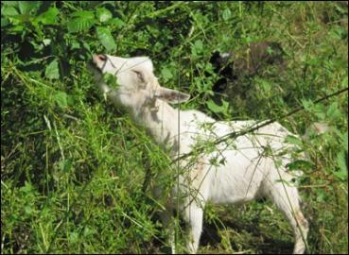
Goat production
Goats can also contribute to the farm by cleaning areas that would otherwise not be accessible to other livestock
Because of their browsing behavior they can eat and clear brambles from paddocks
Also because of their small size, agility and because they love to climb they can forage in hilly and rocky pastures
Goats’ manure replaces the soil with important nutrients and reduces the need for fertilizers
http://news.opb.org/article/goats-take-some-pain-out-yard-work/

Slide 6
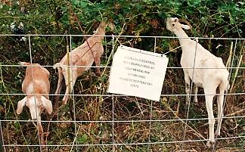
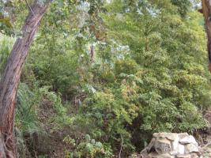
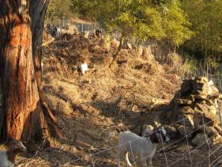
“Goats for hire”
Because of their unique feeding habits, goats can be “hired” to clear out thick lots of invasive plant species from lots, gardens, pastures. They also help to reduce “fire fuel” in areas prone to wild fires
People pay “per acre” of land cleared by the goats and in some cases the price can go up to $1,500 dollars/acre
http://www.bendbulletin.com/article/20110916/NEWS0107/109160343/
Fuel reduction of poison oak and pampa grass field (before and after)
http://www.brushgoats4hire.com/photo.htm

Slide 7
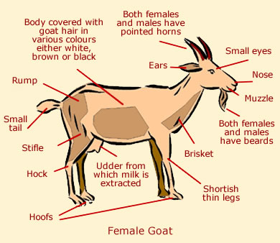
Understanding goats
http://www.animalcorner.co.uk/farm/goats/goat_anatomy.html

Slide 8
Goat behavior
Goats have unique behavior characteristics that are important to understand before you decide to raise goats
They are “matriarchal”, that means that there will be a “herd queen” or dominant female
She usually leads the way and decides when to go out to pasture. She gets the best sleeping spot and the first spot at the feeder, and if she is a dairy goat, she gets to be milked first
If another goat tries to change things, you can be sure that the queen will make it clear who is in charge

Slide 9
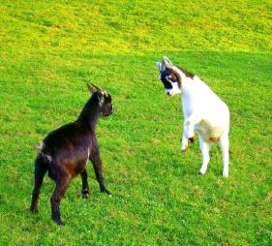
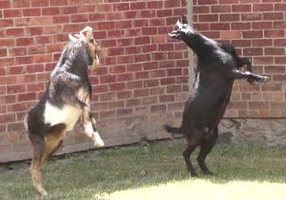
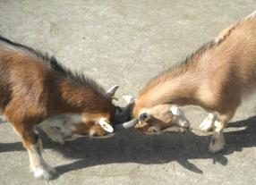
Goat behavior
Goats sometimes communicate by biting
Goats butt others to establish their place in the herd, it can be used in playing, fighting or during rut
Dehorning is commonly used to reduce damage from butting (to you and other goats) but that animal will be at a clear disadvantage. Either all your goats get dehorned or none should
http://www.marshalltrio.com/index/about/around-the-house/
http://www.fotothing.com/pxlbarrel/photo/0d2de8275934efa8eb493fd16b4d1820/
http://forums.steves-digicams.com/pentax-samsung-dslr/118333-kid-goat-his-friend-lily-lamb-bigma.html

Slide 10
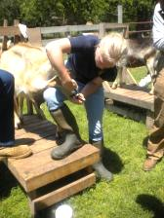
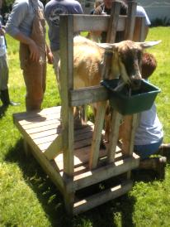
Goat handling
Caring for your goats is easier if your goats are used to being handled.
There is nothing worse than having to chase down and capture a sick goat!
They need regular handling so that you can do routine maintenance and care of the animals
Get the goats used to being on the milking stand, this way you can trim their hooves, give shots and other husbandry procedures without stressing them out

Slide 11
Goat handling
There are some important things to remember when you start handling a goat:
Goats duck their heads to get away, so keep the goat’s head up with one hand under the chin and one on the top of the neck or by holding the collar up
To catch a fleeing goat, grab the back leg. The front legs are very delicate and can be hurt or broken very easily
To handle a horned goat, firmly grasp the base of the horns to lead her
Never push on a goat’s head, pushing stimulates butting and teaches the goats that butting humans is all right
Never let a goat kid jump on you or anyone else
Don’t let children chase or ride the goats. They will become afraid of people and they can get hurt or break their backs.

Slide 12
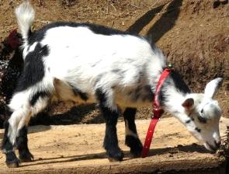
Goat handling
Collars are a useful tool for handling, moving or milking goats
Remember that collars can get stuck in plants or fences, so make sure to check the area where your animals are housed to make sure they are safe
Only put the collars on when you will be working with them, or around to keep and eye on them
http://boonedockswilcox.blogspot.com/2009/05/goat-boys.html

Slide 13
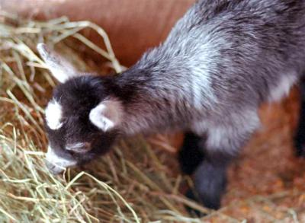
Goat Nutrition
http://www.northrup.org/photos/goat/?page=7

Slide 14
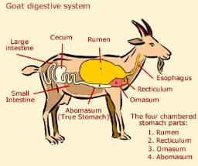
Goats are ruminants
Ruminants are those animals that have several compartments in their stomach to digest large quantities of forages
The ruminants get their name from their rumen, which is the largest compartment of the stomach and serves as a fermentation vat
Ruminants eat quickly and swallow their food and thoroughly chew it and swallow
This regurgitated food is called the cud, and healthy ruminants spend as much time chewing as they do grazing or eating hay
http://www.animalcorner.co.uk/farm/goats/goat_anatomy.html

Slide 15
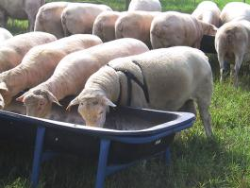
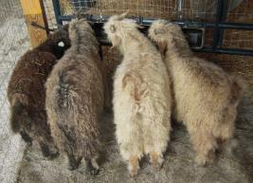
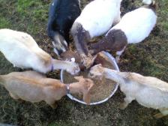
Raising goats
Goats have the ability to select the more nutritious parts of a plant
Therefore, they typically will consume a higher quality diet if they have the opportunity to be selective
With the exception of dairy goats, goats grazing a high quality pasture can usually meet their protein requirements without supplemental feeding
In some cases an energy supplement (grain) may be necessary
http://www.sheepandgoat.com/articles/feedingsmallruminants.html
http://migrationbrewing.com/blog/2011/11/02/brewers-who-talk-to-goats
http://thatlldofarm.com/slideshow/1268

Slide 16
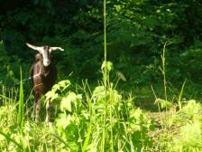
Goats are ruminants
The health and productivity of the goat as with all ruminants depends on the rumen (as with all ruminants) depends on the rumen function; microorganisms in the rumen digest fiber and carbohydrates and protein to supply the animal with nutrients
Without those microorganisms, the goat will become very sick and may die
It is very important that the animal is appropriately fed so that the ruminal organisms stay healthy
The rumen microorganisms are healthier when goats are eating good-quality forages, such as vegetative pasture
However it is difficult (if not impossible) to provide good-quality forages year round. Thus, supplementation with concentrates may be necessary

Slide 17
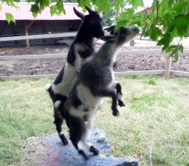
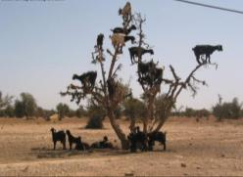
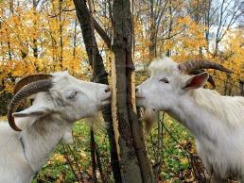
Diet
Goats can be picky eaters and they may not immediately accept new feeds
However once they decide to eat something they will try everything to get it
Also if there is nothing around that they like they will start to look around for something to eat
http://ikoupon.com/Funny-Pics/Animal-World/Goats-Eating-515.html
http://www.brusorchards.com/goat.php
http://www.123rf.com/photo_7699530_goats-eating-round-a-tree.html

Slide 18
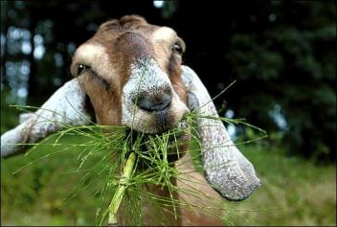
Diet
Feeding is usually the highest expense of any livestock operation
It is important to remember that goats are not little goats
Goats have shorter digestive tracts which limits their ability to digest the cell walls of plants, such as grass or hay, in comparison to cattle
Then again, their narrow muzzle and highly motile, prehensile lips allows them to choose the tender leaves and buds from trees and shrubs that cattle cannot fully use as a food source
Goats have a perfect feeding strategy as intermediate feeder, eating grass when it is at its peak and shrubs when those have the best nutrients available
http://mcaaron.wordpress.com/tag/dylan-mckay/

Slide 19
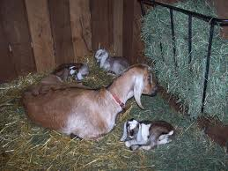
Diet
Feeding good quality hay or pasture is usually sufficient to sustain your goats, but during production they will need supplements
The more productive goats should be fed high quality feed, especially kids being prepared for market, young replacement doelings and does in late gestation and early lactation. Also, does lactating twins or triplets have greater nutritional requirements than does lactating a single kid
http://www.takeawalk.com/catherine-renzi-articles/2009/4/2/nubian-dairy-goats-triplets-born.html

Slide 20
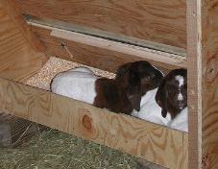
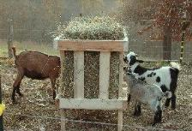
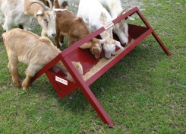
Supplemental feeding
Grain is the concentrate most often fed to goats; cereal grains such as oats, corn, barley and wheat are high in energy (carbohydrates/fat)
Less commonplace are grains such as amaranth or buckwheat are also used sometimes
Soybean meal and cottonseed meal are high protein supplements
The choice of concentrate is determined by the composition of the forage available
High-quality forages usually have adequate or even excess protein, animals eating these will need a higher-energy concentrate to utilize the protein present in the pasture
Lower-quality forages or hays will require a higher protein supplement to meet the goats’ protein requirement
http://www.goatworld.com/articles/feeders/feeder.shtml
http://www.flickr.com/photos/baalands/384226152/
http://www.tartergate.com/news/bgg_trough.php

Slide 21
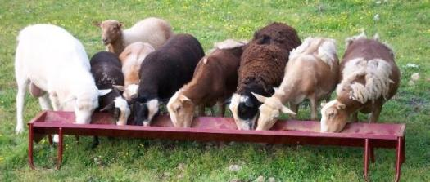
Supplemental feeding
While good quality forages are usually adequate, goats may sometimes need supplemental feeding, especially during the winter
Goats need a proper balance of energy in the form of roughage or grain, as well as protein, vitamins, minerals and clean water
There is a rule of thumb for all goats:
Browse and pasture in the summer
Hay and grain in the winter
Trace mineralized salts all the time
The mineral mixture should be fortified with selenium if you live in an area of the country with selenium-poor soils (Check with your Extension agent or veterinarian)
http://www.bjmanufacturing.com/feeders.htm

Slide 22
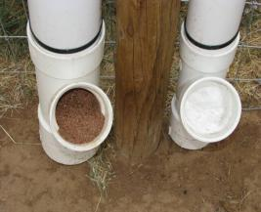
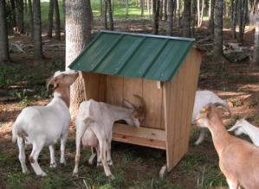
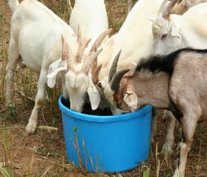
Minerals
It is very important that you consistently offer this mix (preferably in a loose form), monitor its consumption and ensure that all goats are in fact eating adequate amounts of the mineral supplements
http://www.hippityhooves.com/HerdManagement.html
http://www.theikga.org/goat_feeders.html
http://www.sheepandgoat.com/articles/generalfeedingguidelines.html

Slide 23
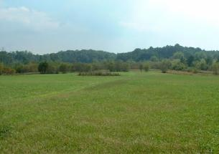
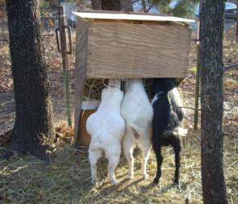
Diet
Goats must consume a more concentrated diet than cattle
Goats grazing poor quality areas will also have higher nutritional requirements than goats on better pastures
http://www.organic-gardening-and-homesteading.com/how-to-raise-goats.html

Slide 24
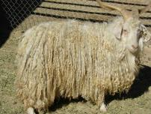
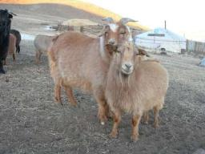
Meat, dairy, hair?
Adult meat goats should be fed a maximum of 1% of bodyweight in supplemental grain, with lactating does reaching a maximum of 1.5%
Dairy goats need both high quality forage and supplemental grain to reach their full potential, especially during peak lactation or growth
Fiber goats on the other hand may not do well with supplemental grain, because feeding too much protein to angora goats can make mohair fiber coarser and reduce its value and feeding beyond maintenance requirements will not improve the fiber production of cashmere goats
Angora goat
Cashmere goats
http://www.theanimalagency.com/animals/barnyard/barnyard.htm
http://tsandawesome.com/2010/11/

Slide 25
Most common breeds of goats in the USA
Dairy goats | Meat goats | Hair/Fiber
Alpine | Boer | Angora
La Mancha | Kiko | Cashmere
Nigerian Dwarf | Spanish Meat goat | Pygora
Nubian | Tennessee Fainting goat
Oberhasli
Saanen
Toggenburg
Pets
Nigerian Dwarf
Pygmy
Fainting goat

Slide 26
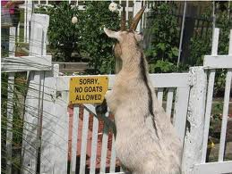
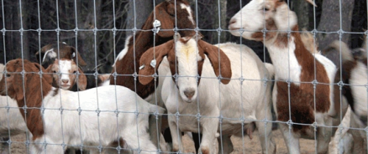
Fencing
Fencing is the most critical
factor in raising goats on pasture
There is nothing more frustrating than having to constantly chase goats back into the pasture
Fencing will also be the greatest expense, other than the initial cost of the animals
http://www.louispage.com/blog/?Tag=woven%20wire%20mesh

Slide 27
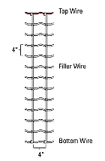
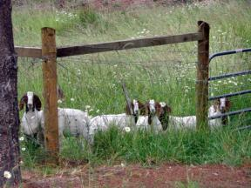
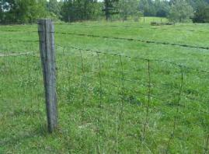
Fencing
There are several different options for fencing
One of the best permanent fencing solutions is 4-foot woven wire with barbed wire along the top
Some producers use four or five strands of high-tensile electric wire
Electric netting (usually 4x4 inches) is also used as temporary or permanent fencing options, however some animals can get their horns tangled in the netting
Electric wires can be used in combination with standard fences, however goats need to be trained to this
It is very important to keep electric fences charged to 4,500 volts or more
Regular checking and testing are necessary and any problems must be fixed promptly, or goats will escape.
http://www.agry.purdue.edu/ext/forages/rotational/fencing/wovenwire.htm
http://www.mysouthernheart.com/?cat=28

Slide 28
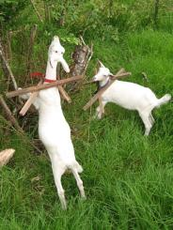
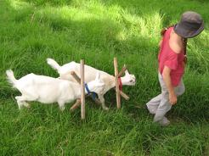
Fencing
Goats are famous scape artists and will definitely try to get through fences if they can see something good on the other side
Here is something that I have seen to teach “scape prone goats” to stay inside their pens
This is called the “naughty collar”, they get it on everyday before they go out to pasture and it is taken off in the afternoon
It doesn’t hurt them and they learn quickly that they can’t get through the fence
http://farmlet.co.nz/?p=59

Slide 29
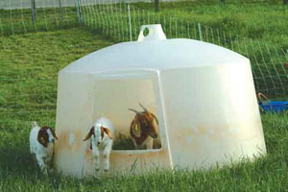
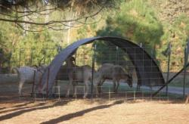
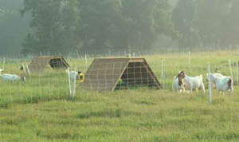

Shelter
Goats can tolerate cold weather, but will get chilled by wet cold conditions
Buildings used for shelter may be minimal, but they should be well-ventilated and clean
The necessary shelter or shelters depend on the producers’ operation
A dairy operation will usually have extensive barn and pen set-ups while a large meat goat operation may use only trees in the pasture as shelter
http://goatseeker.com/guides/quonset-hut-goat-shelters
http://blog.henrymilker.com/2010/11/alaskan-goat-igloos-perfect-winter-home.html
http://www.extension.org/pages/19427/goat-pastures-shelter
There are portable shelters, moveable shades and even old hog huts that can be used as shelters for your animals

Slide 30













Shelter and climbing
http://www.steelmasterusa.com/got-milk-steel-buildings-have-it-covered/metal-goat-shelter
http://www.flickr.com/photos/lucindalunacy/5802777698/
Goats love climbing!
Add some rocks, ramps, steps or any structure for them to climb and they will make full use of it
If you don’t give them something to climb, they will find something
http://people.tribe.net/themuse/blog/9f8f9464-333f-4f10-ab1b-14c9d0dc821c
www.logcabinpethouse.com
http://www.mbfarviewfarm.com/Cross-Bred-Dairy-Goats.htm
http://www.lostcreekboers.com/girls.html
http://www.mysouthernheart.com/?cat=28
http://www.strangefarmer.com/content/item/111266.html
http://pinoyagribusiness.com/forum/small_ruminant_sheep_and_goat/housing_design-t584.0.html
http://adrenalinesshadow.wordpress.com/2009/10/19/i-dont-care-that-its-shopped/
http://thegoat.backcountry.com/2009/06/22/illinois-style-climbing/
http://wilamarfarm.blogspot.com/2007_03_01_archive.html
http://www.lostcreekboers.com/girls.html

Slide 31




This presentation was prepared by:
USDA-ARS-Dale Bumpers Small Farms Research Center
Annie Donoghue
Joan Burke
Dale Bumpers College of Agricultural, Food and Life Sciences and the Division of Agriculture; University of Arkansas, Fayetteville
Dan Donoghue
Ixchel Reyes Herrera
This presentation is part of an educational modular program designed to provide new and beginning farmers and ranchers with relevant information to initiate, improve and run their agricultural operations
This program is funded by the
Beginning Farmer and Rancher Development Program (USDA-NIFA-BFRDP)
USDA-NIFA-BFRDP 2010-03143

Slide 32







This project is the result of the collaboration of these institutions:
USDA-NIFA-BFRDP 2010-03143

Slide 33
Want more information?
ATTRA publications https://attra.ncat.org/ | Illustrated guide to sheep and goat production
 | Goats: sustainable production overview
 | Dairy goats: sustainable production overview
 | Meat goats: sustainable production overview
 | Managing internal parasites in sheep and goats

Slide 34
Want more information?
National Goat Handbook | http://members.toast.net/dawog/Goats/national_goat_handbook.pdf
Breeds of Livestock (goats) | http://www.ansi.okstate.edu/breeds/goats/
American Dairy Goat Association | http://www.adga.org/
Dairy goat journal | http://www.dairygoatjournal.com/
Boer Goats Home | http://www.boergoatshome.com/
Meat Goat production (Susan Schoenian, University of Maryland) | http://www.sheepandgoat.com/articles/meatgoat.htm

