Slide 1





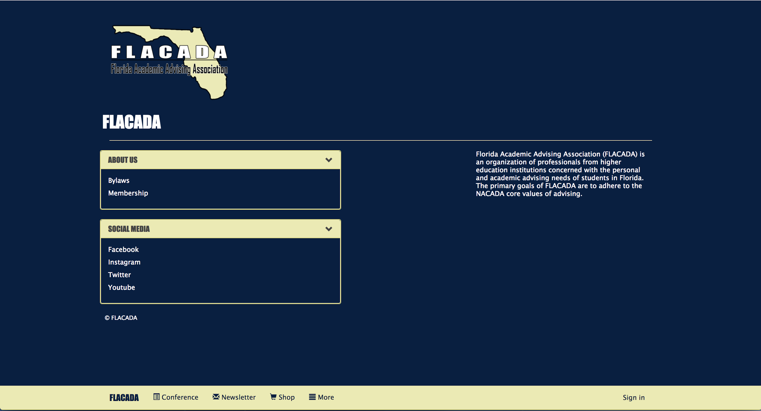
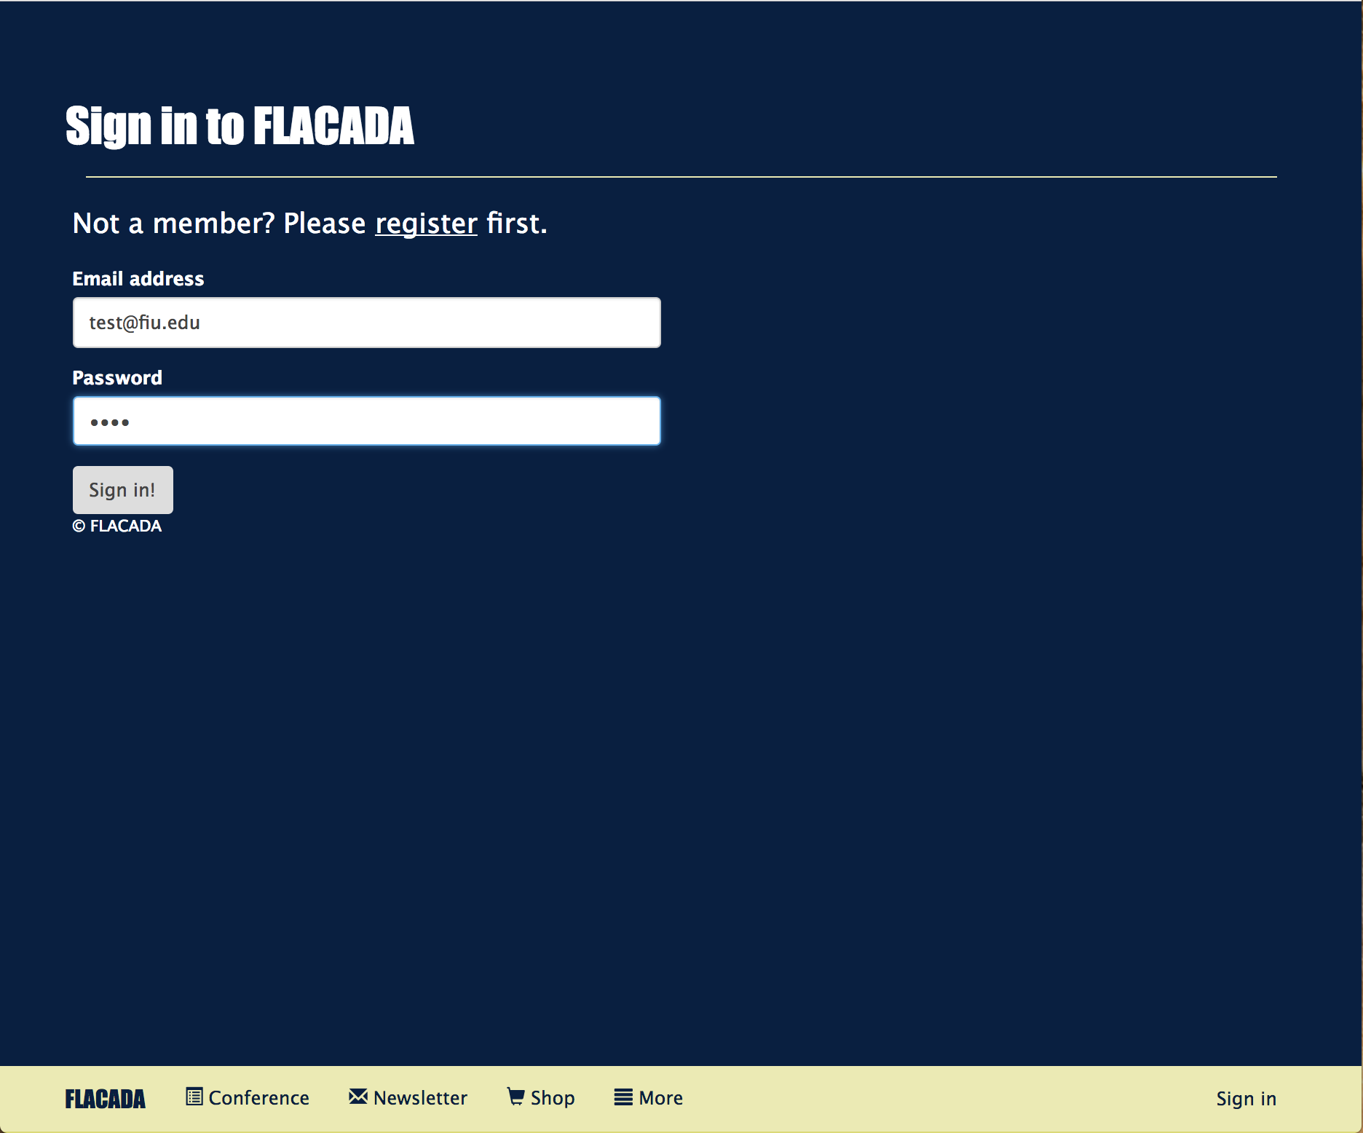
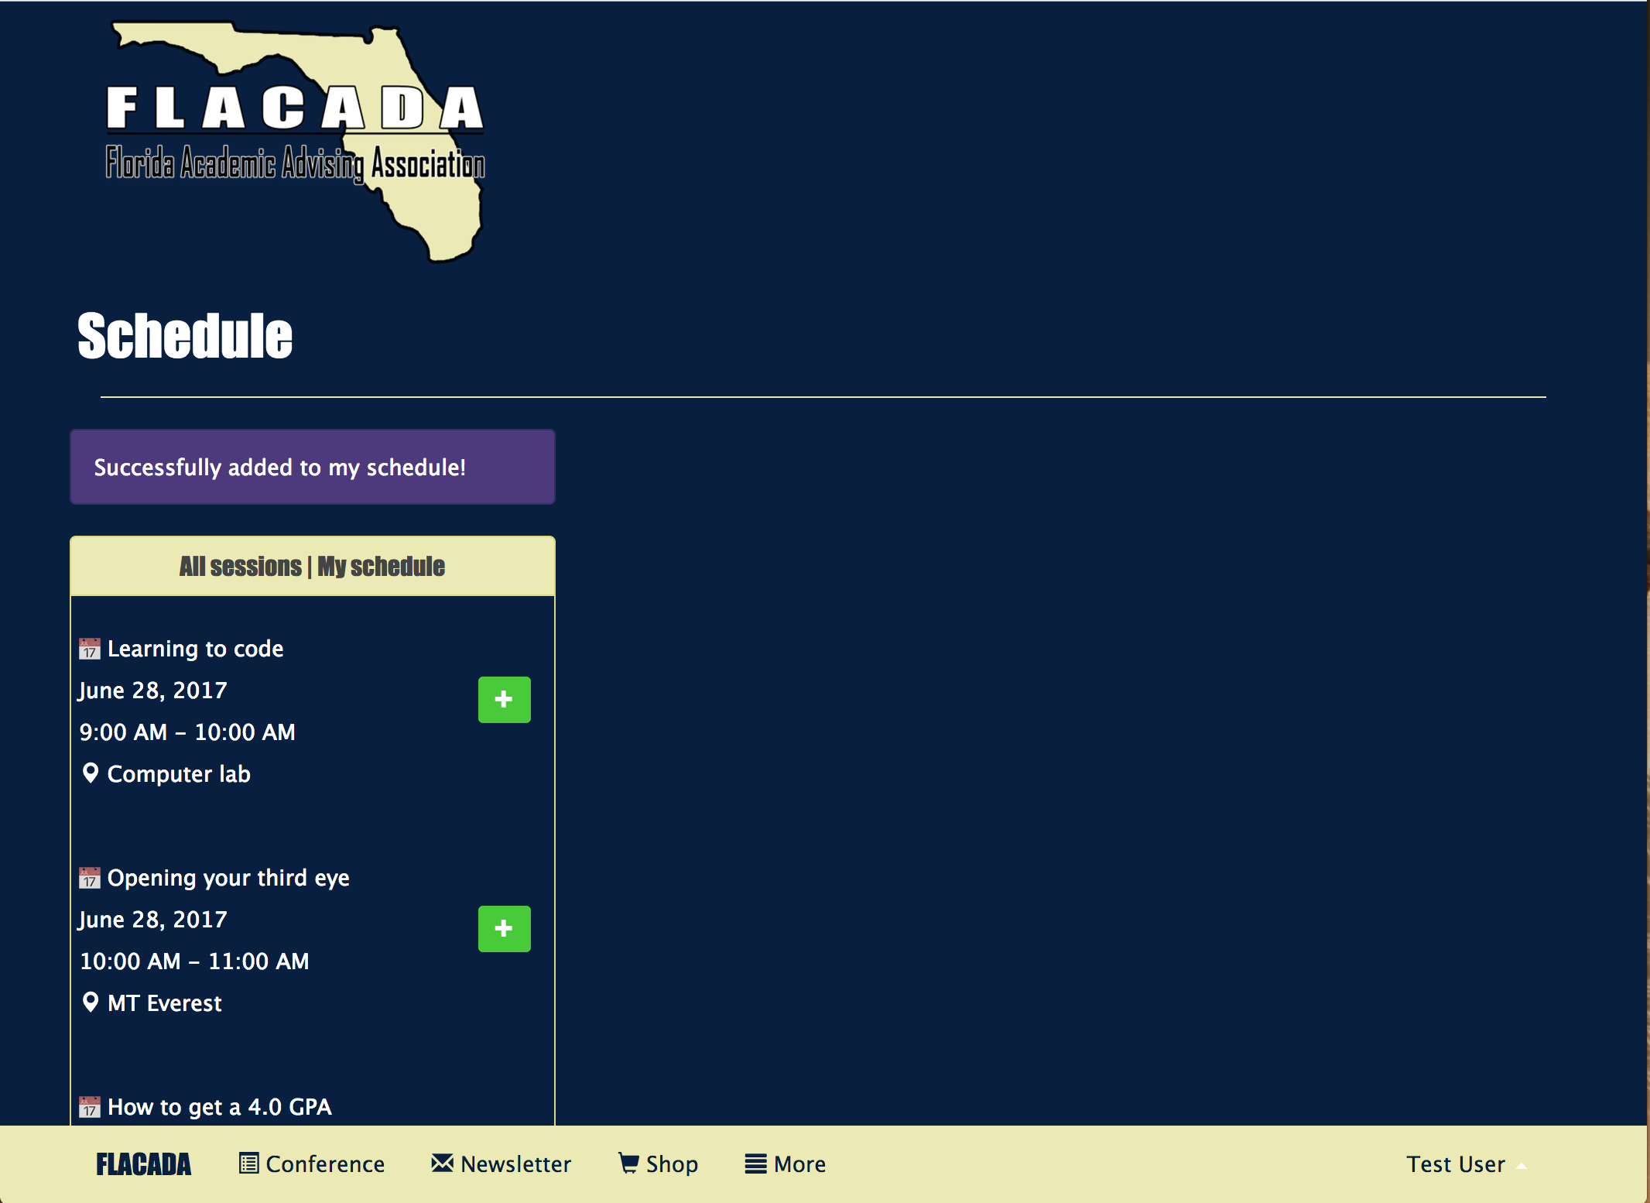
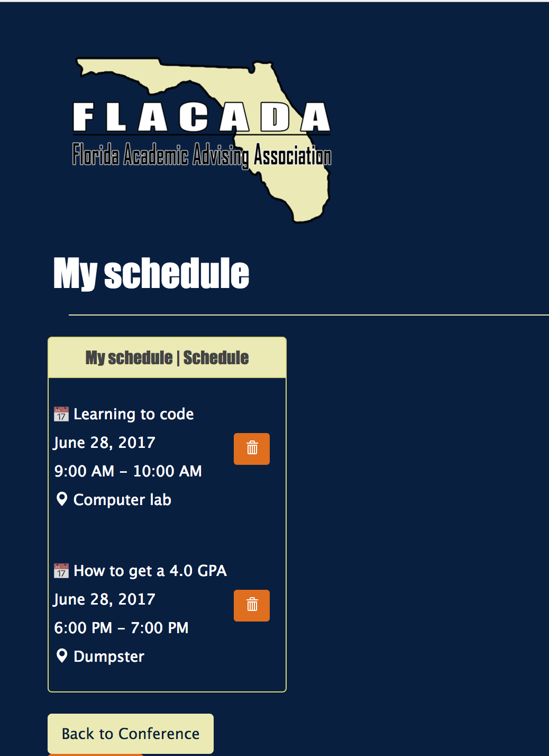
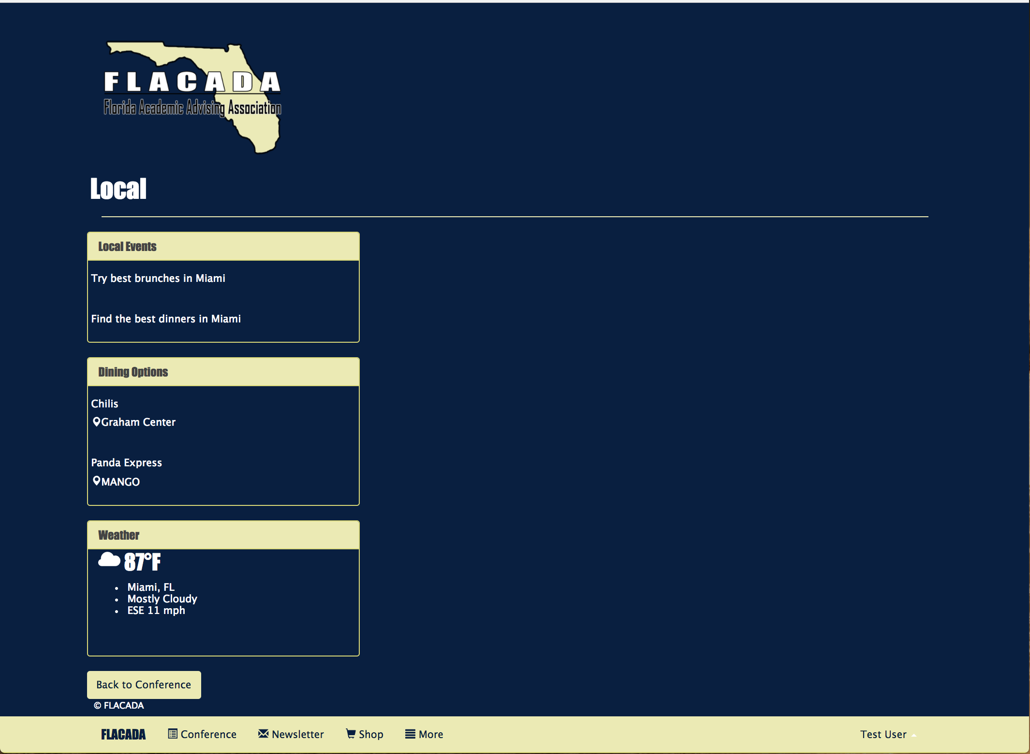
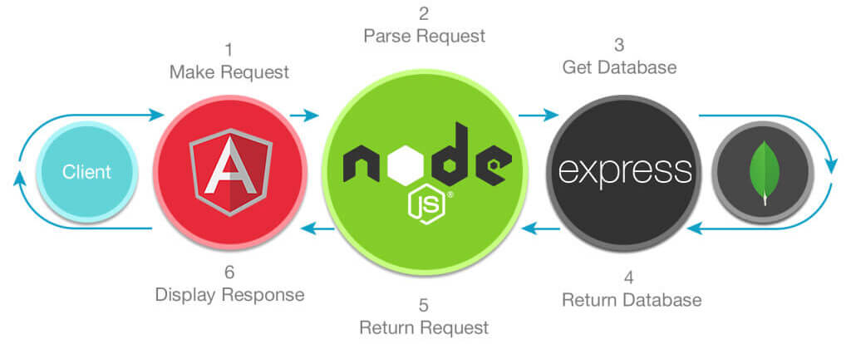



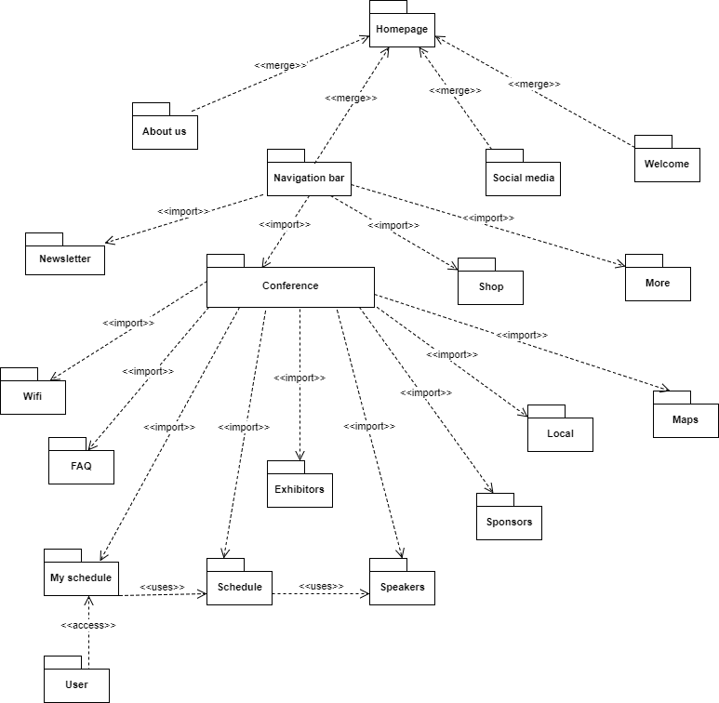
School of Computing & Information Sciences
VIP, 2017, Summer C
FLACADA 1.0
Student: Nickolas Morales, Florida International University
Mentor: Helen Gonzalez, Product Owner
Instructor: Masoud Sadjadi, Florida International University
Problem
An application is needed that allows FLACADA members to see all exhibitors, sponsors, sessions and speakers from a conference. It also allows users to create an account so they can add sessions to their schedule for the conferences. Admins will also have the privilege to add and delete sessions, speakers, sponsors and exhibitors from the app.
Solution
FLACADA 1.0 (figure 1) is the first iteration of this app. Supports user accounts (figure 2) and schedule management (figure 3 & 4) and access to local information (figure 5). Admin privileges include more functionality with editing page contents.
Current System
Base code is modular so it’s easy to add features, refactor code
Supports exponential amount of users as long as more resources are added in Heroku
FLACADA 1.0 is cross platform and resizes in any screen size
Screenshots
Figure 1 Figure 2 Figure 3 Figure 4 Figure 5
Requirements
Angular dependencies injected
All the JS files are declared in the application.
Heroku cloud services
Bootstrap 3
Internet Browser
System Design
Implementation
This project was built in Javascript using:
Develop with:
Verification
Test case: As a user, navigate the application, and add sessions to your account.
Purpose: To test every rendering of the web application.
Action: Register a new account, navigate through the web application, add sessions to the user’s schedule, and logout.
Expected result: Successfully register account, successful rendering of all the pages, and successfully logout.
Object Design
Summary
FLACADA 1.0 is the first iteration of this app, we started from scratch using the MEAN stack framework for full stack web development.
Allows users to see all exhibitors, sponsors, sessions and speakers from the conference.
The architecture is scalable and easy to change based on desired changes in functionality. All of our functions are fully integrated and hosted in our cloud service platform: ‘Heroku’ using ‘Mlab with Amazon Web Services’.
Acknowledgement
The material presented in this poster is based upon the work supported by Helen Gonzalez. I am thankful to the help that I received from my group members, Mabel Amaya, in the process of creating this software for developing the Back end of the application. Special thanks to Stackoverflow for bug fix help and the documentation for the respective technologies mentioned above.
Notes:
1

