Slide 1

Real-Time Summarization
Jianbo Pei

Slide 2
Outline
Introduction
Methods used in Top 3 ranked teams for Scenario A
1. COMP – HK Polytechnic University
2. QU – Qatar University
3. PRNA – Artificial Intelligence Laboratory
Discussion

Slide 3
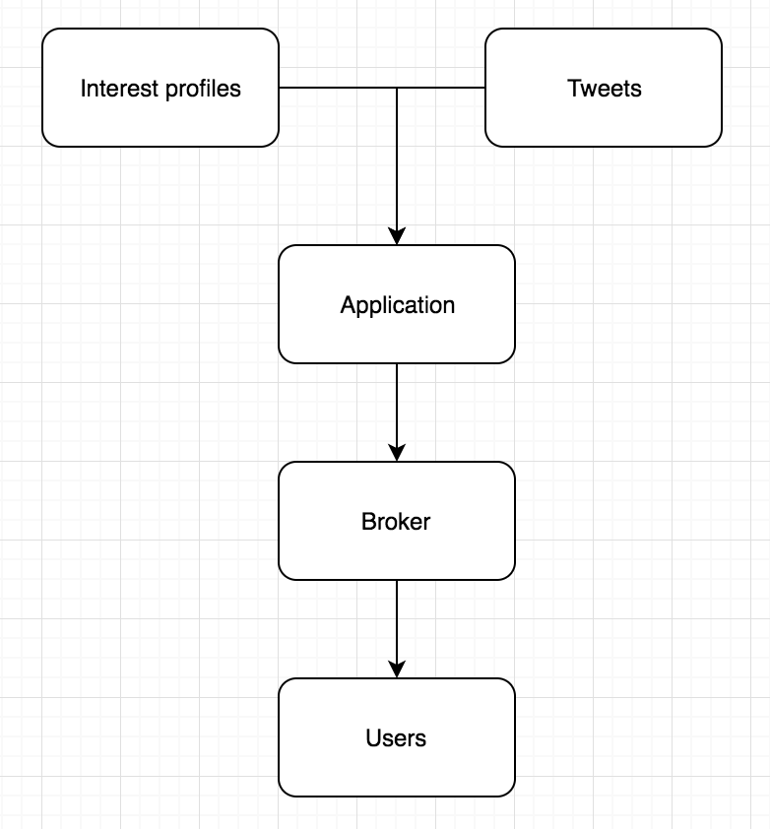
Introduction
Overview:

Slide 4
Introduction (continued)
Interest profile:
Example:

Slide 5
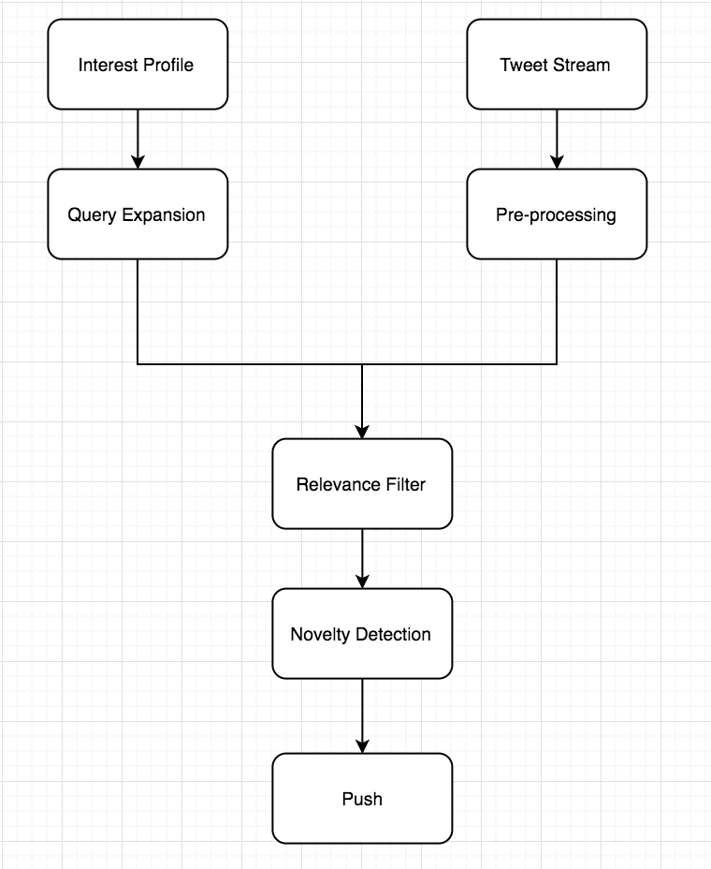
Introduction (continued)
System procedures:

Slide 6
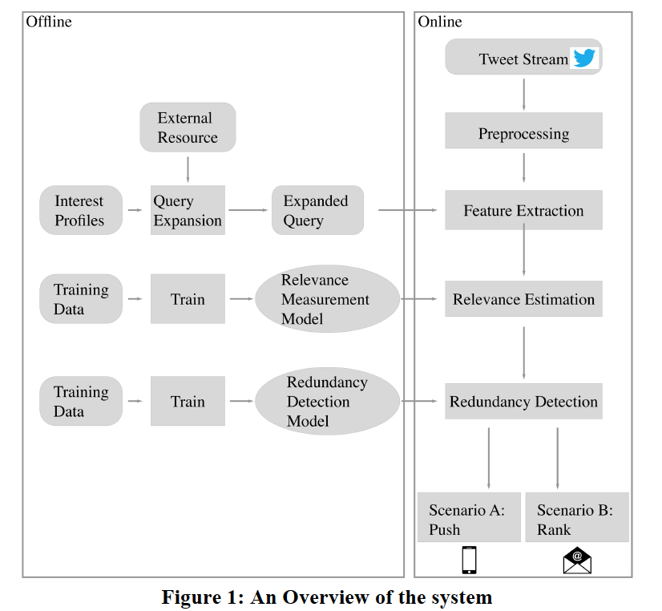
COMP

Slide 7
COMP (continued)
Offline Part
Query Expansion
For each topic title -> select top 50 search results’ snippets in Bing News Search API
For every term in all snippets -> calculate TF-IDF score and select top-20-score terms as “Expansion Terms”
Select top 10 terms from narrative and description as “Narr-Desc Terms” using same technique above
Select title as “Title Terms” except stopwords

Slide 8
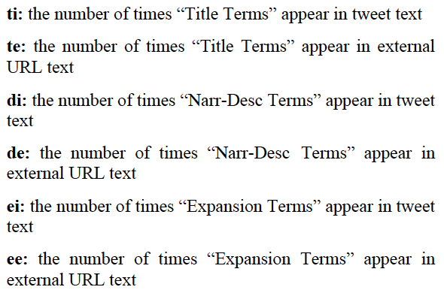

COMP (continued)
Relevance Model Training
Run 3: Naïve Strategy (6 kinds of number of appearance)
Efficient to estimate the relevance between ”interest profile” and tweets

Slide 9
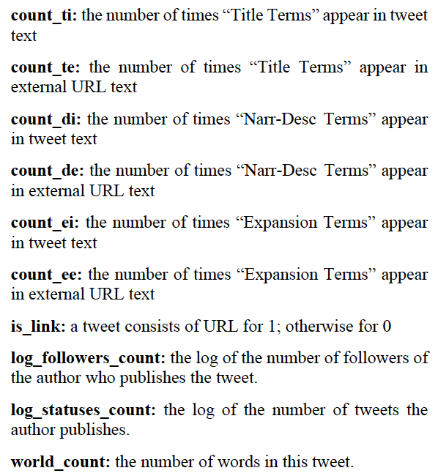
COMP (continued)
Run 2: 11-features model (without word2vec-info feature)
Trained a SVM model from Microblog Track past data
Built a classifier, predict tweets into 3 classes
2 (highly-relevant),
1 (relevant),
0 (non-relevant)

Slide 10

COMP (continued)
Word2vec example, topic MB236, “California drought agricultural effects
Expanded query becomes “water” “groundwater” “California” “drought” ”impact” and etc
Two tweets: tweet A: “water drought groundwater” tweet B: “water California impact”
Although both hit 3 times, tweet B is more relevant.
Run 1: 12-features model (add word2vec-info feature)
Trained Word2vec-info model in GoogleNews Corpus to calculate similarity between words
Then, calculate how much relevant information a tweet has using:
Ti – the term which hits the text
N – number of terms which hit the text
Tclose – most similar term to ti which hits the text

Slide 11
COMP (continued)
Online Part
Redundancy detection
Similarity score = intersection score/union score
Union score – sum of word length of the union of two tweets
Intersection score – sum of word length of the common words of two tweets
Using training data from previous years to choose an optimal threshold of 0.6 for redundancy detection

Slide 12
COMP (continued)
Push strategy and Ranking strategy
Recall is less important than precision,
Three threshold chosen for three runs:
Run 3: push tweets with relevance score >= 7
Run 2: push tweets classified as “highly-relevant” with probability >= 0.6
Run 1: push tweets classified as “highly-relevant” with probability >= 0.7
Probability is based on well-trained SVM classifier

Slide 13
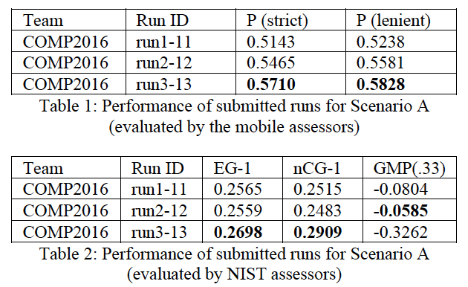
COMP (continued)
Results:

Slide 14
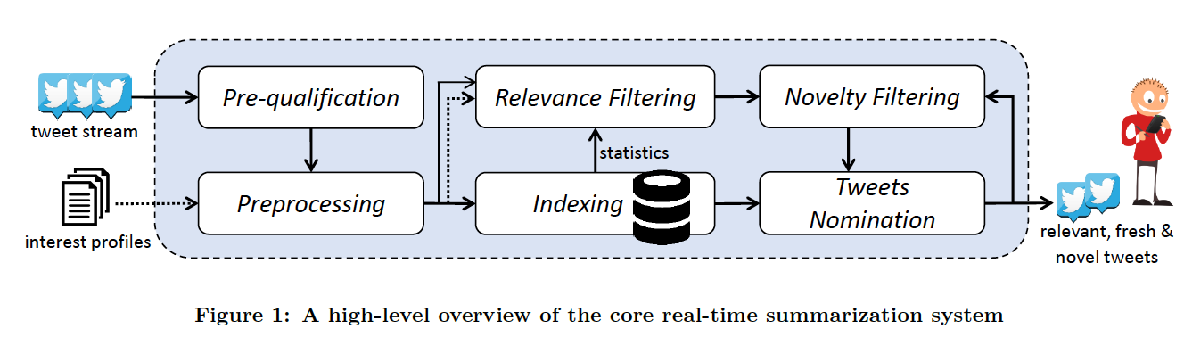
QU

Slide 15
QU (continued)
System Design
Indexing
To acquire term statistics in other components, initialize index of a 5-day tweets stream before evaluation
Incrementally indexes for all English tweets during evaluation

Slide 16
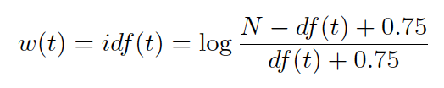
QU (continued)
Relevance Filtering
Represent each interest profile using vector space model
Represent each tweet as a vector using idf-base term weighting
Compute term weights:
N – number of tweets indexed at the time of constructing the vector
df(t) – document frequency of the term

Slide 17
QU (continued)
Relevance Filtering (continued)
Using Cosine Similarity to compute relevance score between tweets in vector space against interest profiles
To efficiently compute relevance score, an in-memory index of profile vectors is applied
Select relevance threshold Tr based on experiments, consider similarity score above Tr as potentially relevant

Slide 18
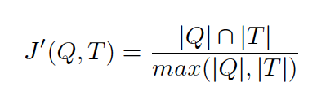
QU (continued)
Novelty Filtering
Any potentially relevant tweet for a profile needs to be examined with all previous ones
Lexical similarity measurement
|Q|, |T| are lengths (in terms) for profile and tweet
Select a novelty threshold Tn

Slide 19
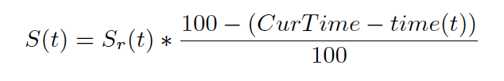
QU (continued)
Push Notification Scenario
Tweets Nomination (based on tweet freshness)
Candidate tweets: the tweets found relevant and novel for each profile
System re-ranks candidate tweets based on relevance and freshness and push the top one to the user through the broker:
Sr(t) – relevance score of tweet t
CurTime – current system time (in minutes)
Time(t) – tweet t creation time (in minutes)

Slide 20
QU (continued)
Profile Expansion
Enrich the topic representation for each profile using Rocchio’s pseudo relevance feedback:
Periodically select k “relevant” terms from p potentially-relevant tweets, and add those terms to topic representation

Slide 21
QU (continued)
Profile Expansion (continued)
Two sources of the expansion:
First source: potentially-relevant tweets detected by relevance filtering
Second source: Top resulting tweets from searching Twitter using online search service
use topic title as query and restrict search date to current date to get fresh tweets

Slide 22

QU (continued)
Profile Expansion (continued)
IDF-based formula to score terms of all candidate tweets:
Then, add top k terms to topic vector
To avoid topic drift, the topic vector is reset to original vector before each expansion
We(t) – score of the term t in the pseduo-relevant tweet set R
nR(t) – number of tweets in R that contains t
Idf(t) – idf-based weight of t

Slide 23
QU (continued)
Submitted three runs
QUBaseline: no expansion to topic profile
QUExpP: uses pseudo relevance feedback to expand the profile hourly from potentianlly-relevant tweets
QUExpT: also performs hourly expansion from Twitter live search

Slide 24
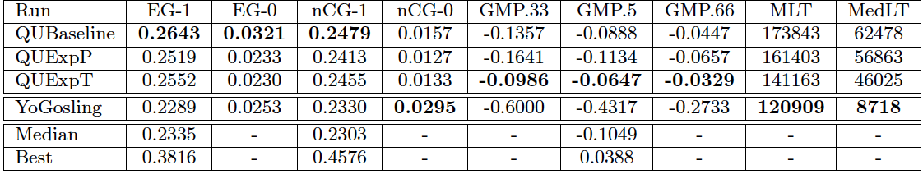
QU (continued)
Results:

Slide 25
PRNA
Textual Feature Extraction (interest profile)
Seven categories of textual features.
Extracting toolkits: NLTK chunker and NLTK interface of the Stanford Parser
Title words; title phrases; noun phrases; phrases within quotations; named entity phrases; location named entity phrases; TF-IDF phrases from narrative

Slide 26
PRNA (continued)
Feature Expansion with paraphrases (interest profile)
Add synonymous phrases to contribute to relevance measuring
PPDB Paraphrase Database for paraphrase-based feature expansion
Expand all categories except Entity phrases and phrases with quotations
Total of 11 categories of textual features

Slide 27
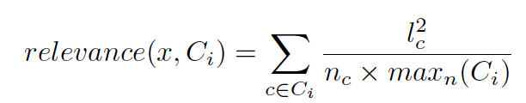
PRNA (continued)
Relevance measurement
Rely on exact and partial matches with a textual feature
Formula to calculate a category relevance:
X – tweet
Lc – maximum number of rightmost words from phrase c
Ci – set of textual features for the ith textual feature category
Nc – total number of words in c
Maxn(Ci) – maximum phrase length among all phrases in Ci

Slide 28
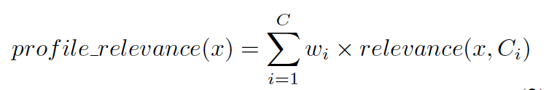
PRNA (continued)
Final score for an interest profile is the weighted sum of the category relevance scores:
All profiles with profile_relevance score above a threshold are candidate profiles for tweet

Slide 29
PRNA (continued)
Novelty Detection
compare ordered lexical and semantic overlap of the tweet content using an algorithm that can compute pairwise text similarity between two given texts
Select similarity score threshold 0.65 or higher in the already-pushed tweets pool
Discard tweets with similarity >= 0.65
Ran several instances of semantic similarity algorithm in parallel to reduce processing time

Slide 30
PRNA (continued)
Technique explained:
First half day: set threshold at 0.75
After 12 hours, check the percentage of an interest profile’s daily quota: num of message_pushed/num of tweets limit per profile (e.g. 10 tweets per profile)
#message_pushed >= 5, threshold unchanged; 0 < #message_pushed < 5, threshold changes to a medium relevance threshold (0.6 selected); #message_pushed = 0, threshold lowers further to a weak relevance (0.5 selected)
Strict Threshold-based Push Notification (run 1)
For strong relevance, relevancy threshold is 0.75 and push any tweet with relevancy >= 0.75
Time-adjusted Dynamic Threshold-based Push Notification (run 2)
Adjust threshold for less popular topic
Technique explained:

Slide 31
PRNA (continued)
Quota-restricted threshold-based push notification (run 3)
When relevance score of a tweet > a weak relevance threshold (0.5 selected), push the tweet only until 5 tweets
Remaining for relevance score > 0.75
If all tweets have relevance score > 0.75, all 10 tweets can be pushed

Slide 32
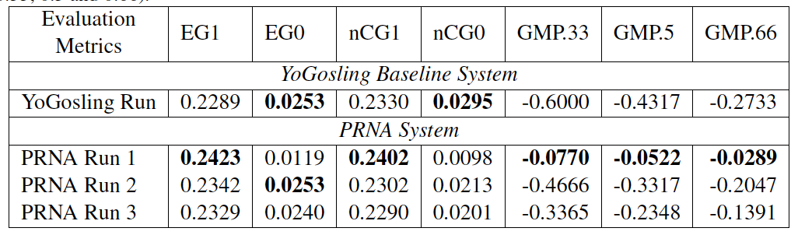
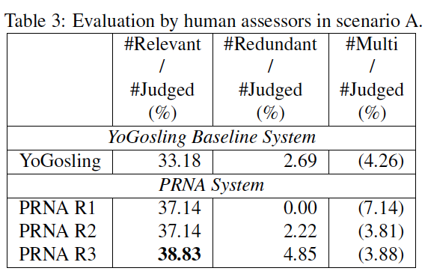
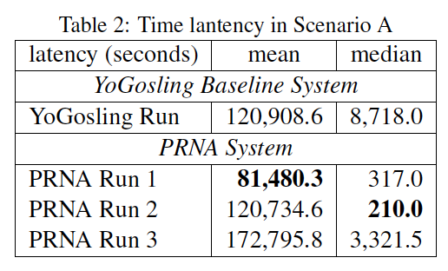
PRNA (continued)
Results:

Slide 33
Discussion
Major differences among three teams:
Query expansion:
COMP and PRNA expanded the query before computing the relevance score
COMP put title, description, and narrative of each interest profile to Bing news search API and calculate TF-IDF score to select top terms
PRNA used paraphrases-based feature expansion from textual features

Slide 34
Discussion
Query expansion:
QU periodically enriched the topic representation for an interest profile using Rocchio’s pseudo relevance feedback

Slide 35
Discussion (continued)
Relevance filter
COMP used training data trained in GoogleNews corpus to build a classifier
QU used vector space model to represent each interest profile and each incoming tweet as a vector. Then, applied Cosine similarity to compute relevance score
PRNA did not only rely on an exact match with textual feature, and also took partial matches in to account

Slide 36
Discussion (continued)
Novelty detection
COMP used an efficient and naïve similarity measurement to detect redundancy
QU and PRNA both used Lexical similarity measurement to detect redundancy

Slide 37
Discussion (continued)
Push strategy
COMP used strict threshold
QU re-ranked tweets based on tweet freshness to select qualified tweets
PRNA applied strict-threshold, time-adjusted dynamic threshold, and quota-restricted threshold method

Slide 38
Discussion (continued)
Possible improvements:
Query expansion: Search titles in Twitter, search description in google, and search each sentence in narrative + title in google
Novelty detection: combine word order similarity and semantic similarity together

Slide 39
Thank you!

