Slide 1
DL Lab – Object Detection
Team 8
Nick Wagner | David Unger

Slide 2
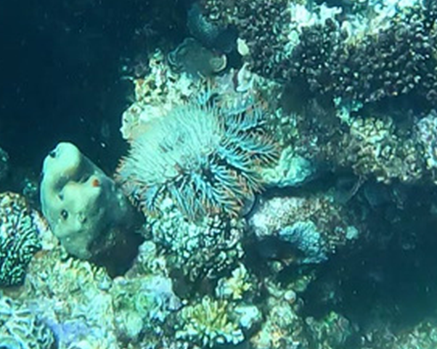
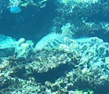
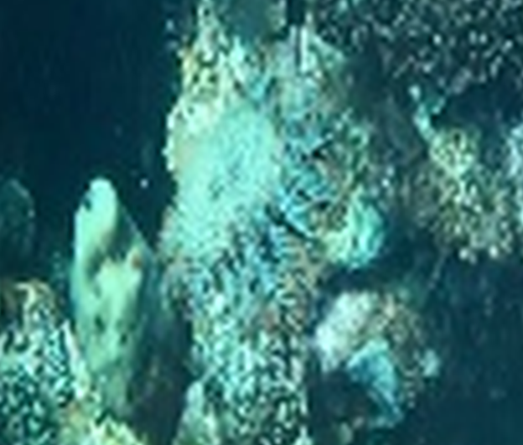

1 Problem Statement
1280x720
16.jpg
57.jpg
Nick Wagner | David Unger - 08.01.2022

Slide 3

2 Architecture
Nick Wagner | David Unger - 08.01.2022

Slide 4
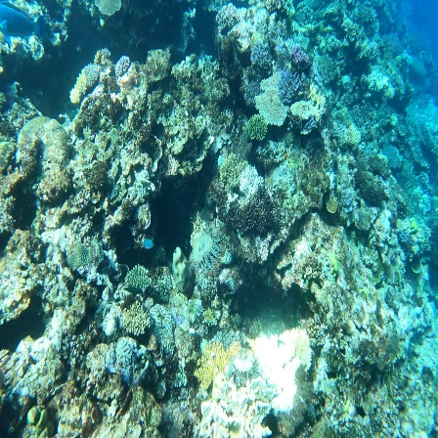
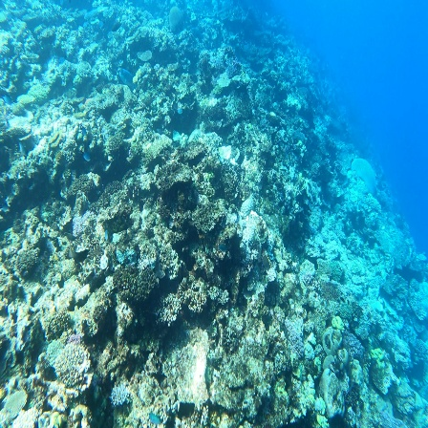
3 Loss Function
Nick Wagner | David Unger - 08.01.2022

Slide 5
4 Results
Nick Wagner | David Unger - 08.01.2022

