Slide 1
Post-det Fission Product Prediction Tool
(FPPT)
Capt Nick Quartemont
Air Force Institute of Technology
May 2019

Slide 2
Motivation
Volatile
Mass
Chains
Refractory Mass
Chains

Slide 3
FPPT Use
Input to use in exercises
Fission product mass chain yields.
Selected fission product cumulative yields.
Verification and validation of known fission products against a suspected nuclear weapon neutron spectrum / fission spectrum.

Slide 4
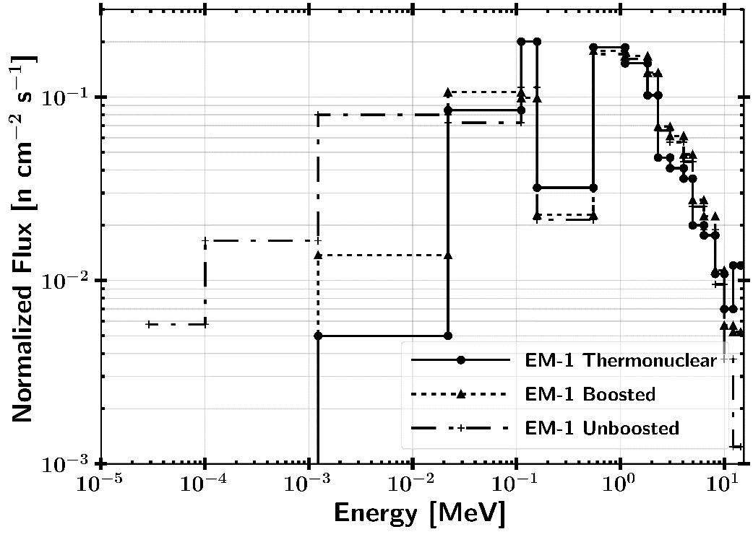
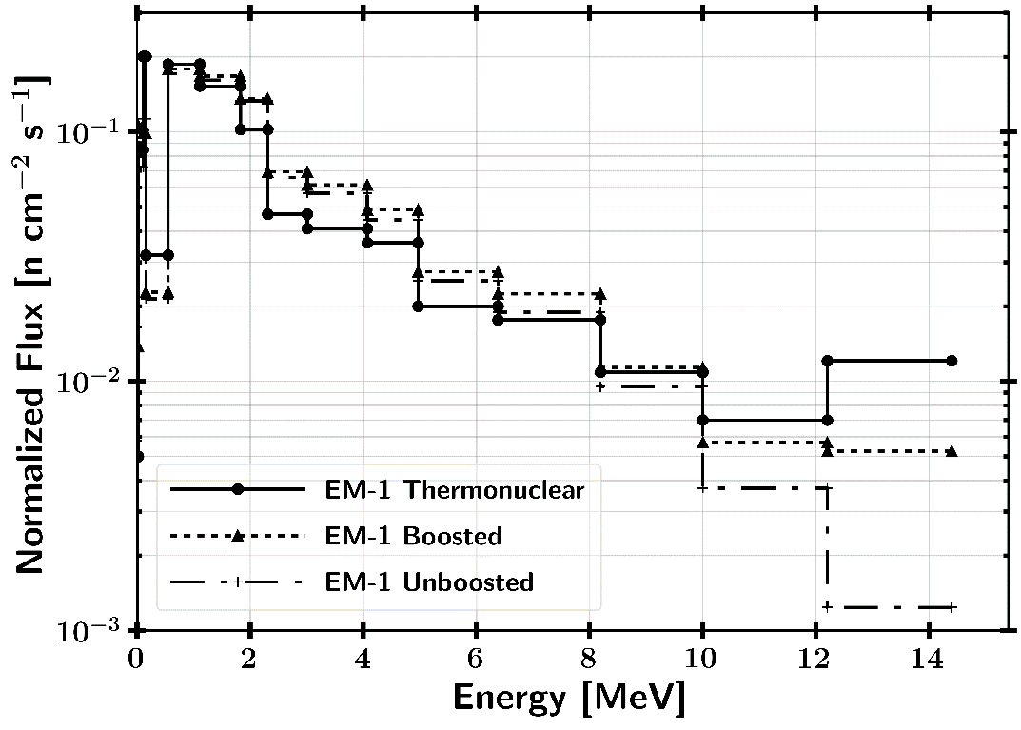
Effects Manual One (EM-1) Nuclear Weapon Spectra
Nuclear weapon neutron spectrum is not well represented by the low fidelity group structure.
Need higher fidelity energy resolution. EM-1 unclassified spectra utilize an 18 energy group structure.

Slide 5
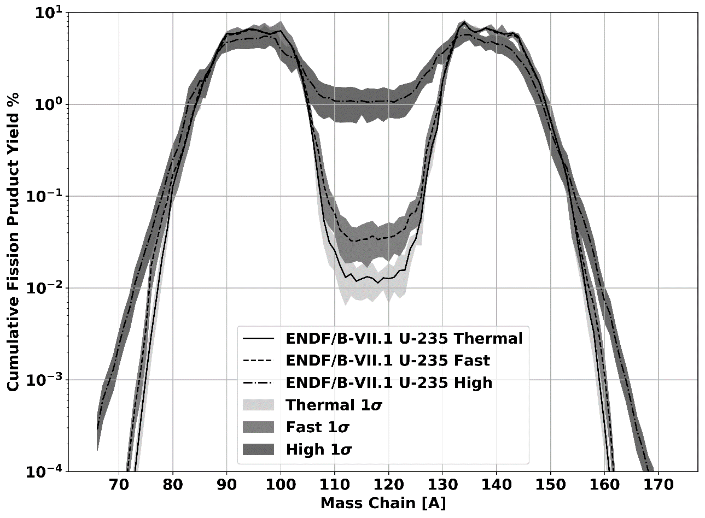
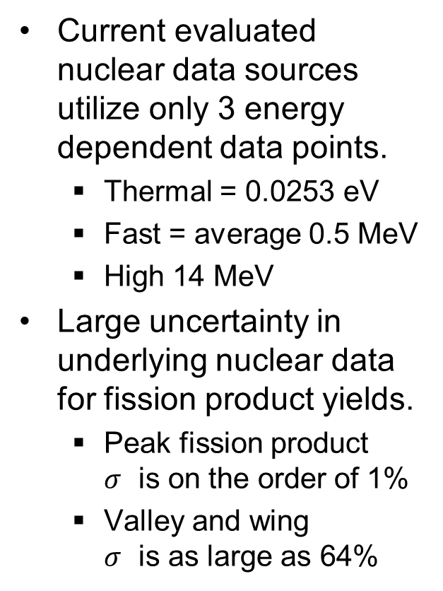
Problem
Current evaluated nuclear data sources utilize only 3 energy dependent data points.
Thermal = 0.0253 eV
Fast = average 0.5 MeV
High 14 MeV
Large uncertainty in underlying nuclear data for fission product yields.
Peak fission product $σ$ is on the order of 1%
Valley and wing $σ$ is as large as 64%
Valley
Light Peak Heavy Peak
Light Tail Heavy Tail

Slide 6
Post-Detonation FPPT
Solutions
General Observables of Fission (GEF)
Fit experimental data to phenomenological model
Inputs
Fissioning energy distribution for U-235, U-236, U-238, Pu-239, Pu-240
Optional weights. Used when approximating U-236 as U-238 to calculate estimate of experimental data fit.
Energy group structure 46 DPLUS for optimal fits with GEF

Slide 7
Limitations
Not for nuclear reactors. Burnup is not included in the tool. Only for prompt timescales such as a nuclear weapon.
Currently, very little experimental data for plutonium fission yield data exists. The available data has mixed assays which can introduce large errors in some mass chains.
U-236 has almost no experimental data. At low concentration, this isotope can be approximated with U-238 because both are threshold fissioners.
Fractionation (chemical, physical) of the fission products is not addressed.

Slide 8
GEF Code
General Observables of Fission (GEF)
Monte Carlo
Theory
Experimental data
Important because energy dependent fissioning systems can be assessed.
Utilized GEF 2017 1-2 for U-235, U-236, U-238, Pu-239, and Pu-240.
Calculation methodology
46 group DPLUS input
Multiplication of groups to output from GEF directly.
Error is reported through the error propogation of the summation.
Alternate group structure
Fit 46 group DPLUS group structure mass chain yield data to target energy group structure.
Multiplication of groups to output of fit values.
Error is reported though the error propagation of the summation of each group in addition to the error in fitting the data.
Nuclear data covariance
Multi-chance fission

Slide 9
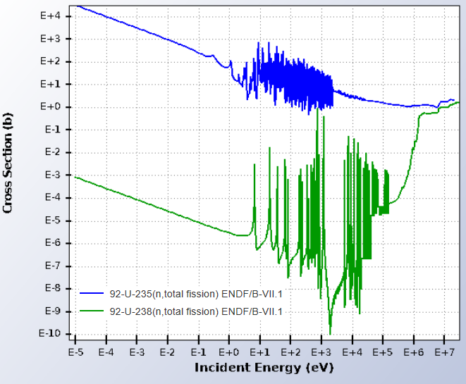
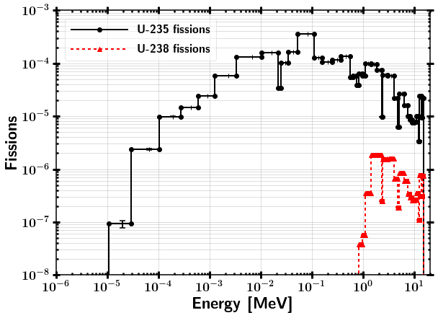

Fissioning System Energy Example
Neutron Energy Spectrum
Fission
Cross-section
Fissioning System Spectrum
x
$∝$
46 Group DPLUS Structure Output
93% HEU Thermonuclear Neutron Spectrum `

Slide 10
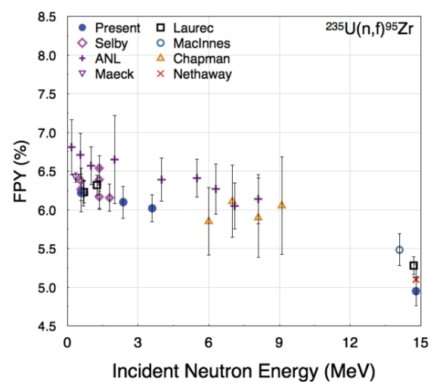

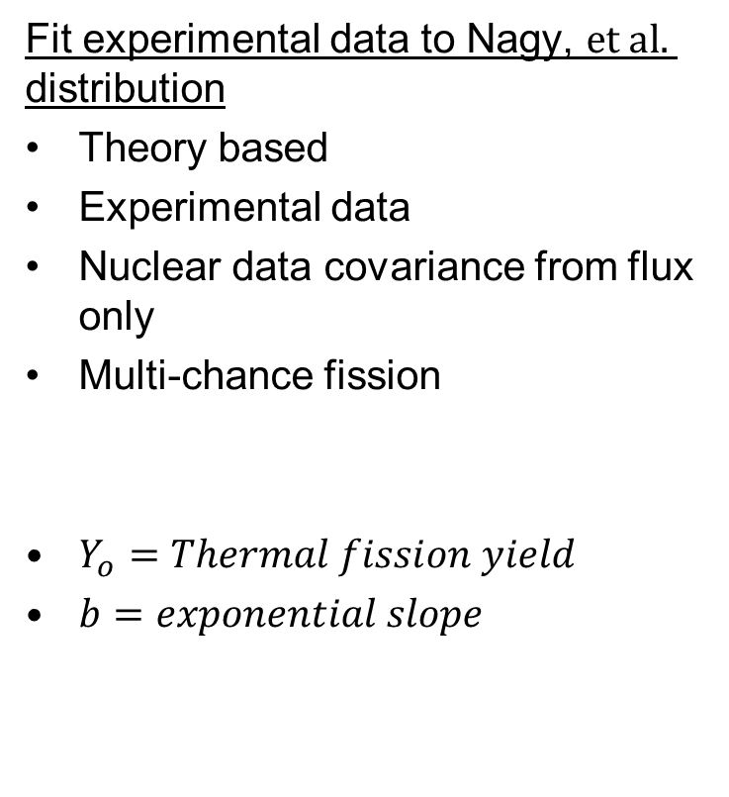
Experimental Data Fits
Fit experimental data to Nagy, $et al.$ distribution
Theory based
Experimental data
Nuclear data covariance from flux only
Multi-chance fission
$Y_{o}=Thermal fission yield$
$b=exponential slope$
Can leverage experimental data, where it exists,
to drive down error for better approximations.

Slide 11
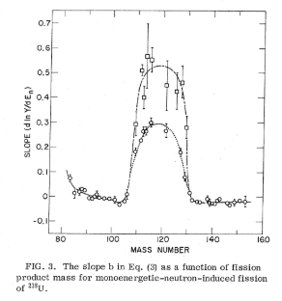
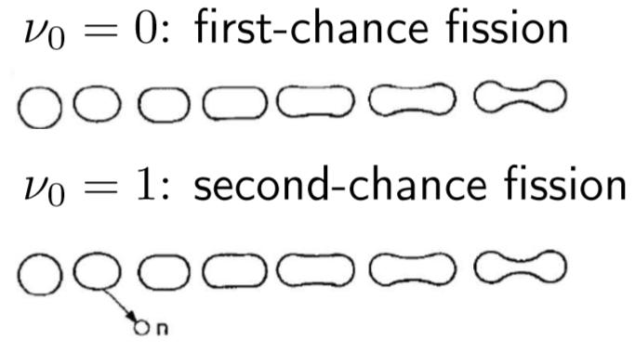
Fit Parameter “b”
First-chance fission dominant up to 5.5 MeV
Second-chance fission dominant up to 14.1 MeV

Slide 12
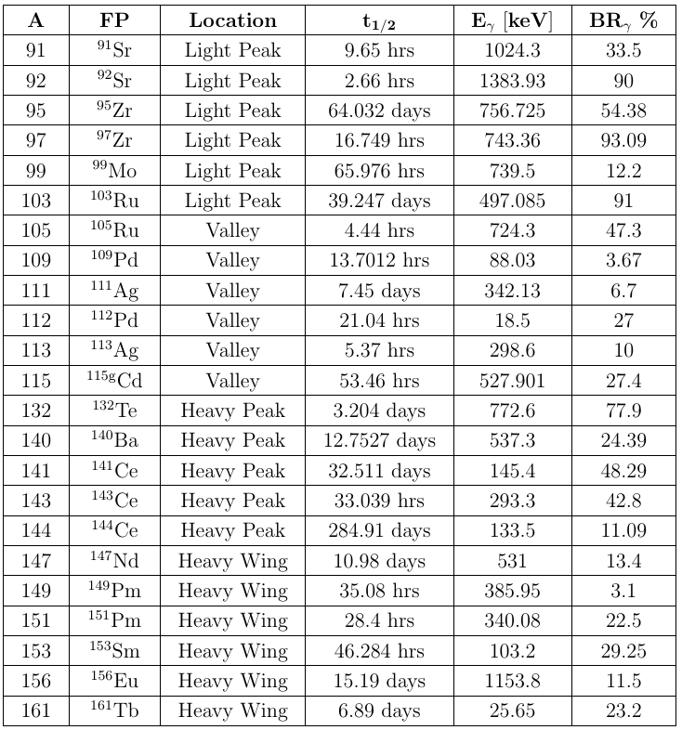
Included Experimental Data for U-235 and U-238
Light Peak
Valley
Heavy Peak
Heavy Wing

Slide 13
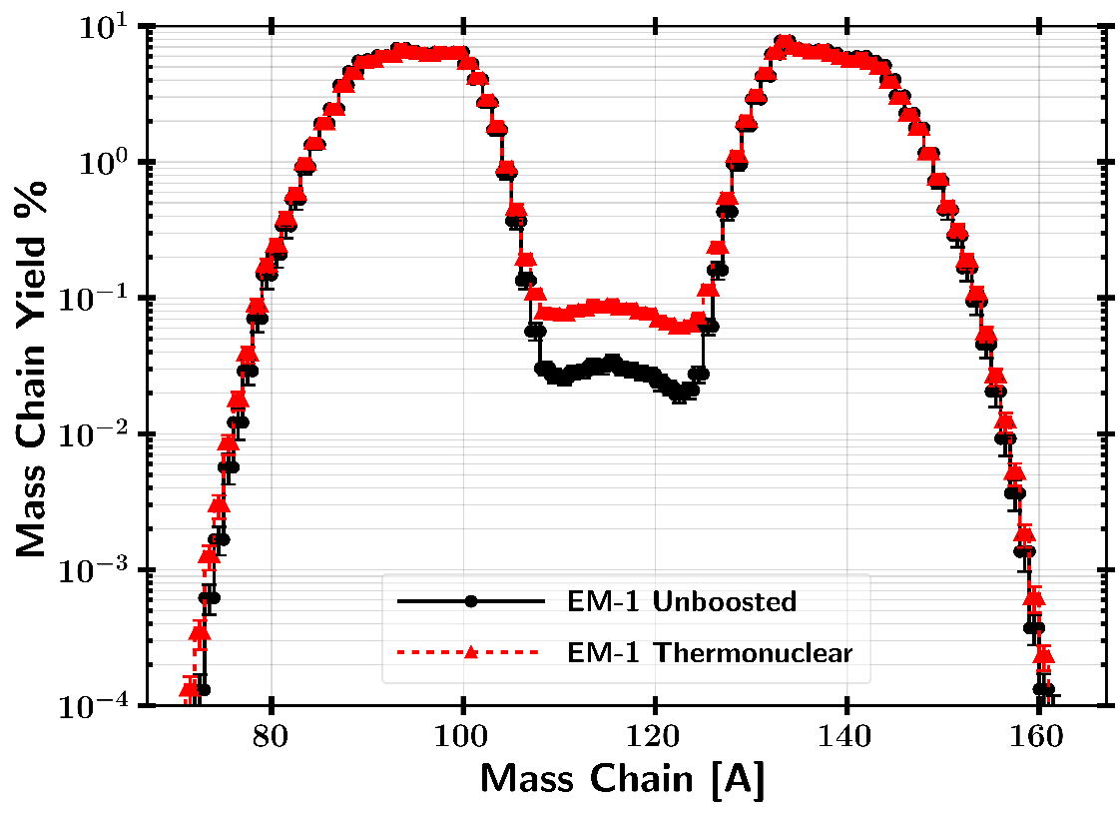
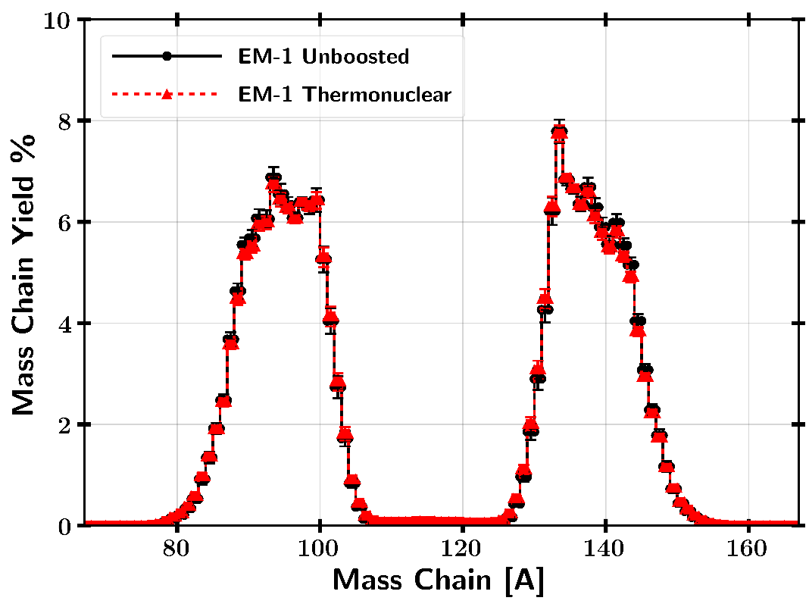
Example EM-1 Thermonuclear vs Unboosted

Slide 14
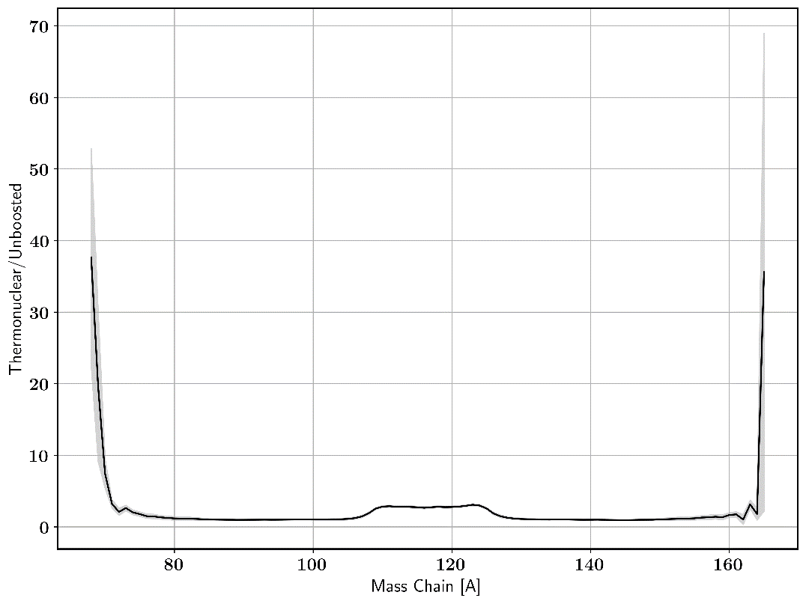
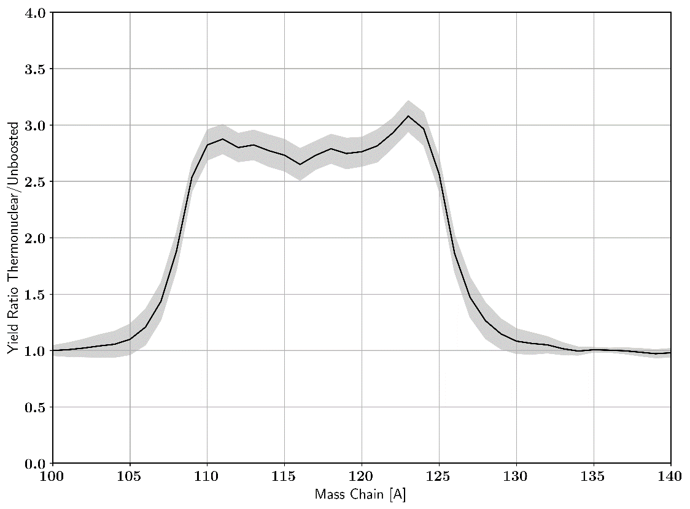
Example EM-1 Thermonuclear vs Unboosted
Comparison of Thermonuclear to Unboosted
fission product mass chain ratios

Slide 15
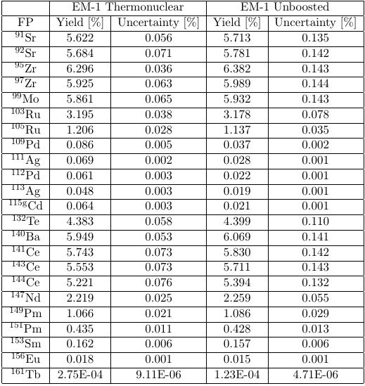
Example EM-1 Thermonuclear vs Unboosted
Observable differences in cumulative fission product yields based on neutron environment.
Valley fission and wing fission products are the key region. If experimental data exists, these can be predicted with lower uncertainty.
* Uncertainty is absolute fission product percent yield uncertainty, not relative uncertainty

Slide 16
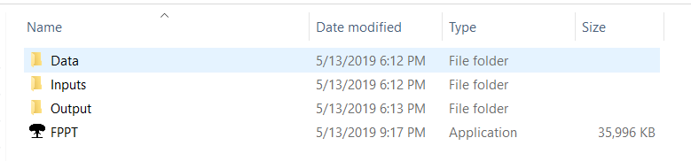
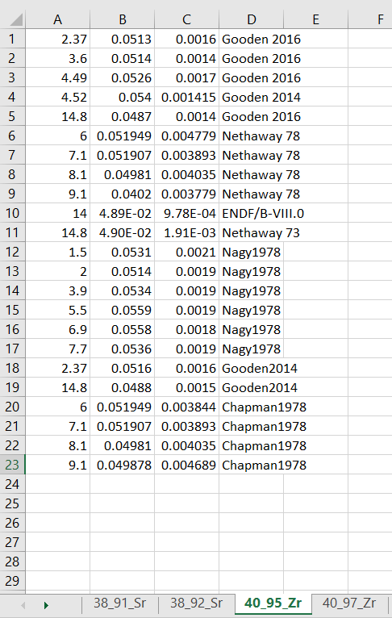
Tool Implementation
Main Distribution (all code is Python 2.7 based)
Data
Pickle format for GEF
Excel format for Experimental Data
Format is:
Energy [MeV] / Yield / Yield Uncertainty

Slide 17
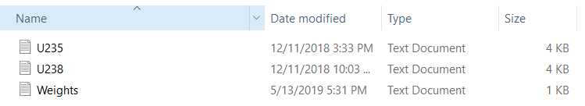
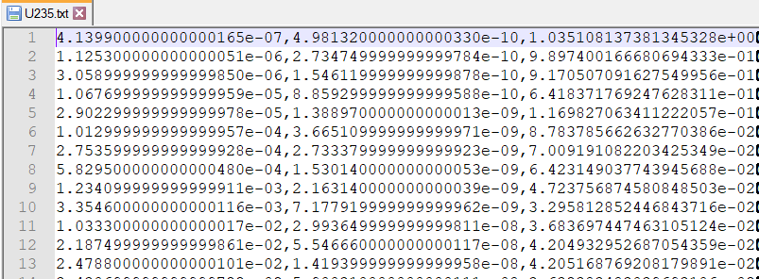
Tool Implementation
Input
Input fissioning systems (example U-235 and U-238)
Weights (optional file to approximate U-236 as U-238)
Energy [MeV] fissions Relative Uncertainty

Slide 18
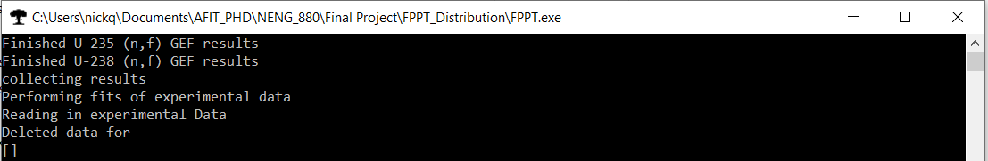
Tool Implementation
Running the code
Double click nuclear weapon mach stem
Execute FTTP.exe from command line
Deleted data for [ ] will be populated if some inputs do not all have the same isotopes for cumulative fission product yields.
File is created in output that is formatted as YYYY_MM_DD_#.txt

Slide 19
Future Work
Add more data
Group structure format for fissioning systems cross-sections.

Slide 20
Tool Demo

Slide 21
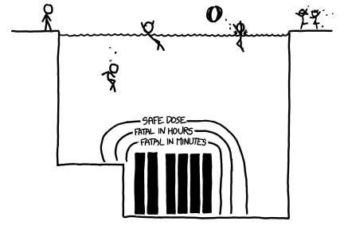
Questions?

