Slide 1
Analysis of a Novel NIF Platform for Simulating Nuclear Relevant Neutron Environments
NENG 725 – Spring 2018
Lt Nick Quartemont
Air Force Institute of Technology
16 Apr 2018

Slide 2
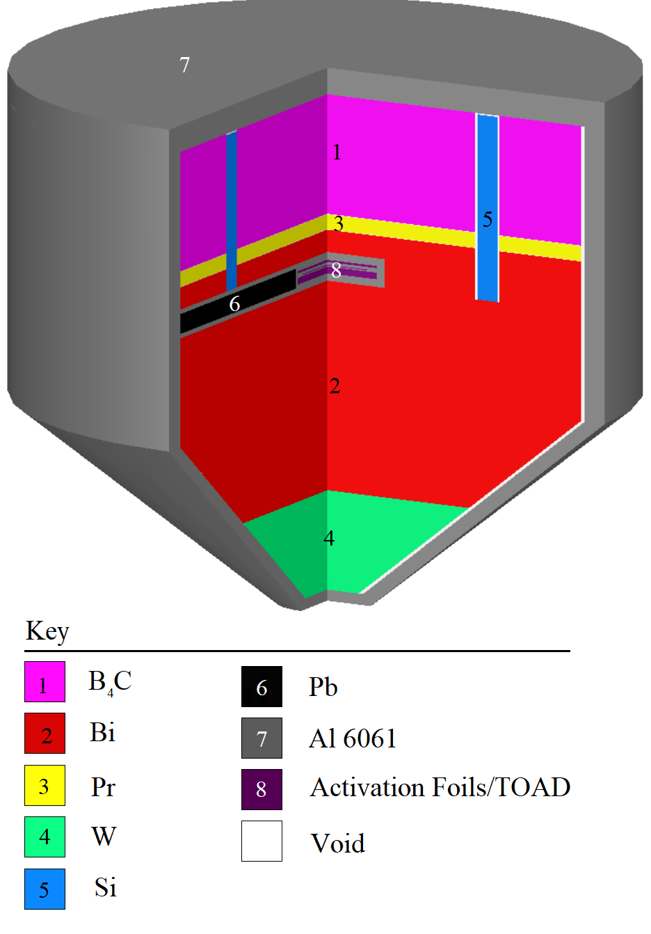
Project Description
An energy tuning assembly (ETA) can be used to modify a source neutron spectrum to an objective neutron spectrum.
ETA design created with COEUS (Metaheuristic Optimization )
An ETA designed for a 14.1 MeV DT fusion source at the National Ignition Facility is will be analyzed with new parameters (distance to source).

Slide 3
Project Objectives
Hypothesis:
Modified ETA model will be consistent with previous calculations
Covariance will be small for macroscopic values, and may be very large (10s of %) for microscopic values.
Project goals:
Model ETA and foil reactions with nuclear data covariance
Tools utilized:
Monte Carlo Analysis – MCNP and SCALE
Python / Excel – data post-processing and analysis
Topics:
Monte Carlo transport
Neutron interaction mechanisms (Fission Products, Rxn Rates)
Variance reduction / Nuclear Data Covariance

Slide 4
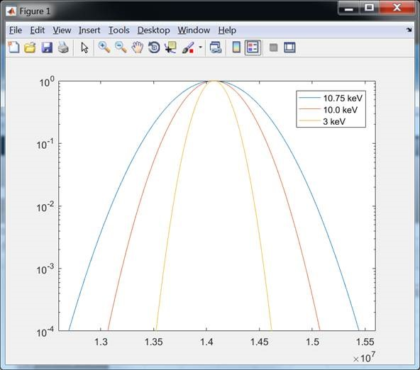
NIF DT Source

Slide 5
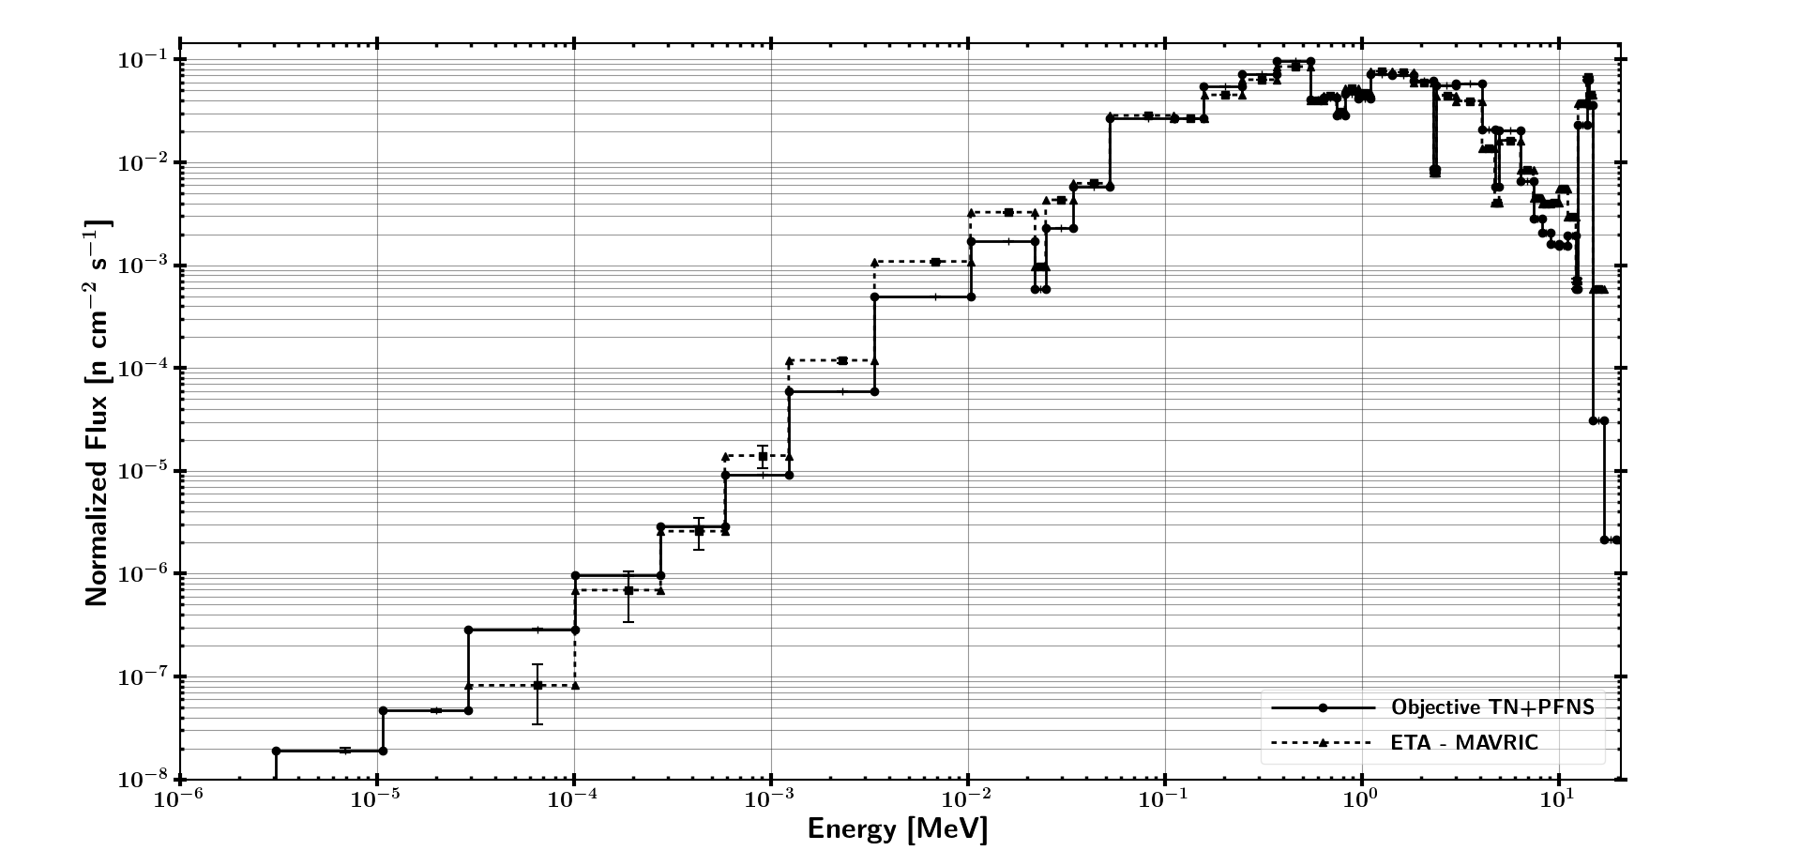
Neutron Flux in HEU Foil

Slide 6
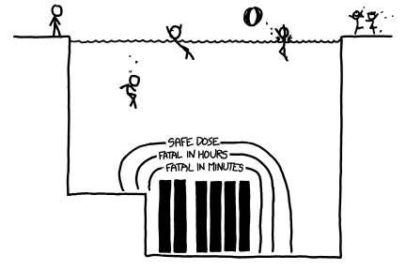
Questions

