Slide 1
Application of Spectral Shaping for Simulating Neutron Environments
Lt Nick Quartemont
MS Nuclear Engineering 19M
Air Force Institute of Technology
21 July 2018

Slide 2
Overview
Motivation
Research Objectives
Nuclear Data Covariance
Energy Tuning Assembly Design
Energy Tuning Assembly Analysis
Summary

Slide 3


Motivation
Create spectrally accurate neutron energy flux environment
Nuclear weapons effects
Forensics exercises
2018 Nuclear Posture Review key efforts in countering nuclear terrorism - “deterring state support for nuclear terrorism through advanced forensics and attribution capabilities.”

Slide 4
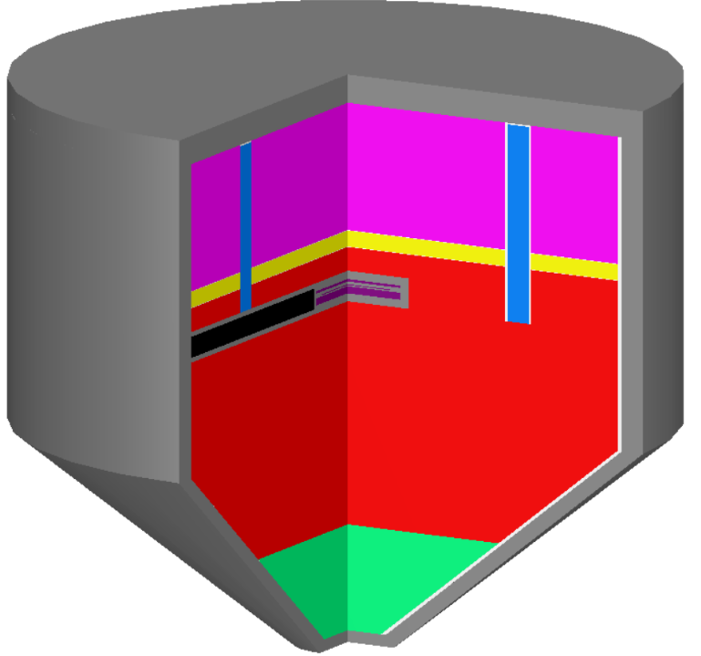
Research Objectives
Energy tuning assembly (ETA) optimized for synthetic weapons debris production
ETA 1 – 2019 proof of concept experiment at National Ignition Facility (NIF)
ETA 2 – Proposed 2020 shot at NIF
Explore ETA for ‘short pulse’ neutron source
Proposed for 2020 shot at NIF

Slide 5
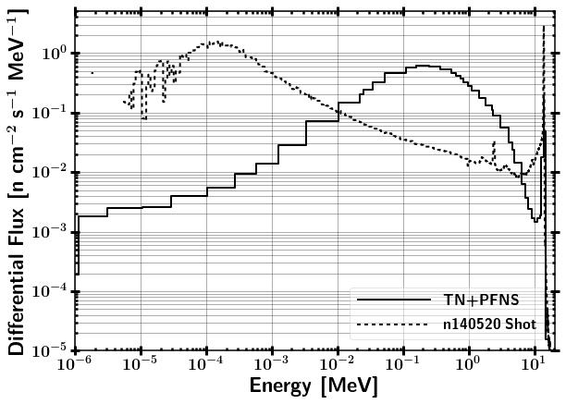
ETA Research Objectives
Research Question:
Can we produce an accurate fission product distribution expected from a "typical" thermonuclear or boosted nuclear weapon detonation using spectral modification at the NIF?

Slide 6
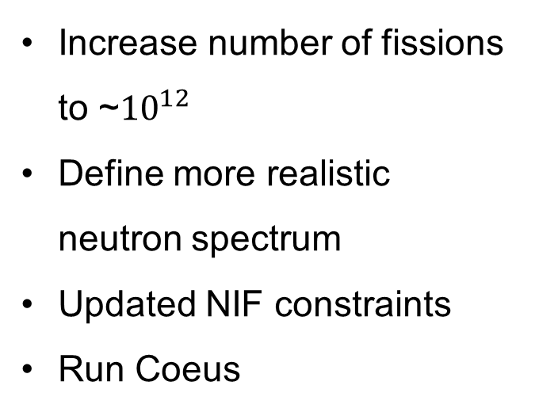
ETA2 Research Objectives
Enhanced efficiency for generating synthetic fission debris
Investigate capability for use as a short pulse neutron source
Time profile of neutron flux
Energy spectrum of incident neutron flux
Run Coeus
Increase number of fissions to ~${10}^{12}$
Define more realistic neutron spectrum
Updated NIF constraints
Run Coeus

Slide 7
ETA Analysis
Problem Objectives
Coeus v1.0
Problem Constraints
Energy Tuning Assembly Design
SCALE 6.2
252 Energy Group Covariance Analysis
MCNP 6.1 and 5.1
Continuous Energy Transport Analysis
Radiation
Transport
Additional
Analysis
Optimize Foil Diagnostic Activation Pack
GEF
Fission Product Isotopes
STAYSL
Neutron Energy Spectra Unfold

Slide 8
SCALE Nuclear Data Covariance Libraries
Distributed with 252 and 56 energy group structure
Based on evaluated covariance data and approximate data
ENDF/B-VI,VII.1,VII.2-previously proposed
JENDL-4.0
Collaborative research with Brookhaven National Laboratory, Los Alamos National Laboratory, and Oak Ridge National Laboratory
Working Party on International Nuclear Data Evaluation Co-operation (WPEC) Subgroup-26
SCALE has corrected correlation data to meet the definition of a correlation matrix (ie. Maximum value of 1)

Slide 9
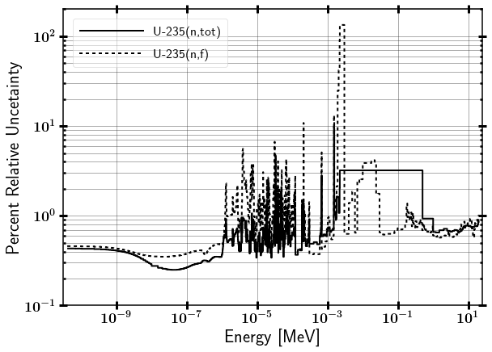
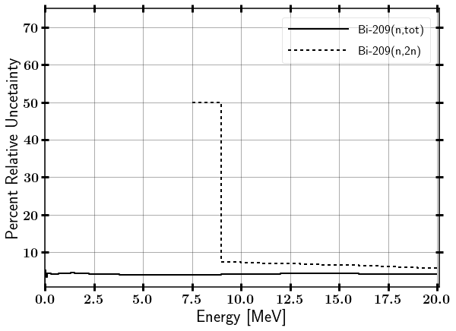
SCALE Nuclear Data Covariance
Evaluated nuclear data comes in as a correlation matrix, which can create a covariance matrix with the uncertainty
U-235 (n,f) Bi-209 (n,2n)
U-235 relative uncertainty peaks near 2.23 keV at 133.6%

Slide 10
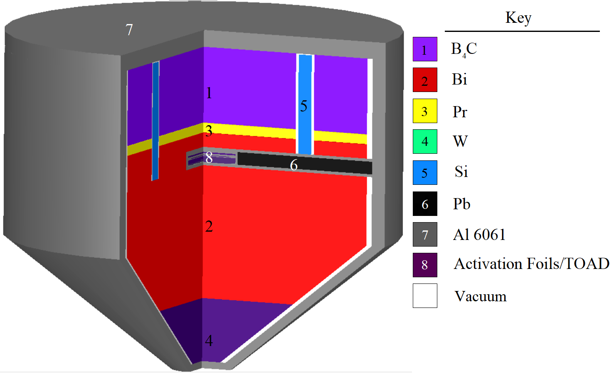
Energy Tuning Assembly Design
~28 cm
~28 cm
NIF Source 15 cm from cone base
Notes:
ETA created with the Coeus v1.0 metaheuristic optimization software package
Objective thermonuclear and prompt fission neutron spectrum (TN+PFNS).
Input spectrum NIF D-T fusion
Optimize flux in highly enriched uranium (HEU) foil adjacent to Target Option Activation Device (TOAD)
Base of cone originally 6 cm from neutron source (moved to 15 cm)

Slide 11
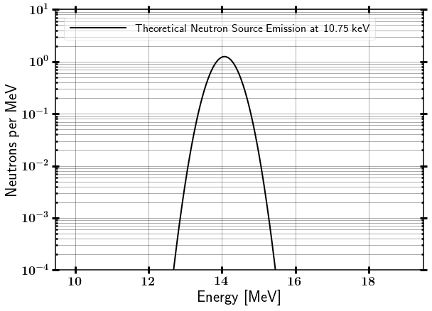
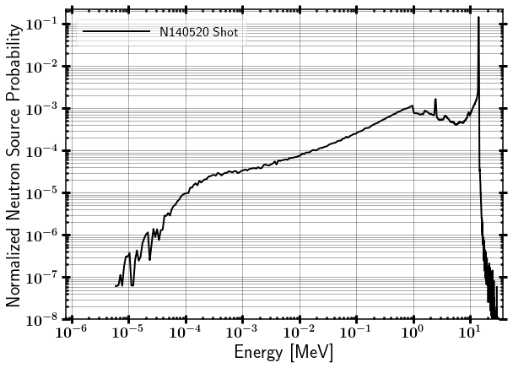
NIF Neutron Source
Appelbe HiFoot Time of Flight
Notes:
14.1 MeV in 250-300 ps
Nominal yield of 3.7E+15 neutrons
Source deviates from theoretical from “room return” and downscatter including fusion compression techniques

Slide 12
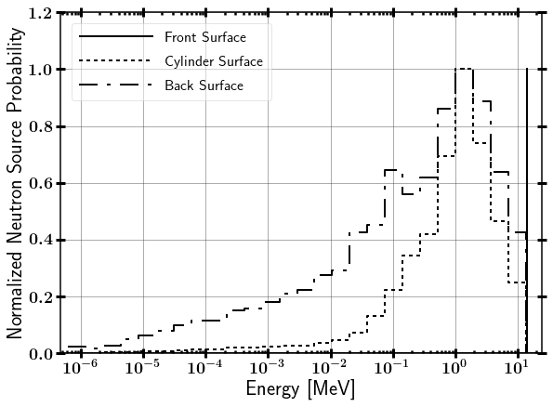
NIF Neutron Source
DT Fusion
Zero
Temperature
Source
Notes:
14.1 MeV in 250-300 ps
Nominal yield of 3.7E+15 neutrons
Source deviates from theoretical from “room return” and downscatter including fusion compression techniques

Slide 13
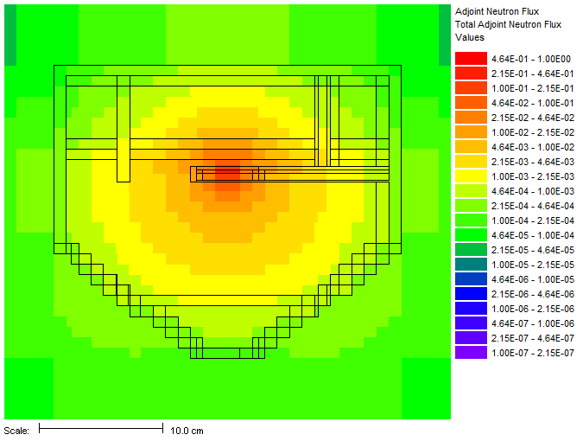
SCALE MAVRIC Sequence
Notes:
10.75 keV temperature plasma fusion source
Point source 15 cm from cone base of ETA

Slide 14
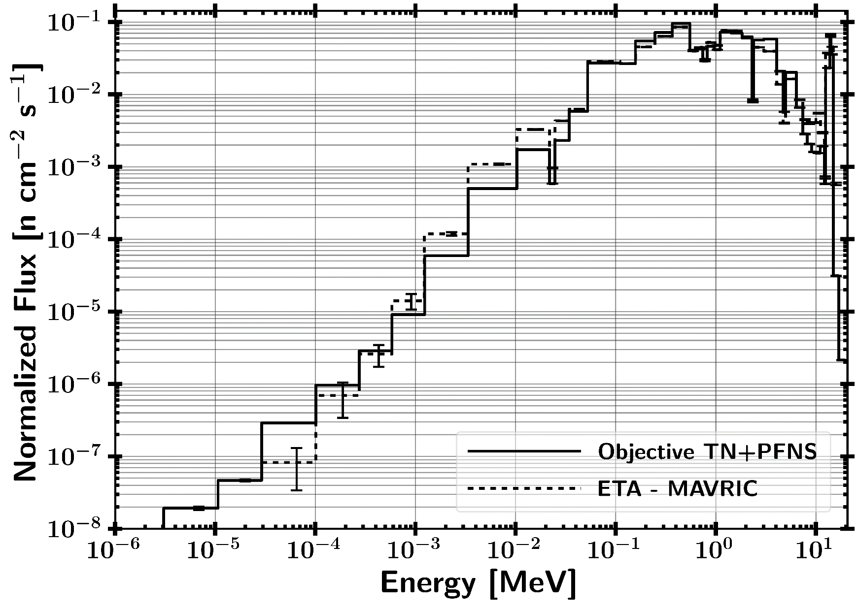
ETA HEU Foil Incident Neutron Energy Spectrum

Slide 15
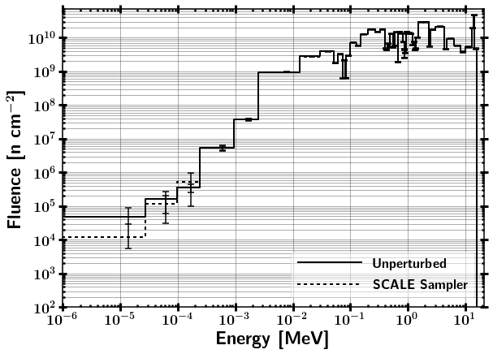
59 Group HEU Foil Incident Neutron Energy Spectrum

Slide 16
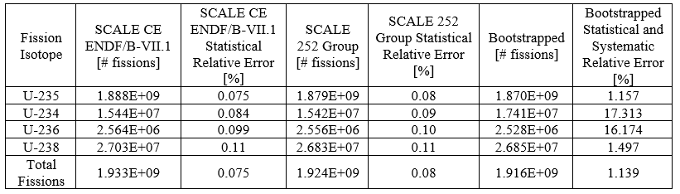
HEU Foil Fissions

Slide 17
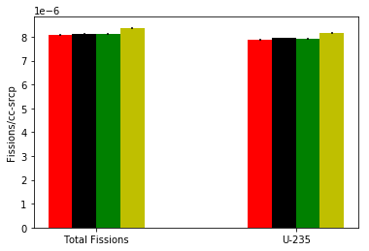
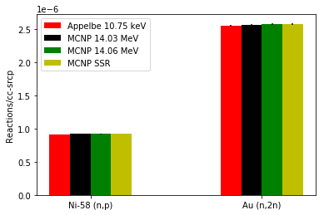
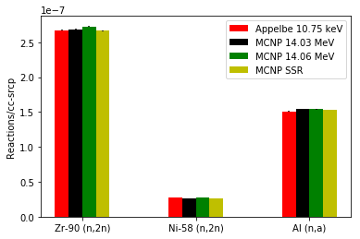
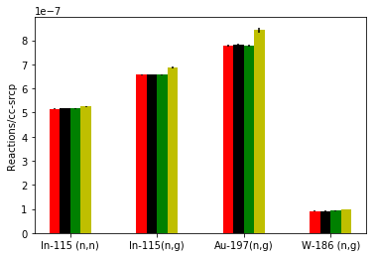
Source Impacts on Reactions

Slide 18
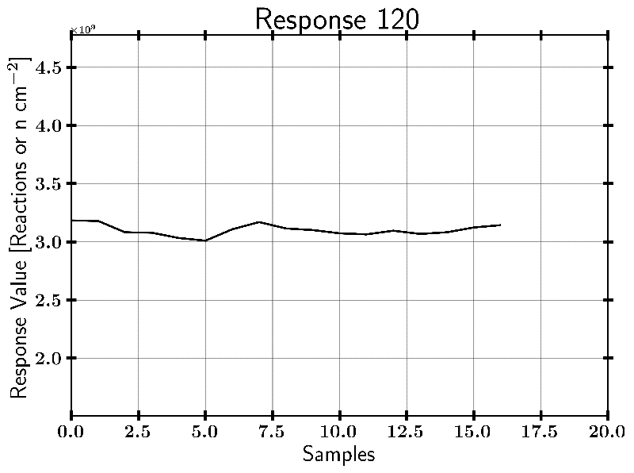
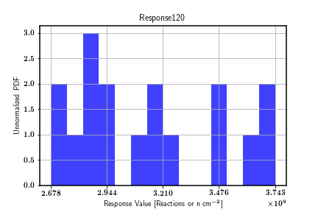
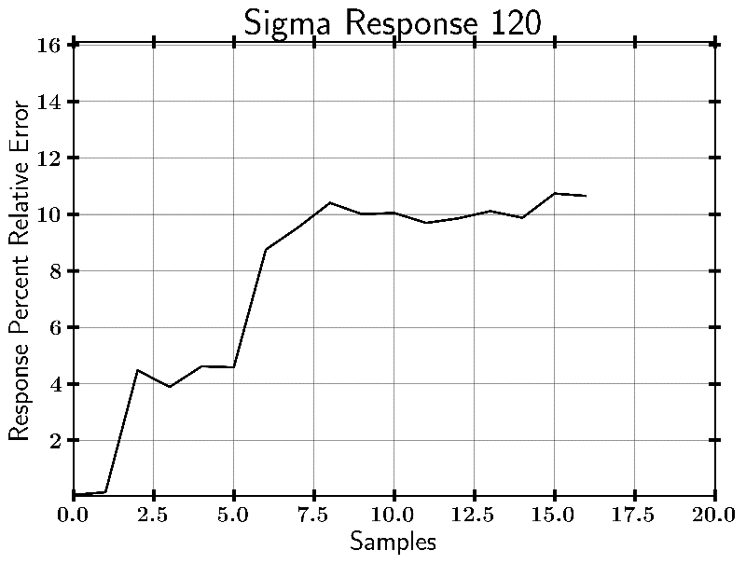
In-115 (n,g) Example Case
Output from SAMPLER
***16 SAMPLER Cases, results not converged

Slide 19
Results
Modeled ETA with covariance is consistent with the continuous energy solution
Covariance adds about 1% relative uncertainty for well studied reactions (ex. U-235) and adds above 10% for less well studied reactions (ex. U-234)
Future work to add to this research:
Increased number of samples until mean and relative error have converged.
Move to real NIF spectrum

Slide 20
Summary
Motivation
Research Objectives
Nuclear Data Covariance
Energy Tuning Assembly Design
Energy Tuning Assembly Analysis
Summary

Slide 21
Questions

Slide 22
Backups

Slide 23
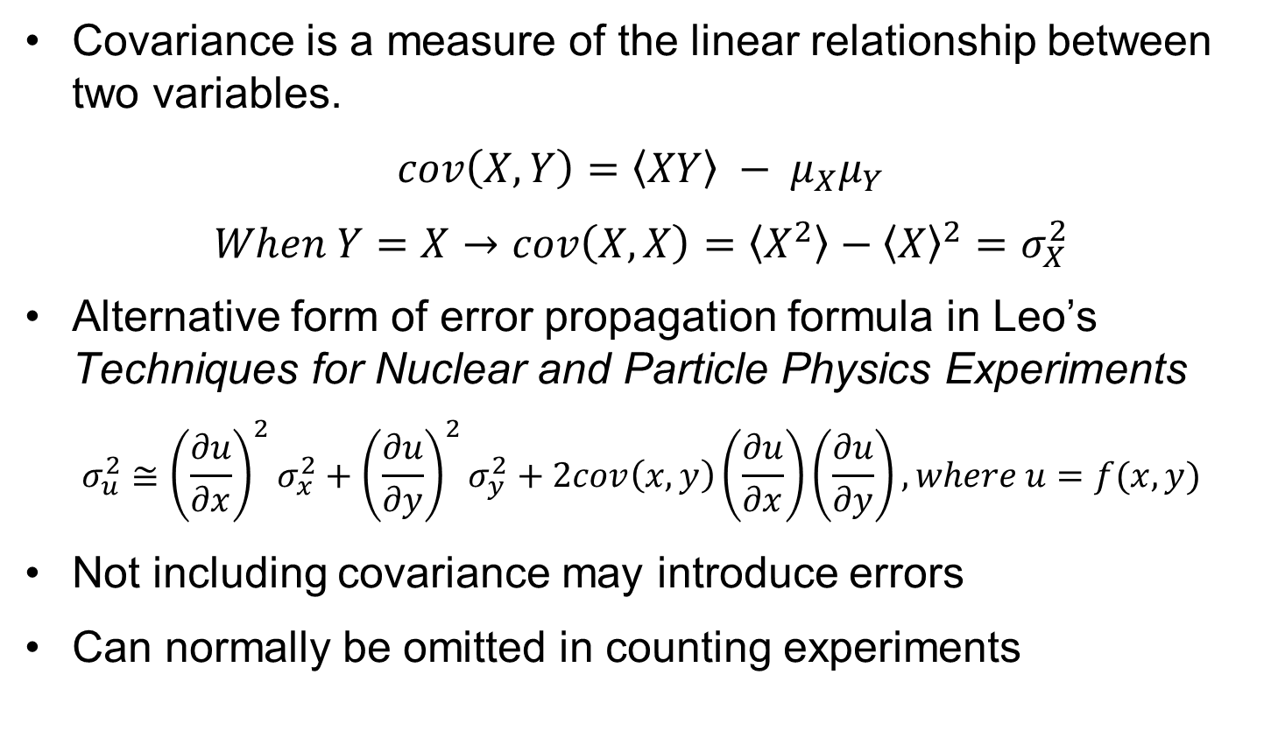
Covariance (What is it?)
Covariance is a measure of the linear relationship between two variables.
$$cov\left(X,Y\right)=\left\langle XY\right\rangle − μ_{X}μ_{Y}$$
$$When Y=X→cov\left(X,X\right)=\left\langle X^{2}\right\rangle −{\left\langle X\right\rangle }^{2}=σ_{X}^{2}$$
Alternative form of error propagation formula in Leo’s Techniques for Nuclear and Particle Physics Experiments
$$σ_{u}^{2}≅{\left(\frac{∂u}{∂x}\right)}^{2}σ_{x}^{2}+{\left(\frac{∂u}{∂y}\right)}^{2}σ_{y}^{2}+2cov\left(x,y\right)\left(\frac{∂u}{∂x}\right)\left(\frac{∂u}{∂y}\right), where u=f(x,y)$$
Not including covariance may introduce errors
Can normally be omitted in counting experiments

Slide 24
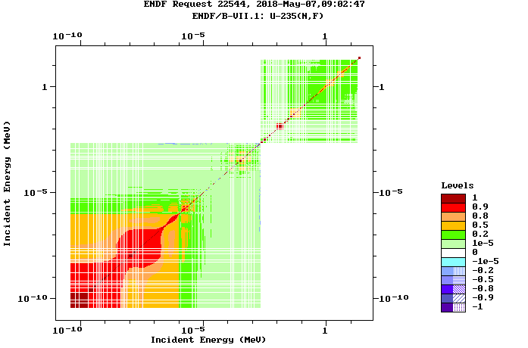
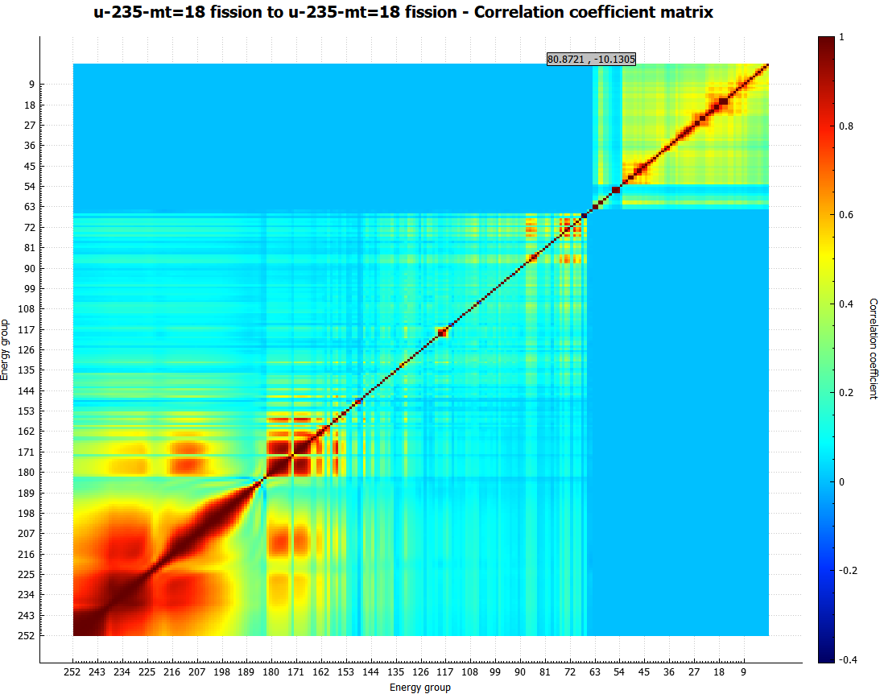
ENDF/B-VII.1 vs SCALE 252 Group Correlation Matrix
ENDF/B-VII.1 SCALE 6.2 252 Group

Slide 25
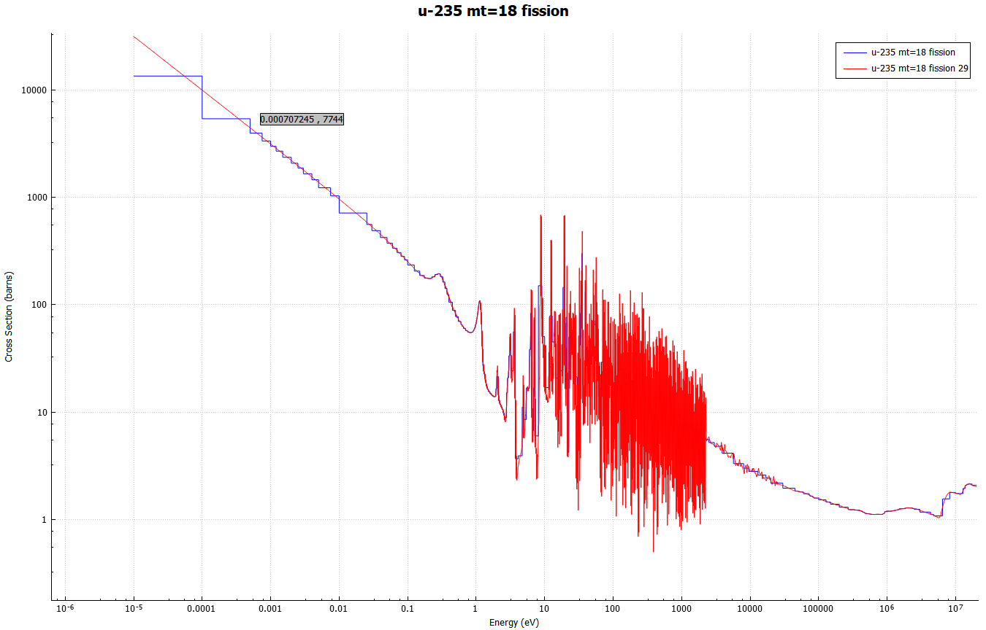
U-235 (n,f) 252 Group Structure

Slide 26
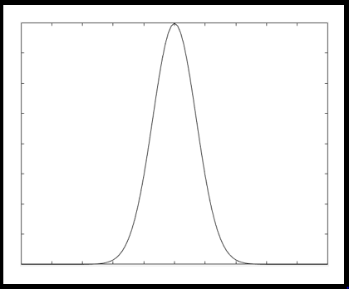
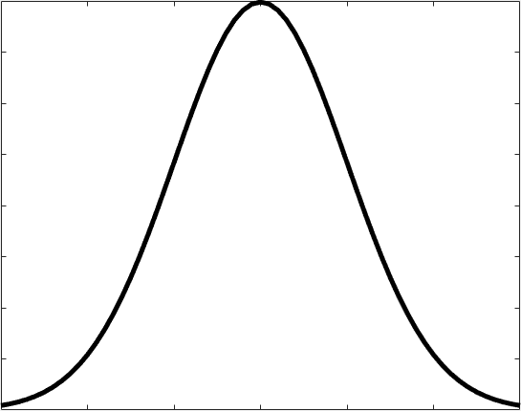
Combining Responses from Perturbed Nuclear Data
SCALE Sampler Module
Unperturbed
Response
N Sampled Responses with Perturbed Nuclear Data
Combine Data with Bootstrapping
Sampled with replacement from each Sampler case and Gaussian distribution based on response statistical uncertainty
Final Response with Statistical and Nuclear Data Covariance Uncertainty

Slide 27
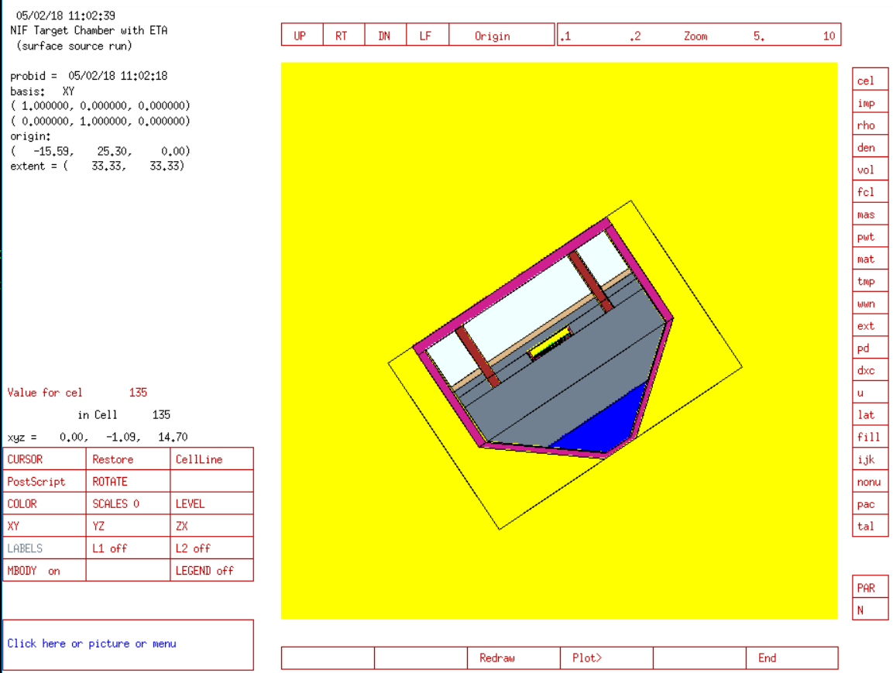
NIF Neutron Source
Surface Source Read file from LLNL
Contains NIF “room return”, which accounts for less than 1% of source.

Slide 28
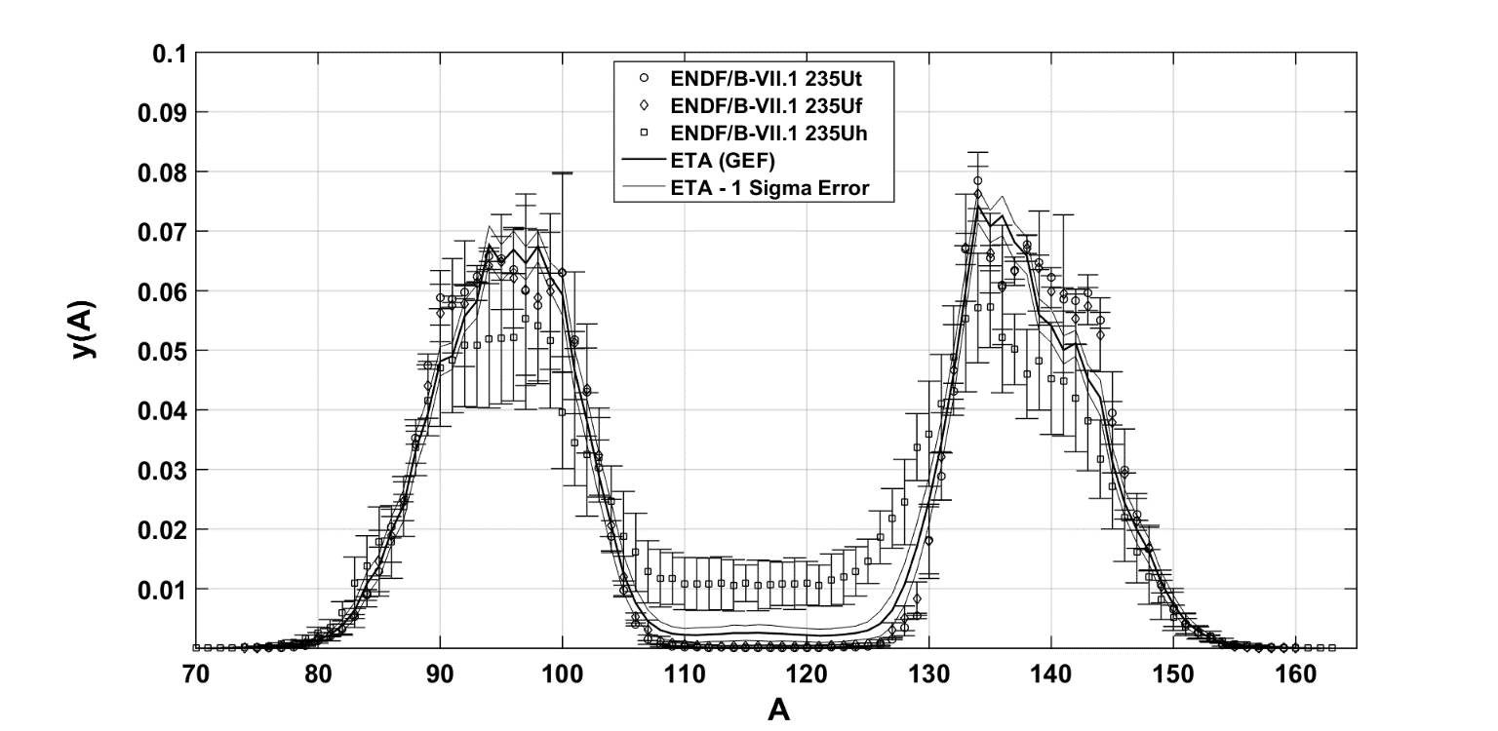
Fission Product Isotopes
ENDF uses thermal, watt fission spectrum, and fast neutron spectra to provide fission product yields.
Determining fission product yields a priori can have relative errors on the order of 10%.
Options:
Fit experimental data to phenomenological model.
Use A General Description of Fission Observables (GEF)

Slide 29
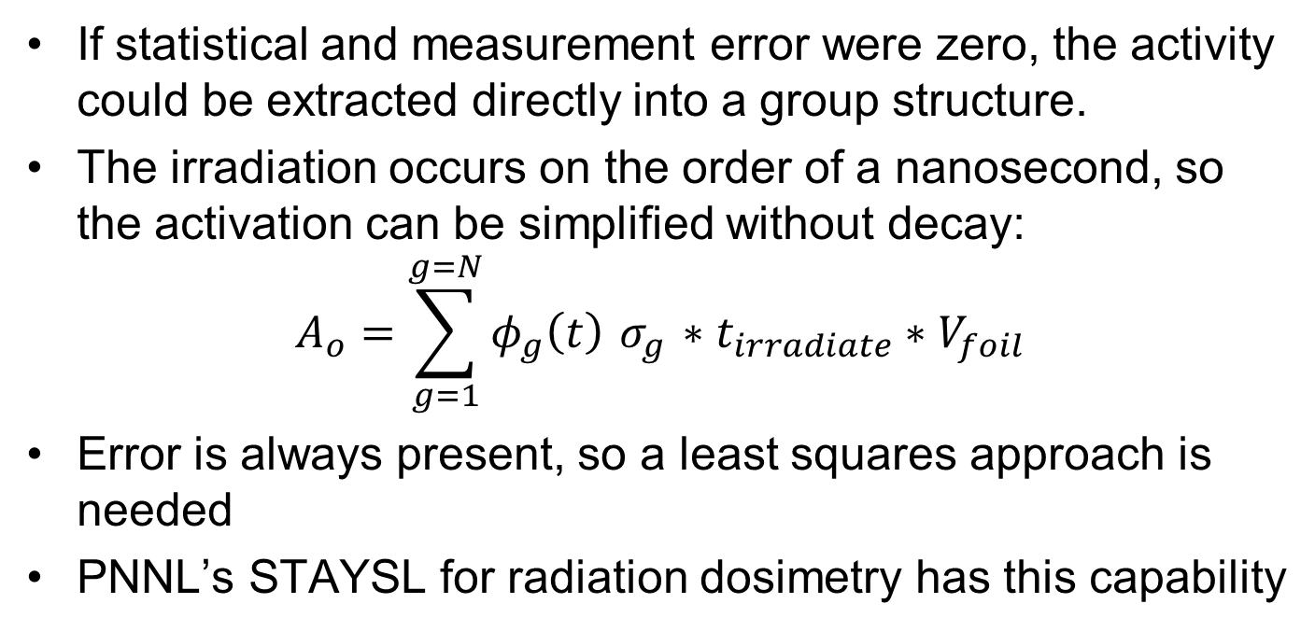
Unfolding the Neutron Spectrum From Foil Activation
If statistical and measurement error were zero, the activity could be extracted directly into a group structure.
The irradiation occurs on the order of a nanosecond, so the activation can be simplified without decay:
$$A_{o}=\sum_{g=1}^{g=N}{φ_{g}\left(t\right){ σ}_{g} ∗t_{irradiate}}∗V_{foil}$$
Error is always present, so a least squares approach is needed
PNNL’s STAYSL for radiation dosimetry has this capability

Slide 30
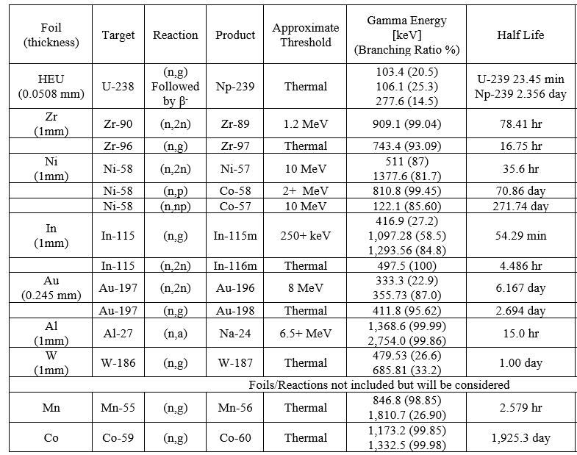
Foil Diagnostic Activation Pack

Slide 31
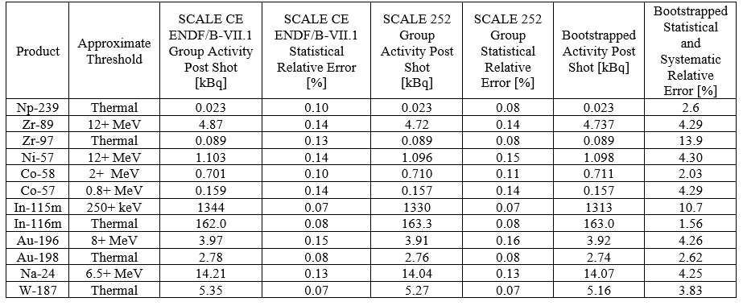
Foil Diagnostic Activation Pack
Notes:
Activities are on the order of what is needed for counting experiments
Foils can be counted in a High Purity Germanium Detector (HPGe)
Large increase in uncertainty based on reaction data uncertainty.

Slide 32
