Slide 1
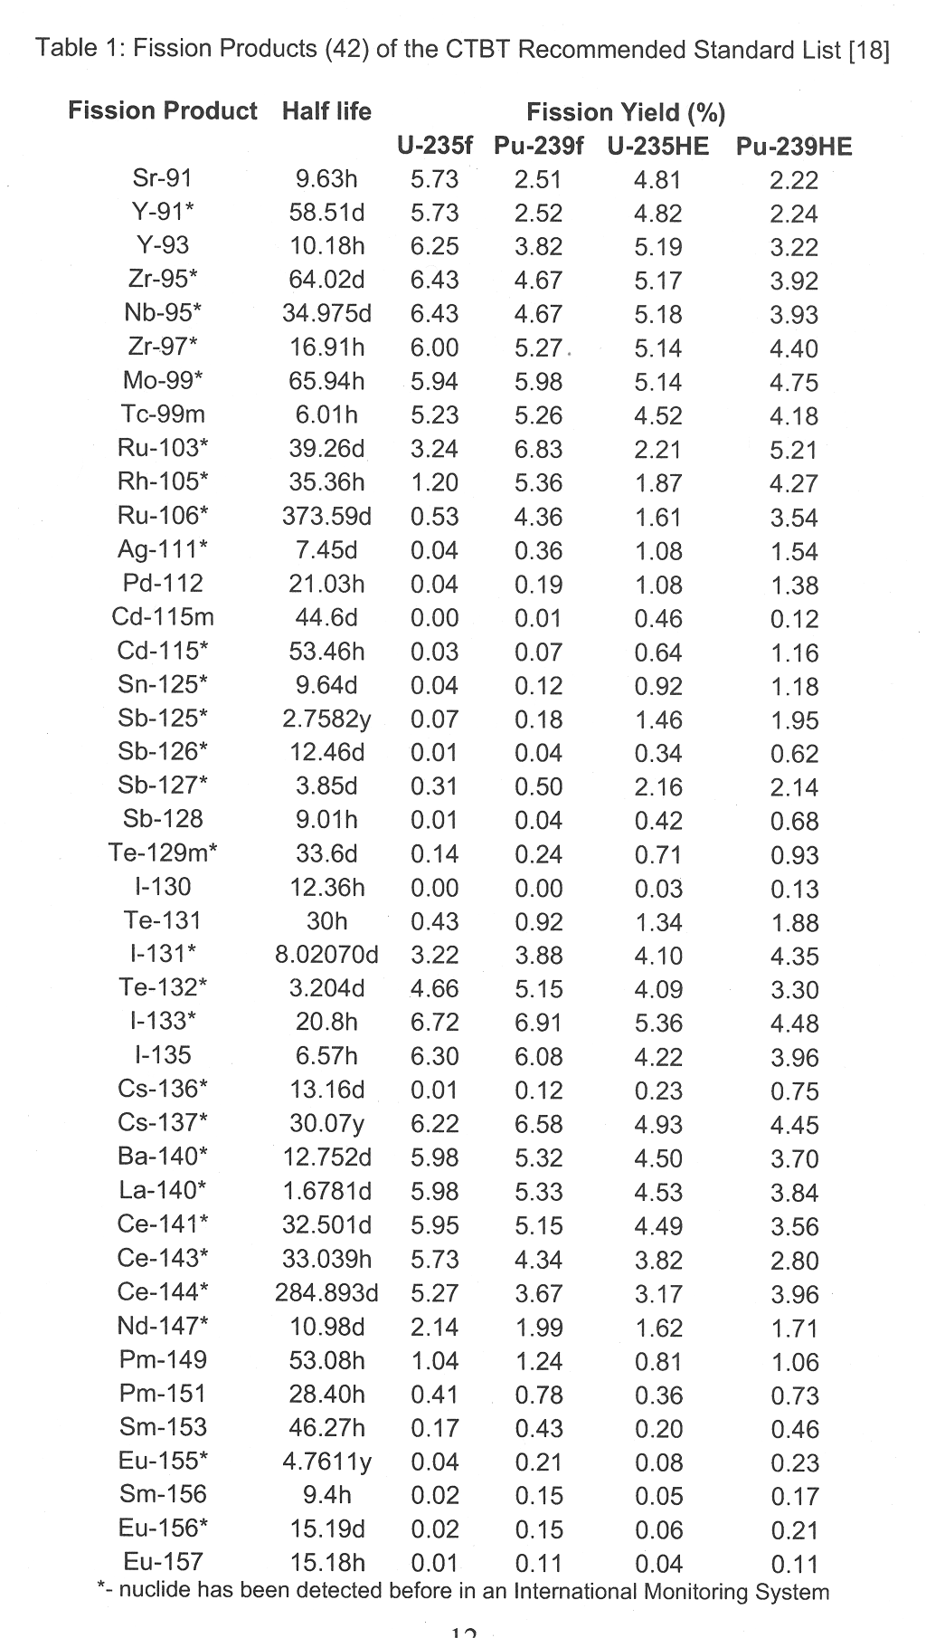
Fission Product List
Zr-95, 97 Ag-111, 113 Cd-115, 117m, 117g Ba-139, 140 Nd-147 Pm-149, 151 Sm-153 Tb-161 Pd-109, 111m, 112 Ce-141,143,144 Mo-99 Eu-156,157 Interested in
(Some not feasible based on previous discussions) I -131,132,133,134,135 Xe-135 Kr-85m, 87,88 Sr-91,92 Y-93 Ru-103,105 Rh-105 Sb-127,128,129 Te-131m, 132,134

Slide 2
Foil Pack
In order from proximity to source
W (1 mm) 2.5 cm radius
Zr (1 mm) 2.5 cm radius
Ni (1 mm) 2.5 cm radius
In (1 mm) 2.5 cm radius
Mn (1 mm) 2.5 cm radius
Au (0.0254 mm) 2.004 cm radius
HEU (0.00508 mm) 2.004 cm radius ~1.25 g. Limit on adding more?
Al (1 mm) 2.5 cm radius

Slide 3
NIF Constraints
Weight?
Stay-out Angle?
TOF spectrum for PDXP
Anything else?

Slide 4
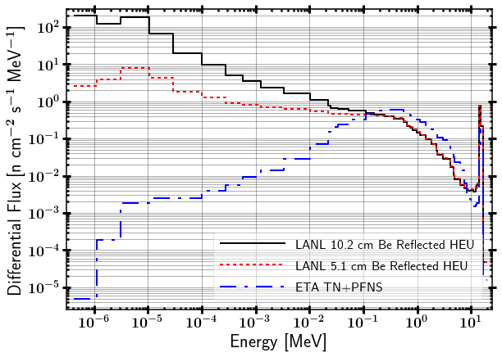
ATHENA Spectrum

Slide 5
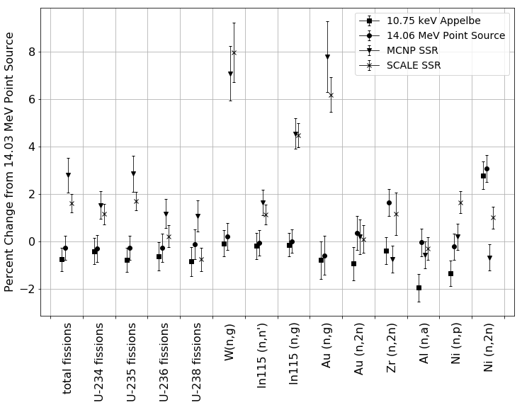
Importance of source characterization

