Slide 1
A THErmonuclear and prompt fission Neutron spectrum energy tuning Assembly (ATHENA)
Capt Nick Quartemont
MS Nuclear Engineering 19M
Air Force Institute of Technology
18 October 2018

Slide 2
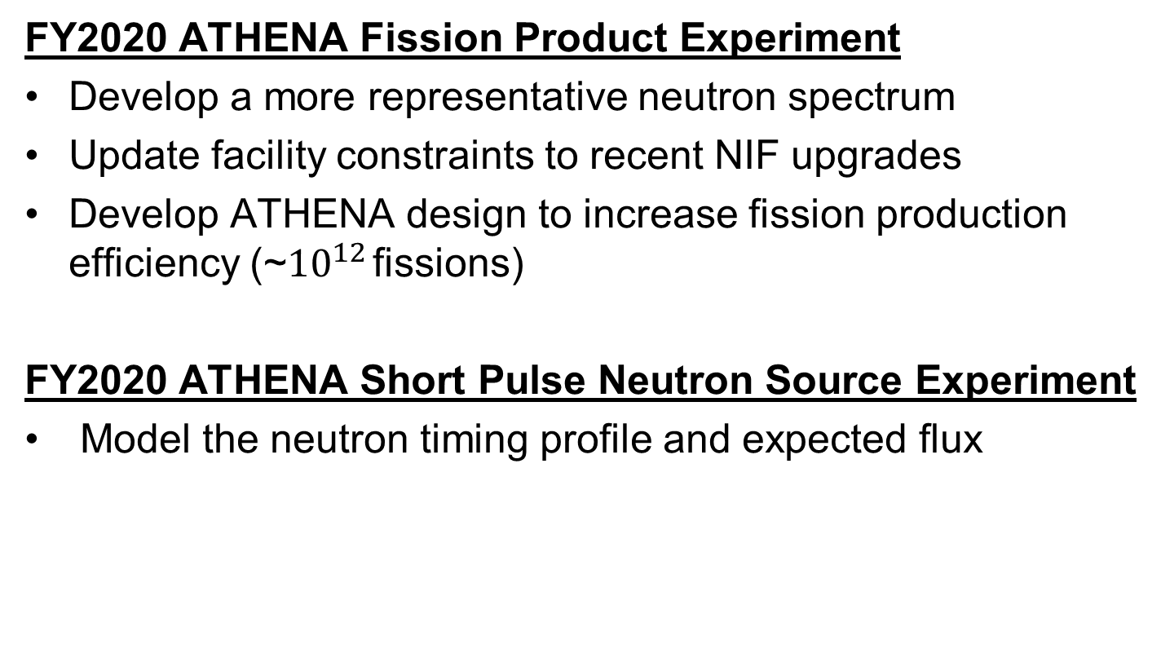
Research Problem (ATHENA)
FY2020 ATHENA Fission Product Experiment
Develop a more representative neutron spectrum
Update facility constraints to recent NIF upgrades
Develop ATHENA design to increase fission production efficiency (~${10}^{12}$ fissions)
FY2020 ATHENA Short Pulse Neutron Source Experiment
Model the neutron timing profile and expected flux

Slide 3
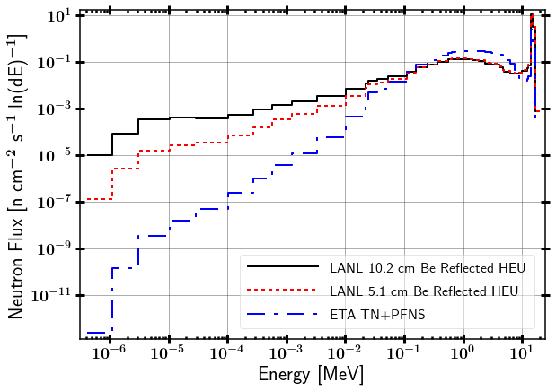
Objective Spectrum

Slide 4
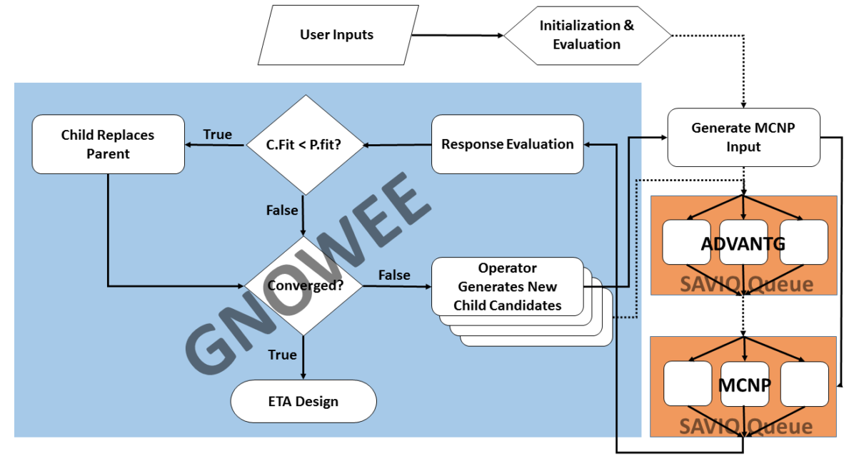
Bevins Dissertation Coeus Flow Chart

Slide 5
Future Work (Not all inclusive)
Develop capability to create synthetic debris in a matrix (ex: glass) by doping fission products

