Slide 1
ETA Committee Update
Round III
Capt Nick Quartemont
MS Nuclear Engineering 19M
Air Force Institute of Technology
December 2018

Slide 2
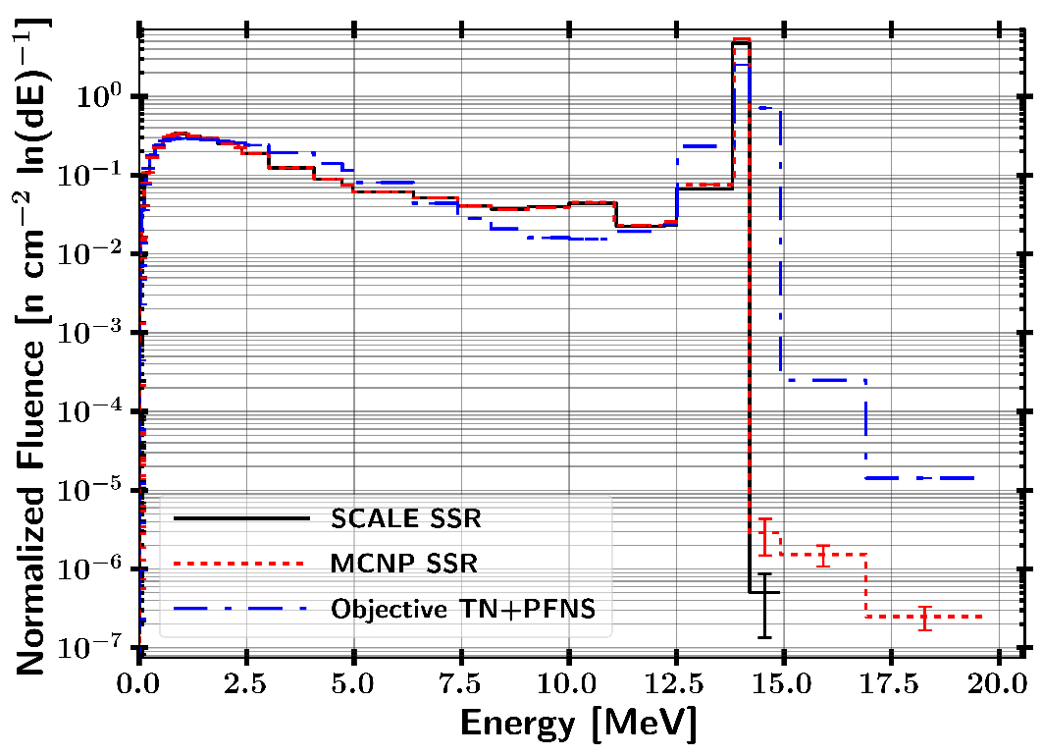
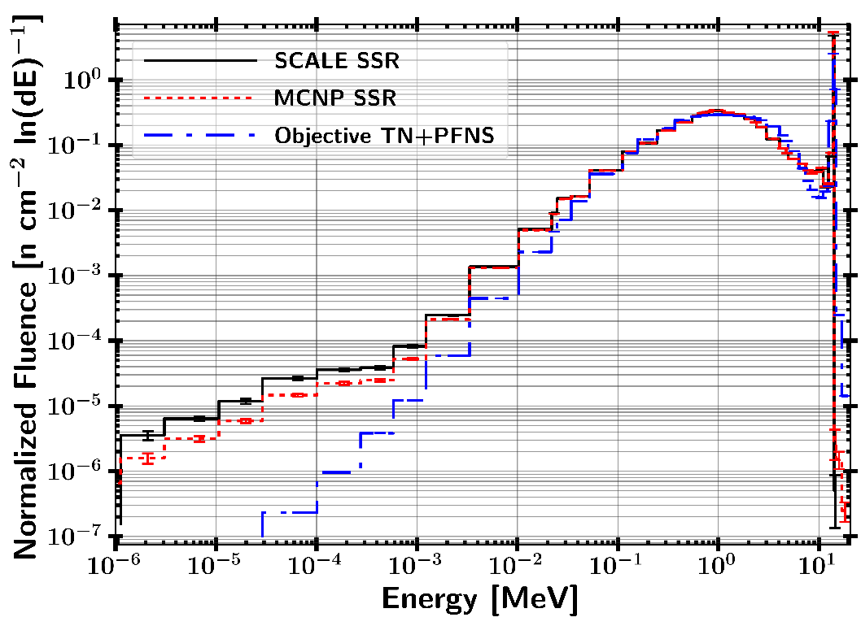
Fluence Mapping

Slide 3
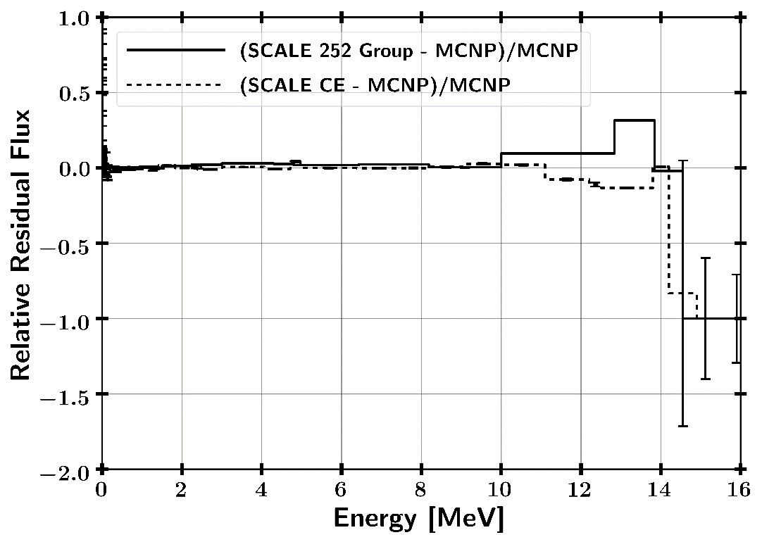
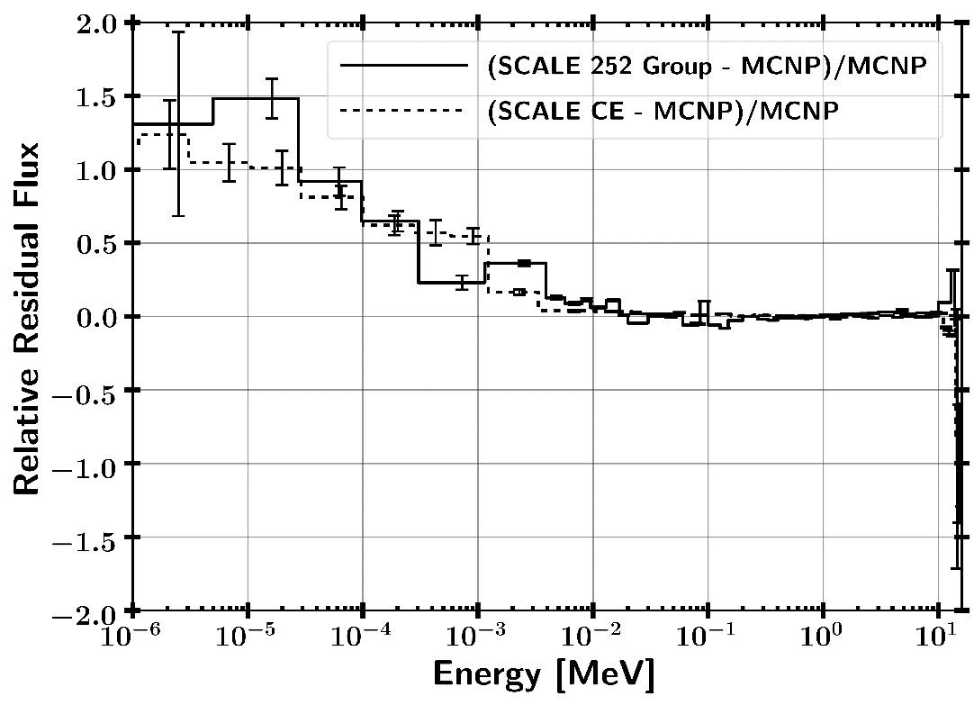
Residuals SCALE / MCNP

Slide 4
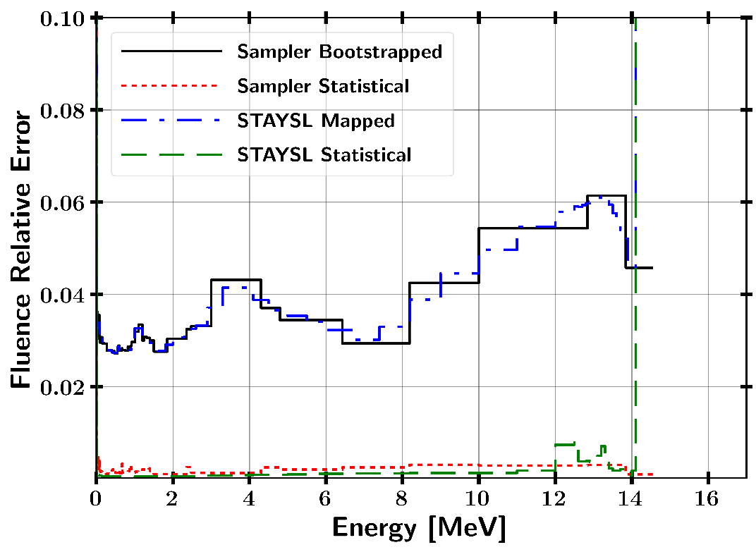
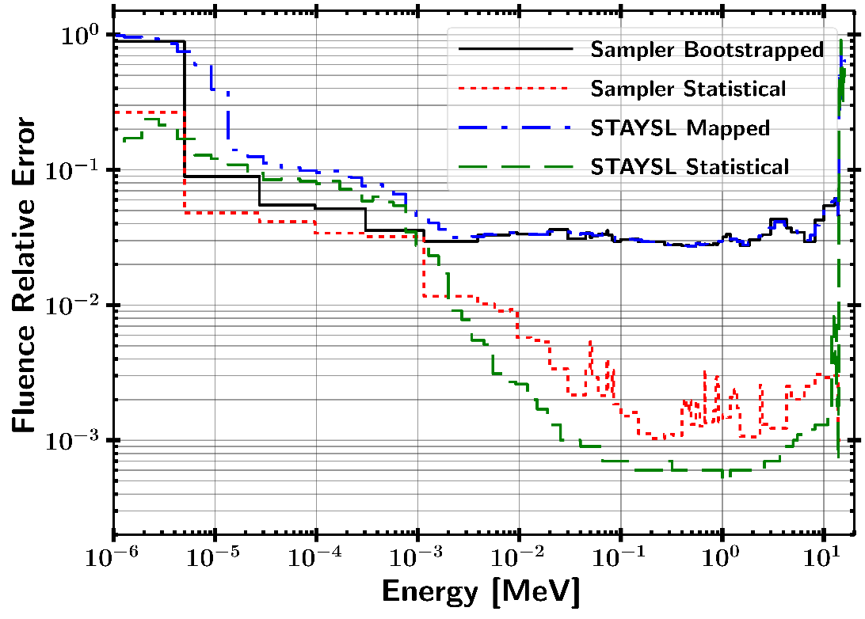
Mapped Fluence Uncertainty

Slide 5
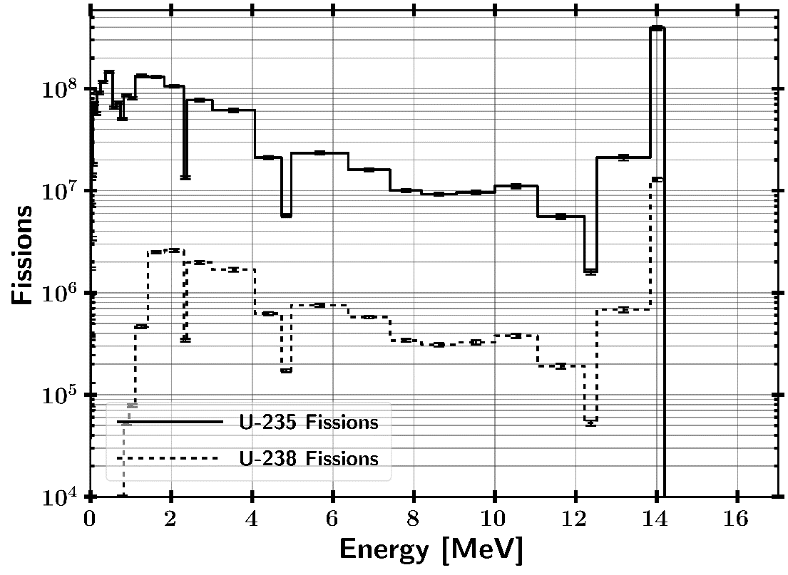
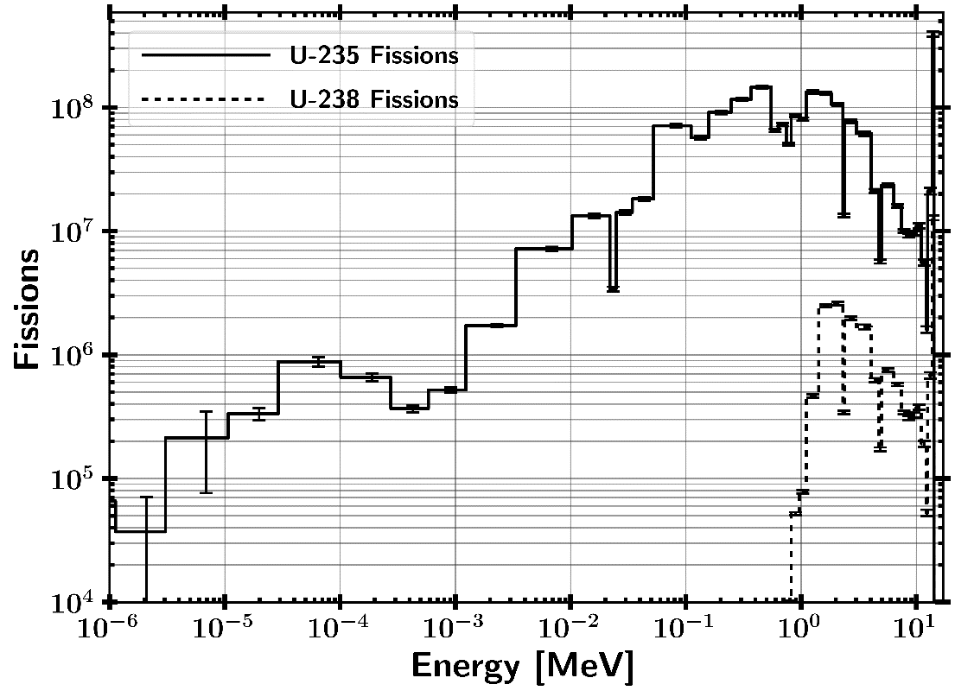
Fissioning Energies
ETA Produced $2∗{10}^{9}±1\%$ fissions

Slide 6
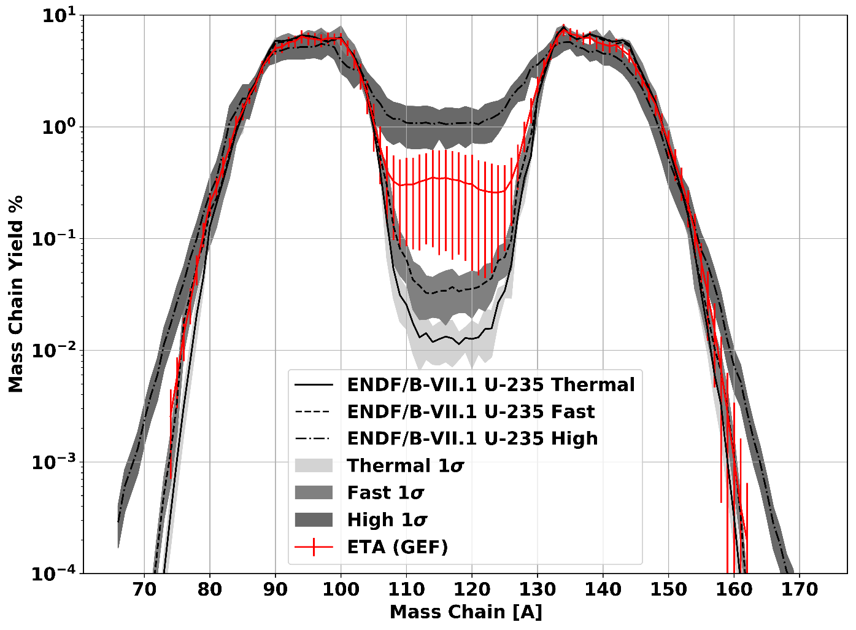
ETA Fission Products – GEF

Slide 7
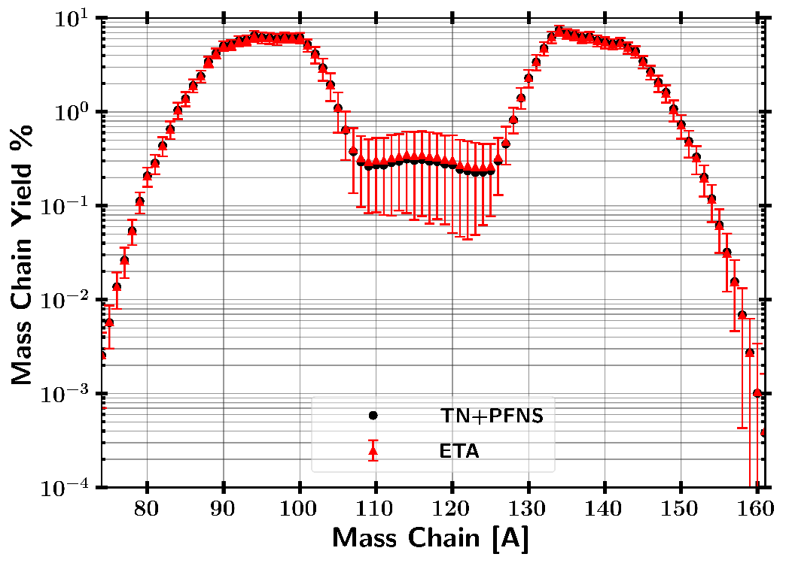
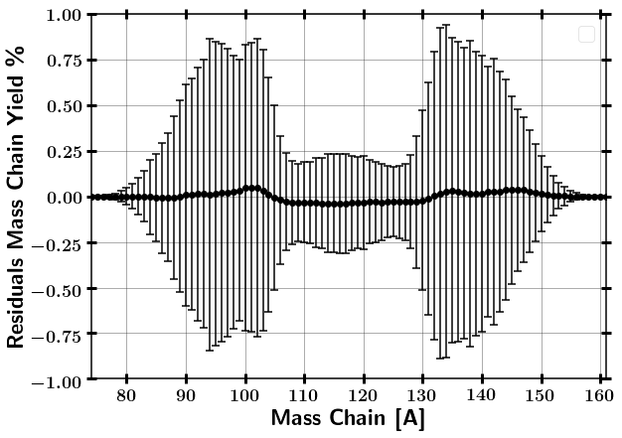
ETA Fission Products – GEF

Slide 8
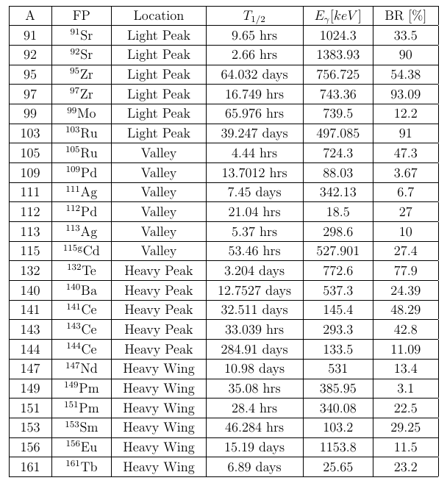
Predicted Fission Products for Radiochemical Analysis
Most from CTBT condensed list
Removed volatiles for now as they will be lost in dissolution
Volatiles may be able to be detected if HEU pack is sealed

Slide 9
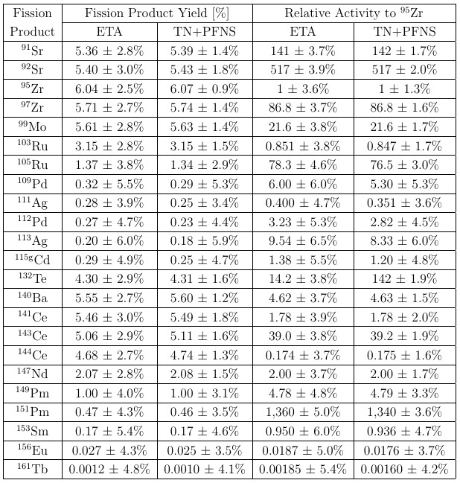
Predicted Fission Products for Radiochemical Analysis
ETA produced fission products are consistent to predicted TN+PFNS within error.

Slide 10
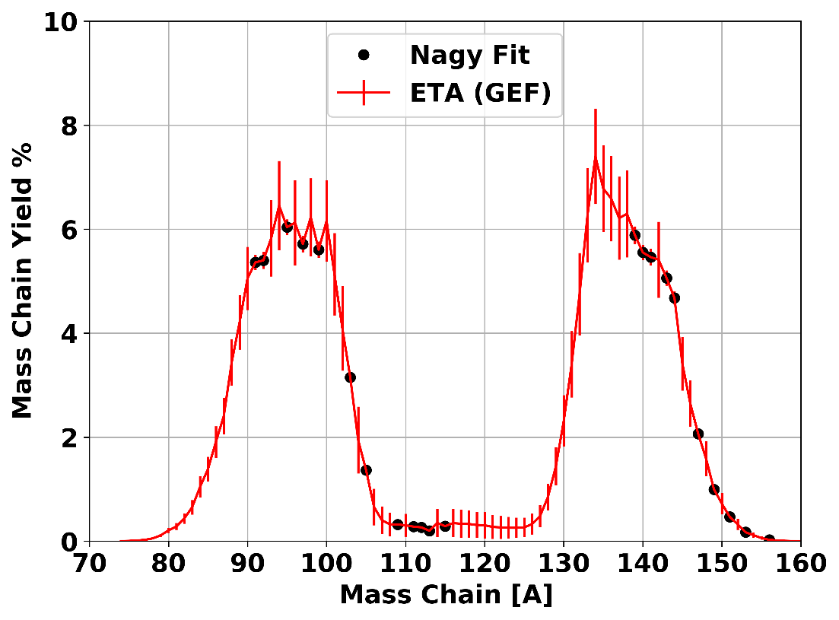
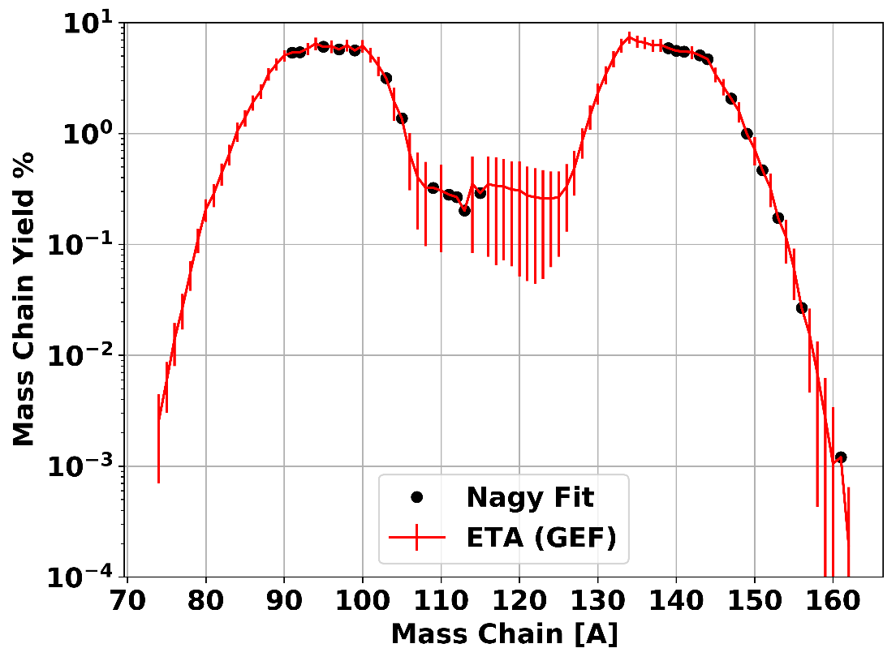
ETA Fission Products GEF with Nagy Fit Chain Yield Isotopes

Slide 11
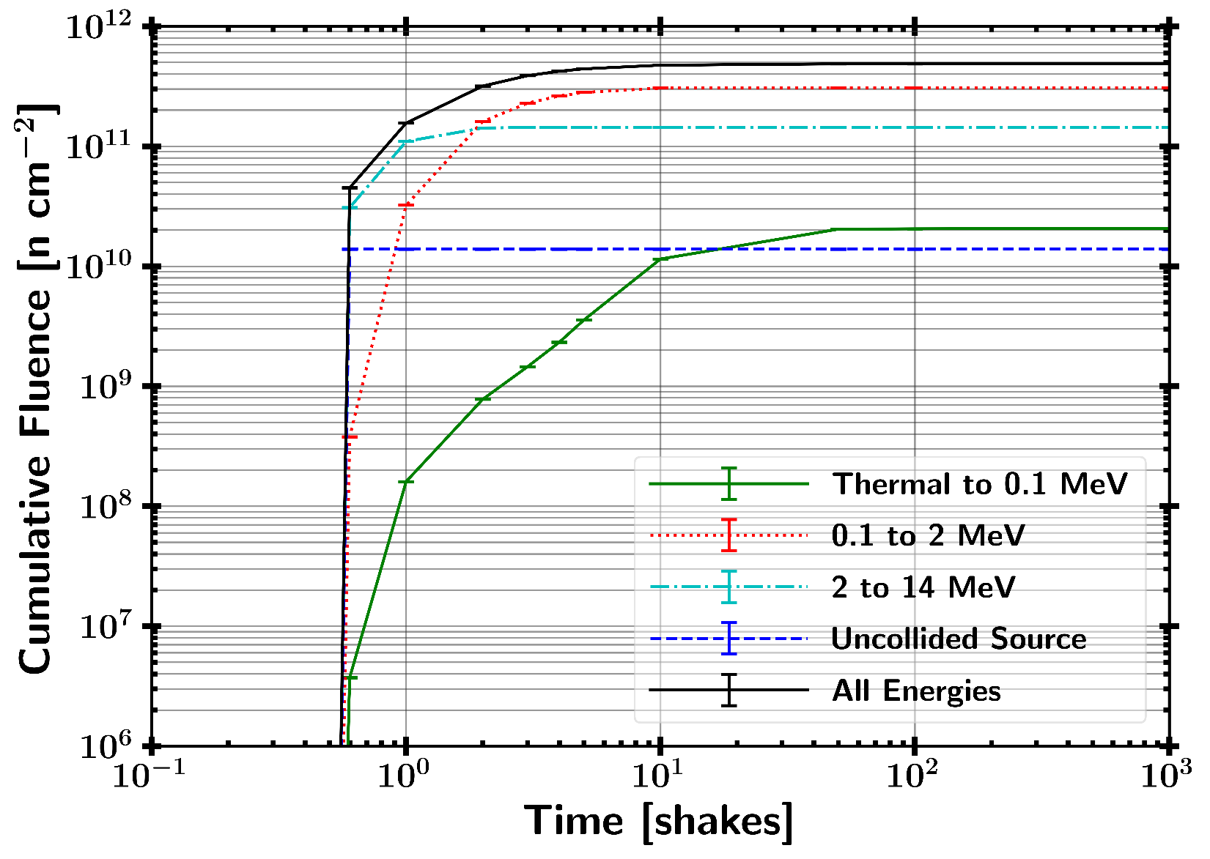
Neutron Timing Profile

Slide 12
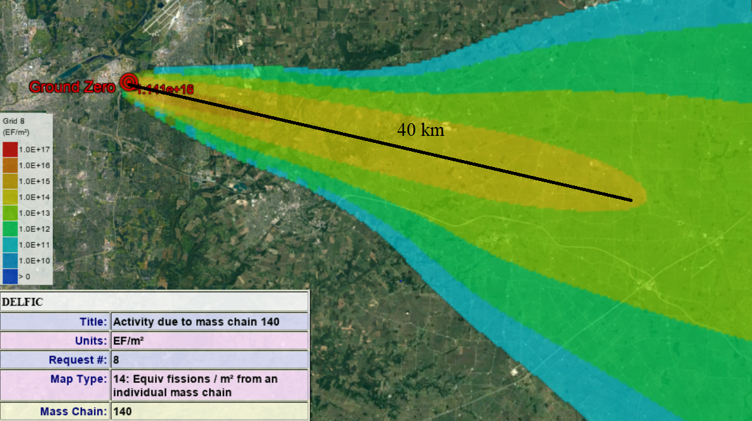
Capability Perspective
Neutron Fluence – Similar in magnitude to 10 KT device at 7.5 km in space or very high altitude
Fissions Produced – DELFIC 10 KT fission device 1 m HOB on 16 Aug 17

Slide 13
Writing Updates
Thesis
Done with draft
Receiving Comments from Capt Bevins
Through revisions with Ch 3
Title Changed to “NUCLEAR DATA COVARIANCE ANALYSIS OF AN ENERGY TUNING ASSEMBLY FOR SIMULATING NUCLEAR WEAPON ENVIRONMENTS”
Transactions on Nuclear Science Article
Done, need to review and submit
Title – “A Framework for Quantifying the Impact of Nuclear Data Covariance in Radiation Transport Simulations”
Focused on quantifying fluence uncertainty and including IRDFF library in SCALE. Added complaints about multivariate normal distribution
More on next slides if there is time

Slide 14
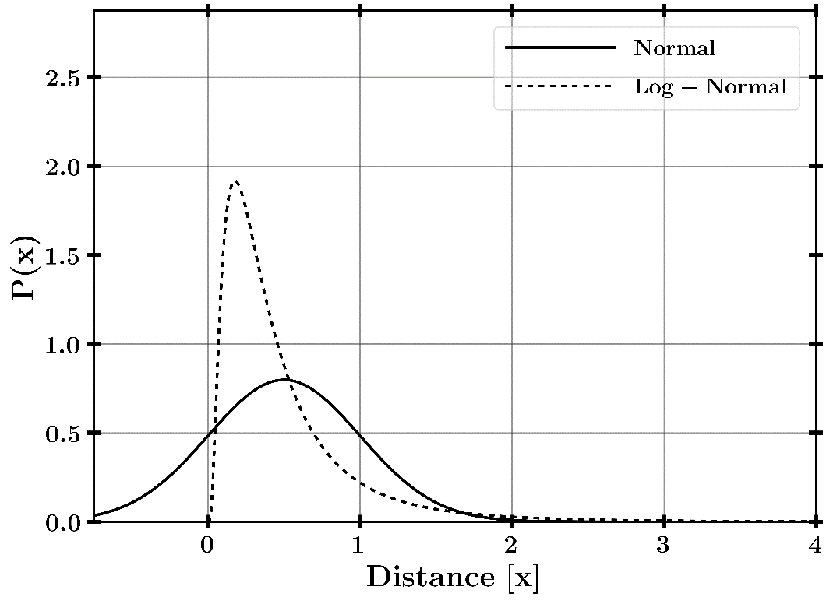
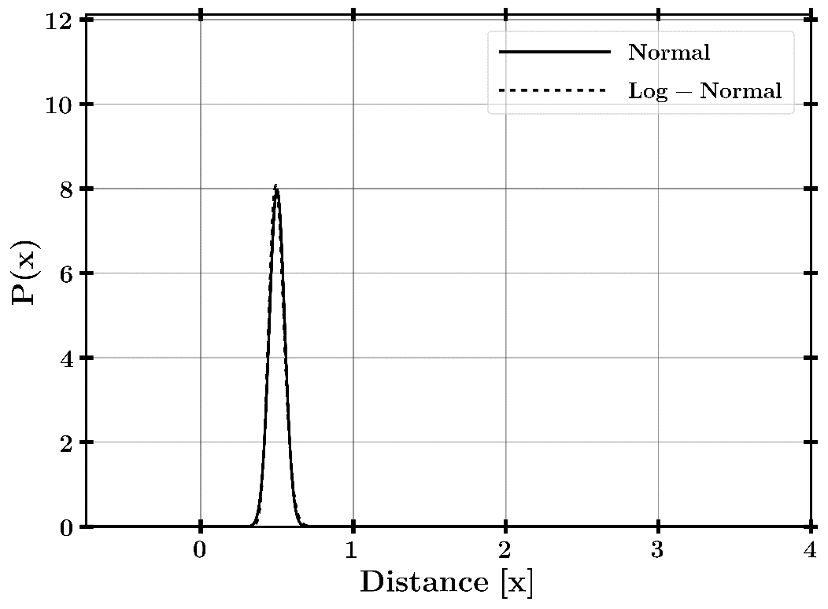
Log-normal vs Normal
$$μ=0.5, σ=0.5 μ=0.5, σ=0.05$$

Slide 15
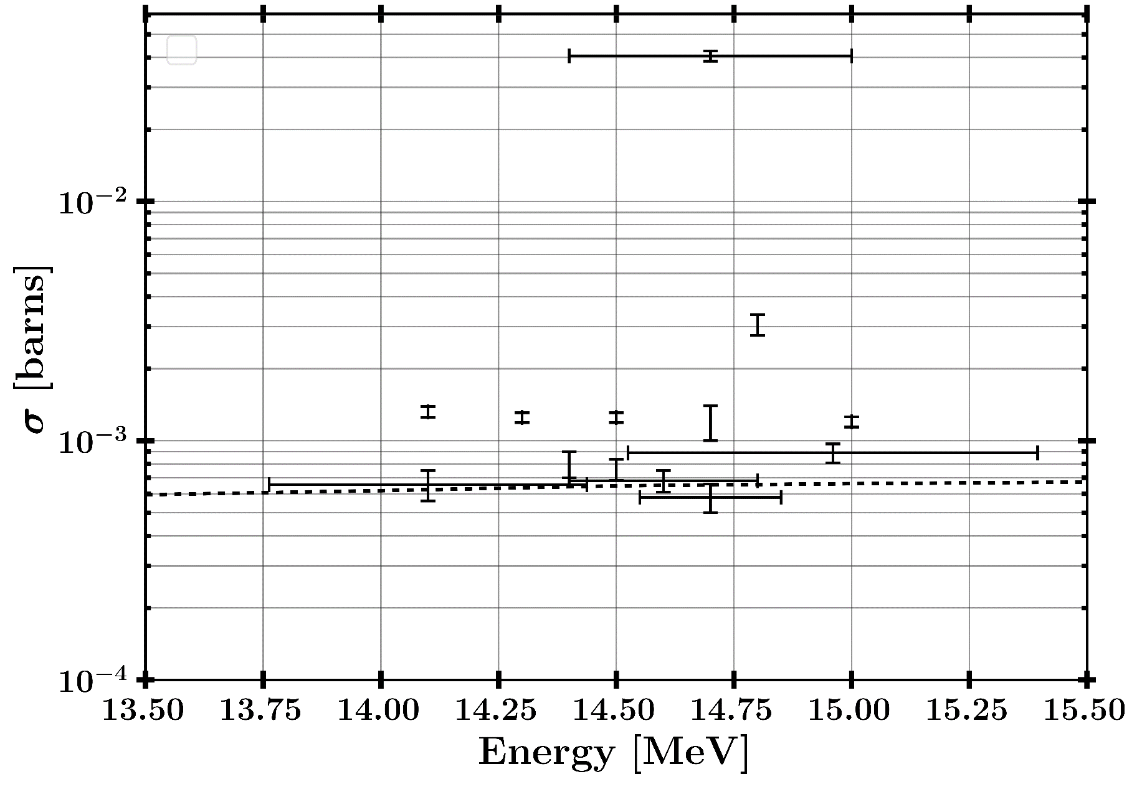

Mn-55 (n,g) Evaluation $σ\left(σ_{g}\right)>100\%$

Slide 16
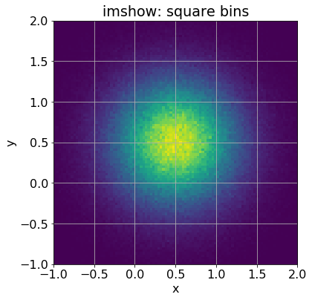
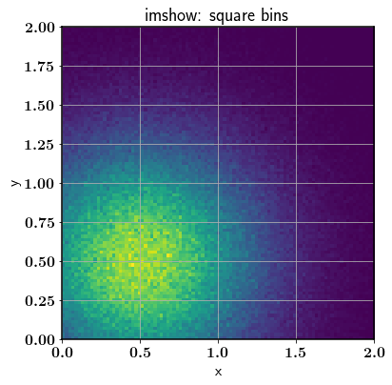
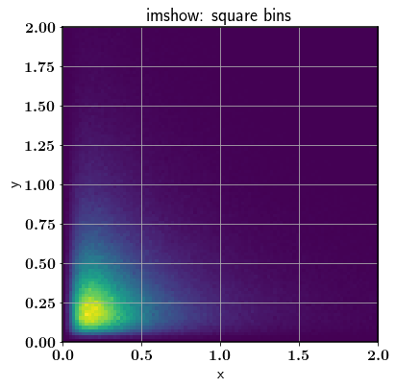

Monte Carlo Darts Example
x, y – determined by distributions with $μ=0.5$
Normal, Normal with rejected negatives, Log-normal

Slide 17
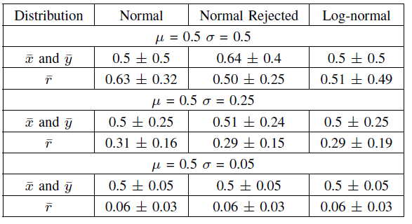
Monte Carlo Darts Example
Normal is appropriate up to about low 10s percent error
There are issues above ~20%
Nuclear data uncertainty goes well above 20% in some cases; however, this is generally where the cross-section is low.
Need to be cautious when reactions occur in area of high uncertainty

Slide 18
BACKUPS

Slide 19
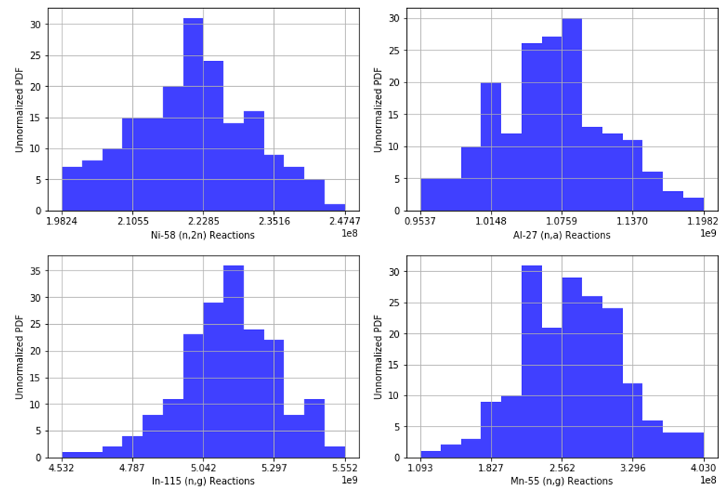
Convergence

Slide 20
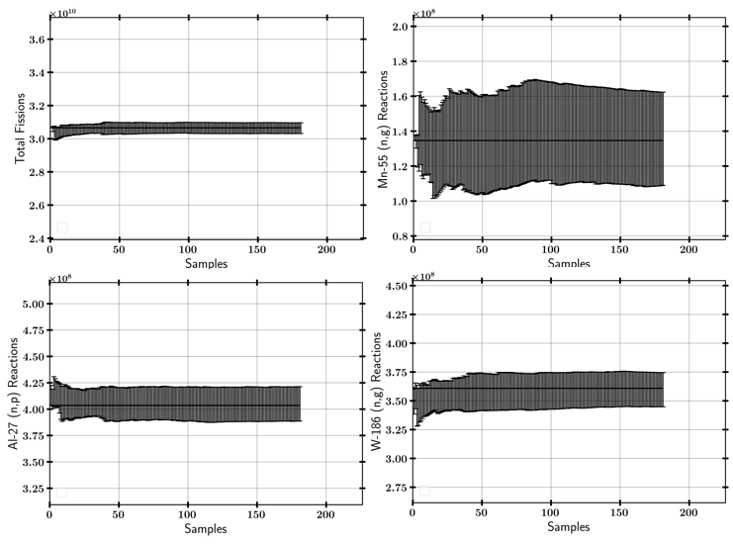
Convergence

Slide 21
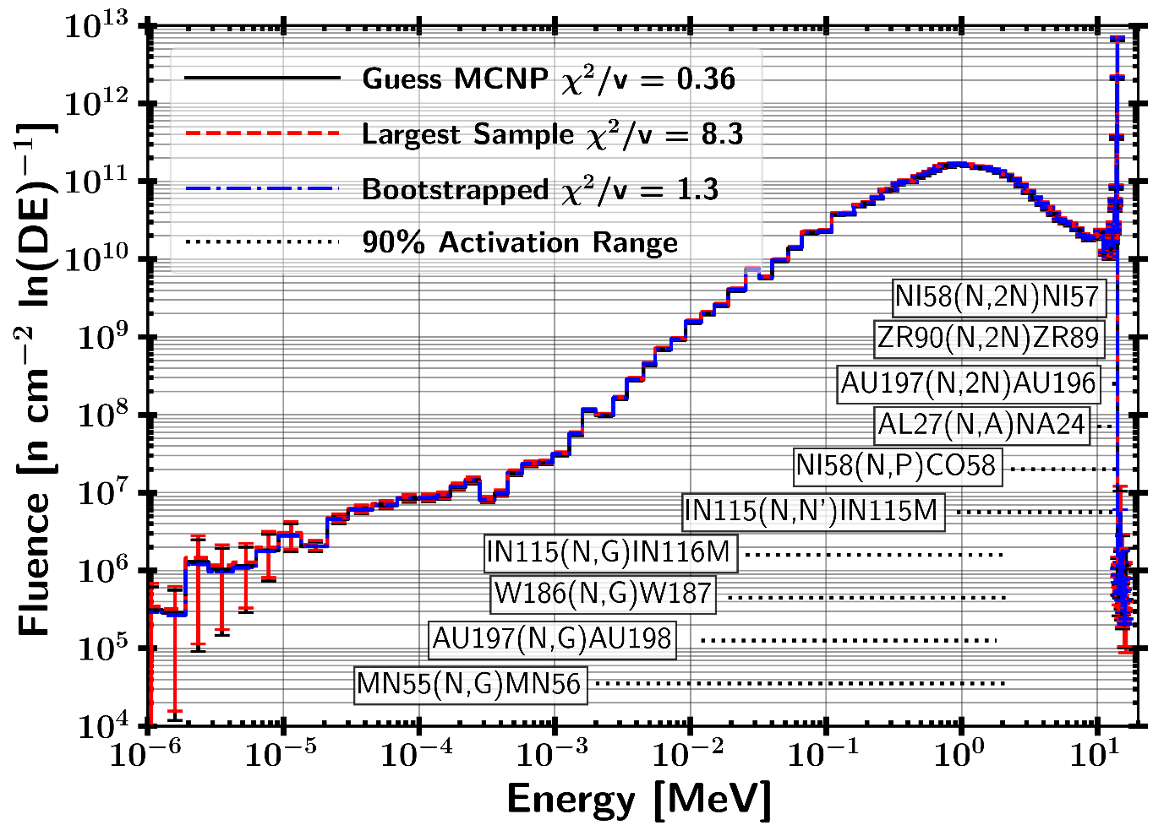
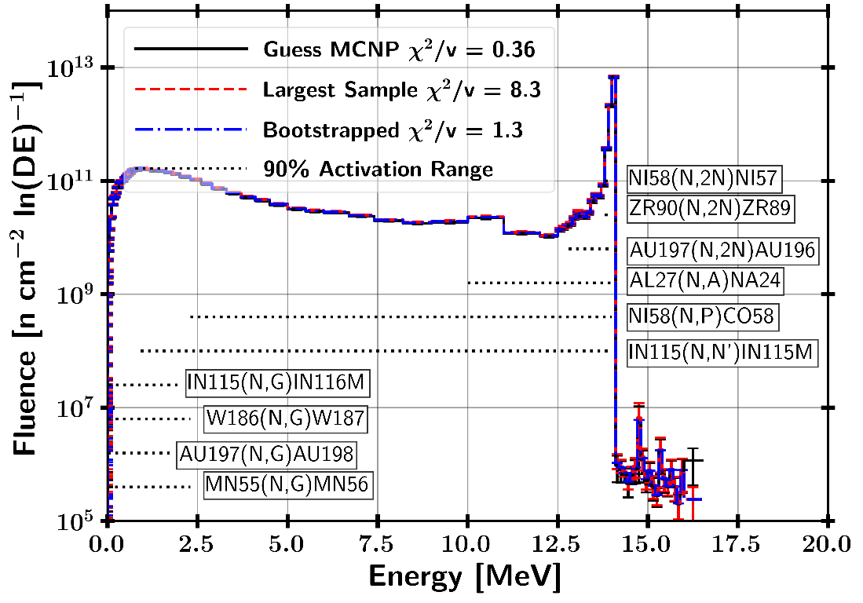
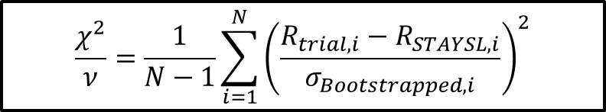
STAYSL Unfolded Spectrum
H₀ : Two sets of data are governed by the same expected distribution
$$\frac{χ^{2}}{ν}=\frac{1}{N−1}\sum_{i=1}^{N}{{\left(\frac{R_{trial,i}−R_{STAYSL,i}}{σ_{Bootstrapped,i}}\right)}^{2}}$$

Slide 22
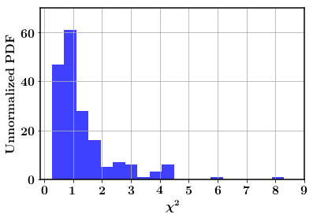
STAYSL Unfolded Spectrum
182 Sampled Activation Results
81.9% of samples were not rejected with a p-value greater than 0.05
18.1% of samples were rejected with a p-value lower than 0.05
H₀ : Two sets of data are governed by the same expected distribution
$$\frac{χ^{2}}{ν}=\frac{1}{N−1}\sum_{i=1}^{N}{{\left(\frac{R_{trial,i}−R_{STAYSL,i}}{σ_{Bootstrapped,i}}\right)}^{2}}$$

Slide 23
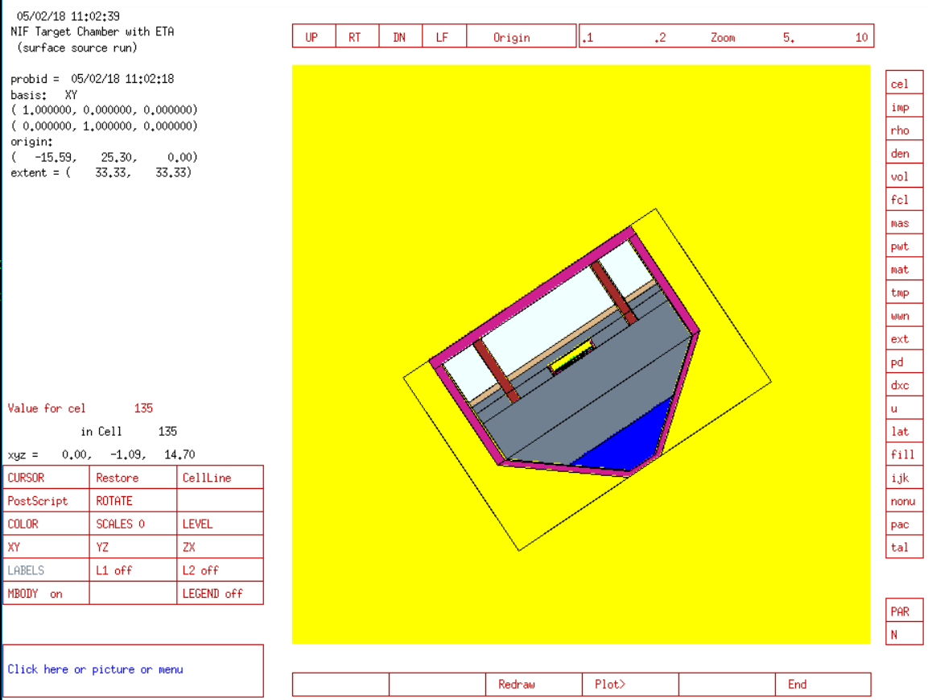
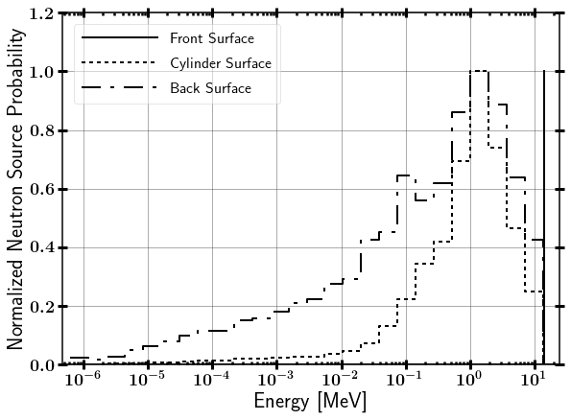
NIF Neutron Source
Surface Source Read file from LLNL
Contains NIF “room return”, which accounts for less than 1% of source.

Slide 24
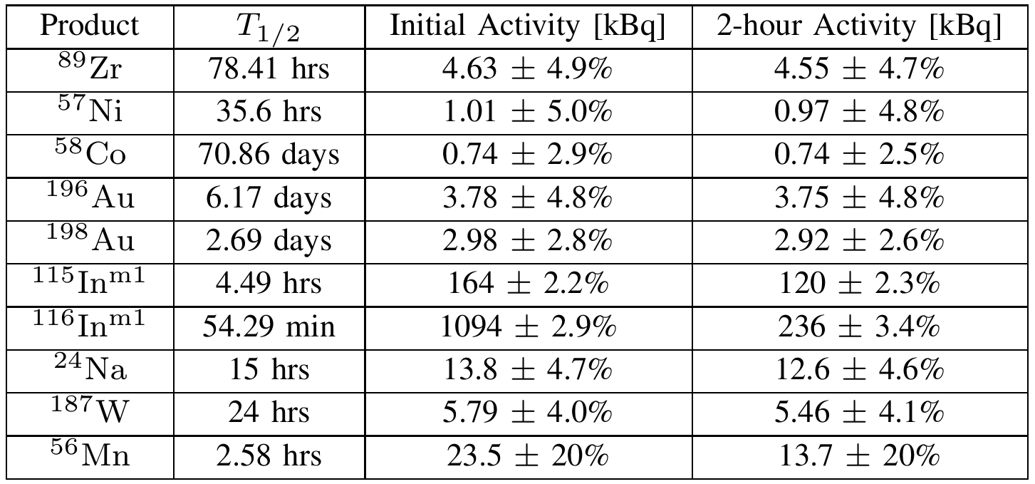
Activation Foil Pack Results

