Slide 1
Nuclear Data Covariance Analysis of Energy Tuning Assembly (ETA)
Capt Nick Quartemont
MS Nuclear Engineering 19M
Air Force Institute of Technology
December 2018

Slide 2
Overview
Example Nuclear Data Uncertainties
Combining Responses from Perturbed Nuclear Data
Mapping Uncertainty to Continuous Energy / Alternate Bin Structure
ETA Design and Model
Results
Neutron Environment in Sample Cavity
Fission Product Production
Foil Activation
Neutron Flux Unfolding
Path Forward / Future Work

Slide 3
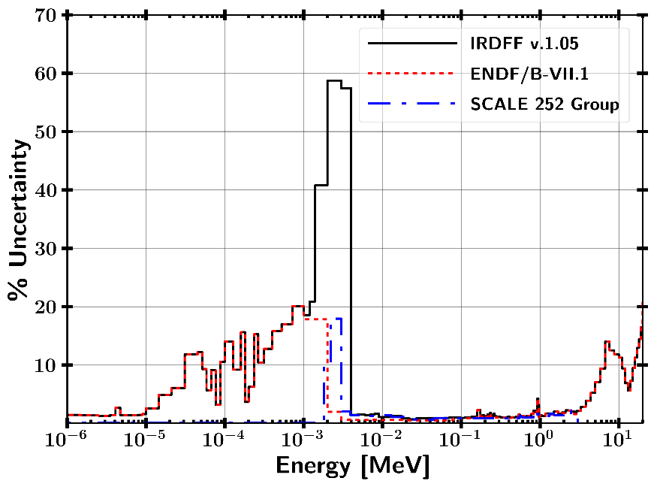
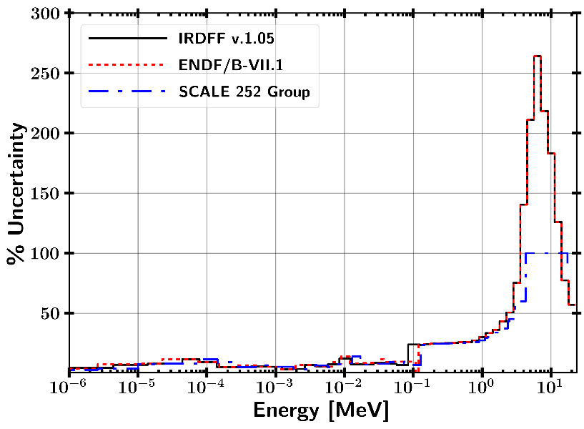
Selected Activation Foil Uncertainties
Au-197 (n,g) Mn-55 (n,g)

Slide 4
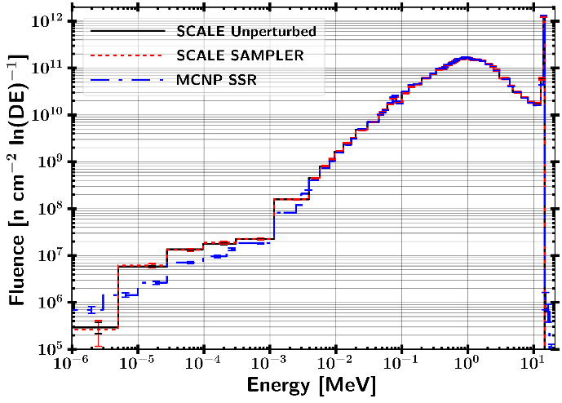
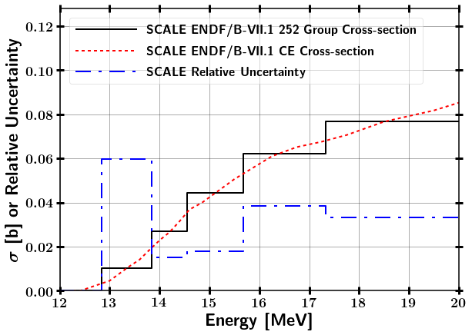
Monte Carlo Transport
Uncertainty Methodology
Uncertainty from
Statistical
Neutron transport
Foil activation data
Ni-58 (n,2n)
4

Slide 5
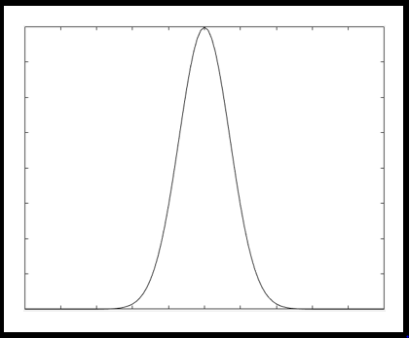
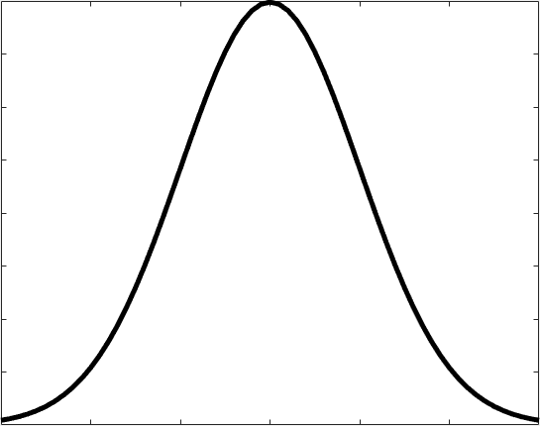
Monte Carlo Transport
Uncertainty Methology
Uncertainty from
Statistical
Neutron transport
Foil activation data
SCALE Sampler Module (Neutron Transport)
Unperturbed
Response
N Sampled Responses with Perturbed Nuclear Data
Ni-58 (n,2n)
5

Slide 6
Monte Carlo Transport
Uncertainty Methodology
Uncertainty from
Statistical
Neutron transport
Foil activation data
SCALE Sampler Module (Neutron Transport)
Unperturbed
Response
N Sampled Responses with Perturbed Nuclear Data
IRDFF Nuclear Data Covariance
Ni-58 (n,2n)
6

Slide 7
Monte Carlo Transport
Uncertainty Methodology
Uncertainty from
Statistical
Neutron transport
Foil activation data
SCALE Sampler Module (Neutron Transport)
Unperturbed
Response
N Sampled Responses with Perturbed Nuclear Data
IRDFF Nuclear Data Covariance
Continuous Energy Statistical Uncertainty
Combine Data with Bootstrapping
Ni-58 (n,2n)
Final response with statistical, neutron transport, and reaction cross-section uncertainties
7

Slide 8
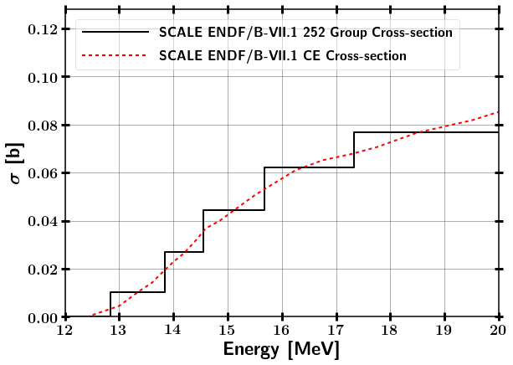
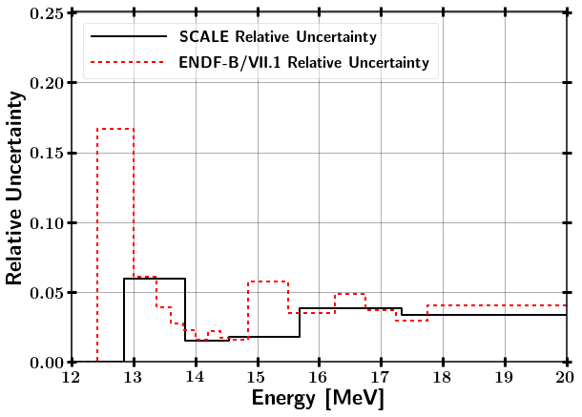
Test Case - Mapping SAMPLER Uncertainty to alternate bin structure
⁵⁸Ni(n,2n) comparison between SCALE 252 Group and CE
1 n/cm²-s flux scaled by bin width from 12.4 – 20 MeV
Notes:
Assumed pure ⁵⁸Ni, 1 cc, and N = 10²⁴ at/cc
1 n/cm²-s flux scaled by bin width from 12.4 – 14 MeV

Slide 9
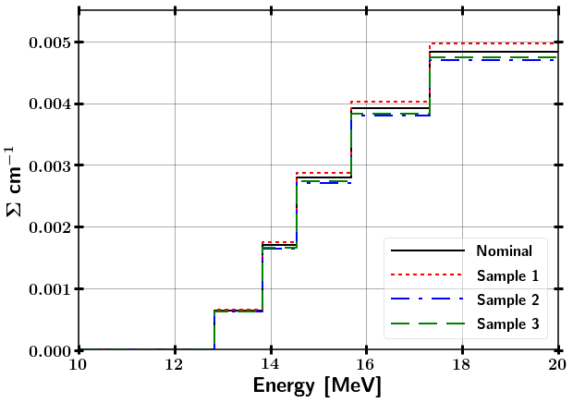
Test Case - Mapping SAMPLER Uncertainty to alternate bin structure
⁵⁸Ni(n,2n) comparison between SCALE 252 Group and CE
1 n/cm²-s flux scaled by bin width from 12.4 – 20 MeV
Ni-58 (n,2n) SAMPLER Samples
Sample Cross-section
Notes:
Assumed pure ⁵⁸Ni, 1 cc, and N = 10²⁴ at/cc
1 n/cm²-s flux scaled by bin width from 12.4 – 14 MeV

Slide 10
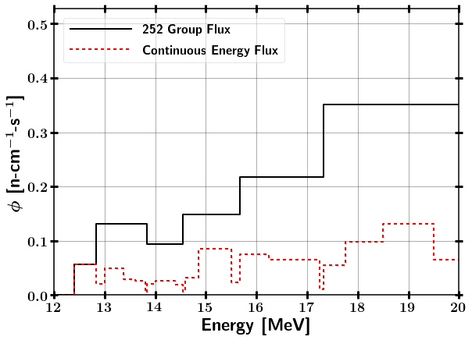
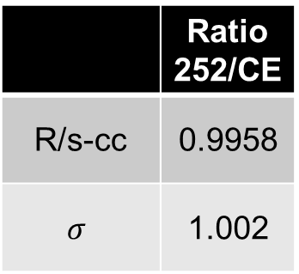
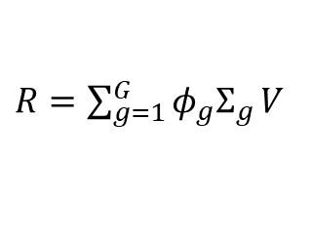
Test Case - Mapping SAMPLER Uncertainty to alternate bin structure
⁵⁸Ni(n,2n) comparison between SCALE 252 Group and CE
1 n/cm²-s flux scaled by bin width from 12.4 – 20 MeV
Ni-58 (n,2n) SAMPLER Samples
Sample Cross-section
$R=\sum_{g=1}^{G}{{φ_{g}Σ}_{g}}V$
 | Ratio 252/CE
R/s-cc | 0.9958
$$σ$$ | 1.002
Notes:
Assumed pure ⁵⁸Ni, 1 cc, and N = 10²⁴ at/cc
1 n/cm²-s flux scaled by bin width from 12.4 – 14 MeV

Slide 11
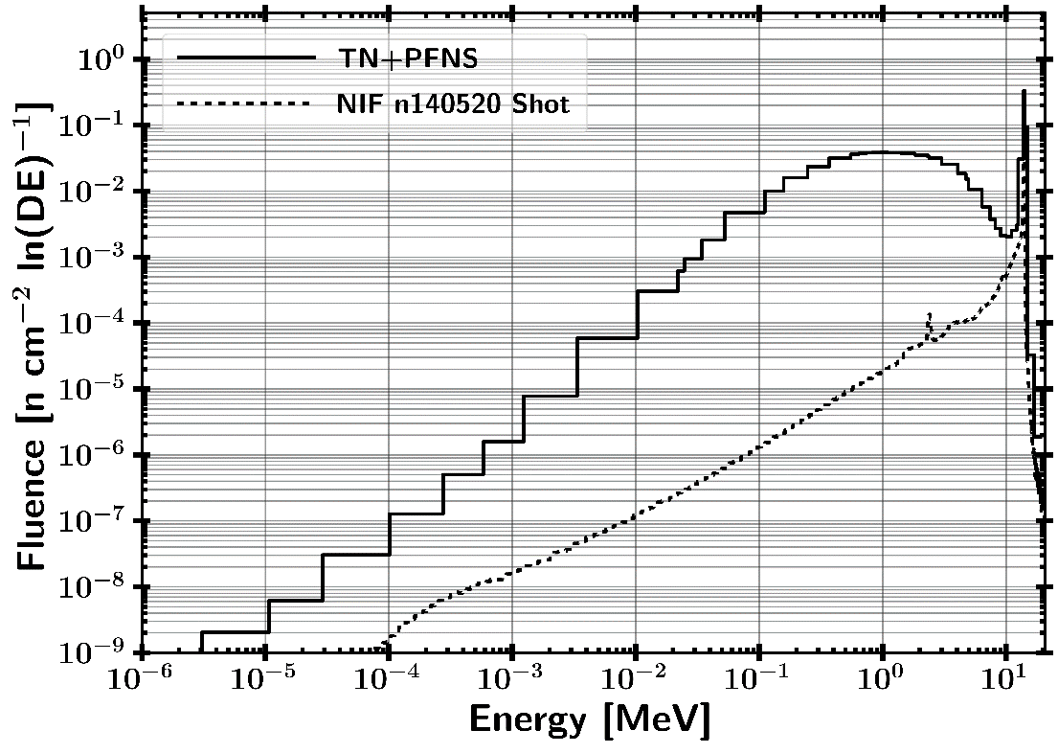
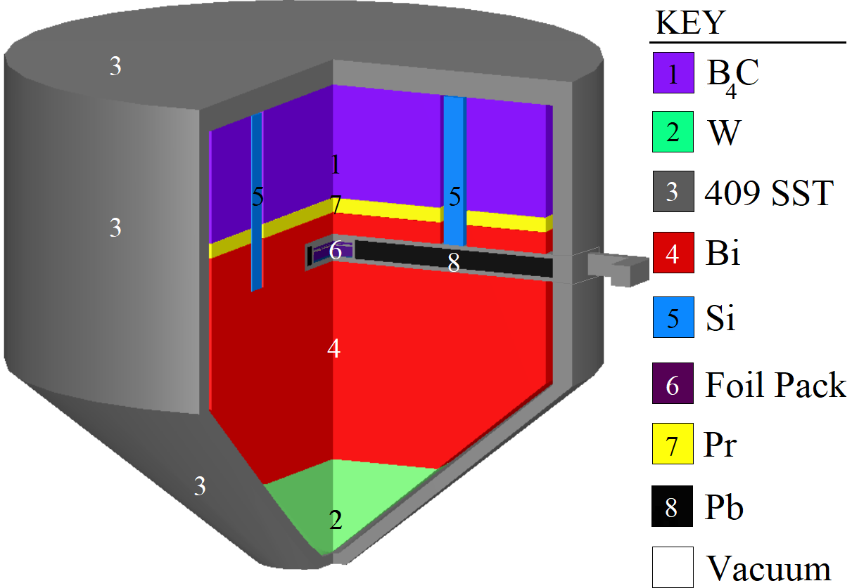
ETA Design
15 cm
Foil Pack Contains
HEU
Au, Zr, Ni, Al, In, W, Mn
NIF SOURCE

Slide 12
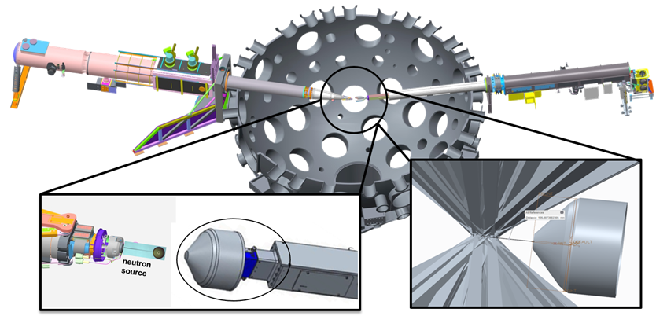
Full NIF Model Source Surface Read
Modeled Polar Drive Exploding Pusher (PDXP) Deuterium-Tritium neutron source
3.7 x 10¹⁵ 14 MeV neutron yield
Minimal downscatter compared indirect drive methods utilizing a hohlraum
NIF Neutron Source with Mounted ETA Incident Laser Exclusion Zone
Notes:
including the target positioner (TARPOS), Target and Diagnostic Manipulator (TANDM) with ETA and diagnostic snout, polar diagnostic instrument manipulator (DIM), and target chamber with first panel walls

Slide 13
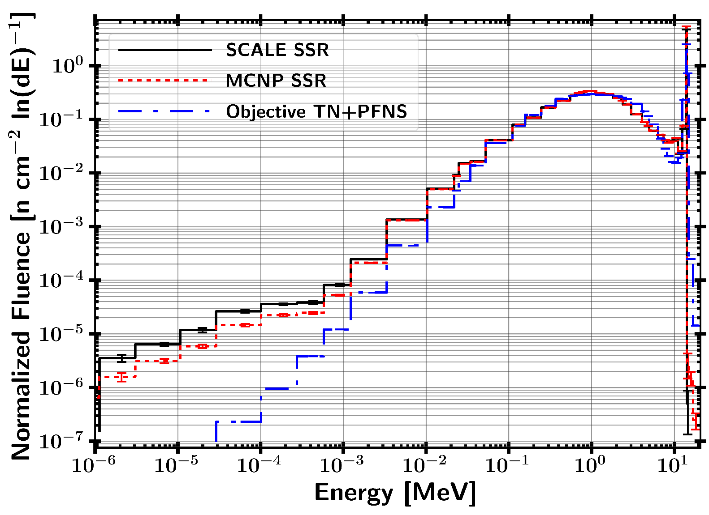
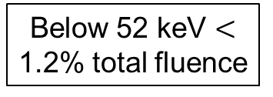
Current Results SSR Source Mapping to SCALE
Below 52 keV $<$ 1.2% total fluence
Pearson Correlation Coefficient Kolmogorov-Smirnov Statistic
r(MCNP, Objective) = 0.90 p_{value}(MCNP, Objective) = 0.935
r(MCNP,SCALE)= 0.9999 p_{value}(MCNP,SCALE)=1.00

Slide 14
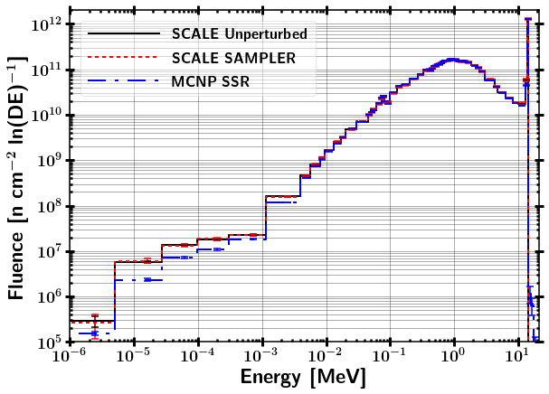
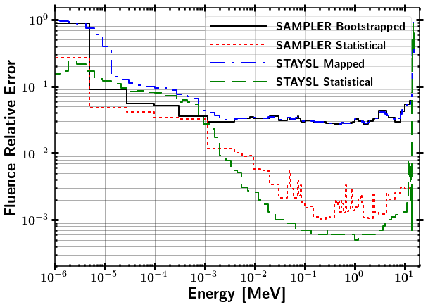
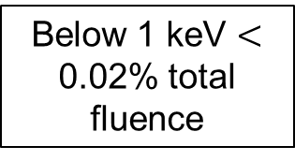
SCALE SAMPLER Fluence Results
Fluence Spectra Comparison Fluence Uncertainty
Below 1 keV $<$ 0.02% total fluence

Slide 15
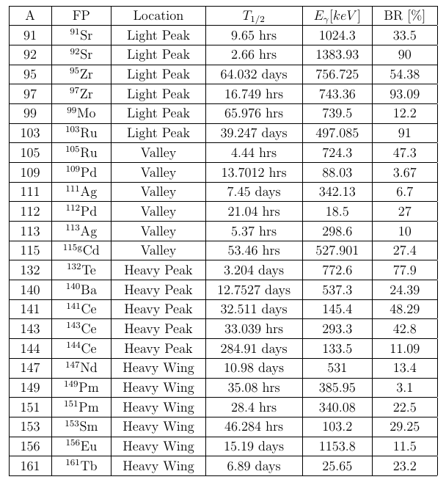
Predicted Fission Products for Radiochemical Analysis
Most from CTBT Condensed List

Slide 16
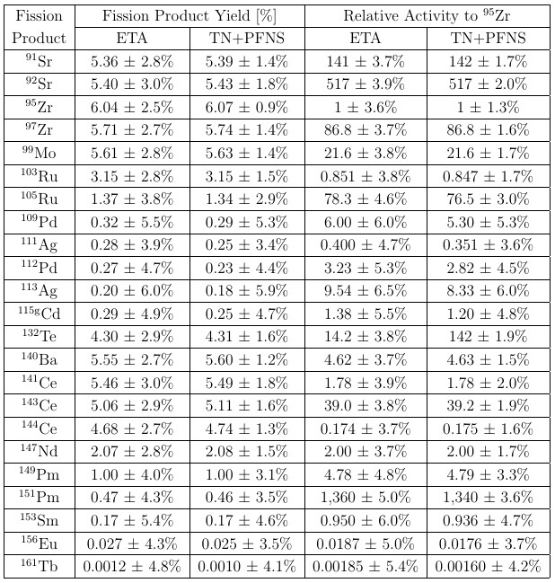
Predicted Fission Products for Radiochemical Analysis

Slide 17
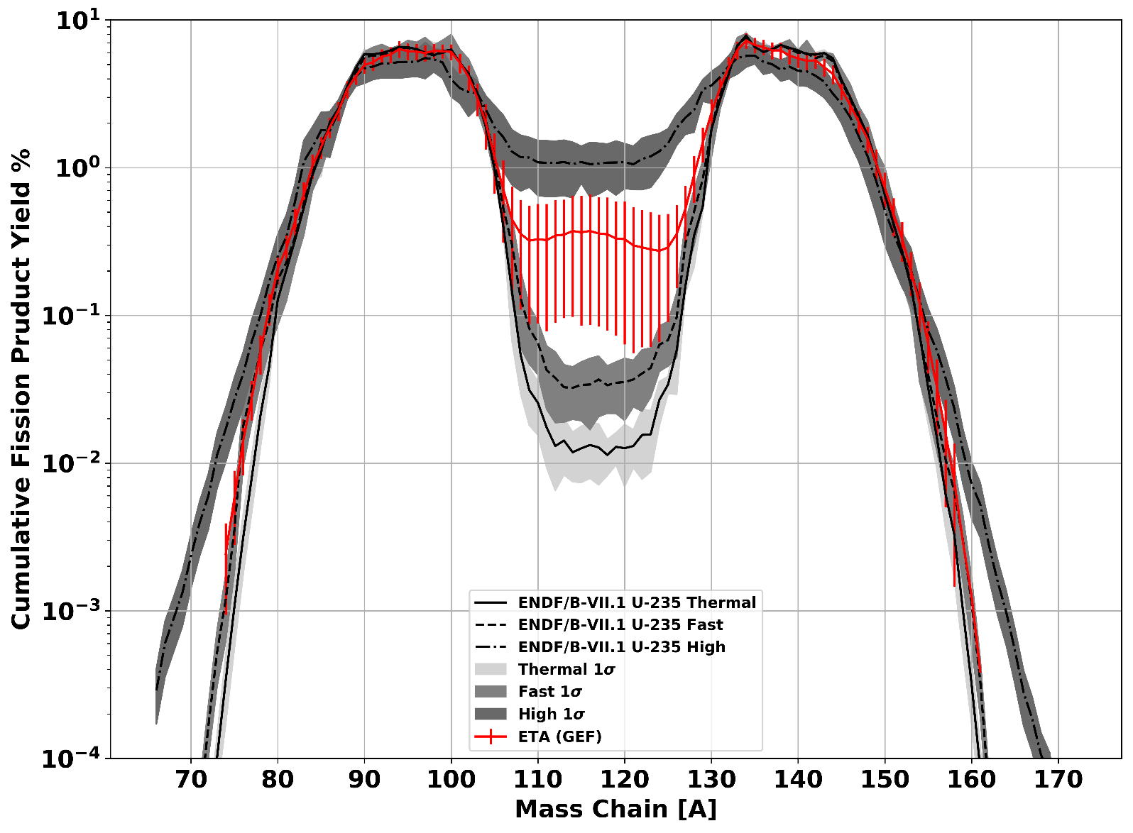
Fission Product Mass Chains

Slide 18
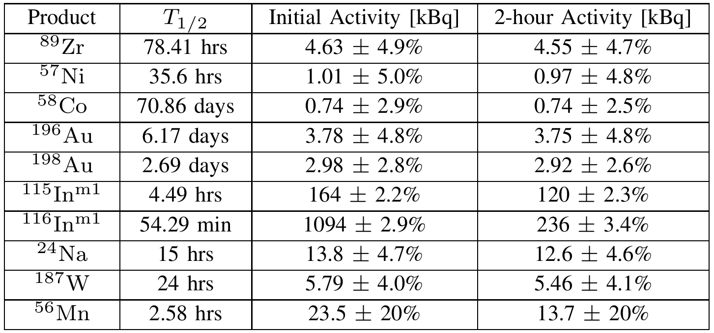
Activation Foil Pack Results

Slide 19
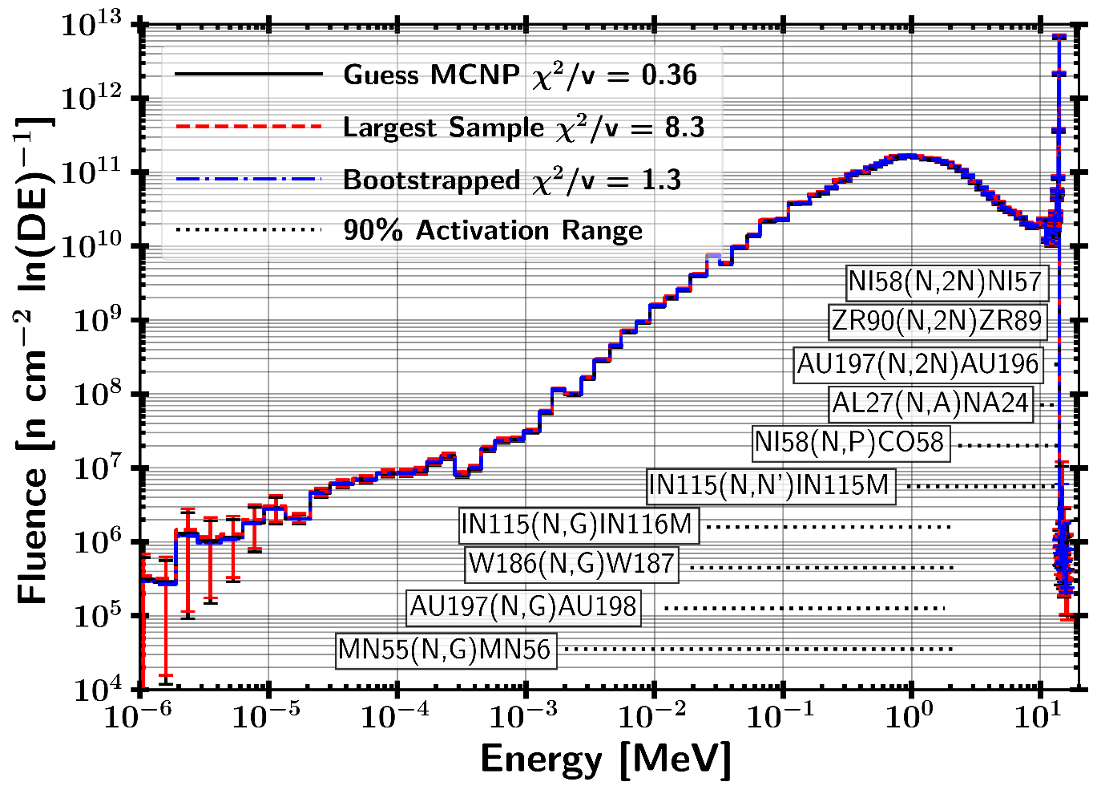
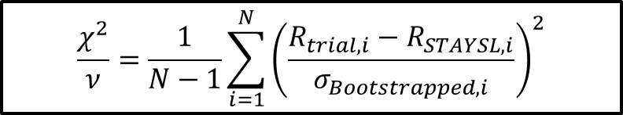
STAYSL Unfolded Spectrum
182 Sampled Activation Results
H₀ : Two sets of data are governed by the same expected distribution
$$\frac{χ^{2}}{ν}=\frac{1}{N−1}\sum_{i=1}^{N}{{\left(\frac{R_{trial,i}−R_{STAYSL,i}}{σ_{Bootstrapped,i}}\right)}^{2}}$$

Slide 20
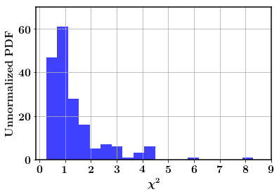
STAYSL Unfolded Spectrum
182 Sampled Activation Results
81.9% of samples were not-rejected with a p-value greater than 0.05
18.1% of samples were rejected with a p-value lower than 0.05
H₀ : Two sets of data are governed by the same expected distribution
$$\frac{χ^{2}}{ν}=\frac{1}{N−1}\sum_{i=1}^{N}{{\left(\frac{R_{trial,i}−R_{STAYSL,i}}{σ_{Bootstrapped,i}}\right)}^{2}}$$

Slide 21
Path Forward
Experiment 2019
Explore Short Pulse Neutron Source Capability of ETA
ATHENA - Next Generation ETA
Increase Fission Product Production (Objective 10¹² fissions)

Slide 22
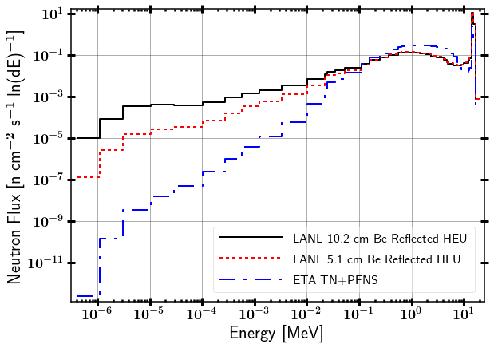
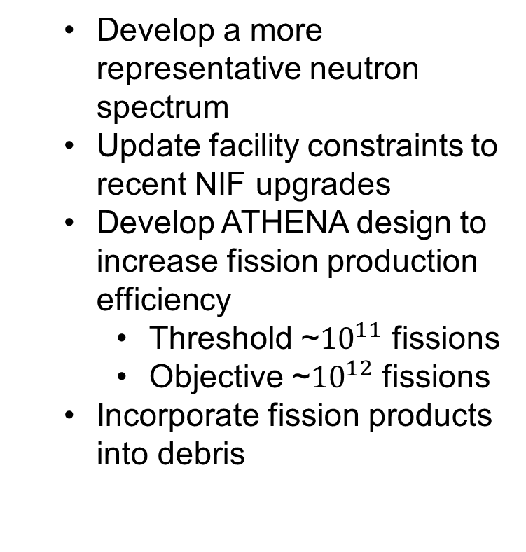
ATHENA
A THErmonuclear and prompt fission Neutron spectrum energy tuning Assembly (ATHENA)
Develop a more representative neutron spectrum
Update facility constraints to recent NIF upgrades
Develop ATHENA design to increase fission production efficiency
Threshold ~${10}^{11}$ fissions
Objective ~${10}^{12}$ fissions
Incorporate fission products into debris

Slide 23
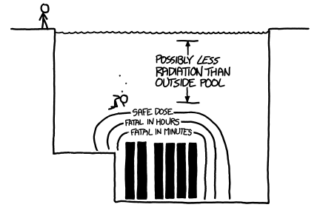
Questions?

Slide 24
BACKUPS

Slide 25

Current Results SSR Source Mapping to SCALE
Below 52 keV $<$ 1.2% total fluence
r(MCNP, Objective) = 0.90
D(MCNP, Objective) = 0.11
r(MCNP,SCALE)= 0.9999
D(MCNP,SCALE)=0.067
Pearson Correlation Coefficient Kolmogorov-Smirnov Statistic

Slide 26
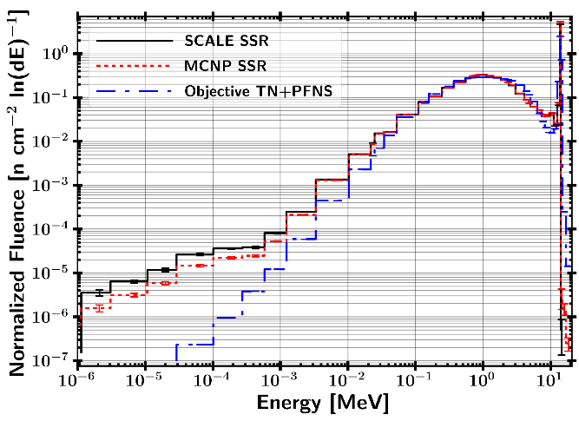
Statistics
Pearson correlation r and p-value objective to MCNP
r = 0.90, p-val = 7.34e-18
Pearson correlation r and p-value SCALE Map to MCNP
r = 0.99993, p-val = 1.09e-84
KS 2 Sample D and p-value objective to MCNP
D = 0.11, p-val = 9.35e-01
KS 2 Sample D and p-value SCALE Map to MCNP
D = 0.06667, p-val = 1.00e+00

Slide 27
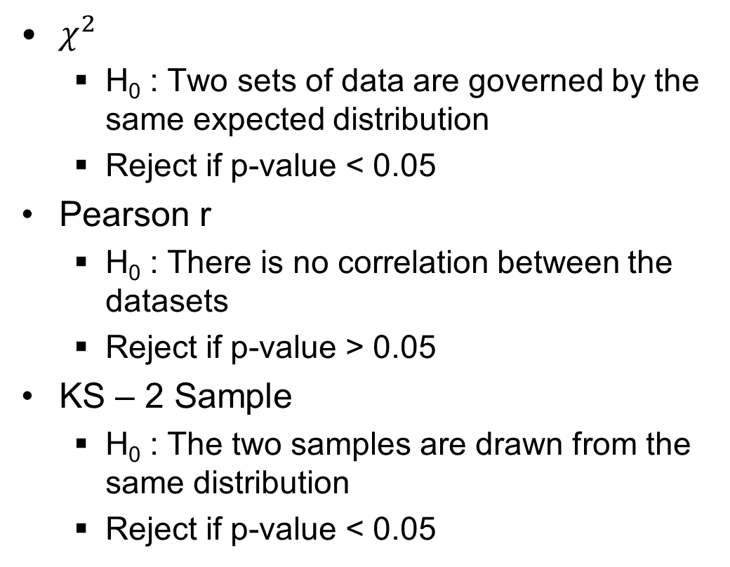
Statistics
$χ^{2}$
H₀ : Two sets of data are governed by the same expected distribution
Reject if p-value < 0.05
Pearson r
H₀ : There is no correlation between the datasets
Reject if p-value > 0.05
KS – 2 Sample
H₀ : The two samples are drawn from the same distribution
Reject if p-value < 0.05

Slide 28
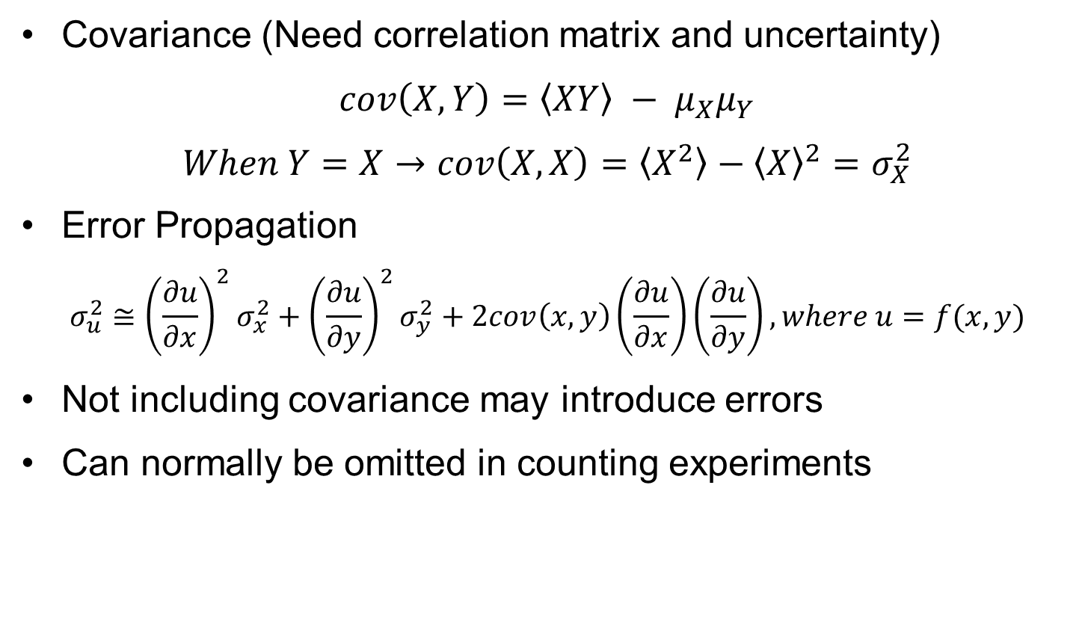
Covariance (What is it?)
Covariance (Need correlation matrix and uncertainty)
$$cov\left(X,Y\right)=\left\langle XY\right\rangle − μ_{X}μ_{Y}$$
$$When Y=X→cov\left(X,X\right)=\left\langle X^{2}\right\rangle −{\left\langle X\right\rangle }^{2}=σ_{X}^{2}$$
Error Propagation
$$σ_{u}^{2}≅{\left(\frac{∂u}{∂x}\right)}^{2}σ_{x}^{2}+{\left(\frac{∂u}{∂y}\right)}^{2}σ_{y}^{2}+2cov\left(x,y\right)\left(\frac{∂u}{∂x}\right)\left(\frac{∂u}{∂y}\right), where u=f(x,y)$$
Not including covariance may introduce errors
Can normally be omitted in counting experiments

Slide 29
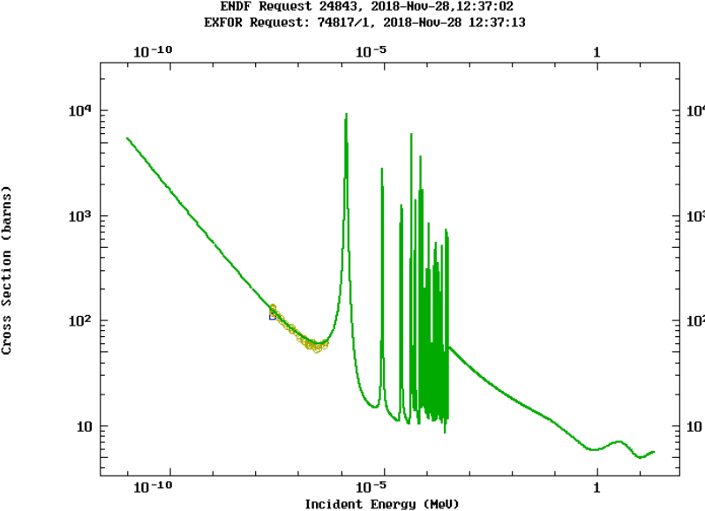
Ir-193 (n,tot) Example
Experimental Data

Slide 30
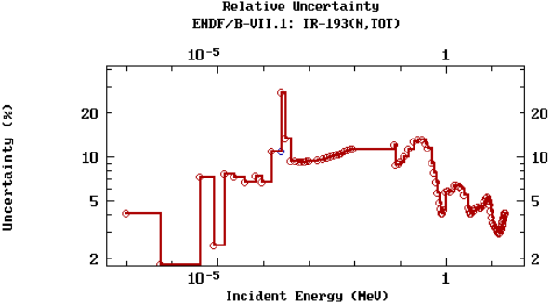
Ir-193 (n,tot) Example
Experimental Data

Slide 31
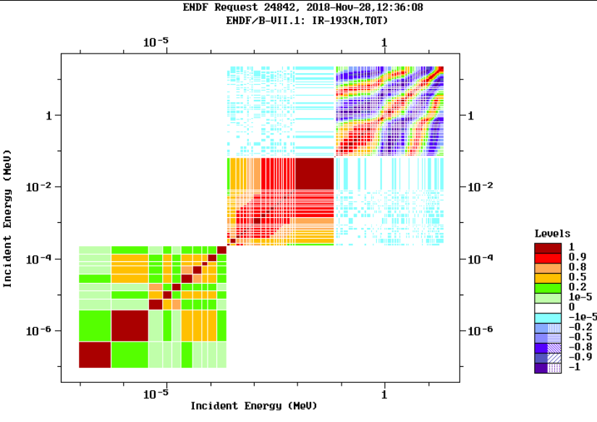
Ir-193 (n,tot) Example

Slide 32
Ir-193 (n,tot) Example

Slide 33
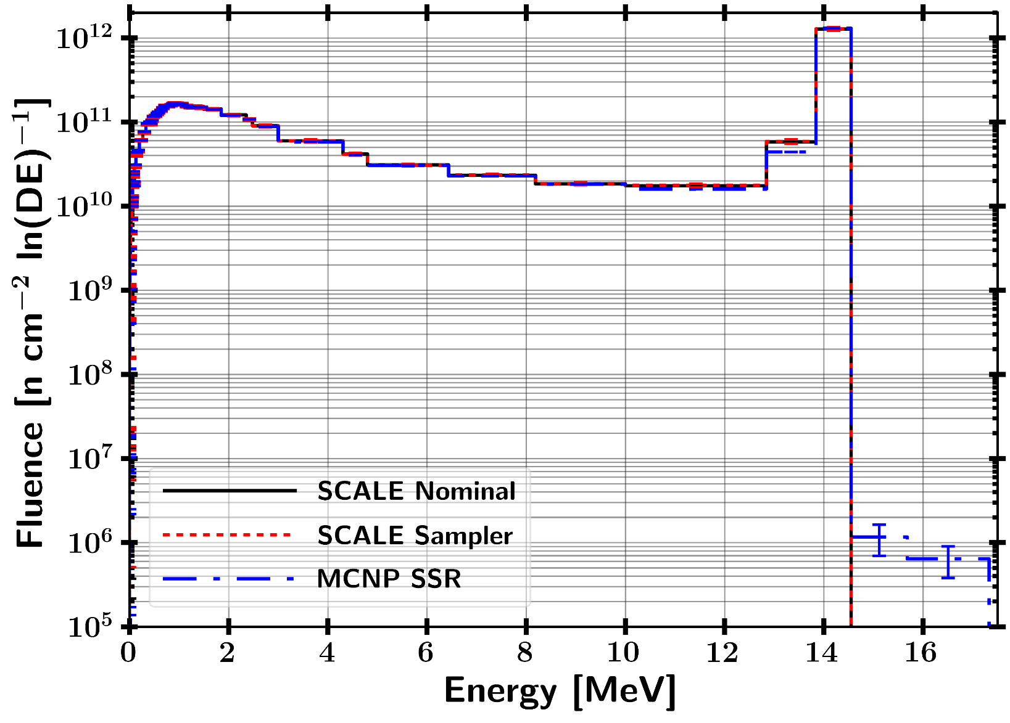
Linear Mapping

Slide 34
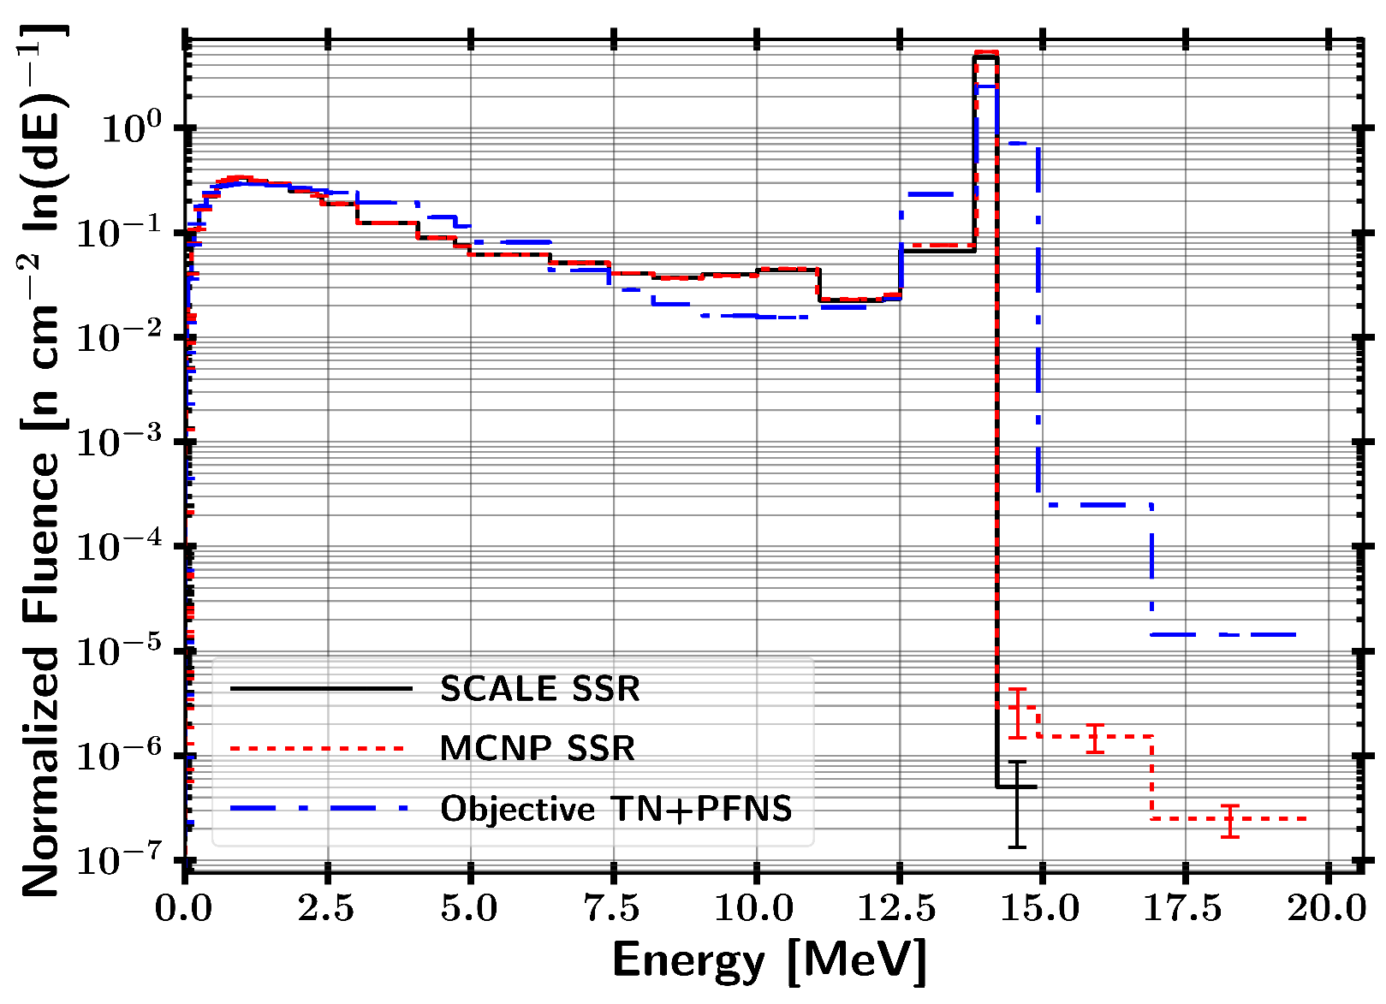
Linear comparison TN+PFNS

Slide 35
Combining Responses from Perturbed Nuclear Data
SCALE Sampler Module
Unperturbed
Response
N Sampled Responses with Perturbed Nuclear Data
Combine Data with Bootstrapping
Sampled with replacement from each Sampler case and Gaussian distribution based on response statistical uncertainty
Final Response with Statistical and Nuclear Data Covariance Uncertainty

Slide 36
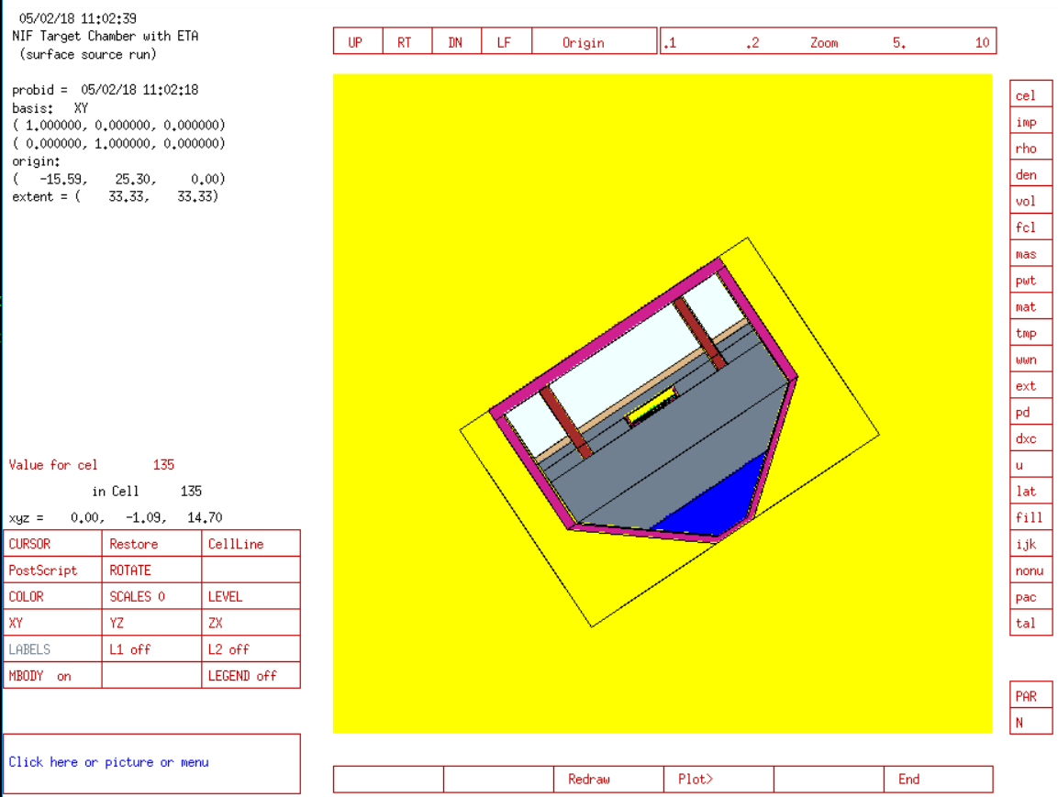
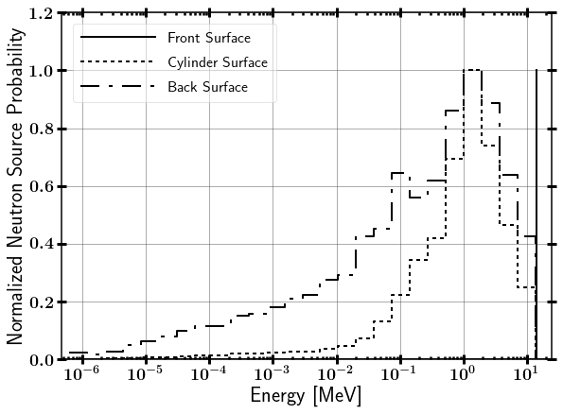
NIF Neutron Source
Surface Source Read file from LLNL
Contains NIF “room return”, which accounts for less than 1% of source.

Slide 37
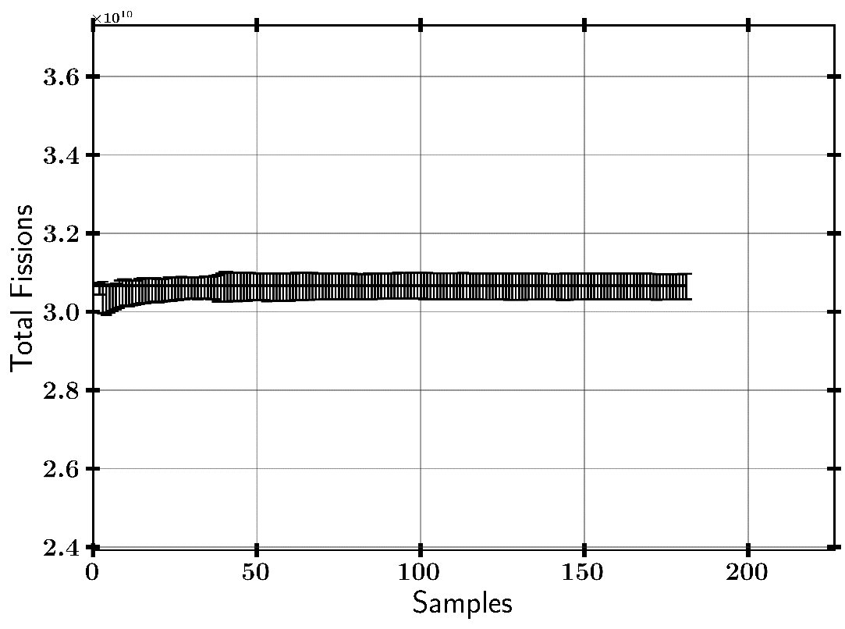
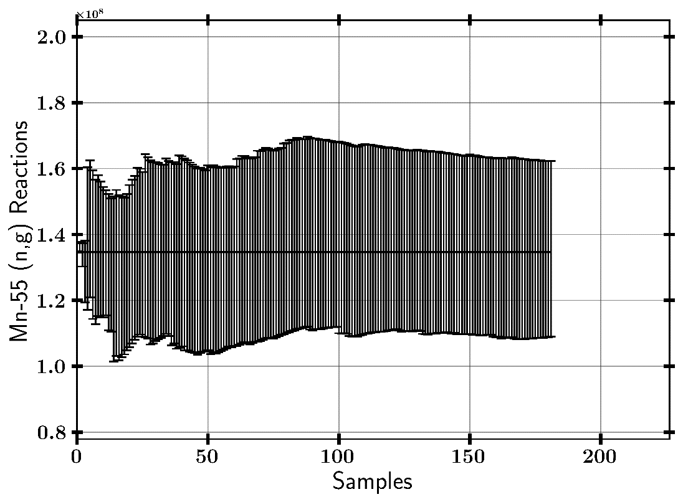
Convergences

Slide 38
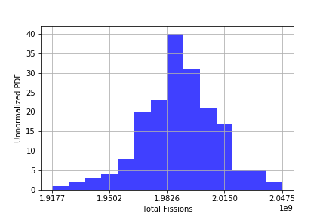
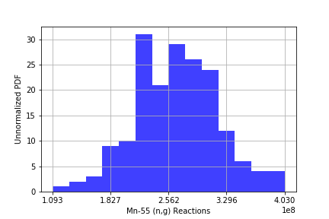
Convergences – Histogram

