Slide 1
Source Mapping / DT Source
ETA covariance results w/ Full NIF Surface Source Read (SSR)
Fission Products
Post-Shot Analysis
ATHENA / ETA II

Slide 2
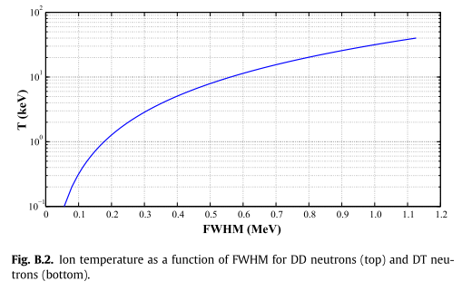
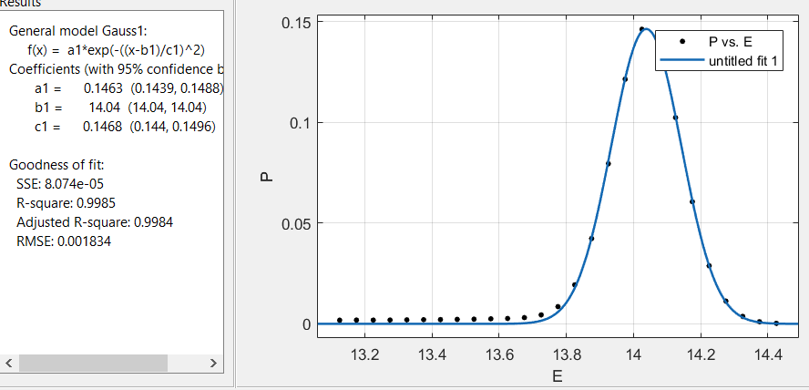
DT Neutron Source Term
N120405 Shot
FWHM = 0.346 MeV
T = 3.8 keV

Slide 3
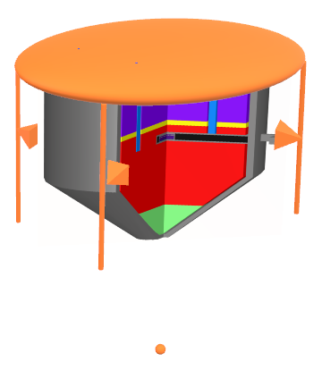
Mapping to SCALE / No Inward Facing Cylinderical Source
Mapped SSR sources to
4 line sources (emitting in 2-pi, not right as pictured)
Point source
Disk source emitting in 2 pi
This didn’t make it in my thesis, so I never went back to make the lines more parallel

Slide 4
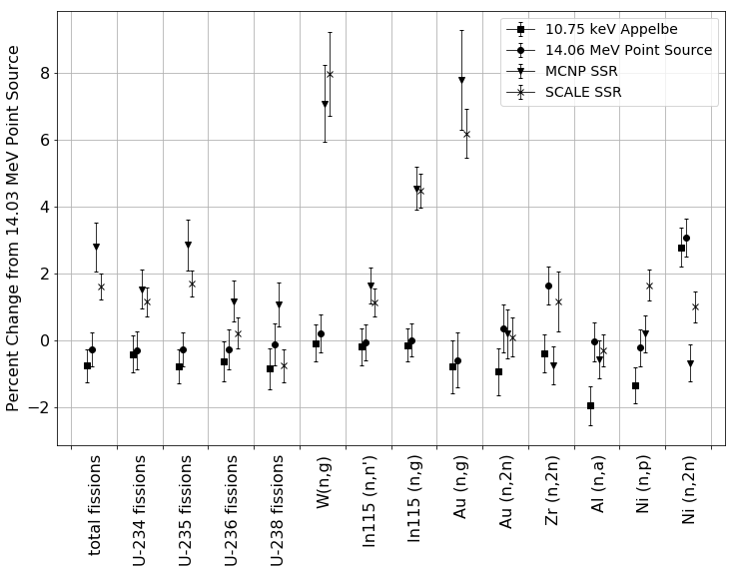
Importance of Source Characterization
Compared 4 sources relative to MCNP5 14.03 MeV neutron point source
Impact of source term
10.75 keV plasma temperature Appelbe distribution point source
14.06 MeV point source
Impact of room return
MCNP SSR
SCALE MAVRIC Mapped SSR

Slide 5
Source Mapping / DT Source
ETA covariance results w/ Full NIF Surface Source Read (SSR)
Fission Products
Post-Shot Analysis
ATHENA / ETA II

Slide 6
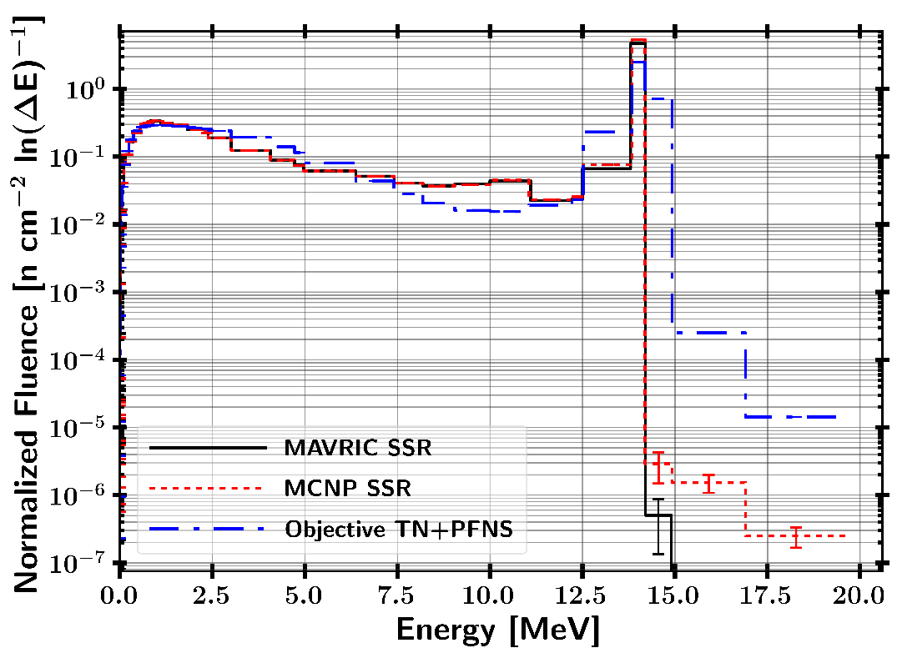
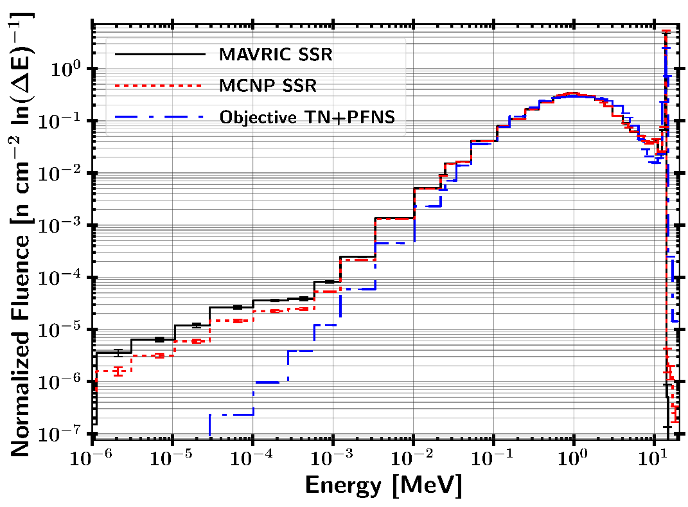
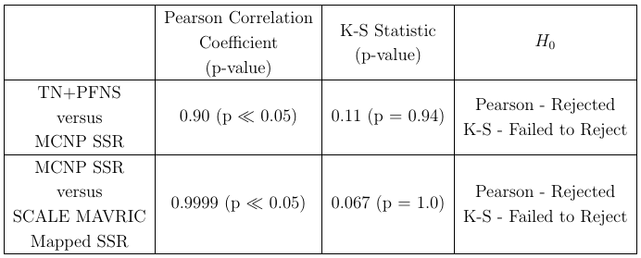
ETA Neutron Spectrum Performance Continuous Energy Results
Neutron spectrum achieved by ETA is consistent with the objective TN+PFNS.

Slide 7
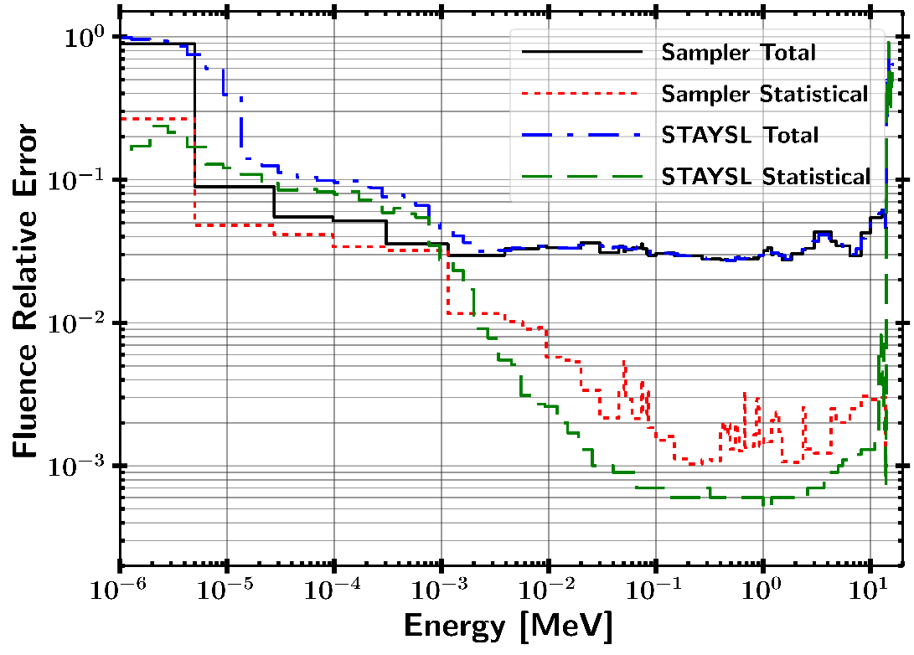
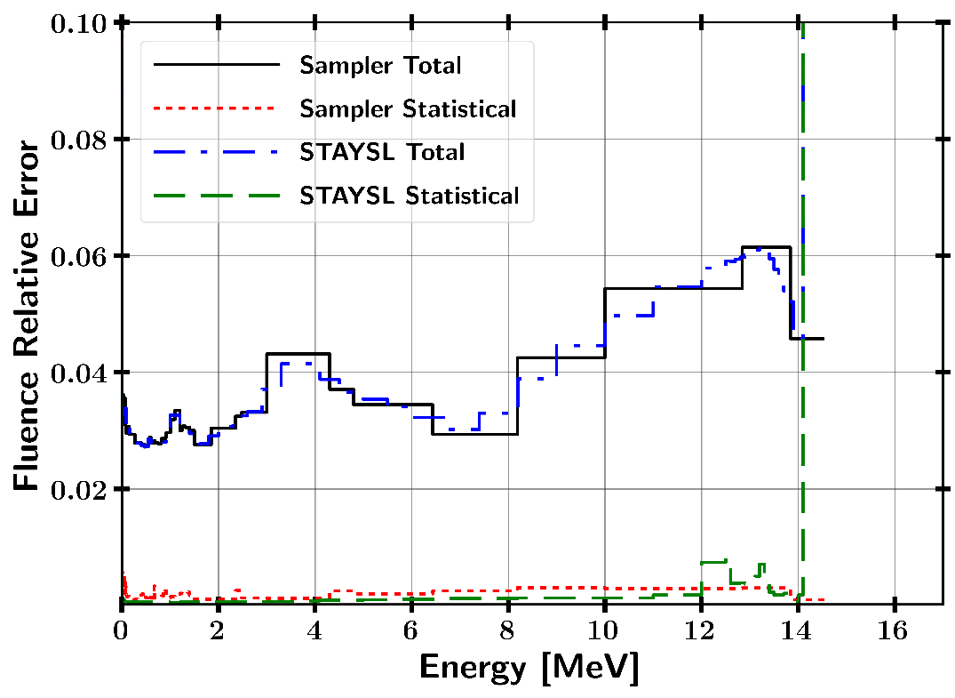
Neutron Fluence Uncertainty

Slide 8
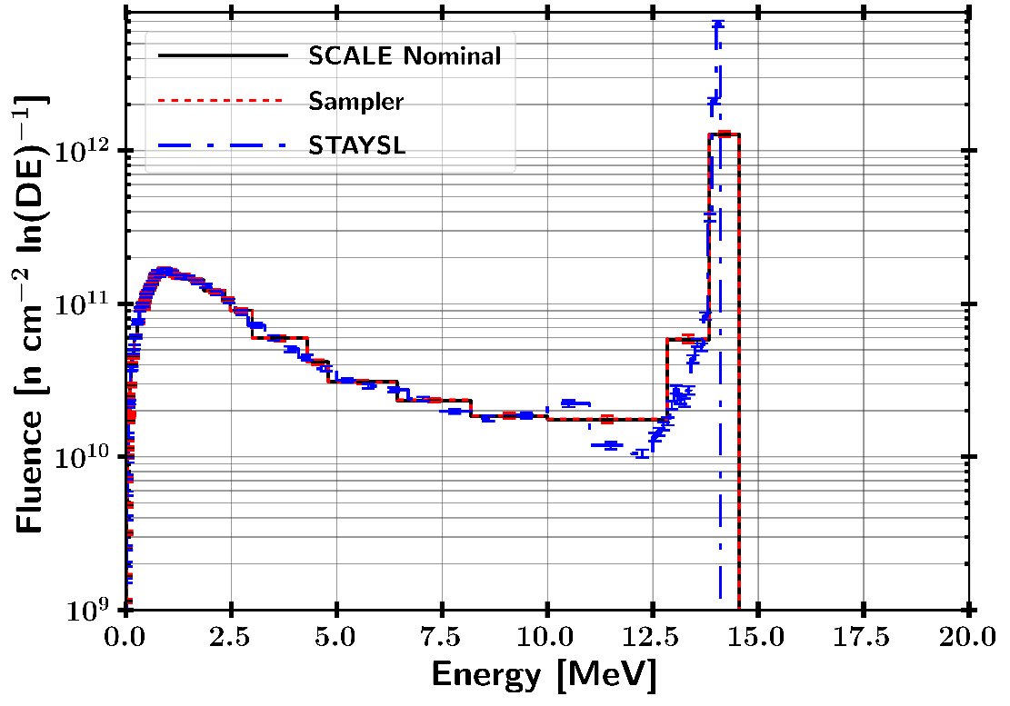
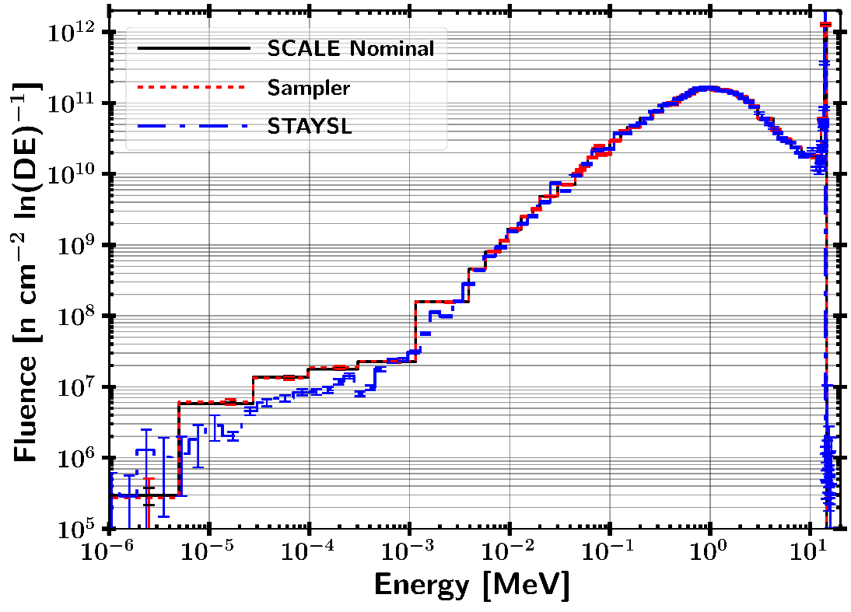
Neutron Fluence Uncertainty Mapped to STAYSL 129 Group Structure
Guess neutron spectrum for neutron fluence unfolding with STAYSL.
Mean value from MCNP CE
Uncertainty mapped from SCALE Sampler

Slide 9
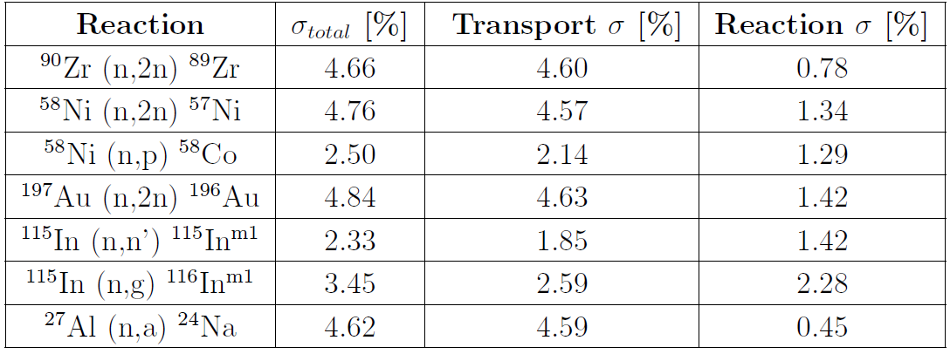

Activation Foil Uncertainties
$$R∝σ_{rxn}φ →\frac{σ_{R}}{R}=\sqrt{{\left(\frac{σ_{φ}}{φ}\right)}^{2}+{\left(\frac{σ_{σ_{rxn}}}{σ_{rxn}}\right)}^{2}}$$

Slide 10
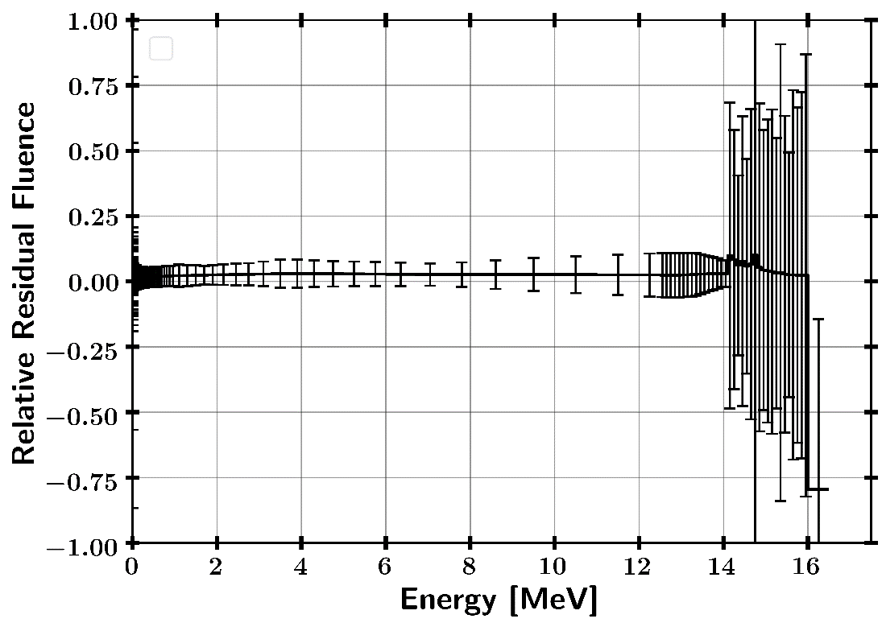
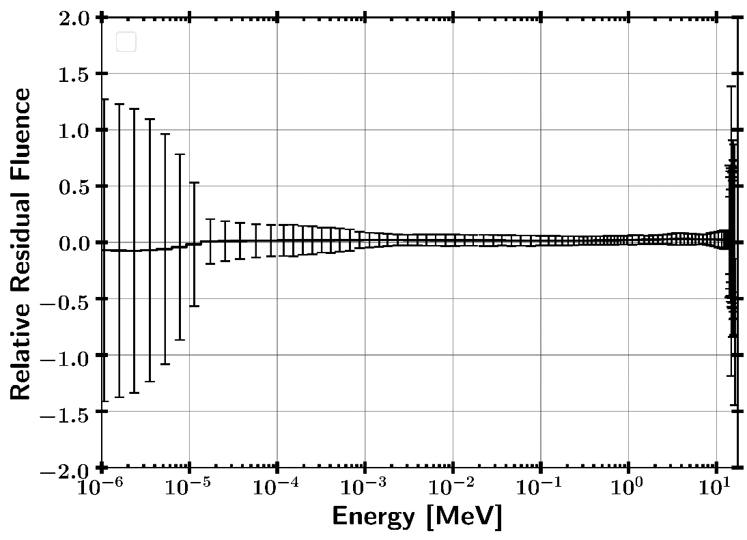
STAYSL Changes to MCNP Guess Neutron Spectrum
Increase in fluence normalization is caused by not entirely homogenous flux in ETA sample cavity

Slide 11
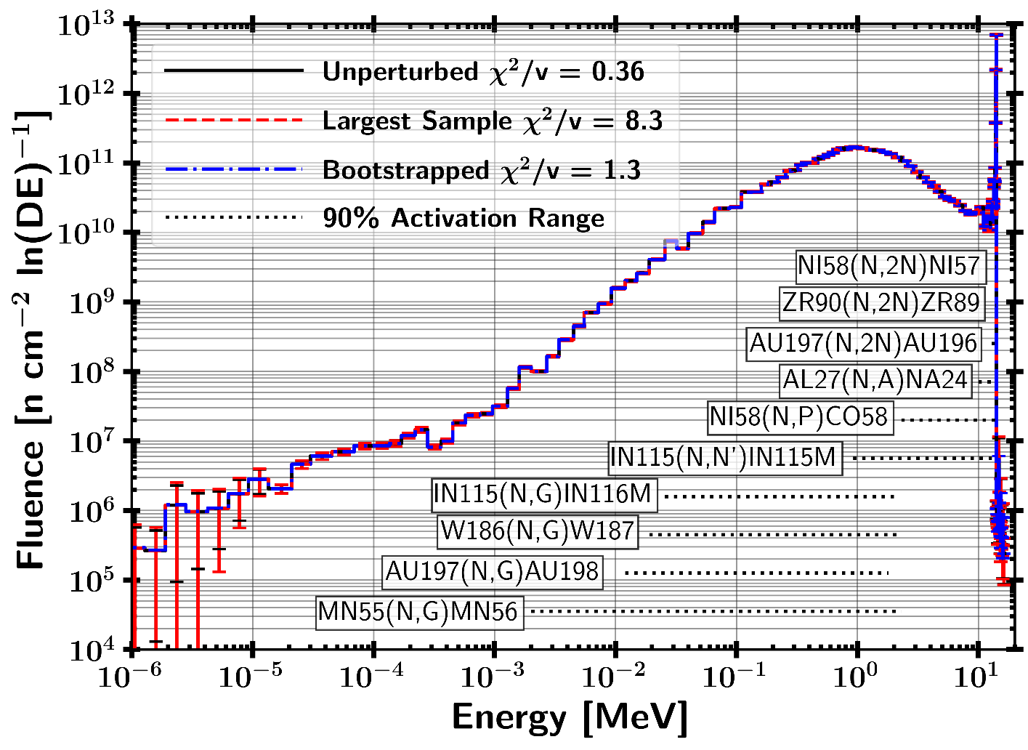
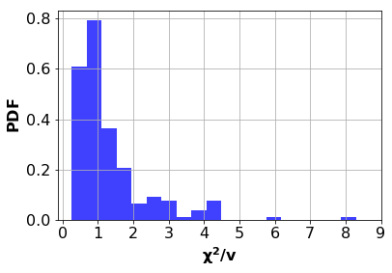
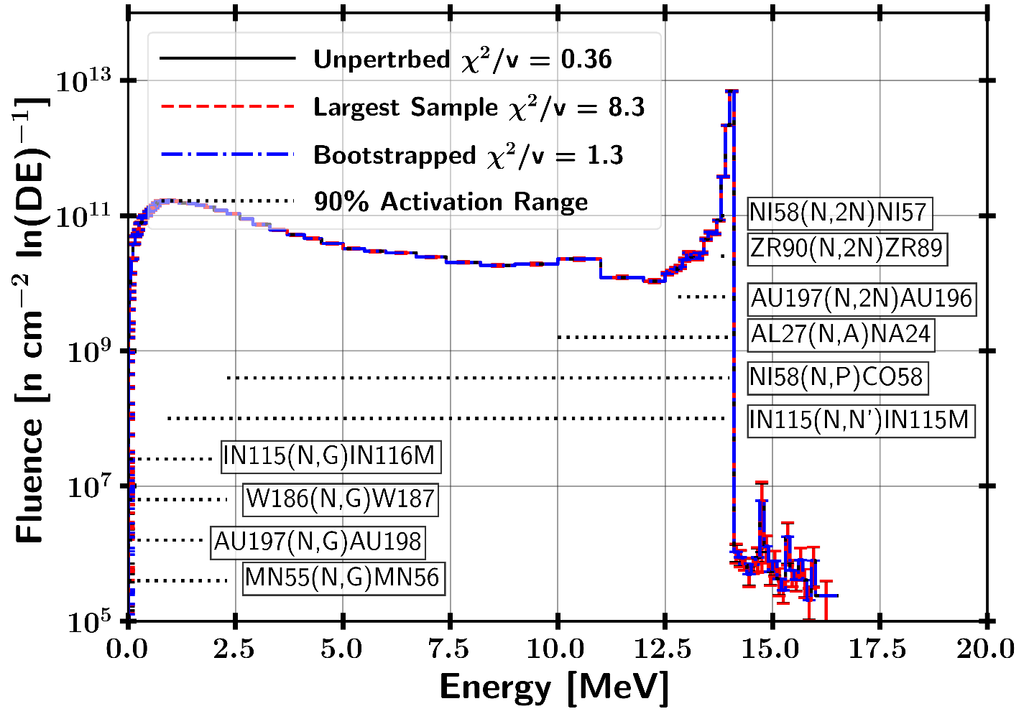

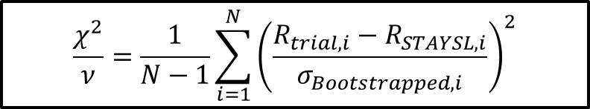
STAYSL Unfolded Spectrum $χ^{2}$
182 Sampled Activation Results
81.9% of samples were not-rejected with a p-value greater than 0.05
18.1% of samples were rejected with a p-value lower than 0.05
H₀ : Two sets of data are governed by the same expected distribution .
$$\frac{χ^{2}}{ν}=\frac{1}{N−1}\sum_{i=1}^{N}{{\left(\frac{R_{trial,i}−R_{STAYSL,i}}{σ_{Bootstrapped,i}}\right)}^{2}}$$

Slide 12
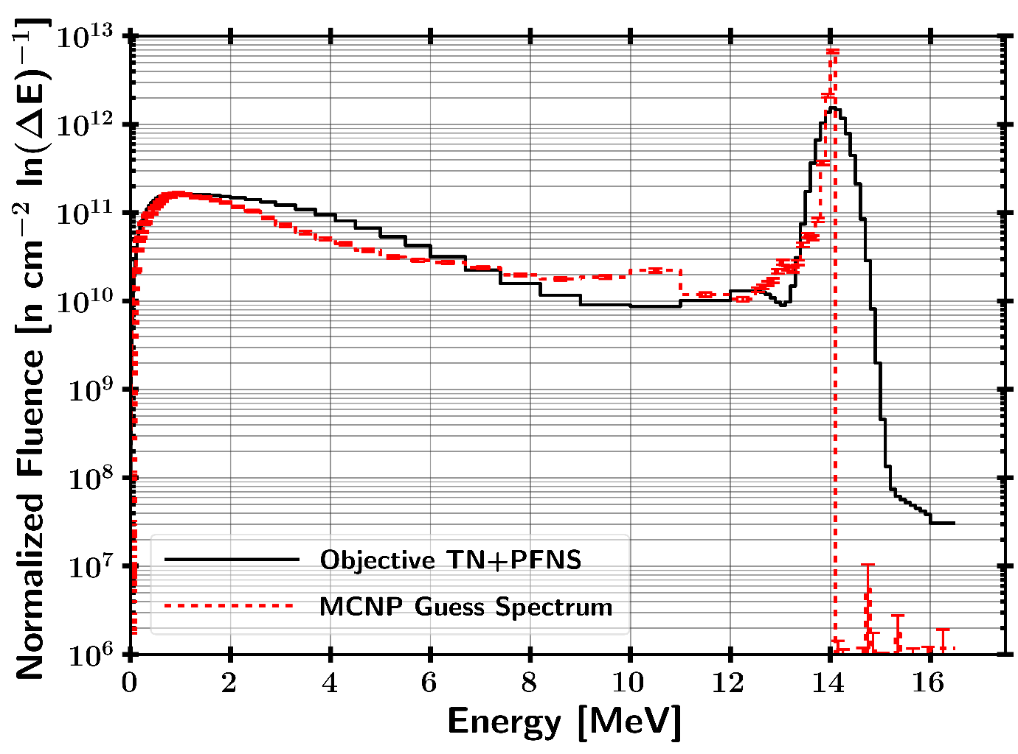
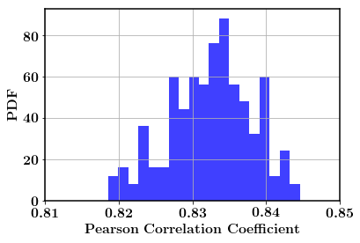
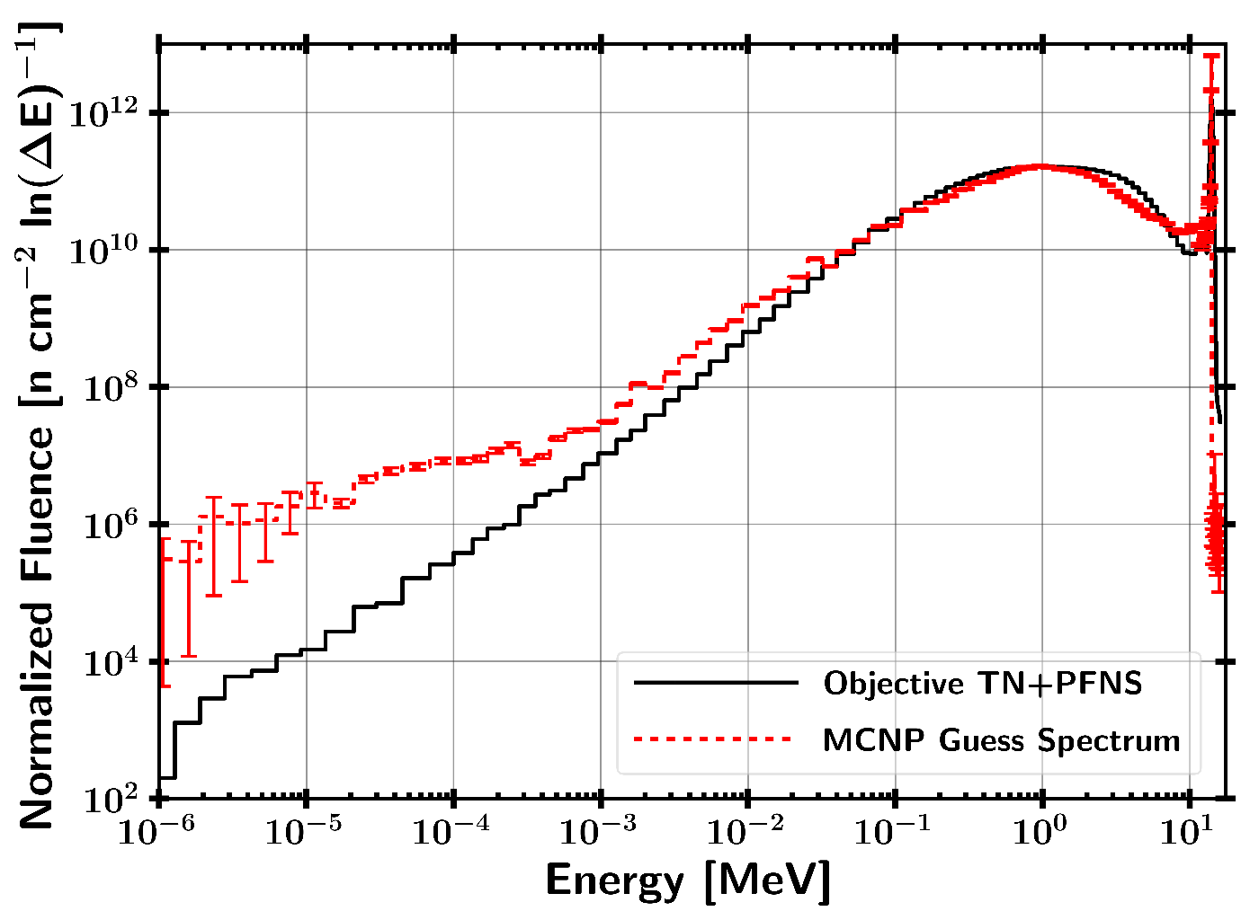


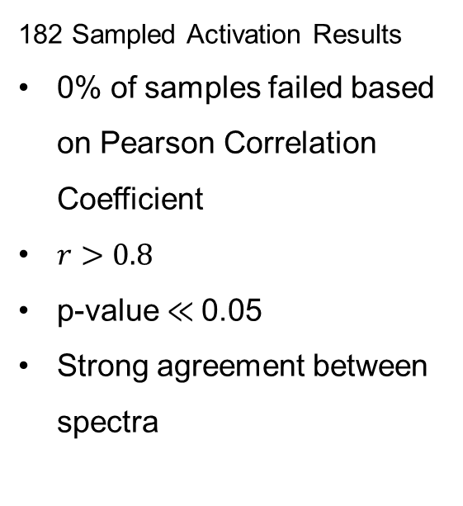

STAYSL Unfolded Spectrum Pearson Correlation Coefficient and K-S Statistic
182 Sampled Activation Results
0% of samples rejected based on K-S Statistic
$D=0.094$
p-value $=0.61$
182 Sampled Activation Results
0% of samples failed based on Pearson Correlation Coefficient
$r>0.8$
p-value $≪$0.05
Strong agreement between spectra
H₀ : The two samples are drawn from the same distribution.
H₀ : There is no correlation between the datasets.
12

Slide 13
Source Mapping / DT Source
ETA covariance results w/ Full NIF Surface Source Read (SSR)
Fission Products
Post-Shot Analysis
ATHENA / ETA II

Slide 14
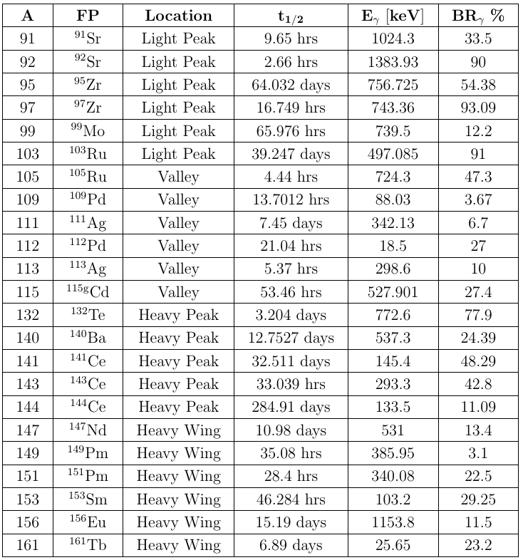
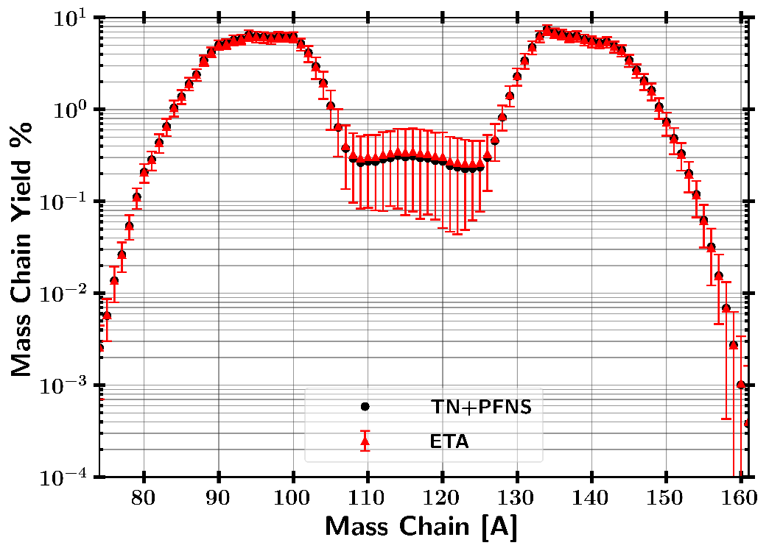
Selected Fission Products for Analysis
Light
Peak
Heavy
Peak
Valley
Heavy
Wing

Slide 15
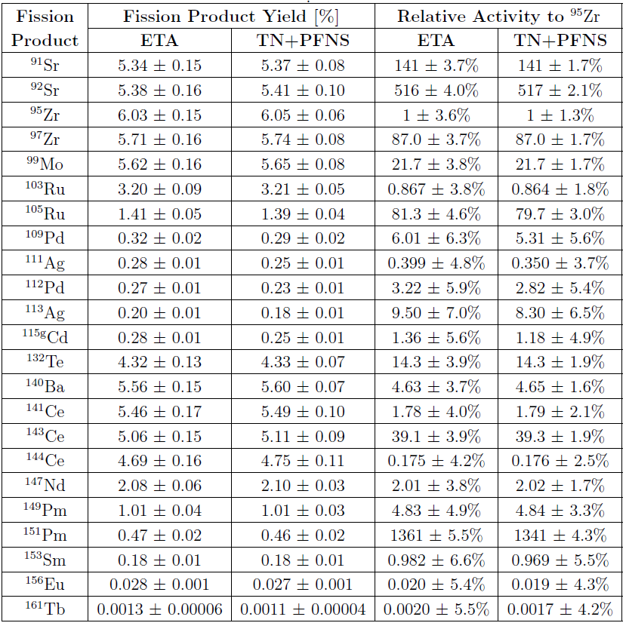
Nagy Fit Results - Predicted Fission Products for Radiochemical Analysis

Slide 16
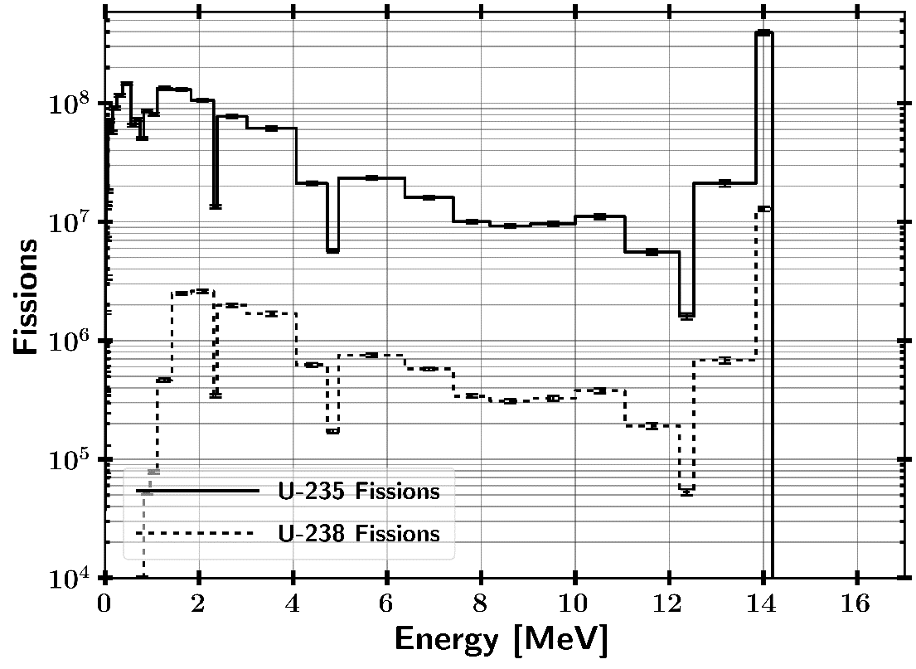
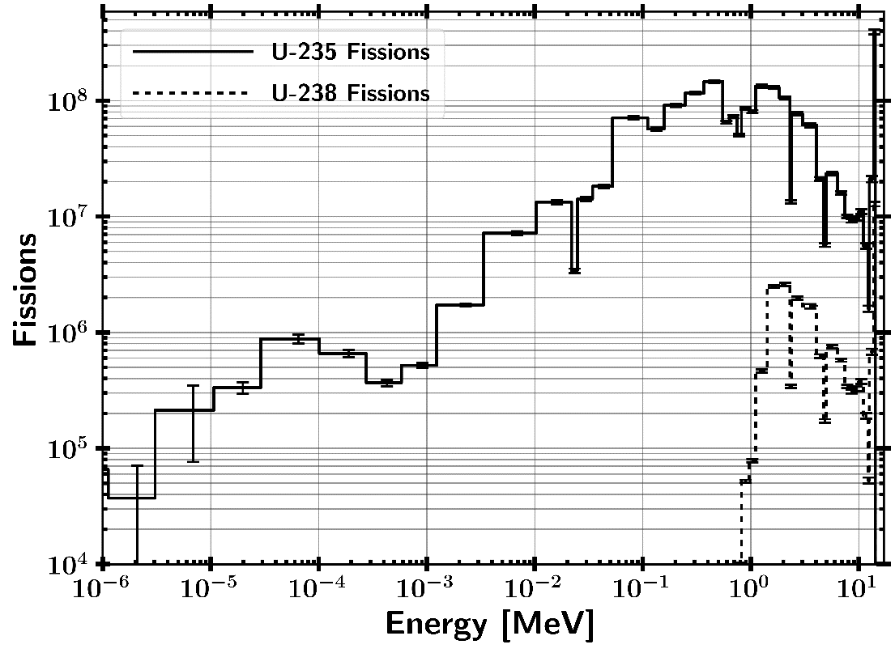
ETA HEU Fission Spectra
ETA Produced $2∗{10}^{9}±1\%$ fissions

Slide 17
General Count Plan at 18 cm
Product (Gamma keV) | Early w/o high dead time | Late
Zr-89 (909) | 2 counts (1 hr) | 2 counts (1 hr)
Ni-57 (1378) Co-58 (810.8) | N/A | 2 counts (4 hr)
Au-196 (356) Au-198 (411.8) | Use standard counting schedule | 2 counts (1 hr)
In-115m (336) In-116m (1294) | 2 counts (15 min) | N/A
Na-24 (1368) | 2 Counts (30 min) After In | N/A
W-187 (685.5) | N/A | 2 counts (2 hrs)
Mn-56 (846.8) | 2 counts (1 hr) | 1 count (6 hr)

Slide 18
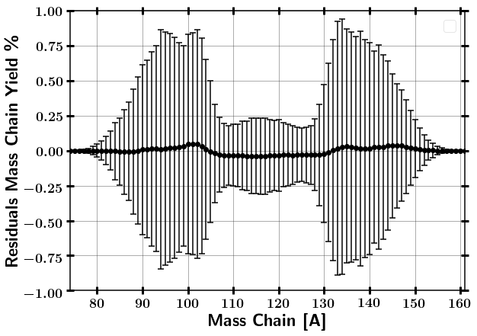
GEF Results
ETA Produced $2∗{10}^{9}±1\%$ fissions
Modeled ETA produced fission products are consistent to predicted TN+PFNS within error.

Slide 19
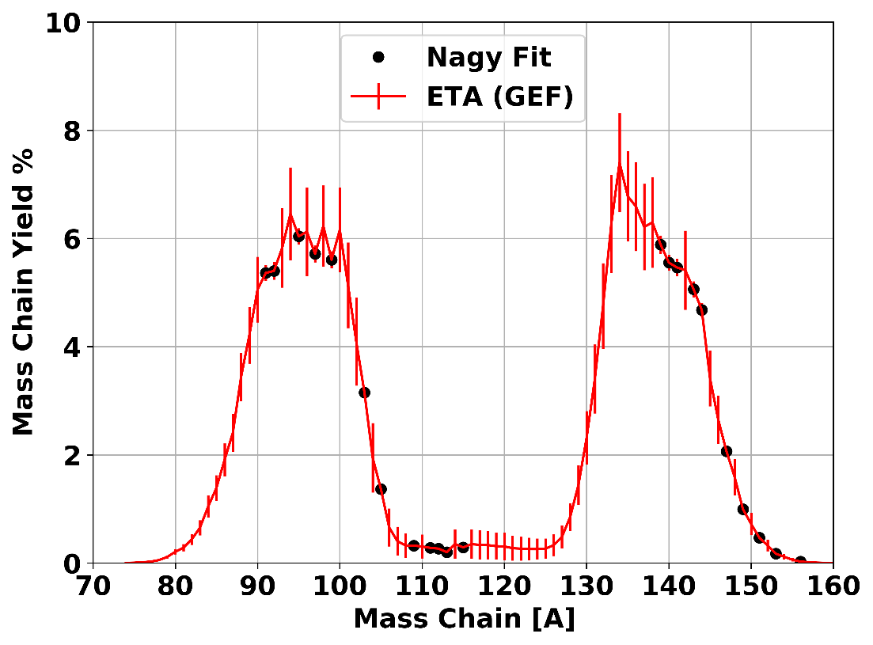
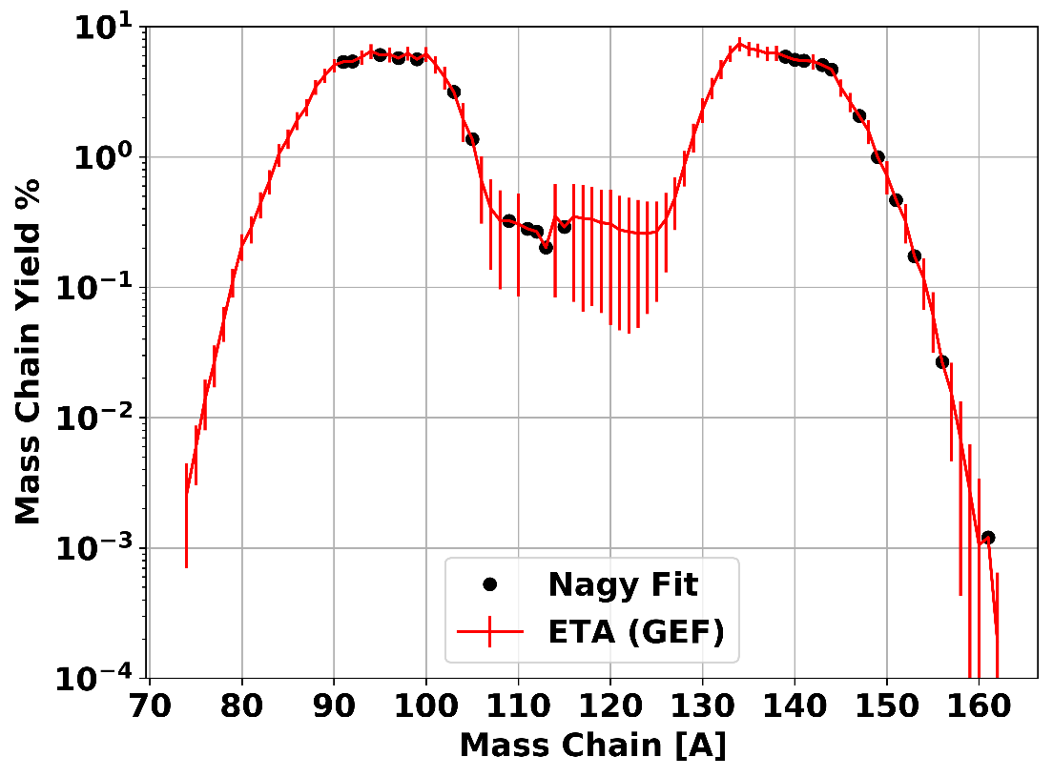
Nagy Fit Results - Predicted Fission Products for Radiochemical Analysis
Cumulative fission products predicted from Nagy fit data can replace GEF results.
All fission products except ¹³²Te are approximate cumulative yields.

Slide 20
Source Mapping / DT Source
ETA covariance results w/ Full NIF Surface Source Read (SSR)
Fission Products
Post-Shot Analysis
ATHENA / ETA II

Slide 21
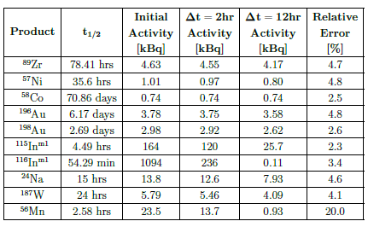
Post-Experiment Analysis
HEU sample
Long count (~2 weeks) / until HEU dominates – (4/5) of HEU
Radiochemical analysis – (2/5)
Activation foils (activities expected at 15 cm ETA standoff)
Count each twice on different detectors / limit bias

Slide 22
Activation Foils
Product | Count Time Starting at 2 hrs for 10,000 | Count Time Starting at 12 hrs for 10,000
Zr-89 | 0.5 | 0.5
Ni-57 | 4.1 | 5.0
Co-58 | 2.7 | 2.7
Au-196 | 0.3 | 0.4
Au-198 | 0.4 | 0.5
In-115m | 0.0 | 0.1
In-116m | 0.0 | N/A
Na-24 | 0.2 | 0.4
W-187 | 1.0 | 1.3
Mn-56 | 0.2 | 3.5

Slide 23
Source Mapping / DT Source
ETA covariance results w/ Full NIF Surface Source Read (SSR)
Fission Products
Post-Shot Analysis
ATHENA / ETA II

Slide 24
ATHENA (ETA II) Needs
Mass constraints
Laser exclusion zone
Source development

Slide 25
Other interesting things past here

Slide 26
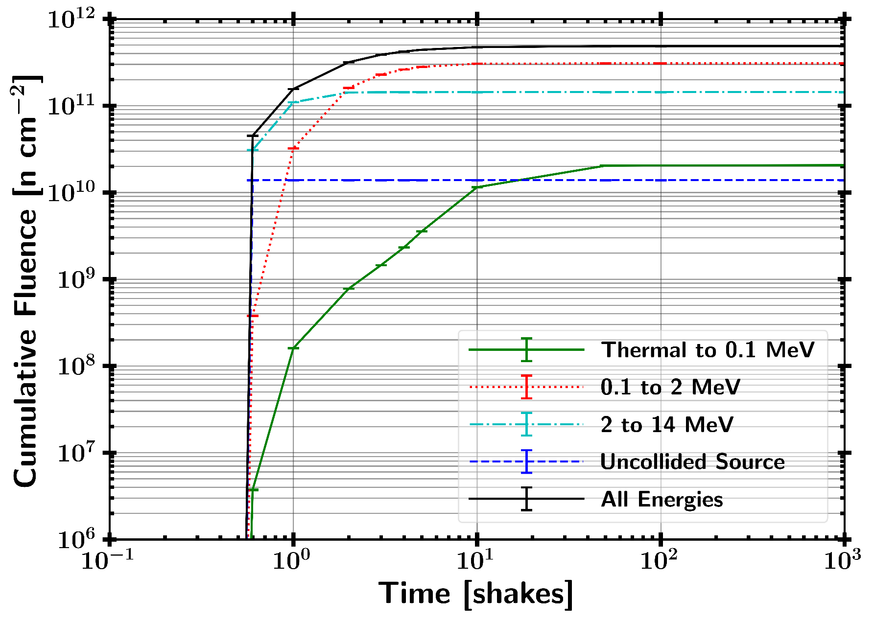
Neutron Fluence Timing Profile

Slide 27
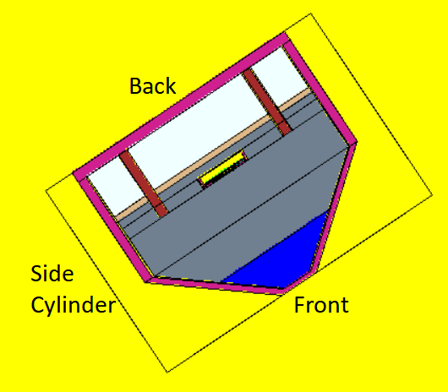
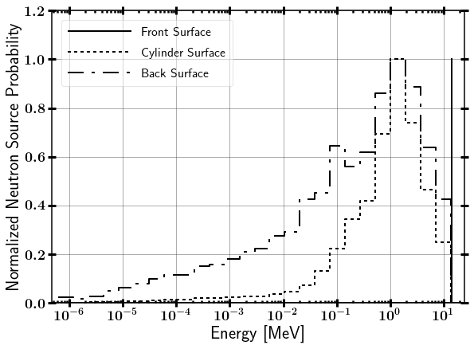
Modeled NIF Neutron Source Term
Surface Source Read file from LLNL
Contains NIF “room return”, which accounts for less than 1% of source neutrons on ETA.
Modeled as 14.03 MeV point source

